Slide 1
A Future in Chemistry
Careers education and information resources from the Royal Society of Chemistry

Slide 2
Careers from Chemistry
Background presentation and information about different careers
A Future in Chemistry
Exploring the website
How you can use the website
Web quest game
Not all chemists wear white coats
Using the posters to stimulate discussions
Print literature
ChemNet
Dr Careers
Personalised support for you
Forum of questions which can be searched.

Slide 3
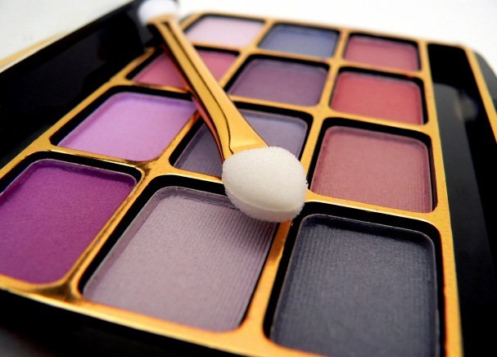






What do all these have in common?
… chemistry!

Slide 4
What jobs do you think chemists do?

Slide 5
What jobs do chemical scientists do?
Food scientist
Agricultural chemist
Biochemist
Toxicologist
Marine chemist
Atmospheric chemist
Formulation chemist
Forensic scientist
Industrial chemist
Materials scientist
Environmental chemist
Analytical chemist
Computational chemist
Medicinal chemist
Chemical engineer
Polymer scientist
Crystallographer
Notes:
Get students to think of all the chemical related careers

Slide 6
What is happening in industry?
Unpredictable and challenging environment
  reduced funds
  increased costs
  global competition
Job security and job opportunities
Reduced training capacity (SMEs)
Networking
  from David Fox- RSC Industry Associate

Slide 7
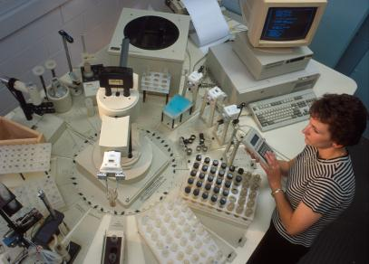
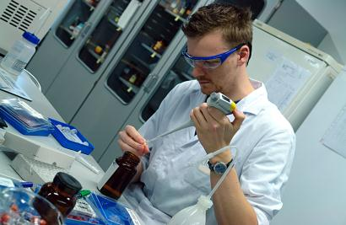
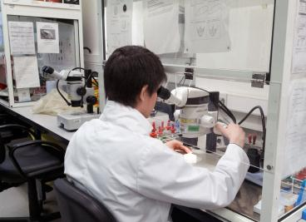
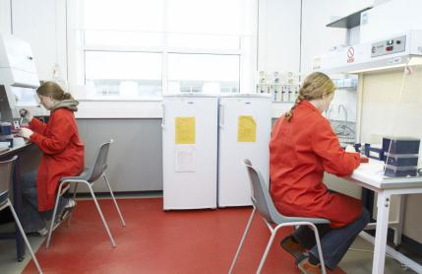
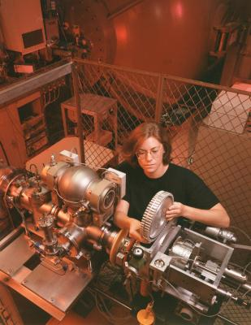
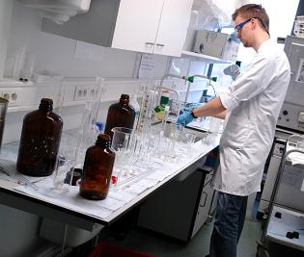
Life in the Lab
Labs are everywhere!
No two labs are the same
Chemists often concentrate on a specific area of chemistry
Research can have a big impact outside the lab
Notes:
As the transition from A-level (or equivalent) to the next level (a degree or equivalent) is a big step up, it might help students to understand what working in a chemical laboratory is really like (i.e. it isn’t like doing a practical lesson at school!)
These two slides give you the opportunity to discuss your own experiences in the lab, or what you like about the job of a “chemist”. Some suggestions have been made for you.
Laboratories are found in a whole range of places from universities to hospitals to pharmaceutical and energy industries, museums and government departments
Every lab has different aims - so chemists do lots of different jobs and no two labs are exactly the same
As a research chemist you get the chance to focus on your own specific scientific interests, and often end up specialising in a certain area such as medicinal chemistry, computational chemistry, organic synthesis etc.
The outcomes of laboratory work can have a global impact – like removing the lead from petrol, new materials such as Teflon and Kevlar, new medicines etc.

Slide 8
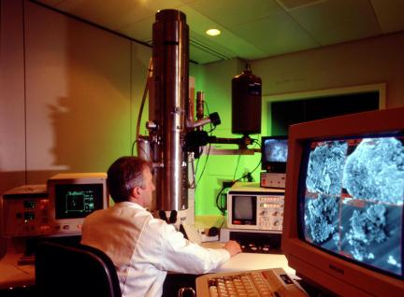
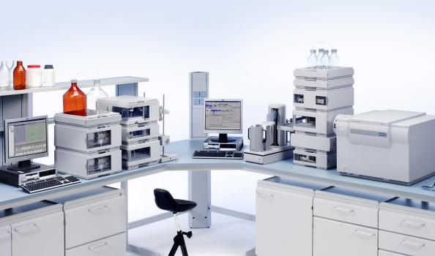
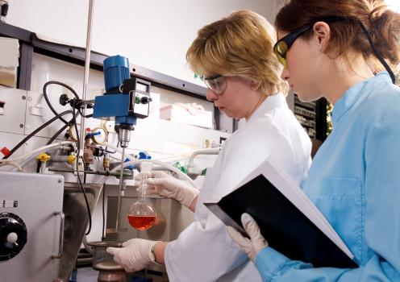
Life in the Lab – Day to Day
Team player vs. lone ranger?
DIY – experimental design and risk assessment
Keeping notes
Technology rich and poor
The ‘uniform’
Notes:
Most chemists work in teams, but focus on their own individual projects on a day-to-day basis
You don’t just get told how to do a procedure – many laboratory chemists will design experiments themselves and carry out their own risk assessments
Because chemists’ work is useful to others it’s important that they keep track of everything they’ve done properly, so that it can be repeated. Many laboratories now use electronic lab books to record experiments.
Many labs have cutting edge technology available to use, but sometimes you might have to be creative with old pieces of kit – or even make it yourself!
Working with chemicals can be dangerous – hence why all laboratory chemists wear lab coats, lab specs and gloves

Slide 9
Routes to study chemistry
14-16 study
16-18 study
Higher Education
Postgraduate
GCSEs /
Standard Grades/
Intermediates
A Levels (AS and A2) / Highers and Advanced Highers
Undergraduate degree (BSc, BA, MChem, MSci)
Masters (MSc, MA)
Baccalaureate (International / Scottish / Welsh / AQA)
HND, HNC
PhD/MRes
BTEC
Foundation degrees, Access to HE courses
PGCE/PGDE
NVQ/SVQ level 1-2
NVQ/SVQ level 3
NVQ level 4
NVQ level 5
Study whilst working
Intermediate apprenticeships
Advanced Apprenticeships
Higher Apprenticeships
Part time and distance learning courses
Notes:
Now that you have shown the students some of the exciting jobs chemists can do, help explain how they might get there. Once you have explained this you may wish to highlight your own route into chemistry.
These are just some of the routes students can follow to study chemistry. It is important for them to think about what is right for them and follow the route that takes them where they want to go. There are many options to study part-time while working, but these will take longer.

Slide 10


Vocational routes
You don’t have to go to university..
Apprenticeships
Part-time study
Notes:
Going to university isn’t right for everyone – some people find that the financial burden is too much, or they learn better outside of a classroom. Maybe they would like to get paid whilst they learn.
It is worth emphasising that you don’t have to go to university to have a career in chemistry
Vocational routes into chemistry include part-time study and apprenticeships.
Part time study: work full-time and study in the evenings, spare time, or go to college/university one day a week.
Apprenticeships: on the job training while studying for qualifications on a part time basis.
A few benefits:
Many employers fund part time study or apprenticeships = no student debt
Valuable work experience gained
A job with the employer isn’t guaranteed at the end of an apprenticeship but often you gain the skills needed to secure a role within the company

Slide 11
Apprenticeships
Science apprenticeships are currently rare,
<1000 year across all sciences
(out of approx 400,000 apprenticeships in total)
Most are at higher or advanced level
Work being done to increase number of science apprenticeships
Further info
www.apprenticeships.org.uk
www.notgoingtouni.co.uk
https://www.gov.uk/government/publications/future-of-apprenticeships-in-england-guidance-for-trailblazers
http://www.rsc.org/careers/future/earn-while-you-learn
https://www.accesstohe.ac.uk/Pages/Default.aspx
Notes:
Apprenticeships basics
There are different levels of apprenticeship:
Intermediate (equivalent to GCSEs)
Advanced apprenticeship (equivalent to A-levels)
Higher apprenticeship (equivalent to HNC, HND, Degree)
Apprenticeships usually include:
A competence qualification
A knowledge qualification
Functional skills
Personal learning thinking skills
Employer rights and responsibilities
For more information see:
www.apprenticeships.org.uk
www.notgoingtouni.co.uk
https://www.gov.uk/government/publications/future-of-apprenticeships-in-england-guidance-for-trailblazers
BUT currently very few chemistry apprenticeships, most are likely to be higher or advanced i.e. need good GCSEs or A levels.
Can be hard to find.

Slide 12
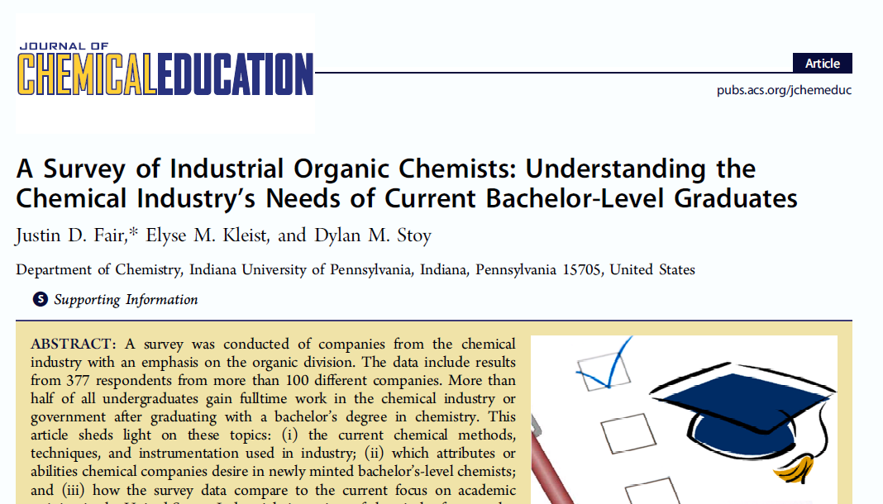
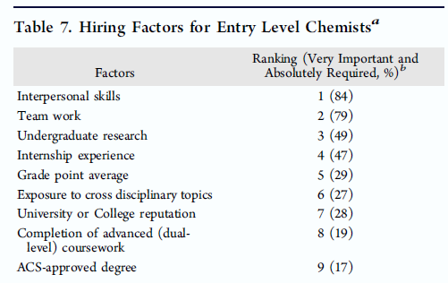
Importance of Transferable Skills
http://pubs.acs.org/doi/pdf/10.1021/ed400570f

Slide 13
What else can I do with a chemistry qualification?
Practical
Analytical
Numerate
Transferable skills
Problem solvers
Creative
Good communicators
Team workers
Notes:
Chemists are valuable employees because of the transferable skills they develop: for example practical, communication, numeracy, problem solving and team working skills. These are valuable in all kinds of work, as shown in the next slide.

Slide 14
What else can I do with a chemistry qualification?
Advise on science policy
Help people protect their ideas
Sell scientific equipment
You could…
Analyse data for reports
Become a science writer
Notes:
Chemists are valuable employees because of the transferable skills they develop: for example practical, communication, numeracy, problem solving and team working skills.
Some people want to use their chemistry knowledge but don’t want to stay in the lab – and it’s possible to do that. Examples could be patent attorneys, journalists and science writers, technical sales and marketing, consultancy and advisory roles, scientific publishers and policy researchers.
The following slides contain some examples of the above, for more see http://www.rsc.org/learn-chemistry/collections/faces-of-chemistry/careers-with-chemistry

Slide 15
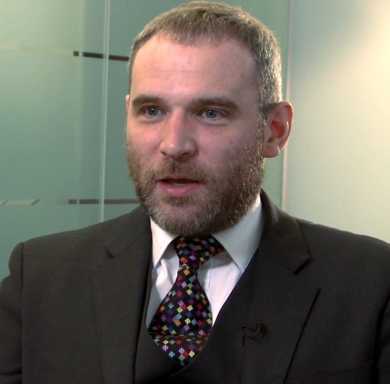
Darren Smyth - Patent Attorney
Darren helps companies protect new products by writing patents
Patents give companies a monopoly on their product for 20 years
Patents can be for a wide range of products such as drugs, foods, batteries and plastics
Darren uses his scientific knowledge every day
He also has to communicate complicated ideas
There are lots more profiles on A Future in Chemistry
Notes:
An example of one job that requires a scientific background, outside of research is patent law. Patent lawyers must have an academic background in a certain area, such as chemistry. With a science degree and an aptitude for English language students could consider converting to law.
Darren originally trained as a chemist and spent time as a researcher before deciding to train as a patent lawyer. He is now a partner in a company of patent and trademark lawyers called EIP.
Patents
New products cost companies a huge amount of time and money to develop. In order to recoup their investment they need to be the only ones to produce or use it. They can do this by applying for a patent – a document which lawyers like Darren write that give companies a monopoly on their product for 20 years.
If you study chemistry, you can help develop patents for a wide range of products such as drugs, foods, batteries and plastics.
Patent attorneys need to use their scientific and legal knowledge everyday and they also need to be able to communicate extremely effectively with their clients, who could be from all over the world.
Link to a video of Darren Smyth: http://www.youtube.com/embed/_DH5A0zfwUM [6.01 minutes, also embedded in image. Click to start]
Scientist to lawyer much easier than lawyer to scientist
Other interesting jobs I’ve come across:
Making ink and paper for bank notes at the Bank of England
Working for the world gold council
Computational chemistry is one that lots of people ask for but not many jobs…
drug testing for racehorses athletes (HFL in Newmarket),
public analysts
formula one fuel/lubrications chemists

Slide 18
A Future in Chemistry – Web quest
1. What two routes can you take to earn while you learn?
2. How old will you be when you leave education (and training)?
3. What is the Royal Society of Chemistry’s student (14-18 year olds) membership called?
4. Do you need chemistry to become a vet?
5. How much can a degree in chemistry increase your lifetime earnings, compared to other graduates?
6. Which famous triathlete enjoyed chemistry at school; and studied sports science at university?
7. Do you have to work in a laboratory (lab) if you are a chemist?

Slide 19
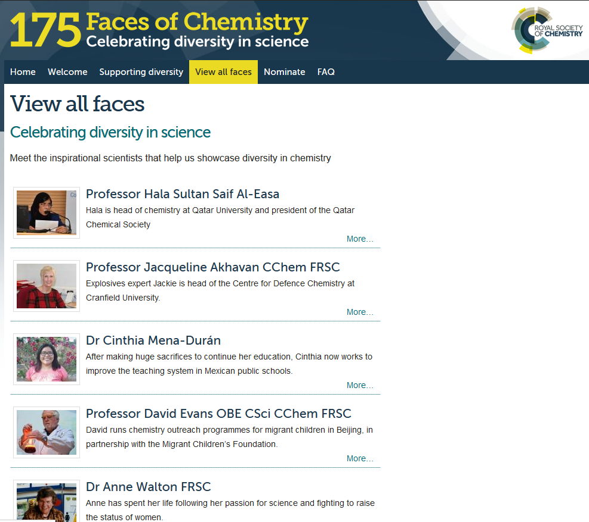
175 Faces of Chemistry
www.rsc.org/diversity/175-faces/

Slide 20
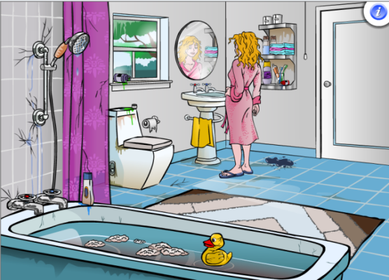

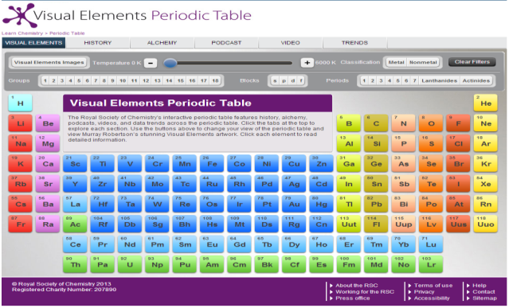
How can the Royal Society of Chemistry help?
Thousands of resources to help you teach chemistry like the Visual Elements Periodic Table, Chemistry in your Bathroom, and Mechanism Inspector!
www.rsc.org/learn-chemistry
Notes:
Learn Chemistry is the Royal Society of Chemistry’s online resource hub for students and teachers. It has thousands of resources from videos to quizzes to games and experiments.
Some examples of resources that students may find useful:
Visual Elements Periodic Table - Bring the periodic table to life with videos and interactive features like a sliding temperature scale
Chemistry in your Bathroom - How might your bathroom look without some key chemicals?
Connect your school to the world's leading chemistry community through our Learn Chemistry Partnership.
Learn Chemistry Partnership is a free programme to ensure your school makes the most of our activities and resources.
Be the first to know about new resources and benefits through our monthly e-newsletter
Receive printed copies of Education in Chemistry magazine, written by chemistry teachers for chemistry teachers, and The Mole student magazine
Benefit from discounts on products and services; including 25% off our online courses for teachers and an offer on giant periodic table wall charts for the classroom, worth £30 each
One main contact registers their school and becomes an advocate for chemistry education, sharing the information and resources you receive with colleagues.
After you register your school, you will be offered complimentary personal membership (one teacher per school) to recognise your expertise and support your career.
Through Learn Chemistry Partnership, discover more about ouropen online resources and how we support educators to inspire the next generation.
Check this month's list of partner schools to see whether your school is already registered.

Slide 21
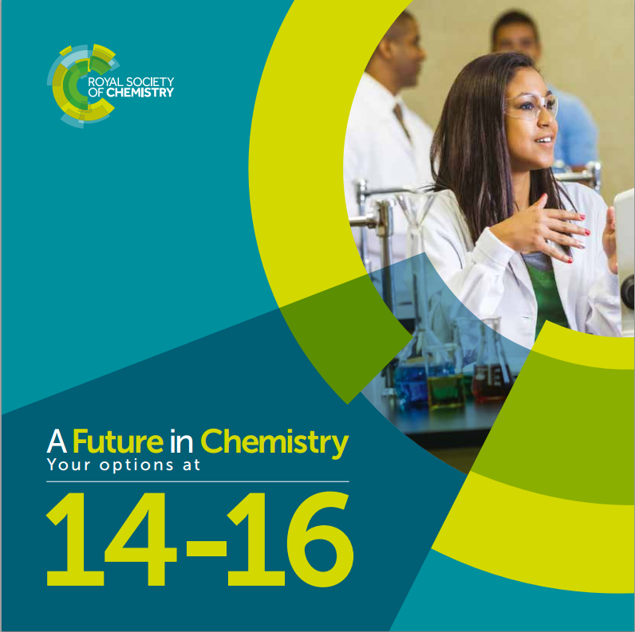

Options booklets for you
Notes:
available from: education@rsc.org

Slide 22

ChemNet is the Royal Society of Chemistry’s provision for 14-18 year olds.

Slide 23

As part of ChemNet you will benefit from…
events all over the UK, such as university and industry visits, as well as hands-on workshops;
ask an expert service from Dr ChemNet and Dr Careers;
study support;
monthly newsletters, chemistry events and a competition

Slide 24
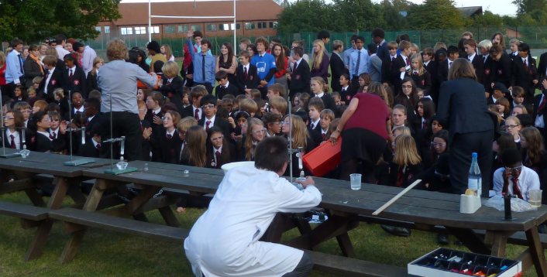
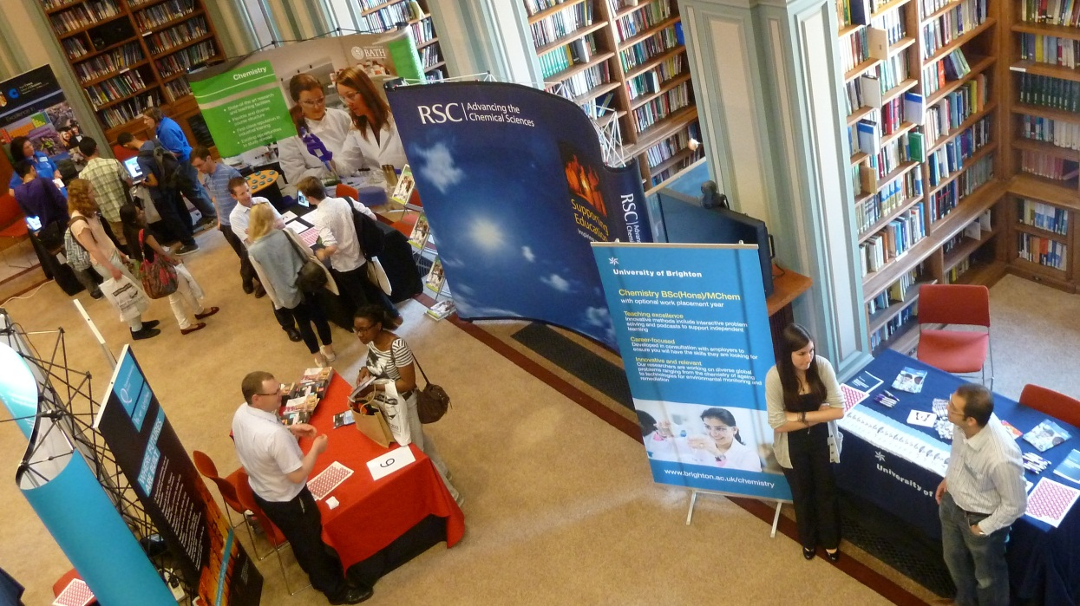
Events …
Schools events
Meet the Universities
Notes:
Please feel free to change and add your own photos.

Slide 25
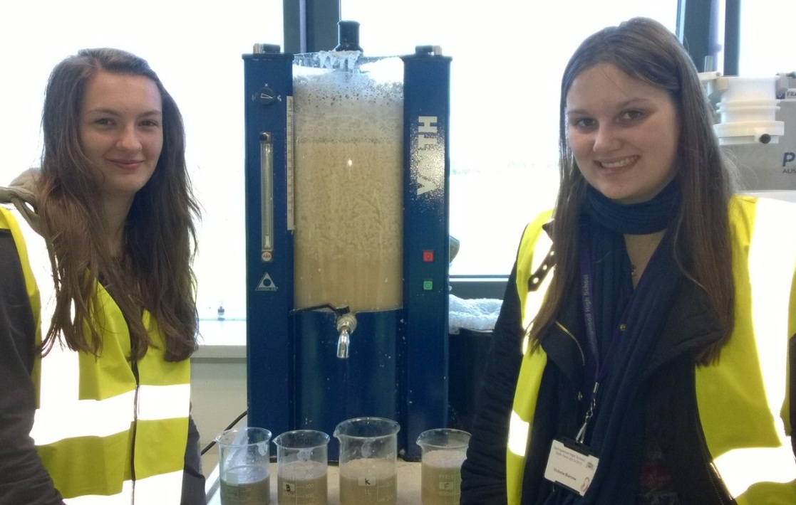
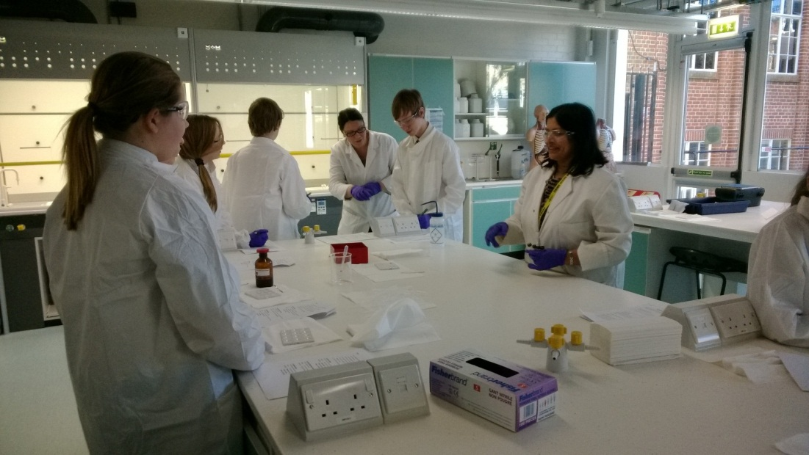
Events …
Industry tour
Hands-on workshop
To view all the forthcoming events visit
http://www.rsc.org/events/?eventtype=14

Slide 26
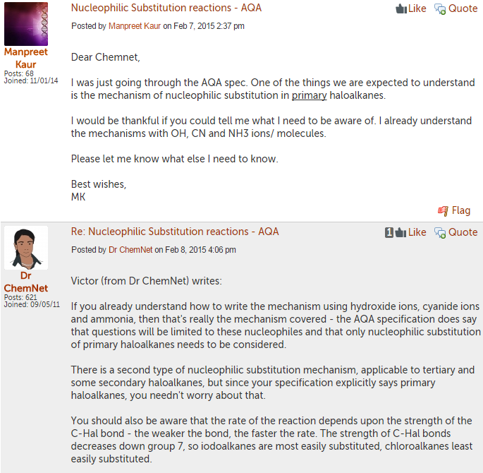
Dr ChemNet
You can post any chemistry question to our experts, Dr ChemNet.
You should receive a response within 48 hours.

Slide 27
Questions to Dr ChemNet
What is enthalpy? At GCSE, I think enthalpy change=energy change, but apparently it's not quite like that. What does enthalpy really mean and what is the difference between enthalpy change and energy change?
What is the chemical reaction for benzoic acid and ethanol
and the meaning of W/W , W/V and V/V.
thank you!!!

Slide 28
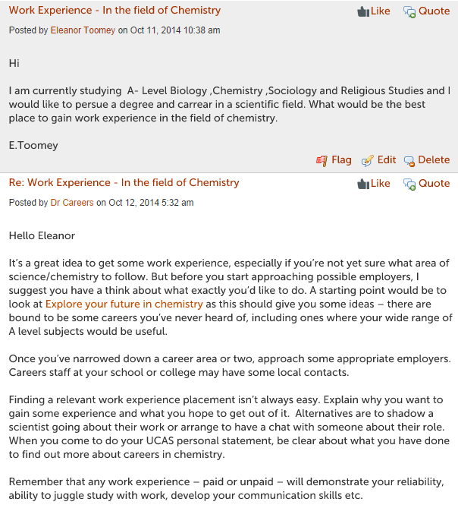
Dr Careers
You can post any careers question to our experts, Dr Careers.
You should receive a response within 48 hours.

Slide 29
Questions to Dr Careers
I'm studying A2 Chemistry and would like to study chemistry in uni and become a chemistry teacher. I was wondering would be better to have a chemistry degree to teach or could I do a branch of chemistry, such as analytical or environmental chemistry and still be a chemistry teacher.
I am currently studying A- Level Biology ,Chemistry ,Sociology and Religious Studies and I would like to pursue a degree and career in a scientific field. What would be the best place to gain work experience in the field of chemistry.

Slide 30
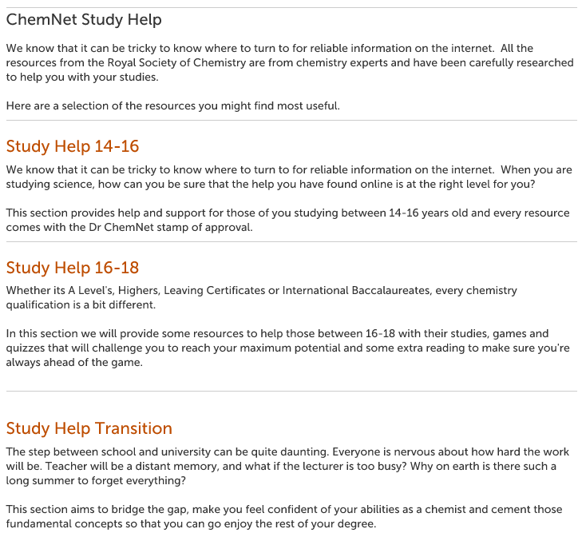
Study Support
Here you can view highlighted resources from Learn Chemistry and other useful links.

Slide 31
Monthly newsletter
You will receive a monthly mailing which includes:
  events in your area
  competitions
  resources

Slide 32
Feedback from other students
“Thank you so much for a fantastic day!!! It truly exceeded my expectations, and I’ve learnt so much! Who knew having fun could be so productive?”
M. Hughes
"Lovely and refreshing to take a couple of hours out of a hectic exam schedule to remember why we study and to think about the doors our A-levels will open when we succeed."
Anon

