Slide 1
The role of technology in sporting performance

Slide 2
The role of technology in sporting performance
How much effect does engineering technology have on sport?
Is technology only used to increase performance?
What are the ‘new technologies’ being introduced?

Slide 3
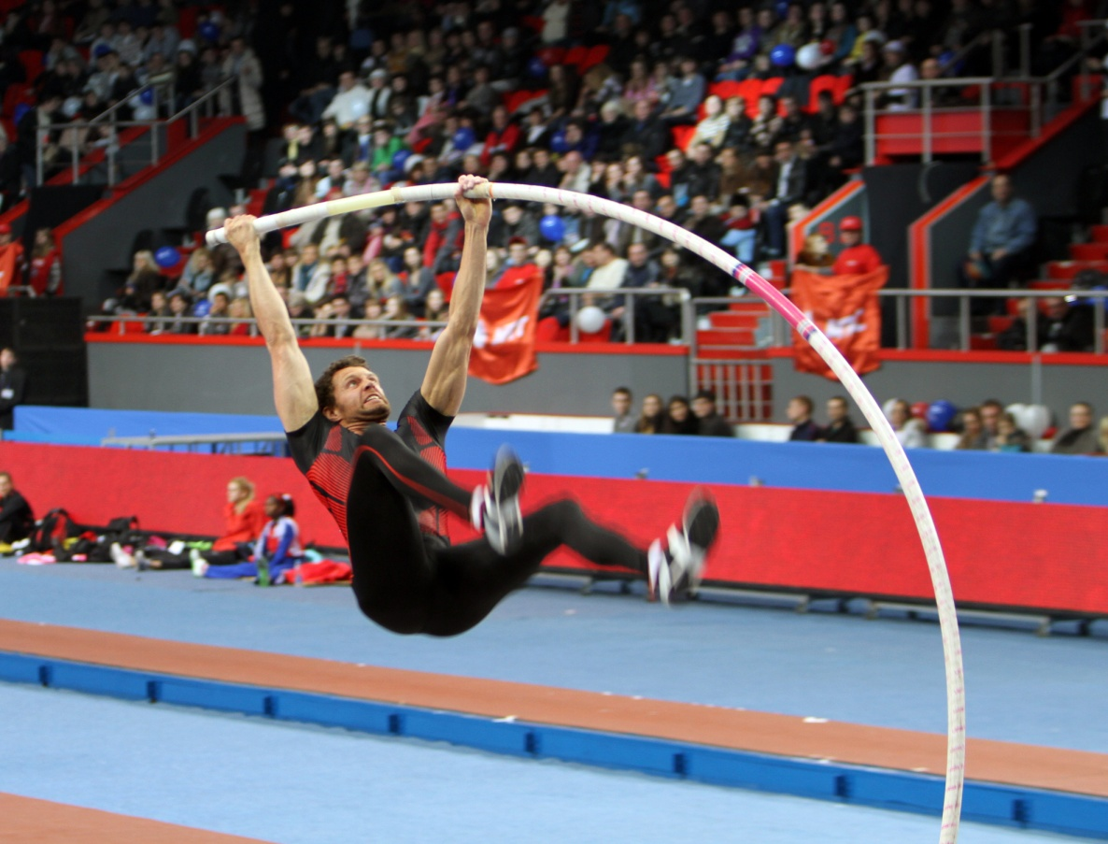
Pole Vaulting
Photograph accredited to Denis Kuvaev
Notes:
Image of pole vaulter

Slide 4
Pole Vaulting - history
19th & 20th Ash or hickory poles, hands moved up century pole during vault
1889 USA banned hand movement
1900 - 1942 Introduction of bamboo poles
Early 1900s Box introduced to receive pole on ‘plant’

Slide 5
Pole Vaulting - history
1957 Bob Gutowski (USA), first used an
aluminum pole world record (WR) 4.78 m
1957 Don Bragg (USA), used a steel pole WR
4.80 m
≈1956 Introduction of flexible composite
(fibre-glass) poles
1961 WR first broken with composite (fibre-glass) pole

Slide 6
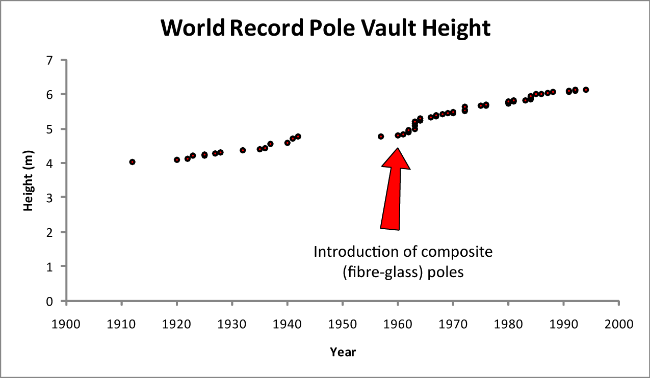
Effect of technology on performance
Current world record:
Men: 6.14 m (Sergei Bubka 1994) Women: 5.06 m (Yelena Isinbayeva 2009)

Slide 7
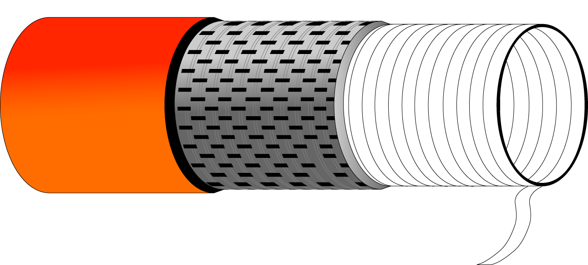
Modern poles
Single-direction carbon
fibre in glue or resin
Woven carbon
fibre in glue or resin
Filament-wound
glass fibre core

Slide 8
Modern poles
As you push the technology to the limit then failures can occur resulting in potential safety implications - poles occasionally break during a jump in an unpredictable manner.

Slide 9
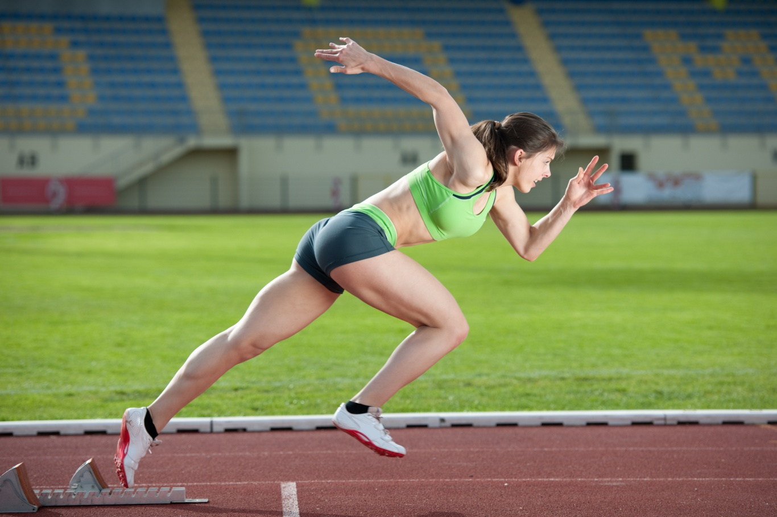
Sprinting

Slide 10
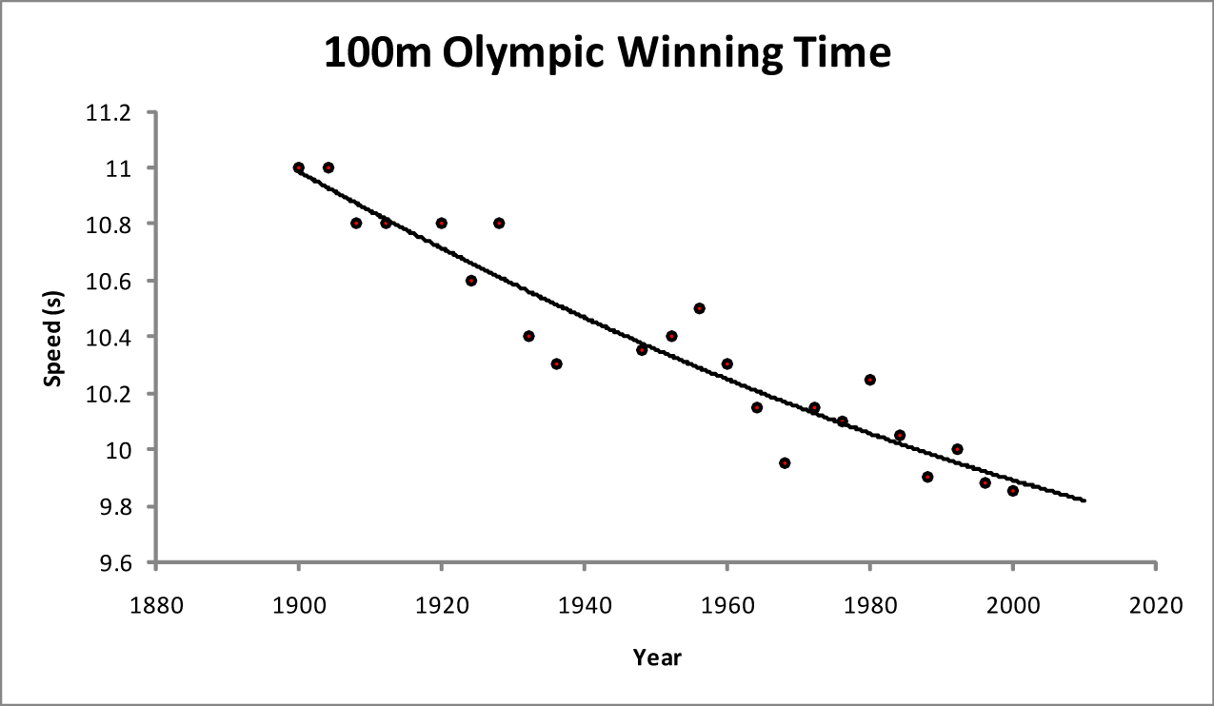
Sprinting
The pace of improvement has slowed.
The performance improvement comes from better prepared athletes:
  Better training
  Better nutrition
There is little room for improvement in the technology – only shoes, clothing and track surface.

Slide 11
How much effect does engineering technology have on sport?
Are all sports equally affected by the introduction of engineering technology?
No – it depends on the nature of the sport
There is less capacity for affecting a sport with limited equipment

Slide 12
Is technology only used to increase performance?
Technology and research is usually used to improve performance, is this the only use?

Slide 13
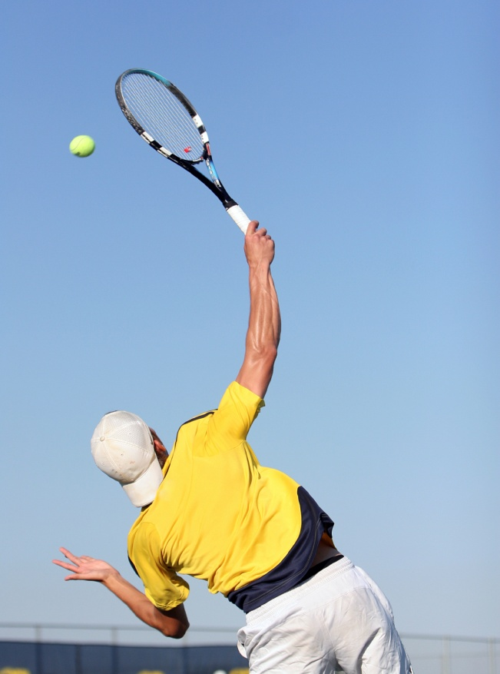
Tennis
The serve speed has increased to the current record of 155 mph.
Spectators have complained about the lack of rallies and excitement in the game.
To slow the game down on fast surfaces different balls are being introduced. These balls are larger, which makes them slower and gives more response time to the receiver.

Slide 14
Is technology only used to increase performance?
Technology and research is usually used to improve performance, is this the only use?
No – it can be used to improve safety, limit advances or improve player and spectator enjoyment

Slide 15
Does technology affect country performance?
How does,
and how will,
Great Britain perform at the Olympics?

Slide 16
Technology and sports performance
‘Technology-driven’ sports Non-technology sport
Track cycling + rowing + sailing Athletics
Total medals (2008) Total medals (2008)
Great Britain 24 USA 23
Australia 7 Russia 18
New Zealand 6 Kenya 14
Netherlands 5 Jamaica 11
France 5 Ethiopia 7
Spain 5 Belarus 7
Germany 5 Jamaica 5
USA 5 Cuba 5
China 5 Ukraine 5
Canada 4 Australia 4
Italy 2 Great Britain 4
The UK is focussing on specific sports and research is on-going into new materials and designs.

Slide 17
This presentation was created on the 21st of June, 2006.

