Slide 1
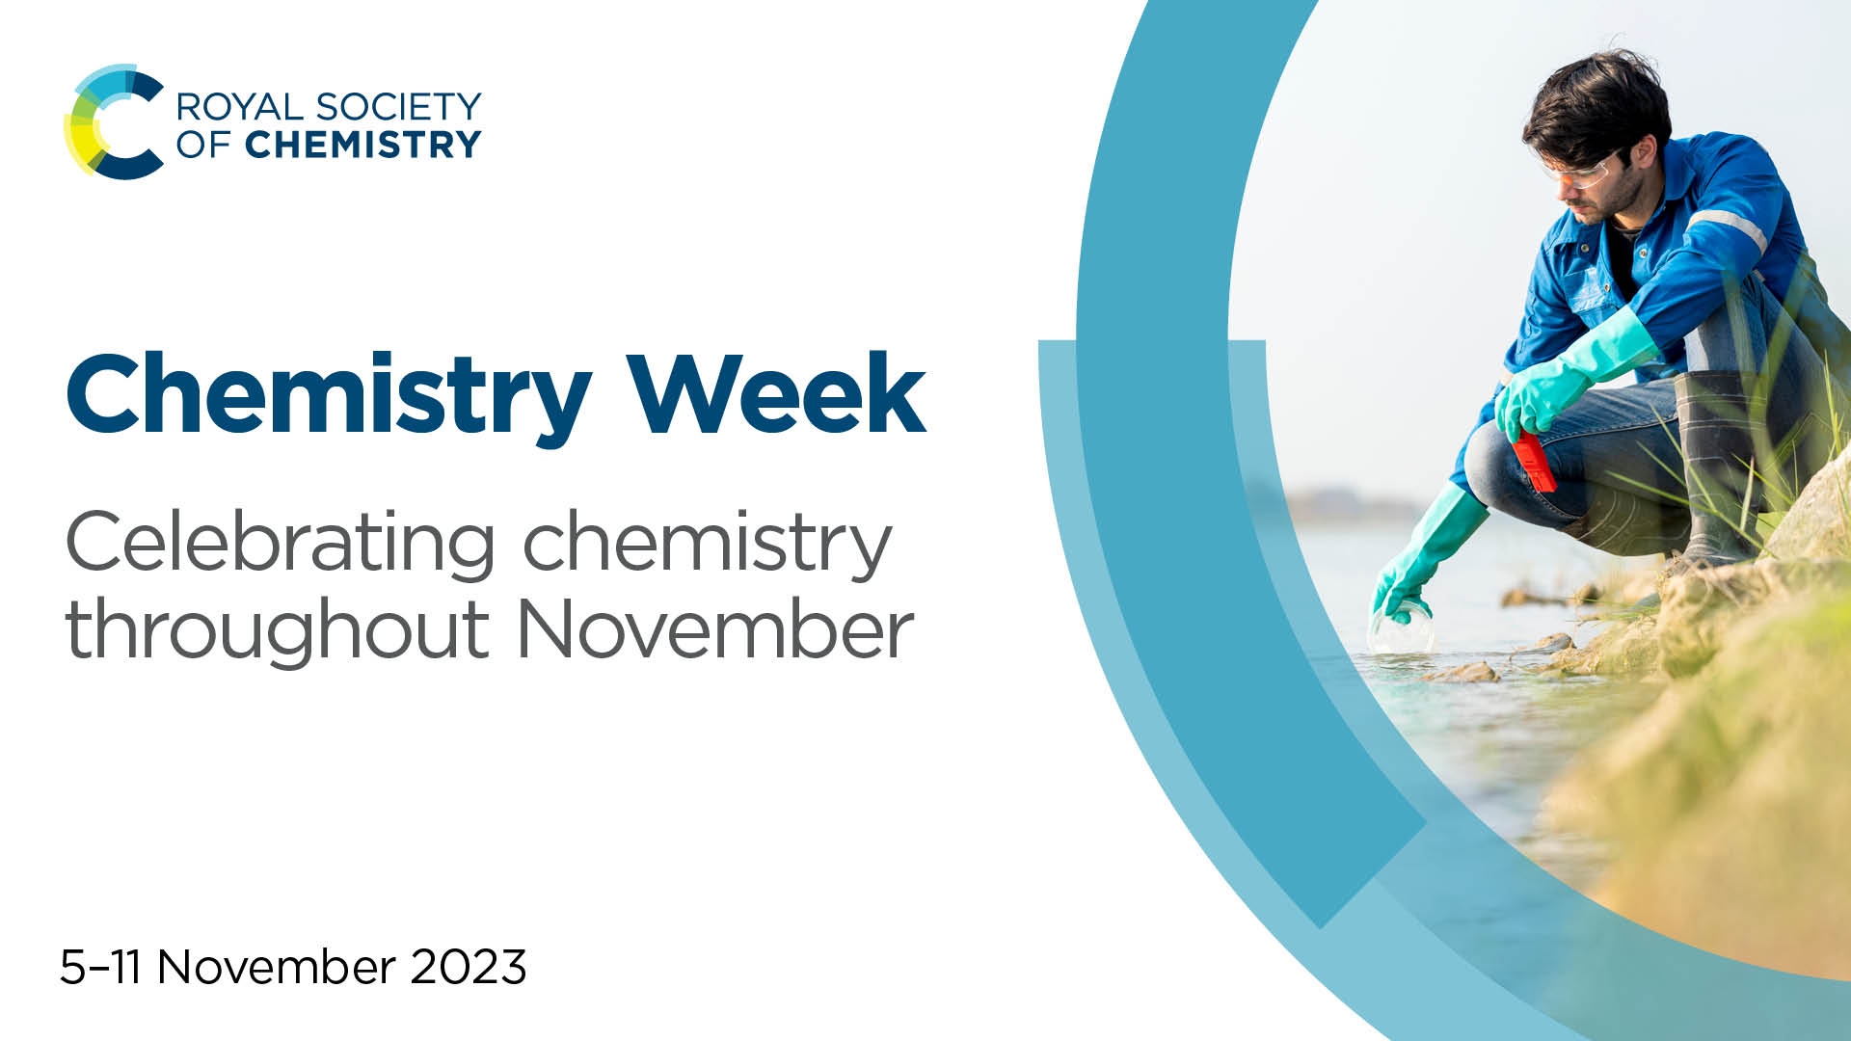
Chemistry Week
Celebrating chemistry throughout November
5–11 November 2023
Notes:
Title slide

Slide 2
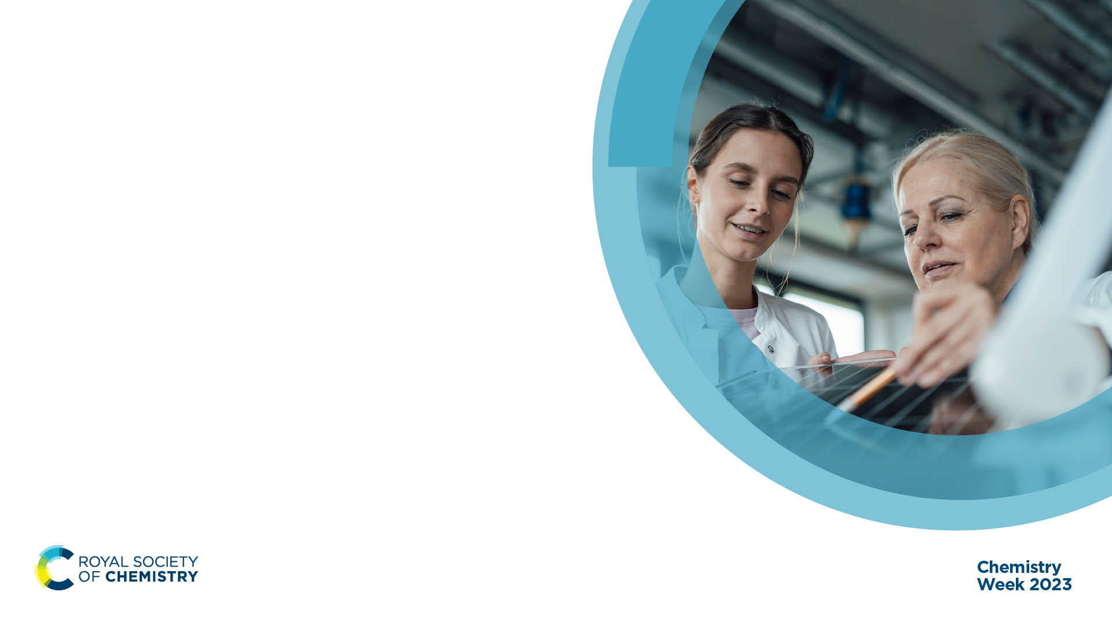
What is Chemistry Week?
An annual celebration of chemists and the chemical sciences
Raising awareness of the positive developments in chemistry
Showing how chemistry can help to make the world a better place
Notes:
Chemistry Week is an annual celebration of chemists and the chemical sciences, and although it’s taking place 5–11 November, we think the theme of ‘chemistry making the world a better place’ is worthy of a whole month. The Royal Society of Chemistry want all of November to be a celebration of chemistry and the positive impact it has on everyone’s daily lives, right now and in the future.

Slide 3
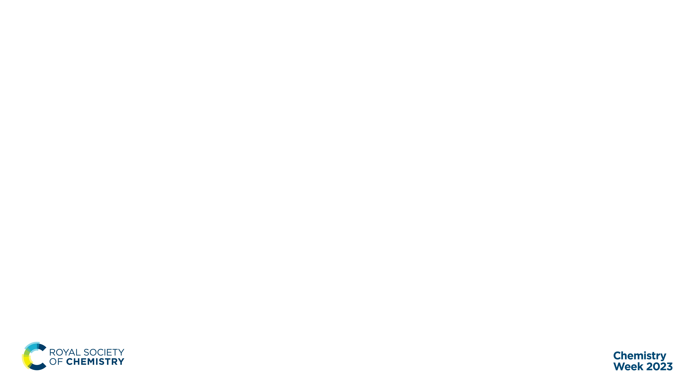
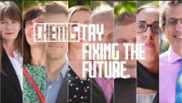
Chemistry Week 2023
Chemistry making the world a better place
Notes:
Each year, the Royal Society of Chemistry assigns a theme to Chemistry Week and encourages people working or studying within the chemical sciences to come together with those who don’t to tell them about the incredible things chemists do to make positive change in the world.
For 2023 the theme for Chemistry Week is ‘chemistry making the world a better place’.
Chemistry is at the heart of everything around us. It is essential to everything we touch, wear and use. It’s crucial in helping us to tackle climate change. It brings us closer to easing the pressures on energy, food and water. And it is our means for developing the life-changing medicines that let us live healthier, happier lives.
This video shows just some of the ways that chemistry and chemistry is fixing the future and bringing about positive change in the world.
Note: more videos here: https://edu.rsc.org/future-in-chemistry/making-the-difference

Slide 4
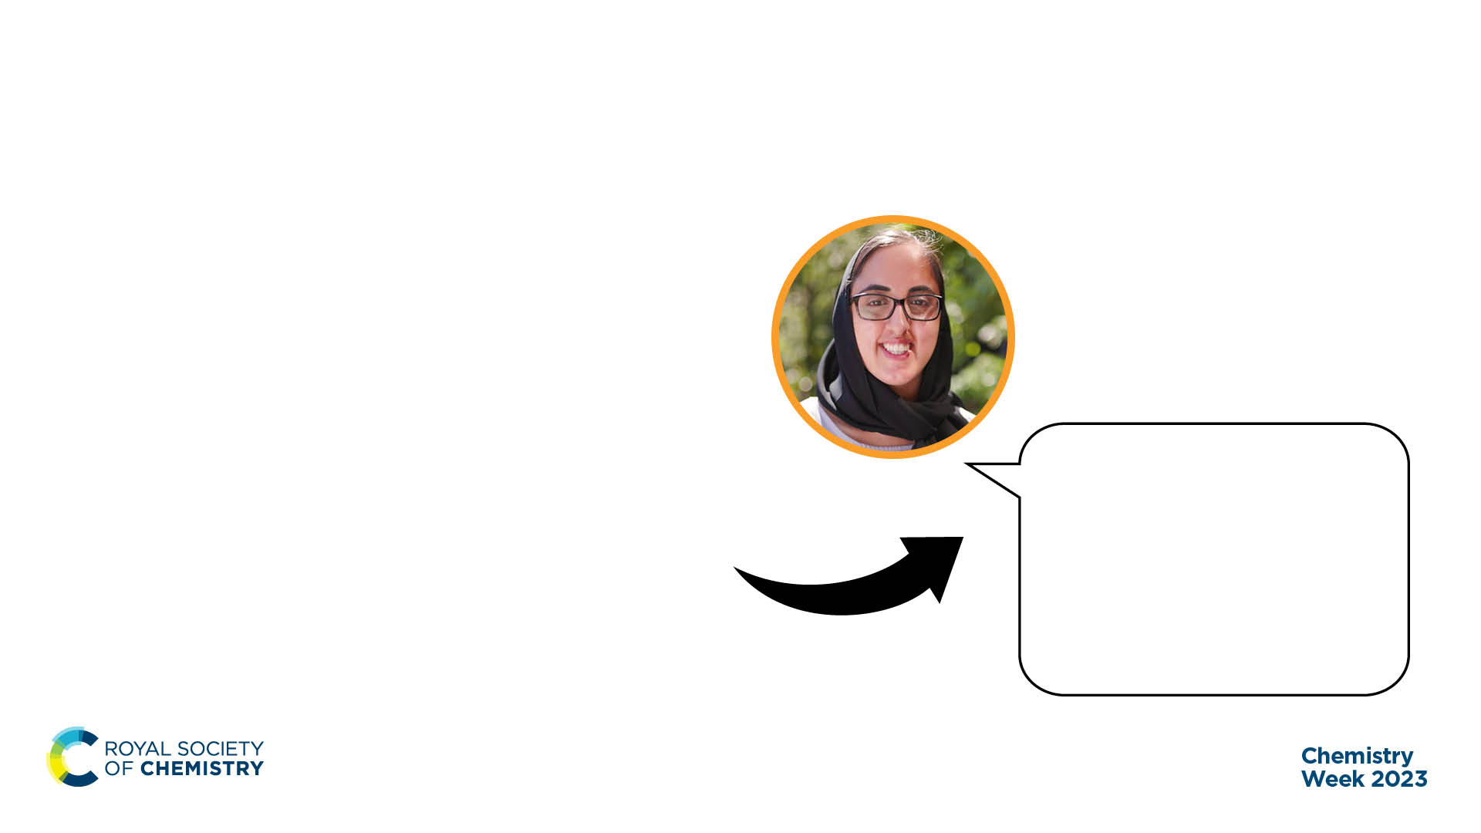
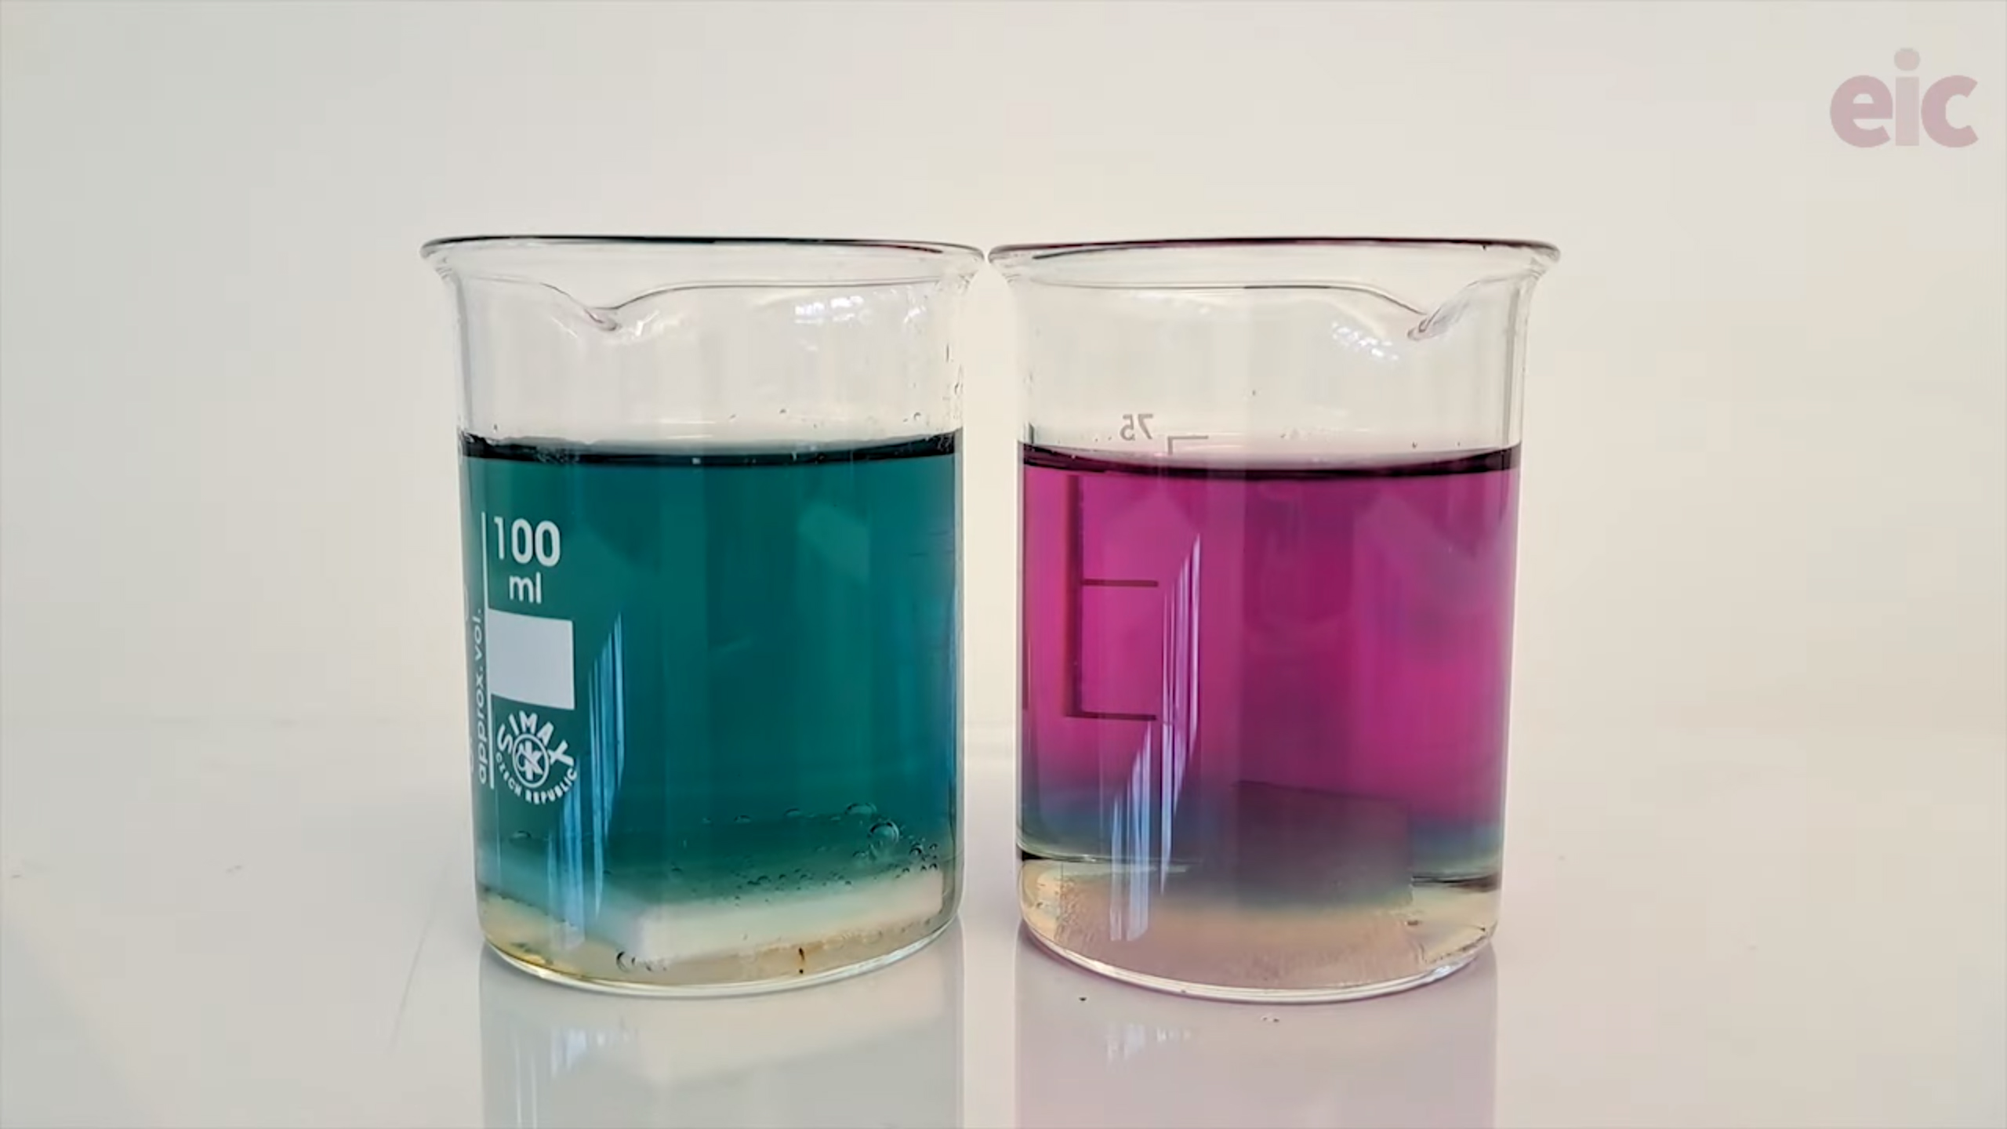
Making the world a better place
From classroom to career
“I hope to provide a sustainable process to power greener, low-carbon transport.”
Zubera, Research Fellow,
Battery Recycling
Notes:
Chemistry isn’t all white coats and bubbling test tubes. Though these should not be dismissed!
The experiments that you learn about in the classroom can be linked to lots of exciting and inspiring jobs in the real world.
Teacher note: below is an optional practical to demonstrate this.
The chameleon redox reaction gives students an understanding of how redox is applied in a colour changing experiment. Redox also underpins a lot of metal extraction techniques. The understanding of this process is the basis for Zubera’s job role, where she’s currently 'fixing the future' by researching the best ways to recycle electric car batteries. This is an important step in the solution to cutting CO₂ emissions as the UK moves to electric vehicles by 2035.
Our suggestion to make the Chemistry Week presentation more engaging is to do the experiment live as part, however if this is not possible, alongside the practical instructions on the webpage there is also a video you can use to walkthrough the experiment with students: https://edu.rsc.org/exhibition-chemistry/demonstrating-the-chameleon-redox-reaction-with-a-lollipop/4016633.article
Zubera profile & video case study: https://edu.rsc.org/job-profiles/research-fellow-battery-recycling/4013825.article Teacher note: Click the image of Zubera to be taken to their job profile and case study video on A Future In Chemistry.

Slide 5
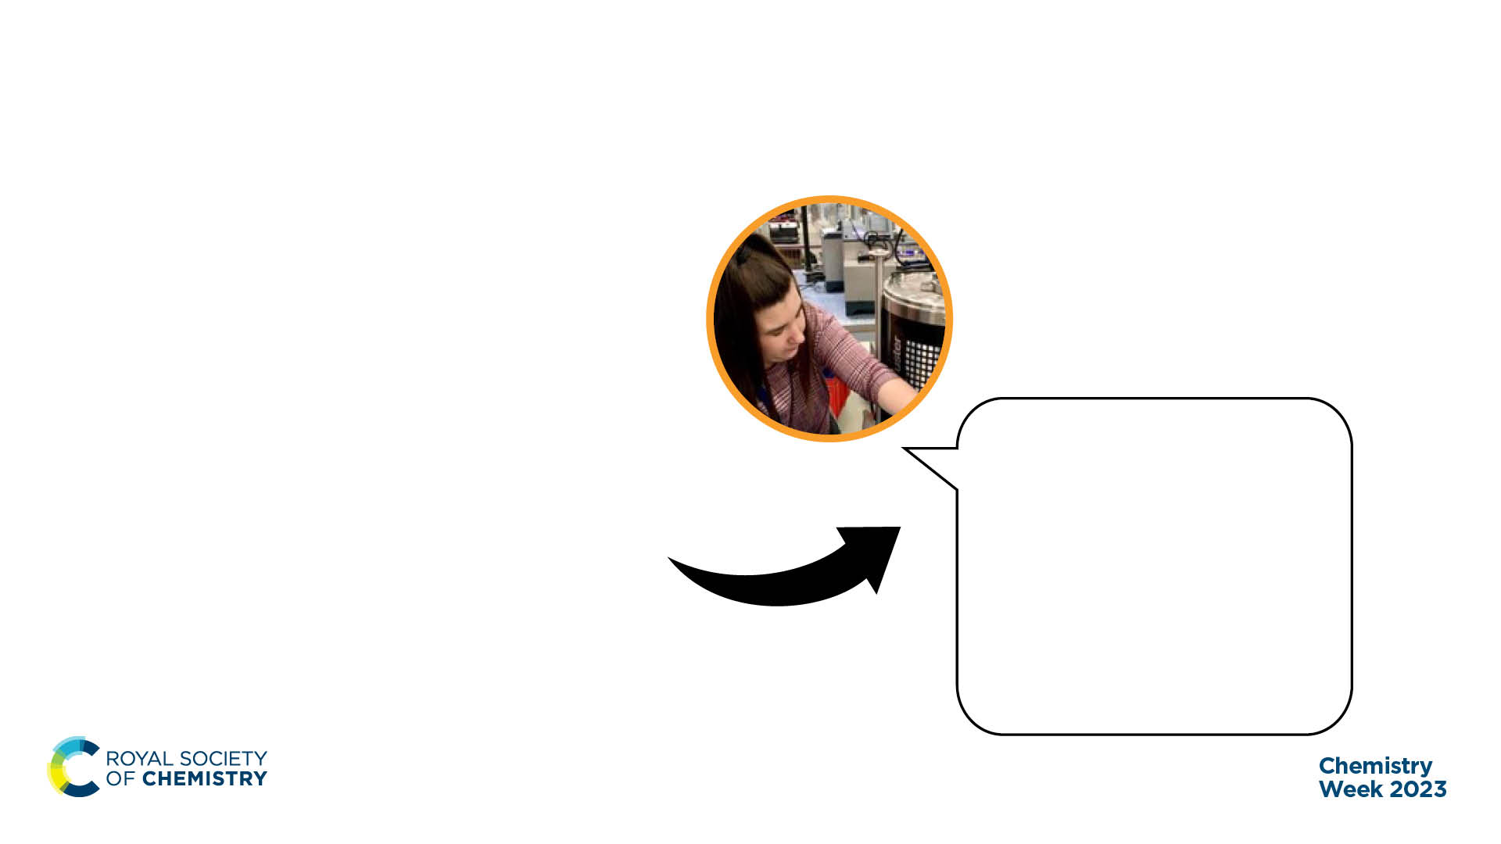
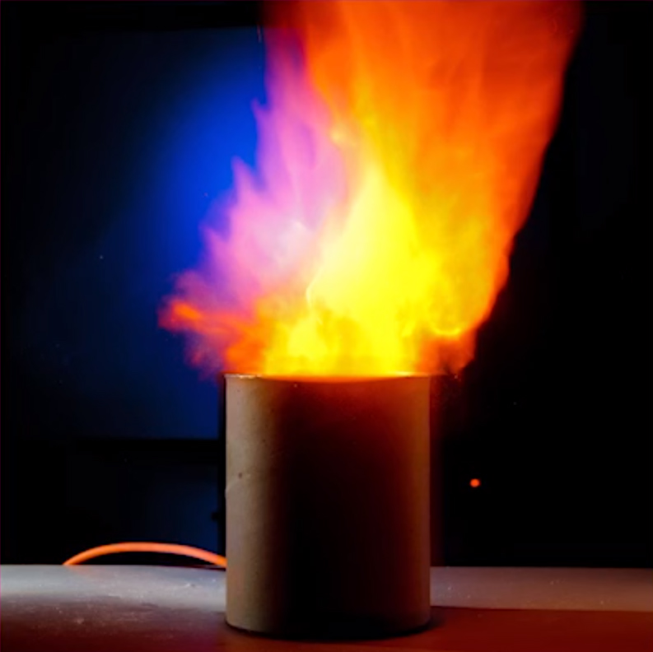
Making the world a better place
From classroom to career
“I find ways to produce new medicines in large quantities so that they are safe and accessible for everyone who needs them.”
Erin, Process Chemist
Higher Apprentice, Pharmaceuticals
Notes:
Chemistry isn’t all white coats and bubbling test tubes. Though these should not be dismissed!
The experiments that you learn about in the classroom can be linked to lots of exciting and inspiring jobs in the real world.
Teacher note: below is an optional practical to demonstrate this.
The surface area : volume ratio demo links learning of factors which affect the rate of reaction. Understanding this topic is integral to Erin’s role where she working to turn new medicines into finished products so that they can be mass-produced for patients and has to apply her understanding of rates of reaction to make processes more efficient. Without this, many of us wouldn’t have access to life-changing medicines and treatments.
Our suggestion to make the Chemistry Week presentation more engaging is to do the experiment live, however if this is not possible, alongside the practical instructions on the webpage there is also a video you can use to walkthrough the experiment with students: https://edu.rsc.org/exhibition-chemistry/demonstrating-the-importance-of-surface-area-to-rates-of-reaction/4016400.article
Erin profile: https://edu.rsc.org/job-profiles/process-chemist-higher-apprentice-pharmaceuticals/4013847.article Teacher note: Click the image of Erin to be taken to their job profile on A Future In Chemistry.

Slide 6
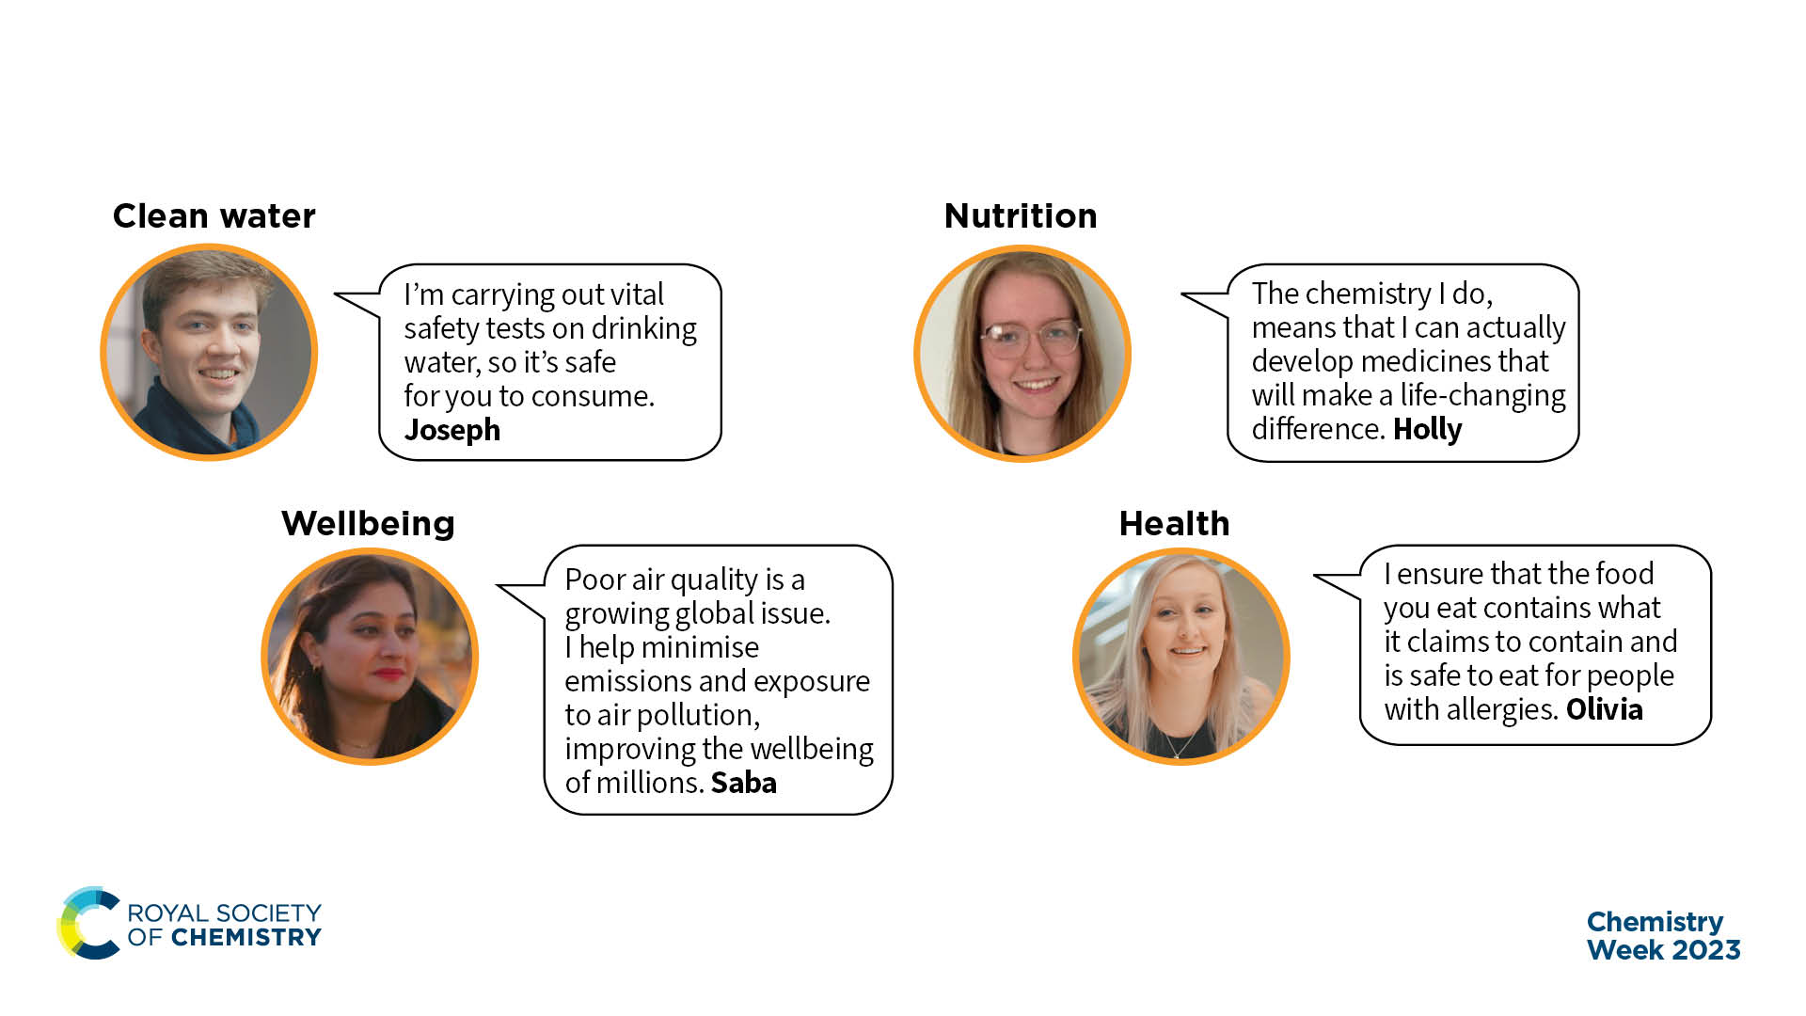
Positive change is already happening
Notes:
The impact of chemistry is incredible. It has led to positive outcomes and developments for the individual up to global society. Chemistry supports development across all aspects of society, including health, climate and the environment, wealth and industry, sustainability, wellbeing, education, justice, equality, nutrition, and alleviation of poverty. Within the chemical sciences there is a rich and diverse community of groups and individuals who, driven by dedication and professionalism, work to make the world a better place.
Joseph: https://edu.rsc.org/job-profiles/laboratory-analyst-and-higher-degree-apprentice-water/4010930.article
Holly: https://edu.rsc.org/job-profiles/senior-laboratory-technician/4016128.article
Saba: https://edu.rsc.org/job-profiles/principal-air-quality-consultant/4017018.article
Olivia: https://edu.rsc.org/job-profiles/associate-scientist-pharmaceuticals/4010913.article
Teacher note: Click the image of each case study to be taken to their job profile on A Future In Chemistry.

Slide 7
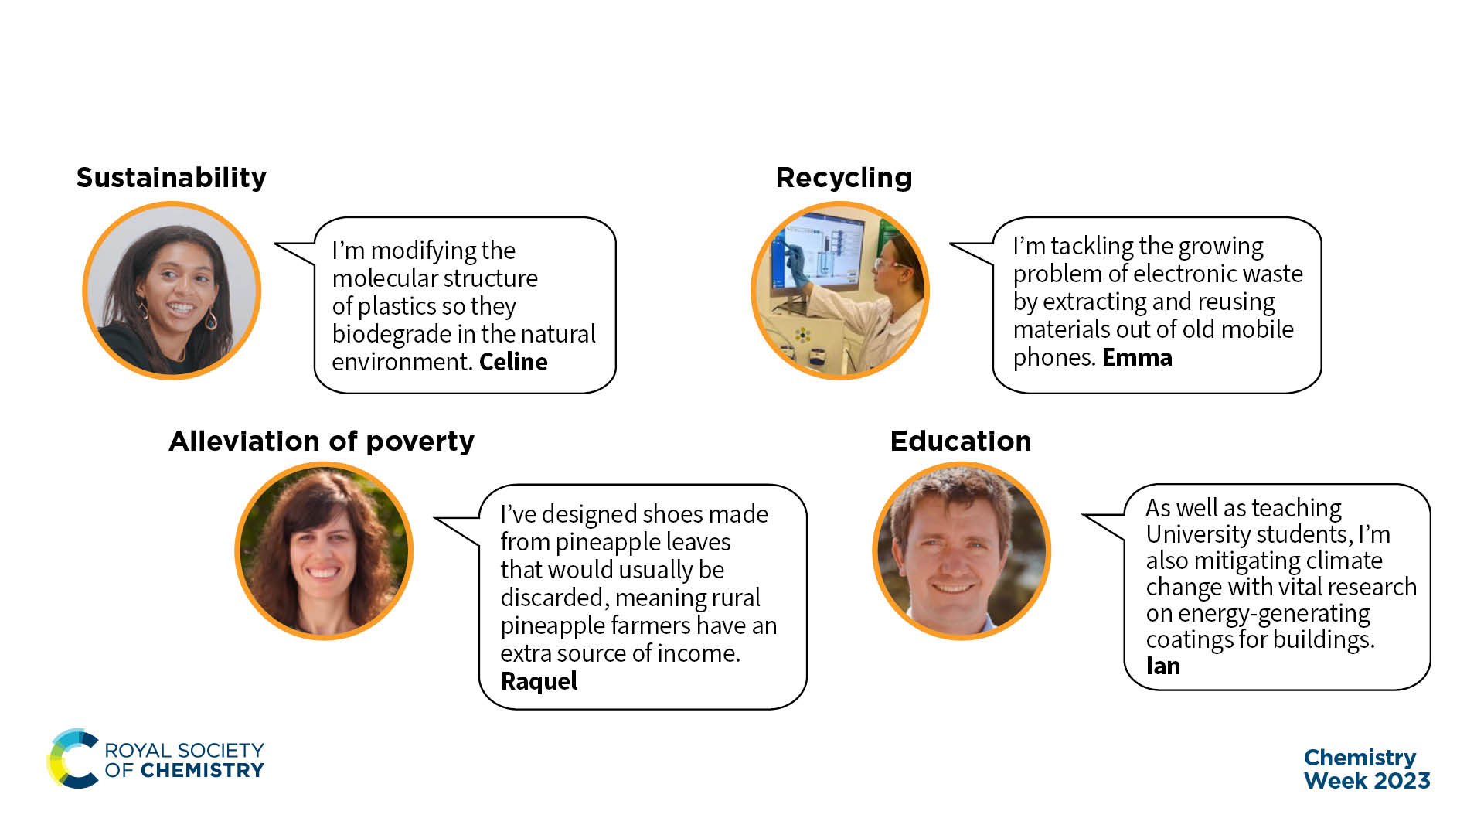
Positive change is already happening
Notes:
The impact of chemistry is incredible. It has led to positive outcomes and developments for the individual up to global society. Chemistry supports development across all aspects of society, including health, climate and the environment, wealth and industry, sustainability, wellbeing, education, justice, equality, nutrition, and alleviation of poverty. Within the chemical sciences there is a rich and diverse community of groups and individuals who, driven by dedication and professionalism, work to make the world a better place.
Celine: https://edu.rsc.org/job-profiles/analytical-technician-plastics/4010921.article
Emma: https://edu.rsc.org/job-profiles/bioleaching-lab-technician/4014506.article
Ian: https://edu.rsc.org/job-profiles/professor-and-enterprise-partnerships-and-innovation-lead/4016090.article
Raquel: https://edu.rsc.org/job-profiles/head-of-research-and-sustainability/4013826.article
Teacher note: Click the image of each case study to be taken to their job profile on A Future In Chemistry.

Slide 8
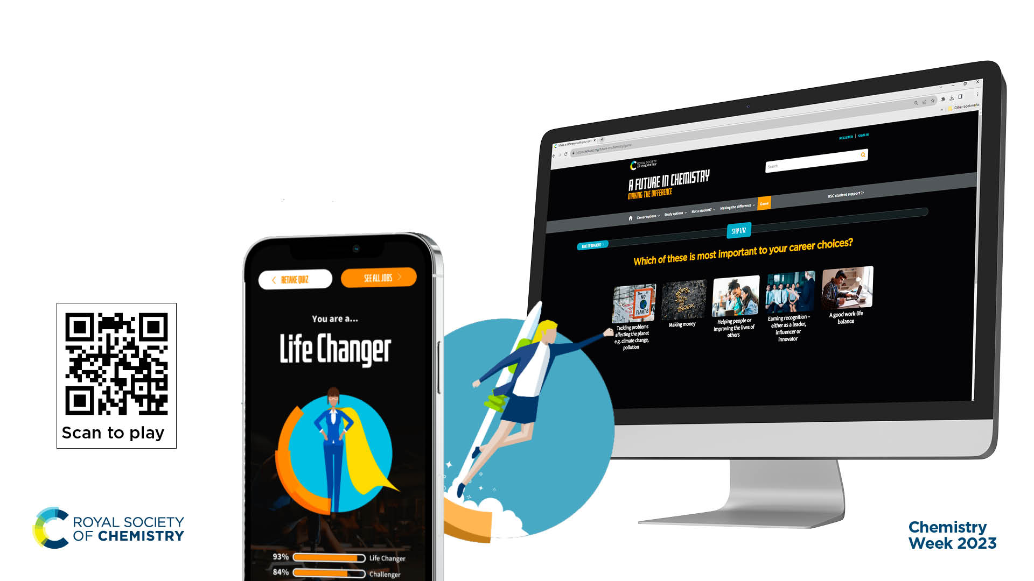
Game: find your role in fixing the future
Notes:
Your dream job could be in chemistry – you just might not know it yet!
Celebrate Chemistry Week by trying out RSC’s interactive careers game. Solve puzzles and answer questions about your hobbies and interests to discover your hidden talents and famous faces with the same skillset as you. Are you a challenger? A life changer? A catalyst? An innovator? At the end of the game, you’ll be linked to more information about chemistry careers that could help you use your skills to make a difference in the world.
Play game: https://edu.rsc.org/future-in-chemistry/game

Slide 9
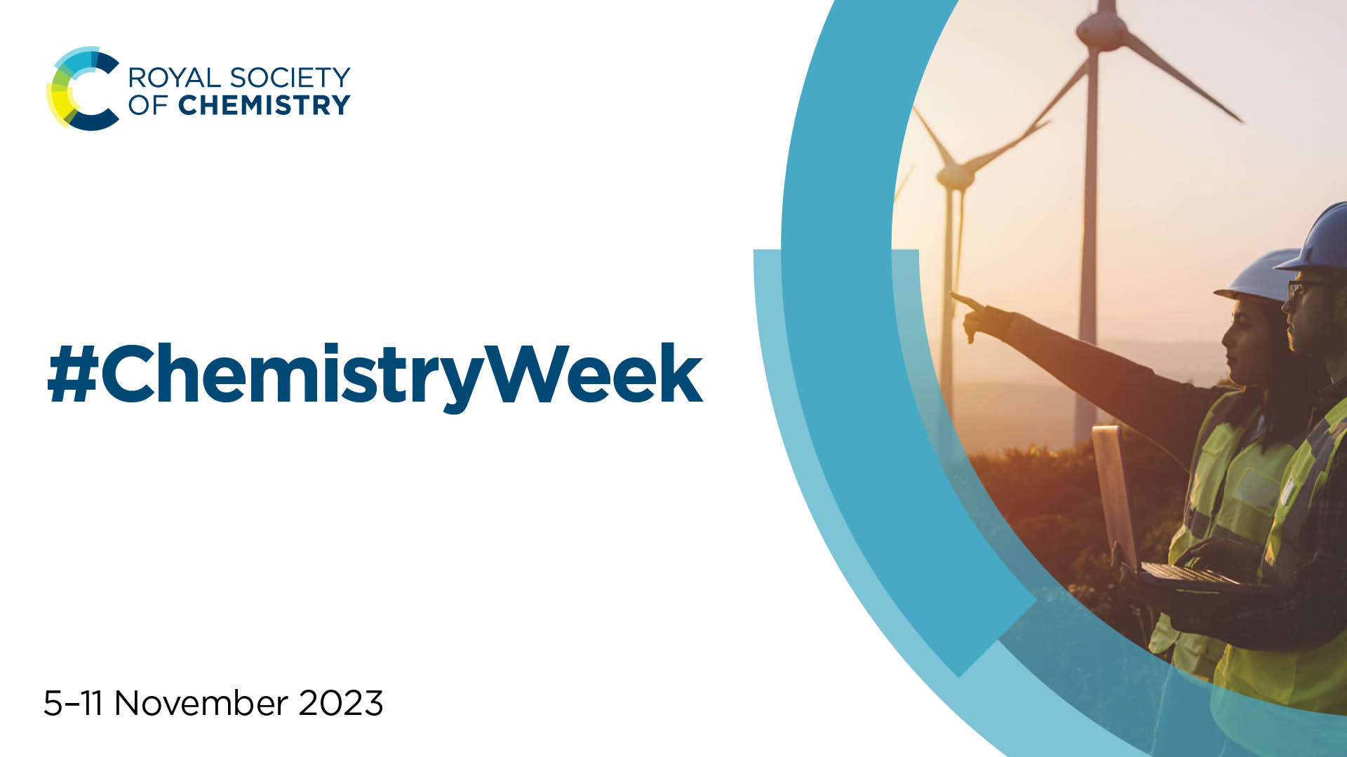
#ChemistryWeek
Notes:
The RSC always loves to hear about how everyone is celebrating Chemistry Week. If you are taking part, you can share what you are up to and what you’ve learned with us via email (outreach@rsc.org) or by tagging us on social media (don’t forget the hashtag: #ChemistryWeek).
If you want to know about more ways that the Royal Society of Chemistry can support you, email either outreach@rsc.org or education@rsc.org. We look forward to hearing from you!

