Slide 2
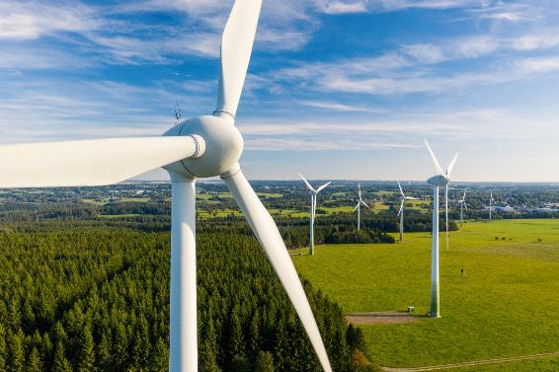
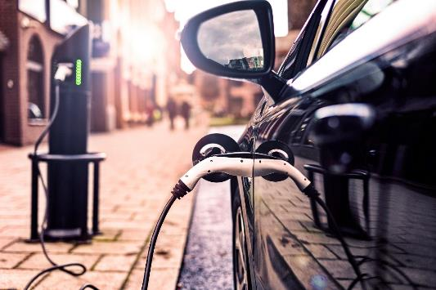
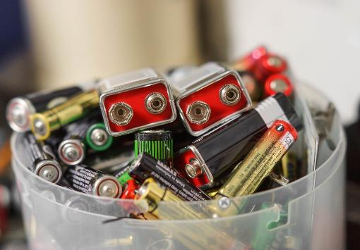
Investigating batteries
We need to stop using fossil fuels and use renewable energy resources such as wind and solar.
This means we need better batteries to store energy so we can use it where and when we need it.
Scientists are working on creating batteries that are efficient and made from materials that are easy to source.
You are going to make your own battery to light up an LED.

Slide 3
Learning objectives
Understand that batteries are made up of layers of different materials.
Understand that batteries store energy.
Make observations and record measurements.

Slide 4
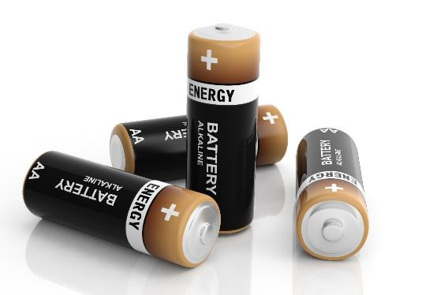
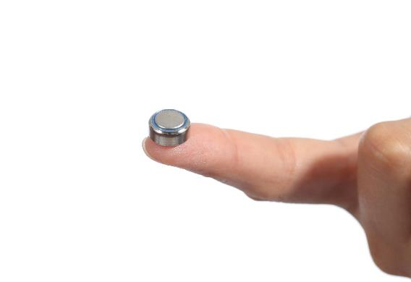
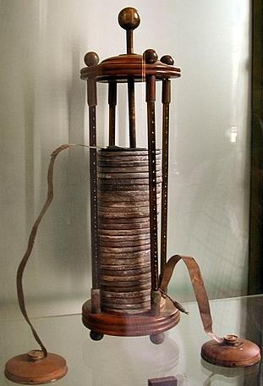
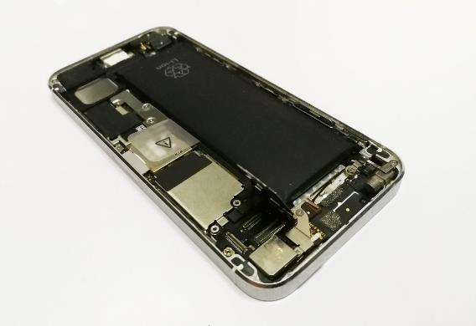
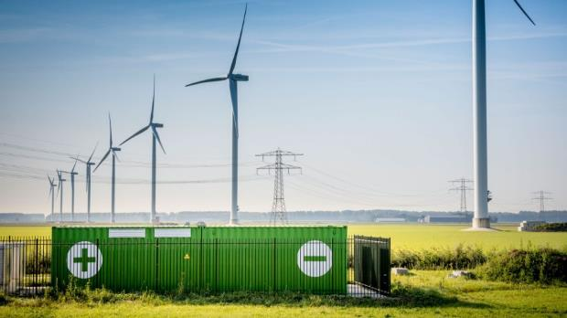
What is a battery?
1
2
3
4
5
Watch the introduction video

Slide 5
Useful vocabulary
Cell – a device that stores energy and uses chemical reactions to make a current flow in a complete circuit.
Battery – made up of one or more cells joined together.
Circuit – contains a power supply (such as a battery) and a component (such as an LED) connected by wires. A circuit needs to be complete (closed) to work.
Electrode – a cell has two electrodes made of different materials, one positive and one negative.
Electrolyte – a liquid that will conduct an electric current.
LED (light emitting diode) – an electrical component that produces light when an electric current flows through in one direction.

Slide 6
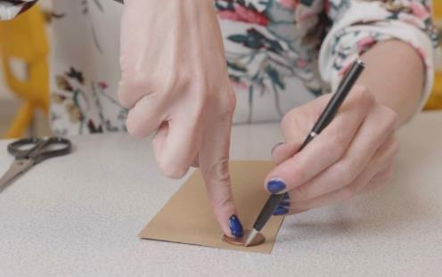
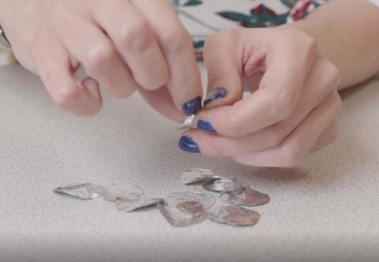
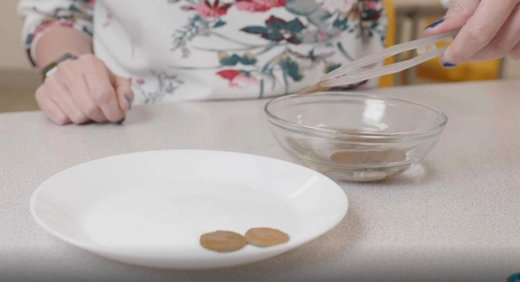
Method – to set up
Cut out 10 cardboard discs the same size as your coin.
Fold a square of aluminium foil four times, draw around a coin, cut out and separate the layers.
Soak the cardboard discs in the vinegar (the electrolyte) for about one minute.
Place the cardboard discs in a dry dish ready
to use.

Slide 7
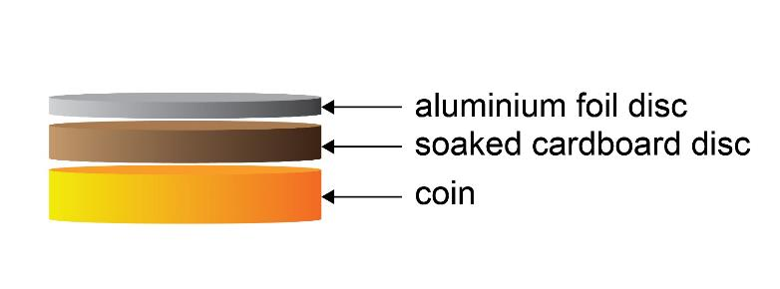
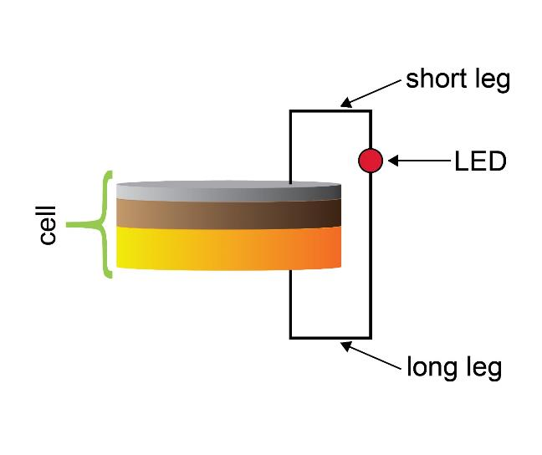
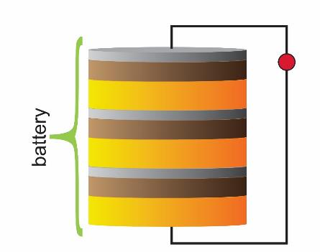
Method – build your battery
1. Make the first cell
2. Connect an LED to the cell
3. Add more cells
Assemble a second cell and place it on top of the first.
Test the two-cell device with the LED again.
Repeat the process by adding cells until the LED lights up.
Record the number of cells required to light up the LED.

Slide 8
Discussion questions
How many cells did it take to light up an LED? Did we all get the same result?
Did using different solutions as the electrolyte give different results?
What happened when we added more cells to our battery?
Is there anything we want to change about this experiment? What else could we test?

Slide 9
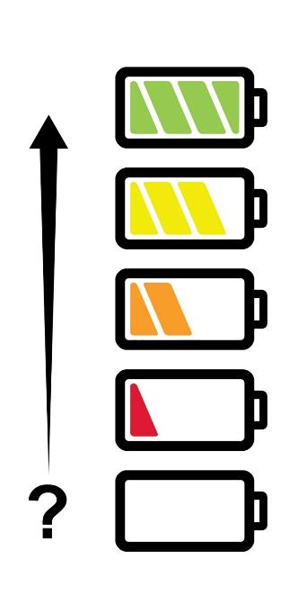
Evaluation
How do you feel about our learning objectives today?
Understand that batteries are made up of layers of different materials.
Understand that batteries store energy.
Make observations and record measurements.
How do you know you have learnt these objectives today?

Slide 10
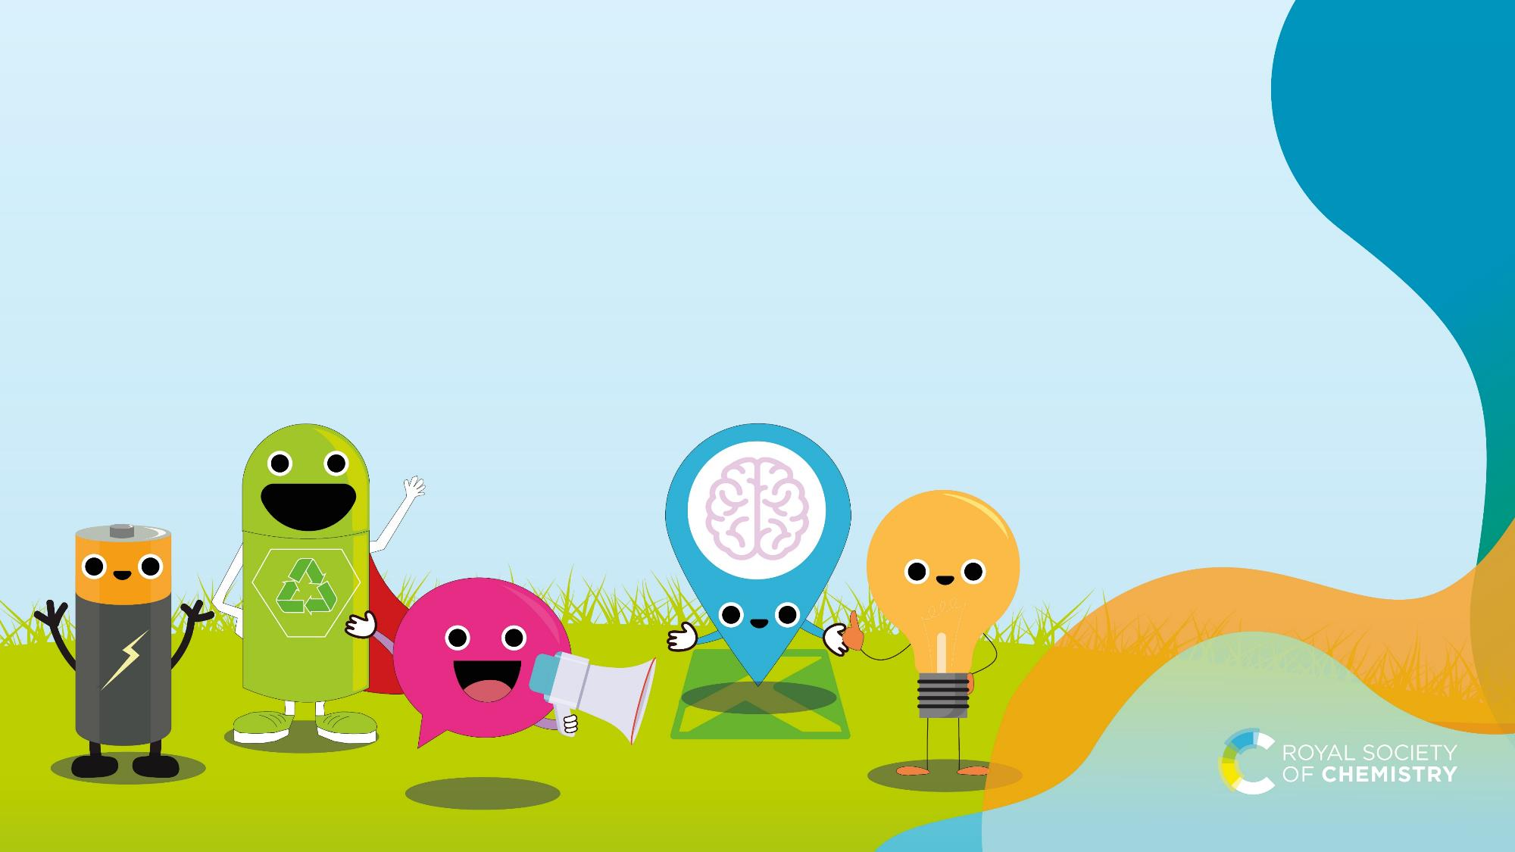
Next steps
Developing better batteries is one way that scientists are tackling climate change and helping to create a sustainable future.
What will you do?
Find and share ideas. Make a commitment https://rsc.li/takecharge

Slide 11
Image credits
Slide 2: all images © Shutterstock
Slide 4: images 1, 2 and 4 © Shutterstock; image 4 © Vattenfall, source https://group.vattenfall.com/press-and-media/newsroom/2021/hybrid-parks--new-opportunities-with-multi-technology-facilities; image 5 © GuidoB used under creative commons license https://commons.wikimedia.org/wiki/File:VoltaBattery.JPG
Slide 9: adapted from an original image © Shutterstock
All other images © Royal Society of Chemistry.

