Slide 2
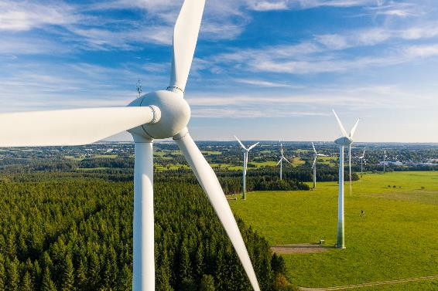
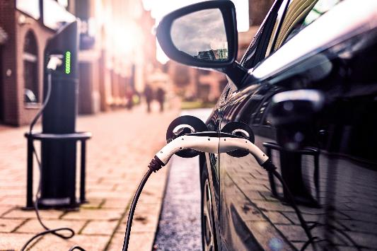
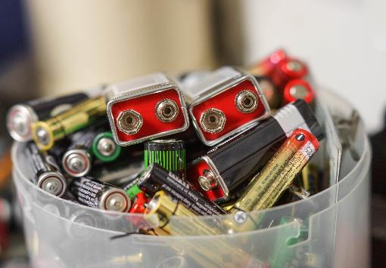
Investigating batteries
We need to stop using fossil fuels and use renewable energy resources such as wind and solar.
This means we need better batteries to store the energy from renewable resources for when it is needed.
Batteries are composed of cells. Each cell consists of layers made of different materials.
Scientists are working on creating better batteries that are efficient and made from materials that are easy to source.
Your task is to create batteries made of different materials and record which has the best performance.

Slide 3
Learning objectives
Understand that batteries are made up of cells, comprised of layers of different materials.
Understand that changing the different layers of a cell can affect its performance.

Slide 4
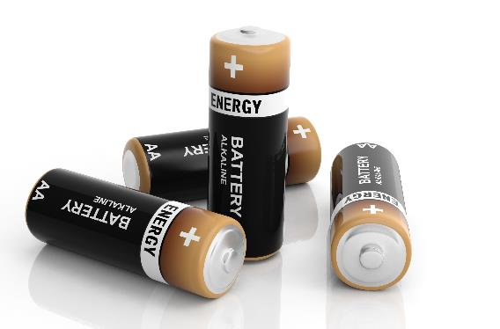
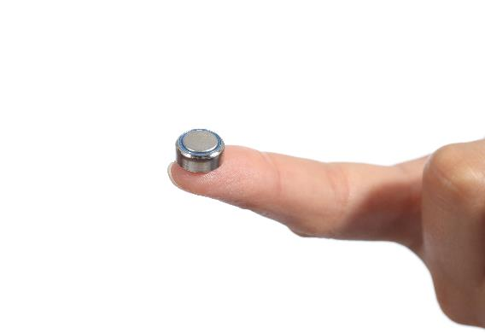
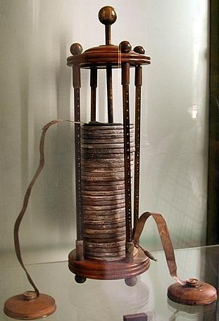
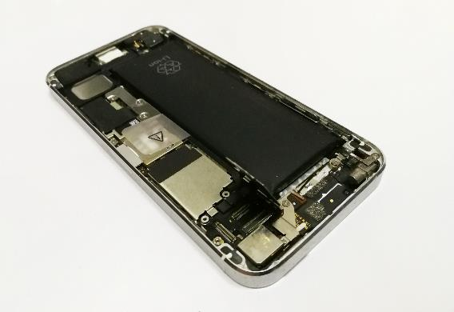
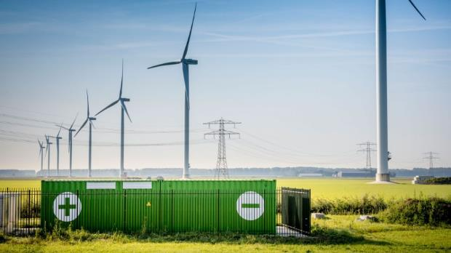
What is a battery?
1
2
3
4
5
Watch the introduction video.

Slide 5
Useful vocabulary
Cell – a device that stores energy and uses chemical reactions to make a current flow in a complete circuit.
Battery – made up of one or more cells joined together.
Circuit – contains a power supply (such as a battery) and a component (such as an LED) connected by wires. A circuit needs to be complete (closed) to work.
Current – the flow of charged particles around a circuit.
Electrode – a cell has two electrodes made of different materials, one positive and one negative.
Electrolyte – a liquid that will conduct an electric current.

Slide 6
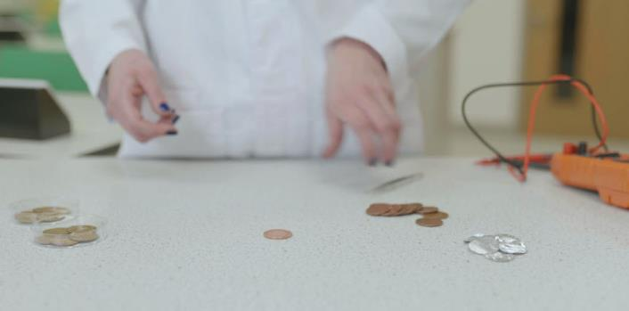
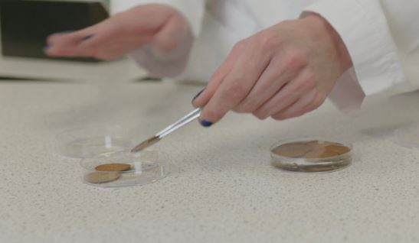
You will need
10 x coins (same shape and size)
10 x cardboard discs (same size as coin)
10 x aluminium foil discs (same size as coin)
Voltmeter
Sticky tape
Tweezers
2 x Petri dishes (or similar)
Electrolyte to test (one from the following):
Ethanoic acid solution (vinegar)
Sulfuric acid solution
Sodium chloride solution (saline)
Sodium hydroxide solution
Deionised/distilled water
Preparation
Soak the carboard discs in the electrolyte for
about one minute.
Use tweezers to move discs to the dry dish ready to use.

Slide 7
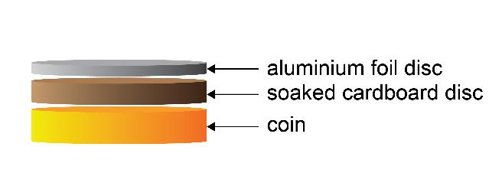
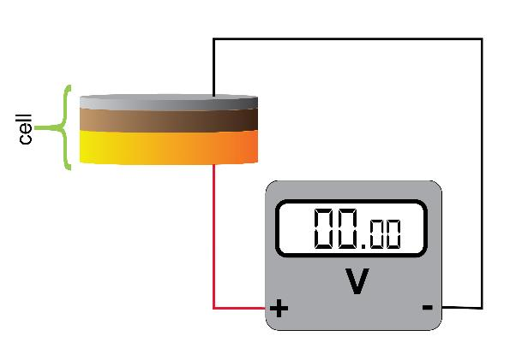
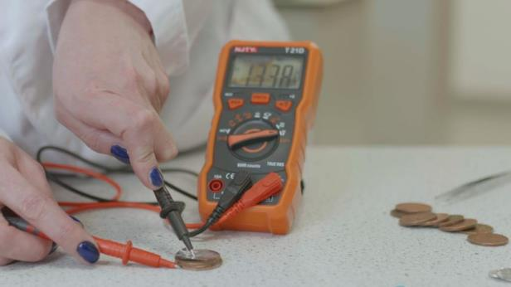
Method
1. Make the first cell
Stack a coin, a pre-soaked cardboard disc and a disc of aluminium foil.
2. Connect the cell to a voltmeter
3. Record the potential difference
4. Add more cells
Repeat the process up to a maximum of 10 cells.
Record your result for each addition.

Slide 8
Discussion questions
How do your results compare to the results from different electrolytes?
Did your results match your predictions throughout?
What do you predict would happen to the performance of the battery if you added 20 cells?
Does a higher potential difference relate to a greater performance?
What sort of graph should we use for these results? Why?
What could the coin be replaced with?

Slide 9
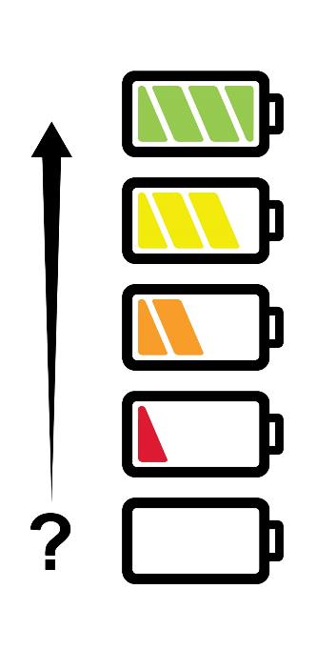
Evaluation
How do you feel about our learning objectives today?
Understand that batteries are made up of cells, comprised of layers of different materials.
Understand that changing the different layers of a cell can affect its performance.
How do you know you have learnt these objectives today?

Slide 10

Next steps
Share your results and see how they compare with others around the world.
Developing better batteries is one way that scientists are tackling climate change and helping to create a sustainable future. What will you do?
Find and share ideas. Make a commitment https://rsc.li/takecharge

Slide 11
Image credits
Slide 2: all images © Shutterstock
Slide 4: images 1, 2 and 4 © Shutterstock; image 4 © Vattenfall, source https://group.vattenfall.com/press-and-media/newsroom/2021/hybrid-parks--new-opportunities-with-multi-technology-facilities; image 5 © GuidoB used under creative commons license https://commons.wikimedia.org/wiki/File:VoltaBattery.JPG
Slide 9: adapted from an original image © Shutterstock
All other images © Royal Society of Chemistry.

