Slide 1
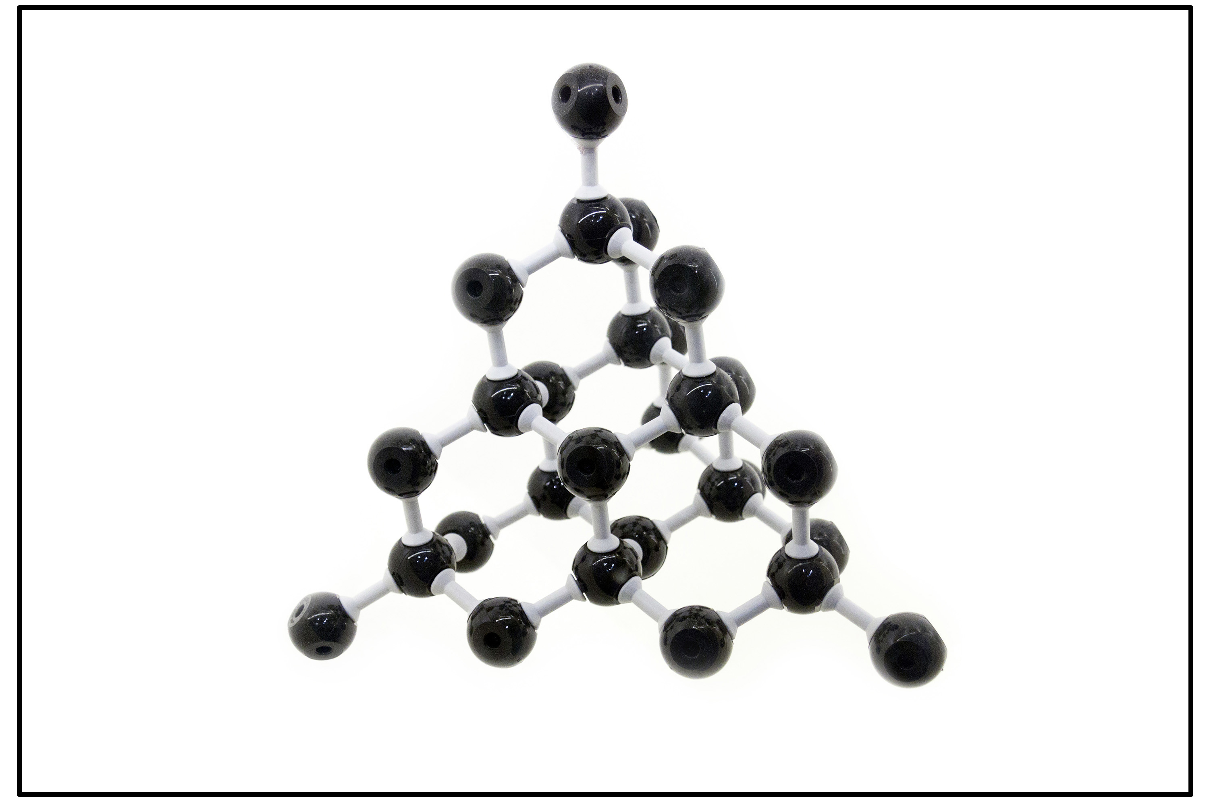
Scientists form liquid carbon for the first time
Science research news
Slide by Neil Goalby. Available from rsc.li/4maYOaH
Scientists have successfully formed liquid carbon in the lab for the first time. Liquid carbon only exists at very high temperatures and pressures that are difficult to reach in the lab.
The researchers used a powerful laser to fire strong shock waves into solid carbon. This achieved high enough pressures and temperatures to form liquid carbon for a few nanoseconds. They then took snapshots of the structure using x-rays.
The researchers found that carbon atoms stay near their four neighbouring atoms in liquid form and keep aspects of the solid structure of diamond.
© Getty Images
Researchers found the structure of liquid carbon is surprisingly similar to solid diamond’s structure
Questions
Name the type of bond between atoms in solid carbon. Describe the structure of solid diamond. Explain why liquid carbon is difficult to form.
Notes:
This slide summarises a recent article published by Chemistry World. Use this as a lesson starter when teaching about bonding and structure of carbon.
Answers
Covalent bonds.
Giant structure. Each carbon atom forms bonds to four other carbon atoms. There is a tetrahedral arrangement of bonds around each carbon atom.
The covalent bonds between carbon atoms are very strong. Many strong bonds need to be broken to form a liquid. This requires very high temperatures and pressures to supply enough energy to break the bonds. The melting point is so high that no known material can contain the liquid carbon in the lab.

