Slide 1
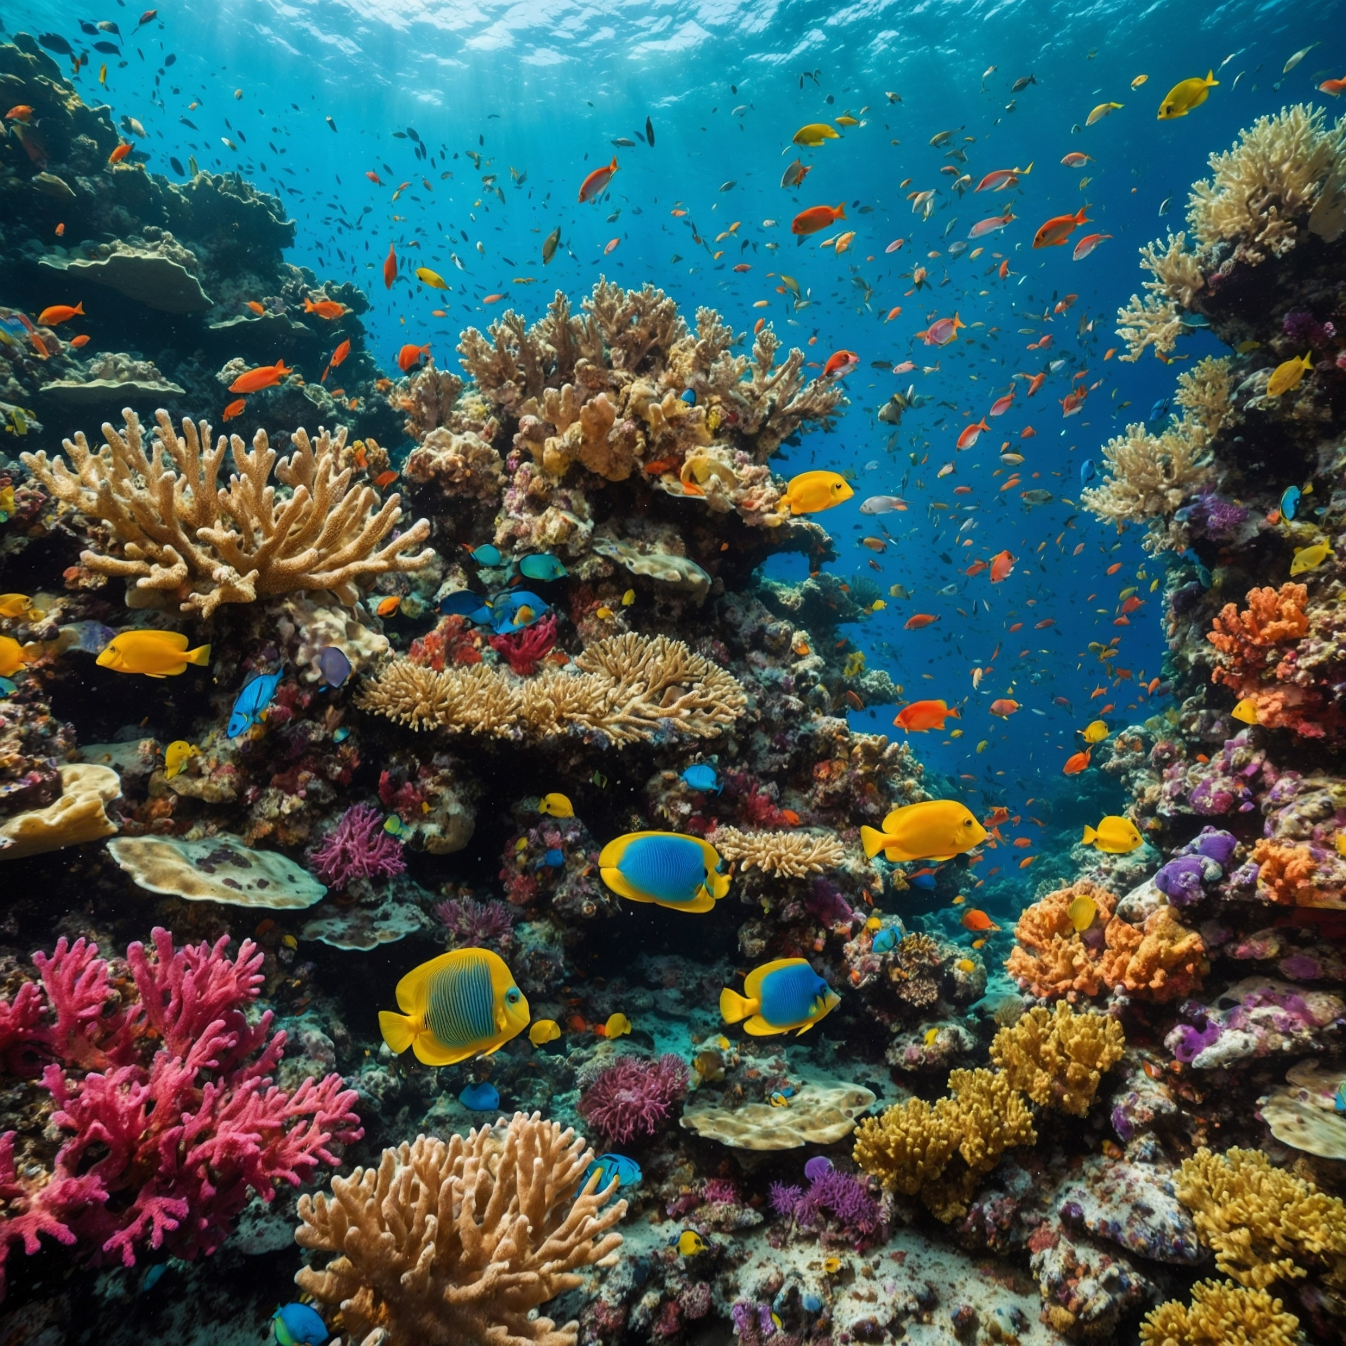
11–14 years
Dissolved substances in tap water and seawater
Downloaded from: rsc.li/4aHGiSF

Slide 2

The problem
Introduction
Clean rivers, lakes and the ocean sustain aquatic life including:
plants
fish
other marine animals.
All these organisms need oxygen for respiration, just like those living on land.
Air contains approximately 20% oxygen gas.
How do aquatic organisms get their oxygen?
Source: © Shutterstock/Reehan Raza
Notes:
Image Source: © Shutterstock/Reehan Raza
https://www.shutterstock.com/image-photo/vibrant-coral-reef-teeming-colorful-fish-2562874843

Slide 3
Learning objectives
During this lesson you will:
set up and carry out an evaporation practical.
compare the dissolved substances in tap water and seawater.
describe what happens to the particles of a substance when it dissolves.
explain why it’s important for water to contain dissolved substances.

Slide 4
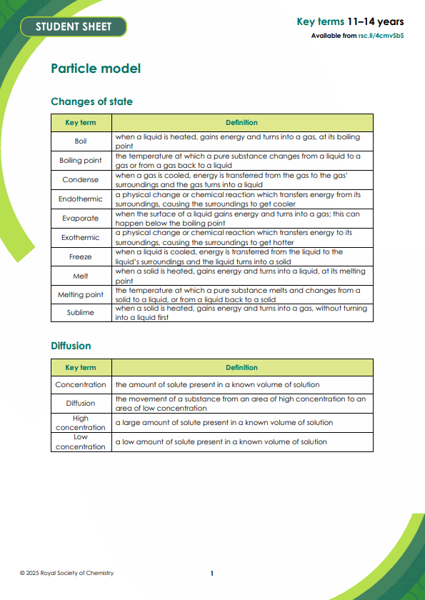
Key terms
Solute – a substance that dissolves in a solvent to make a solution.
Solvent – a substance that dissolves the solute to make a solution.
Solution – the mixture produced when a solute dissolves in a solvent.
Dissolve – when a solute is added to a solvent and the solute breaks into much smaller particles and spreads out.
Soluble – describes a substance which dissolves in a particular solvent.
Insoluble – describes a substance which does not dissolve in a particular solvent.
Key terms
Find more Key terms support for this topic, including Frayer models, an accessible glossary and unscrambling definitions at: rsc.li/4cmvSbS
Notes:
Find more Key terms support for this topic, including Frayer models, an accessible glossary and unscrambling definitions at: rsc.li/4cmvSbS

Slide 5
Method
Set up a Bunsen burner on a heat resistant mat. Over it, place a tripod and gauze.
Half fill a beaker with water and place it on the gauze.
Take a watch glass and place enough tap water on it to cover half its area. Place the watch glass on the beaker.
Heat the water in the beaker until it boils and then let it boil briskly.
When all the water on the watch glass has evaporated, turn off the Bunsen and use tongs to remove the watch glass. (Do not touch, it will be hot. It can safely be placed on the bench though.)
Examine the watch glass for traces of solid residue.
Repeat the steps 3 to 6 with:
    Distilled water
    Seawater
Method

Slide 6


Integrated instructions
❹ Once water evaporated use tongs to remove watch glass 
❸ Heat the water in the beaker until it boils 
❺ Record your observations 
❷ Half fill a watch glass with tap water. 
c
❻ Repeat with:
distilled water 
and seawater 
❶ Half fill a beaker with water 
Royal Society of Chemistry
Downloaded from: rsc.li/4aHGiSF
Notes:
Evaporating water
Half fill a beaker with water
Place it on a tripod
Half fill a watch glass with tap water
Place the watch glass on the beaker and heat the water in the beaker until it boils
When the water on the watch glass has evaporated, remove it using tongs
Record your observations
Repeat steps 3 -6 with distilled water and seawater.

Slide 7
Results table
Type of water | Observations
Tap water
Seawater
Distilled water
Results

Slide 8
Questions
Complete the results table.
Suggest a reason for your observations:
Tap water
(b) Seawater
(c) Distilled water
Describe what happens on a particle level when a substance dissolves.
Explain what happened to the water particles when the seawater was heated.
Find out what dissolved solids are present in tap water.
Suggest a reason why water companies add salts such a fluorides to tap water.
Questions
Notes:
Student questions to discuss/answer during/after the demonstration. See teacher notes for answers.

Slide 9
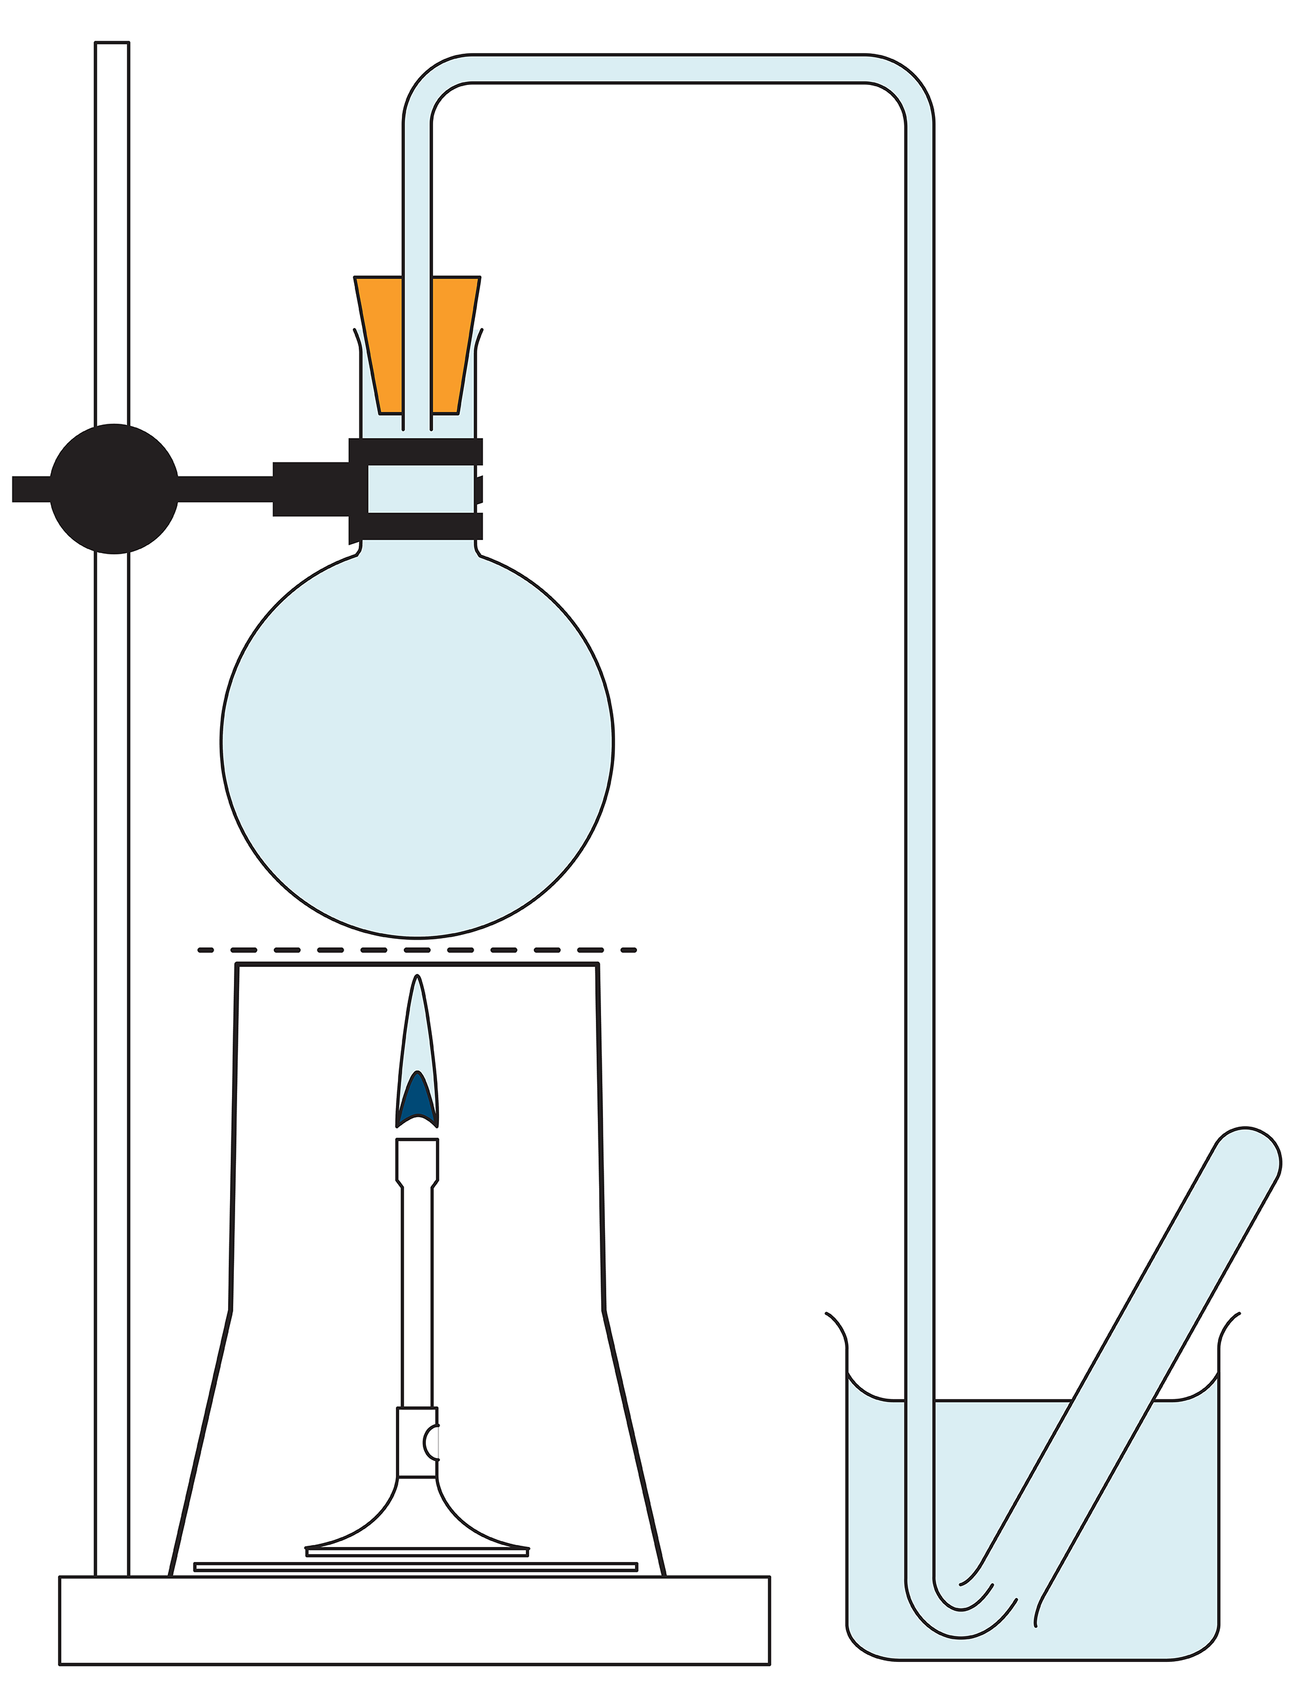
Teacher demonstration questions
What do you observe when the round bottomed flask is heated?
Suggest a reason why the apparatus is completely filled with water at the start of the experiment.
Name a gas that is collected in the test tube. Give a reason for your answer.
How did the results from the tap water experiment compare to those from seawater?
Suggest how the gas got into the water?
Why is it important for seawater and freshwater to contain dissolved gases?
Predict what you would see if the experiment was repeated with distilled water. Suggest a reason for your answer.
Questions
Notes:
Student questions to discuss/answer during/after the demonstration. See teacher notes for answers.

Slide 10
Learning objectives
During this lesson you will:
set up and carry out an evaporation practical.
compare the dissolved substances in tap water and seawater.
describe what happens to the particles of a substance when it dissolves.
explain why it’s important for water to contain dissolved substances.
Have you met all of the learning objectives?

