Slide 1
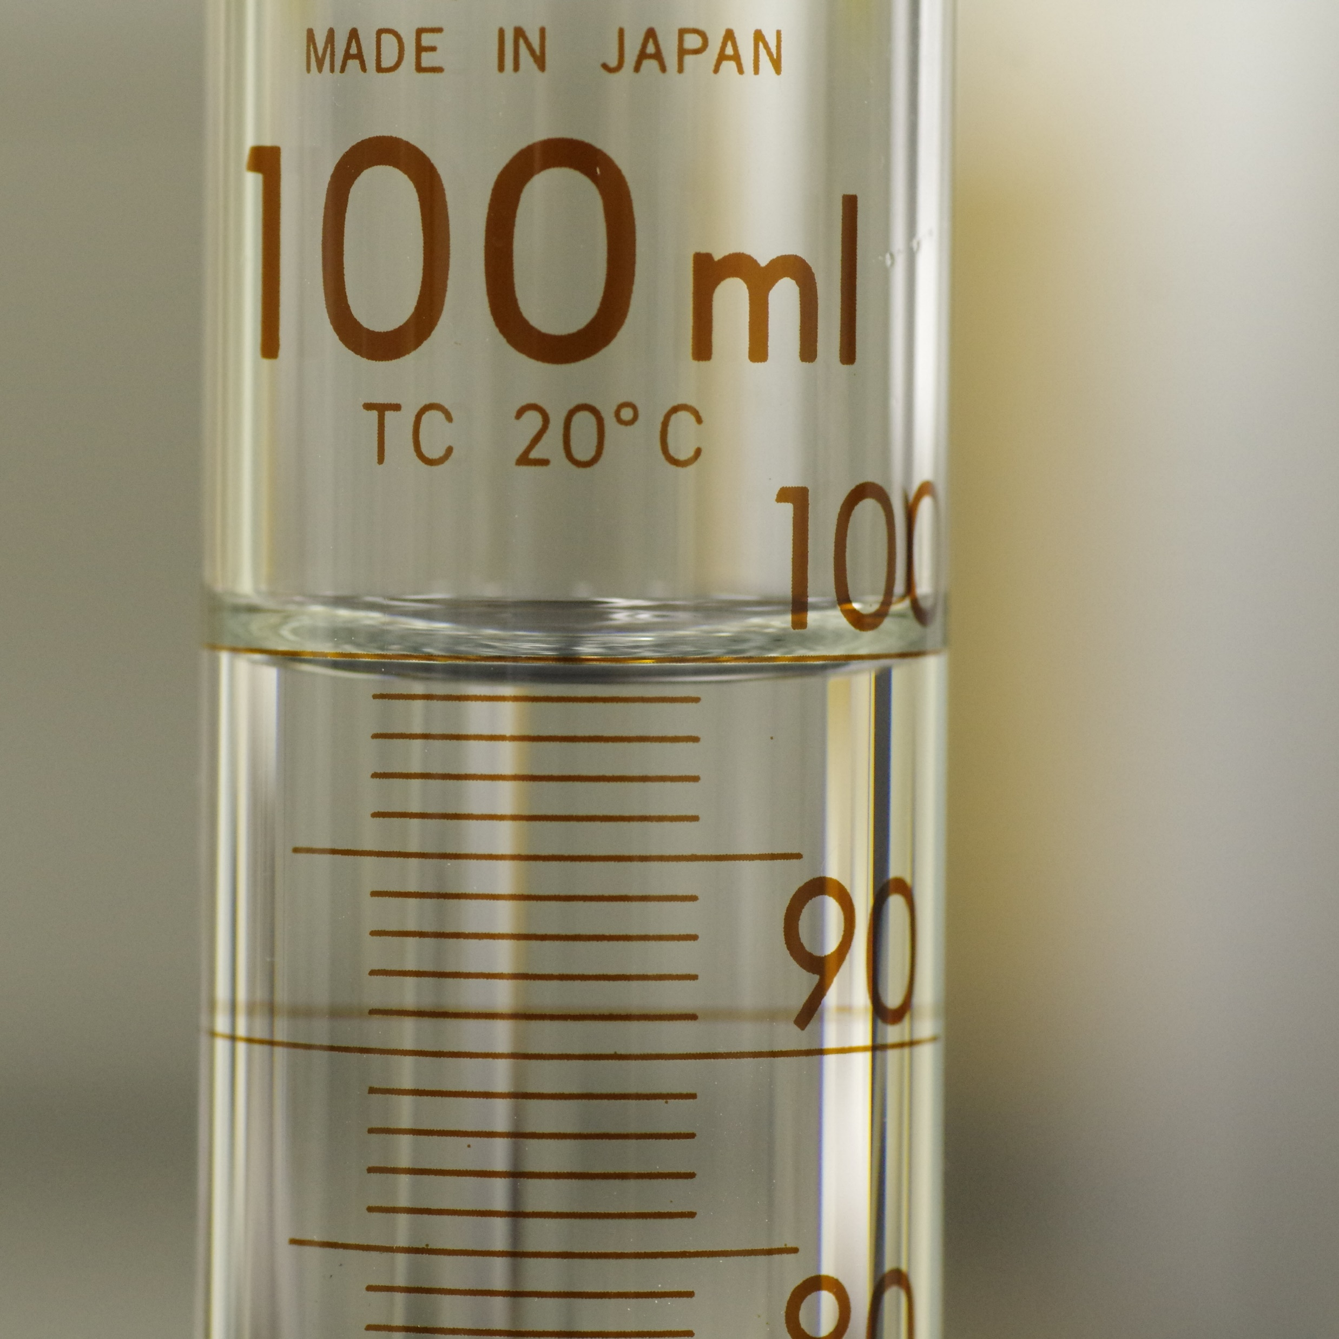
11–14 years
Experiments with particles
Downloaded from: rsc.li/3HtbjNJ
Notes:
Image © Shutterstock/mutsu7211
https://www.shutterstock.com/image-photo/close-graduated-cylinder-2254573431

Slide 2
Learning objectives
During this lesson you will:
predict how the volume will change when two substance are mixed.
make careful observations.
apply your knowledge of particles to explain your observations.

Slide 3
Making a prediction
A prediction is a scientific guess about what you think will happen in an experiment based on what you already know and have learnt in previous science lessons.
In this lesson, you will investigate what happens to volume when substances mix. To help make your predictions you will need to use ideas about particles.
A good starting point is to consider:
how particles are arranged in the solid, liquid or gas state.
how particles of different substances are different.
Prediction

Slide 4
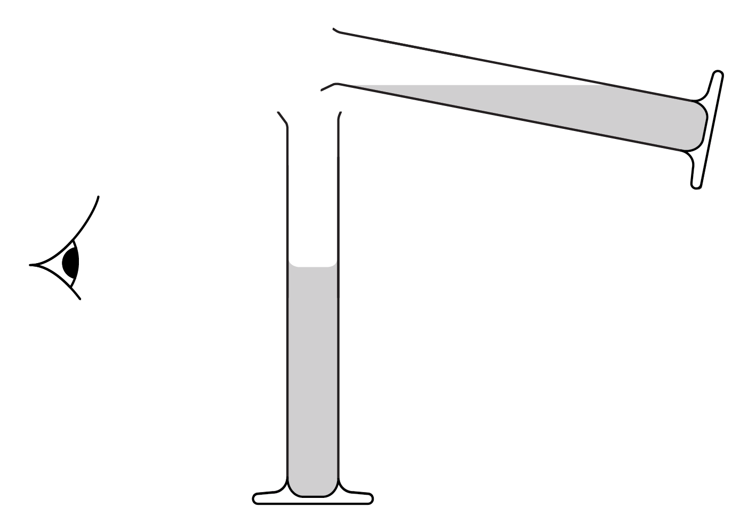
Activity 1
Don’t forget to make a prediction before you start.
Add approximately 25 cm³ of dried peas and 25 cm³ of sand to separate measuring cylinders. Accurately measure and record the volumes.
Add the contents of one cylinder to the other and shake until the two substances mix together.
Place the measuring cylinder on the bench and gently shake from side to side to allow the mixture to settle.
Read the combined volume.
Record your readings in a table.
Practical activities
Take measurements when eye is level with liquid surface.

Slide 5
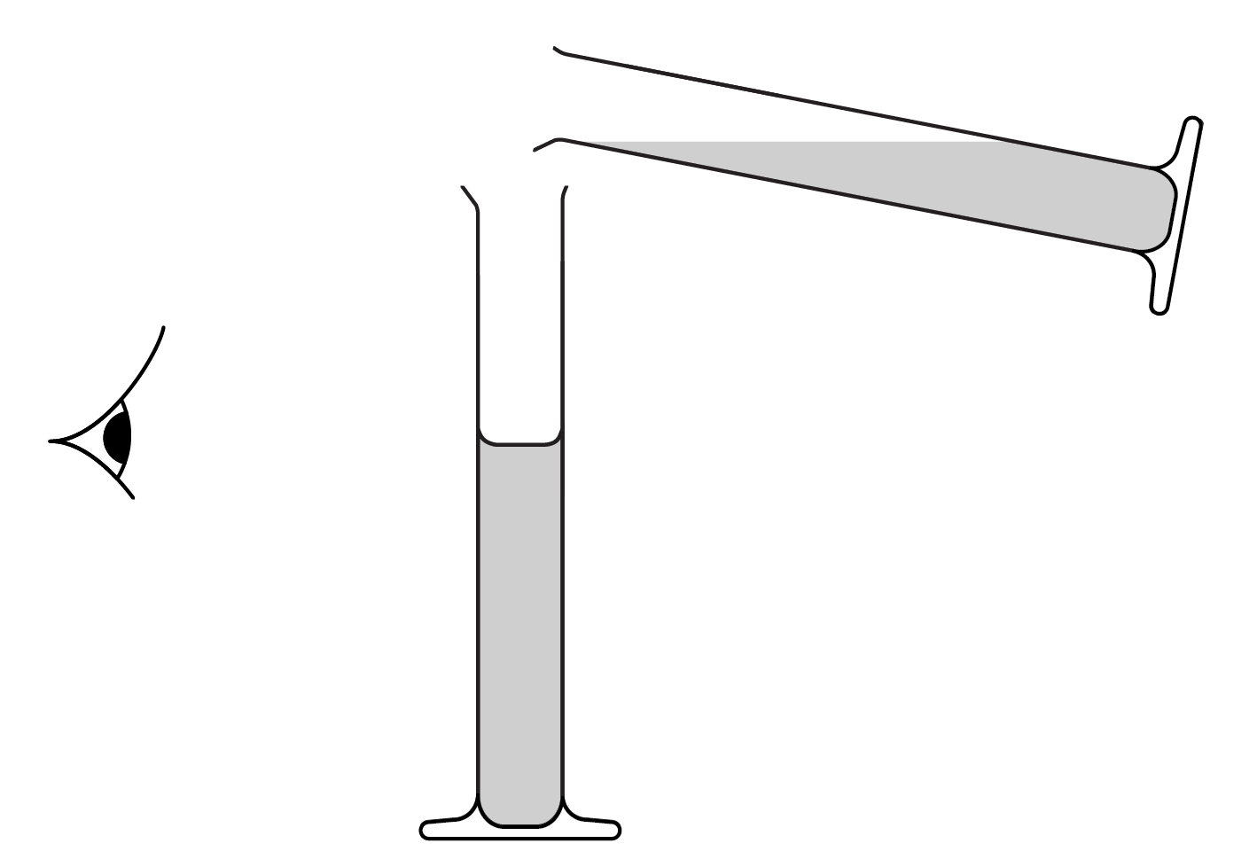
Activity 2
Don’t forget to make a prediction before you start.
Add approximately 25 cm³ of ethanol and 25 cm³ of water to separate measuring cylinders. Accurately measure and record the volumes.
Add the contents of one cylinder to the other and shake from side to side for 15–30 seconds until the two substances mix together, and then leave to stand for 1 minute.
Read the combined volume.
Record your readings in a table.
Practical activities

Slide 6
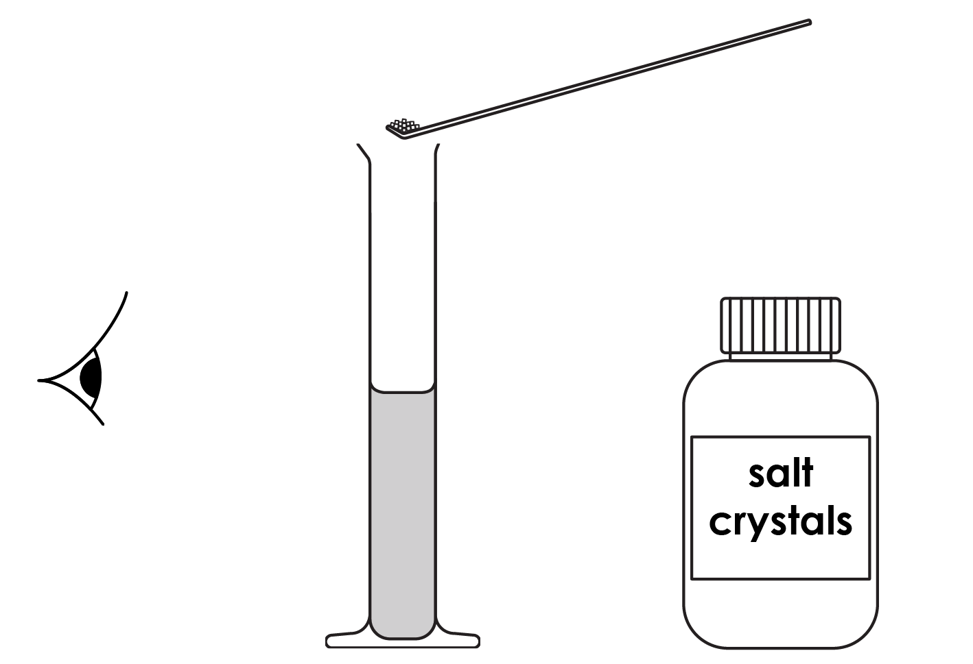
Activity 3
Don’t forget to make a prediction before you start.
To the measuring cylinder, add approximately 75 cm³ of water. Accurately measure and record the volume.
Add spatulas of salt one at a time until salt begins to be left at the bottom of the cylinder, despite continued stirring.
Read the combined volume.
Record your readings in a table.
Practical activities

Slide 7
Questions
For Activity 1, calculate the difference between the combined volume and the total volume of peas and sand. Suggest a reason for your answer.
For Activity 2, calculate the difference between the combined volume and the total volume of alcohol and water. Suggest a reason for your answer.
Draw a particle diagram to show how the particles are arranged in:
water
salt crystals
salt solution
4. Suggest a reason for the result observed in Activity 3.
Questions
Notes:
Find answers to these questions and explanations in the teacher notes at rsc.li/3HtbjNJ.

