Slide 1
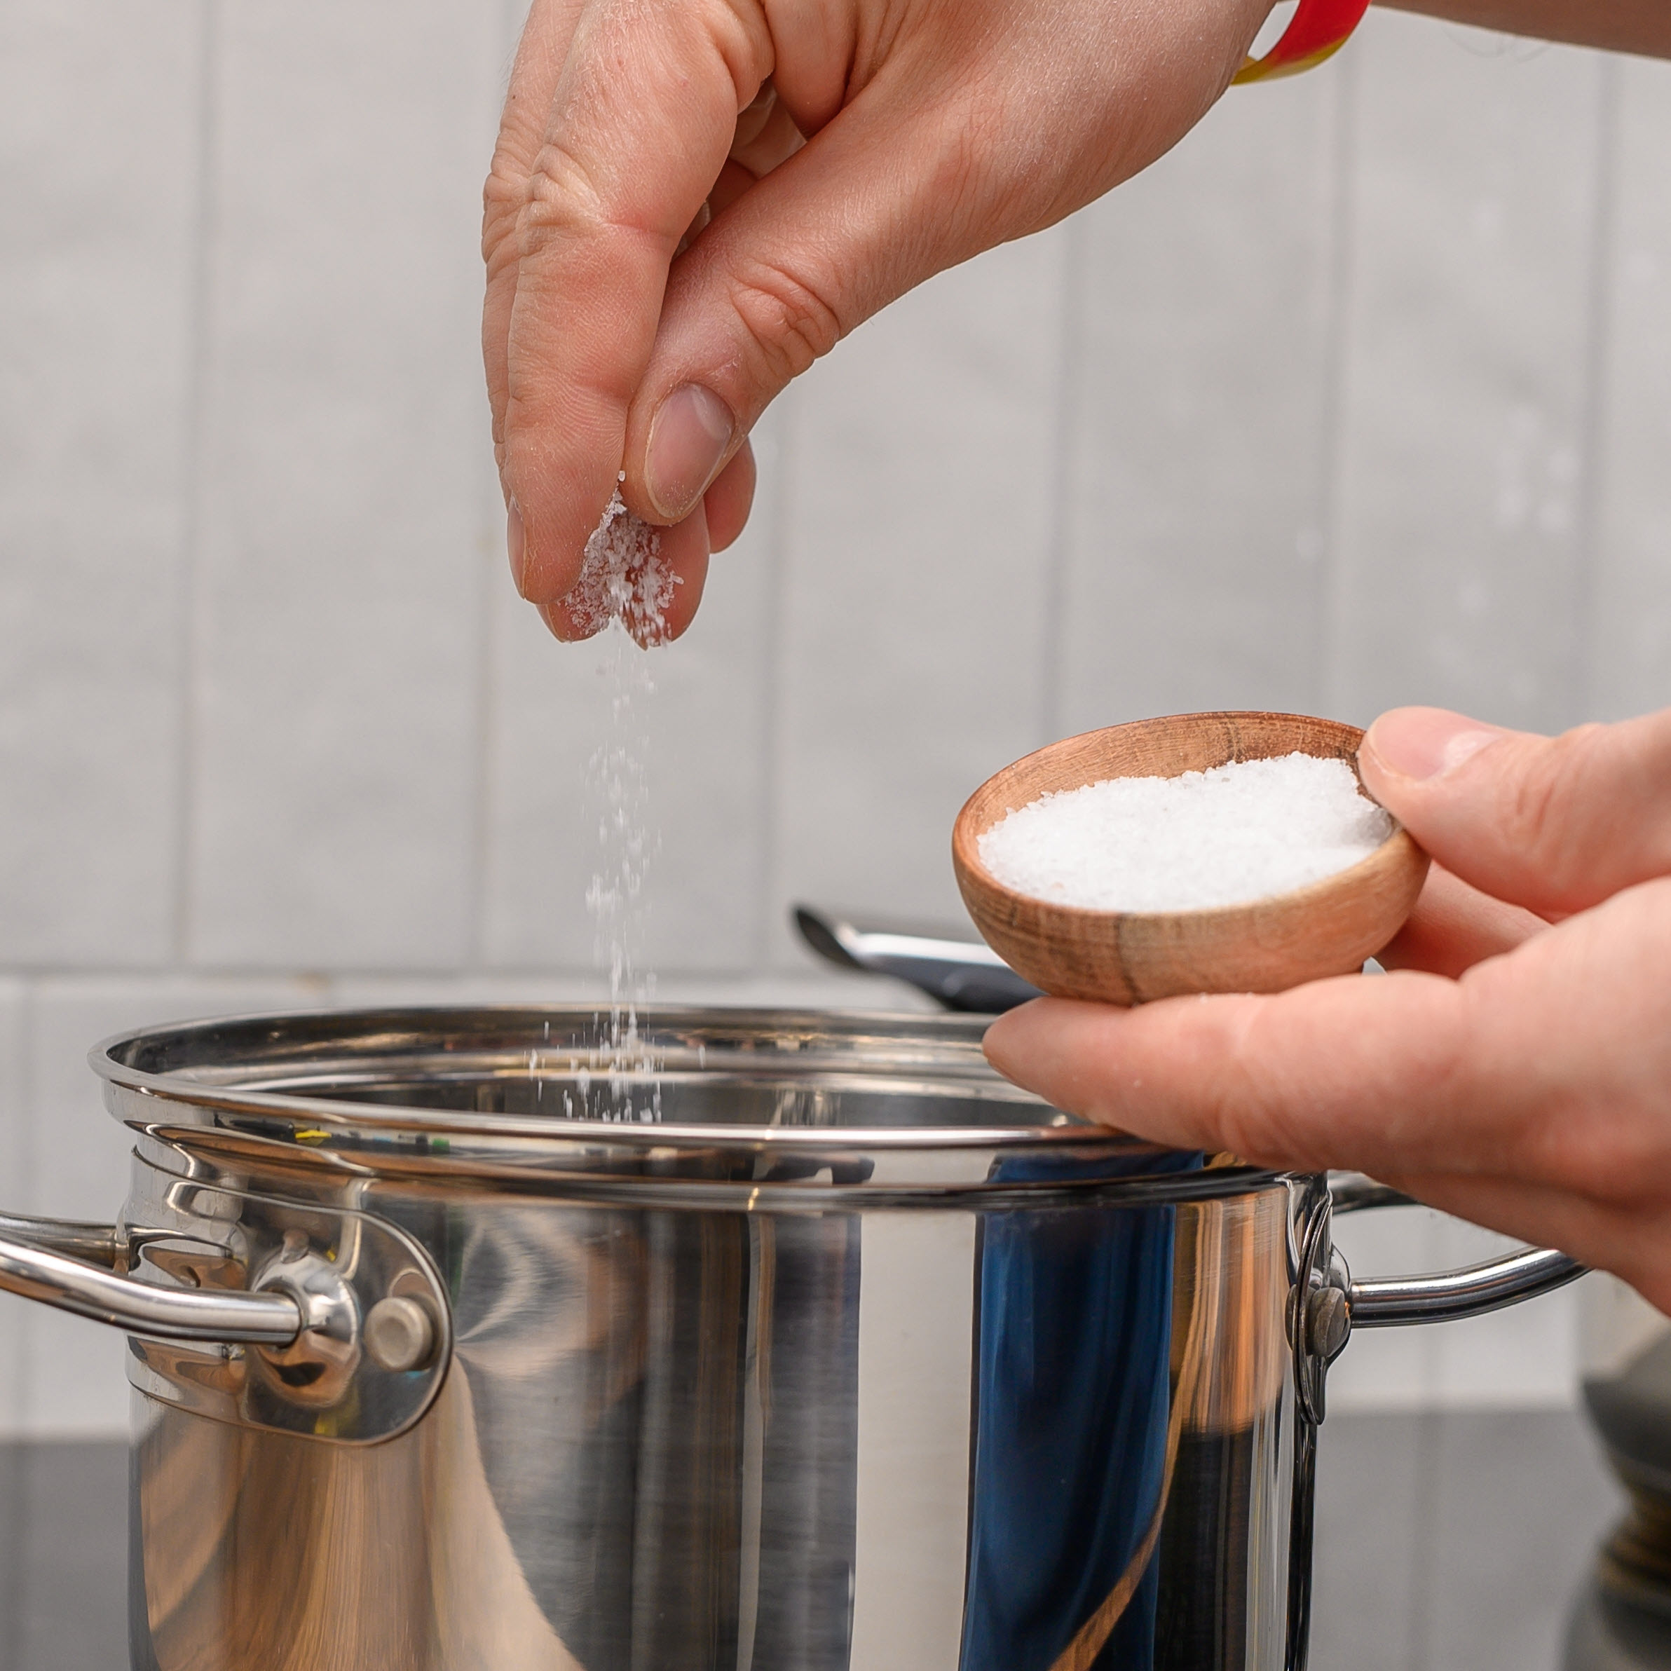
11–14 years
What happens when something dissolves?

Slide 2
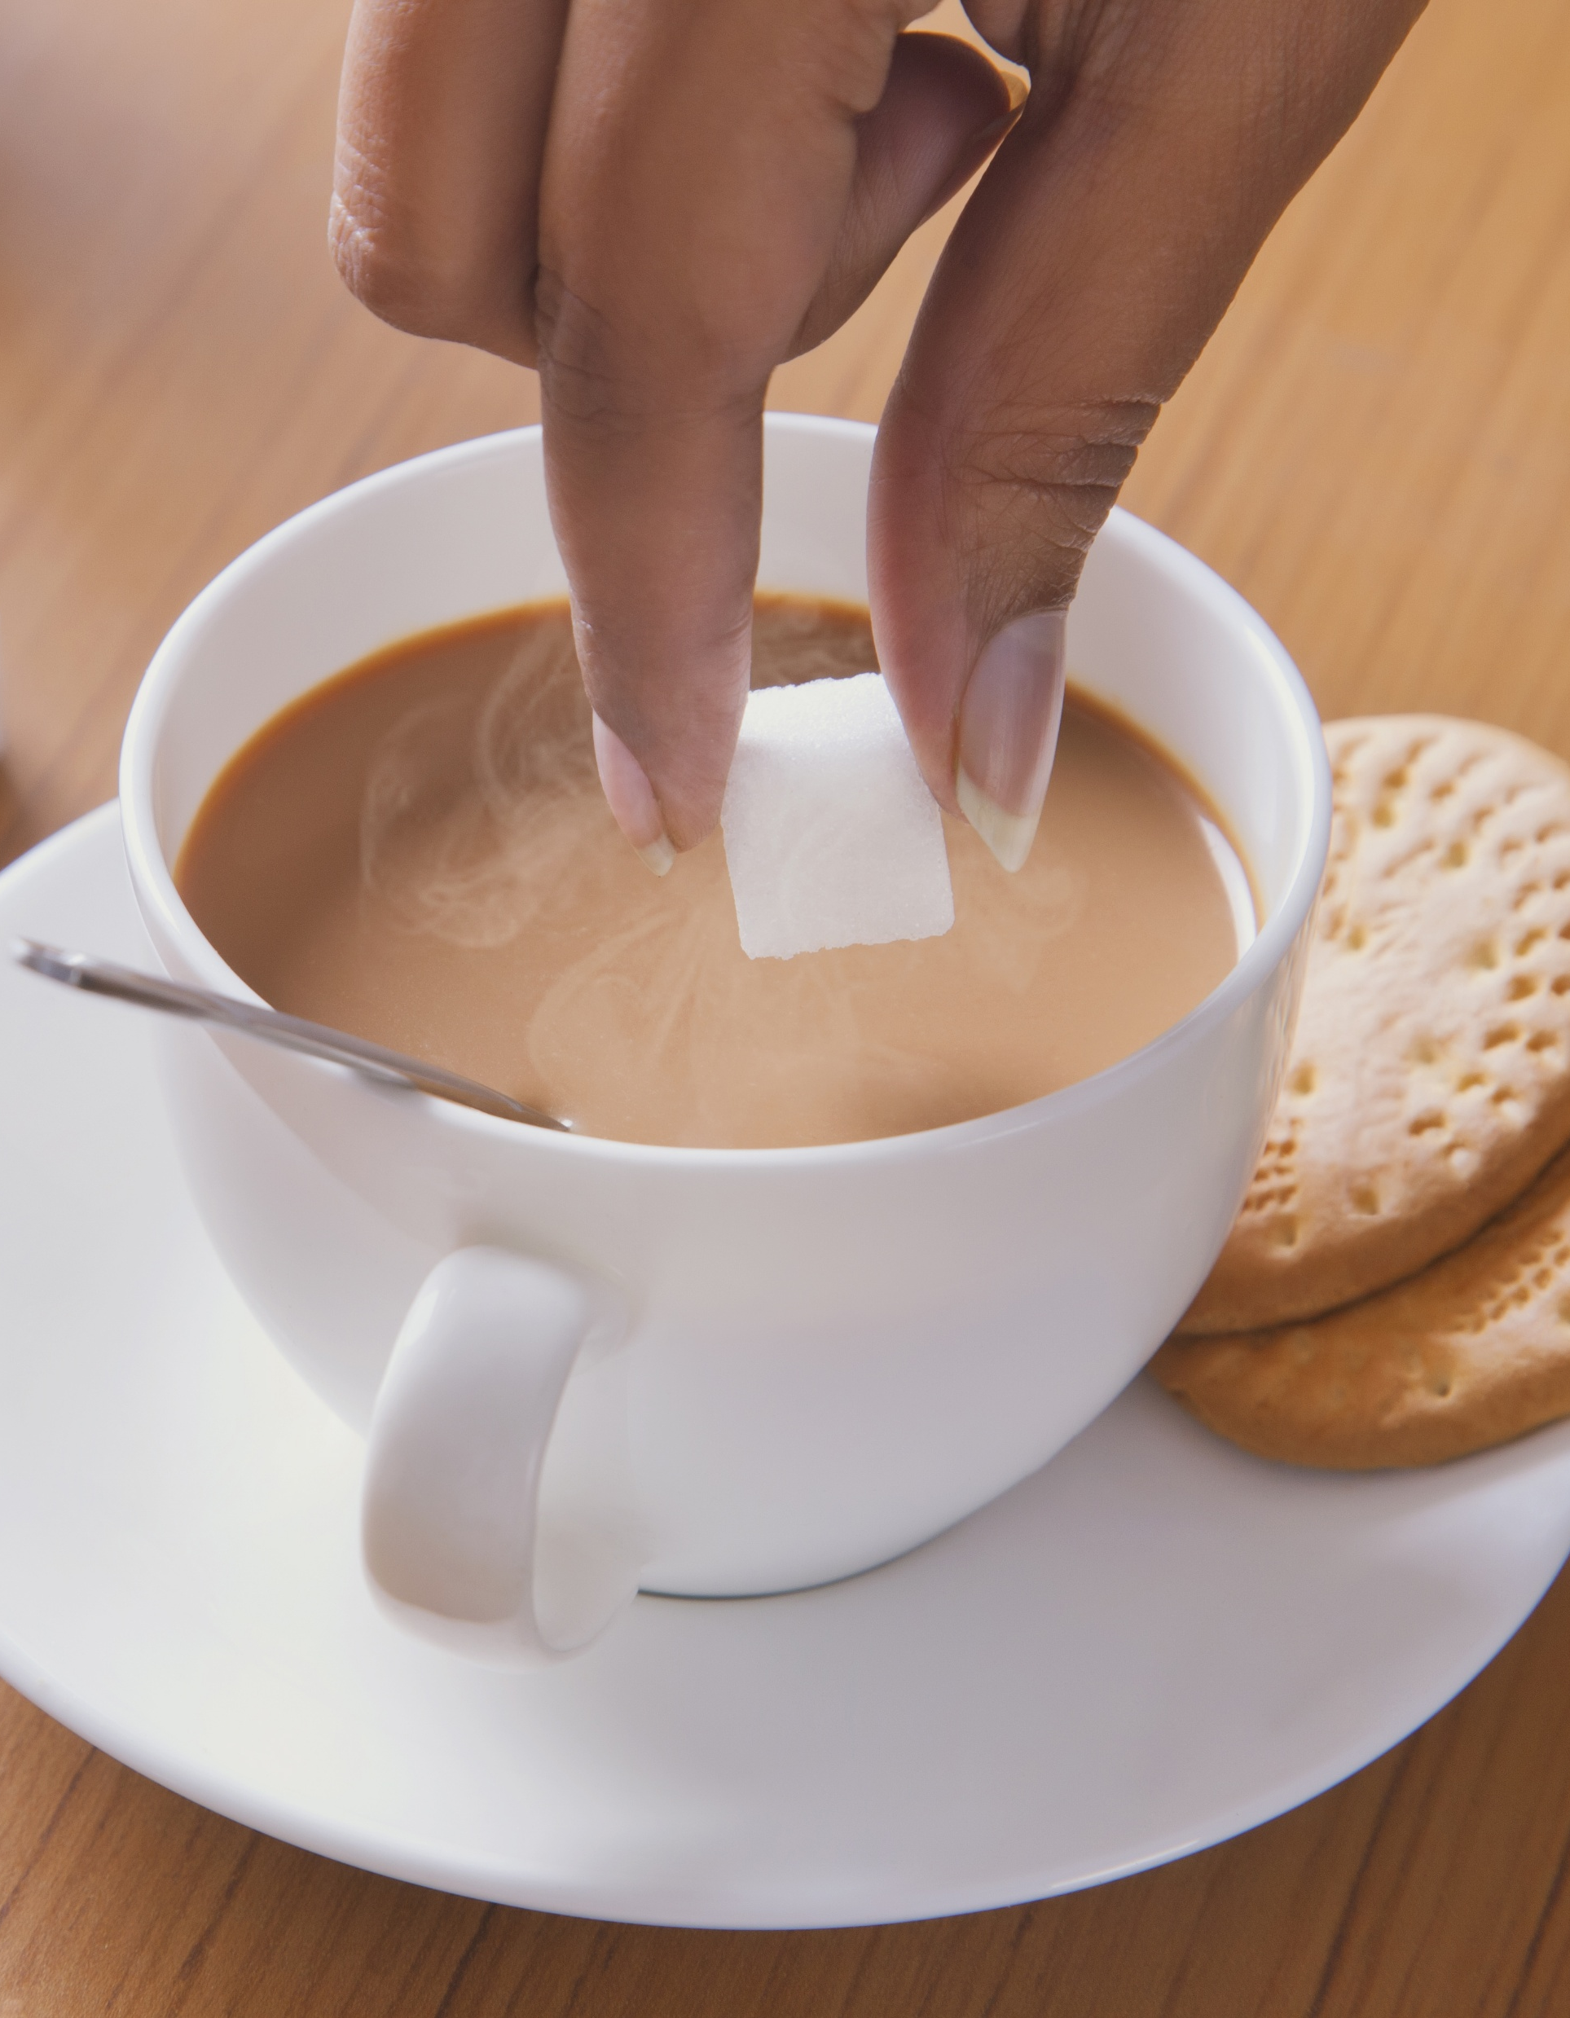
Introduction
Introduction
If you drink a cup of tea with sugar in, do you have a mouthful of solid sugar as your drink it?
No!
Sugar is a soluble solid. This means it can dissolve in water to form a solution.
There are many substances that will dissolve in liquids.
Add an image of a cup of tea
Notes:
Photograph © Shutterstock / India Picture

Slide 3
Learning objectives
Recall the structure of particle diagrams for solids and liquids.
Describe how particles of the solid are dispersed between particles of the liquid during dissolving.
Describe the process of diffusion during dissolving and explain why this is evidence of the movement of particles in a liquid.

Slide 4
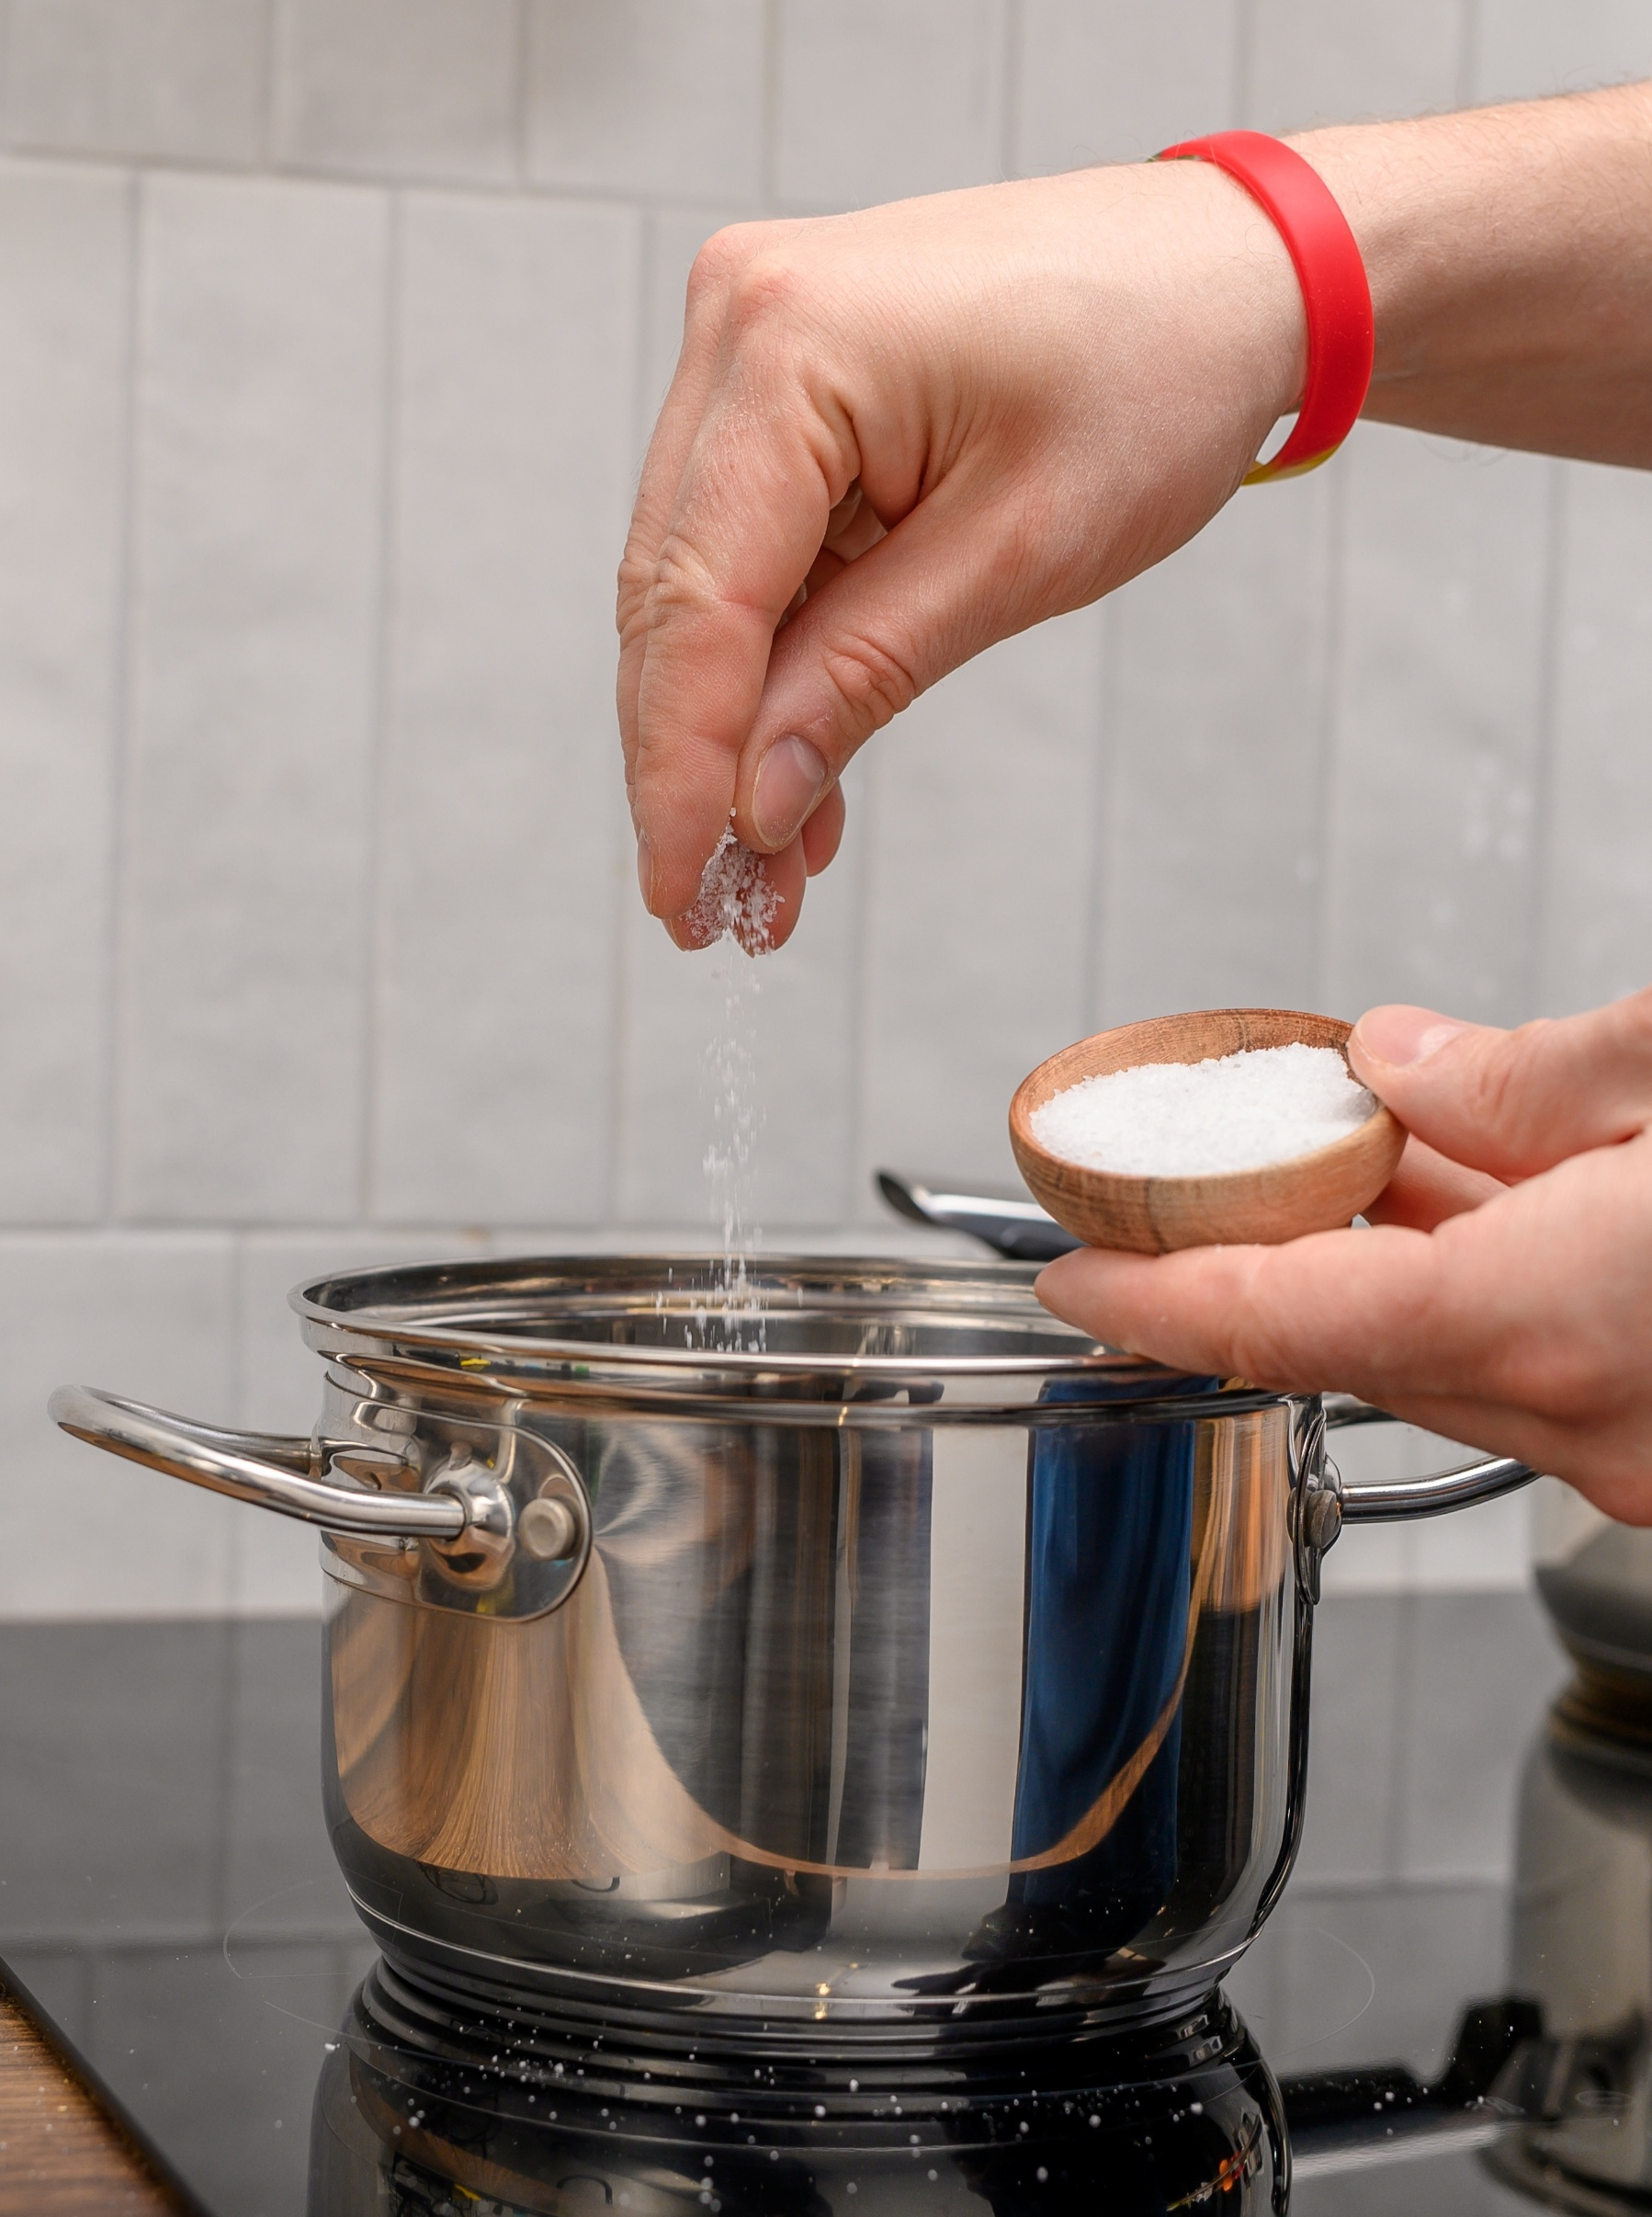
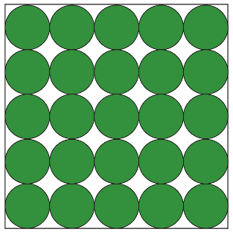
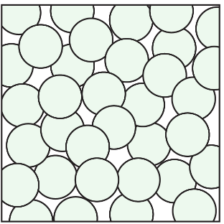
Starter
Starter activity
Today we are going to explore what happens visually and on a particle scale when substances dissolve.
In pairs, write a brief description of the arrangement of particles in a solid (salt) and in a liquid (water).
solid
liquid
Notes:
Photograph © Shutterstock / PawelKacperek

Slide 5

Paired task – self assess
Write a brief description of the arrangement of particles in a liquid (water) and a in a solid (salt).
Paired task
Solid
Particles are the same size
Particles are in fixed positions
Particles vibrate
Particle form a regular pattern
Particles are touching
Liquid
Particles are the same size
Particles move around each other
Particles are in an irregular pattern/randomly arranged
Particles are touching

Slide 6
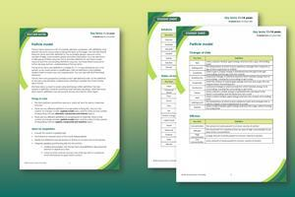
Key terms
Find more support for vocabulary in our Key terms support bundle for 11–14 Particle model.
Available to download from: rsc.li/4cmvSbS
Key terms
Key term | Definition
Dissolve | when a solute is added to a solvent and the solute breaks into much smaller particles and spreads out
Diffusion | the movement of a substance from an area of high concentration to an area of low concentration
Insoluble | describes a substance which does not dissolve in a particular solvent
Miscible | when two liquids can mix and do not separate out into layers
Soluble | describes a substance which dissolves in a particular solvent
Solute | a substance that dissolves in a solvent to make a solution
Solution | the mixture produced when a solute dissolves in a solvent
Solvent | a substance that dissolves the solute to make a solution
Notes:
Find even more key terms and definitions for the Particle model topic at: https://rsc.li/4cmvSbS

Slide 7
Teacher demonstration
Demonstration
You are going to observe potassium manganate(VII) crystals being added to a beaker of water. As you observe this, complete the table below to show your observations.
Chemical | Observations
 | Before | During | After
Water
Potassium manganate(VII)

Slide 8
Teacher demonstration
Share your observations in pairs. Student 1 presents their ideas. Student 2 actively listens and responds by agreeing, disagreeing or building on this point.
Demonstration
Chemical | Observations
 | Before | During | After
Water
Potassium manganate(VII)
Notes:
Table Salt Added Pot Salt Boiling Stock Photo 2488099447 | Shutterstock

Slide 9
Teacher demonstration
Self-assess your answers. Add in any information that you missed.
Chemical | Observations
 | Before | During | After
Water | Colourless liquid | Water closest to the crystal turns purple | All the water is now purple
Potassium manganate(VII) | Dark purple solid crystals | Starts to dissolve, purple colour moves into the water, crystals get smaller | No purple crystals remaining, solution is purple
Self-assess

Slide 10

Teacher demonstration – particle model
Particle model
Potassium manganate(VII)
(solute)
Water
(solvent)
Potassium manganate(VII) aqueous solution
(solution)
Notes:
Guidance for teacher:
Why are the particles green and not purple?
On this slide we have used dark green instead of purple to represent particles of the solid potassium manganate and the potassium manganate aqueous solution. This is because we do not wish to perpetuate (or introduce) the misconception that colour is a sub-microscopic property. Colour is a bulk property of a material and should not be attributed to a single particle.
We used a 5-colour scale across our resources. All of the particles in this resource are green but the different shades represent different substances.

Slide 11
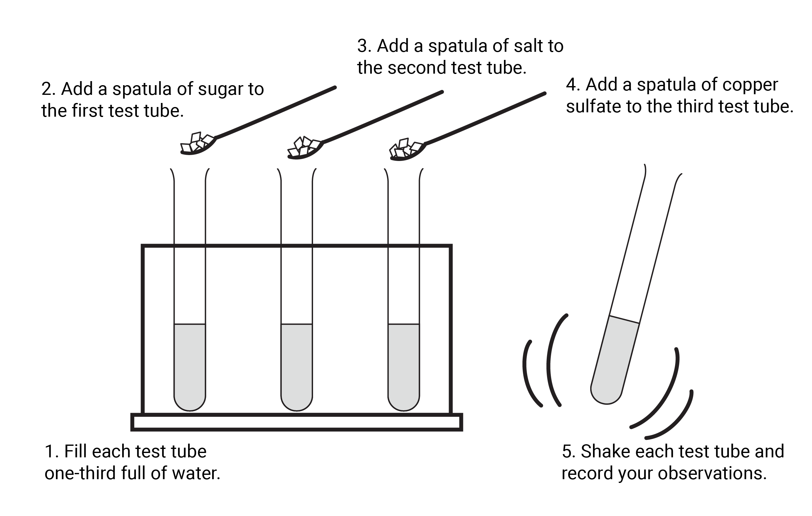
Class practical
Make observations when sugar, salt and copper(II) sulfate crystals are dissolved separately in test tubes of water.
Class practical

Slide 12



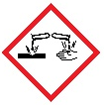
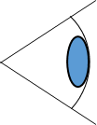

Integrated instructions: what happens when something dissolves
⬥ 1 x spatula of salt 
 1 x spatula of copper(II) sulfate 
❖ 1 x spatula of sugar 
c
 Shake each test tube and record your observations 
◆ 1/3 full of water 
What happens when something dissolves, RSC Assessment for learning (11–14):
rsc.li/3jwKgBO
1
2
3
Notes:
Method:
Fill each test tube 1/3 full of water
Add a spatula of sugar to the third test tube
Add a spatula of salt to the second test tube
Add a spatula of copper sulfate to the third test tube
Shake each test tube and record your observations

Slide 13
Class practical – observations
Make observations when sugar, salt and copper(II) sulfate crystals are dissolved separately in test tubes of water.
Chemical | Observations
 | Before | During | After
Water
Sugar
Class practical

Slide 14
Class practical – self-assess
Make observations when sugar, salt and copper(II) sulfate crystals are dissolved separately in test tubes of water.
Chemical | Observations
 | Before | During | After
Water | Colourless liquid | Colourless liquid with solid at the bottom | All the water is colourless again
Sugar | White solid crystals | Starts to dissolve, crystals get smaller | No white crystals remaining, solution is colourless
Class practical

Slide 15
Class practical – observations
Make observations when sugar, salt and copper(II) sulfate crystals are dissolved separately in test tubes of water.
Chemical | Observations
 | Before | During | After
Water
Salt
Class practical

Slide 16
Class practical – self-assess
Make observations when sugar, salt and copper(II) sulfate crystals are dissolved separately in test tubes of water.
Chemical | Observations
 | Before | During | After
Water | Colourless liquid | Colourless liquid with solid at the bottom | All the water is colourless again
Salt | White solid crystals | Starts to dissolve, crystals get smaller | No white crystals remaining, solution is colourless
Class practical

Slide 17
Class practical – observations
Make observations when sugar, salt and copper(II) sulfate crystals are dissolved separately in test tubes of water.
Chemical | Observations
 | Before | During | After
Water
Copper(II) sulfate crystals
Class practical

Slide 18
Class practical – self-assess
Make observations when sugar, salt and copper(II) sulfate crystals are dissolved separately in test tubes of water.
Chemical | Observations
 | Before | During | After
Water | Colourless liquid | Water closest to the crystals turns blue | All the water is now blue
Copper(II) sulfate crystals | Bright blue solid crystals | Starts to dissolve, blue colour moves into the water, crystals get smaller | No blue crystals remaining, solution is blue
Class practical

Slide 19
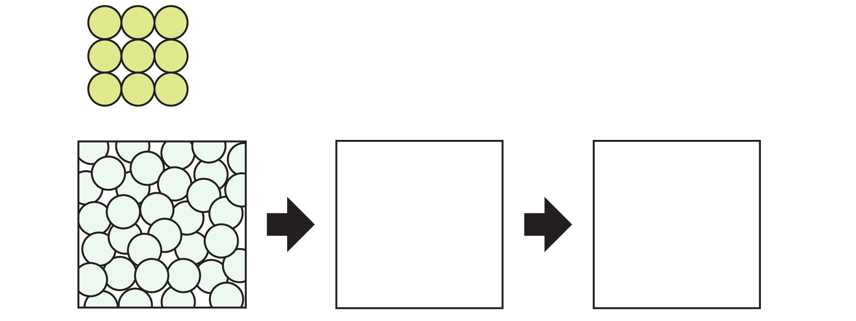
Paired task – describing your observations
Draw particle diagrams to show what happens when a soluble solid (salt) dissolves in this liquid solvent (water).
Write an explanation of your observations from salt and water in terms of particles.
Paired task

Slide 20
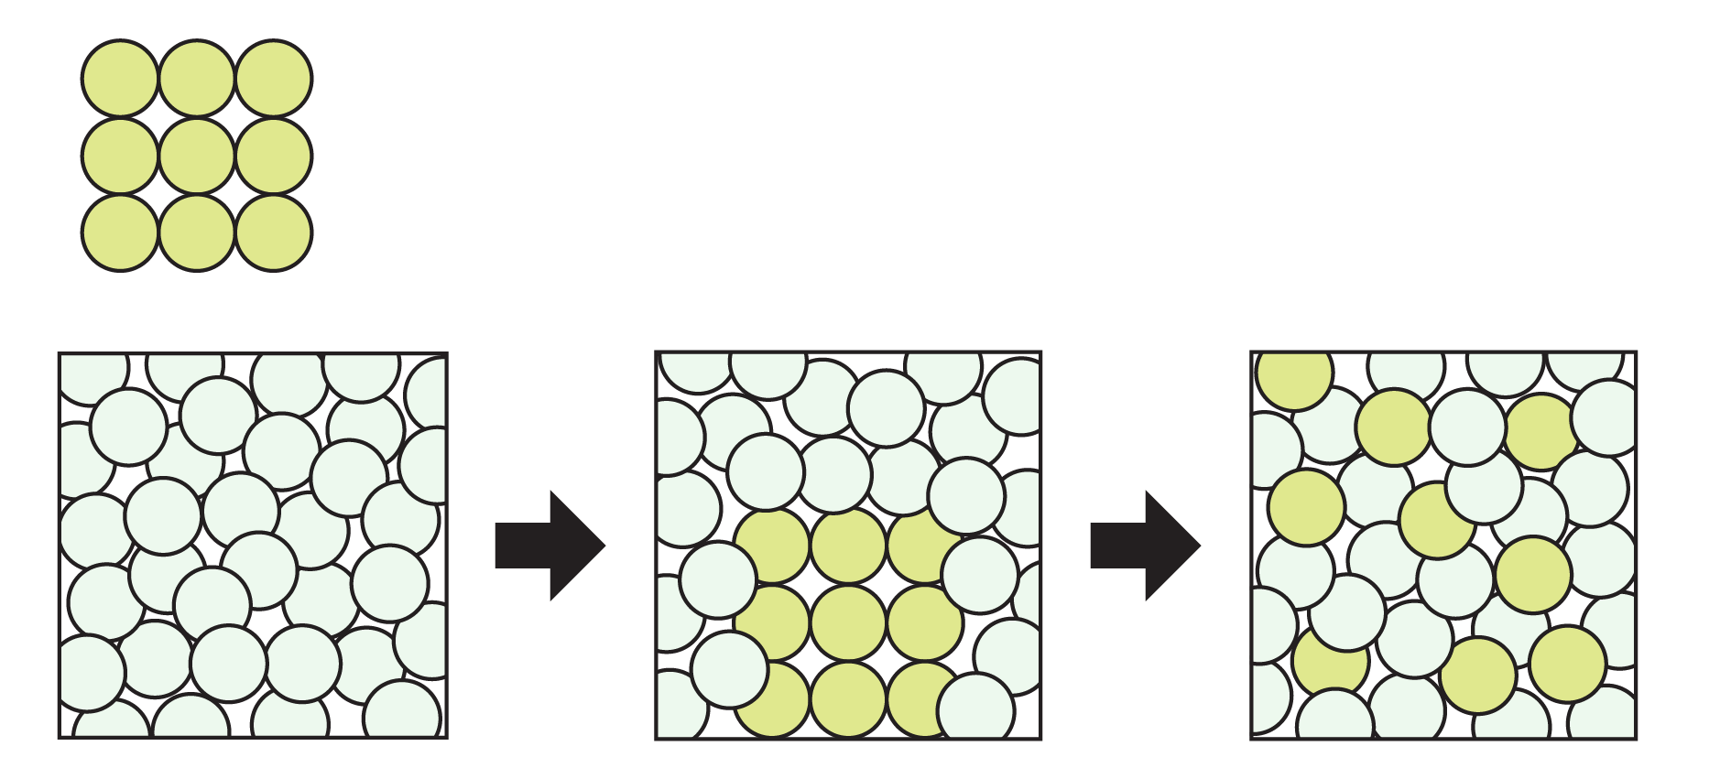
Paired task – self assess
Draw particle diagrams to show what happens when a soluble solid (salt) dissolves in this liquid (water).
Write an explanation of your observations from salt and water in terms of particles.
    As a solid, there are enough particles of salt packed closely together to see a white solid. When salt is added to water, the salt particles move apart from each other and disperse, as the water particles move into the space between them. This can be seen as the crystals get smaller. The particles then spread out through the water by diffusion. This can be seen as we can no longer see white crystals.
Paired task

Slide 21
Individual task
Using the information from the previous task to support you, write an explanation of your observations from copper(II) sulfate crystals and water in terms of particles.
The observations are below for convenience.
Individual task
Chemical | Observations
 | Before | During | After
Water | Colourless liquid | Water closest to the crystals turns blue | All the water is now blue.
Copper(II) sulfate crystals | Bright blue solid crystals | Starts to dissolve, blue colour moves into the water, crystals get smaller | No blue crystals remaining, solution is blue

Slide 22
Individual task – self assess
Using the information from the previous task to support you, write an explanation of your observations from copper(II) sulfate crystals and water in terms of particles.
As a solid, there are enough particles of copper sulfate packed close together to see as blue crystals.
When copper sulfate is added to water, the particles in copper sulfate move apart from each other and disperse. This can be seen through the movement of blue colouring into the water as it dissolves and by the crystals getting smaller.
The particles then spread out through the water by diffusion. This can be seen through the solution turning blue.
Individual task

Slide 23
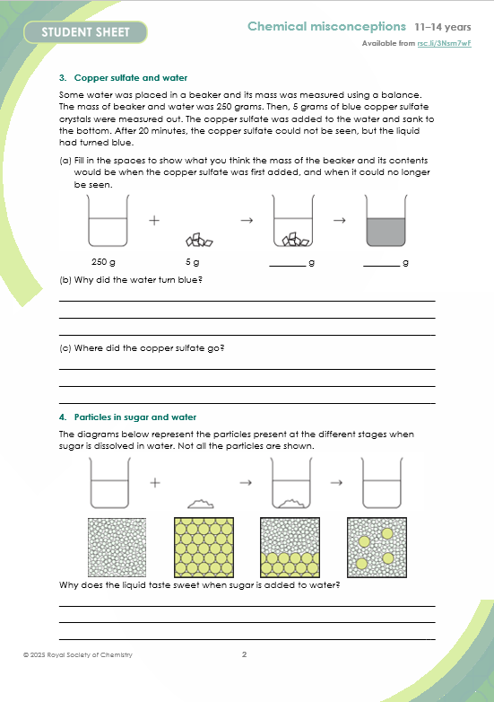
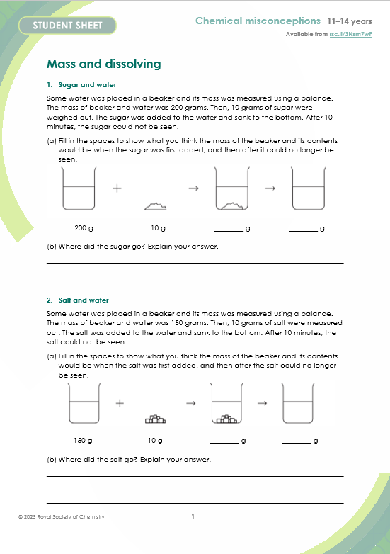
Mass and dissolving
Complete the worksheet Mass and dissolving to identify and resolve any misconceptions that are still held following this investigation.

