Slide 1
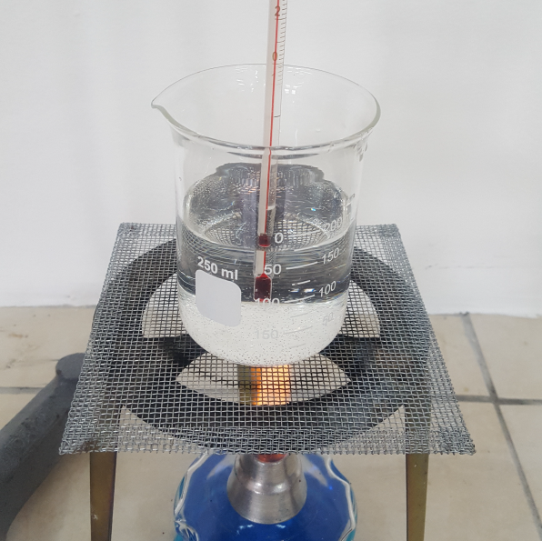
11–14 years
Boiling point: a surprising measurement!
Downloaded from: rsc.li/4aJXPcS
Notes:
Photo of beaker © Shutterstock/fen deneyim

Slide 2
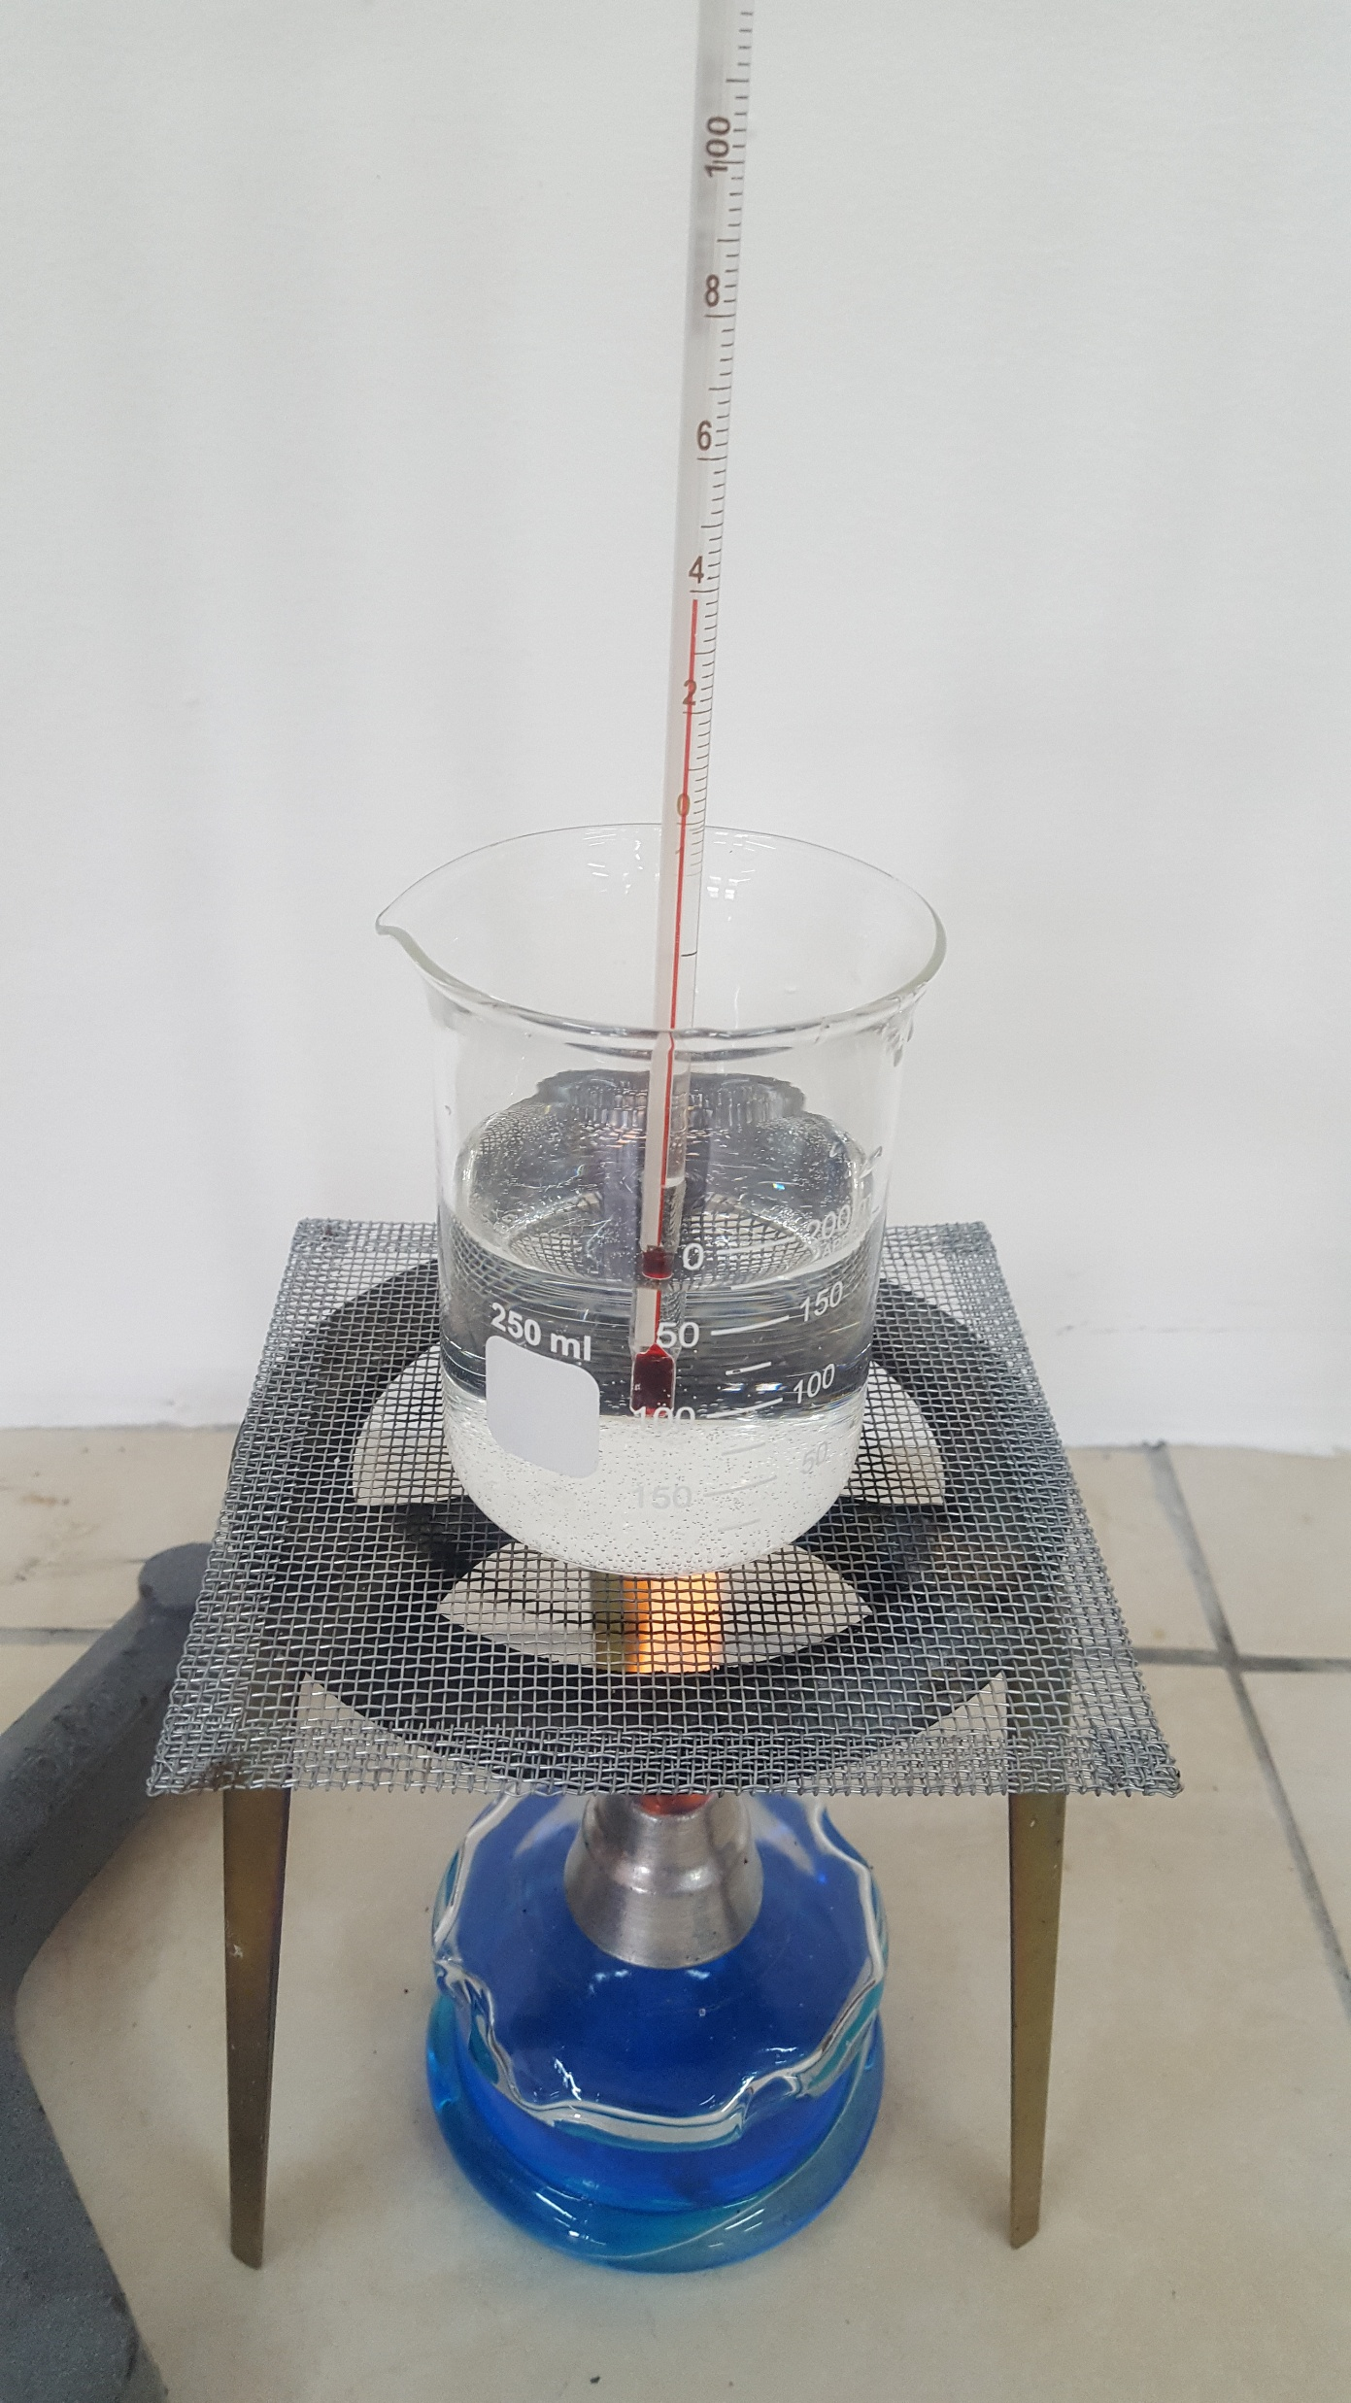

The problem
Introduction
Lydia carried out an experiment to measure the boiling point of water. She heated some water, in a beaker, with a Bunsen burner. When the water started to boil, she added a thermometer and took the reading. The temperature was 102°C.
Lydia was surprised.
What a surprise!
I was not expecting to measure the boiling point of water as 102°C.
Image ©: Shutterstock/fen deneyim
Lydia
Notes:
Photo of beaker © Shutterstock/fen deneyim
Silhouette adapted from © Shutterstock.

Slide 3

Why might that be?
Lydia’s classmates made some suggestions as to why the reading was not 100°C as she was expecting.
The thermometer was touching the beaker, which was hotter than the water.
What a surprise!
I have measured the boiling point of water as 102°C.
It was warm in the science lab today and this has added to the temperature reading.
The thermometer was inaccurate.
Suggestions
The thermometer had not been left long enough in the water.
The water was not pure, and the impurities changed the boiling point.
Lydia has taken the reading incorrectly.
The thermometer was left too long in the water.
Uri
Lydia
Sam
Narinder
Phil
Zhi
Niko
Poppy
Notes:
Image adapted from © Shutterstock.

Slide 4

Activity 1: table sort
In a small group, discuss the suggestions Lydia’s friends made. Arrange the suggestions into two categories, reasonable (plausible) explanations and unreasonable ones.
Activity 1
Reasonable explanations | Unreasonable explanations

Slide 5

Activity 2: test it out
For each reasonable (plausible) explanation, describe what further experiment you would do to decide whether it might be correct or not. Explain how that experiment would help you decide if the suggestion was correct.
Activity 2
Lydia has taken the reading incorrectly.
Reasonable explanation
Lydia misread the thermometer.
How to test this explanation:
Get several members of the class to take the reading themselves.
How would this help to decide if the suggestion was correct?
If they agree that the thermometer reads 102°C, then you can rule out Narinder’s suggestion as a possible explanation. If the other students take the reading to be 100°C, then you could conclude that Narinder’s was the correct explanation.
Narinda
Narinder
Notes:
Image adapted from © Shutterstock.

Slide 6
Activity 3: your ideas
You may be able to suggest a different explanation for the reading.
If you can, write it down and discuss the idea with your group.
Activity 3

Slide 7
Discussion of answers
This activity is designed to help develop critical thinking (evaluation) skills. You are asked to make judgments about the suggestions based on scientific reasoning.
Without being there at the time we can’t say for sure why the thermometer reading taken was 102°C. However, we can form opinions about how likely each explanation is. We can also suggest experiments to test the suggestions.
Discussion of answers
Image ©: Shutterstock/fen deneyim
What a surprise!
I was not expecting to measure the boiling point of water as 102°C.
Lydia
Notes:
Photo of beaker © Shutterstock/fen deneyim
Silhouette adapted from © Shutterstock.

Slide 8

Discussion of answers
This seems a reasonable suggestion. Impurities would raise the boiling point of water. That is why salt is often added to boiling vegetables. However, it is unlikely that the typical amounts of impurities in normal tap water would change the boiling point by as much as two degrees.
To test this idea, you could do the experiment using distilled water after carefully washing and rinsing the beaker.
The water was not pure, and the impurities changed the boiling point.
Sam’s suggestion
Sam
Notes:
Image adapted from © Shutterstock.

Slide 9

Discussion of answers
This is the most likely explanation. It is tempting to believe that all apparatus is accurate. This is not the case. Different thermometers can be more, or less, accurate. Some thermometers are manufactured to be more accurate than others.
To test this idea, you could put several different thermometers into the water and take readings from them all.
The thermometer was inaccurate.
Phil’s suggestion
Phil
Notes:
Image adapted from © Shutterstock.

Slide 10

Discussion of answers
The thermometer had not been left long enough in the water.
This is not very likely. If the thermometer had not been in the water long enough, it would still be warming up and would be likely to read less than 100°C.
To test this explanation, you could leave the thermometer in the water and take readings every 30 seconds to see if it changed.
Zhi’s suggestion
Zhi
Notes:
Image adapted from © Shutterstock.

Slide 11

Discussion of answers
The thermometer was touching the beaker which was hotter than the water.
This is a sensible suggestion. The beaker would be hotter than the water because heat energy is flowing from the flame to the beaker then from the beaker into the water, to keep the water boiling. Flame, beaker, water is the order in decreasing temperature.
To test this suggestion, you could repeat the experiment, this time holding the thermometer off the bottom of the beaker.
Poppy’s suggestion
Poppy
Notes:
Image adapted from © Shutterstock.

Slide 12

Discussion of answers
The temperature of the room should not affect the boiling point of the water.
However, if the room was warm that might be because it was a fine day associated with high atmospheric pressure.
Boiling points can be affected by air pressure. For example, they tend to decrease high up a mountain where the air pressure is low.
The boiling point of water could vary by as much as one degree either side of 100°C depending on whether the air pressure is high or low.
It was warm in the science lab today and this has added to the temperature reading.
Uri’s suggestion
Uri
Notes:
Why isn’t this tested via experiment? It would not be possible to recreate the conditions when the surprising measurement was taken to prove or disprove this suggestion, at least not in a school-based setting.
Image adapted from © Shutterstock.

Slide 13

Discussion of answers
The thermometer was left too long in the water.
The water should boil at 100°C, no matter how long you heat it or how vigorously it boils.
Niko’s suggestion
Niko
Notes:
Why isn’t this tested via experiment? There is no need to check this via experiment because the reasoning behind it is flawed. The water is not above 100°C therefore the length of time you leave the thermometer in wouldn’t make a difference - unless the thermometer is inaccurate - in which case it is not the time that caused the reading to be wrong, and we can refer to Phil’s suggestion and experiment to test.
How is that different from Zhi’s question? Zhi suggested that the thermometer hadn’t been in long enough, which could mean that the reading was taken before the liquid in the thermometer had finished changing to the new temperature – this would be a user error of not waiting until it had stopped moving.

Slide 14

Activity 4: create your own!
Devise your own concept cartoon about another surprising experimental result.
What a surprise!
I was not expecting…
Activity 4
Notes:
Image adapted from © Shutterstock.

