Slide 1
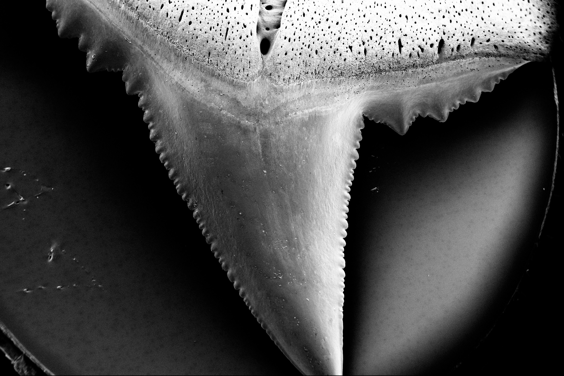
Ocean acidification and shark tooth corrosion
Science research news
Slide by Neil Goalby. Available from rsc.li/3JABdT8
Shark teeth are at risk of becoming less strong and more fragile as the oceans acidify. The oceans are becoming more acidic due to rising carbon dioxide levels. Researchers collected naturally discarded teeth from the aquarium floor of a shark enclosure. The team then left the teeth for eight weeks in two tanks, one with a pH of 8.1 (current oceanic conditions) and one with a pH of 7.3 (the predicted level for 2300). The scientists found the teeth they exposed to more acidic conditions experienced corrosion on the roots, crowns and serrations of the teeth.
© Steffen Köhler/Baum et al, 2025
Losing their edge. The sharks’ teeth were weaker in more acidic waters
Questions
Suggest what effect weaker teeth would have on sharks. Explain why the pH of seawater will decrease if it absorbs more carbon dioxide. Suggest why the teeth become weaker in more acidic water.
Notes:
This slide summarises a recent article published by Chemistry World. Use this in lessons on acids or on the effects of climate change.
Answers
Less easy to catch or break apart prey. Weaker teeth could lead to sharks not getting enough food.
Carbon dioxide is an acidic gas. If more carbon dioxide is dissolved in the oceans, they will become more acidic and hence have a lower pH.
The acids in the water will react with compounds in the teeth and cause corrosion.

