Slide 1
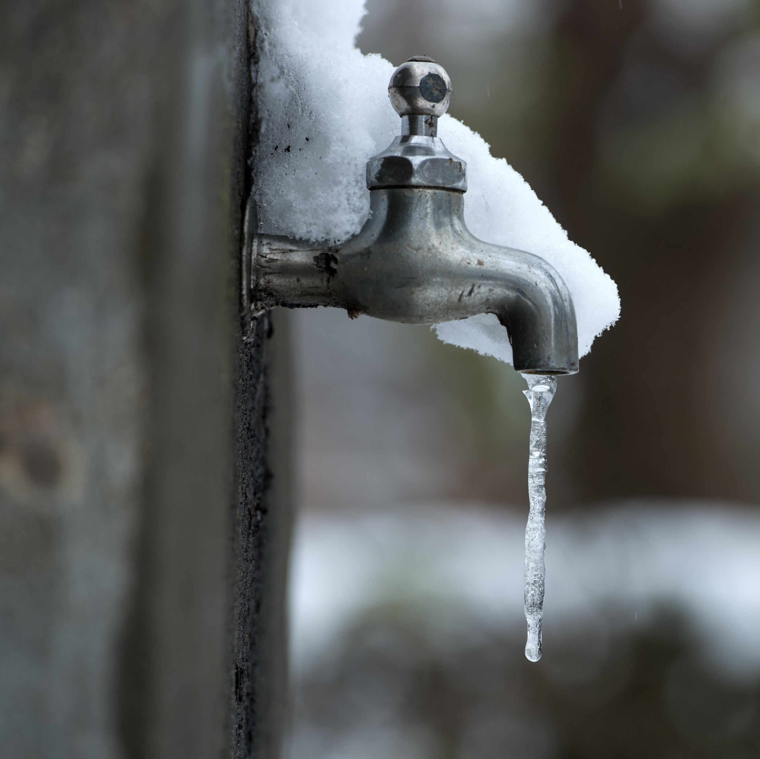
11–14 years
What happens when a substance changes state?
Notes:
Photo © Shutterstock/DONGSEUN YANG

Slide 2
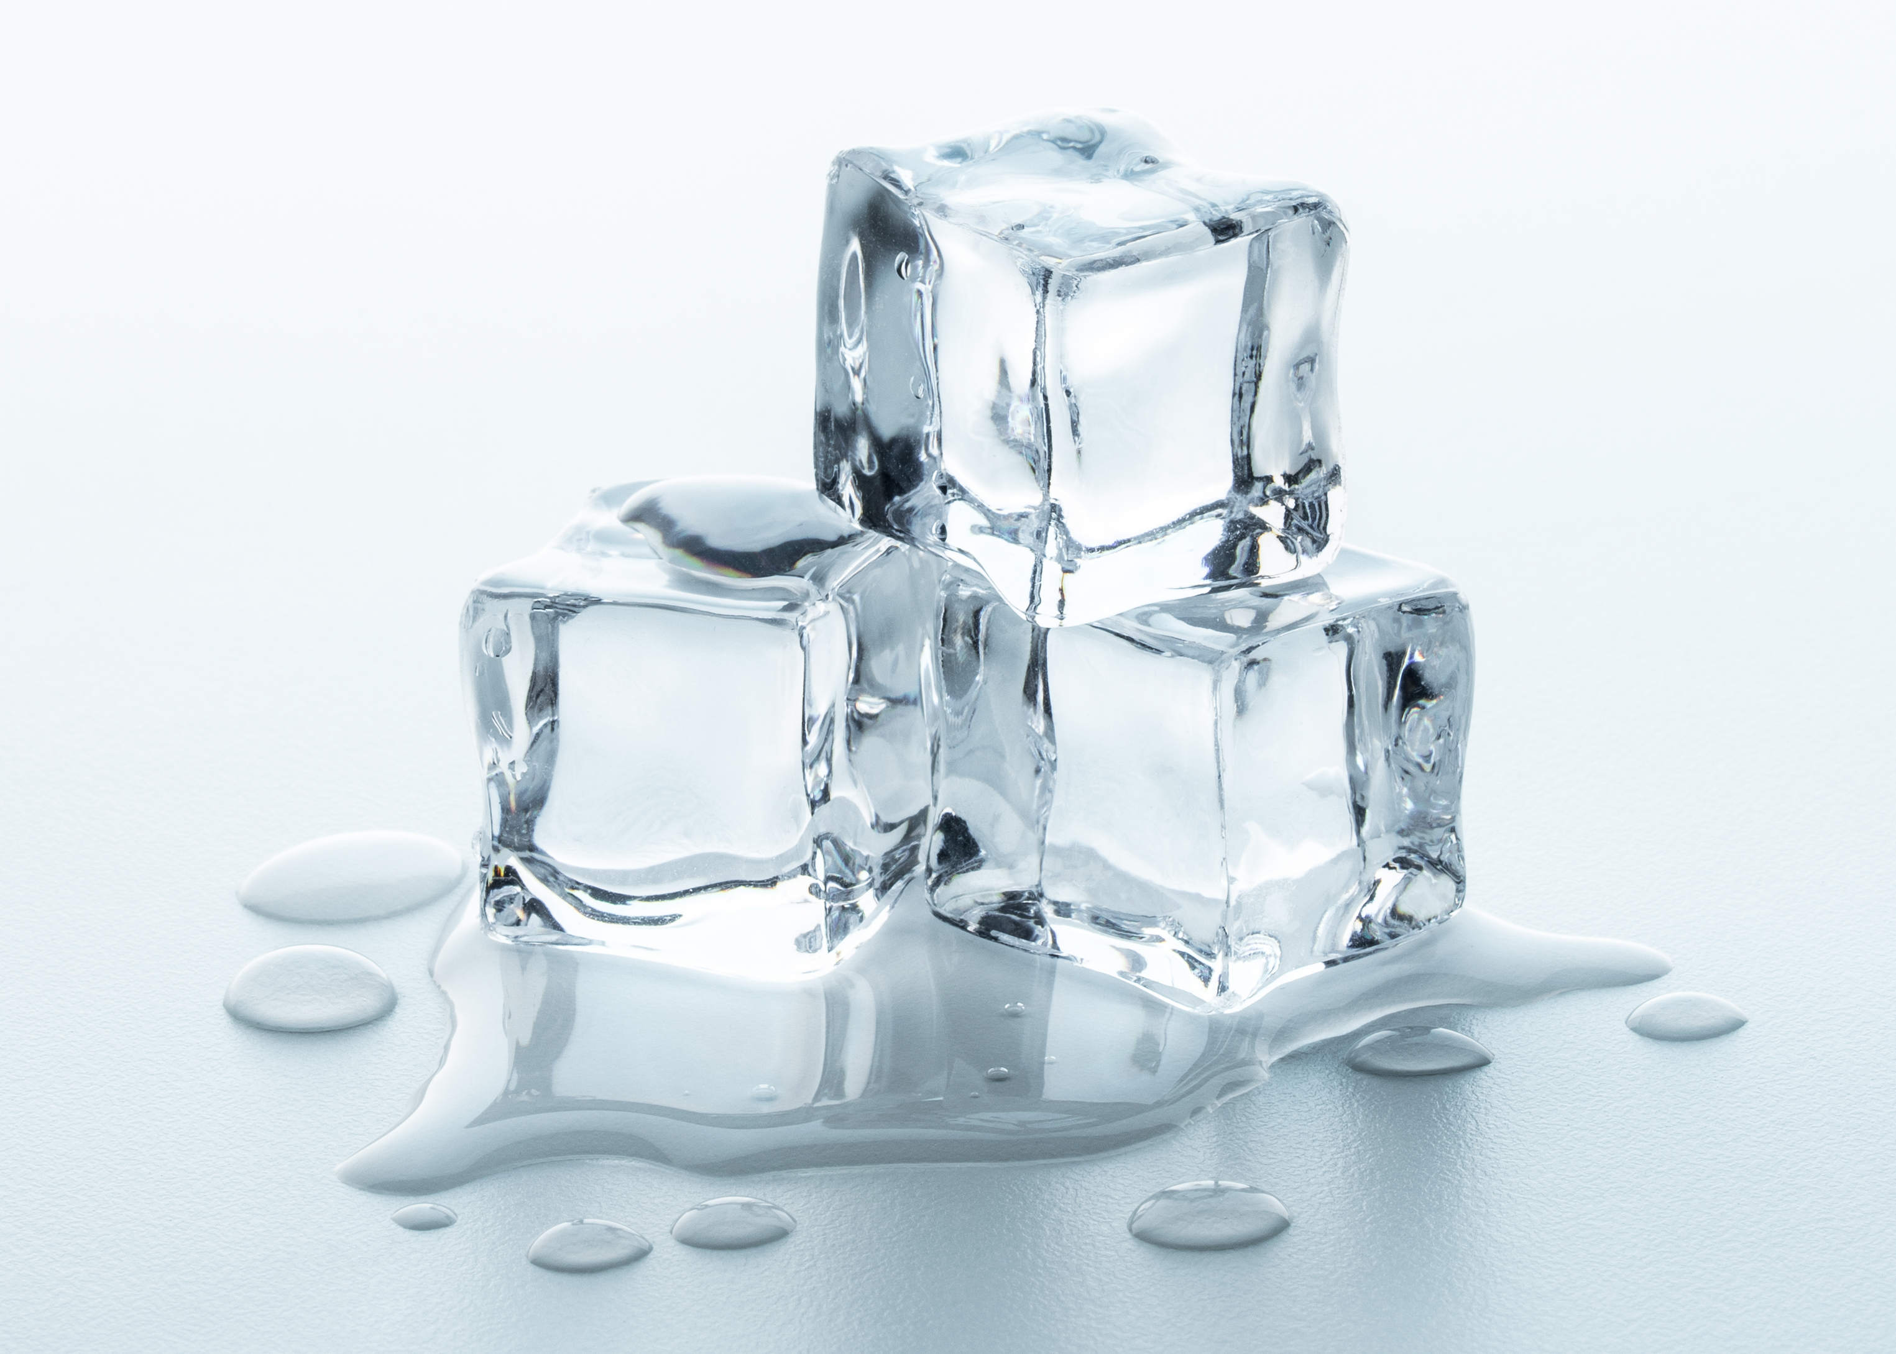
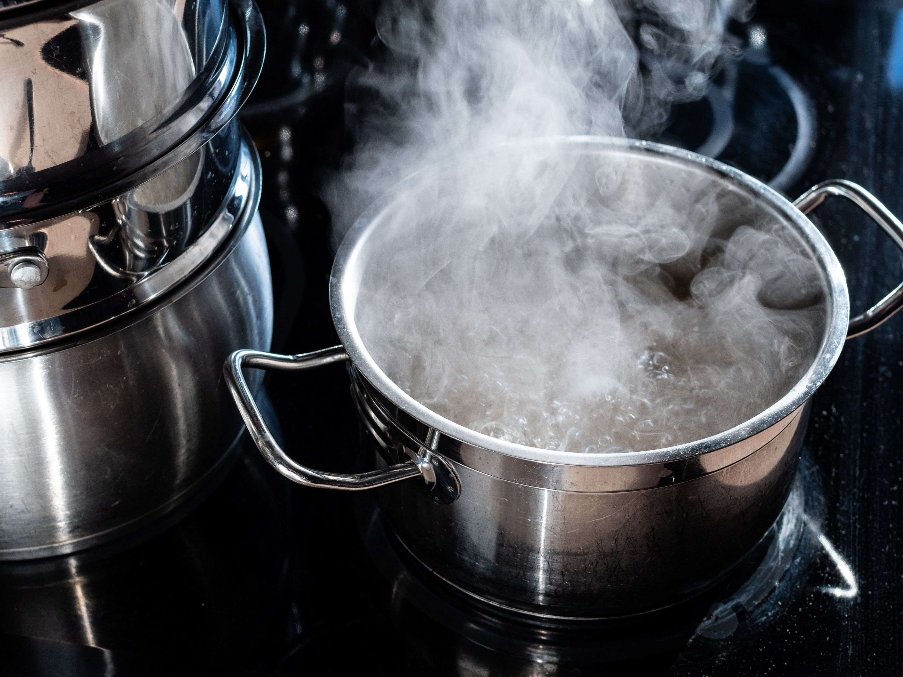
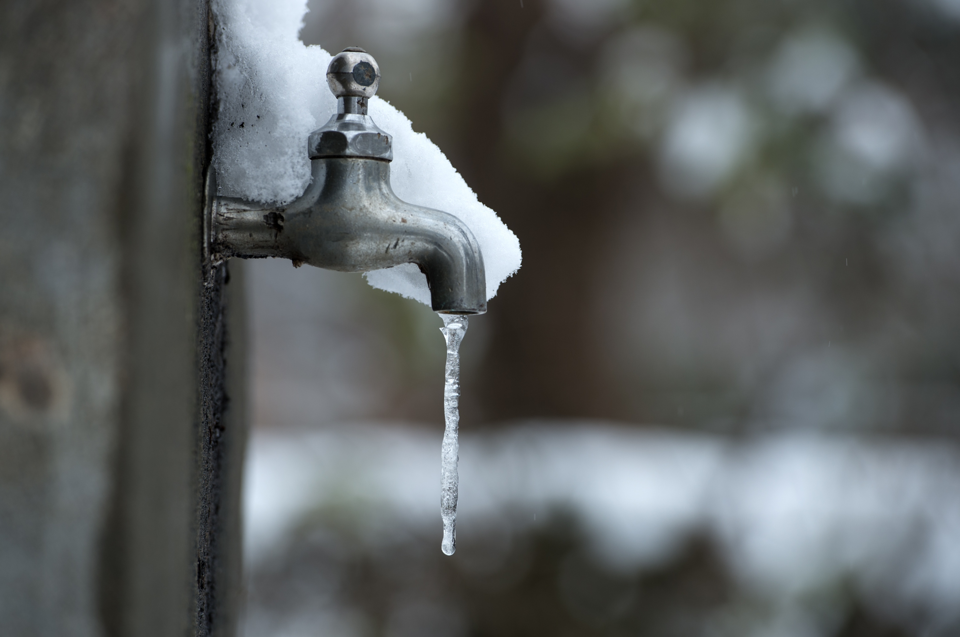
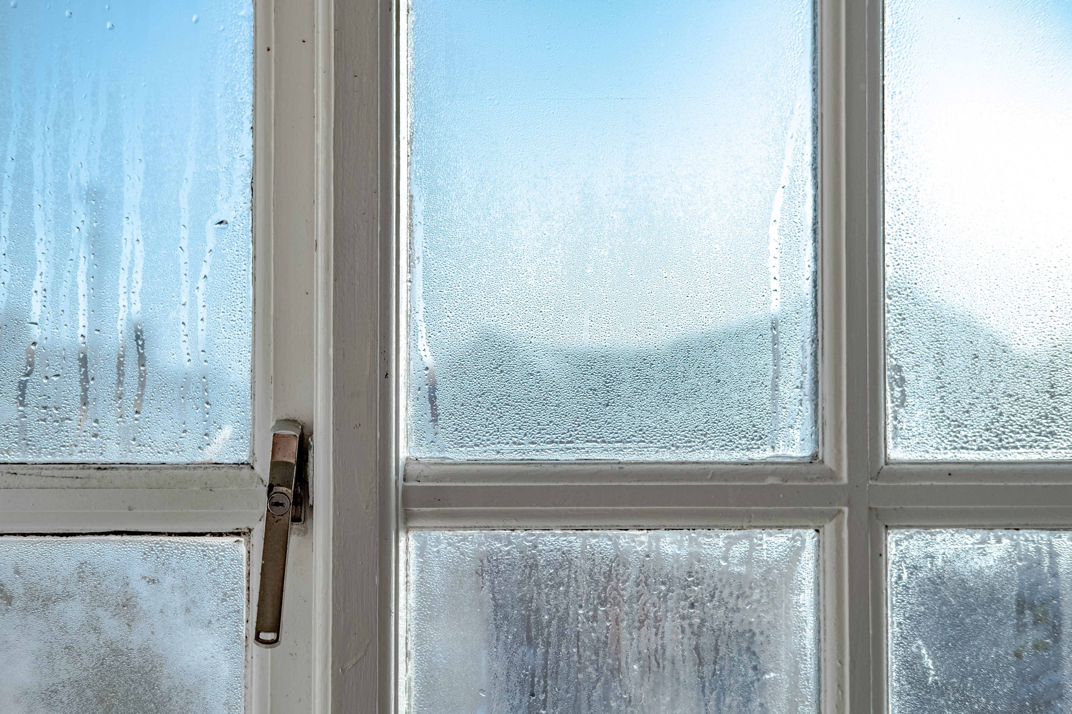
Introduction
A
B
What is happening in the images?
Introduction
D
C
Notes:
A: Photo © Shutterstock/Artiom Photo
B: Photo © Shutterstock/KrimKate
C: Photo © Shutterstock/Nick Beer
D: Photo © Shutterstock/DONGSEUN YANG

Slide 3
Think, pair, share
Introduction
What do you understand about the key terms below?
Melting
Freezing
Boiling
Condensing
Challenge: Can you link all three of these terms to water?
Sentence starters to support discussion:
‘I think that…’
‘I would like to start by saying…’
‘I would like to build on that by adding…’
‘I agree/disagree because…’

Slide 4
Learning objectives
Recall the definitions of freezing, boiling, condensing and melting as changes of state.
Describe the difference between particle diagrams at different states.
Explain that molecules do not break up and reform when a substance boils and cools.

Slide 5
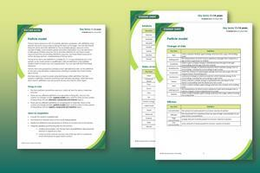
Key terms
Find more support for vocabulary in our Key terms support bundle for 11–14 Particle model.
Available to download from: rsc.li/4cmvSbS
Key terms
Key term | Definition
Boil | when a liquid is heated, gains energy and turns in a gas, at its boiling point
Boiling point | the temperature at which a pure substance changes from a liquid to a gas or from a gas back to a liquid
Condense | when a gas is cooled, energy is transferred from the gas to the gas’ surroundings and the gas turns into a liquid
Evaporate | when the surface of a liquid gains energy and turns into a gas; this can happen below the boiling point
Freeze | when a liquid is cooled, energy is transferred from the liquid to the liquid’s surroundings and the liquid turns into a solid
Melt | when a solid is heated, gains energy and turns into a liquid, at its melting point
Melting point | the temperature at which a pure substance melts and changes from a solid to a liquid, or from a liquid back to a solid
Sublime | when a solid is heated, gains energy and turns into a gas, without turning into a liquid first
Notes:
Find even more key terms and definitions for the Particle model topic at: https://rsc.li/4cmvSbS

Slide 6
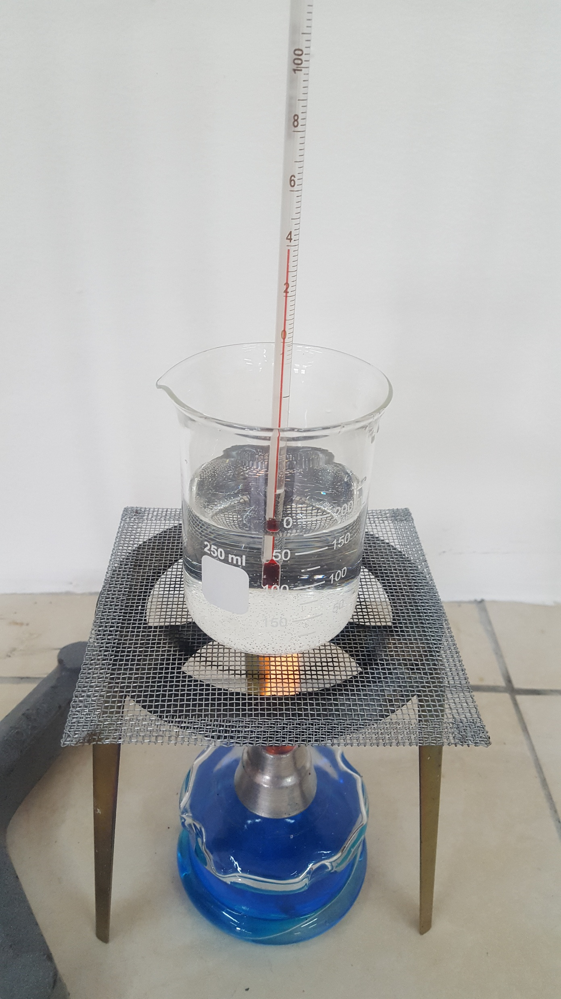
Boiling water
Watch the demonstration of water boiling closely.
What do you observe?
Make a note of this as you will need it later.
Demonstration – boiling water
Notes:
Photo © Shutterstock/fen deneyim

Slide 7
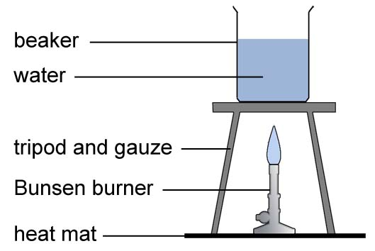
Boiling water: diagram
Demonstration – boiling water

Slide 8
Observation and inference
When drawing a conclusion, you need to take care that it is consistent with the evidence.
As part of this you need to know the difference between an observation and an inference.
An observation is what is seen – in this practical, bubbles and steam
An inference is interpreting what is seen – what impact does this have on the molecules of water?
Observations

Slide 9
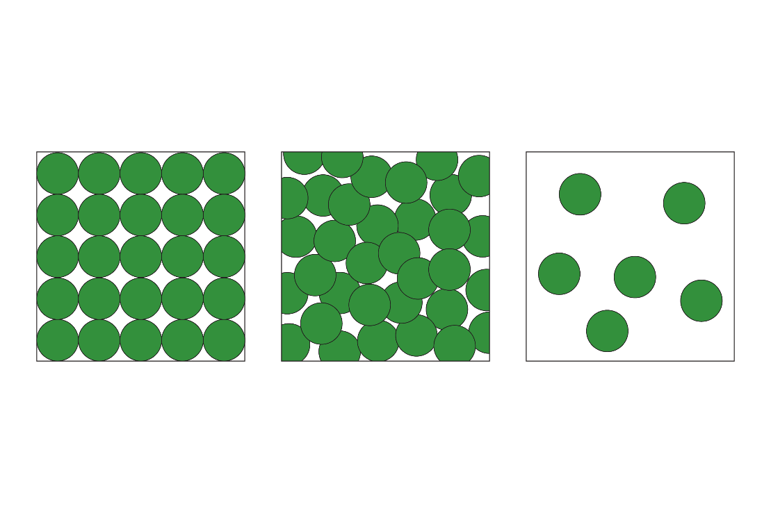
What do our observations mean?
=
water particle
Boiling water
boiling
liquid water
water vapour (steam)
Using the particle diagrams, describe how the particle arrangement changes as a liquid turns into a gas. Describe the difference in:
relative distances between particles
relative energy/movement of particles
relative strength of forces of attraction between particles

Slide 10
What happens when water boils?
Using your observations from the demonstration, independently decide whether each of the statements is true or false by adding a tick to that column.
If you don’t know, place a tick in that column instead.
Statement | True | False | Don’t know
The bubbles contain a mixture of hydrogen and oxygen
The bubbles contain carbon dioxide
The bubbles contain steam (water vapour)
The bubbles are empty (vacuum)
The bubbles contain air
The bubbles contain oxygen only
Independent task

Slide 11
What happens when water boils?
Statement | True | False
The bubbles contain a mixture of hydrogen and oxygen
The bubbles contain carbon dioxide
The bubbles contain steam (water vapour)
The bubbles are empty (vacuum)
The bubbles contain air
The bubbles contain oxygen only
Working in groups of four:
come to an agreement on whether each statement is true or false
explain why you agreed on this
elect a spokesperson to feed back to the class
complete the following sentences:
  My group agreed that…
  I changed my ideas because…
Group task

Slide 12
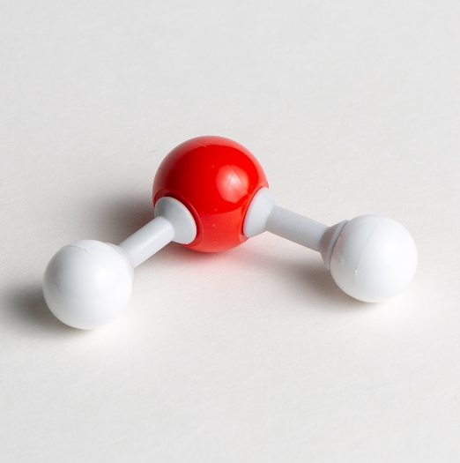
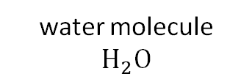
What do our observations mean?
What is a particle of water?
oxygen
Demonstration
=
hydrogen
water vapour
(gas)
water particle
water molecule
$H_{2}O$
There are bonds between the hydrogen and oxygen atoms in a water molecule. Do you think these bonds break when ice melts or water boils?
Notes:
No, bonds between atoms in the water molecule do not break when water changes state. Water is still a molecule of H₂O when it is a solid, liquid and a gas.

Slide 13
What do our observations mean?
Hydrogen atoms
What is happening to the water molecules?
Particle model − boiling
Oxygen atom
Why do you think the particle model simplifies ‘particles’ as circles?
Notes:
Benefits of the particle model:
easier to see the relationship between molecules in the different states (e.g. position, arrangement)
easier to illustrate and interpret (it is not easy to tell which molecule the hydrogen atoms belong to when the molecules are all touching and overlapping)
allows us to generalise for all materials – particles can be complex or simple molecules or atoms; elements or compounds

Slide 14
What happens when water boils?
Self-assess your answers using the table below
Statement | True | False
The bubbles contain a mixture of hydrogen and oxygen |  | ✓
The bubbles contain carbon dioxide |  | ✓
The bubbles contain steam (water vapour) | ✓
The bubbles are empty (vacuum) |  | ✓
The bubbles contain air |  | ✓
The bubbles contain oxygen only |  | ✓
Although there are oxygen and hydrogen atoms, they have a bond between then so are not a mixture.
Self-assessment

Slide 15
Melting ice
Watch the demonstration of ice melting closely.
What molecule is ice made from?
What do you observe?
Which state has more energy?
Demonstration – melting ice

Slide 16
What happens when ice melts?
Using your observations from the ice in front of you, independently decide whether each of the statements is true or false by adding a tick to that column.
If you don’t know, place a tick in that column instead.
Statement | True | False | Don’t know
The molecules in ice get smaller because water takes up less space than ice
The molecules in ice get warmer because the water is hotter than ice
The molecules move around more as water than they did in the ice
Ice molecules and water molecules have different chemical structures
Ice changes to water at 0°C
Ice only melts above its melting point
Independent task

Slide 17
What happens when ice melts?
Statement | True | False
The molecules in ice get smaller because water takes up less space than ice
The molecules in ice get warmer because the water is hotter than ice
The molecules move around more as water than they did in the ice
Ice molecules and water molecules have different chemical structures
Ice changes to water at 0°C
Ice only melts above its melting point
Working in groups of four:
come to an agreement on whether each statement is true or false
explain why you agreed on this
elect a spokesperson to feedback to the class
complete the following sentences:
  My group agreed that…
  I changed my ideas because…
Group task

Slide 18
What happens when ice melts?
Particle model − melting
melting
Using the particle diagrams, describe how the particle arrangement changes as a liquid turns into a gas. Describe the difference in:
relative distances between particles
relative energy/movement of particles
relative strength of forces of attraction between particles

Slide 19
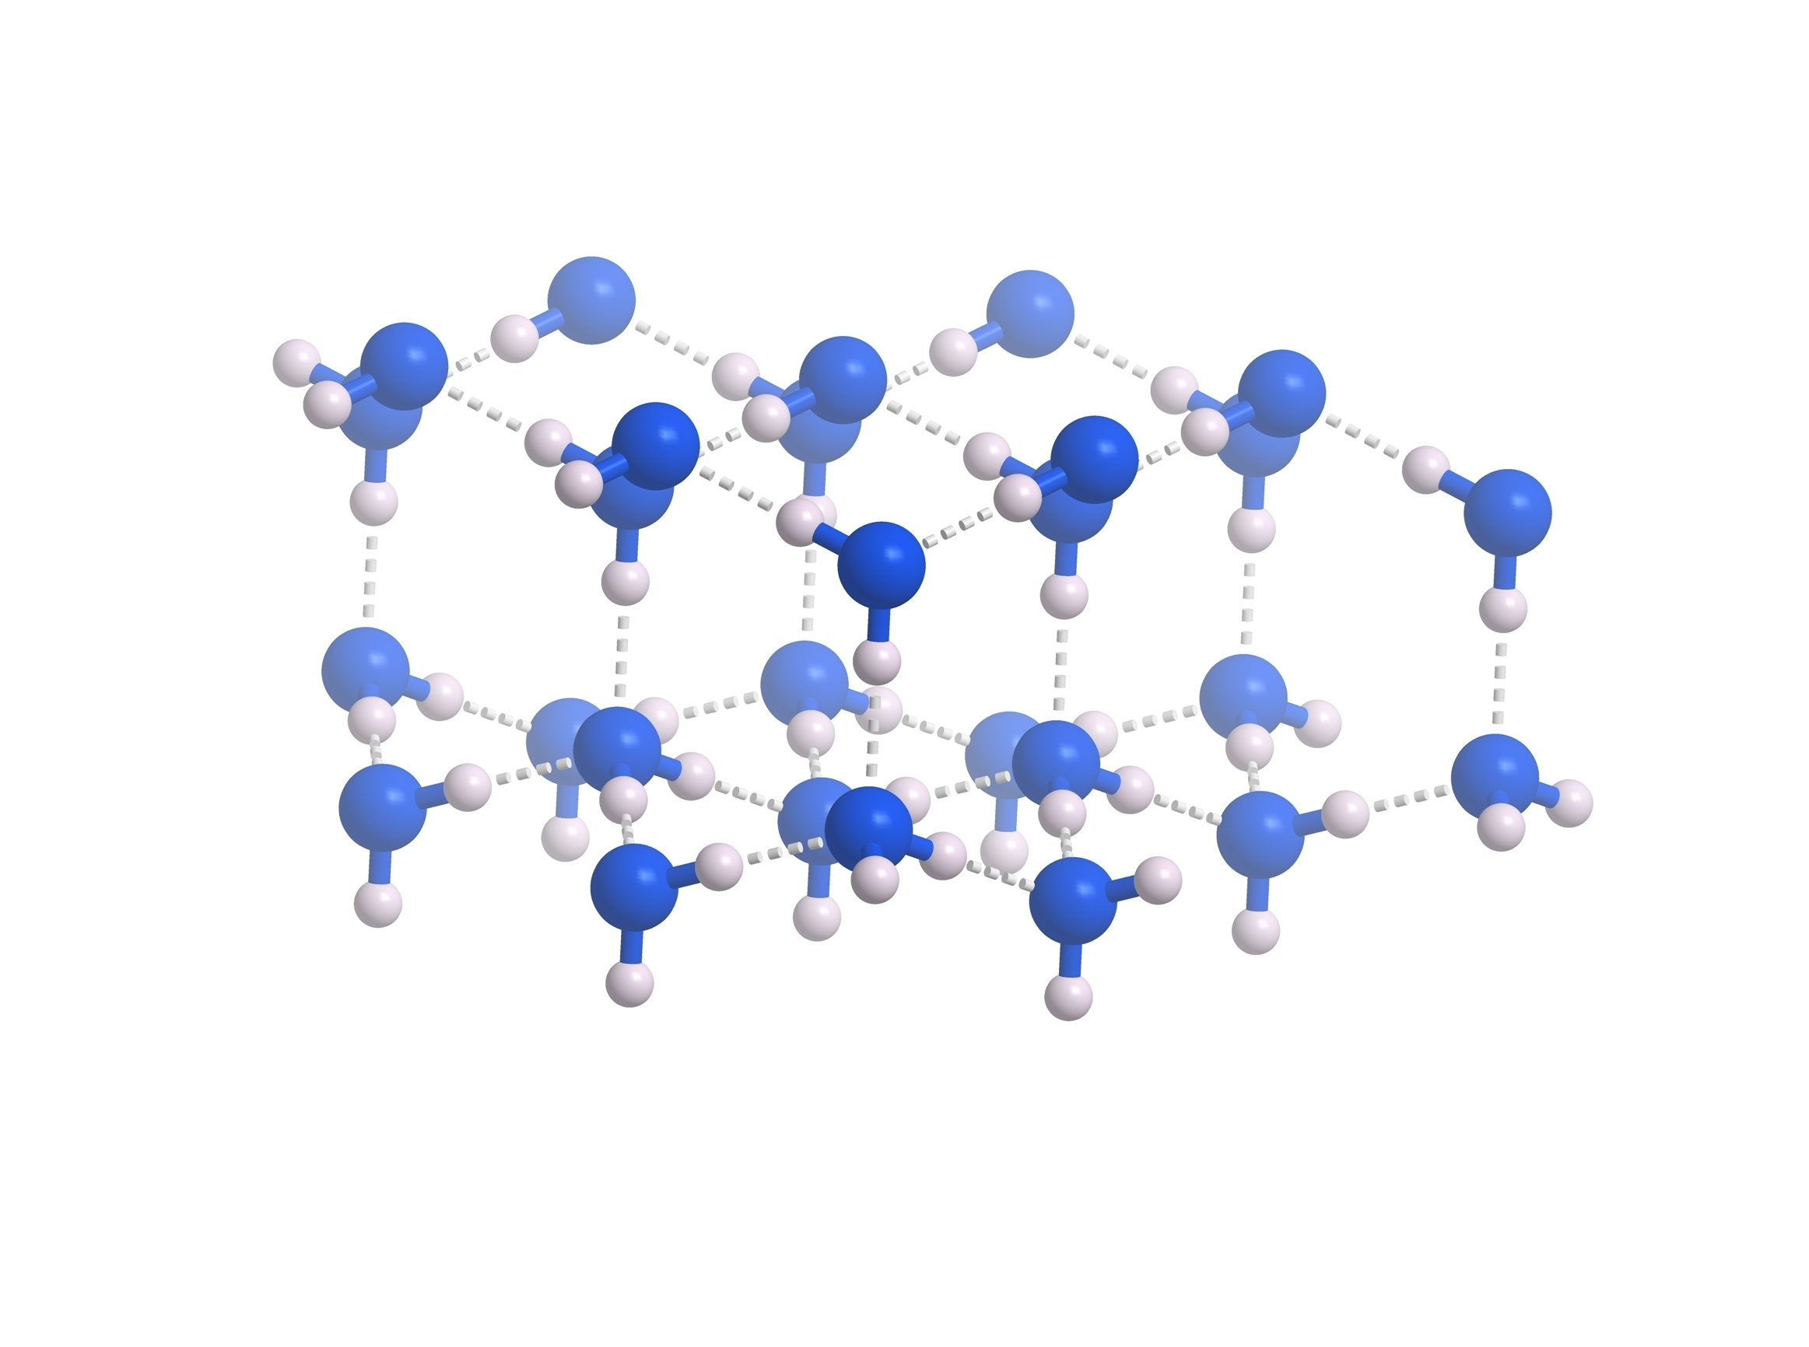
What happens when ice melts?
Hydrogen atoms
Structure of ice
Oxygen atom
melting
Water in a solid is arranged in hexagons rather than rows.
Why do you think the particle model diagram of a solid does not match the real structure of ice?
Notes:
Limitations of the particle model: cannot show the true structure of more complex materials as the circular ‘particle’ is so simplified.

Slide 20
Bonds vs forces
forces between water molecules
Structure of ice
a molecule of water
Changes of state affect the forces between molecules not the bonds between the atoms in a molecule.
bonds between atoms

Slide 21
What happens when ice melts?
Self-assess your answers using the table below
Statement | True | False
The molecules in ice get smaller because water takes up less space than ice |  | ✓
The molecules in ice get warmer because the water is hotter than ice |  | ✓
The molecules move around more as water than they did in the ice | ✓
Ice molecules and water molecules have different chemical structures |  | ✓
Ice changes to water at 0°C | ✓
Ice only melts above its melting temperature |  | ✓
Self-assessment
Thermal energy is transferred from the surroundings.
Molecules in a liquid state have more energy than the same molecules in a solid state.
It melts at its melting point or above.

Slide 22
Changes of state in water
Use the terms boiling, condensing, freezing and melting to label the changes of state shown as particle diagrams below.
Label the arrows to show whether these state changes occur with increasing or decreasing temperature.
Plenary task
________________ temperature
________________
________________
________________
________________
________________ temperature

Slide 23
Changes of state in water
Use the terms boiling, condensing, freezing and melting to label the changes of state shown as particle diagrams below.
Label the arrows to show whether these state changes occur with increasing temperature or decreasing temperature.
Self-assessment
Increasing temperature
Melting
Boiling
Freezing
Condensing
Decreasing temperature

Slide 24
Revisiting
A
B
What is happening in the images?
A – melting
B – boiling
C – condensing
D – freezing
Plenary task
D
C
Notes:
A: Photo © Shutterstock/Artiom Photo
B: Photo © Shutterstock/KrimKate
C: Photo © Shutterstock/Nick Beer
D: Photo © Shutterstock/DONGSEUN YANG

Slide 25
Reviewing our ideas
Plenary task
Have our ideas changed/developed? Use the sentence starters below.
Melting
Freezing
Boiling
Condensing
Challenge: Can you link all three of these terms to water?
Sentence starters:
‘Initially I thought that… but now I know…’
‘I changed my ideas because…’
‘Before this lesson, I didn’t know about…’

