Slide 1
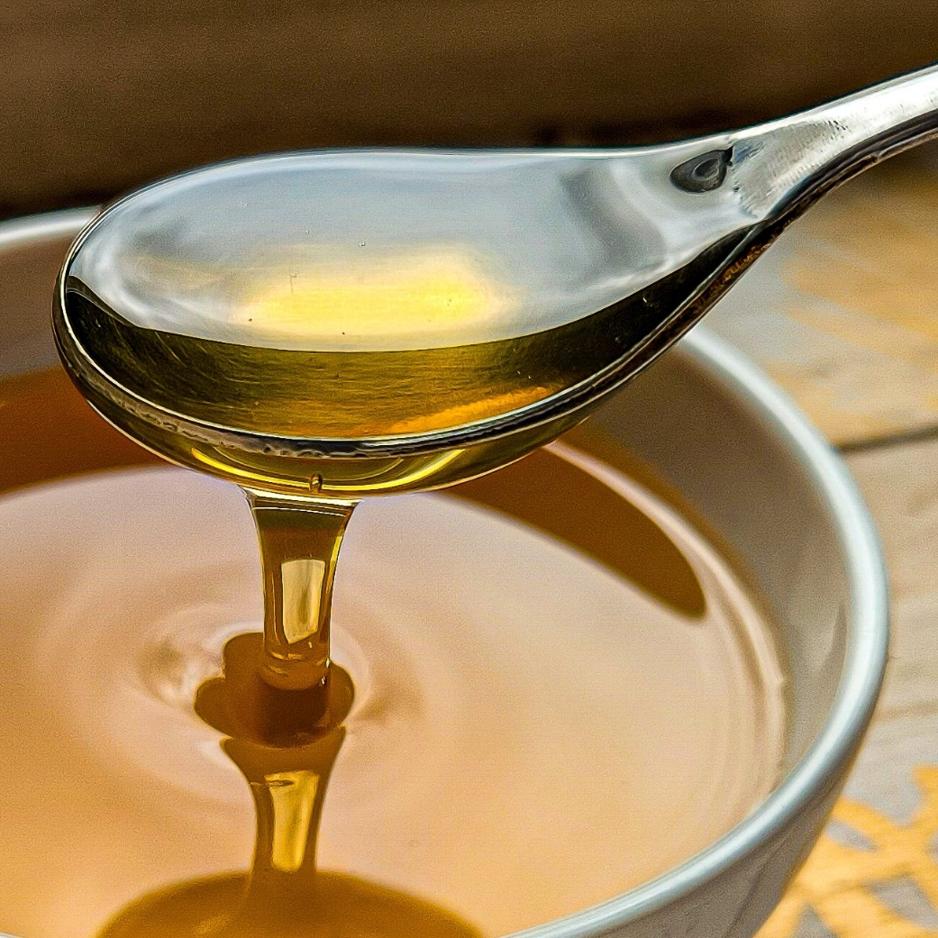
Viscosity
Notes:
Image © Shutterstock/lyuba.smith

Slide 2
Learning objectives
During this lesson, you will:
compare the viscosity of different liquids by making careful observations.
apply your understanding of particles to explain your observations.
design an experiment.

Slide 3
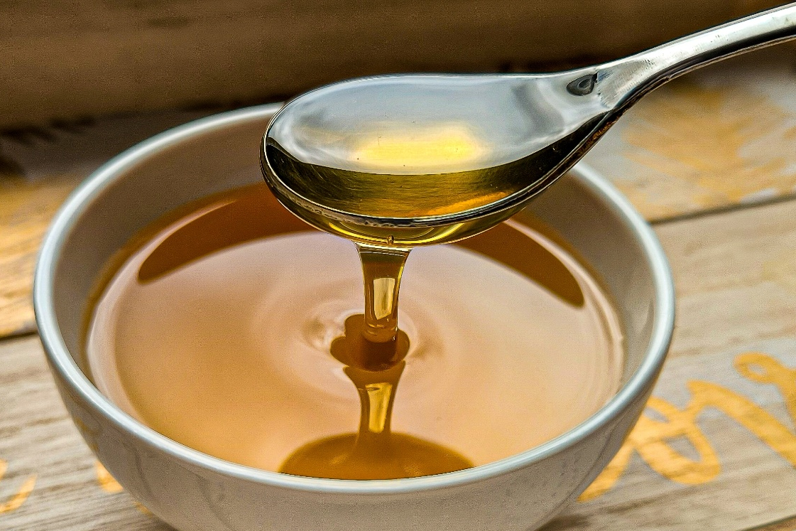
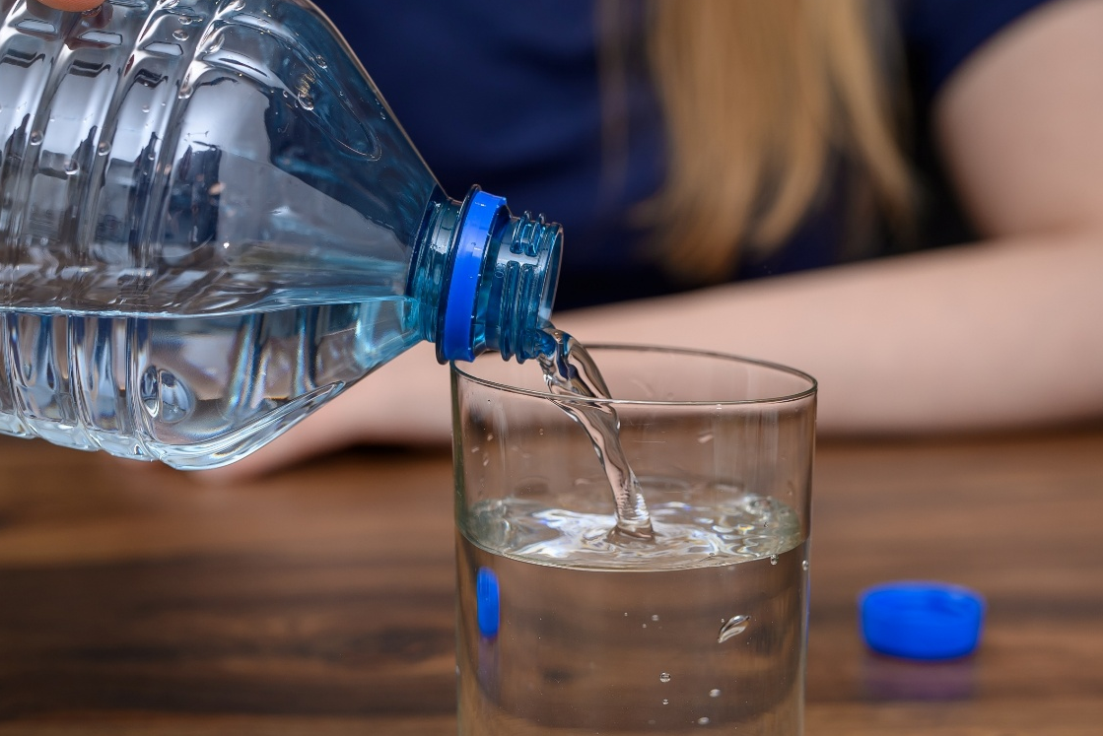
What words would you use to describe…?
Honey
Water
Notes:
Use these images to promote a class discussion around the different properties of liquids and viscosity.
Image 1: © Shutterstock/lyuba.smith
Image 2: © Shutterstock/PawelKacperek

Slide 4
Defining viscosity
Viscosity is a measure of how difficult it is for a liquid to flow.
Definition
Honey has a higher viscosity than water because it is thicker or more gloopy than water.
Water is less viscous than honey because the forces of attraction between the water particles are weaker than those between the honey particles.
Notes:
Image 1: © Shutterstock/lyuba.smith
Image 2: © Shutterstock/PawelKacperek

Slide 5

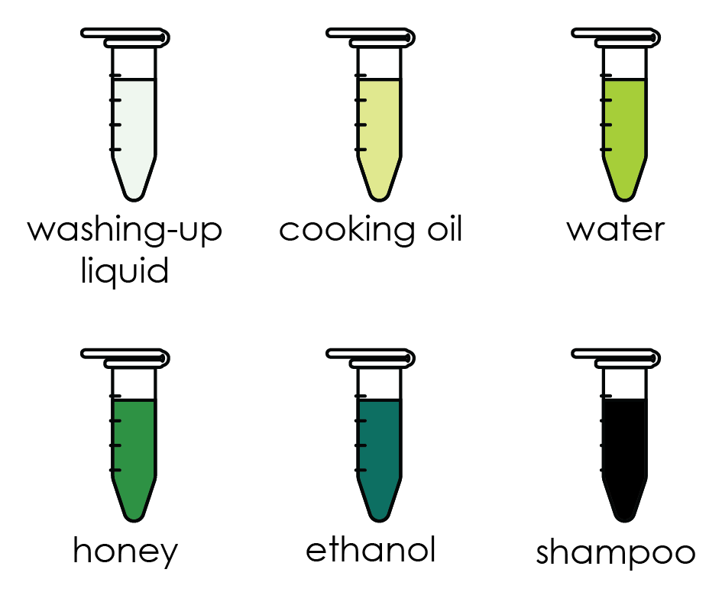
Method
Take one of the tubes provided.
Make sure the bubble is at the top and the tube is held vertical.
Quickly invert the tube and measure the time it takes for the bubble to reach the top.
Repeat this measurement for all the samples.
Complete the table provided.
The practical

Slide 6


❷ Hold the tube vertically, making sure the bubble is at the top 
❸ Quickly invert tube. Start the stop clock 
00.00
❶ Take a sealed sample tube 
❹ Note the time taken for bubble to reach the top 
c
01.24
Classic chemistry experiments
Viscosity
rsc.li/3VP1KMT
❺Repeat steps ❶ to ❹ for all samples 
Notes:
Viscosity
Take one of the tubes provided.
Hold the tube vertically, making sure that the bubble is at the top.
Quickly invert the tube and start the stop clock.
Note the time it takes for the bubble to reach the top.
Repeat this measurement for all the samples.

Slide 7
Results table
Liquid | Time taken (s) |  |  | Average time (s)
 | Test 1 | Test 2 | Test 3
Water
Cooking oil
Washing up liquid
Ethanol
Shampoo or bubble bath
Honey
Results table
Notes:
.

Slide 8
Questions
State the meaning of the word viscosity.
Use your results to identify the most viscous liquid. Why did you choose your answer?
Use your results to identify the least viscous liquid. Why did you choose your answer?
Draw a diagram to show how the particles are arranged in cooking oil.
Describe what happens to the particles when a sample of cooking oil is poured into a frying pan.
Explain why the viscosity of water is lower than the viscosity of bubble bath.
Predict how the viscosity of honey will change as the temperature of the honey is increased. Suggest a reason for your answer.
Design an experiment to investigate how the temperature effects the viscosity of a liquid.
Questions

Slide 9
Learning objectives
During this lesson, you will:
compare the viscosity of different liquids by making careful observations.
apply your understanding of particles to explain your observations.
design an experiment.
Have you met all of the learning objectives?

