Slide 1
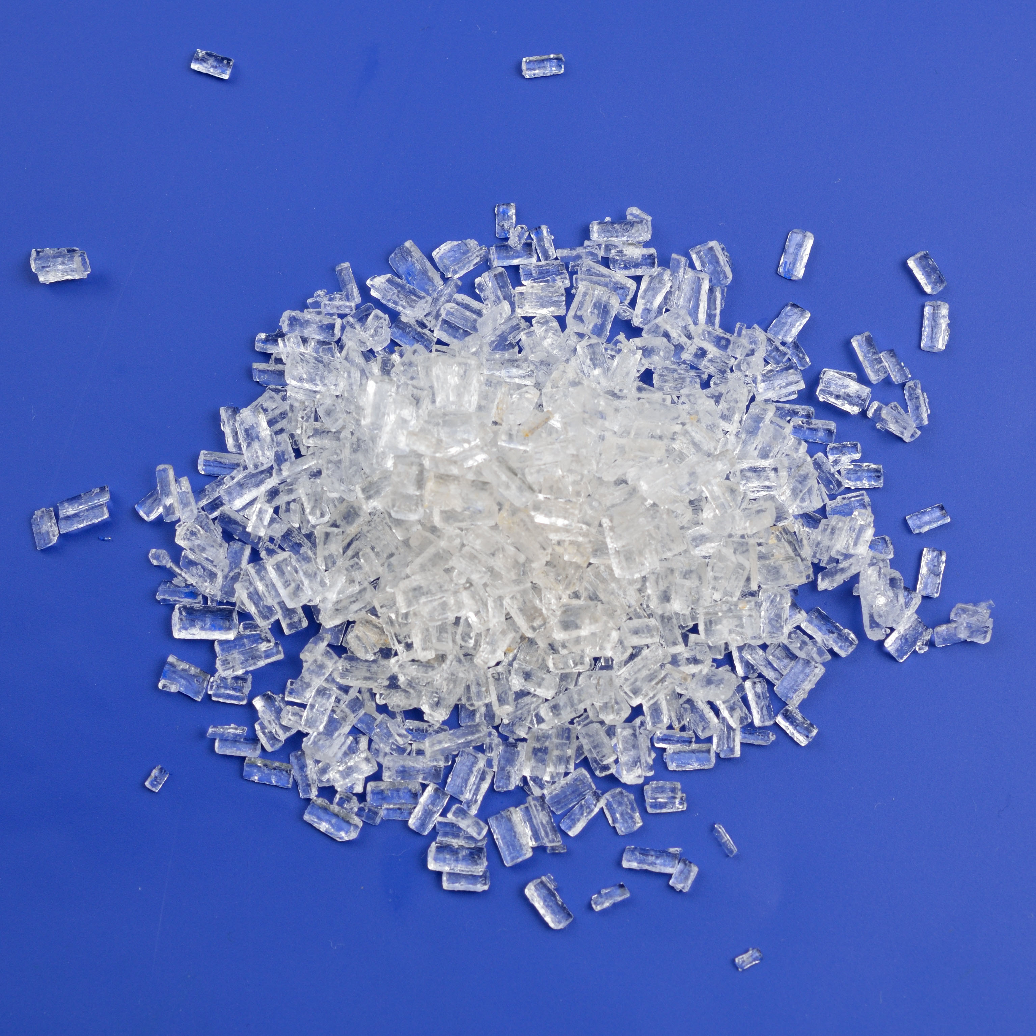
11–14 years
Supercooling and the energetics of freezing

Slide 2
Learning objectives
During this lesson, you will:
Make and record observations.
Interpret a graph.
Describe the energy changes that take place during a change of state.
Learning objectives

Slide 3
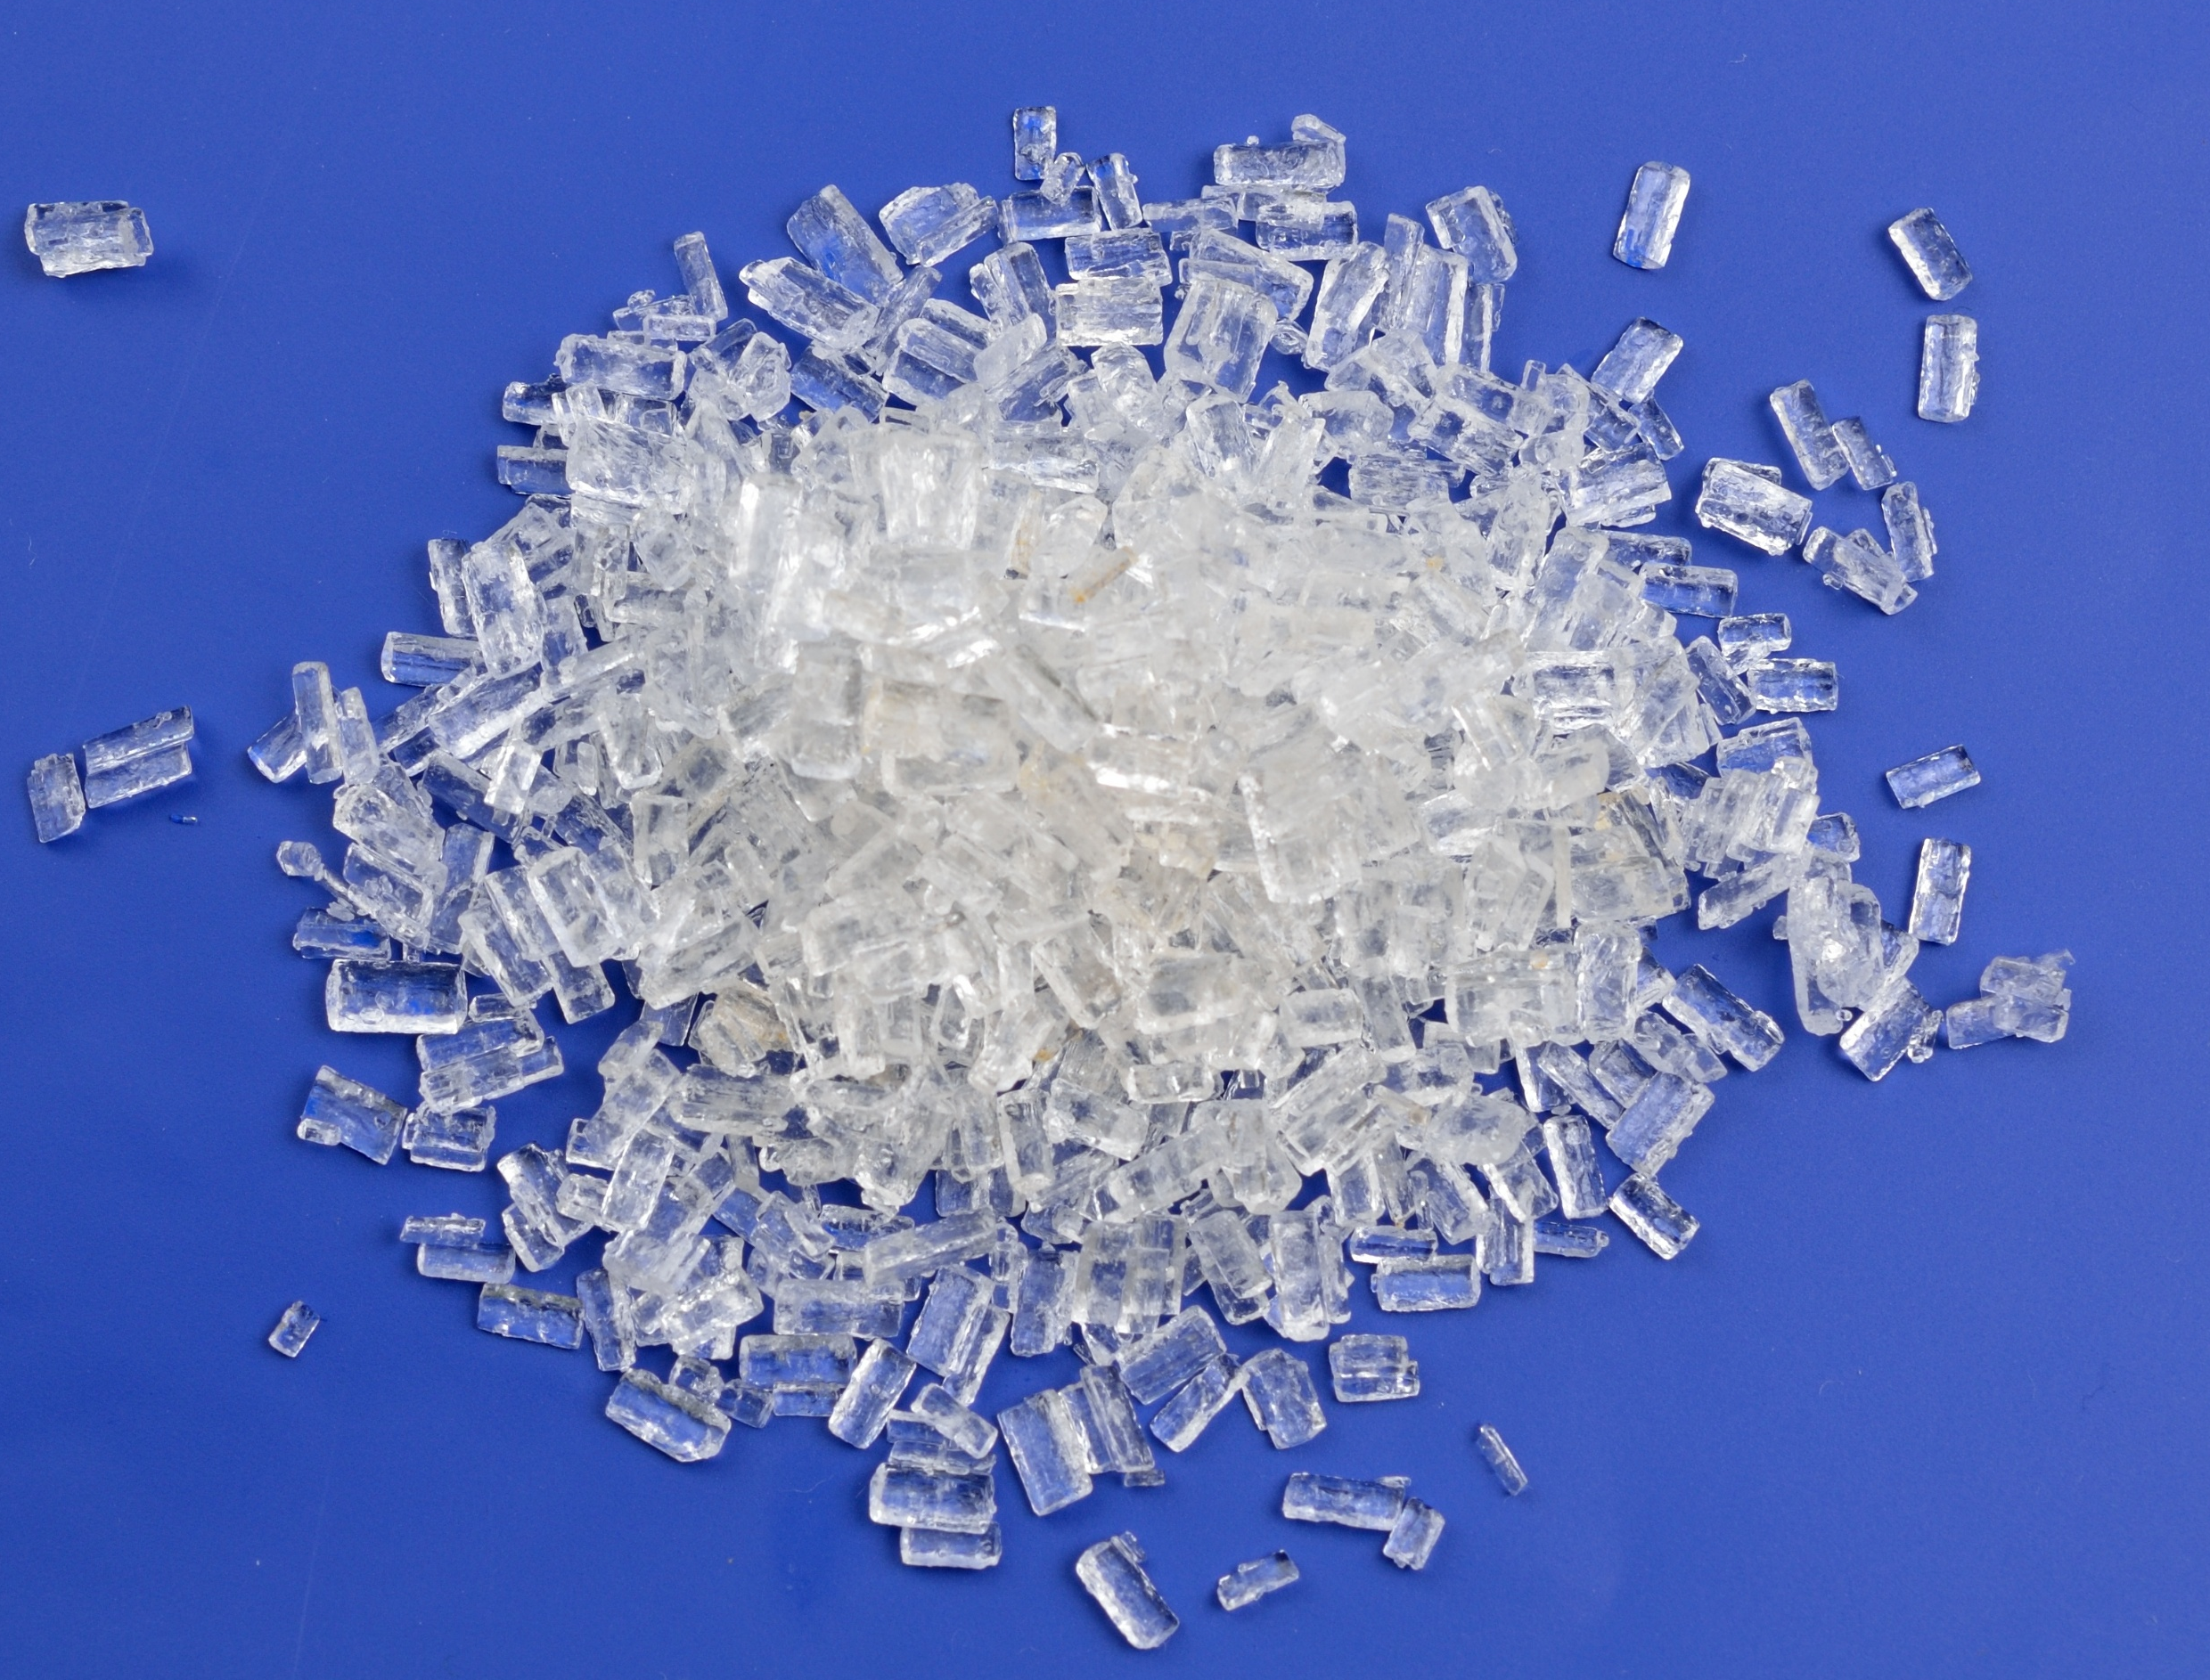
Supercooling
Introduction
You are going to explore what happens when a liquid is supercooled, by melting sodium thiosulfate crystals.
Supercooling is the process of lowering the temperature of a liquid (or gas) to below its freezing point, without it solidifying.
The melted crystals exist in a metastable supercooled state.
How low the temperature will go depends on:
the purity of the sample.
how clean the boiling tube is.
whether the sample is disturbed.

Slide 4
Method
Half-fill a very clean boiling tube with crystals of sodium thiosulfate pentahydrate.
Put a tuft of cotton wool in the end of the boiling tube. Then put the boiling tube in a beaker of hot water (about 50°C) to melt the crystals.
When all the crystals have melted, remove the cotton wool, put a thermometer in the boiling tube and record the temperature of the liquid. If the liquid starts to crystallise on inserting the thermometer, reheat in water to melt all the solid.
Stand the boiling tube in an empty beaker and leave to cool where it won’t be disturbed.
Observe the temperature at various intervals until the value is in the region of 30-40°C. No crystallisation should have occurred.
Add a fresh crystal of sodium thiosulfate, observe the rapid crystallisation which occurs, and continue to monitor the temperature at regular intervals. Record your results in a table
Continue to record your results until the temperature has fallen to about 25−30°C.
Method

Slide 5


❶ Add sodium thiosulfate pentahydrate crystals to boiling tube 
❽ Continue to record the temperature until it reaches 25−30°C 
c
❷ Put cotton wool in end of tube 
❼ Add a fresh crystal of sodium thiosulfate pentahydrate 
❸ Melt crystals in beaker of hot water 
❻ Record the temperature, until it reaches 30−40°C 
c
❹ Remove boiling tube from hot water and stand in an empty beaker 
❺ Place thermometer in boiling tube. Leave to cool.
Start timer 
00.00
Royal Society of Chemistry
Supercooling and energetics of freezing
Downloaded from: rsc.li/4aeiMyg
Notes:
Supercooling and energetics of freezing
Add sodium thiosulfate pentahydrate crystals.
Put cotton wool in end of tube.
Melt crystals in hot water.
Remove boiling tube from hot water.
Place thermometer in tube. Leave to cool. Start timer.
Record the temperature, until it reaches 30−40ºC.
Add a fresh crystal of sodium thiosulfate pentahydrate.
Record the temperature until it reaches 25−30ºC.

Slide 6
Results table
Time (minutes) | Temperature (°C) | Observations
Results

Slide 7
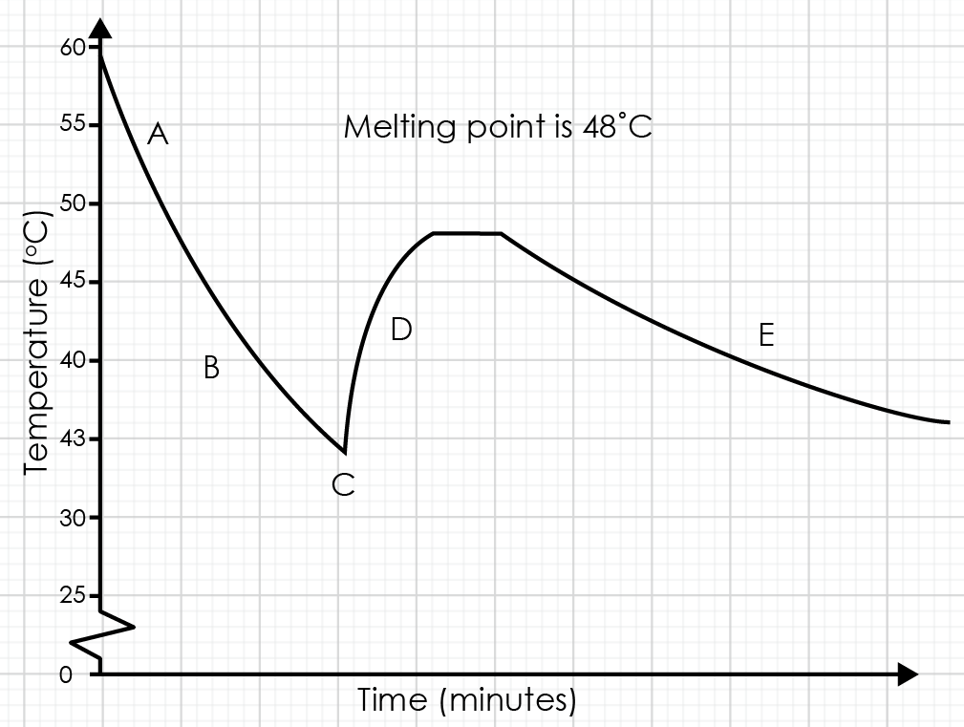
Sketch graph of the results
Results

Slide 8
Questions
State the meaning of the following key words:
freezing
supercooled
exothermic
crystallisation
Plot a graph of temperature (y-axis) against time (x-axis) of your results.
Label the parts of the graph that show:
the melting point of sodium thiosulfate is 48°C
sodium thiosulfate as a liquid
sodium thiosulfate as a supercooled liquid
sodium thiosulfate as a solid
Describe what happened to the shape of the graph when a crystal of fresh sodium thiosulfate was added to the liquid. Suggest a reason for your answer.
Questions

Slide 9
Challenge question
When a substance changes state from a solid to liquid, an exothermic reaction takes place.
Use your experimental results and ideas about particle theory to explain this statement. Include particle diagrams to support your answer.
Challenge

Slide 10
Learning objectives
During this lesson, you will:
Make and record observations.
Interpret a graph.
Describe the energy changes that take place during a change of state.
Have you met all of the learning objectives?
Learning objectives

