Slide 1

11–14 years
Elements, compounds and mixtures:
Frayer models

Slide 2

How to use Frayer models
Frayer models are a simple but effective way to develop learners’ understanding of a new piece of vocabulary. You will see what your learners already know and identify any misconceptions they have.
There are four stages learners can work through, but you can adapt this model to best suit your learners. You can guide learners through all quadrants, but particularly quadrant 2 works best as a teacher-led discussion. Quadrant 3 might also need/benefit from some discussion.
1. Explore Link to science capital and draw on learners’ experience. | 2. Break down Look at the composite parts of the word to help unpack its meaning.
4. Consolidate Learners apply their knowledge. | 3. Explain Introduce the definition.
Key term
Find more guidance, including tips, adaptations and further reading, in the teacher notes: rsc.li/42AcGmK

Slide 3
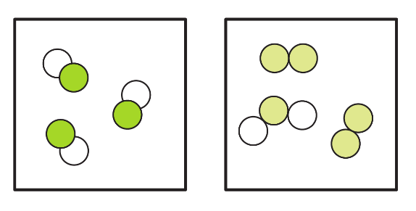
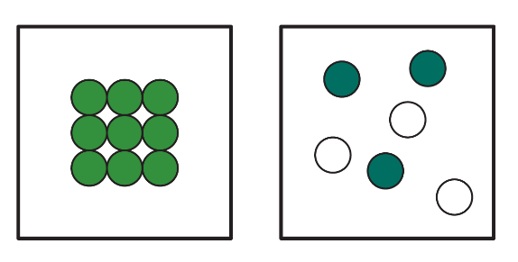
1. What does the word ‘pure’ mean to you? Where have you come across this word before? In everyday language lots of items are described as pure. pure orange juice pure air pure table salt pure honey Which do you think a scientist would describe as pure? | 2. What is the origin of the word ‘pure’? In classical Latin, pūrus means ’clean’ or ‘unmixed’.
4. Which of the particle diagrams represent a pure substance (choose all that apply)? | 3. Write down what you think a ‘pure substance’ is. Hint: what must be true about all the particles in a substance if it is pure? | Compare what you wrote with the definition (slide 7).
pure substance
Notes:
In everyday language, we use the word ‘pure’ for substances that have not had anything added to them/substances found in their natural state, e.g. orange juice fresh from an orange. When you pick up a bottle of mineral water from the shop you might think you are drinking pure water, but in fact the water has several minerals dissolved in it – that’s what makes it so tasty. To obtain pure water you need to carefully distil it and collect the liquid with a boiling point of exactly 100°C.
Answer for quadrant 3: a substance that is just one compound or element with nothing else mixed in.
(Answer for quadrant 1: only the table salt is a pure substance.)

Slide 4
1. What does the word ‘aqueous’ mean to you? Where have you come across this word before? What do all these words have in common? Aqueduct Aquatic Aquarium | 2. Break down the word ‘aqueous’. aqu- In classical Latin, aqua means ‘water’. -ous If something is dangerous, it is full of danger. If someone is joyous, they are full of joy. What does the suffix -ous mean in these words?
Which substance(s) are ‘aqueous’ in the chemical reaction shown below. Hint: look at the state symbols for each substance. CuO(s) + 2HCl(aq) → CuCl₂(aq) + H₂O(l) | 3. What do you think ‘aqueous’ means? Put together your understanding of the parts aqua and -ous to form the definition. | Compare what you wrote with the definition (slide 8).
aqueous
Notes:
Answer for quadrant 2: in classical Latin, ‘aqua’ means water; -ous means ‘full of’. So, put together, ‘aqueous’ is a substance full of water.
Water makes up approx. 60% of your body mass. Many of the reactions that take place throughout your body (from your organs down to individual cells) are aqueous reactions.
Answer for quadrant 3: when a substance is dissolved in water; shown by the state symbol (aq).
(Answer for quadrant 1: aqueduct - a structure that carries water across a valley or river; aquatic - growing or living in water; aquarium - a tank for underwater creatures.)

Slide 5
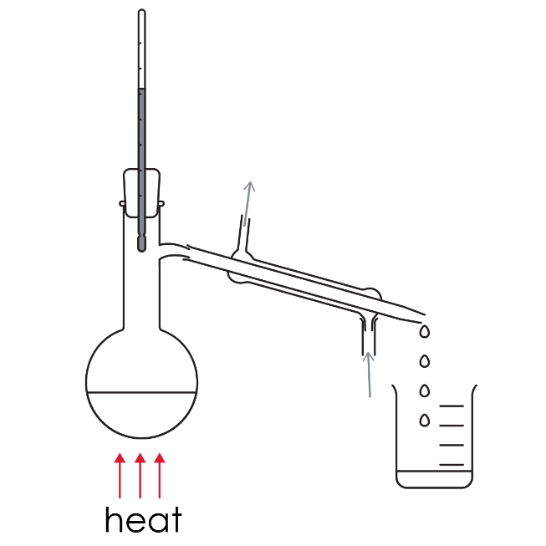
1. What does the word ‘condenser’ mean to you? Where have you come across this term or parts of this term before? Here are some ideas. You often see condensation on the mirror in the bathroom after a hot shower. What is condensation? You might condense a page of notes into two sentences on a revision card. What are you doing? | 2. Break down the word ‘condenser’. con- Prefix meaning ‘with’ or ‘together’. -dense- Liquids are much denser than gases. Why? -er A mixer is an object that mixes things. A boxer is someone who boxes. What does the suffix –er mean in all these terms?
The image shows apparatus set up for distillation. Circle the condenser. | 3. Write down what you think a ‘condenser’ does. Put together your understanding of the parts con-, -dense- and -er to form the definition. | Compare what you wrote with the definition (slide 9).
condenser
Notes:
Answer for quadrant 2: con- = ‘with’ or ‘together’, -dense- = ‘measure of the amount of matter in a set of volume’, er- = ‘referring to’.
Did you know, the use of the word ‘retort’ for a remark that is sent back in reply has the same Latin origins as a retort flask? (A retort is a type of flask used for distillation with a characteristic long neck which serves as a condenser.) Provide learners with a link to this article which includes the name of some historical flasks. Ask them to do some research and find out more about the flasks: https://edu.rsc.org/opinion/get-me-a-flask-any-flask/2021049.article
Answer for quadrant 3: a glass tube used in distillation to condense a gas into liquid, by surrounding the tube with a continuous flow of cold water.
(Answer for quadrant 1: condensation is when a vapour turns into a liquid.)

Slide 6
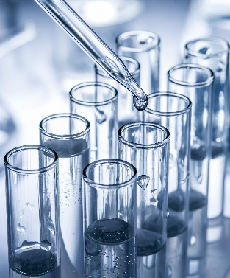
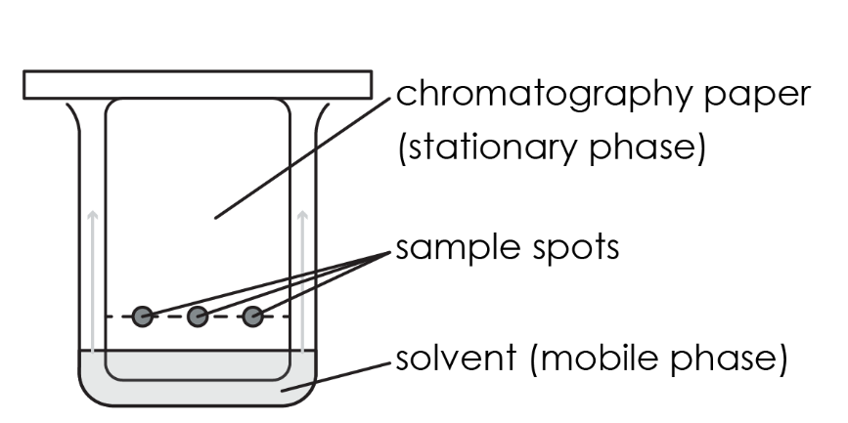
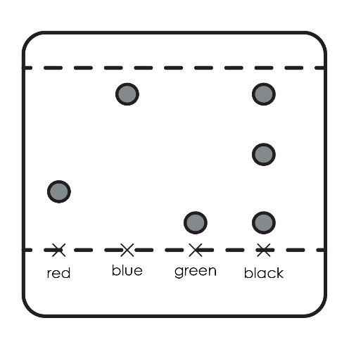
1. What does the word chromatography mean to you? Here are some ideas. In art, the chroma of a colour refers to the purity and depth of the colour. This image is monochrome. It contains just a single colour. | 2. Break down the word ‘chromatography’. Chroma- ‘colour(s)’ -graphy The choreography of a dance is a description of the steps and movements in the dance. A biography is a description of someone’s life. What does the suffix -graphy mean in these words?
A student uses chromatography to find the colours in a black ink. Look at the chromatogram. What colours are in the black ink? | 3. Write down what you think ‘chromatography’ means. Put together your understanding of the parts chroma- and -graphy to form the definition. | Compare what you wrote with the definition (slide 10).
chromatography
chromatography
chromatogram
Notes:
Answer for quadrant 2: chroma- = ‘colours’, -graphy = ‘description’. So, put together, is a description of colours (in a mixture).
Find out how archaeological chemist, Stephen Buckley uses chromatography to study the natural products used by Egyptians to embalm mummies. Scroll to poster 6 on this website: https://www.compoundchem.com/enablescience/
Answer for quadrant 3: a method of separation based on how easily each substance is carried by a liquid that is moving through a porous solid, like paper.
Photograph on this slide © Shutterstock

Slide 7
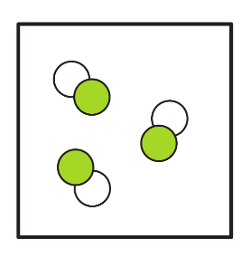
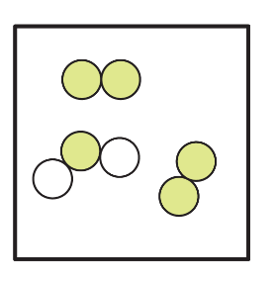

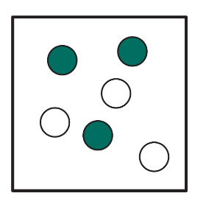
What does the word pure mean to you? Where have you come across this word before? In everyday language lots of items are described as pure. Pure orange juice Pure air Pure table salt Pure honey Which do you think a scientist would describe as pure? | 2. What is the origin of the word pure? In classical Latin pūrus means ’clean’ or ‘unmixed’.
4. Which of the particle diagrams represent a pure substance (choose all that apply)? A pure compound Not pure A pure element Not pure | 3. Write down what you think the key term means (below is the definition from the key terms list). A substance that is just one compound or element with nothing else mixed in. Encourage learners to compare their attempted definition with the definition above.
pure substance
Notes:
Answer for quadrant 1: only the table salt is a pure substance

Slide 8
1. What does the word ‘aqueous’ mean to you? Where have you come across this word before? What do all these words have in common? Aqueduct Aquatic Aquarium | 2. Break down the word ‘aqueous’. aqua In classical Latin aqua means ‘water’ -ous Borrowed from classical Latin ‑ōsus meaning ‘abounding in, full of, characterised by’ aqueous A substance full of water.
4. Which substance(s) are ‘aqueous’ in the chemical reaction shown below. CuO(s) + 2HCl(aq) → CuCl₂(aq) + H₂O(l) Aqueous substances in the reaction are: HCl - hydrochloric acid CuCl₂ - copper chloride | 3. Write down what you think key term means (below is the definition from the key terms list). When a substance is dissolved in water; shown by the state symbol (aq). Encourage learners to compare their attempted definition with the definition above.
aqueous
Notes:
Answer for quadrant 1: aqueduct - a structure that carries water across a valley or river; aquatic - growing or living in water; aquarium - a tank for underwater creatures.

Slide 9
1. What does the word ‘condenser’ mean to you? Where have you come across this term or parts of this term before? Here are some ideas. You often see condensation on the mirror in the bathroom after a hot shower. What is condensation? You might condense a page of notes into two sentences on a revision card. What are you doing? | 2. Break down the word ‘condenser’. con- Prefix meaning ‘with’ or ‘together’ -dense- A measure of the amount of matter in a set volume. So liquids are denser than gases because in liquids, the particles are closer together. -er A person or thing that performs an action. condenser An object that brings together particles to form something that is more dense.
4. The image shows apparatus set-up for distillation. Circle the condenser. | 3. Write down what you think key term means (below is the definition from the key terms list). A glass tube used in distillation to condense a gas into liquid, by surrounding the tube with a continuous flow of cold water. Encourage learners to compare their attempted definition with this one.
condenser
condenser
Notes:
Answer for quadrant 1: condensation is when a vapour turns into a liquid.

Slide 10
1. What does the word chromatography mean to you? Where have you come across this word (or parts of this word) before? | 2. Break down key term chroma- From the Greek khrōma meaning colour -graphy From the Greek -graphia ’description of’ chromatography description of the colours in a mixture
4. A student uses chromatography to find the colours in a black ink. What colours are in the black ink? The black ink consists of; blue ink green ink an unknown colour | 3. Write down what you think key term means/copy the definition from the key terms list A method of separation based on how easily each substance is carried in a liquid that is moving through a porous solid, like paper. Encourage learners to compare their attempted definition with the key terms list definition
1. What does the word chromatography mean to you? | 2. Break down the word ‘chromatography’. chroma- colour(s) -graphy The choreography of a dance is a description of the steps and movements in the dance. A biography is a description of someone’s life. What does the suffix –graphy mean in these words? Description chromatography A description of the colours in a mixture.
A student uses chromatography to find the colours in a black ink. What colours are in the black ink? The black ink consists of: blue ink green ink an unknown colour. | 3. Write down what you think chromatography means (below is the definition from the key terms list). A method of separation based on how easily each substance is carried by a liquid that is moving through a porous solid, like paper. Encourage learners to compare their attempted definition with this one.
chromatography

Slide 11
1. Explore Link to science capital and draw on learners’ experience. | 2. Break down/’what do we know about X?’ Look at composite parts of the word to help unpack its meaning. Or invite learners to suggest what, as a class, they already know about the key term (with the help of a few bullet points).
4. Consolidate Learners apply their knowledge. | 3. Explain Introduce the definition.
Select your key term

