Slide 1
14–16 years
Electrolysis of brine
Downloaded from: rsc.li/48FHu9J

Slide 2
Learning objectives
Learning objectives
Safely investigate the electrolysis of brine.
State and describe your observations for the electrolysis of brine.
Apply your understanding of electrolysis to explain your observations and the products formed.
Predict the products formed.

Slide 3
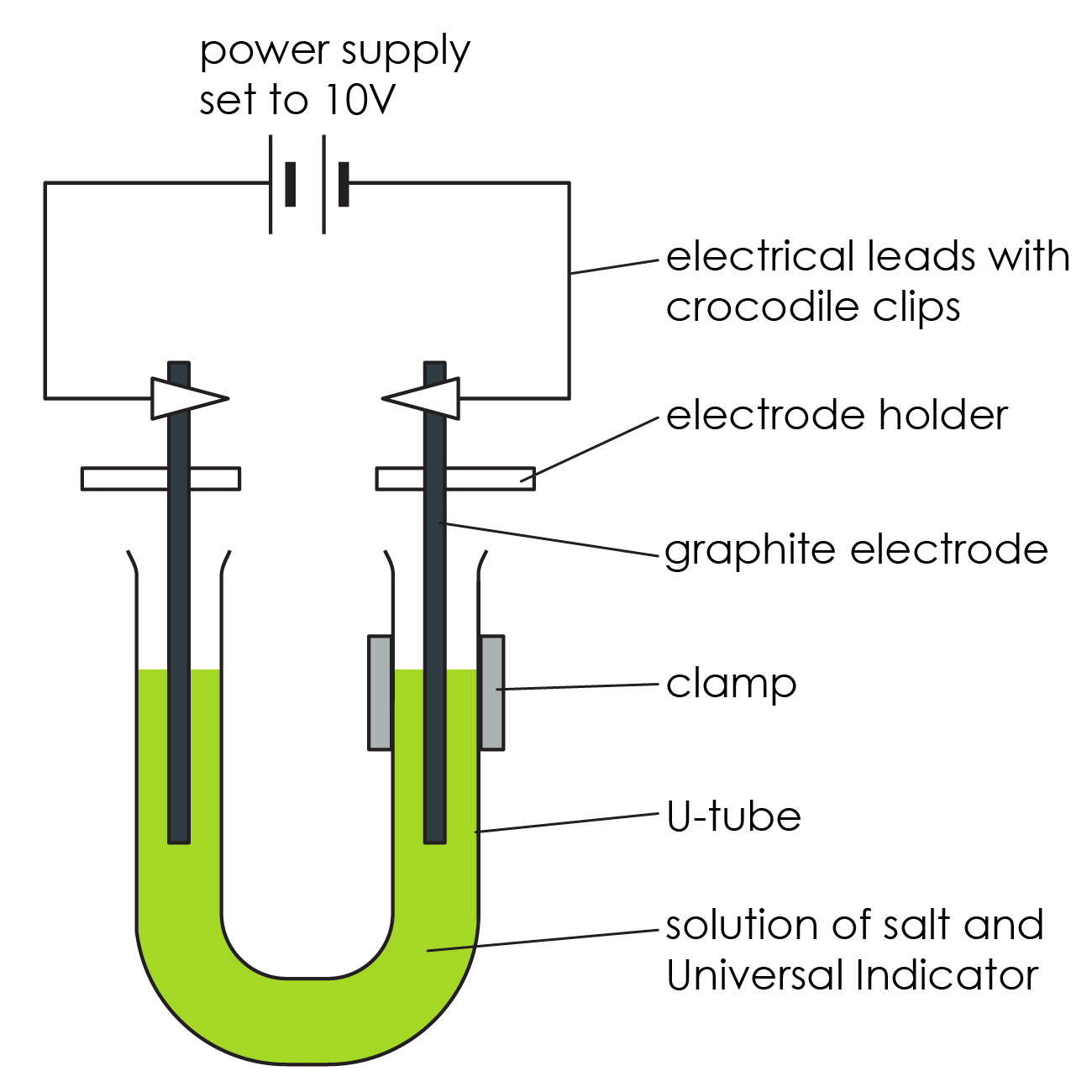
Electrolysis of brine
Introduction
In this experiment, you will observe what happens during the electrolysis of brine (sodium chloride solution), using universal indicator to help you follow the reaction that takes place.

Slide 4
Pre-experiment questions
Pre-experiment questions
State the ions present in this solution.
State the colours that indicate the presence of an acid and an alkali when using universal indicator.
Name the positive and negative electrodes.
State the colour that the distilled water (deionised water) should turn in the presence of universal indicator solution.
State which ions will move to the positive electrode and which ions will move to the negative electrode.
Predict what you will observe at both electrodes and explain your reasoning.
Predict the products at both electrodes and explain your reasoning.
Notes:
There is a scaffolded version of these questions available to download as a student worksheet from: https://rsc.li/48FHu9J

Slide 5
Method
Method
Put about 75 cm³ distilled water into the beaker. Add about two heaped spatulas of sodium chloride.
Stir until the salt dissolves. Then add several drops of universal indicator solution. Stir to mix thoroughly. You need enough indicator to give the water a reasonable depth of green colour.
Pour the coloured salt solution into the U-shaped test tube and clamp it as shown in the diagram.

Slide 6
Method
Wash the carbon electrodes carefully in distilled water and then fix them so that there is about 3 cm of electrode in each side of the U-tube – see diagram. This is most easily done using electrode holders.
Attach leads to the electrodes and connect them to a power pack set to 10 V (DC).
Turn on the power pack and observe closely what happens. A piece of white paper held behind the U-tube can help. Make sure the U-tube is kept very still during the experiment.
Turn off the power as soon as you notice any change at the positive electrode, or when you smell a ‘bleachy, swimming pool’ smell. This will probably take less than five minutes.
Method

Slide 7
Observations
Observations
Record your observations of what is happening in the following places:
Left electrode
Right electrode
Middle of the U-shaped test tube

Slide 8
Further questions
Further questions
Considering your observations, what is the product formed at the anode? Explain your answer.
Considering your observations, what is the product formed at the cathode? Explain your answer.
Considering your observations, explain what happened in the middle of the U-shaped test tube.
Notes:
There is a scaffolded version of these questions available to download as a student worksheet from: https://rsc.li/48FHu9J

Slide 9
Learning objectives
Learning objectives
Safely investigate the electrolysis of brine.
State and describe your observations for the electrolysis of brine.
Apply your understanding of electrolysis to explain your observations and the products formed.
Predict the products formed.
Have you met all of the learning objectives?

