Slide 1
11–14 years
Key terms accessible glossary:
elements, compounds and mixtures

Slide 2
Contents
For how to use, metacognitive prompts, ideas for support and challenge and linked resources, visit: rsc.li/42AcGmK
Atoms and molecules
Atom……………………….........……….. 4
Molecule…………………………………. 5
Properties of elements and compounds
Chemical property……………………... 6
Compound…………………………........ 7
Element…………………………………… 8
Impurity................................................... 9
Mixture.................................................. 10
Physical property..…………………..… 11
Pure substance………...……………… 12
Separating mixtures
Chromatography………………....… 13
Condenser…………………...........…. 14
Crystal…………………………........…. 15
Crystallisation……………………...…. 16
Evaporation……………….............…. 17
Filter paper…………………............... 18
Filtrate………………………................ 19
Filtration...........................……………. 20
Porous...................……………............ 21
Residue..................…….……….......... 22
Simple distillation.................……...… 23

Slide 3
Contents
Solutions
Dissolve…..…………………….…………… 24
Insoluble………..……………………….….. 25
Miscible..………………………………….… 26
Soluble…………………………………..….. 27
Solute….………………………………….… 28
Solution.…………………………….….…… 29
Solvent..………………………………..…… 30
Symbols and formulas
Aqueous………………………………. 31
Chemical formula…………………… 32
Chemical symbol……………............ 33
State symbol………........................... 34

Slide 4
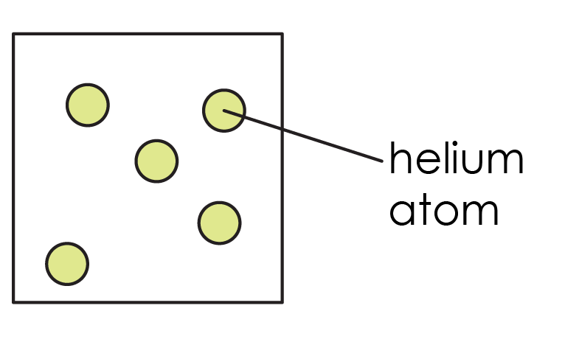


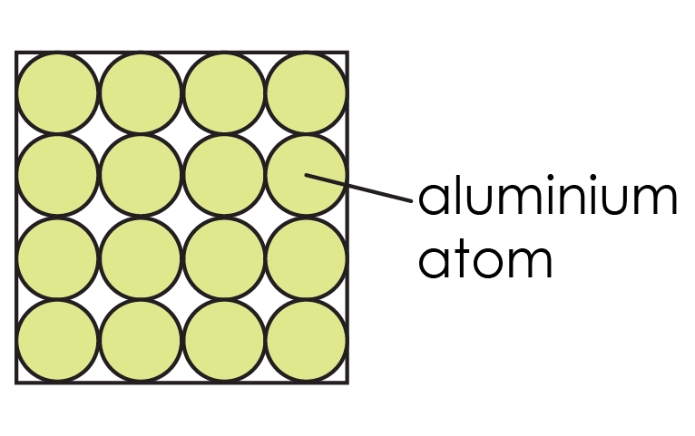
Atom
the smallest possible particle of an element
Sign it
Watch a video:
bit.ly/3G7XpSi
Example
Helium is an element; it is made up of helium atoms
Don’t confuse with …
particle, compound or molecule
Say it
At-am

Slide 5
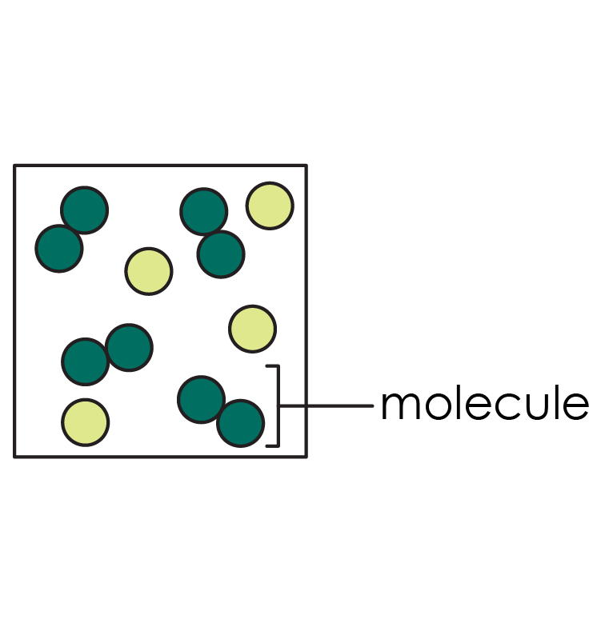
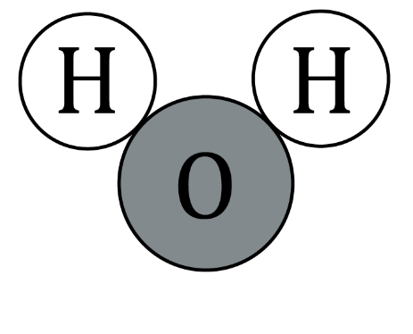
Molecule
two or more atoms connected by chemical bonds
In other words …
two or more atoms joined together
Example
Water is a molecule made from two hydrogen atoms and one oxygen atom. Hydrogen is an element which forms a molecule of two hydrogen atoms
Sign it
Watch a video:
bit.ly/4lBjGbG
Don’t confuse with …
a molecule can be an element or a compound, but a compound does not have to be made up of separate small molecules
Say it
Mol-ic-yue-l
water molecule

Slide 6
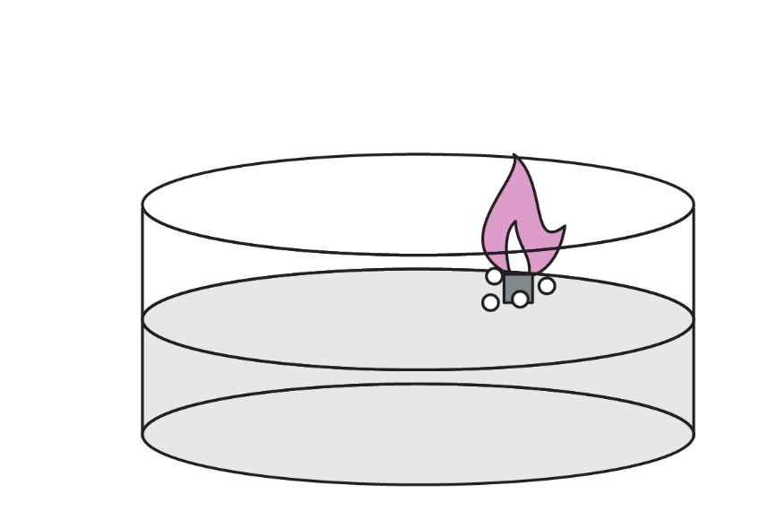
Chemical property
describes something about how a substance reacts, such as its reactivity with water
In other words …
a characteristic that describes how a substance reacts with other substances
Example
Some chemical properties of iron are:
it reacts with oxygen and water to form rust
it reacts with acids
Say it
Cem-i-cel pro-pa-ty
potassium reacts vigorously with water, fizzing and producing a lilac flame
Break it down
Chem (related to chemicals),
ical (related to),
property (feature)
Similar words
Reactivity (if talking about how easily something reacts)

Slide 7


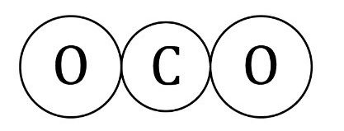
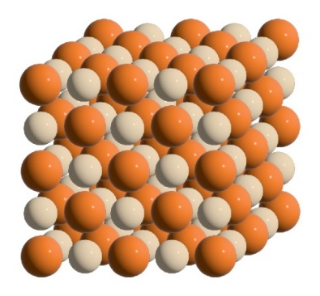
Compound
a pure substance made of the atoms of two or more different elements joined by chemical bonds; the atoms are in a fixed ratio
In other words …
two or more different elements chemically bonded
Example
Carbon dioxide is a compound made up of two oxygen atoms and a carbon atom
Sign it
Watch a video:
bit.ly/4jDLKJD
Don’t confuse with …
mixture. In a compound, the atoms are chemically bonded together, but in a mixture the atoms can be physically separated
carbon dioxide
Say it
Comp-ou-nd
sodium chloride
Other meanings
A compound can mean a fenced–off area e.g. a military compound
Break it down
Com (together), pound(put/place) – substances put together
Similar words
Molecule – but not all molecules are compounds

Slide 8
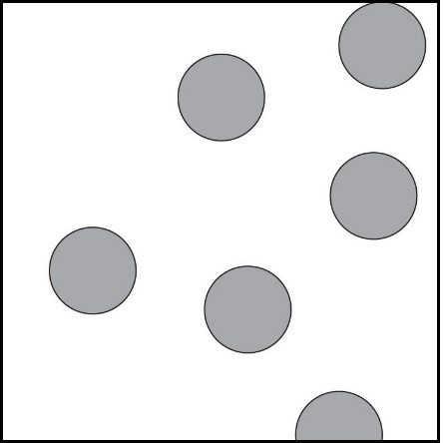
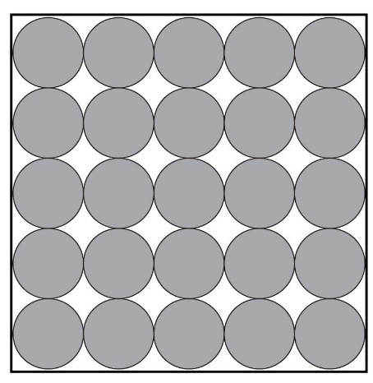
Element
a pure substance made of only one type of atom
In other words …
a substance that is only made of the same type of atoms, with no other atoms types present
Example
Nitrogen and oxygen are pure substances made of only one type of atom, so they are found on the periodic table
Sign it
Watch a video:
bit.ly/4jAYL6M
Don’t confuse with …
an atom. An element and an atom are not the same thing – an element is made up of atoms of the same type
Say it
El-i-mant

Slide 9
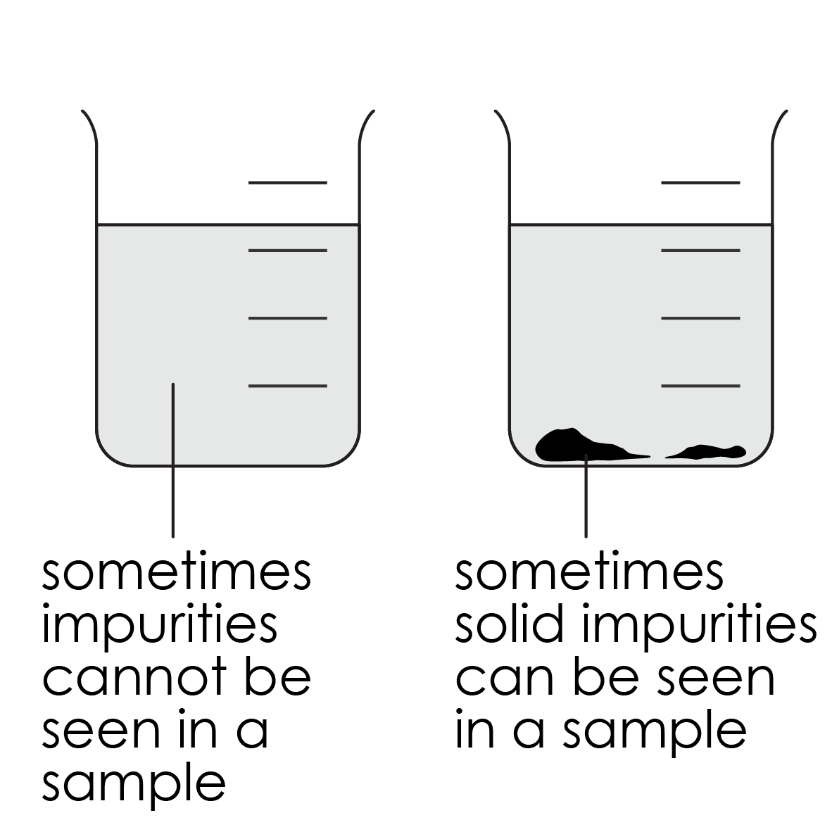
Impurity
a substance that is not wanted, which is mixed in with another substance
In other words …
something that is not supposed to be in the substance, it is not a pure substance
Example
If tap water had dirt in it, the dirt would be an impurity
Say it
Imp-j-ure-aty
Don’t confuse with …
mixture. Impurities mean that we have a mixture – but not all mixtures contain unwanted impurities. Tea is a mixture, but the ‘impurities’ are not unwanted!
Break it down
Im (not),
pure (clean, single)
Similar words
Contaminant

Slide 10
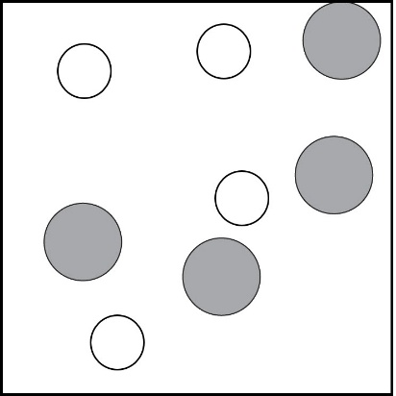
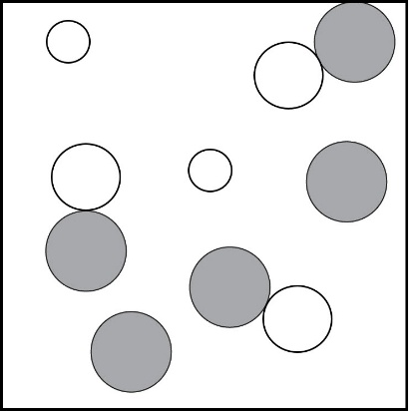
Mixture
two or more substances added together in any proportion; they are not chemically bonded, so they keep their own properties
In other words …
a combination of two or more particles that haven't been chemically joined. The particles could be elements or compounds
Example
Sand and salt together make a mixture. They can be separated
Sign it
Watch a video:
bit.ly/42JLq6p
Don’t confuse with …
compounds. Compounds are chemically joined, mixtures are not.
Say it
Mics-cha
Similar words
Blended
Other meanings
Mixture in everyday life means a combination, like 'a mixture of emotions'
Break it down
Mix (combine),
ture (result of)
Notes:
The inclusion of alloys on this slide’s image may be confusing for some learners. However, we have included it because we are aware that some schemes of work include discussion of alloys as mixtures. Feel free to edit as best suits your learners.

Slide 11

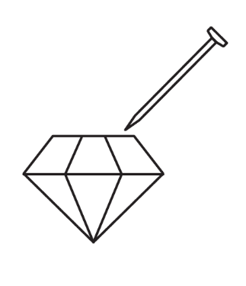
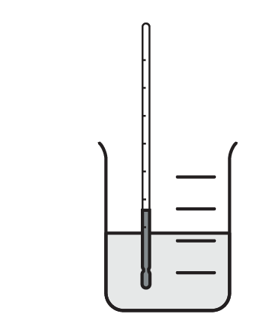
Physical property
describes something about the behaviour of a substance that does not involve a chemical reaction, such as its malleability
In other words …
a characteristic of a material which can be observed without changing the substance and what it is made from
Example
Some physical properties of gold are: it is a yellow, shiny metal, it has a high melting point and it is malleable
Say it
Fiz-i-cel pro-pa-ty
Don’t confuse with …
chemical properties – where the substance itself has changed and the particles are no longer the same as what we started with
malleability
scratch resistance
Similar words
Appearance and behaviour
Other meanings
Physical often relates to the body, like 'physical exercise'
melting point

Slide 12
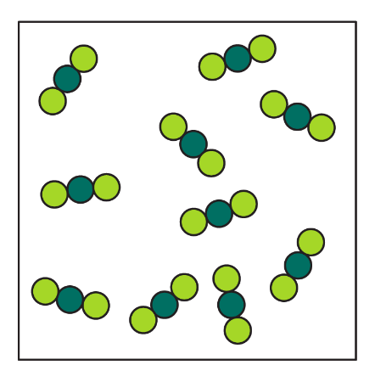
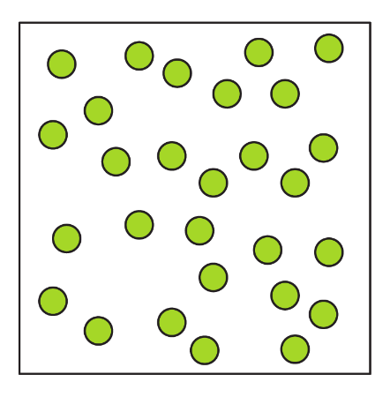
Pure substance
a substance that is just one compound or element with nothing else mixed in
In other words …
a substance containing just one type of particle, with nothing else added. The particle could be an element or a compound, as long as it is the same
Example
Distilled water is a pure substance because it contains only water molecules
Say it
P-j-ure sub-st-en-s
Don’t confuse with …
clean or safe. Pure is about which particles are present
Break it down
Pure (clean, only one thing),
substance (material, matter)
Other meanings
Pure can mean something completely genuine, like 'pure joy'

Slide 13
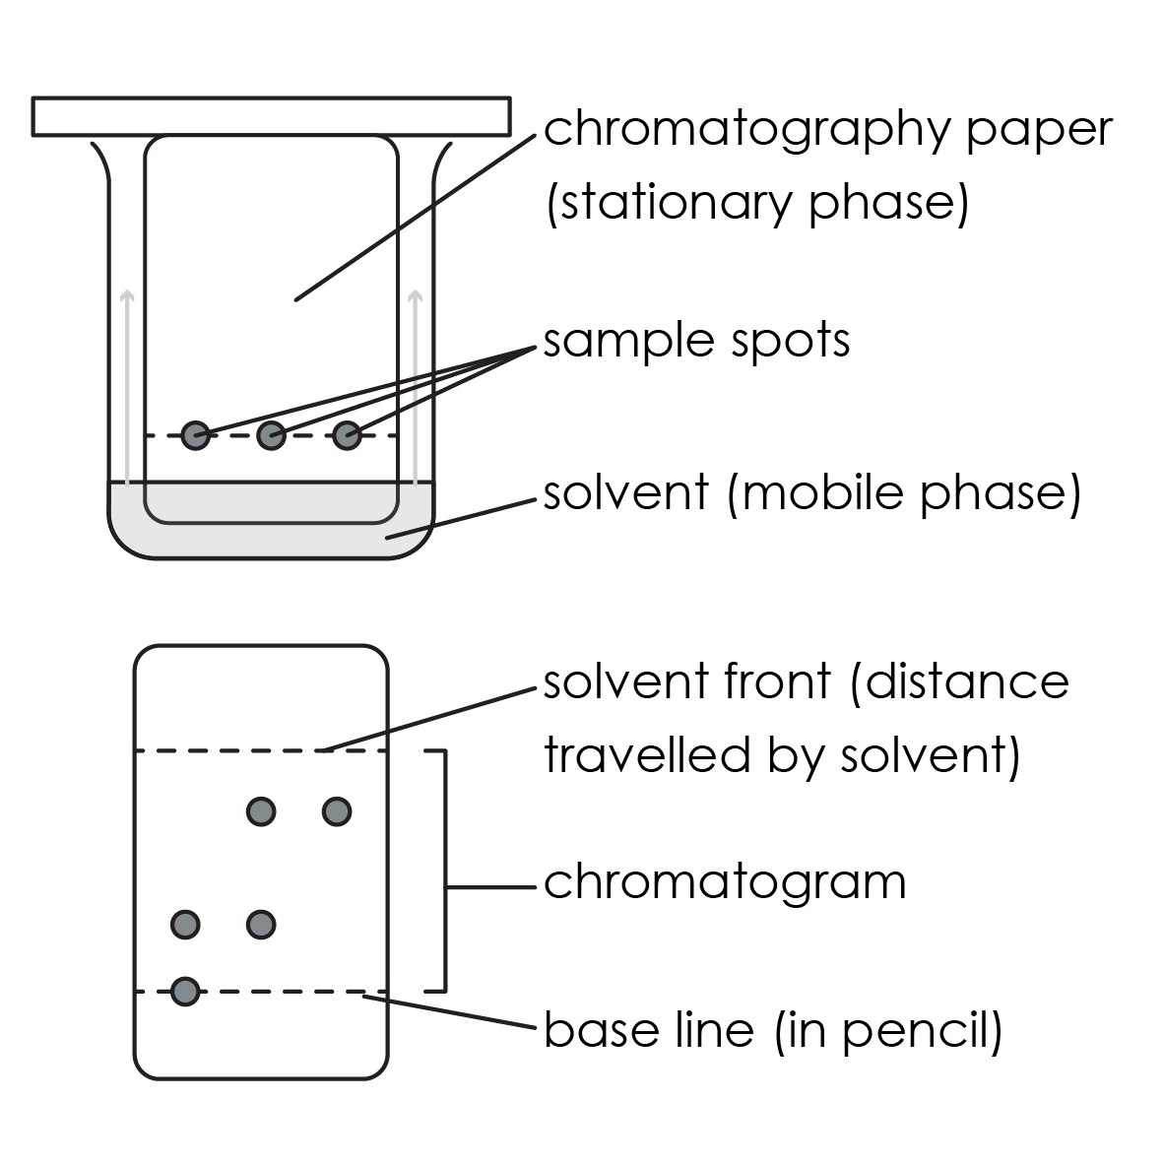
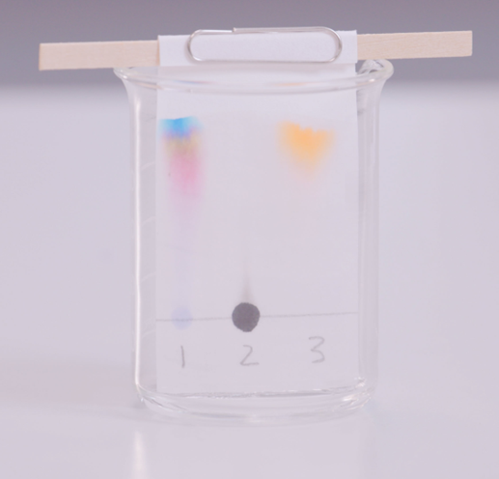
Chromatography
a method of separation based on how easily each substance is carried by a liquid that is moving through a porous solid, like paper
In other words …
a way to separate different substances in a mixture by letting them move through a material at different speeds
Break it down
Chrom (colours)
Example
We use chromatography to separate colours contained in inks
Say it
Cro-ma-tog-ra-fy

Slide 14
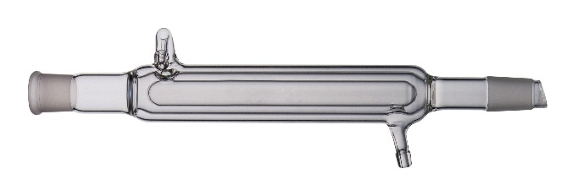
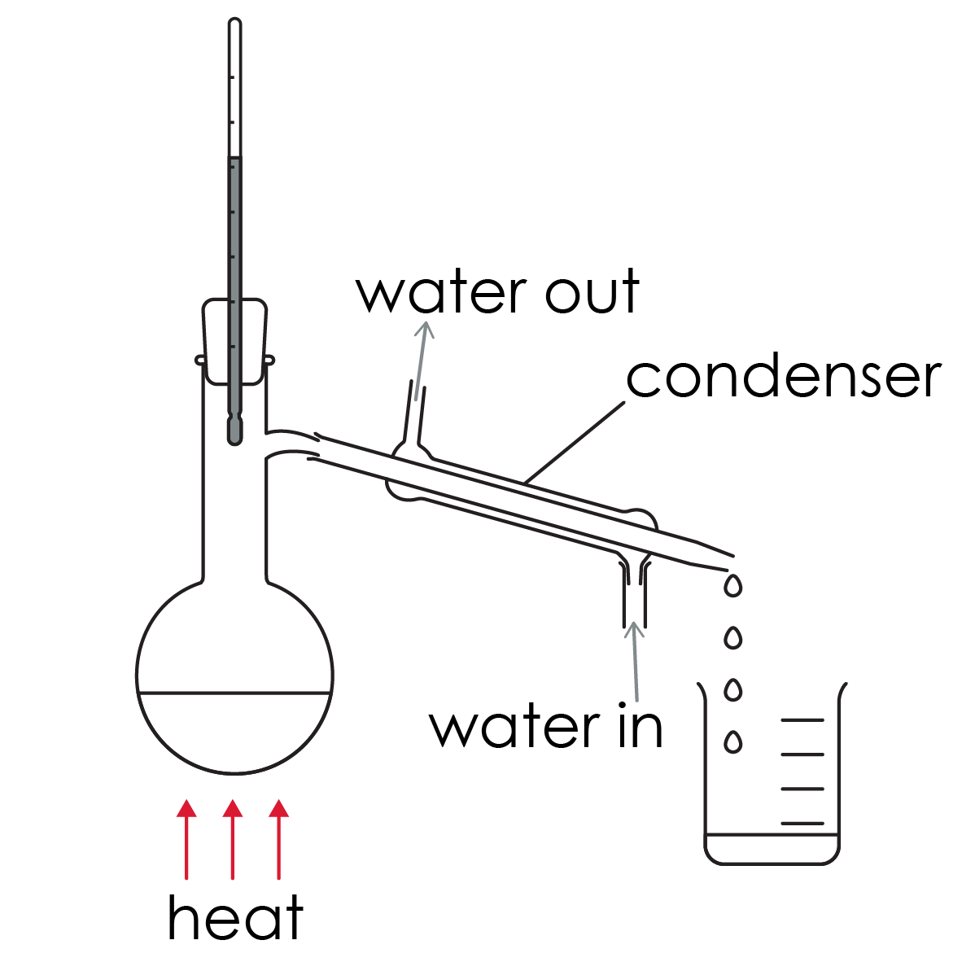
Condenser
a glass tube used in distillation to condense a gas into liquid, by surrounding the tube with a continuous flow of cold water
In other words …
a tube that cools hot gases into liquid in distillation
Example
When seawater is distilled, the steam passes through the condenser and cools into liquid water
Say it
Can-den-sa
Break it down
From the process of 'condensation', where a gas cools and changes state to form a liquid
Similar words
Cooling tube

Slide 15
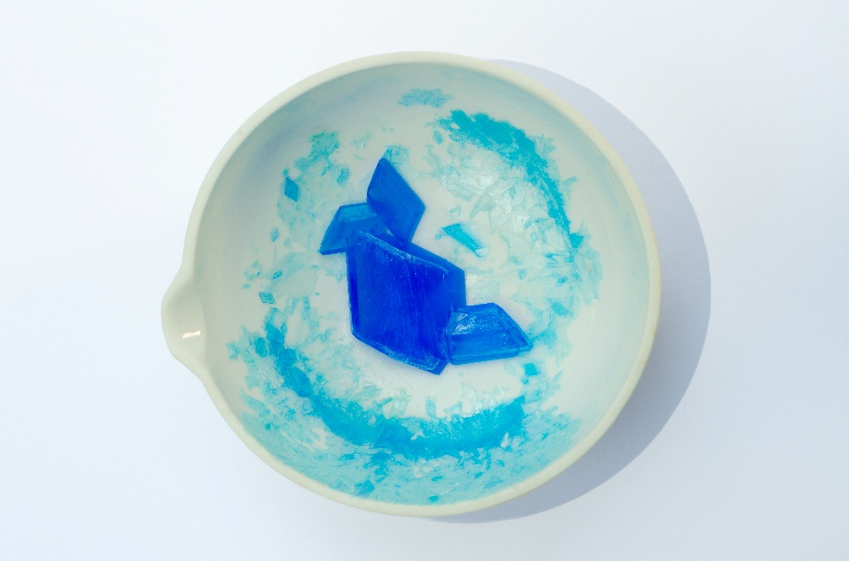
Crystal
a piece of a solid that has formed in a regular shape
In other words …
a solid with a patterned shape
Example
When water evaporates from a salt solution, salt crystals are formed
Sign it
Watch a video:
bit.ly/4k6aQ43
Don’t confuse with …
gemstones. Not all crystals are expensive gemstones like sapphires, rubies or quartz!
Say it
Cris-tel
Break it down
From the Greek meaning 'frozen', observing patterned ice crystals
Other meanings
Crystal glass is used in decorations or expensive glassware
Similar words
Gemstones are examples of crystals, but salts form crystals, too

Slide 16
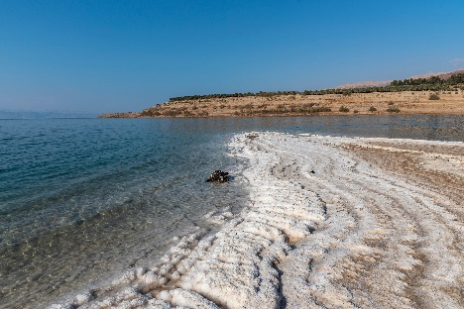
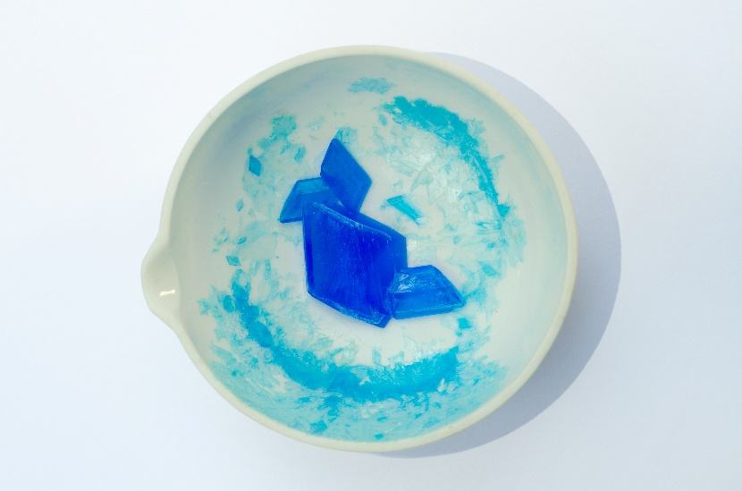
Crystallisation
a method of separation used to get crystals of a solid by very slowly evaporating the solvent from a solution
In other words …
when a dissolved solid forms crystals as the liquid part of the solution slowly evaporates
Example
Rock salts form by crystallisation from seawater
Say it
Cris-tel-eye-zay-shen
Don’t confuse with …
freezing
Break it down
Crystal (solid with a repeating pattern), isation (process of making something)
Similar words
Solidification (but this can also relate to liquids freezing to form solids)

Slide 17
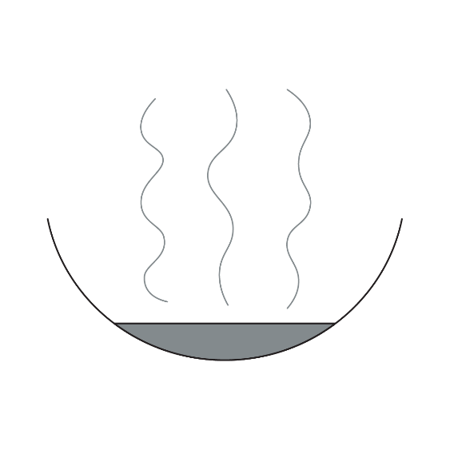
Evaporation
a method of separation used to form solids by heating to remove the solvent from a solution
In other words …
a slow process where a liquid from a solution changes state into a gas, leaving any solids behind
Example
Water is separated from salt water by evaporation, leaving behind the solid salt
Don’t confuse with …
boiling. Evaporation and boiling are different processes. Evaporation can happen at any temperature and is a slower process
Sign it
Watch a video:
bit.ly/4k0GLU1
Say it
Eye-vap-a-ray-shen
Other meanings
Wet clothes dry on the washing line by evaporation
Break it down
Evap (from Latin meaning 'turns to a vapour’),
ation (the process)
Similar words
Vaporisation (relates only to the gas)

Slide 18
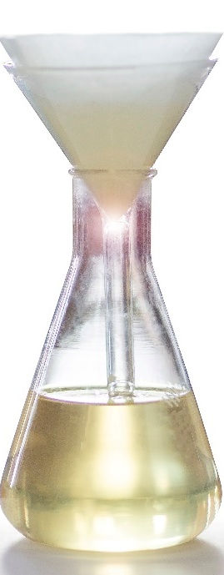
Filter paper
a porous type of paper that is used in filtration to prevent insoluble solids from passing through
In other words …
filter paper is a special type of paper with tiny holes. These holes allow the particles of liquids to pass through, but tiny pieces of solid are too large to pass through and are trapped
Example
We use filter paper in science experiments to separate sand from water
filter paper
Don’t confuse with …
a sponge. Filter paper doesn’t absorb liquids. It allows them to pass through the tiny holes in the paper. The tiny pieces of solid particles are too large and get trapped
Other meanings
Coffee filters remove solid coffee granules from our hot drinks
Say it
Filt-a pay-pa
Similar words
Strainer (used in cooking, with much larger holes!)

Slide 19
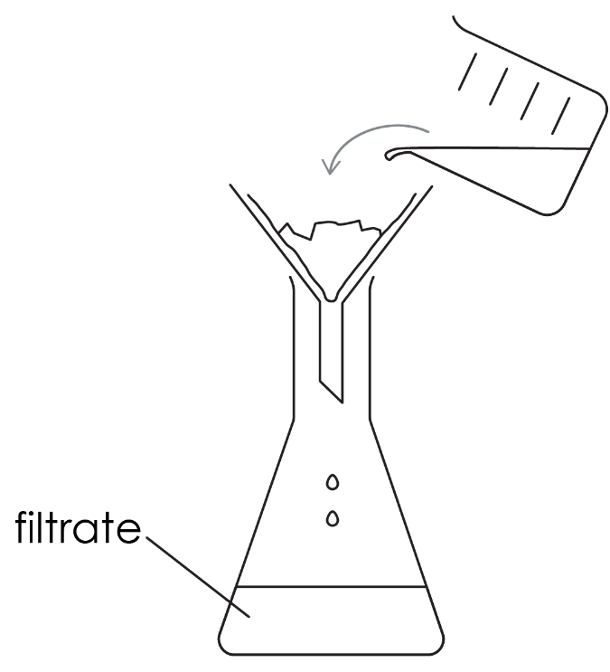
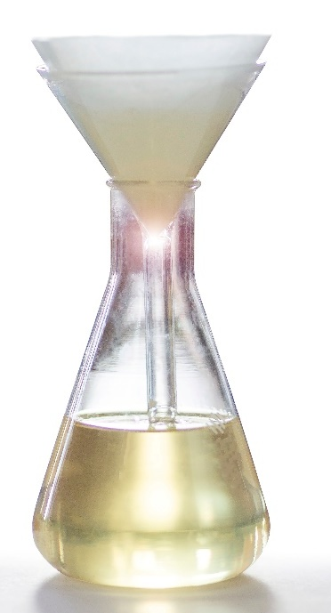
Filtrate
in filtration, this is the liquid that passes through the filter paper
In other words …
filtrate is the liquid that passes through the filter paper when filtering a mixture
Example
When filtering sandy water, the water is the filtrate, as it passes through the filter
Don’t confuse with …
pure. Filtrates are not always pure. For example, salt water would be a filtrate, as the whole solution passes through filter paper
Say it
Filt-ray-t
Break it down
Filtr (to strain), ate (the result of)
Other meanings
Coffee or tea after brewing would be examples of filtrate
Similar words
Filtered
filtrate

Slide 20
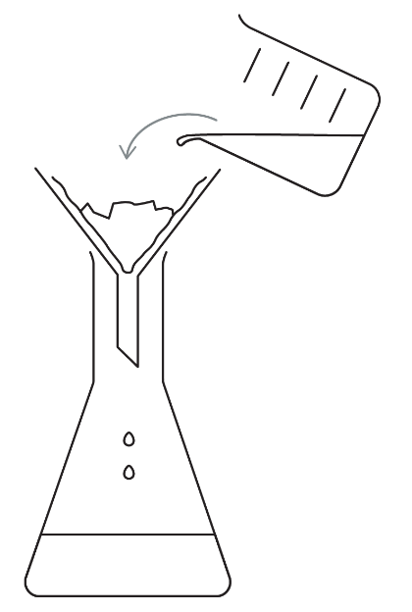
Filtration
a method of separation used to remove an insoluble solid from a liquid
In other words …
a method of separating a solid which is not dissolved from a liquid. The mixture is passed through special porous paper called filter paper
Example
Sand is not soluble in water, so filtration can be used to remove it. The sand remains in the filter, and the water passes through
Sign it
Watch a video:
bit.ly/433R4z8
Don’t confuse with …
evaporation. Filtration cannot separate dissolved substances, like salt from water. Only insoluble solids can be removed from solutions in this way
Say it
Filt-ray-shen

Slide 21

Porous
describes a substance that allows liquid or gas to pass through
In other words …
a porous material has tiny holes that allow liquids or gases to pass through
Example
A colander is a porous piece of cooking equipment. It allows us to strain food, for example pasta from hot water
Say it
Por-ras
Don’t confuse with …
absorption. Porous materials do not 'absorb' water, they allow the water to pass through them
Sign it
Watch a video:
bit.ly/4d0OIWm
Break it down
Por (from the latin 'pore’),
ous (suffix meaning 'full of')
Other meanings
Porous bricks are used in building materials to allow air to flow through the walls
Similar words
Pores

Slide 22
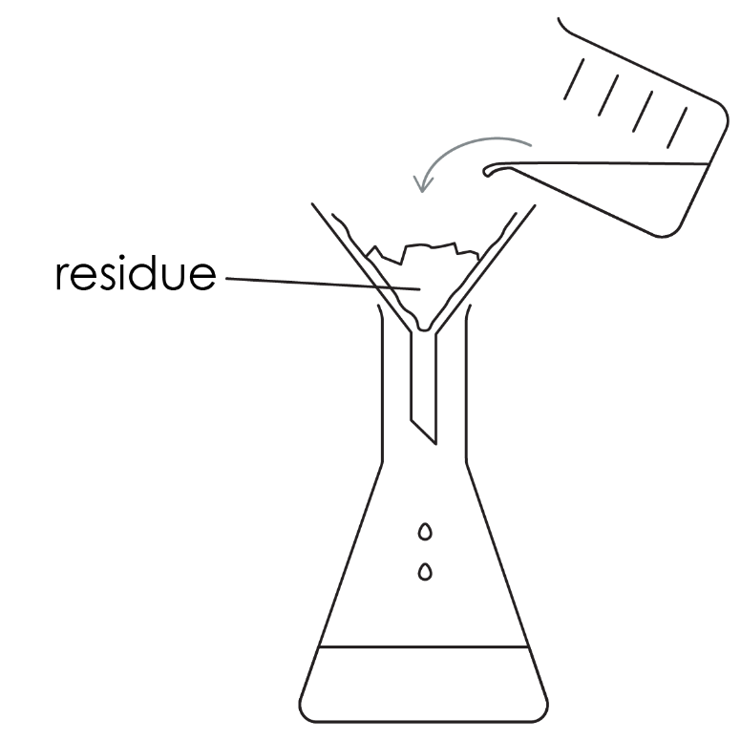
Residue
in filtration, this is the solid that does not pass through the filter paper
In other words …
the solid left behind on the filter paper
Example
When filtering sandy water, the sand is the residue, as it is left behind on the filter paper
Say it
Rez-i-j-ue
Don’t confuse with …
waste material. Often, we need to keep the residue and discard the filtrate!
Break it down
Res (from Latin residuum, meaning 'left behind),
due (remains of something)
Other meanings
The sticky marks left behind when peeling a sticker is often called 'residue'
Similar words
Leftover solid

Slide 23
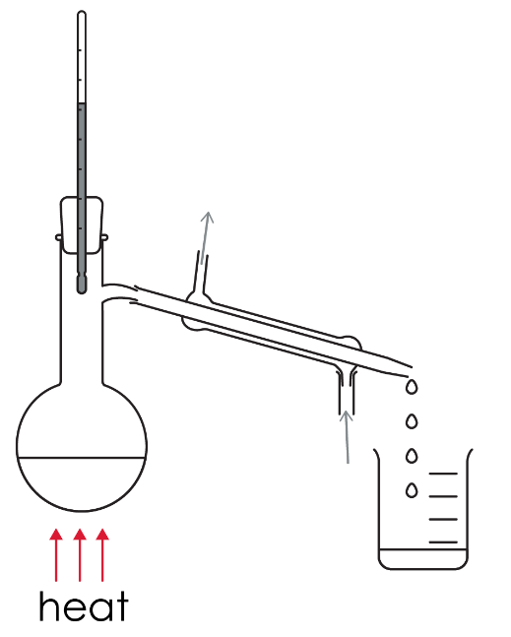
Simple distillation
a method of separation involving evaporation and condensation used to separate the solvent from a solute that does not evaporate
In other words …
a way to separate a liquid from as solution by heating it until it changes into the gas state, then cooling it back into the liquid state
Example
Pure water can be made from the distillation of seawater.
Don’t confuse with …
just evaporation. This process collects the liquid. Evaporation and condensation take place in distillation
Sign it
Watch a video:
bit.ly/4jJMAoA
Say it
Sim-pel dis-til-ay-shen
Break it down
From the Latin distil, meaning to drip down
Similar words
Distil

Slide 24

Dissolve
when a solute is added to a solvent and the solute breaks down into particles that are too small to see that then spread out
In other words …
when a solid mixes with a liquid and spreads out until it looks like it has disappeared
Example
A spoonful of sugar dissolves easily in a cup of tea
Sign it
Watch a video:
bit.ly/3G7Xdm2
Don’t confuse with …
melt; this is a change of state where a solid becomes a liquid
Say it
Di-zol-v

Slide 25
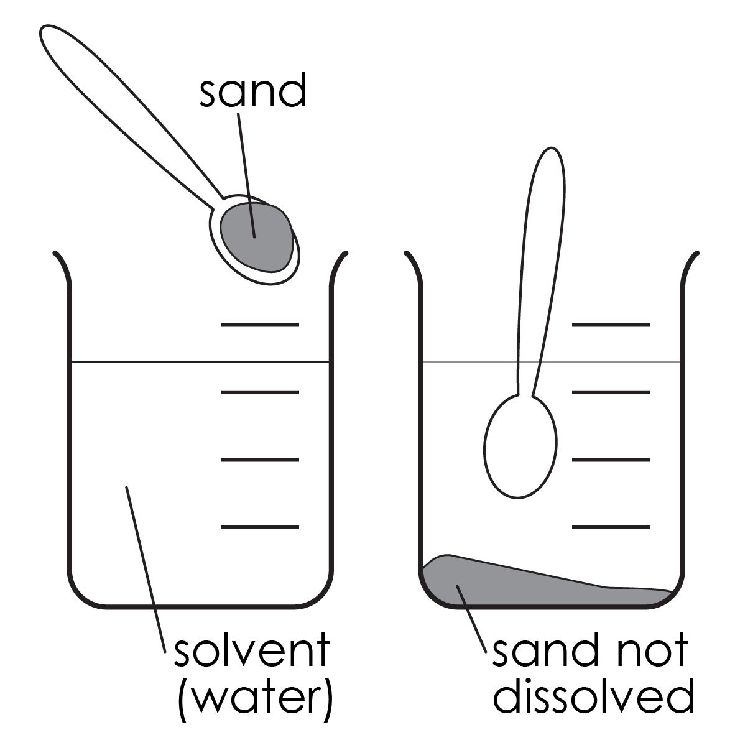
Insoluble
describes a substance which does not dissolve in a particular solvent
In other words …
a substance that does not dissolve and will either sink to the bottom or float on top of the liquid
Break it down
This word has the prefix ‘in’ which means not. Insoluble means not soluble
Sign it
Watch a video:
bit.ly/4lx9wIQ
Don’t confuse with …
soluble. Soluble and insoluble have opposite meanings
Say it
In-sol-ya-bel
Example
Sand is insoluble in water

Slide 26
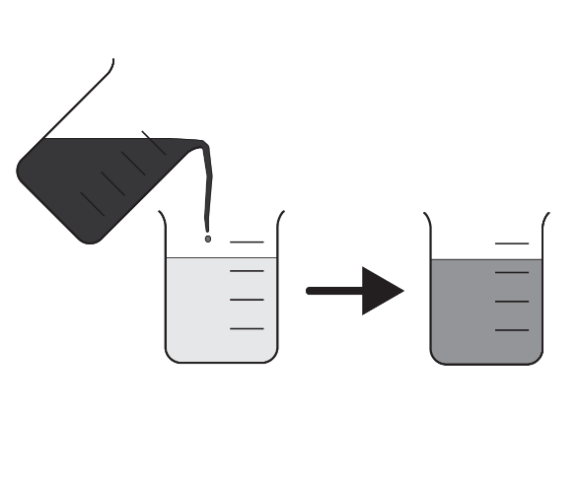
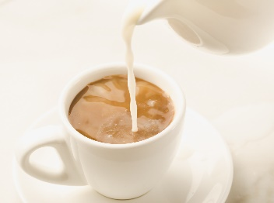
Miscible
when two liquids can mix and do not separate out into layers
In other words…
two or more liquids that can mix together
Example
Milk is added to tea because it is miscible in water, so the two liquids are easily mixed
Say it
Mis-a-bel
Don’t confuse with…
immiscible – two liquids that cannot mix together like oil and water
Similar words
Mixable also means that two or more things can be mixed together

Slide 27

Soluble
describes a substance which dissolves in a particular solvent
In other words …
this is a substance that will dissolve
Example
Salt is soluble in water
Sign it
Watch a video:
bit.ly/3YdfXH3
Don’t confuse with …
disappeared. Just because a soluble substance cannot be seen it doesn’t mean that it has disappeared, it is just really spread out
Say it
Sol-ya-bel

Slide 28
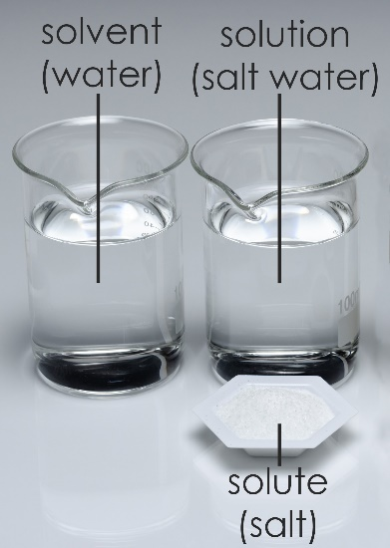
Solute
a substance that dissolves in a solvent to make a solution
In other words …
the solute is the substance that is dissolved in a liquid
Example
When salt is dissolved in water the salt is the solute
Sign it
Watch a video:
bit.ly/3S6Ttnv
Don’t confuse with …
solvent; this is the liquid the solute is dissolved in
Say it
Sol-y-eut

Slide 29
Solution
the mixture produced when a solute dissolves in a solvent
In other words …
a mixture where one substance dissolves completely in another, such as salt in water
Example
In a solution of salt water, the solute is salt and the solvent is water
Sign it
Watch a video:
bit.ly/44uofhF
Don’t confuse with …
answer. Solution can also mean the answer to a problem. In maths and physics, you may be asked to work out the solution to a question
Say it
Sal-ue-shen
Break it down
Sol (dissolve), ution (process)

Slide 30
Solvent
a substance that dissolves the solute to make a solution
In other words…
the solvent is normally a liquid that other substances can dissolve into
Example
When salt is dissolved in water the water is the solvent
Sign it
Watch a video:
bit.ly/4czJbWG
Don’t confuse with…
solute; this is the substance dissolved in the solvent
Say it
Sol-v-ant

Slide 31
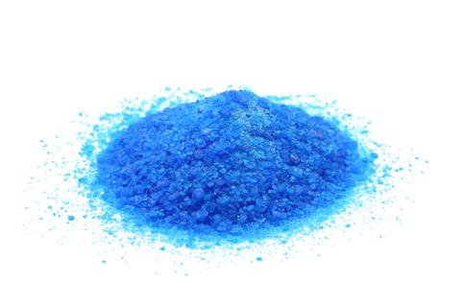
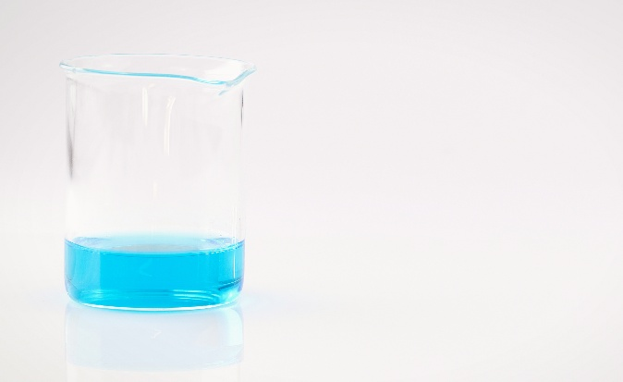
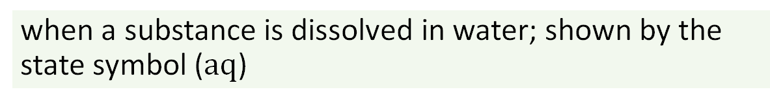
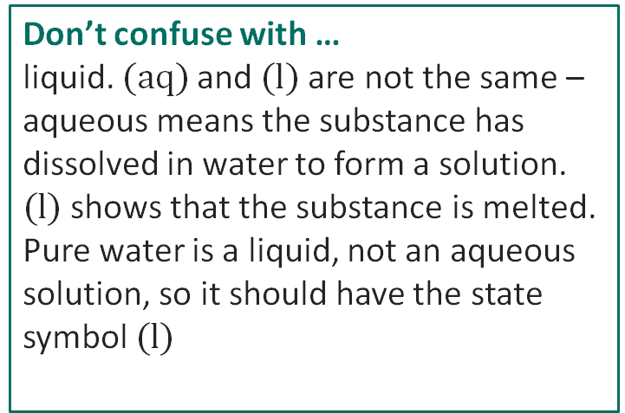
Aqueous
when a substance is dissolved in water; shown by the state symbol ($aq$)
Example
Salt water is an aqueous solution of salt dissolved in water
In other words …
aqueous means that something has been dissolved in water to form a solution
copper sulfate powder CuSO₄(s)
Don’t confuse with …
liquid. $(aq)$and $(l)$are not the same – aqueous means the substance has dissolved in water to form a solution. $(l)$shows that the substance is melted.
Pure water is a liquid, not an aqueous solution, so it should have the state symbol $(l)$
Say it
Ay-cw-ya-s
aqueous solution copper sulfate CuSO₄(aq)
Break it down
Aqua (from the Latin meaning 'water’),
ous (suffix meaning 'full of')
Other meanings
Aqua is often used for things related to water – aquariums and aquatic sports, for example
Similar words
Solution (a liquid mixture, often made with water)

Slide 32
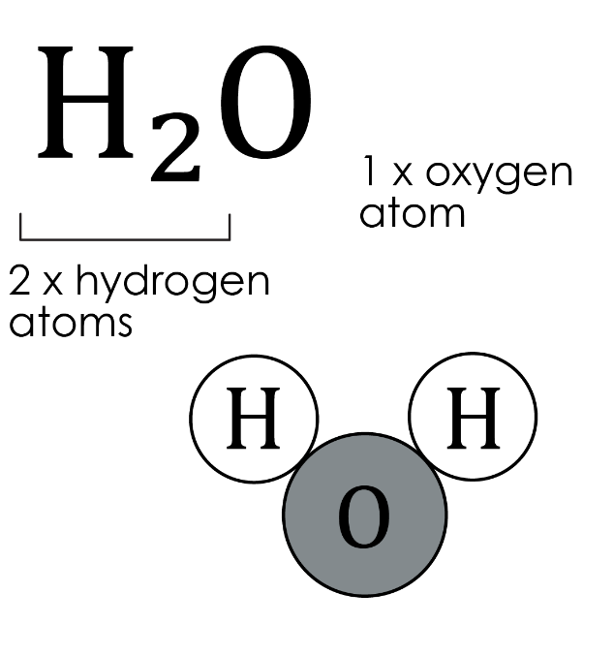
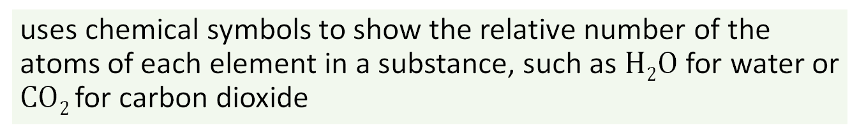
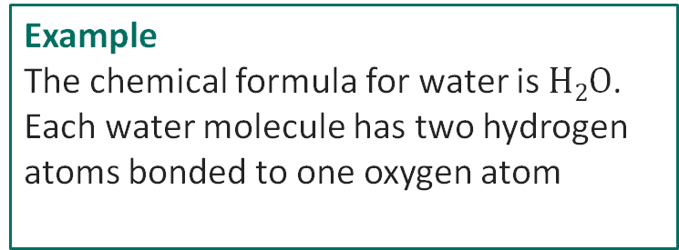
Chemical formula
uses chemical symbols to show the relative number of the atoms of each element in a substance, such as $H2O$ for water or $CO2$for carbon dioxide
In other words …
this type of formula gives the chemical symbols of the elements whose atoms make up the substance. The formula also shows the relative numbers of these atoms
Example
The chemical formula for water is $H2O$. Each water molecule has two hydrogen atoms bonded to one oxygen atom
Don’t confuse with …
the balancing numbers in a chemical equation. Small, subscript numbers tell us how many atoms there are of the element whose symbol they follow
Say it
Cem-i-cel form-ya-la
Other meanings
A formula can also mean a set of instructions, like a maths formula, or a recipe
Break it down
Chemical (relating to substances), formula (a set way of writing things)

Slide 33
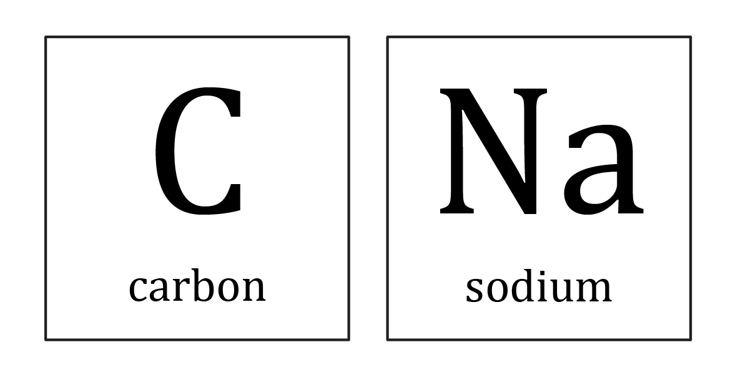
Chemical symbol
a single letter or two letters that is used to represent an element, such as C for carbon, Na for sodium
In other words …
a chemical symbol is a short way of writing the name of an element using one or two letters
Example
The chemical symbol for carbon is C
Sign it
Watch a video:
bit.ly/3Z25eQ6
Don’t confuse with …
initials. Some elements have chemical symbols which match their name in English, e.g. O is for oxygen. Other elements, such as gold, Au, have unexpected chemical symbols, as their names come from other languages
Say it
Cem-i-cel sim-bel
Break it down
Chemical (relating to substances), symbol (a sign or a letter to represent something)
Similar words
Element symbol

Slide 34
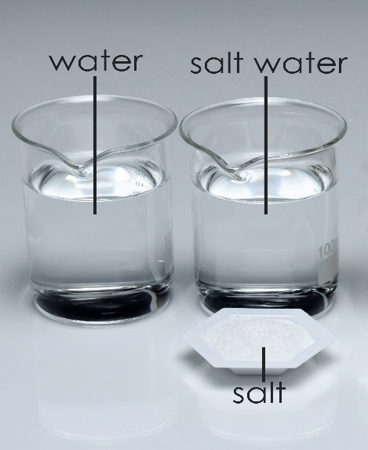
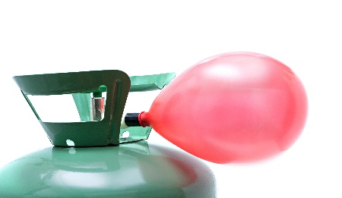
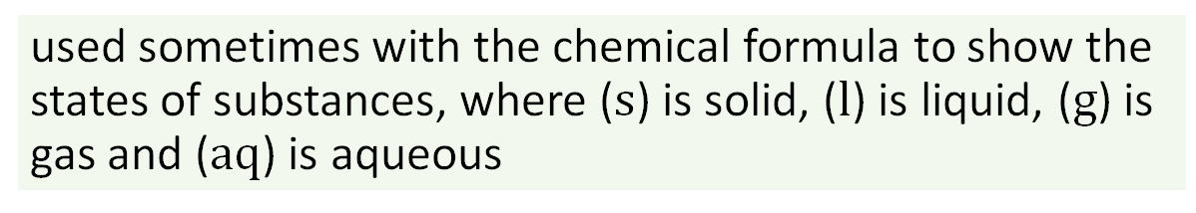
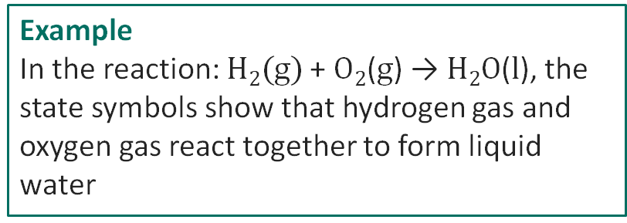
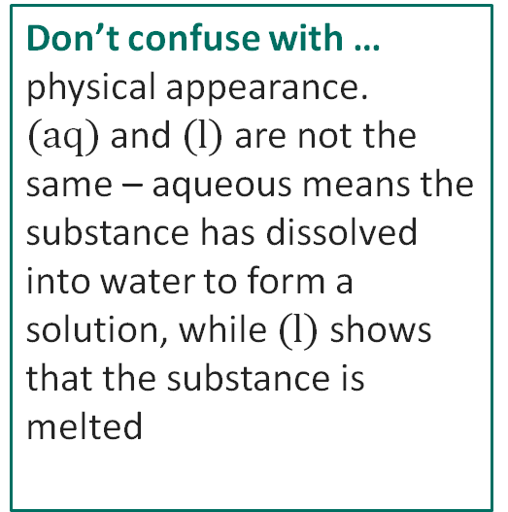
State symbol
used sometimes with the chemical formula to show the states of substances, where ($s$) is solid, ($l$) is liquid, ($g$) is gas and ($aq$) is aqueous
In other words …
a state symbol is a small letter in brackets that tells us whether a substance is in the solid, liquid or gas state or dissolved in water (aqueous)
Example
In the reaction: $H2(g)$+ $O2$($g$) → $H2O$($l$), the state symbols show that hydrogen gas and oxygen gas react together to form liquid water
Sign it
Watch a video:
bit.ly/4iMfO4Q
(l)
(aq)
Don’t confuse with …
physical appearance. $(aq)$and $(l)$are not the same – aqueous means the substance has dissolved into water to form a solution, while $(l)$shows that the substance is melted
Say it
St-ay-t sim-bel
Break it down
State (the form something is in), symbol (a sign or letter to represent something)
(s)
helium (g)

Slide 35
Acknowledgements
Images on slides 28, 29, 30, 34 © Turtle Rock Scientific/Science Photo Library
Images on slide 12, 14, 15, 16, 17, 18, 19, 21, 26, 31 © Shutterstock
Image of copper sulfate powder on slide 31 © Fablok/Shutterstock
Image of helium on slide 34 © Getty Images
All other images © Royal Society of Chemistry
SSC BSL Glossaries of Curriculum Terms (https://www.ssc.education.ed.ac.uk/BSL/)

