Slide 1
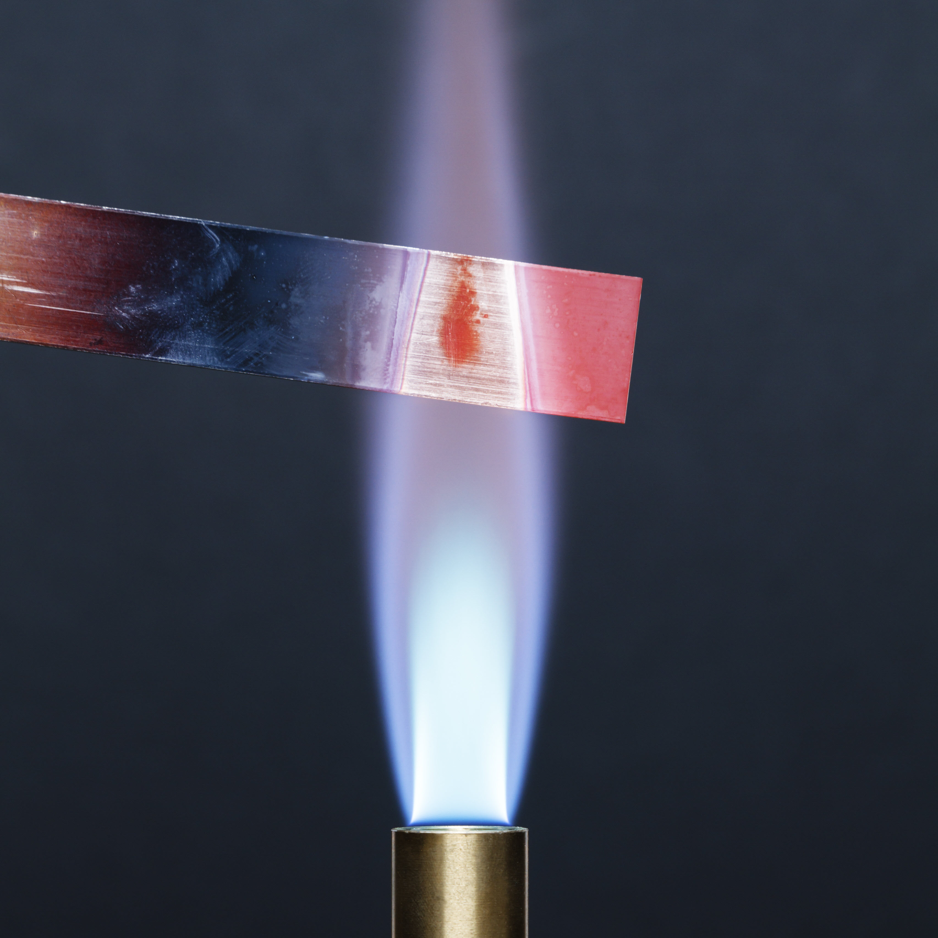
11–14 years
Heating copper in air
Downloaded from: rsc.li/3Yro7eN
Notes:
Photo © Science photo library

Slide 2
Learning objectives
Safely heat copper using a Bunsen burner and record your observations.
Describe and explain observations from a chemical reaction.
Write word and symbol equations to represent a chemical reaction.
Use simple calculations to link mass to reactivity and the availability of oxygen.
Learning objectives

Slide 3
Key terms
Key term | Definition
Chemical reaction/change | when one or more new substances are made from other substances
Conservation of mass | no atoms are lost or made during a chemical reaction, so the total mass of products equals the total mass of reactants
Product | a new substance that is made in a chemical reaction
Reactant | a substance that you start with in a chemical reaction
Balanced symbol equation | for a chemical reaction, this shows the chemical formulas of the reactants and products separated by an arrow; big numbers are written before the formulas if needed to make sure the equation is balanced
Chemical formula | uses chemical symbols to show the relative number of the atoms of each element in a substance
Word equation | for a chemical reaction, this shows the names of the reactants and products separated by an arrow
Key terms

Slide 4
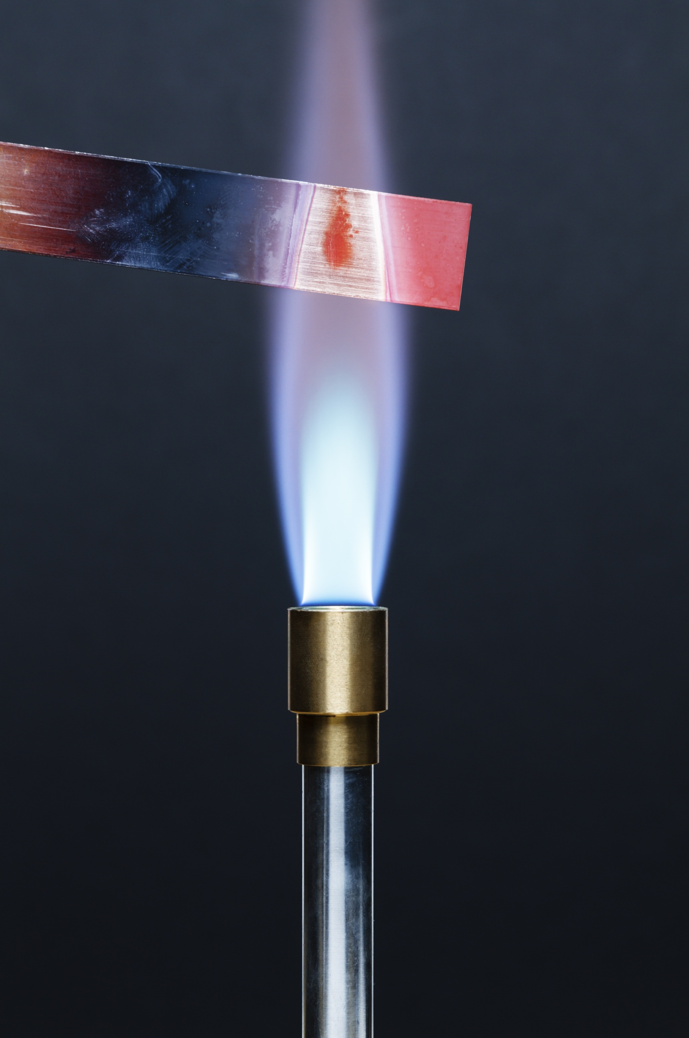
Introduction
Introduction
Many metals can react in the presence of air. This is an example of an oxidation reaction, where the metal reacts with the molecules of oxygen in the air.
Different metals have different reactivities which affects their rate of reaction with oxygen.
Alkali metals, such as sodium and potassium will react almost instantly, but other metals must be heated to increase the rate of reaction.
Copper, like many transition metals, only reacts slowly with oxygen in the air. When heated it forms a layer of black copper oxide on its surface.
Notes:
Photo © Science photo library

Slide 5
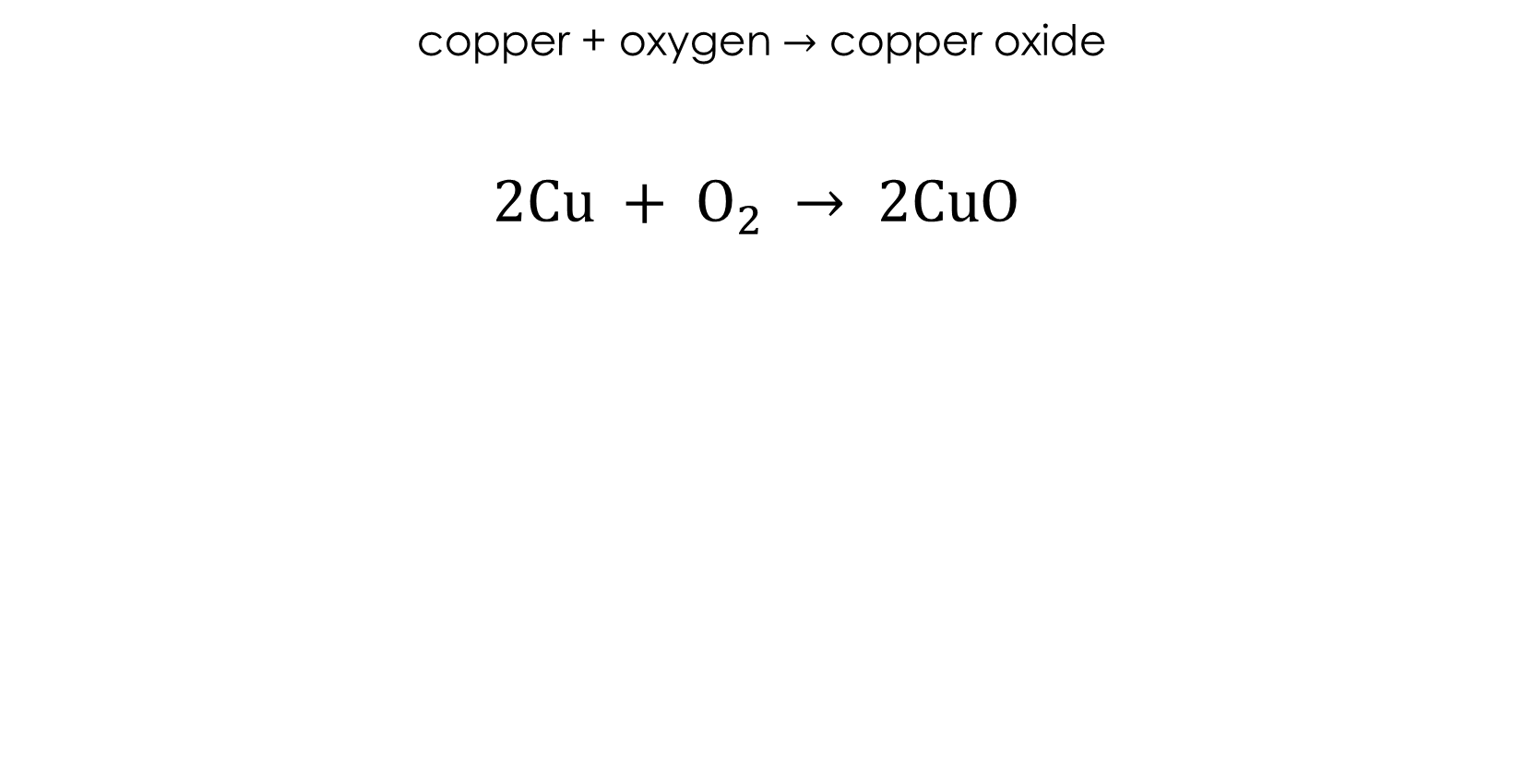
Introduction
copper + oxygen $→$ copper oxide
$$2Cu + O_{2} → 2CuO$$
Introduction
Cu
Cu
O
O
O
Cu
Cu
O

Slide 6
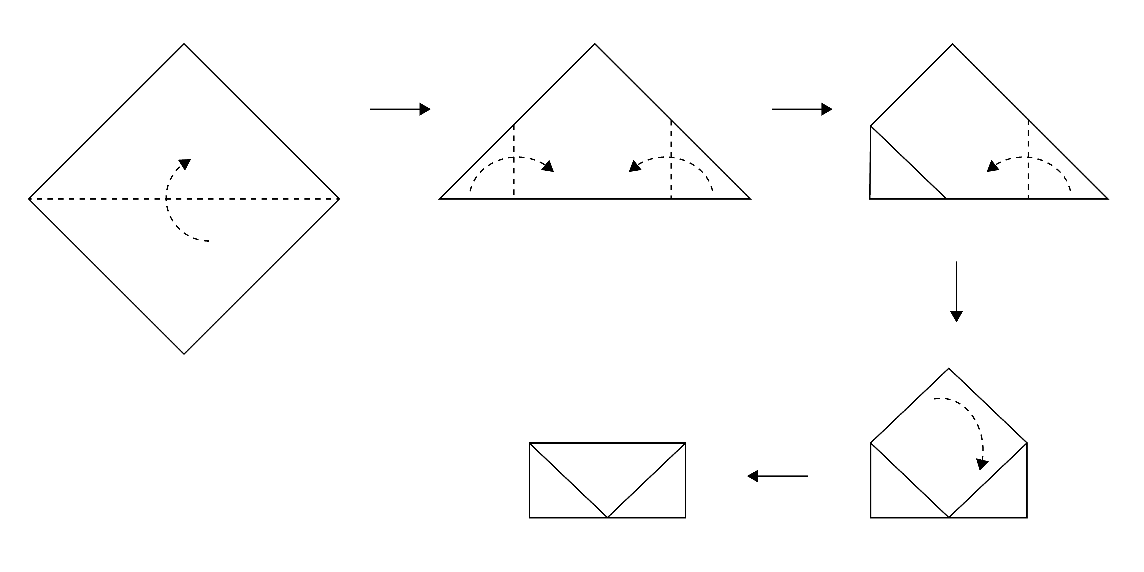
Method
Fold the copper foil into an
envelope as shown in the
diagram:
Wear eye protection and
light the Bunsen burner.
Hold the envelope in the
tongs and heat strongly in
the Bunsen flame for five minutes. You will need to have the air hole fully open.
Place the envelope on the heat resistant mat and allow to cool. This will take a few minutes.
Open the envelope and compare the inside to the outside surface.
Method

Slide 7
Observations
Stage of practical | Part of copper envelope | Observation
Before heating | Inside
 | Outside
After heating | Inside
 | Outside
Observations

Slide 8
Observations
Stage of practical | Part of copper envelope | Observation
Before heating | Inside | Shiny, orange/brown
 | Outside | Shiny, orange/brown
After heating | Inside | Shiny, orange/brown
 | Outside | Dull, black
Observations

Slide 9
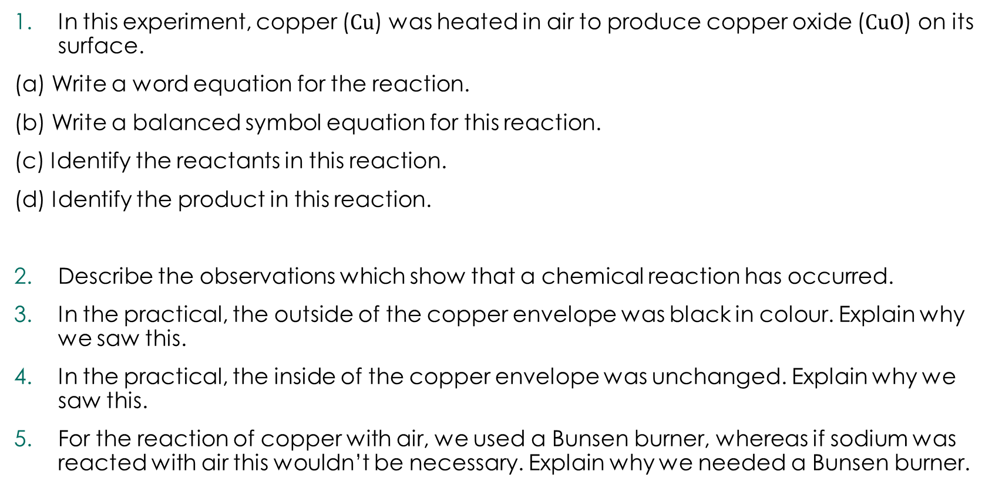
Follow-up questions
In this experiment, copper ($Cu$) was heated in air to produce copper oxide ($CuO$) on its surface.
(a) Write a word equation for the reaction.
(b) Write a balanced symbol equation for this reaction.
(c) Identify the reactants in this reaction.
(d) Identify the product in this reaction.
Describe the observations which show that a chemical reaction has occurred.
In the practical, the outside of the copper envelope was black in colour. Explain why we saw this.
In the practical, the inside of the copper envelope was unchanged. Explain why we saw this.
For the reaction of copper with air, we used a Bunsen burner, whereas if sodium was reacted with air this wouldn’t be necessary. Explain why we needed a Bunsen burner.
Follow-up questions

Slide 10
Follow-up questions
A student measured the mass of the piece of copper before it was heated. It had a mass of 2.5 g. After it was heated, they measured the mass again and it was 2.8 g.
  Name the piece of apparatus used to measure the mass.
  Calculate the change in mass.
  Describe what has happened to the mass.
  Explain these results using the principle of conservation of mass.
A student performed a calculation which said that if they heated 5 g of copper in air, they should produce 6.26 g of copper oxide. However, their final mass was only 5.5 g.
  Calculate the expected increase in mass.
  Calculate the actual increase in mass.
  Explain why the mass didn’t increase as much as expected.
Follow-up questions

