Slide 1

14–16 years
Crude oil:
Frayer models

Slide 2
Frayer models
Frayer models are a simple but effective way to develop learners’ understanding of a new piece of vocabulary. You will see what your learners already know and identify any misconceptions they have.
There are four stages learners can work through, but you can adapt this model to best suit your learners. You can guide learners through all quadrants, but particularly quadrant 2 works best as a teacher-led discussion. Quadrant 3 might also need/benefit from some discussion.
1. Explore Link to science capital and draw on learners’ experience. | 2. Break down Look at the composite parts of the word to help unpack its meaning.
4. Consolidate Learners apply their knowledge. | 3. Explain Introduce the definition.
Key term
Find more guidance, including tips, adaptations and further reading, in the teacher notes: rsc.li/3Ys0jYi

Slide 3

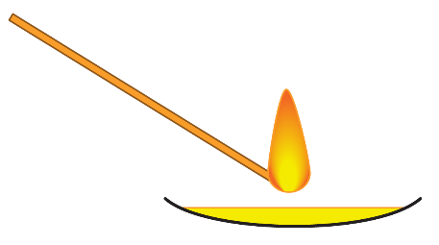
1. What does the word ‘flammability’ mean to you? Where have you come across this word (or parts of this word) before? This is the hazard symbol used for flammable substances. What does it mean? | 2. Break down the word ‘flammability’. flam- List as many words as you can that begin with flam- What do they all have in common? able Having the means, capacity or qualifications to do something. -ity The suffix -ity means ‘state of having (a particular quality)’ For example, oddity means something has the quality of being odd.
A teacher places a few drops of two fractions obtained from the fractional distillation of crude oil in different watch glasses and tries to make them catch fire by using a flame. Fraction A – catches fire easily Fraction B – does not catch fire Which fraction has the highest flammability? | 3. Write down what you think ‘flammability’ means. Put together your understanding of the parts flam-, able and -ity to form the definition. | Compare what you wrote with the definition (slide 7).
flammability
Notes:
Note: Inflammable might look like it means non-flammable. However, it is quite the opposite. Inflammable materials are materials that can catch on fire without the need for an external source of ignition.
Answer to quadrant 2: flam- = flame; able = ‘having the means, capacity or qualifications to do something’; -ity = ‘having’. Put them together and it means having the capacity to catch fire.
Did you know that when a candle burns, the fuel is the wax, but in vapour form? The wick uses capillary action to convey the molten wax to the flame. When the liquid fuel reaches the flame, it vaporises and ignites. Read this article about the chemistry of candles: https://edu.rsc.org/feature/the-chemistry-of-candles/3007566.article
Answer to quadrant 3: how easy it is to ignite a substance.
Image in quadrant 1 © Shutterstock

Slide 4
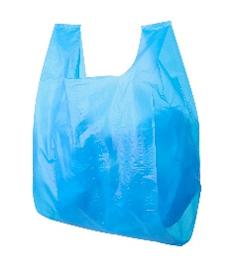
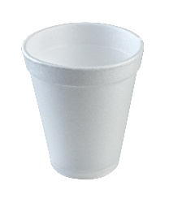

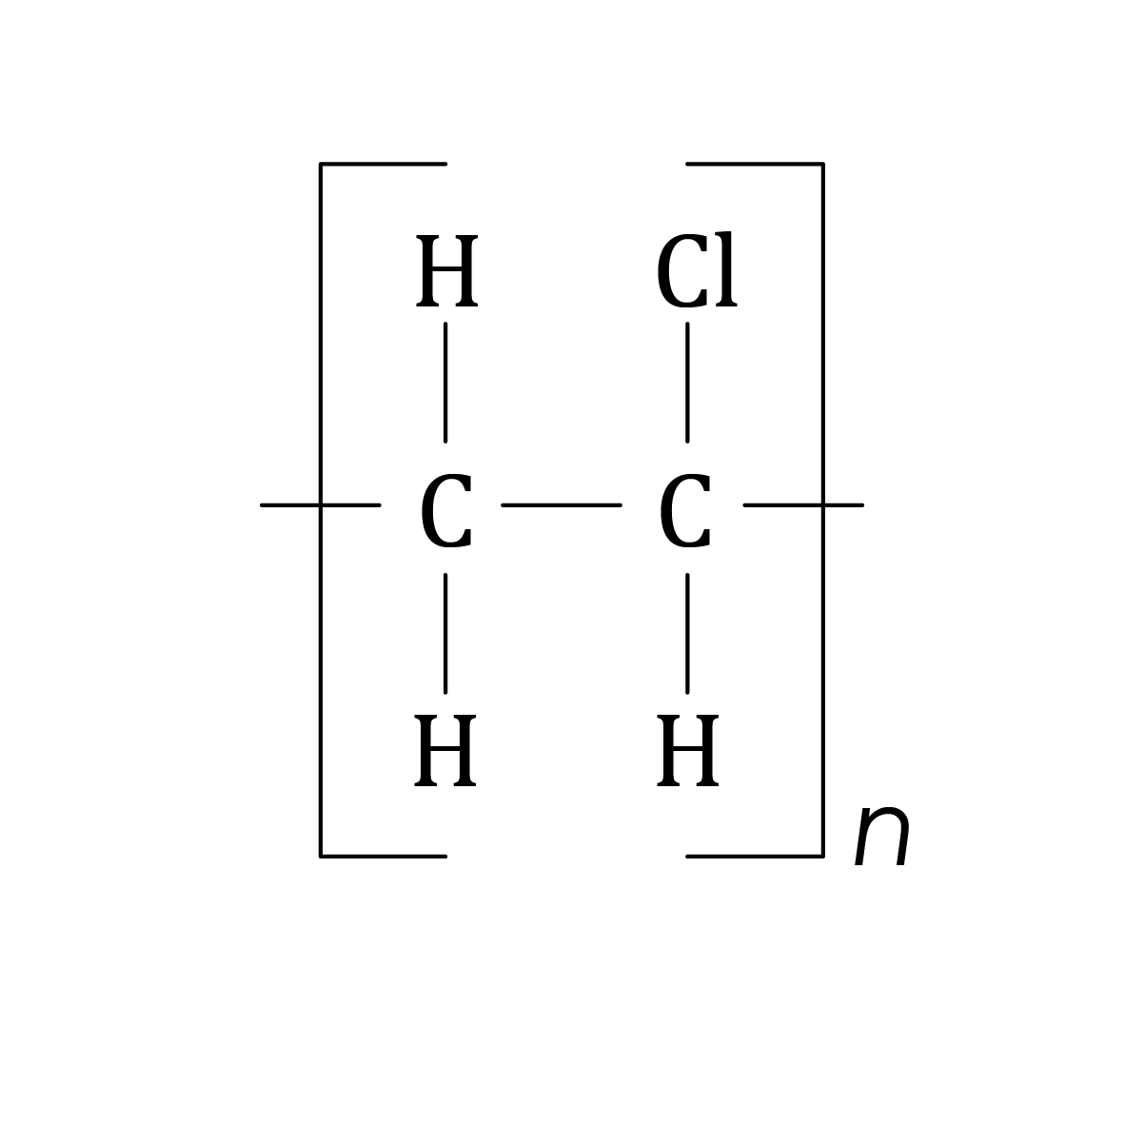
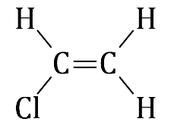
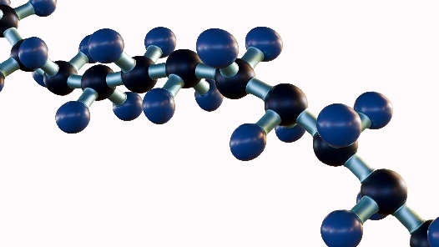
1. What does the word ‘polymer’ mean to you? Where have you come across this word (or parts of this word) before? Here are some ideas. Plastics are made of addition polymers. What names of plastics do you know that begin with the word prefix ‘poly’? In maths a polygon is a 2D shape with at least three sides. | 2. Break down the word ‘polymer’. poly- From the Greek word poly, meaning ‘many’ -mer From the Greek word meros, meaning ‘part’ or ‘segment’
Two of the images below represent polymers. Which two? | 3. Write down what you think a ‘polymer’ is. Put together your understanding of the parts poly- and -mer to form the definition. | Compare what you wrote with the definition (slide 8).
polymer
Notes:
Answer to quadrant 2: poly- = ‘many’; -mer = ‘parts’. Put it together and it means a molecule made from many parts.
Watch this video to see how Dr Mary Elliott Hill used her analytical skills to become an early pioneer in the development of polymerisation techniques: https://www.tiktok.com/@royalsocietyofchemistry/video/7351450004877348129?is_from_webapp=1&web_id=7309107562891740704
Answer to quadrant 3: a very large molecule made by joining together lots of small molecules.
Photographs on this slide © Shutterstock

Slide 5
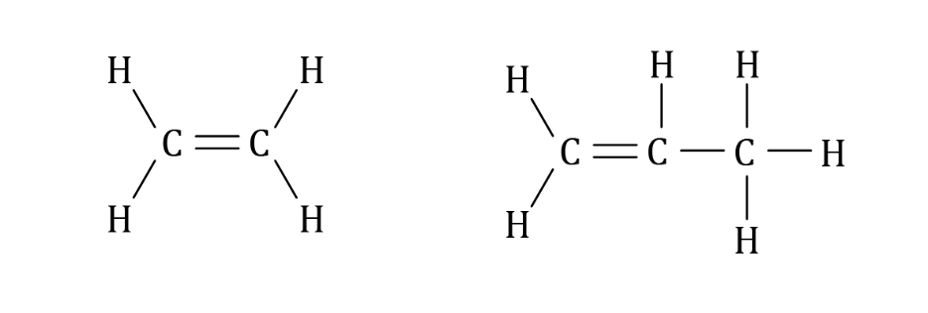
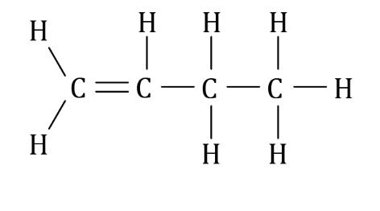
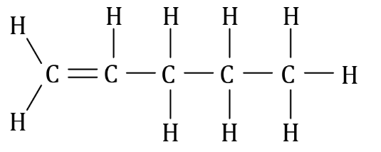
1. What does the term ‘homologous’ mean to you? Where have you come across this term (or parts of this term) before? Here are some ideas. A homonym is a word pronounced and spelt the same but having a different meaning such as novel (a book) and novel (new). Homophones are words that sound the same but have different meanings and spellings like two, to and too. | 2. Break down the term ‘homologous series’ homo- From Greek homos: ’one and the same’ -logous From Greek logos: ’relation, reasoning, computation’ series A number of discrete things of one kind.
The four molecules below all belong to the homologous series called ‘alkenes’. a) Fill in the blank to complete their general formula: C_{n}H___ b) Predict the formula of the alkene with 23 carbon atoms. | 3. Fill in the gaps to describe what a ‘homologous series’ is. A _______________ of related molecules that react the ____________ . | Compare what you wrote with the definition (slide 9).
homologous series
Notes:
Answer for quadrant 2: homo- = ‘the same’; -logous = ‘relation’; series = ‘things of a kind’. Put it together and you get a series of related molecules with the same reactivity.
Read this article about how footballer Charles West became a geochemist: https://edu.rsc.org/the-mole/charles-west-research-geochemist/3007307.article
Answer for quadrant 3: a series of organic compounds with the same general formula, which react in a similar way, such as alkanes.

Slide 6
1. What does the term ‘non-biodegradable’ mean to you? Where have you come across this term (or parts of this term) before? Here are some ideas. What do you study in biology lessons? What is a biofuel? What is a biography? | 2. Break down the term ‘non-biodegradable’. non- ‘not’ bio- Indicating or involving life or living organisms. degrade To break down or deteriorate chemically. -able Having the means, capacity or qualifications to do something.
A learner buries two carrier bags in the ground. Carrier bag A is non-biodegradable. Carrier bag B is biodegradable. The learner digs up the two carrier bags five years later. What do they find? | 3. Write down what you think ‘non-biodegradable’ means. Put together your understanding of the parts of the word to form the definition. | Compare what you wrote with the definition (slide 10).
non- biodegradable
Notes:
Answer to quadrant 2: non- = ‘not’; bio- = ‘involving life’; degrade = ‘break down’; -able = ‘having the means, capacity or qualifications to do something’. Put it together and non-biodegradable means not able to be broken down by living organisms.
If not recycled or disposed of correctly, plastic waste can end up in the ocean as microplastics, with devastating consequences for marine life. Show learners this article about how scientists are working to address the challenge microplastics present: https://edu.rsc.org/science-research/sustainable-foam-can-remove-999-of-microplastics/4020919.article
Answer to quadrant 3: not able to be broken down by living organisms in the natural environment.

Slide 7
1. What does the word ‘flammability’ mean to you? Where have you come across this word (or parts of this word) before? | 2. Break down the word ‘flammability’. flam- From Latin ‘flamma’ – a flame Words beginning with flam are often to do with fire or ignition. able Having the means, capacity or qualifications to do something. -ity The suffix -ity means ‘state of having (a particular quality).’ For example, oddity means something has the quality of being odd. flammability Having the capacity to catch fire.
A teacher places a few drops of two fractions obtained from the fractional distillation of crude oil in different watch glasses and tries to make them catch fire by using a flame. Fraction A – catches fire easily Fraction B – does not catch fire Which fraction has the highest flammability? Fraction A, because it catches fire the most easily | 3. Write down what you think ‘flammability’ means (below is the definition from the key terms list). How easy it is to ignite a substance (in other words, to cause a substance to catch fire using a flame). Encourage learners to compare their attempted definition with this one.
flammability

Slide 8
1. What does the word ‘polymer’ mean to you? Where have you come across this word (or parts of this word) before? | 2. Break down the word ‘polymer’. poly- From the Greek word poly, meaning ‘many’. -mer From the Greek word meros, meaning ‘part’ or ‘segment’. polymer A molecule made from many parts.
Two of the images below represent polymers. Which two? polymer monomer polymer | 3. Write down what you think a ‘polymer’ is (below is the definition from the key terms list). A very large molecule made by joining together lots of small molecules. Encourage learners to compare their attempted definition with this one.
polymer
Notes:
Photograph on this slide © Shutterstock

Slide 9
1. What does the term ‘homologous’ mean to you? Where have you come across this term (or parts of this term) before? | 2. Break down the term ‘homologous series’. homo- From Greek homos ’one and the same’ -logous From Greek logos ’relation, reasoning, computation’ series A number of discrete things of one kind. homologous series A series of related molecules with the same reactivity.
The four molecules below all belong to the homologous series called ‘alkenes’. What is their general formula? C_{n}H_{2n} b) Predict the formula of the alkene with 23 carbon atoms. C₂₃H₄₆ | 3. Fill in the gaps to describe what a ‘homologous series’ is. A series of related molecules that react the same. Encourage learners to compare their attempted definition with this one.
homologous series

Slide 10
1. What does the term ‘non-biodegradable’ mean to you? Where have you come across this term (or parts of this term) before? | 2. Break down the term ‘non-biodegradable’. non- ‘Not’ bio- Indicating or involving life or living organisms. degrade To break down or deteriorate chemically. -able Having the means, capacity or qualifications to do something. non-biodegradable Not able to be broken down by living organisms.
A learner buries two carrier bags in the ground. Carrier bag A is non-biodegradable. Carrier bag B is biodegradable. The learner digs up the two carrier bags five years later. What do they find? Carrier bag A will still be there. Carrier bag B may no longer be there. It will have degraded. | 3. Write down what you think ‘non-biodegradable’ means (below is the definition from the key terms list). Not able to be broken down by living organisms in the natural environment. Encourage learners to compare their attempted definition with this one.
non- biodegradable

Slide 11
1. Explore Link to science capital and draw on learners’ experience. | 2. Break down/’what do we know about X’? Look at composite parts of the word to help unpack its meaning. Or invite learners to suggest what, as a class, they already know about the key term (with the help of a few bullet points).
4. Consolidate Learners apply their knowledge. | 3. Explain Introduce the definition.
Example layout
Select your key term

