Slide 1
14–16 years
Crude oil
Unscrambling definitions

Slide 2
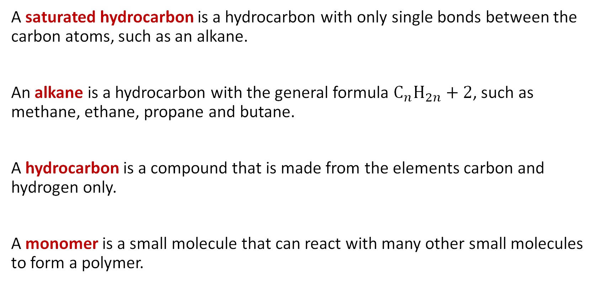
Unscrambled definitions
A saturated hydrocarbon is a hydrocarbon with only single bonds between the carbon atoms, such as an alkane.
An alkane is a hydrocarbon with the general formula $C_{n}H_{2n}+2$, such as methane, ethane, propane and butane.
A hydrocarbon is a compound that is made from the elements carbon and hydrogen only.
A monomer is a small molecule that can react with many other small molecules to form a polymer.

Slide 3
Unscrambled definitions continued
A polymer is a very large molecule made by joining together lots of small molecules.
A repeat unit is a small part of a polymer which repeats to produce the complete polymer chain.
A fraction is a mixture of hydrocarbons with similar boiling points that condense together during fractional distillation of crude oil.
A homologous series is a series of organic compounds with the same general formula, which react in a similar way, such as alkanes.

Slide 4
Connection completion
Choose the letter from the table below that contains the correct row of connective words to complete these sentences:
Polymerisation is the addition of many monomers together ________________ polymer formation. Ethene is a hydrocarbon ________________ it contains only hydrogen and carbon atoms. The C=C double bond in ethene means it can undergo polymerisation and polythene is ________________ formed which is a saturated hydrocarbon.
A | resulting in | since | consequently
B | since | although | therefore
C | causing | because | conversely
D | thus | so | somehow

Slide 5
Connection completion: completed sentences
Polymerisation is the addition of many monomers together resulting in polymer formation. Ethene is a hydrocarbon since it contains only hydrogen and carbon atoms. The C=C double bond in ethene means it can undergo polymerisation and polythene is consequently formed which is a saturated hydrocarbon.

