Slide 1
14–16 years
A microscale acid−base titration

Slide 2
Learning objectives
Learning objectives
Safely carry out a microscale titration of sodium hydroxide and hydrochloric acid.
Use practical results to calculate an unknown concentration.

Slide 3
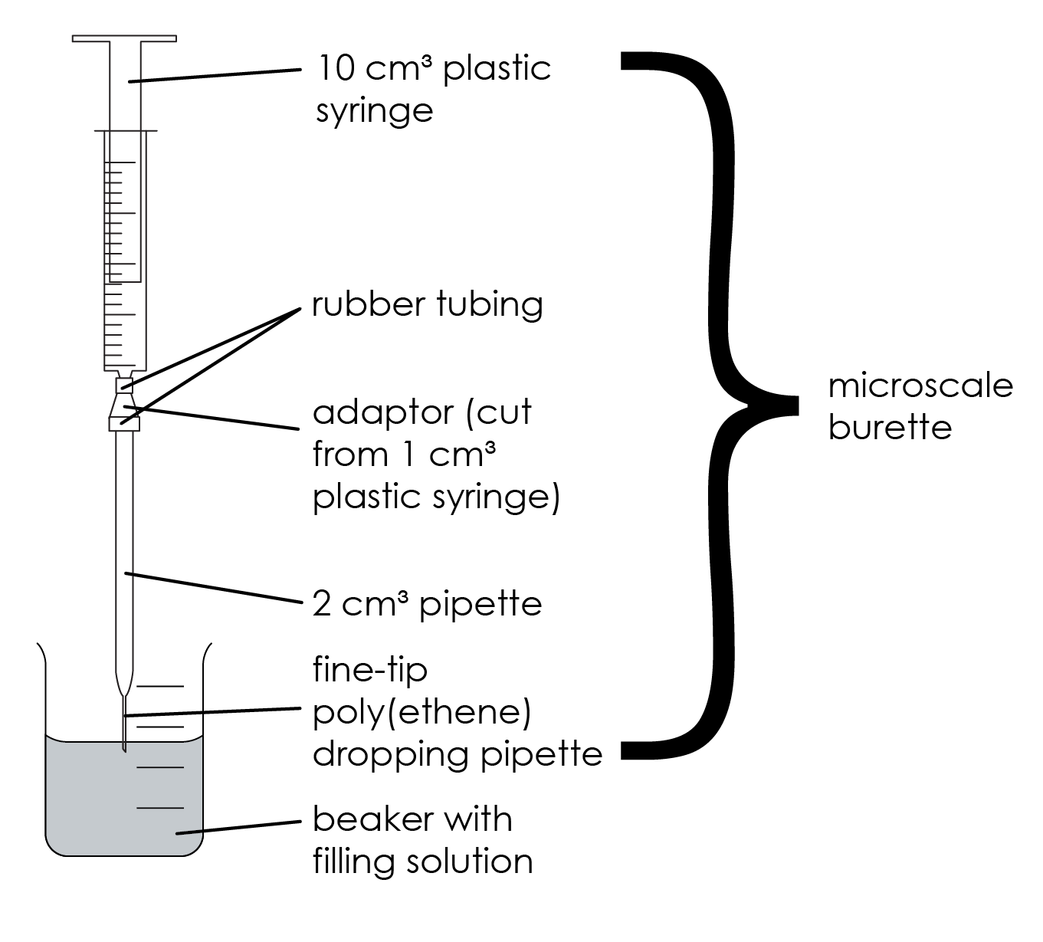
A microscale acid−base titration
Introduction
In this experiment, you will use microscale titration apparatus to carry out an accurate titration on a much smaller scale. You will fill the microscale burette with a known concentration of hydrochloric acid and use a microscale pipette to transfer sodium hydroxide solution to a beaker. You will then carry out the titration, using your results to calculate the concentration of sodium hydroxide.

Slide 4
A microscale acid−base titration
Introduction
This technique can be a little fiddly at first! Microscale techniques allow us to work quicker and more safely (as less chemicals are used) while still maintaining accuracy in our results.

Slide 5
Method
Method
Clamp the microscale burette as shown in the diagram. Fill the microscale burette with 0.1 M hydrochloric acid.
Use the 1 cm³ microscale pipette and pipette filler to transfer exactly 1.0 cm³ of the sodium hydroxide solution into a clean 10 cm³ beaker.
Add one small drop (no more!) of phenolphthalein indicator solution to the sodium hydroxide solution.
Adjust the position of the microscale burette so that the tip is just below the surface of the sodium hydroxide and indicator solution in the beaker.
Titrate the acid solution into the alkali by pressing down on the syringe plunger very gently, swirling to allow each tiny addition to mix and react before adding more.
Continue until the colour of the indicator just turns from pink to permanently colourless.
Record the volume of hydrochloric acid added at that point.
Repeat the titration until you get reproducible measurements – concordant results within 0.1 cm³ of each other.

Slide 6
Results
Results
 | Rough | Trial 1 | Trial 2 | Trial 3
Initial volume / cm³
Final volume / cm³
Titre / cm³
Average titre = ______ cm³

Slide 7
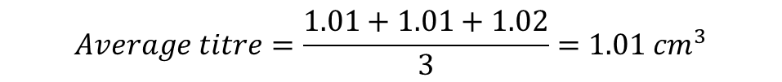
Example results
Example results
 | Rough | Trial 1 | Trial 2 | Trial 3
Initial volume / cm³ | 0.00 | 0.00 | 0.10 | 0.20
Final volume / cm³ | 1.01 | 1.01 | 1.12 | 1.45
Titre / cm³ | 1.01 | 1.01 | 1.02 | 1.25
$$Average titre=\frac{1.01+1.01+1.02}{3}=1.01 {cm}^{3}$$

Slide 8
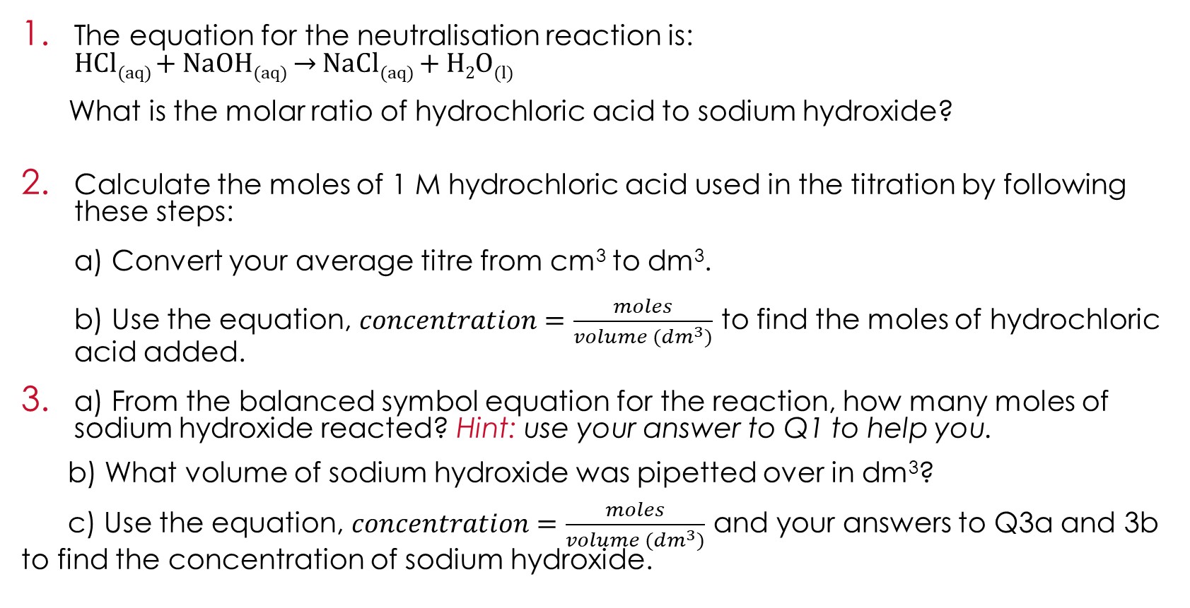
Scaffolded questions
Scaffolded questions
The equation for the neutralisation reaction is:
HCl_{(aq)} + NaOH_{(aq)} → NaCl_{(aq)} + H₂O_{(l)}
  What is the molar ratio of hydrochloric acid to sodium hydroxide?
Calculate the moles of 1 M hydrochloric acid used in the titration by following these steps:
  a) Convert your average titre from cm³ to dm³.
  b) Use the equation, $concentration=\frac{moles}{volume ({dm}^{3})}$ to find the moles of hydrochloric acid added.
a) From the balanced symbol equation for the reaction, how many moles of sodium hydroxide reacted? Hint: use your answer to Q1 to help you.
b) What volume of sodium hydroxide was pipetted over in dm³?
c) Use the equation, $concentration=\frac{moles}{volume ({dm}^{3})}$ and your answers to Q3a and 3b to find the concentration of sodium hydroxide.

Slide 9
Scaffolded questions
Scaffolded questions
A student completed the titration and found the exact amount of hydrochloric acid to neutralise the sodium hydroxide. They repeated the experiment, adding the same volume of acid to the sodium hydroxide without indicator. They then used separation techniques to produce a pure, dry sample of the salt.
  Why did the student need to repeat the experiment without indicator?
  Which separation technique would the student use to produce a pure, dry sample of sodium chloride?
  Explain how the student could use melting point analysis to determine if the salt is pure.

Slide 10
Unscaffolded questions
Unscaffolded questions
Write a balanced symbol equation for the reaction between sodium hydroxide and hydrochloric acid, and the ionic equation.
Calculate the moles of 1 M hydrochloric acid used in the titration. You will need to use your average titre.
Calculate the concentration of sodium hydroxide. You will need to use the balanced symbol equation to find the number of moles of sodium hydroxide that have reacted.
A student wanted to make a pure, dry sample of the salt produced in this reaction. Explain how the student would use titration to do this and give a technique they could use to determine the purity of the salt produced.

Slide 11
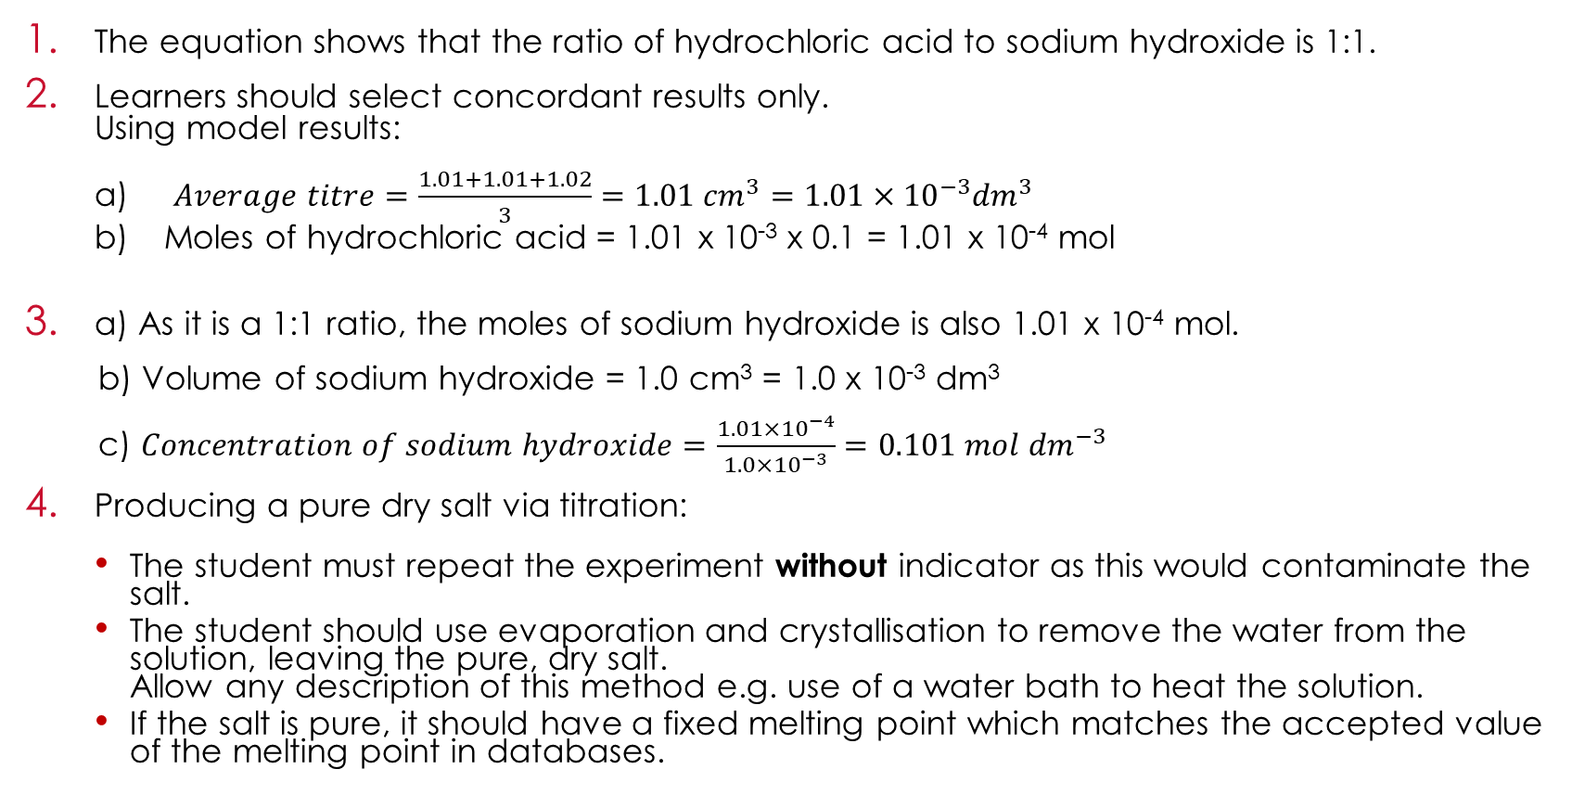
Answers to scaffolded questions
Answers to scaffolded questions
The equation shows that the ratio of hydrochloric acid to sodium hydroxide is 1:1.
Learners should select concordant results only.
Using model results:
  $Average titre=\frac{1.01+1.01+1.02}{3}=1.01 {cm}^{3}=1.01×{10}^{−3}{dm}^{3}$
  Moles of hydrochloric acid = 1.01 x 10⁻³ x 0.1 = 1.01 x 10⁻⁴ mol
a) As it is a 1:1 ratio, the moles of sodium hydroxide is also 1.01 x 10⁻⁴ mol.
b) Volume of sodium hydroxide = 1.0 cm³ = 1.0 x 10⁻³ dm³
c) $Concentration of sodium hydroxide=\frac{1.01×{10}^{−4}}{1.0×{10}^{−3}}=0.101 mol {dm}^{−3}$
Producing a pure dry salt via titration:
  The student must repeat the experiment without indicator as this would contaminate the salt.
  The student should use evaporation and crystallisation to remove the water from the solution, leaving the pure, dry salt.
  Allow any description of this method e.g. use of a water bath to heat the solution.
  If the salt is pure, it should have a fixed melting point which matches the accepted value of the melting point in databases.

Slide 12
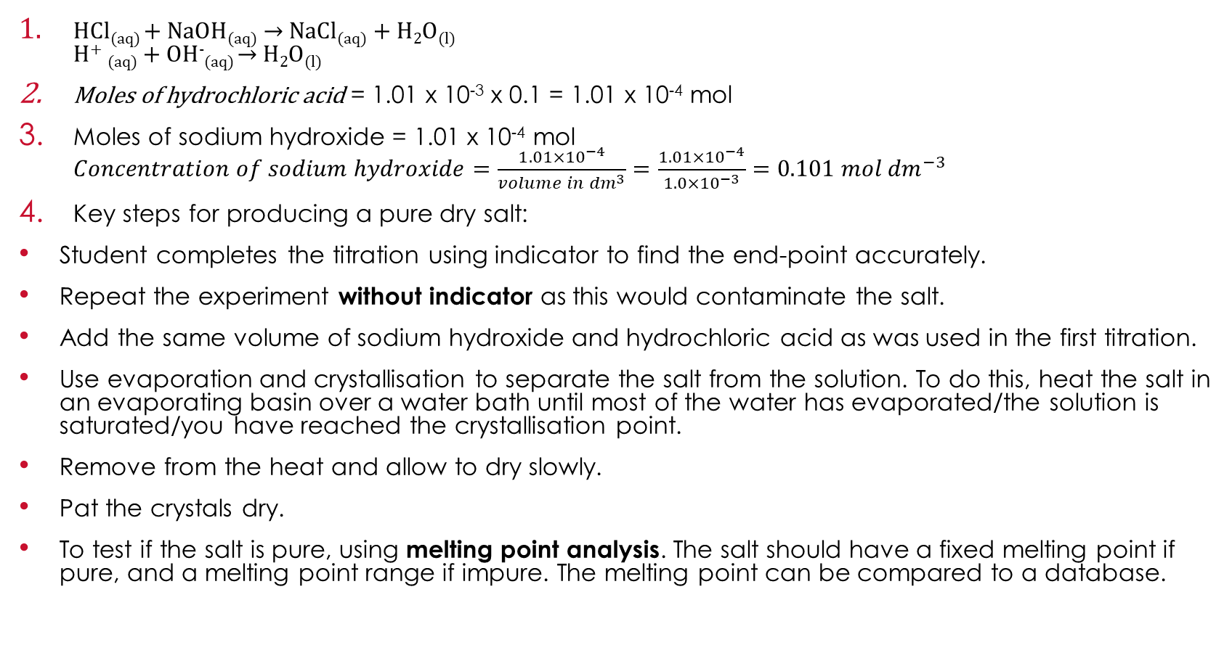
Answers to unscaffolded questions
Answers to unscaffolded questions
HCl_{(aq)} + NaOH_{(aq)} → NaCl_{(aq)} + H₂O_{(l)}
H⁺ _{(aq)} + OH⁻_{(aq)} → H₂O_{(l)}
Moles of hydrochloric acid = 1.01 x 10⁻³ x 0.1 = 1.01 x 10⁻⁴ mol
Moles of sodium hydroxide = 1.01 x 10⁻⁴ mol
$Concentration of sodium hydroxide=\frac{1.01×{10}^{−4}}{volume in {dm}^{3}}=\frac{1.01×{10}^{−4}}{1.0×{10}^{−3}}=0.101 mol {dm}^{−3}$
Key steps for producing a pure dry salt:
Student completes the titration using indicator to find the end-point accurately.
Repeat the experiment without indicator as this would contaminate the salt.
Add the same volume of sodium hydroxide and hydrochloric acid as was used in the first titration.
Use evaporation and crystallisation to separate the salt from the solution. To do this, heat the salt in an evaporating basin over a water bath until most of the water has evaporated/the solution is saturated/you have reached the crystallisation point.
Remove from the heat and allow to dry slowly.
Pat the crystals dry.
To test if the salt is pure, using melting point analysis. The salt should have a fixed melting point if pure, and a melting point range if impure. The melting point can be compared to a database.

