Slide 1
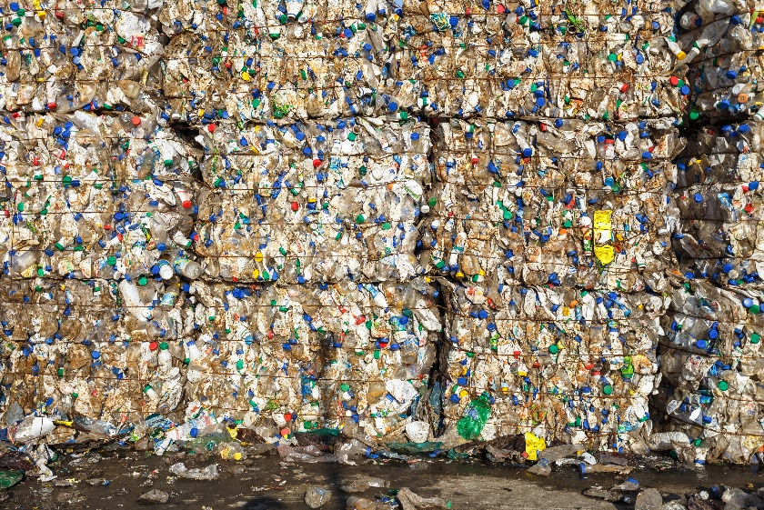
14–16 years
Present the news:
Turning waste into fuel
Notes:
Image on slide 1 © Shutterstock

Slide 2
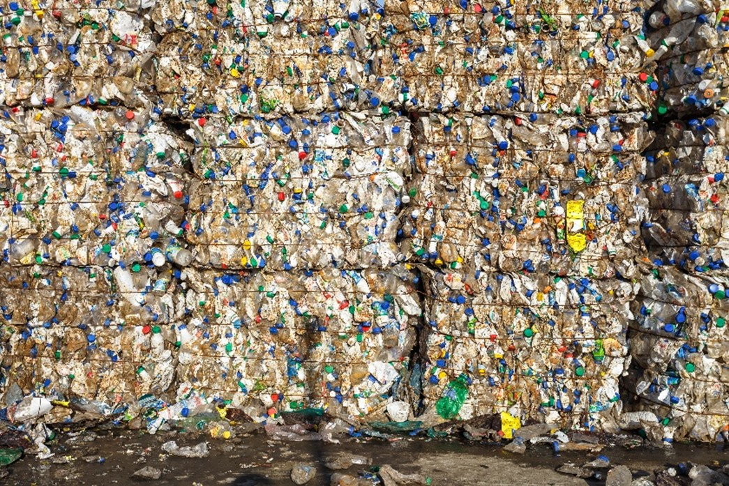
Turning waste into fuel
Science research news
Plastic waste can be converted into methane for fuel using a ruthenium-based catalyst. The technology could lessen our plastic waste problem as well as produce fuel.
Recovering chemicals from plastic waste is not new. Hydrocracking, which is often used in refining oil to make jet fuel and diesel, can convert plastic too. This reacts a feedstock with hydrogen and a catalyst. However, using the approach with plastic has been hampered by a lack of efficient catalysts.
Researchers investigated the use of ruthenium nanoparticles as a catalyst. They discovered this catalyst efficiently transforms the plastics polyethene, polypropene and polystyrene into methane that could be fed into natural gas networks.
© Shutterstock
How a new catalyst could reduce our planet’s plastic waste and create fuel
Notes:
This slide summarises an article published by Chemistry World. Use this as summary slide for reading aloud and modelling active reading.
Images on slide 2 © Shutterstock

Slide 3

The task
In your groups, prepare to present the science research news as an item on a news programme. Use the script template to help you.
You have five minutes for the presentation.
Everyone needs to say something during the ‘broadcast’. You will have the following roles in your group: ​
News anchor – introduces the story. ​
Reporter – gives more detail. ​
Scientist/s – answers questions. ​
Notes:
Images on slide 3 © Shutterstock

Slide 4
What the news anchor needs to do
Introduce the news item and explain simply what problem the scientists were trying to solve, or what they were trying to investigate.
Work with your group to make sure the whole presentation is no longer than five minutes. Talk together about how much time each part should take.
End the news item after your teammates have finished. Give a closing statement in reaction to what’s been said. For inspiration, imagine how your friends or family might feel hearing the news item.
Notes:
Image on slide 4 © Shutterstock

Slide 5
What the reporter needs to do
After the news anchor speaks, tell the audience more about the problem the scientists were trying to solve.
Ask the scientist questions so the audience can learn about their discovery. Think about what the audience would want to know. Look at the prompts in step 7 of your worksheet.
  Findings
  Context
  Relevance/application
  Impact
When practising with your group, try to respond to what the scientist says instead of just reading your questions.
Notes:
Image on slide 5 © Shutterstock

Slide 6
What the scientist needs to do
When the reporter asks you questions, give clear answers that your classmates will understand.
Read the text carefully and make sure you know the main ideas. Look at the prompts in step 7 on your worksheet.
  Findings
  Context
  Relevance/application
  Impact
If any words from the text seem hard, think of simpler ones to explain them.
Talk to your group about whether pictures or diagrams could help the audience understand better. If you decide to use them, find and present them.
Notes:
Images on slide 6 © Shutterstock

Slide 7
What does a good news presentation look like?
In a good presentation...
there is a clear beginning, middle and end
everyone involved gets to speak, and when they do, they are introduced and thanked for their contribution
it's clear that the participants have considered the needs and interests of their audience
it ends on time (remember each group has five minutes to speak).
When speaking...
be clear
be loud enough
look at the audience
use words the audience will understand
look and sound confident (even if you don't feel it yet).

