Slide 1
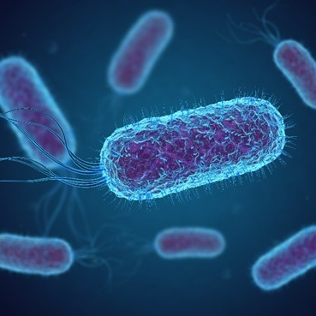
14–16 years
Present the news: Using microbes to convert waste plastic
Notes:
Image on slide 1 © Shutterstock

Slide 2
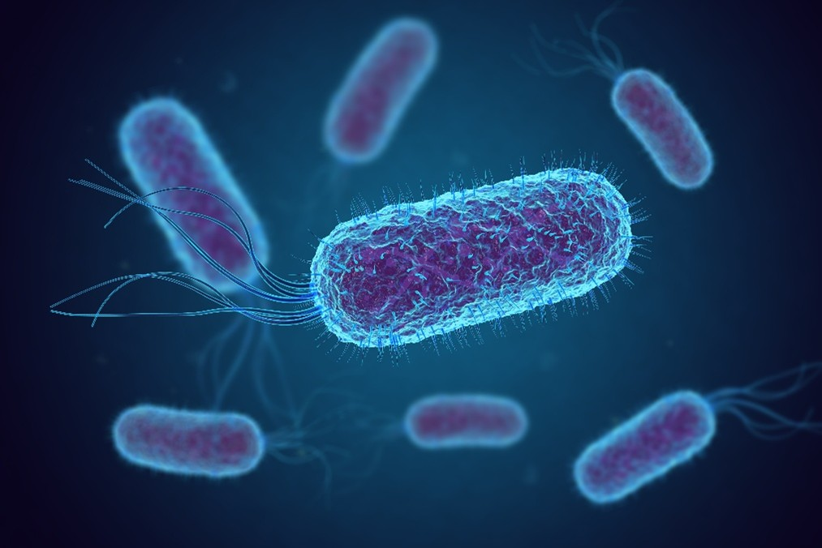
Using microbes to convert waste plastic
Science research news
Polyethylene terephthalate (PET) is a widely used type of plastic. Most recycling technologies turn PET back into its monomers and then use them to make new plastic. Now, scientists have genetically engineered bacteria to transform PET plastic waste into vanillin, which is a very valuable chemical. Vanillin is the molecule responsible for the smell and taste of vanilla. It is used in food and cosmetics. Traditionally, it is extracted from the vanilla plant but global demand far outweighs the supply from natural sources.
The researchers genetically engineered a strain of the Escherichia coli (E. coli) microbe to produce enzymes that convert one of the monomers of PET into vanillin. These enzymes were introduced to a biological cell to carry out the reaction. There were challenges to overcome with the process including getting the substrate into the cell and removing the vanillin, which is toxic to the new strain of E. coli.
© Shutterstock
How a genetically engineered bacteria could reduce our planet’s plastic waste
Notes:
This slide summarises an article published by Chemistry World. Use this as summary slide for reading aloud and modelling active reading.
Images on slide 2 © Shutterstock

Slide 3



The task
In your groups, prepare to present the science research news as an item on a news programme. Use the script template to help you.
You have five minutes for the presentation.
Everyone needs to say something during the ‘broadcast’. You will have the following roles in your group: ​
News anchor – introduces the story.​
Reporter – gives more detail. ​
Scientist/s – answers questions. ​
Notes:
Images on slide 3 © Shutterstock

Slide 4

What the news anchor needs to do
Introduce the news item and explain simply what problem the scientists were trying to solve, or what they were trying to investigate.
Work with your group to make sure the whole presentation is no longer than five minutes. Talk together about how much time each part should take.
End the news item after your teammates have finished. Give a closing statement in reaction to what’s been said. For inspiration, imagine how your friends or family might feel hearing the news item.
Notes:
Image on slide 4 © Shutterstock

Slide 5

What the reporter needs to do
After the news anchor speaks, tell the audience more about the problem the scientists were trying to solve.
Ask the scientist questions so the audience can learn about their discovery. Think about what the audience would want to know. Look at the prompts in step 6 of your worksheet.
  Findings
  Context
  Relevance/application
  Impact
When practising with your group, try to respond to what the scientist says instead of just reading your questions.
Notes:
Image on slide 5 © Shutterstock

Slide 6


What the scientist needs to do
When the reporter asks you questions, give clear answers that your classmates will understand.
Read the text carefully and make sure you know the main ideas. Look at the prompts in step 6 on your worksheet.
  Findings
  Context
  Relevance/application
  Impact
If any words from the text seem hard, think of simpler ones to explain them.
Talk to your group about whether pictures or diagrams could help the audience understand better. If you decide to use them, find and present them.
Notes:
Images on slide 6 © Shutterstock

Slide 7
What does a good news presentation look like?
In a good presentation...
there is a clear beginning, middle and end
everyone involved gets to speak, and when they do, they are introduced and thanked for their contribution
it's clear that the participants have considered the needs and interests of their audience
it ends on time (remember each group has five minutes to speak).
When speaking...
be clear
be loud enough
look at the audience
use words the audience will understand
look and sound confident (even if you don't feel it yet).

