Slide 1
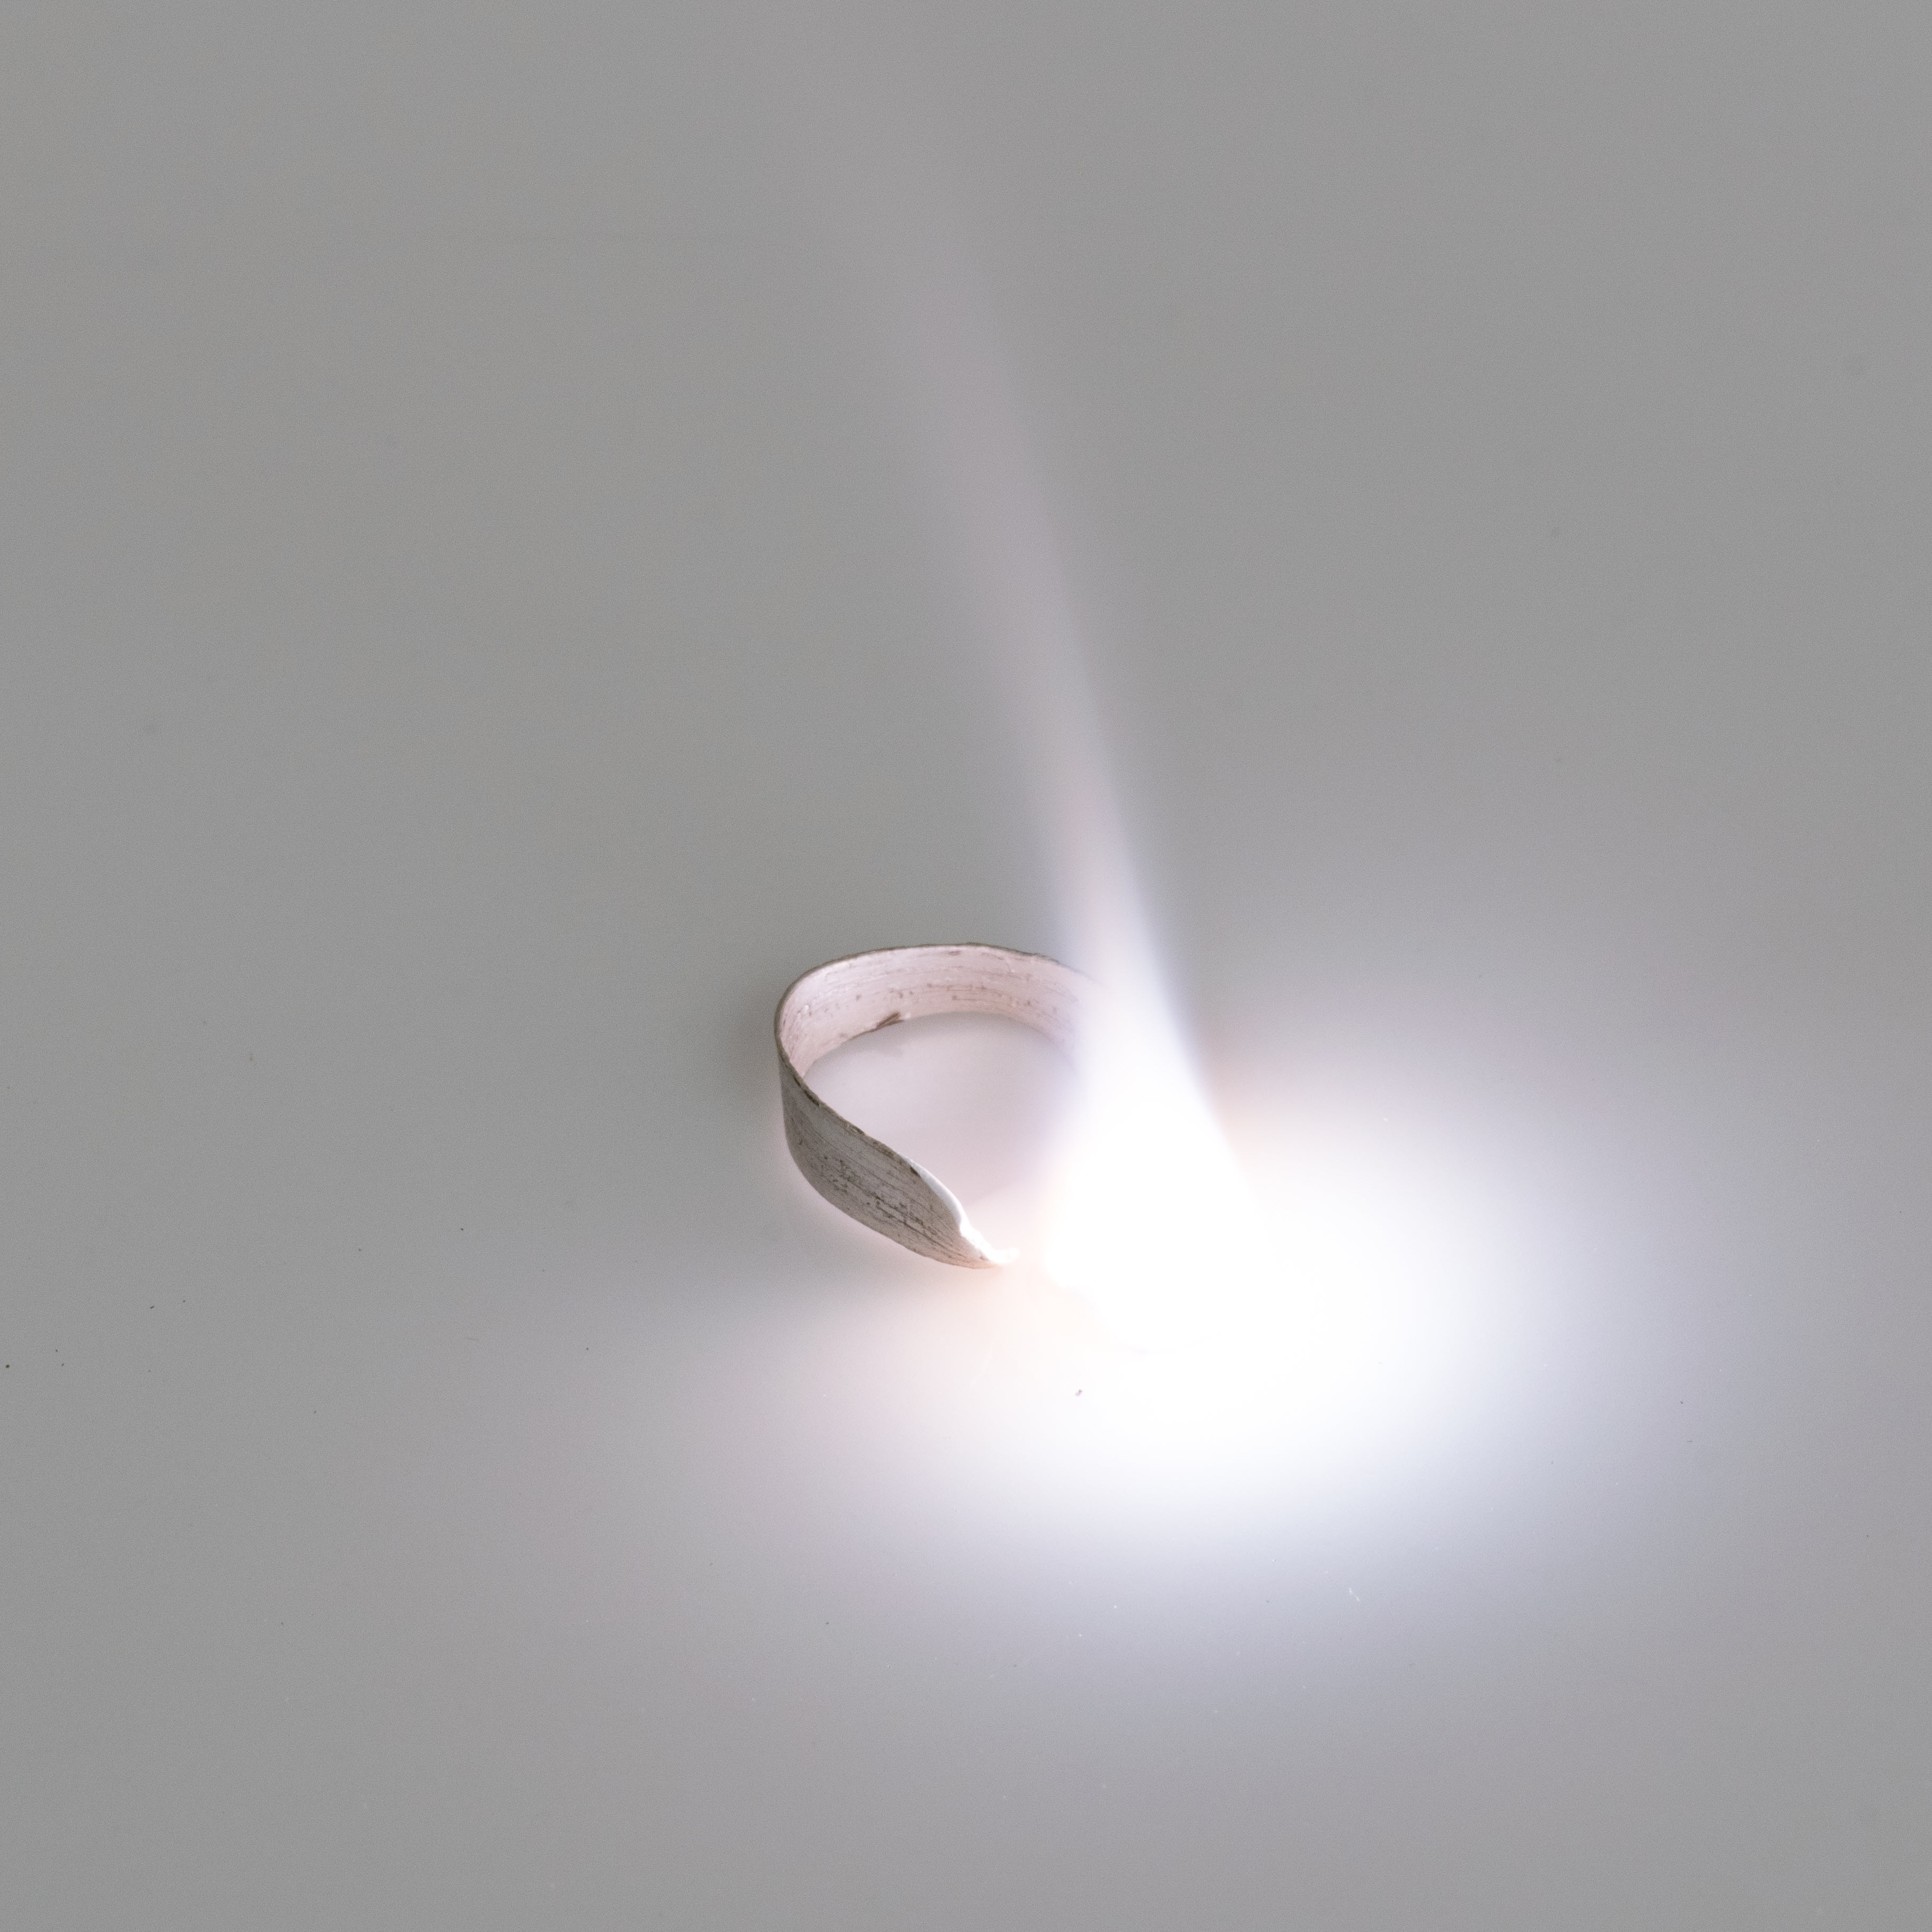
14–16 years
The change in mass when magnesium burns
Downloaded from: rsc.li/3LXAdtr

Slide 2
Learning objectives
Learning objectives
Safely investigate burning magnesium to produce magnesium oxide.
Correctly record the change in mass.
Explain why the mass changes.
Use data to calculate the relative formula mass.

Slide 3
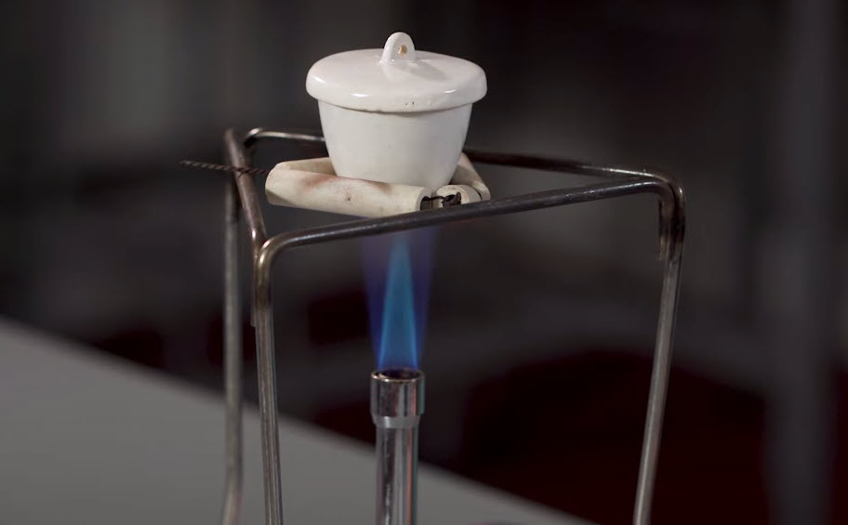
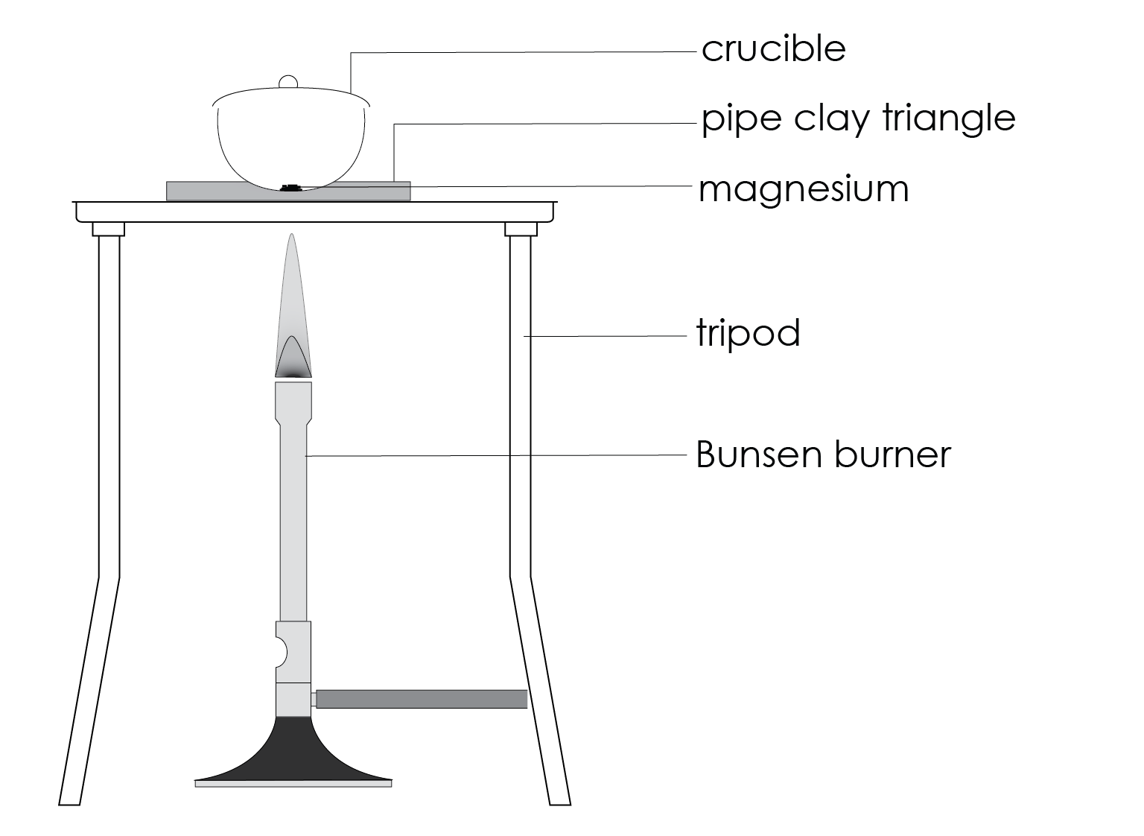
Burning magnesium
Introduction
In this experiment, you will record the mass of magnesium and heat it in a crucible, calculating the change in mass from before it is heated to after.
You will then calculate the formula of magnesium oxide that is formed.
heat resistant mat

Slide 4
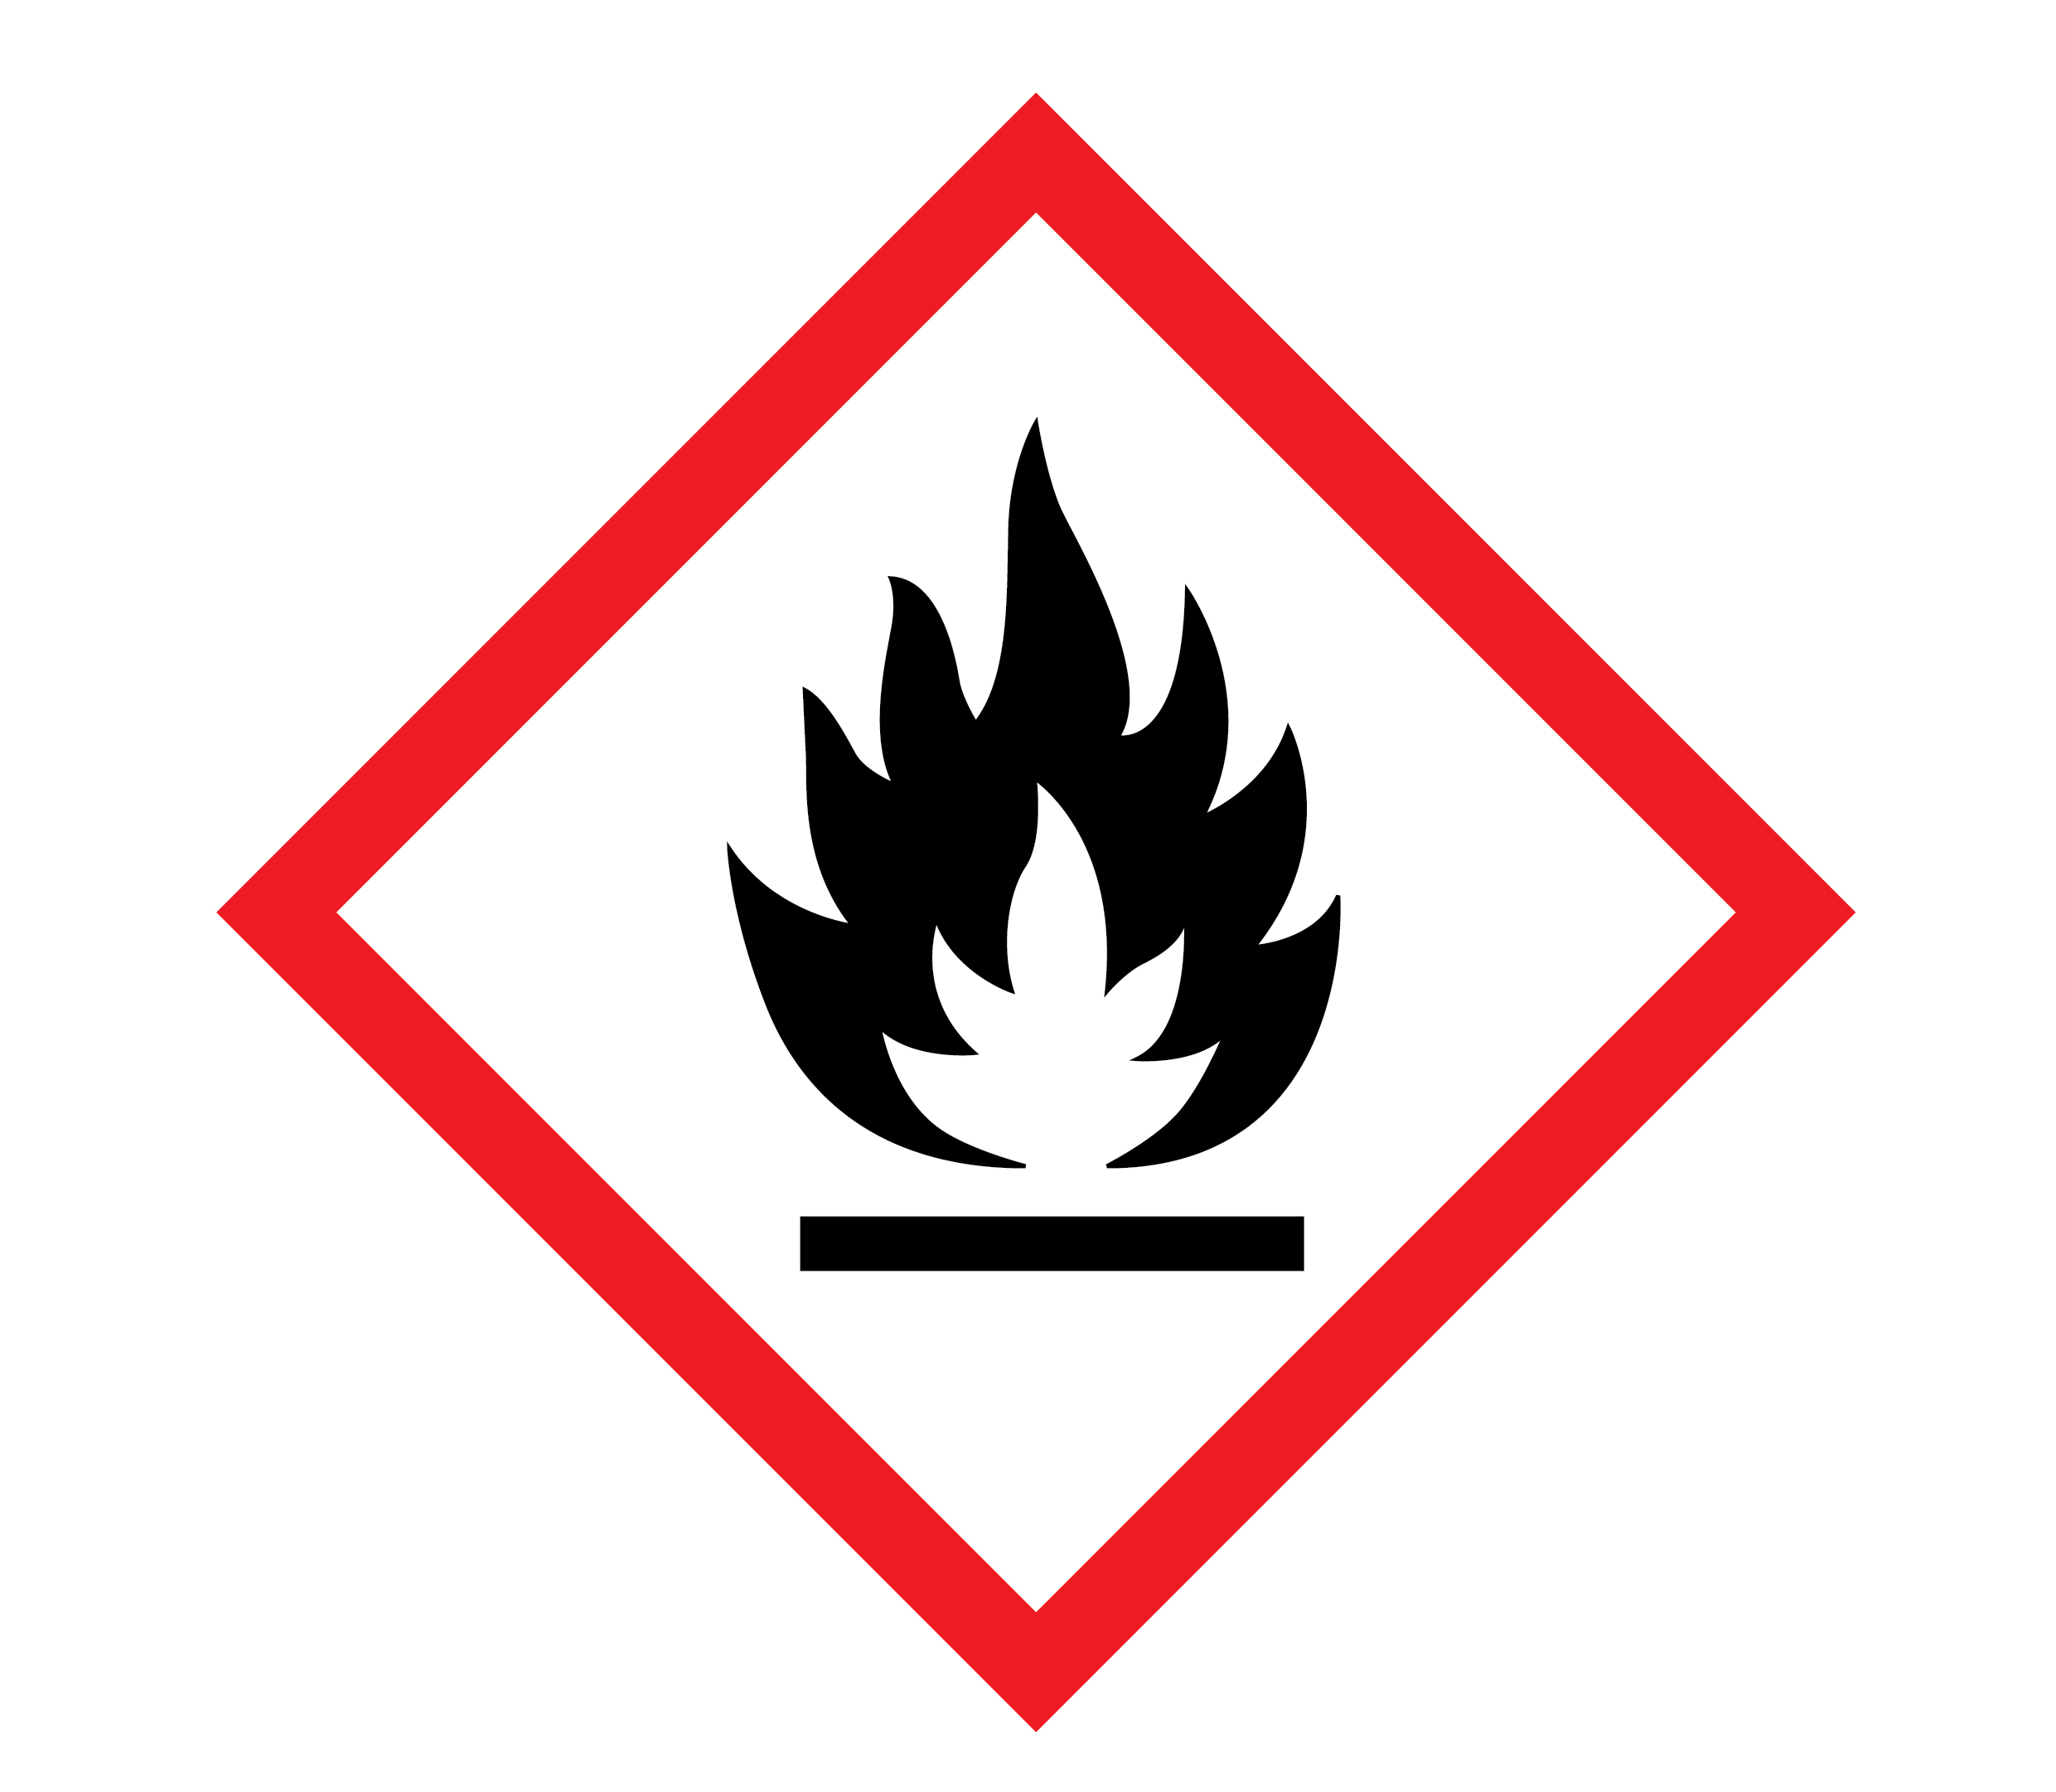

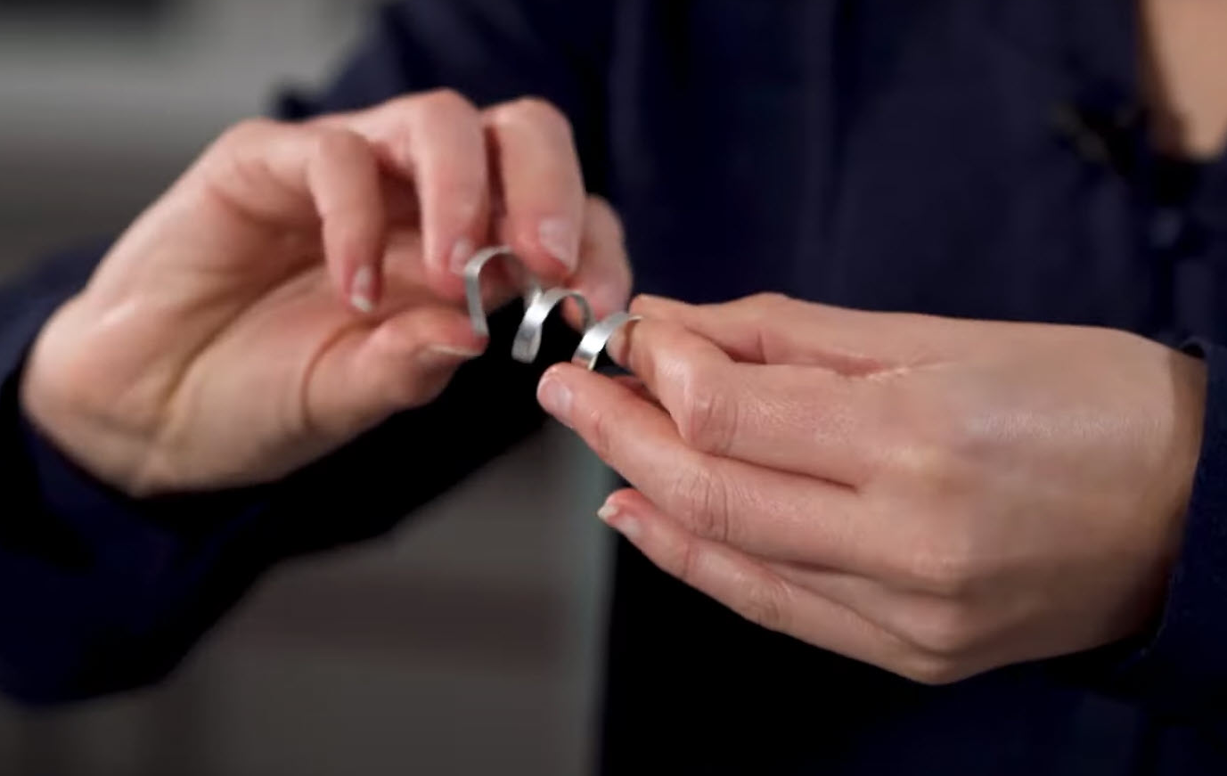
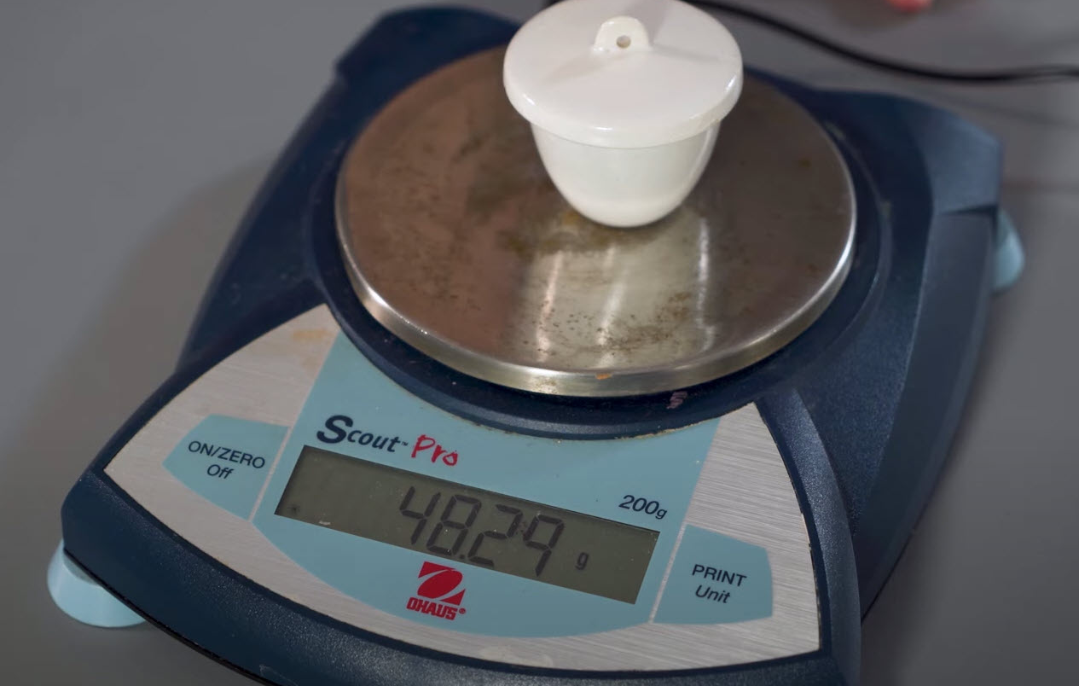
Method (part 1)
Method
Take a piece of magnesium ribbon 5−10 cm long. If it looks tarnished or black, then clean it using the emery paper. Twist it into a loose coil.
Record the mass of the crucible with lid (mass 1) and then again with the magnesium inside (mass 2).
Set up the Bunsen burner on the heat resistant mat with the tripod. Place the pipe clay triangle over the tripod, ensuring that it is secure. Place the crucible containing the magnesium in the pipe clay triangle and put the lid on.

Slide 5
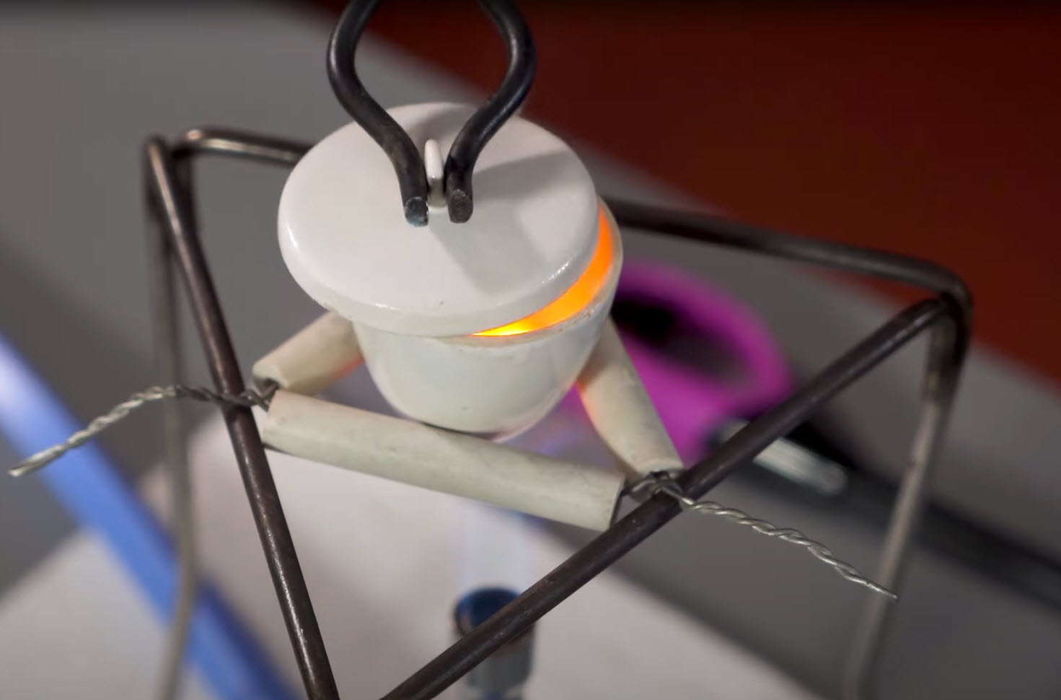
Method (part 2)
Method
Light the Bunsen burner and begin to heat the crucible. It is best to start with a gentle blue flame, then increase to a roaring flame (with the air hole fully open) to get the reaction to go.
Once the crucible is hot, gently lift the lid with tongs a little to allow some oxygen to get in. You may see the magnesium begin to flare up. If the lid is lifted for too long, then the magnesium oxide product will begin to escape. Don’t let this happen.
Keep heating and lifting the lid until there is no further reaction.
DANGER: do not look directly at magnesium when it is burning.

Slide 6
Method (part 3)
Method
Turn off the Bunsen burner and allow the apparatus to cool.
Re-record the mass of the crucible with lid containing the product (mass 3).
Heat the crucible again for a couple of minutes and once again allow to cool. Repeat this step until the mass readings are consistent. This is known as heating to constant mass.

Slide 7
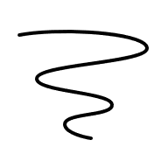

Integrated instructions
❾ Repeat steps 4−8 until mass remains constant 
❽ Record mass of crucible with lid containing product (mass 3)
◆ Record mass of crucible with lid (mass 1) 
c
c
0.00 g
0.00 g
❖ Coil Mg ribbon 
 Leave to cool 
⬥ Record mass of Mg inside crucible with lid (mass 2)
 Keep heating until no further reaction 
c
0.00 g
 Gently lift lid with tongs then replace lid 
 Heat Mg in crucible on roaring flame 
Royal Society of Chemistry
The change in mass when magnesium burns
rsc.li/3LXAdtr

Slide 8
Results table
Results
Mass 1 (g) crucible + lid | Mass 2 (g) crucible + magnesium + lid before heating | Mass 3 (g) crucible + product + lid after heating

Slide 9
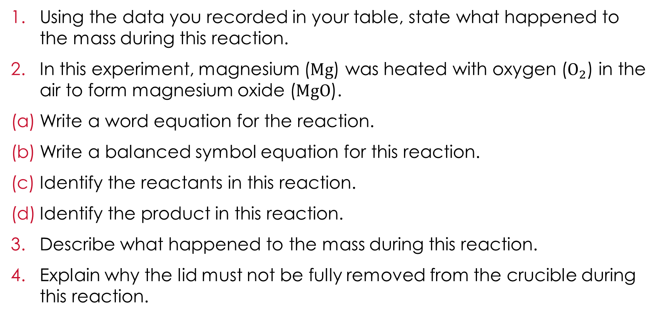
Questions
Follow-up questions
Using the data you recorded in your table, state what happened to the mass during this reaction.
In this experiment, magnesium ($Mg$) was heated with oxygen ($O_{2}$) in the air to form magnesium oxide ($MgO$).
Write a word equation for the reaction.
Write a balanced symbol equation for this reaction.
Identify the reactants in this reaction.
Identify the product in this reaction.
Describe what happened to the mass during this reaction.
Explain why the lid must not be fully removed from the crucible during this reaction.
Notes:
Unscaffolded

Slide 10
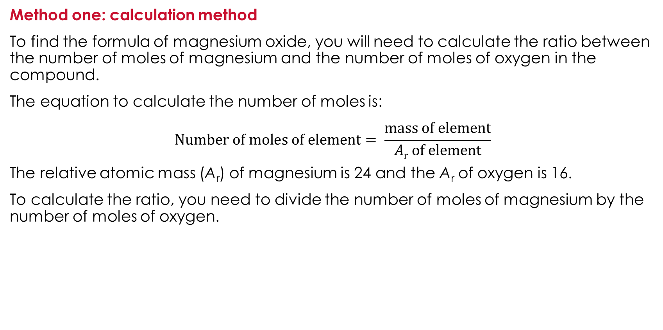
Finding the formula of magnesium oxide
Extension
Method one: calculation method
To find the formula of magnesium oxide, you will need to calculate the ratio between the number of moles of magnesium and the number of moles of oxygen in the compound.
The equation to calculate the number of moles is:
$$Number of moles of element= \frac{mass of element}{Ar of element}$$
The relative atomic mass (A_{r}) of magnesium is 24 and the A_{r} of oxygen is 16.
To calculate the ratio, you need to divide the number of moles of magnesium by the number of moles of oxygen.

Slide 11
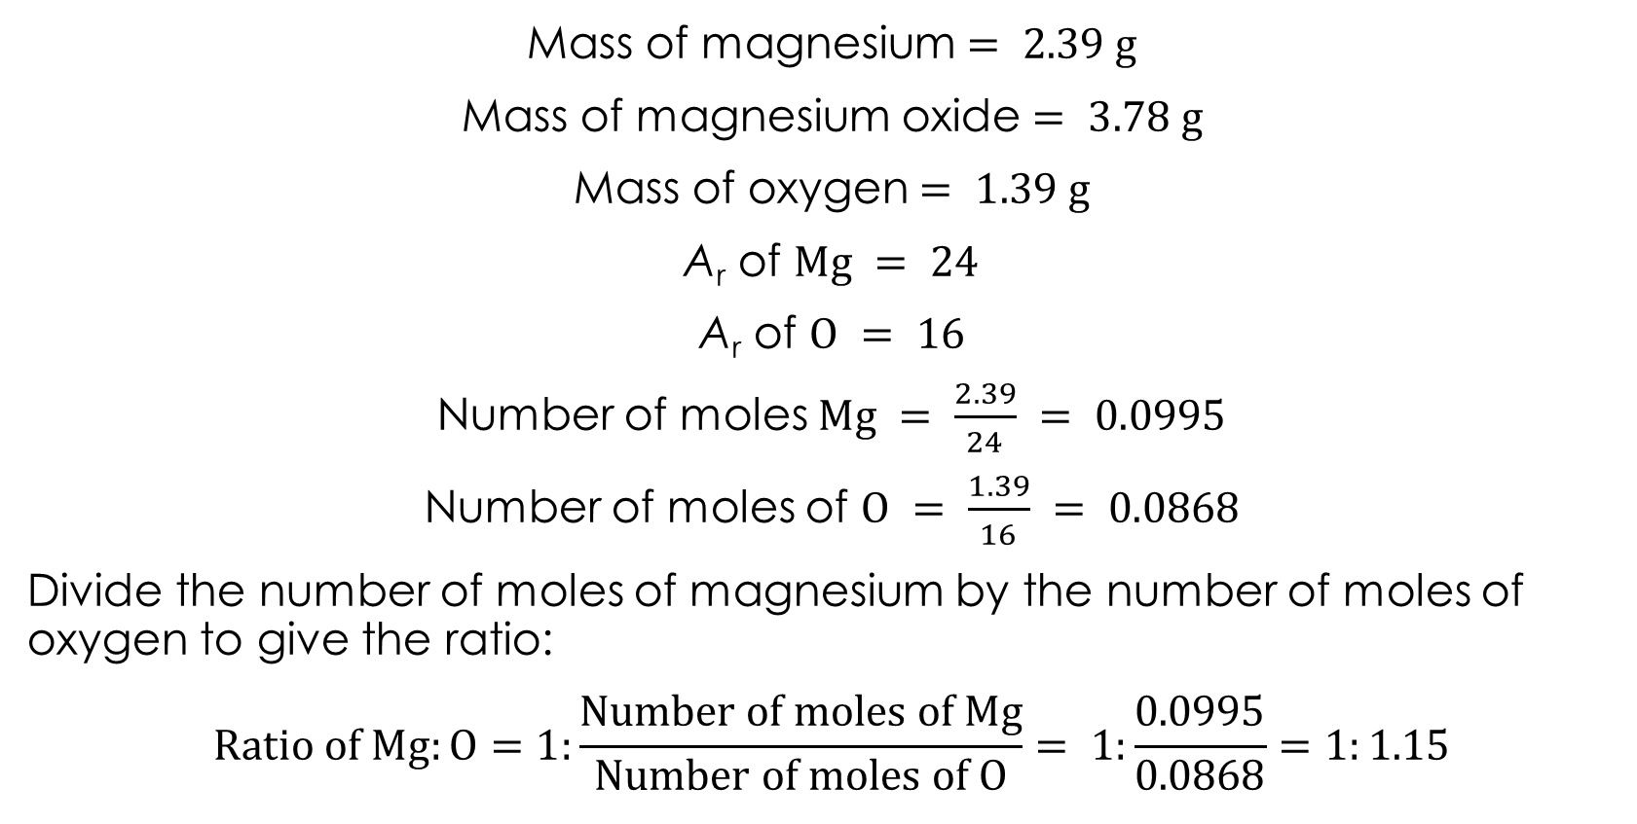
Example calculation
Example
Mass of magnesium $= 2.39 g$
Mass of magnesium oxide $= 3.78 g$
Mass of oxygen$= 1.39 g$
A_{r} of $Mg = 24$
A_{r} of $O = 16$
Number of moles $Mg = \frac{2.39}{24} = 0.0995$
Number of moles of $O = \frac{1.39}{16} = 0.0868$
Divide the number of moles of magnesium by the number of moles of oxygen to give the ratio:
$$Ratio of Mg:O=1:\frac{Number of moles of Mg}{Number of moles of O}= 1:\frac{0.0995}{0.0868}=1:1.15$$

Slide 12
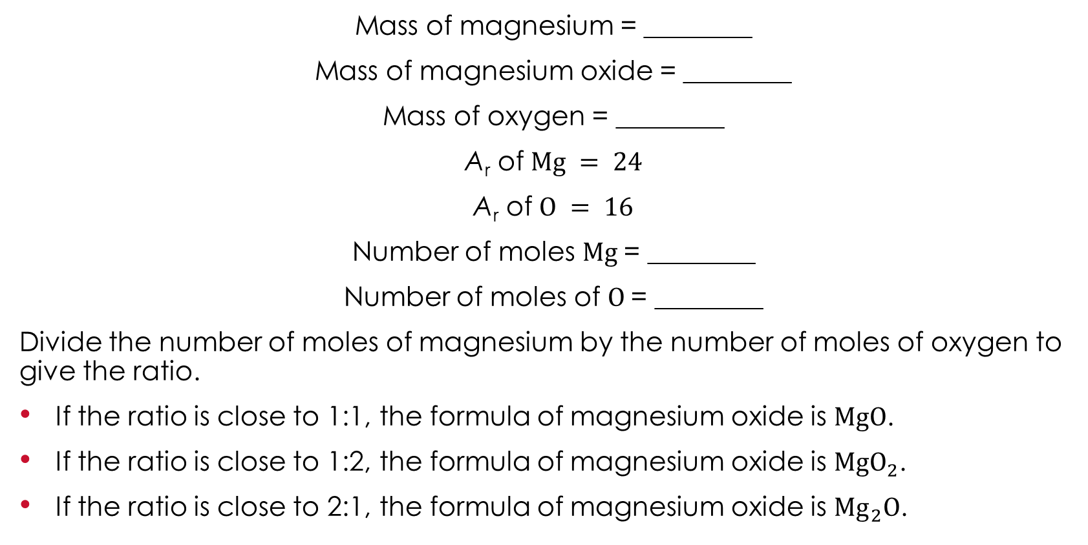
Your turn
Calculation
Mass of magnesium = ________
Mass of magnesium oxide = ________
Mass of oxygen = ________
A_{r} of $Mg = 24$
A_{r} of $O = 16$
Number of moles $Mg \text{= ________}$
Number of moles of $O \text{= ________}$
Divide the number of moles of magnesium by the number of moles of oxygen to give the ratio.
If the ratio is close to 1:1, the formula of magnesium oxide is $MgO$.
If the ratio is close to 1:2, the formula of magnesium oxide is $MgO_{2}$.
If the ratio is close to 2:1, the formula of magnesium oxide is ${Mg}_{2}O$.

Slide 13
Class results
Class results
Method two: graphical method
Collect all the mass of magnesium and mass of oxygen data for your class.
Group | Mass of magnesium (g) | Mass of oxygen (g)
Group 1
Group 2
Group 3
Group 4
Group 5
Group 6
Group 7
Group 8
Group 9
Group 10

Slide 14
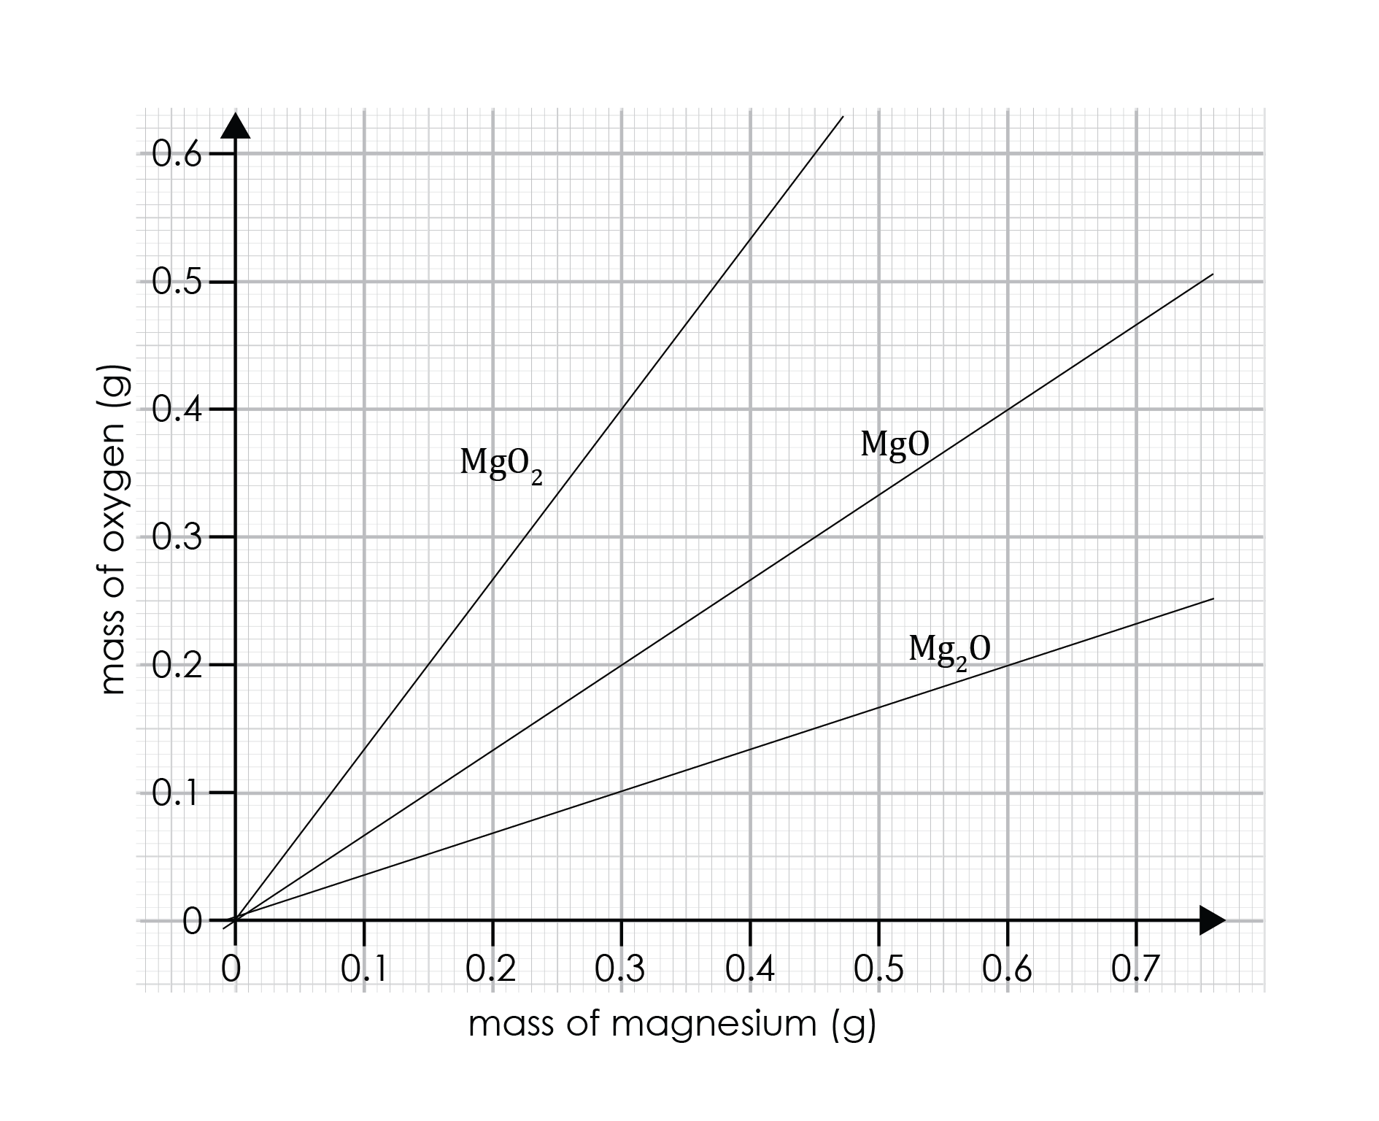
Finding the formula of magnesium oxide
Method two: graphical method
Plot all the class data onto the graph opposite.
Draw a straight line of best fit.
Compare this to the pre-drawn lines on the graph.
Class results

Slide 15
Learning objectives
Learning objectives
Safely investigate burning magnesium to produce magnesium oxide.
Correctly record the change in mass.
Explain why the mass changes.
Use data to calculate the relative formula mass.
Have you met all of the learning objectives?

