Slide 1
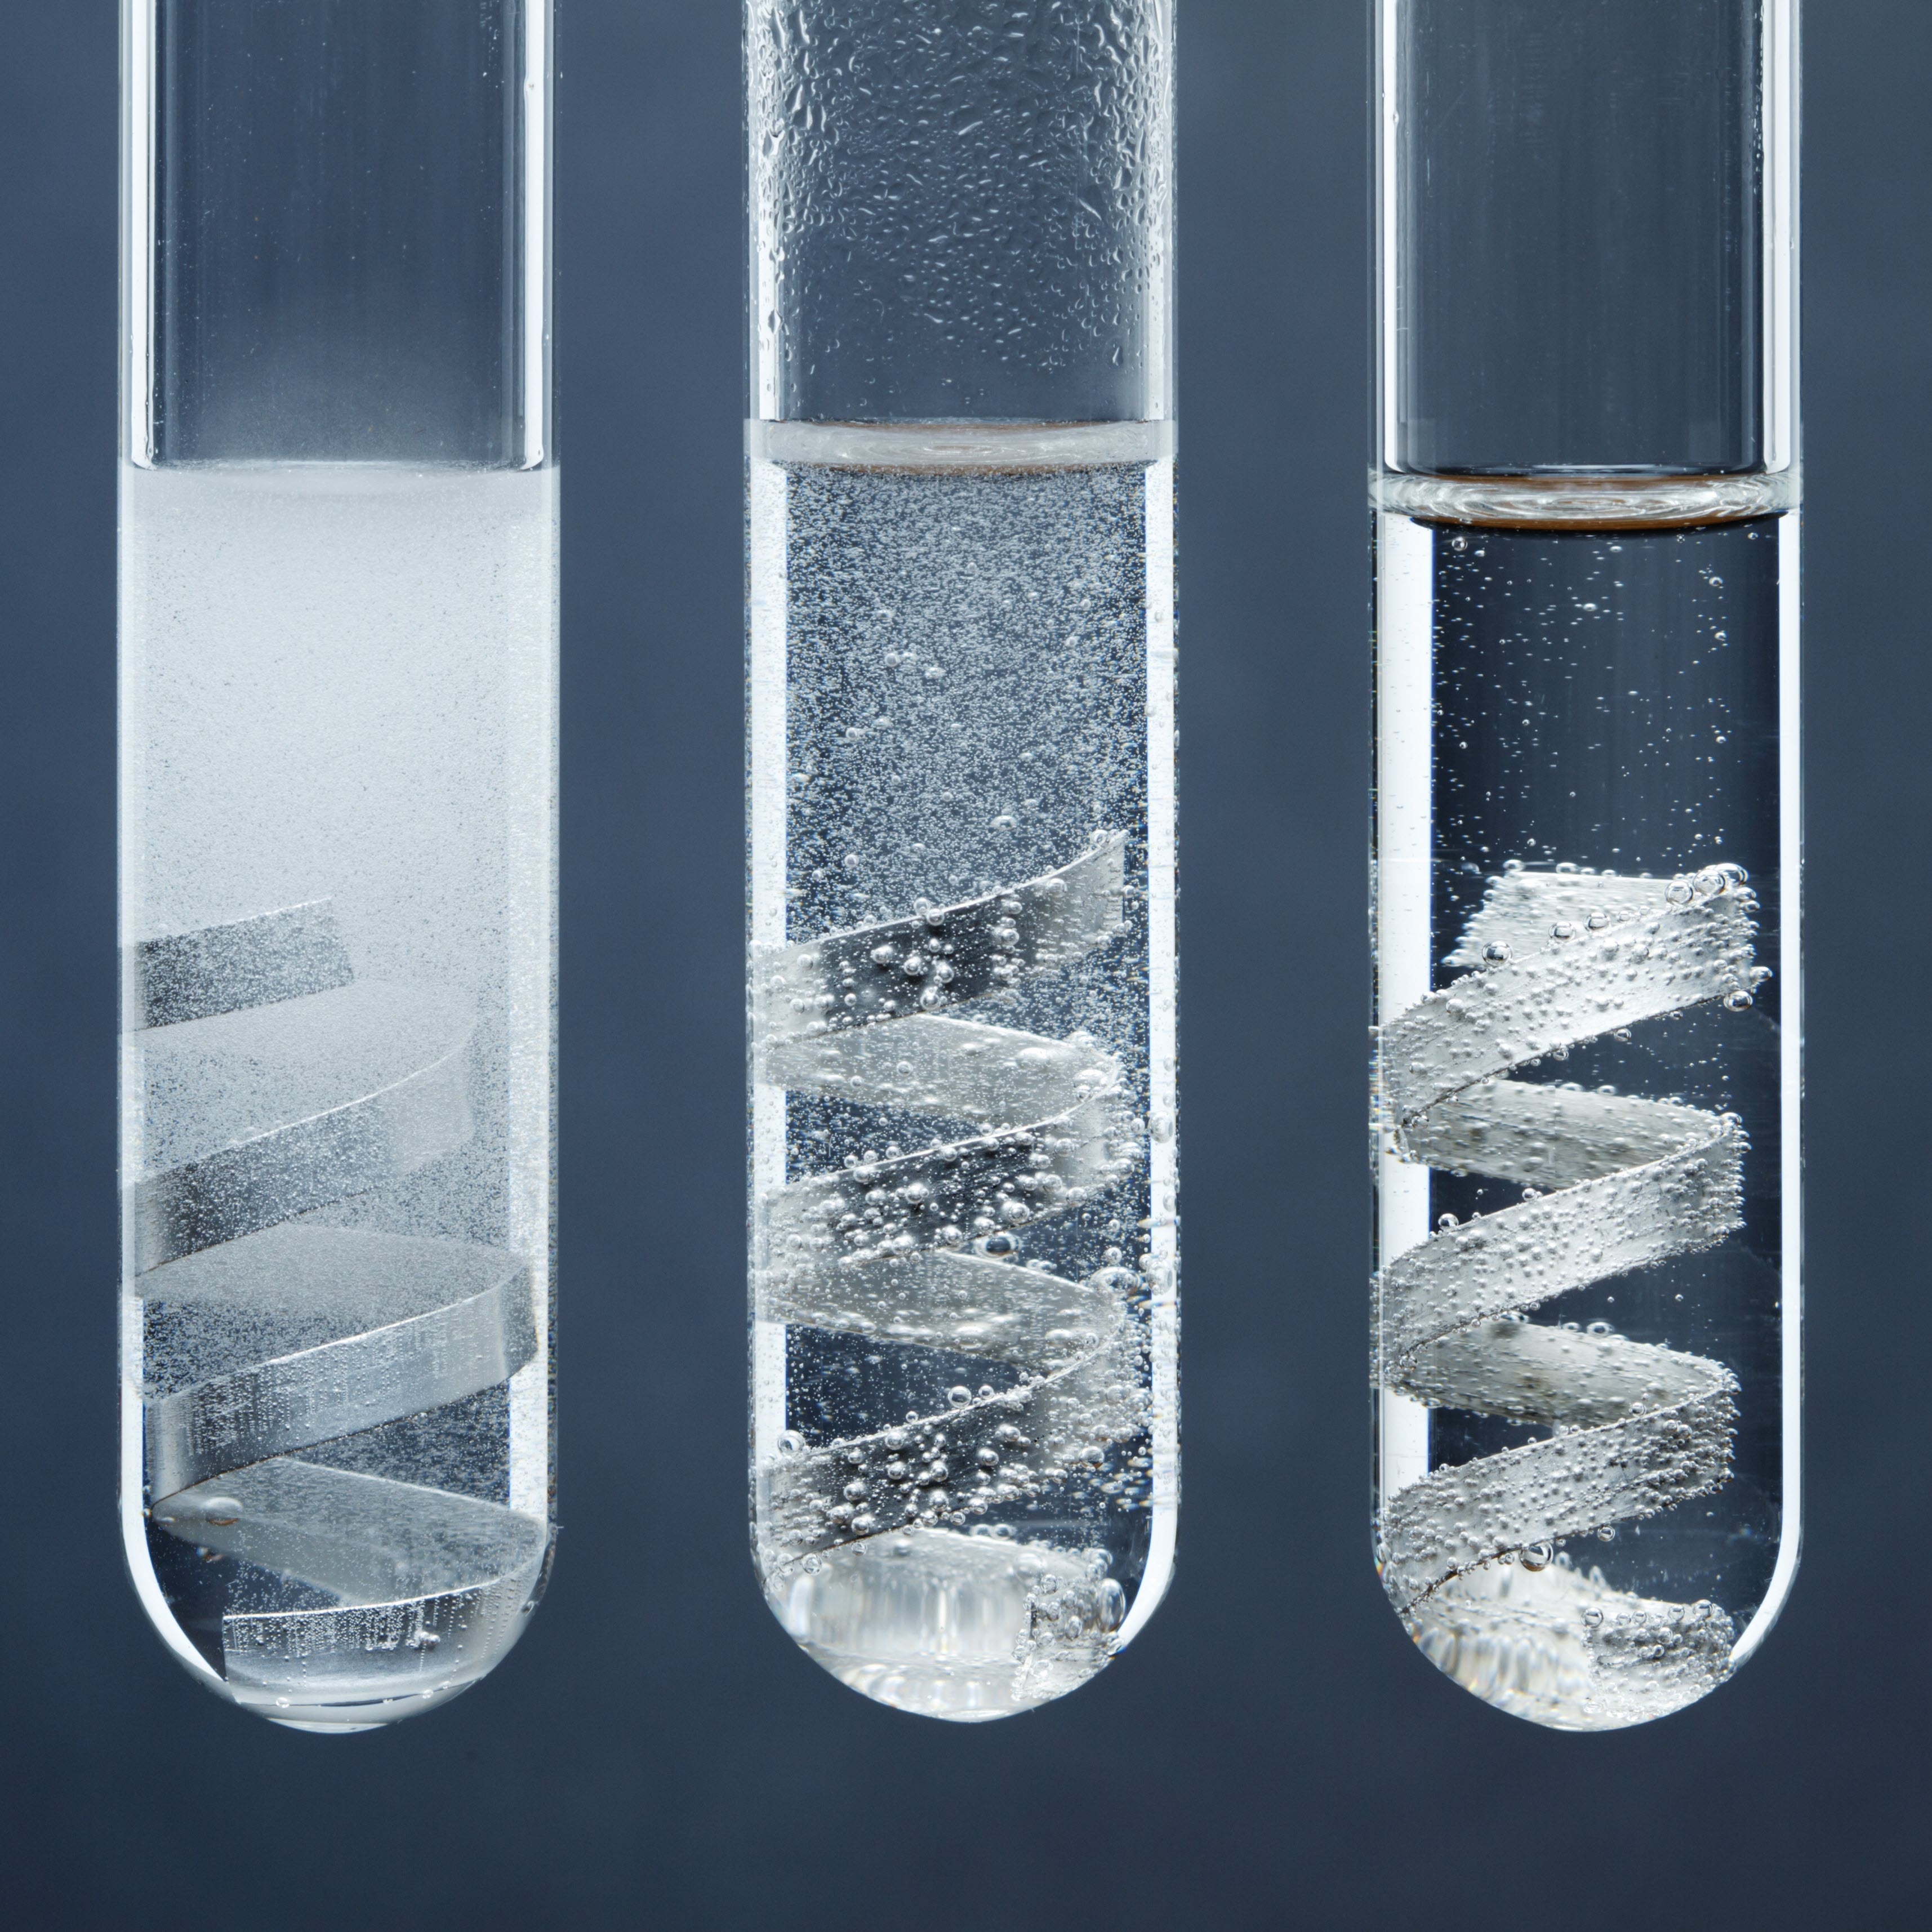
14–16 years
Determining the relative atomic mass of magnesium
Downloaded from: rsc.li/3OqtvNh

Slide 2
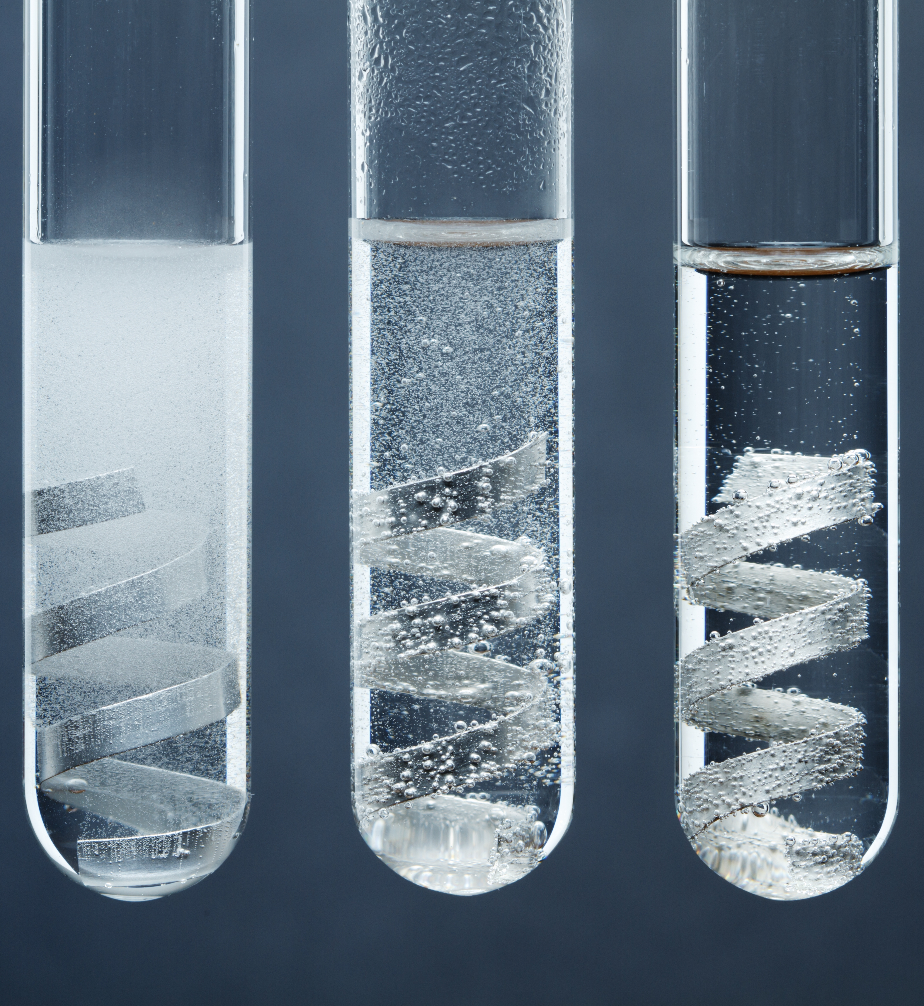
Introduction
Introduction
In this experiment, you will react magnesium ribbon with dilute hydrochloric acid to produce hydrogen gas.
By measuring the mass of magnesium ribbon that you started with and measuring the volume of hydrogen gas produced, you will be able to calculate the molar ratio of hydrogen to magnesium, and therefore the relative atomic mass of magnesium.
© Science Photo Library

Slide 3
Learning objectives
Learning objectives
Measure the volume of hydrogen gas produced during an acid−metal reaction.
Record accurate measurements of mass and volume in a results table.
Determine a molar ratio during a chemical reaction using balanced chemical equations.
Estimate the relative atomic mass of magnesium using your experimental results.

Slide 4
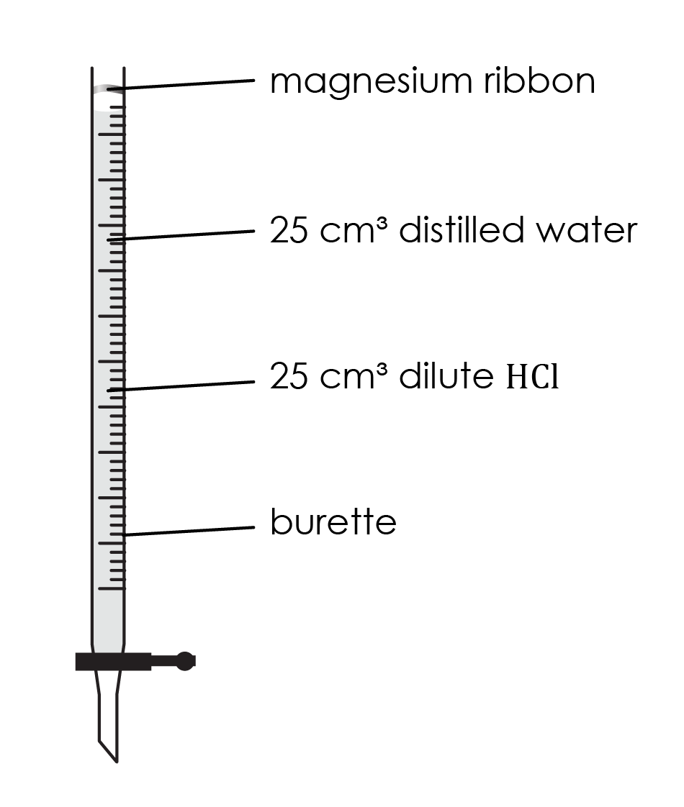
Method (part 1)
Method
Accurately measure the mass, to the nearest 0.001 g, of a length of magnesium ribbon, approximately 3–4 cm long. The mass should lie between 0.020 g and 0.040 g.
Ensure the burette tap is closed. Use a small funnel to pour 25 cm³ of dilute hydrochloric acid into the burette, followed carefully by 25 cm³ of water. Try to avoid mixing the two liquids as far as possible. Accurate volume measurements are not needed. This should leave a space of at least 5 cm between the liquid and the top of the burette.
Carefully push the magnesium ribbon into the open end of the burette, pushing the strip in the middle so that the springiness of the strip holds it in place against the glass. Do not allow it to touch the liquid at this stage.
Add about 50 cm³ of water to a 250 cm³ beaker.

Slide 5
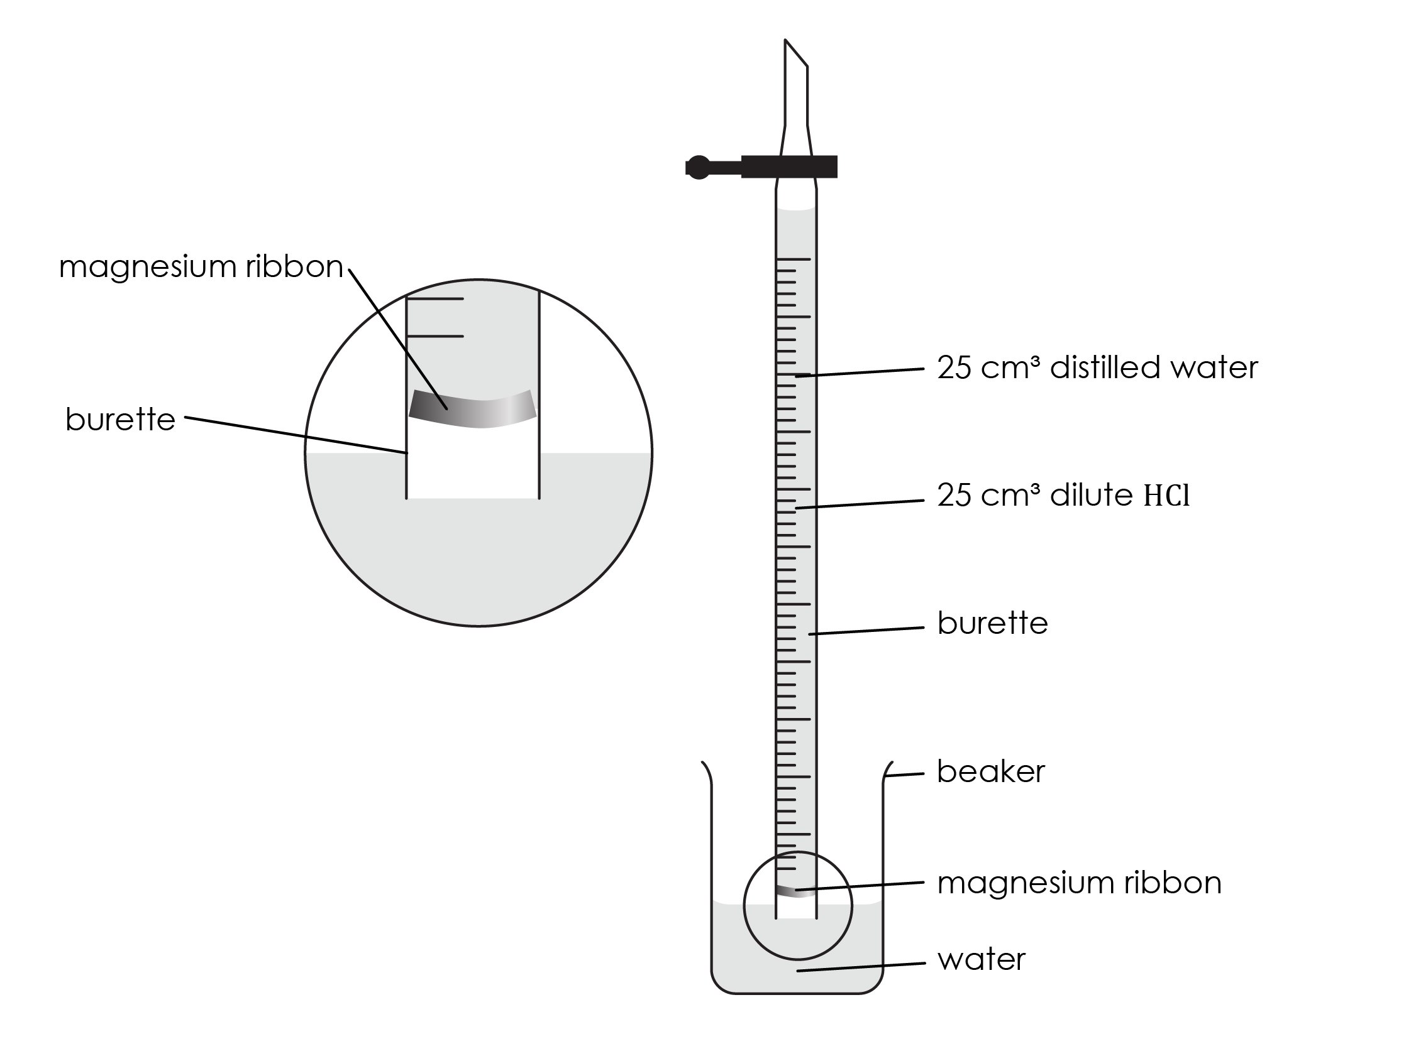
Method (part 2)
Method
Rest the top of the burette gently on the lip of the beaker, then quickly turn the burette upside-down and lower the end beneath the water in the beaker. If this is done quickly and carefully (your teacher will demonstrate this first), little or no liquid will be lost. Clamp the burette vertically in this upside-down position.
Without delay, check that the liquid level in the burette is on the scale – if it is not, open the tap for a moment to allow the level to drop onto the scale.
Take the burette reading of the liquid level. (Note: the scale is also now upside-down!)
As the acid diffuses downwards, the magnesium begins to react. Allow the metal to react completely.
Once the liquid level has stopped changing and no more gas bubbles are being formed, take the final burette reading and record the results.

Slide 6
Results
Results
Record your results in the table provided.
Mass of magnesium ribbon used / g
Start volume on burette / cm³
End volume on burette / cm³
Volume of hydrogen produced / cm³

Slide 7
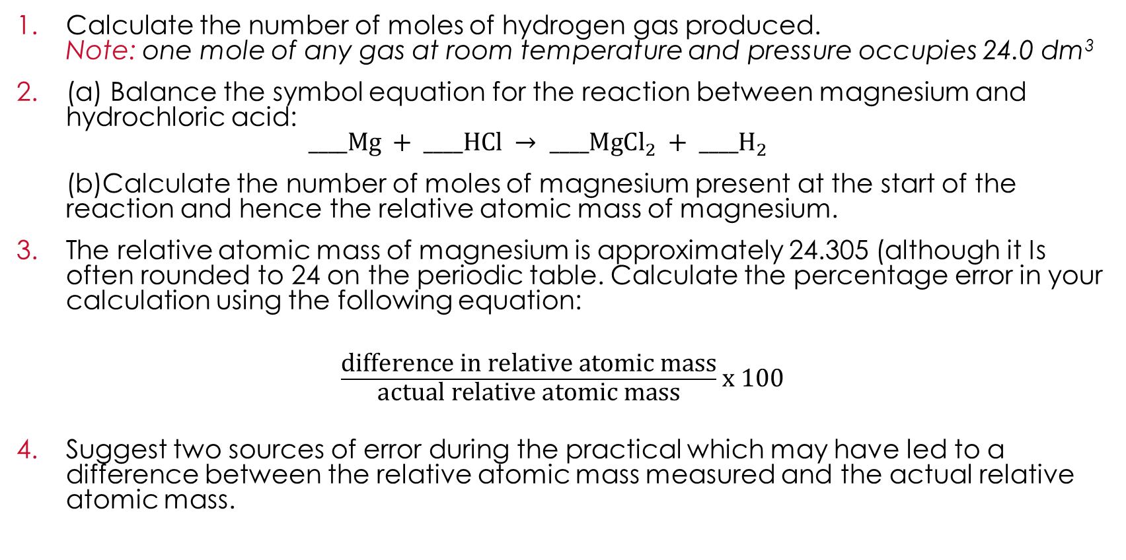
Follow-up questions
Questions
Calculate the number of moles of hydrogen gas produced.
Note: one mole of any gas at room temperature and pressure occupies 24.0 dm³
(a) Balance the symbol equation for the reaction between magnesium and hydrochloric acid:
$____Mg + ____HCl → ____Mg{Cl}_{2} + {____H}_{2}$
(b)Calculate the number of moles of magnesium present at the start of the reaction and hence the relative atomic mass of magnesium.
The relative atomic mass of magnesium is approximately 24.305 (although it Is often rounded to 24 on the periodic table. Calculate the percentage error in your calculation using the following equation:
$\frac{\text{d}\text{ifference} \text{in} \text{relative} \text{atomic} \text{mass}}{\text{a}\text{ctual} \text{relative} \text{atomic} \text{mass}}$x 100
Suggest two sources of error during the practical which may have led to a difference between the relative atomic mass measured and the actual relative atomic mass.

Slide 8
Further practice
Questions
The experiment was repeated using a small piece of calcium metal in place of the magnesium. The following results were obtained:
Mass of calcium used / g | 0.050
Start volume on burette / cm³ | 2.00
End volume on burette / cm³ | 32.00
Volume of hydrogen produced / cm³
(a) Calculate the number of moles of hydrogen gas produced and add the result to the table.
(b) Calculate the number of moles of hydrogen produced in the reaction.
Note: one mole of any gas at room temperature and pressure occupies 24.0 dm³

Slide 9
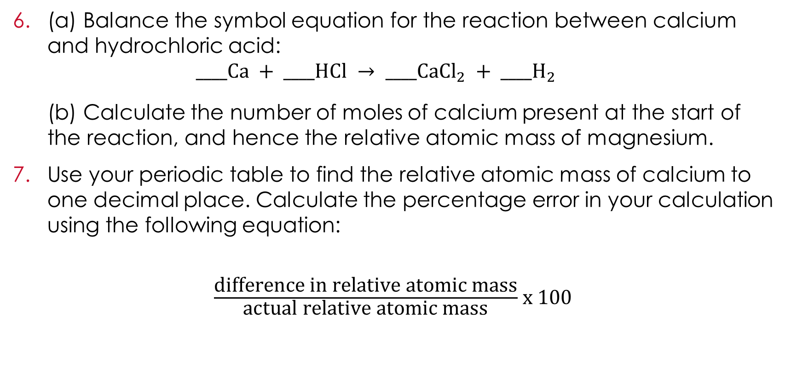
Further practice
Questions
(a) Balance the symbol equation for the reaction between calcium and hydrochloric acid:
$____Ca + ____HCl → ____Ca{Cl}_{2} + {____H}_{2}$
(b) Calculate the number of moles of calcium present at the start of the reaction, and hence the relative atomic mass of magnesium.
Use your periodic table to find the relative atomic mass of calcium to one decimal place. Calculate the percentage error in your calculation using the following equation:
$\frac{\text{d}\text{ifference} \text{in} \text{relative} \text{atomic} \text{mass}}{\text{a}\text{ctual} \text{relative} \text{atomic} \text{mass}}$x 100

