Slide 1
11–14 years
Key terms accessible glossary:
introducing chemical change
Downloaded from rsc.li/3Rej6T9, teacher notes also available

Slide 2
Contents
For how to use, metacognitive prompts, ideas for support and challenge and linked resources, visit: rsc.li/3Rej6T9
Reactants and products
Chemical reaction/change……...……slide 3
Conservation of mass…………….…..…slide 4
Product….………………..………….…….slide 5
Reactant…………………………………..slide 6
Representing chemical reactions
Balanced symbol equation..………..……slide 7
Chemical symbol……………….………..…slide 8
Chemical formula……..………….….…….slide 9
State symbol.…………………………..…..slide 10
Word equation………..……………..…….slide 11

Slide 3
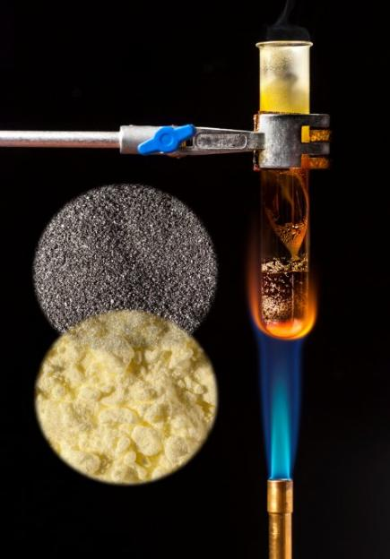


Chemical reaction/ change
when one or more new substances are made from other substances
In other words …
when something new is made from another chemical
Example
When iron and sulfur are heated together a chemical reaction occurs and iron sulfide is made
iron
Sign it
Watch a video:
bit.ly/3ZERn28
iron sulfide
Don’t confuse with …
A chemical reaction isn’t always chemicals combining to form one, it can also be larger compounds being broken down
sulfur
Say it
Cem-i-cel ry-ac-shen
© Science Photo Library

Slide 4
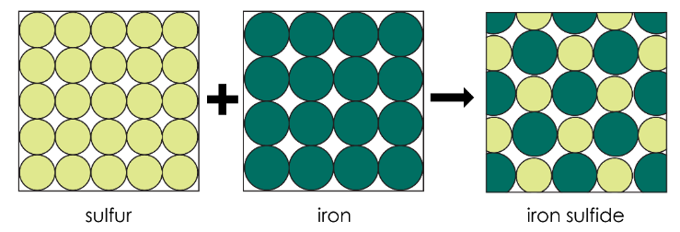
Conservation of mass
no atoms are lost or made during a chemical reaction, so the total mass of products equals the total mass of reactants
In other words …
the total mass of all of the substances before and after a reaction is always the same
Example
Conservation of mass means that if I react 28 g of iron with 16 g of sulfur I will make 44 g of iron sulfide
Say it
Con-sa-vay-shen ov mas
Don’t confuse with …
If a gas is involved in the reaction mass can appear to change but this is only because it is difficult to accurately measure the mass of a gas
28 g + 16 g → 44 g
In other words …
Conservation means keeping something the same

Slide 5
Product
a new substance that is made in a chemical reaction
In other words …
anything that is made in a reaction, or anything after the reaction arrow
Example
When iron reacts with sulfur the product is iron sulfide
Don’t confuse with …
reactants, these are the chemicals that react together
Sign it
Watch a video:
bit.ly/3MNlJg1
Other meanings
In maths you may have used the word product to
mean the result of multiplying two numbers together
Say it
Prod-uct

Slide 6
Reactant
a substance that you start with in a chemical reaction
In other words …
any of the chemicals that react together, or anything before the reaction arrow
Example
When iron and sulfur react to make iron sulfide the reactants are the iron and the sulfur
Sign it
Watch a video:
bit.ly/46biGor
Don’t confuse with …
products, which are what is made in the reaction
Similar words
Reaction is what happens when reactants react
Say it
Ry-act-tent

Slide 7
Balanced symbol equation
for a chemical reaction this shows the chemical formulas of the reactants and products separated by an arrow. Whole numbers may be written before the formulas to balance the equation
In other words …
when the number of atoms for each element is the same on both the left and right sides of an equation
Example
This is a balanced symbol equation because there are four hydrogen atoms and two oxygen atoms in the reactants and the products
2H₂ + O₂ → 2H₂O
H
H
H
H
O
Sign it
Watch a video:
bit.ly/4tuQ8Ae
+ →
O
O
H
H
H
H
O
Say it
Bal-en-st sim-bel
i-cway-si-en
Similar words
Word equation, this is when we write the names of the chemicals and don’t use the symbols

Slide 8
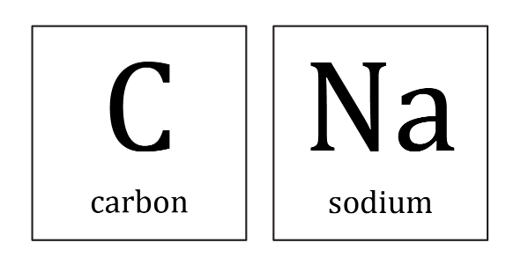


Chemical symbol
a single letter or two letters that is used to represent an element, such as C for carbon, Na for sodium
In other words …
a chemical symbol is a short way of writing the name of an element using one or two letters
Example
The chemical symbol for carbon is C
Sign it
Watch a video:
bit.ly/3Z25eQ6
Don’t confuse with …
initials. Some elements have chemical symbols which match their name in English, e.g. O is for oxygen. Other elements, such as gold, Au, have unexpected chemical symbols, as their names come from other languages
Say it
Cem-i-cel sim-bel
Break it down
Chemical (relating to substances), symbol (a sign or a letter to represent something)
Similar words
Element symbol

Slide 9
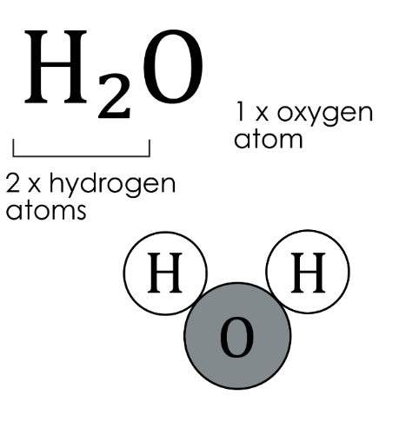
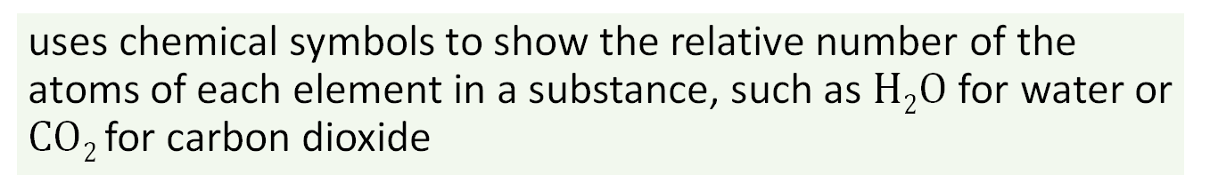
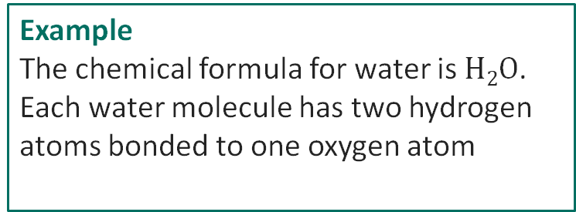
Chemical formula
uses chemical symbols to show the relative number of the atoms of each element in a substance, such as $H2O$ for water or $CO2$for carbon dioxide
In other words …
this type of formula gives the chemical symbols of the elements whose atoms make up the substance. The formula also shows the relative numbers of these atoms
Example
The chemical formula for water is $H2O$. Each water molecule has two hydrogen atoms bonded to one oxygen atom
Don’t confuse with…
Whole numbers used to balance a chemical equation
Say it
Cem-i-cel form-ya-la
Other meanings
A formula can also mean a set of instructions, like a maths formula, or a recipe
Break it down
Chemical (relating to substances), formula (a set way of writing things)

Slide 10
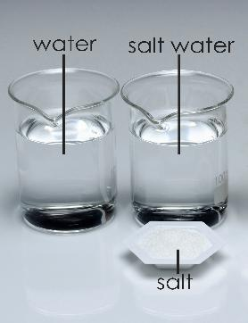
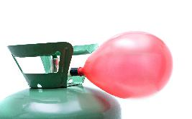
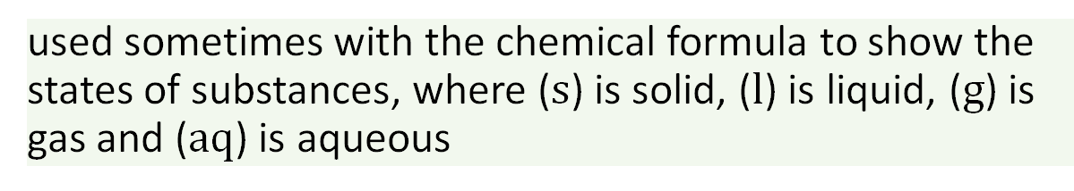
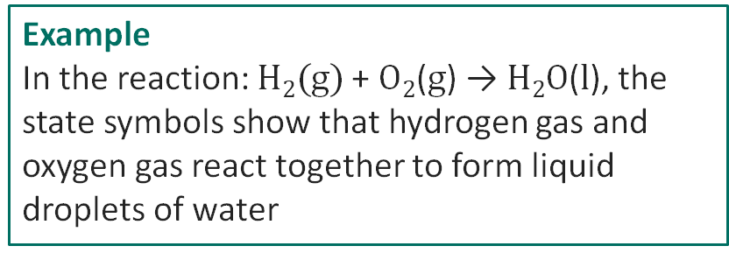
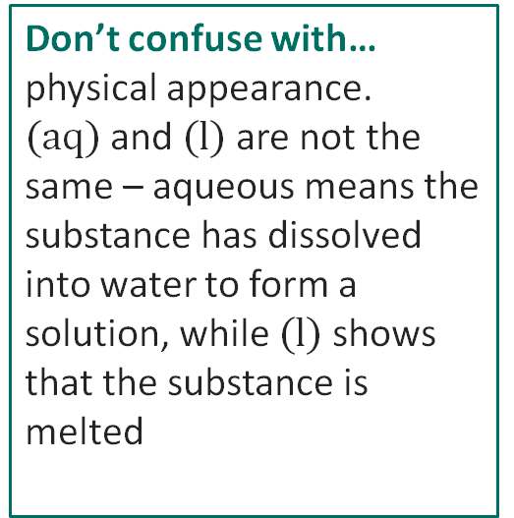
State symbol
used sometimes with the chemical formula to show the states of substances, where ($s$) is solid, ($l$) is liquid, ($g$) is gas and ($aq$) is aqueous
In other words …
a state symbol is a small letter in brackets that tells us whether a substance is in the solid, liquid or gas state or dissolved in water (aqueous)
Example
In the reaction: $H2(g)$+ $O2$($g$) → $H2O$($l$), the state symbols show that hydrogen gas and oxygen gas react together to form liquid droplets of water
Sign it
Watch a video:
bit.ly/4iMfO4Q
(l)
(aq)
Don’t confuse with…
physical appearance. $(aq)$and $(l)$are not the same – aqueous means the substance has dissolved into water to form a solution, while $(l)$shows that the substance is melted
Say it
St-ay-t sim-bel
Break it down
State (the form something is in), symbol (a sign or letter to represent something)
(s)
helium (g)

Slide 11

Word equation
for a chemical reaction, this shows the names of the reactants and products separated by an arrow
In other words …
a way to show a reaction using the names of chemicals and not their symbols
Example
The word equation for
our reaction was
iron + sulfur → iron sulfide
Sign it
Watch a video:
bit.ly/4ak5u31
Don’t confuse with …
symbol equation which just uses the chemical symbols and not their names
Say it
Wir-d i-cway-si-en
Notes:
Image © Science Photo Library

Slide 12
Acknowledgements
Image on slides 3 and 11 © Martyn F. Chillmaid/ Science Photo Library
All other images © Royal Society of Chemistry
SSC BSL glossaries of curriculum terms https://www.ssc.education.ed.ac.uk/BSL/
British sign language dictionary
https://www.signbsl.com/

