Slide 1
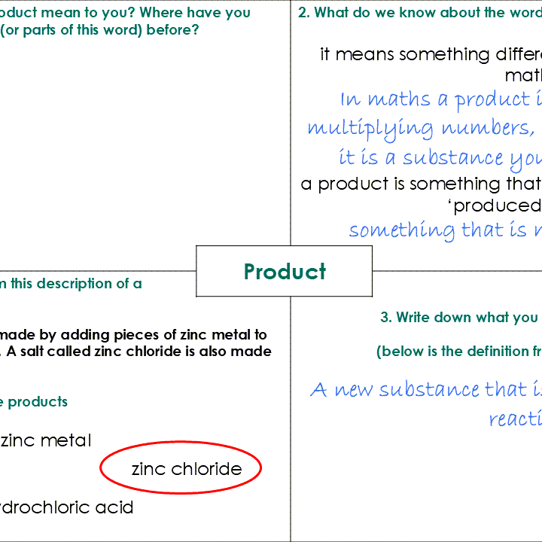

11–14 years
Introducing chemical change: Frayer models
Downloaded from rsc.li/3Rej6T9

Slide 2

How to use Frayer models
Frayer models are a simple but effective way to develop learners’ understanding of a new piece of vocabulary. You will see what your learners already know and identify any misconceptions they have.
There are four stages to work through, but you can adapt this model to best suit your learners. You can guide learners through all quadrants, but particularly quadrant 2 works best as a teacher-led discussion. Quadrant 3 might also need/benefit from some discussion.
Explore Link to science capital and draw on learners’ experience | 2. Break down Look at the composite parts of the word to help unpack its meaning
4. Consolidate Learners apply their knowledge | 3. Explain Introduce the definition
Key term
Find more guidance including tips, adaptations and further reading, in the teacher notes: rsc.li/3Rej6T9.

Slide 3
1. What does the word ‘reaction’ mean to you? Where have you come across this word (or parts of this word) before? Here are some ideas. Other similar words beginning with ‘re’ are ‘response’ and ‘repeat’ – in what way are they similar to ‘reaction’? What do we mean when we use the word ‘reaction’ to describe how someone behaves when something happens to them? | 2. What do we know about the terms ‘chemical reaction’ or ‘chemical change’? Chemical reaction and chemical change are two terms for the same thing, so what do we mean by: reaction change How is a chemical change different from a physical change?
4. Circle the statement below that applies to a chemical reaction or chemical change and not to a physical change. A one or more new substances are formed B it may be accompanied by a transfer of energy to or from the surroundings C it involves a change in state D the atoms emit ionising radiation | 3. Write down what you think ‘chemical reaction’ means (complete the sentence). When one or more new substances … | Compare what you wrote with the definition (slide 6).
Chemical reaction/change
Notes:
Information for quadrant 2: the word ‘chemical’ is used to distinguish a chemical change from a physical change. In a physical change no new substance is produced.
Answer to quadrant 3: when one or more new substances are made from other substances.

Slide 4
1. What does the word ‘product’ mean to you? Where have you come across this word (or parts of this word) before? Here are some ideas. A ‘product’ in maths is the answer you get when you multiply numbers together. In chemistry, the word ‘product’ is used more like in everyday use – to describe something that is produced by a process. Here is an example ‘the art student was really pleased with the finished product’. | 2. What do we know about the word ‘product’? It means something different in chemistry than in maths. A product is something that is produced – what does ‘produced’ mean?
4. Identify the products from this description of a chemical reaction. Hydrogen gas can be made by adding pieces of zinc metal to dilute hydrochloric acid. A salt called zinc chloride is also made by this reaction. Draw a circle around the products. | 3. Write down what you think ‘product’ means (fill in the missing words). A new ___________ that is ___________ in a ___________ reaction. | Compare what you wrote with the definition (slide 7).
Product
zinc metal
hydrogen gas
zinc chloride
hydrochloric acid
Notes:
Information for quadrant 2: a product is something that is produced - something that is made by a process.
Answer to quadrant 3: a new substance that is made in a chemical reaction.

Slide 5
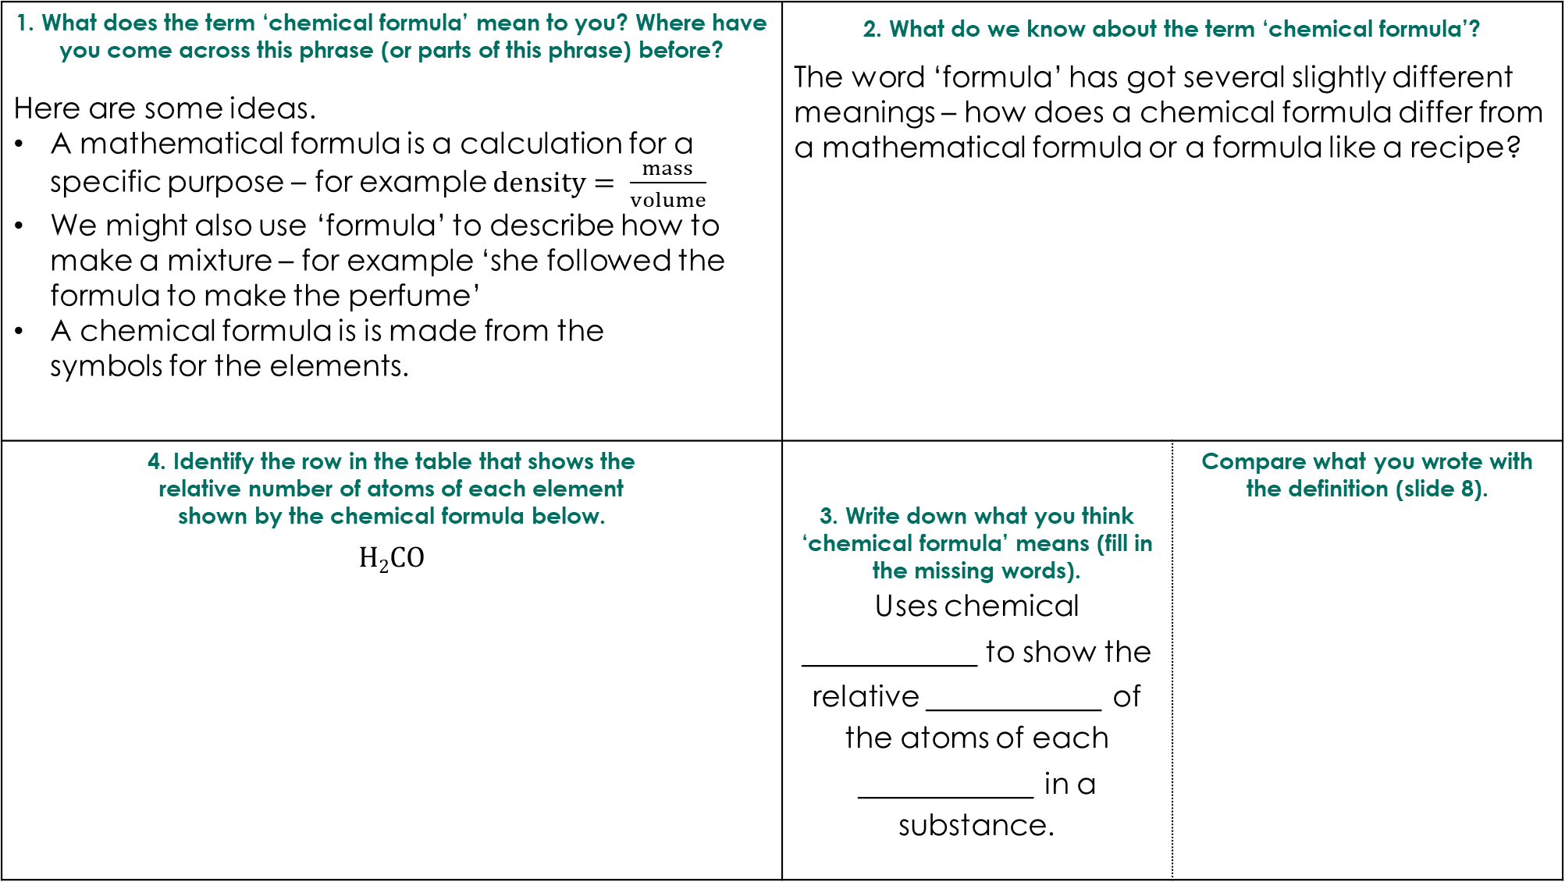
1. What does the term ‘chemical formula’ mean to you? Where have you come across this phrase (or parts of this phrase) before? Here are some ideas. A mathematical formula is a calculation for a specific purpose – for example $density= \frac{mass}{volume}$ We might also use ‘formula’ to describe how to make a mixture – for example ‘she followed the formula to make the perfume’ A chemical formula is is made from the symbols for the elements. | 2. What do we know about the term ‘chemical formula’? The word ‘formula’ has got several slightly different meanings – how does a chemical formula differ from a mathematical formula or a formula like a recipe?
4. Identify the row in the table that shows the relative number of atoms of each element shown by the chemical formula below. H₂CO | 3. Write down what you think ‘chemical formula’ means (fill in the missing words). Uses chemical _________ to show the relative _________ of the atoms of each _________ in a substance. | Compare what you wrote with the definition (slide 8).
Chemical formula
Element and symbol | Carbon C | Cobalt Co | Hydrogen H | Oxygen O
A | 2 | 0 | 1 | 1
B | 0 | 2 | 1 | 0
C | 1 | 0 | 2 | 1
D | 0 | 1 | 2 | 0
Notes:
Information for quadrant 2: a chemical formula contains symbols for the elements in the substance. From the latin ‘forma’ meaning form + ‘ula’ diminutive, i.e. little.
Answer to quadrant 3: uses chemical symbols to show the relative number of the atoms of each element in a substance.

Slide 6
1. What does the word ‘reaction’ mean to you? Where have you come across this word (or parts of this word) before? Here are some ideas. Other similar words beginning with ‘re’ are ‘response’ and ‘repeat’ – in what way are they similar to ‘reaction’? We also use ‘reaction’ to describe how someone behaves when something happens to them. | 2. What do we know about the terms ‘chemical reaction’ or ‘chemical change’? Chemical reaction and chemical change are two terms for the same thing, so what do we mean by: reaction Something that happens – caused by something else. change A process where something becomes different. The word ‘chemical’ is used to distinguish this type of change from a physical change.
4. Circle the statement below that applies to a chemical reaction or chemical change and not to a physical change. A one or more new substances are formed B it may be accompanied by a transfer of energy to or from the surroundings C it involves a change in state D the atoms emit ionising radiation | 3. Write down what you think ‘chemical reaction’ means (complete the sentence). When one or more new substances … are made from other substances. (Below is the definition from the key terms list) When one or more new substances are made from other substances.
Chemical reaction/change

Slide 7
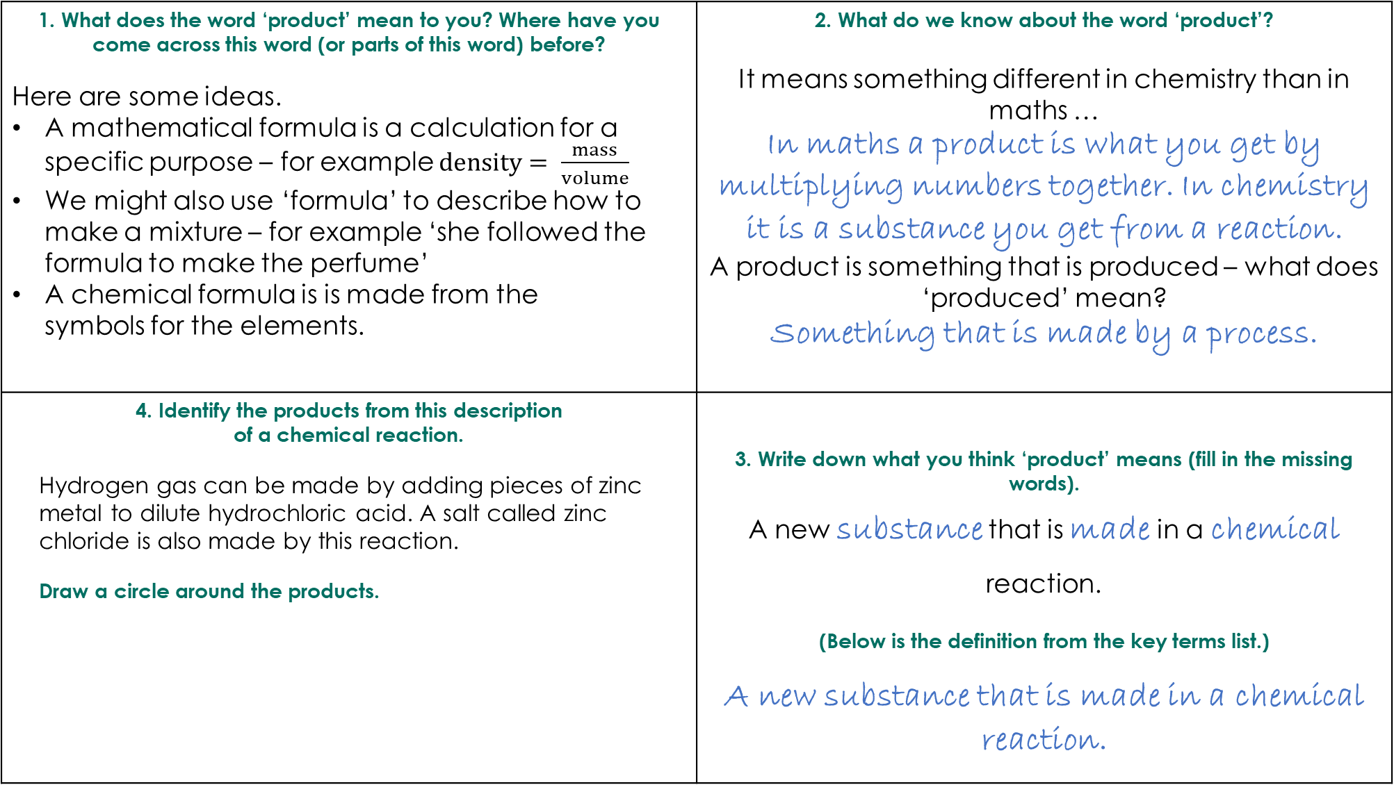
1. What does the word ‘product’ mean to you? Where have you come across this word (or parts of this word) before? Here are some ideas. A mathematical formula is a calculation for a specific purpose – for example $density= \frac{mass}{volume}$ We might also use ‘formula’ to describe how to make a mixture – for example ‘she followed the formula to make the perfume’ A chemical formula is is made from the symbols for the elements. | 2. What do we know about the word ‘product’? It means something different in chemistry than in maths … In maths a product is what you get by multiplying numbers together. In chemistry it is a substance you get from a reaction. A product is something that is produced – what does ‘produced’ mean? Something that is made by a process.
4. Identify the products from this description of a chemical reaction. Hydrogen gas can be made by adding pieces of zinc metal to dilute hydrochloric acid. A salt called zinc chloride is also made by this reaction. Draw a circle around the products. | 3. Write down what you think ‘product’ means (fill in the missing words). A new substance that is made in a chemical reaction. (Below is the definition from the key terms list.) A new substance that is made in a chemical reaction.
Product
zinc metal
hydrogen gas
zinc chloride
hydrochloric acid

Slide 8
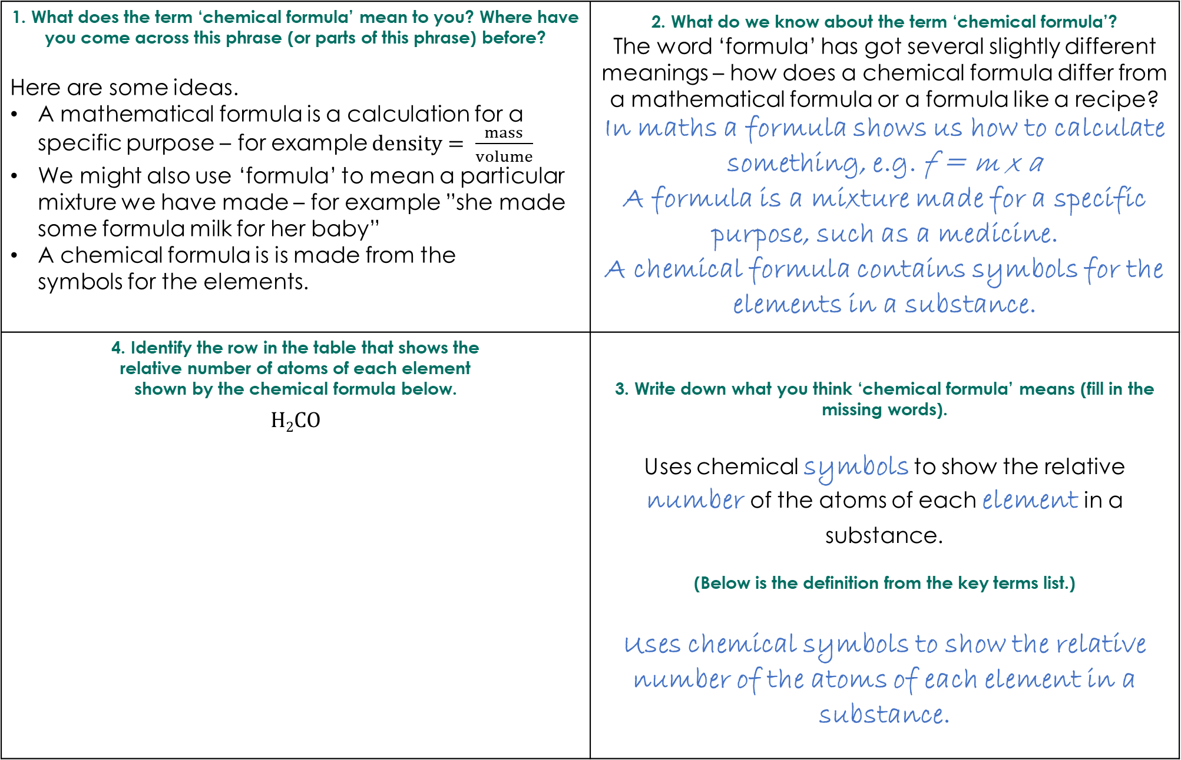
1. What does the term ‘chemical formula’ mean to you? Where have you come across this phrase (or parts of this phrase) before? Here are some ideas. A mathematical formula is a calculation for a specific purpose – for example $density= \frac{mass}{volume}$ We might also use ‘formula’ to mean a particular mixture we have made – for example ”she made some formula milk for her baby” A chemical formula is is made from the symbols for the elements. | 2. What do we know about the term ‘chemical formula’? The word ‘formula’ has got several slightly different meanings – how does a chemical formula differ from a mathematical formula or a formula like a recipe? In maths a formula shows us how to calculate something, e.g. f = m x a A formula is a mixture made for a specific purpose, such as a medicine. A chemical formula contains symbols for the elements in a substance.
4. Identify the row in the table that shows the relative number of atoms of each element shown by the chemical formula below. H₂CO | 3. Write down what you think ‘chemical formula’ means (fill in the missing words). Uses chemical symbols to show the relative number of the atoms of each element in a substance. (Below is the definition from the key terms list.) Uses chemical symbols to show the relative number of the atoms of each element in a substance.
Chemical formula
Element and symbol | Carbon C | Cobalt Co | Hydrogen H | Oxygen O
A | 2 | 0 | 1 | 1
B | 0 | 2 | 1 | 0
C | 1 | 0 | 2 | 1
D | 0 | 1 | 2 | 0
Notes:
Information for quadrant 2: a chemical formula contains symbols for the elements in the substance. From the latin ‘forma’ meaning form + ‘ula’ diminutive, i.e. little.

Slide 9
1. Explore Link to science capital and draw on learners’ experience. | 2. Break down/’what do we know about X?’ Look at composite parts of the word to help unpack its meaning. Or invite learners to suggest what, as a class, they already know about the key term (with the help of a few bullet points).
4. Consolidate Learners apply their knowledge. | 3. Explain Introduce the definition.
Select your key term

