Slide 1
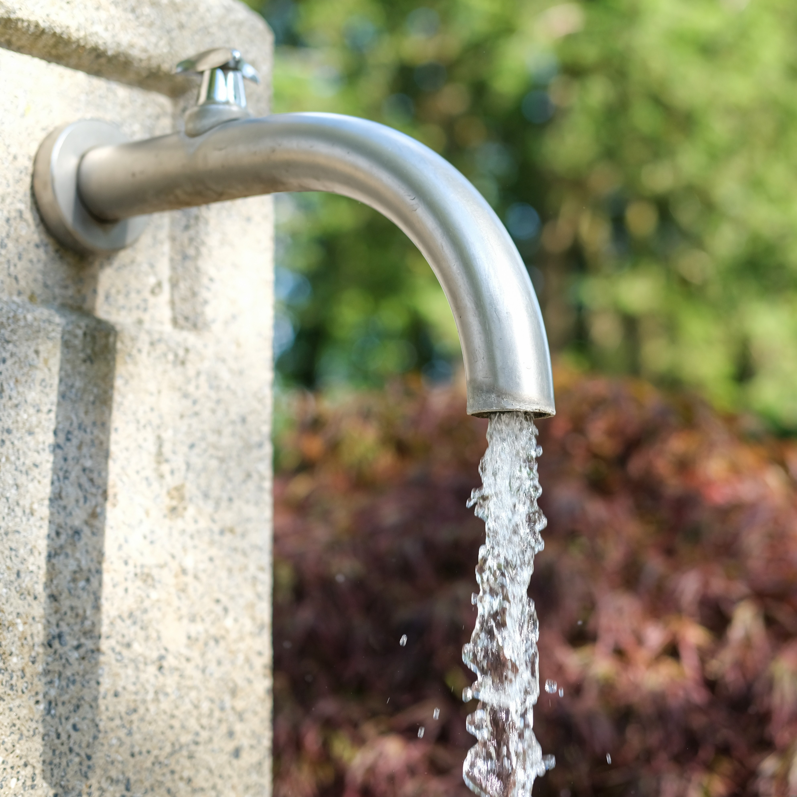
14–16 years
The composition and formula of water

Slide 2
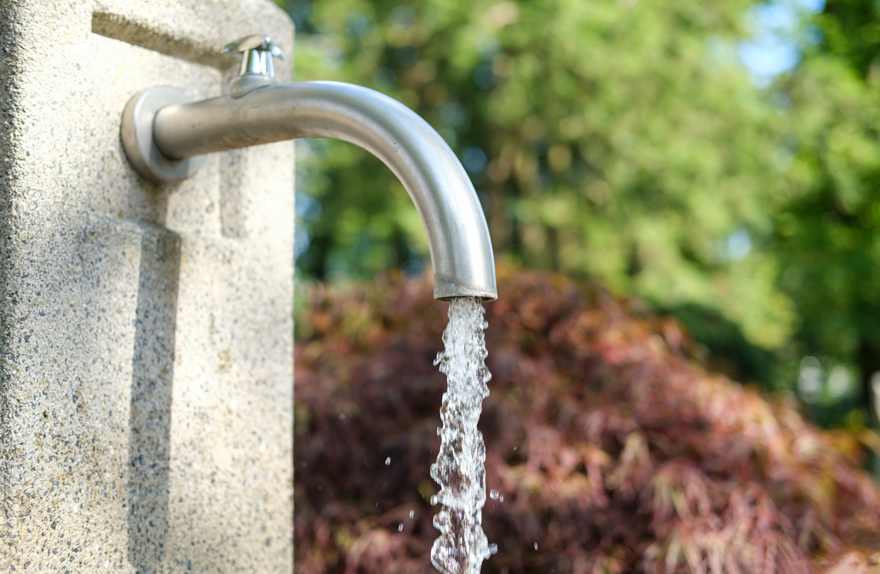
Water, an essential compound
Introduction
Water is an essential compound. Without water, life on Earth could not exist. Both plants and animals depend on water to keep them alive.
In this teacher demonstration we will investigate the composition of water.
You will observe the reaction between copper(II) oxide and hydrogen and use the results to determine the formula of water.
© Redaktion93 / Shutterstock

Slide 3
Learning objectives
Learning objectives
Describe how water is formed during the redox reaction of copper oxide with hydrogen.
Accurately record experimental observations and data.
Determine the formula of water from the experimental data.

Slide 4
Questions
Scaffolded questions
Write the word equation for the reaction.
Select the correct words to complete the sentences.
In a redox reaction, oxidation and reduction occur at the same time.
Reduction occurs when a substance loses/gains oxygen. Oxidation occurs when a substance loses/gains oxygen.
In this experiment, the copper oxide is oxidised/reduced and the hydrogen is oxidised/reduced.
Notes:
Questions to ask your learners whilst you are setting up the demonstration.
Learners may initially note down their answers on a mini whiteboard before moving onto completing the student worksheets.

Slide 5
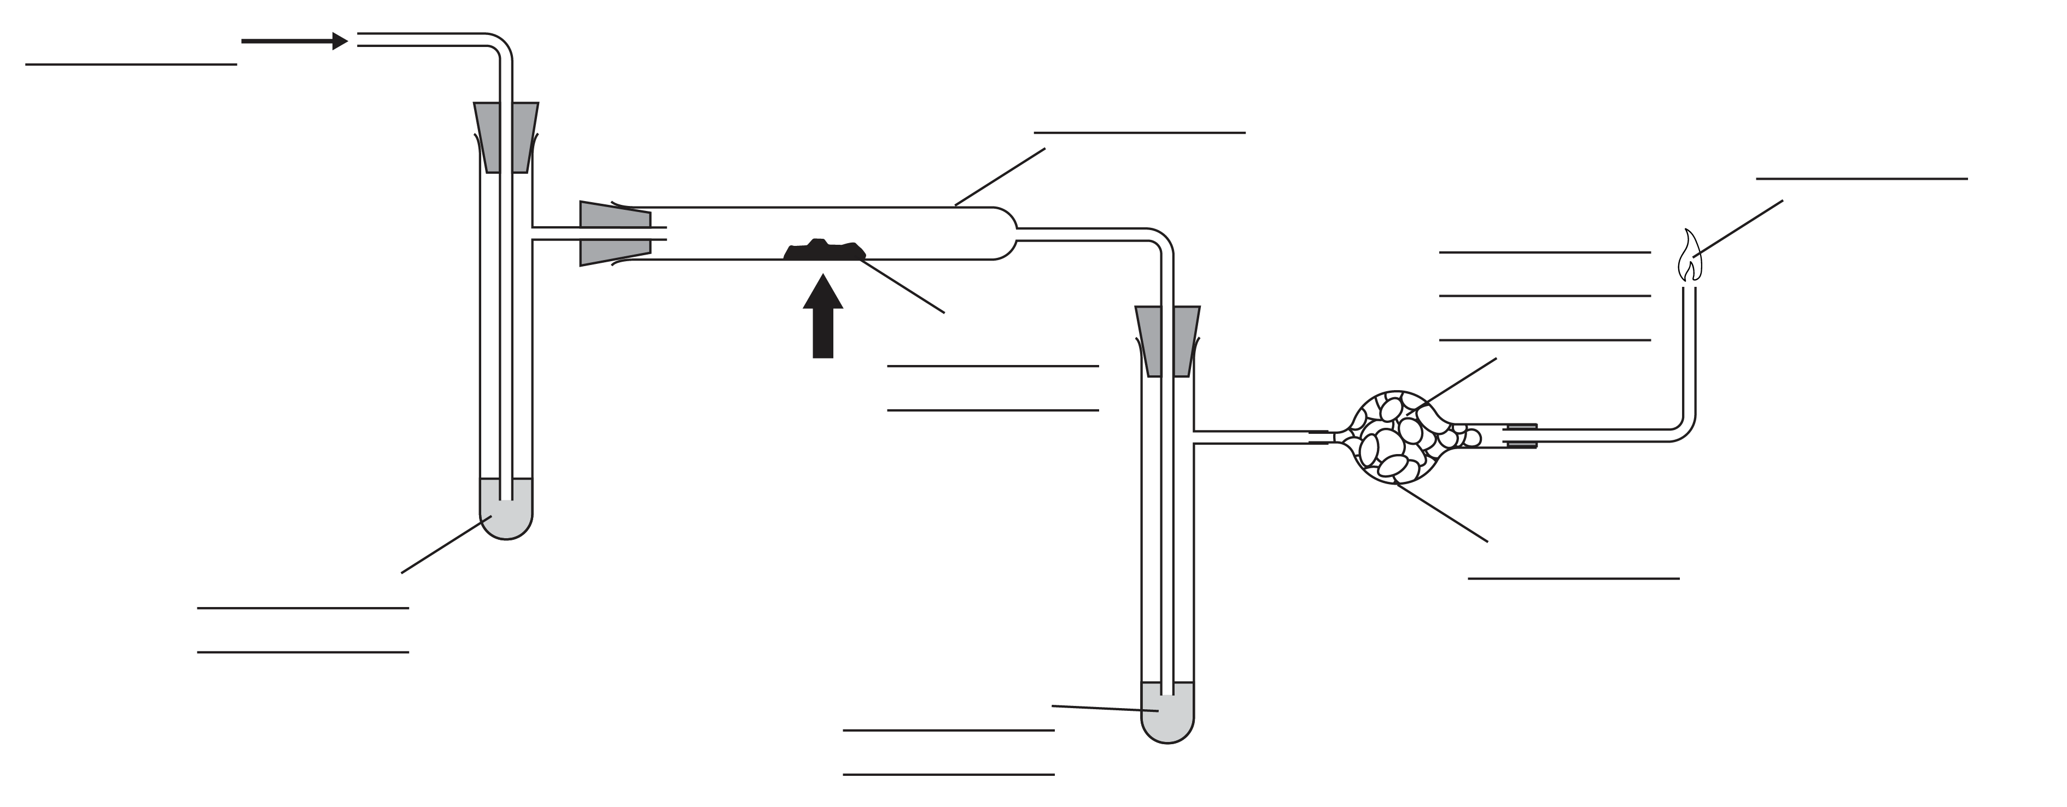
Questions
Scaffolded questions
Label the diagram using the following words:
concentrated sulfuric acid heat drying tube
combustion tube copper oxide hydrogen in
exhaust fumes anhydrous copper chloride

Slide 6
Questions
Scaffolded questions
State why concentrated sulfuric acid was added to the side arms.
Hint: Concentrated sulfuric acid is a drying agent.
It was added to the left-hand arm to dry ______________________________
It was added to the right-hand arm to _________________________________
List two safety precautions taken during the reaction.
Record the masses in the table.
 | Mass before heating / g | Mass after heating / g
Mass of combustion tube and contents
Mass of combustion tube, side arm and contents

Slide 7
Questions
Scaffolded questions
Note your observations in a table.
Use the final column to explain your observation.
 | Observations | Explanations
Before heating
During heating
After heating

Slide 8
Questions
Scaffolded questions
Use the data recorded in your table to calculate:
The mass of oxygen lost from the copper oxide (M5) = M1 – M2 = _________ g
The mass of water formed during the reaction (M6) = M4 – M3 = ___________ g
The mass of hydrogen in the water formed (M7) = M6 − M5 = _____________ g
The relative atomic mass of oxygen is 16 and the relative atomic mass of hydrogen is 1.
Calculate:
The number of moles of oxygen in the water = M5/16 = __________ mol
The number of moles of hydrogen in the water = M7/1 = _________ mol
The mole ratio of H:O in the water = ________________

Slide 9
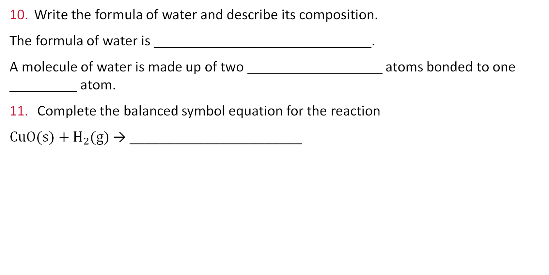
Questions
Scaffolded questions
Write the formula of water and describe its composition.
The formula of water is _____________________________.
A molecule of water is made up of two __________________ atoms bonded to one _________ atom.
Complete the balanced symbol equation for the reaction
CuO(s)$+ H_{2}$(g) → _______________________

Slide 10
Questions
Unscaffolded questions
During the demonstration, listen to your teacher and answer the following questions.
Write the word equation for the reaction.
Describe what happens during a redox reaction. Include what is oxidised and what is reduced.
Label the diagram.

Slide 11
Questions
Unscaffolded questions
State why was concentrated sulfuric acid added to the side arm.
List two safety precautions that should be taken during the reaction.
Record the masses in the table
 | Mass before heating / g | Mass after heating / g
Mass of combustion tube and contents
Mass of combustion tube, side arm and contents

Slide 12
Questions
Unscaffolded questions
Note down your observations in the table.
Use the final column to explain your observation.
 | Observations | Explanations
Before heating
During heating
After heating

Slide 13
Questions
Unscaffolded questions
Use the data recorded in your table to calculate:
The mass of oxygen lost from the copper oxide (M5) = M1 – M2 = _________ g
The mass of water formed during the reaction (M6) = M4 – M3 = ___________ g
The mass of hydrogen in the water formed (M7) = M6 − M5 = _____________ g
The relative atomic mass of oxygen is 16 and the relative atomic mass of hydrogen is 1.
Calculate:
The number of moles of oxygen in the water = M5/16 = __________ mol
The number of moles of hydrogen in the water = M7/1 = _________ mol
The mole ratio of H:O in the water = ________________

Slide 14
Questions
Unscaffolded questions
Write the formula of water and describe its composition.
Write the balanced symbol equation for the reaction.

Slide 15
Answers
Answers
copper oxide + hydrogen → copper + water
In a redox reaction, oxidation and reduction occur at the same time.
Reduction occurs when a substance loses oxygen. Oxidation occurs when a substance gains oxygen.
In this experiment, the copper oxide is reduced and the hydrogen is oxidised.

Slide 16
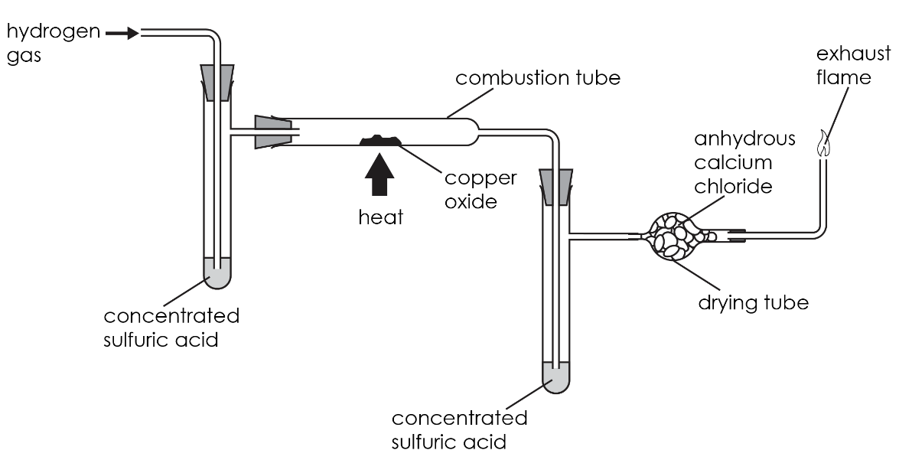
Answers
Answers

Slide 17
Answers
Answers
Concentrated sulfuric acid was added to the left-hand arm to dry the hydrogen gas.
It was added to the right-hand arm to collect the water produced during the reaction.
Any two of:
Wear safety goggles
Light the exhaust gas to stop flammable hydrogen gas going into the room
Wear gloves when handling concentrated sulfuric acid
Use experimental data to complete the table.

Slide 18
Answers
Answers
 | Observations | Explanations
Before heating | The solid in the combustion tube was black | Copper oxide was present
During heating | A colourless liquid was seen on the side of the combustion tube | Water formed during the reaction. It then turned into water vapour when it got hot and exaporated
After heating | The solid in the combustion tube was a pink colour | Copper metal was present

Slide 19
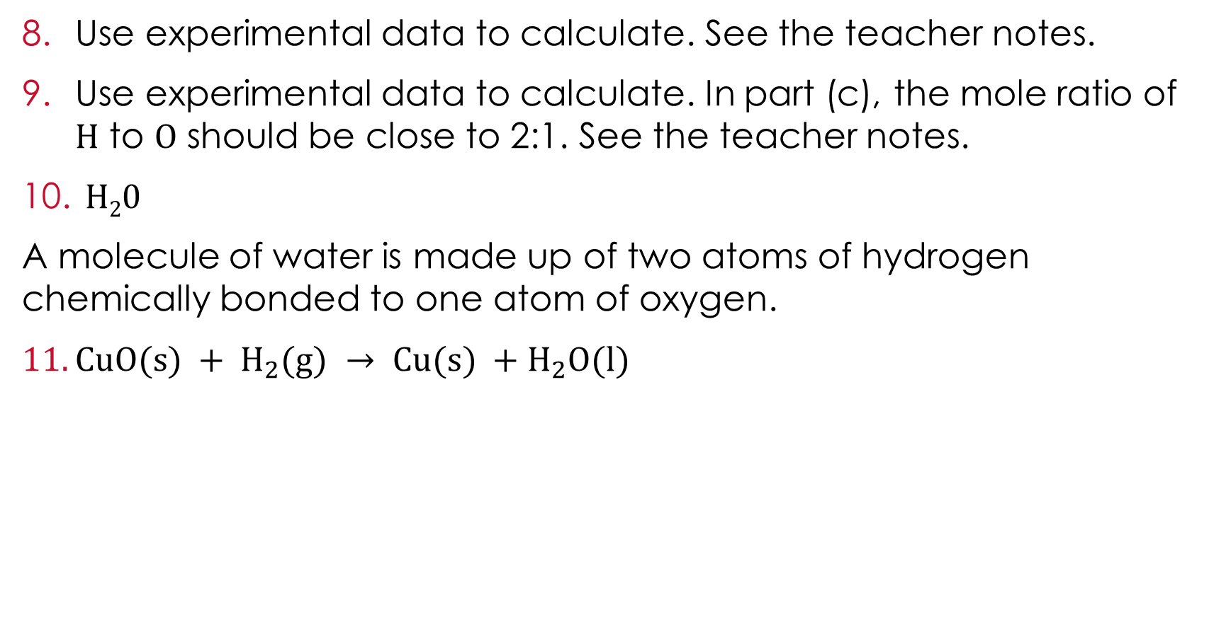
Answers
Answers
Use experimental data to calculate. See the teacher notes.
Use experimental data to calculate. In part (c), the mole ratio of H to O should be close to 2:1. See the teacher notes.
H₂0
A molecule of water is made up of two atoms of hydrogen chemically bonded to one atom of oxygen.
$CuO(s) + H_{2}(g) → Cu(s) +H_{2}O(l)$

Slide 20
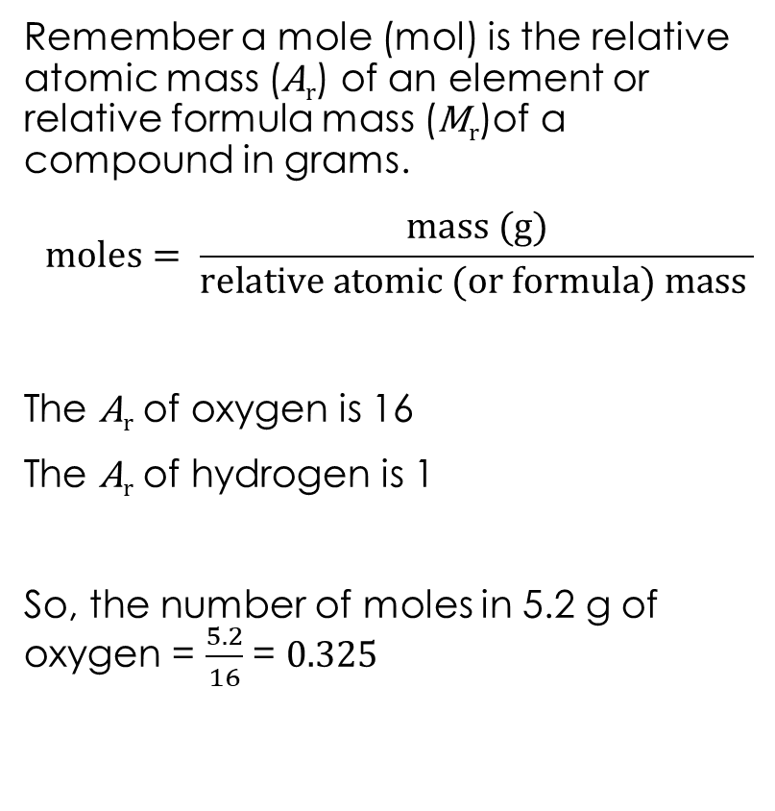
Mole calculations
Mole calculations
Remember a mole (mol) is the relative atomic mass (A_{r}) of an element or relative formula mass (M_{r})of a compound in grams.
$$moles= \frac{mass (g)}{relative atomic (or formula) mass }$$
The A_{r} of oxygen is 16
The A_{r} of hydrogen is 1
So, the number of moles in 5.2 g of oxygen = $\frac{5.2}{16}$ = 0.325
Calculate:
The number of moles of oxygen in the water
The number of moles of hydrogen in the water
The mole ratio of H:O in the water
Hint: to work out a mole ratio, divide the larger number by the smaller number.
Write down the formula of water and describe its composition.

