Slide 1
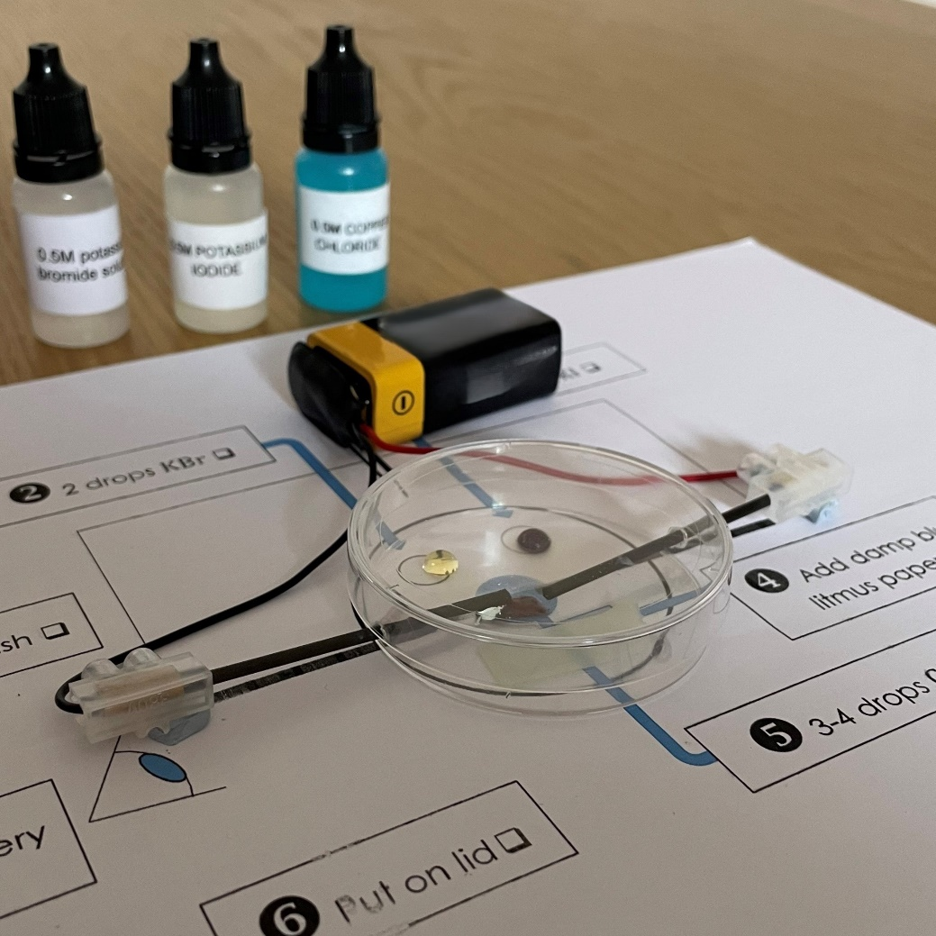
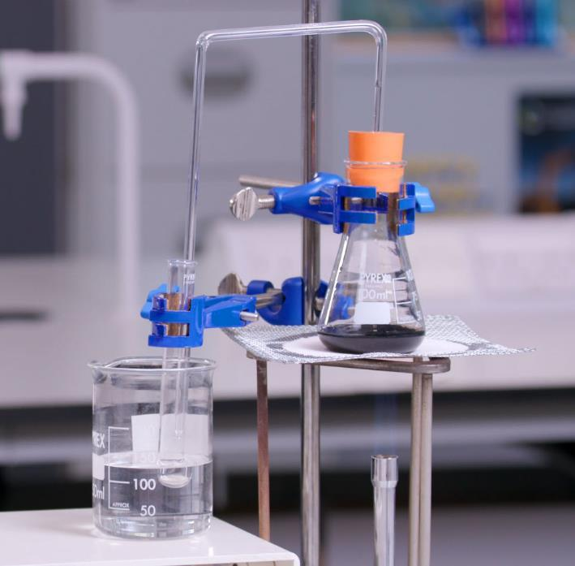
Electrolysis graddfa micro
Cyfarwyddiadau integredig
Notes:
This resource is based on a method developed by CLEAPSS, PP059 Micro-electrolysis of copper(II) chloride solution, available at https://science.cleapss.org.uk/
Image © Royal Society of Chemistry, Emma Lumb

Slide 2
Cyfarwyddiadau integredig
Mae cyfarwyddiadau integredig yn defnyddio rhifo clir, saethau a phictogramau syml, fel llygad i ddangos pryd i wneud arsylwadau. Cawsant eu datblygu gan ddefnyddio theori llwyth gwybyddol ac maen nhw’n dileu gwybodaeth ddiangen. Felly, mae'r cyfarwyddiadau yn lleihau'r llwyth diangen ar ddysgwyr, gan gynyddu gallu eu cof gweithredol i feddwl am yr hyn y maent yn ei wneud a pham.
Darllenwch fwy yn rsc.li/47bIKi5 .
Rhagarweiniad

Slide 3


Cyfarwyddiadau integredig: electrolysis
❖ 2 ddiferyn KBr 
⬥ 2 ddiferyn KI 
◆ Rhowch electrodau mewn dysgl petri 
 Cysylltwch â batri. Arsylwch 
 Ychwanegwch bapur litmws glas llaith 
 Rhowch gaed 
 3–4 ddiferyn CuCl₂ 
RSC cemeg graddfa micro
Electrolysis
Lawrlwytho o rsc.li/4lgoKm4
Notes:
Method:
Measure out 20 cm³ of the coloured solution in a measuring cylinder and pour it into the conical flask.
Add a few anti-bumping granules to the flask.
Clamp the conical flask on a tripod and gauze over a Bunsen burner sitting on a heatproof mat.
Take the delivery tube and place the bung in the top of the conical flask and the other end of the delivery tube in the test tube in the beaker.
Add ice water to the beaker.
Light the Bunsen burner on the yellow safety flame, then open the air hole so you have a blue flame. Heat the solution until it boils, then turn down the Bunsen burner flame by reducing the gas so it boils gently until you collect 1 cm³ of distillate in the test tube.
Place some white anhydrous copper (II) sulfate onto a watch glass and use a pipette to add a few drops of the product on to it to see if you’ve collected water.

