Slide 1
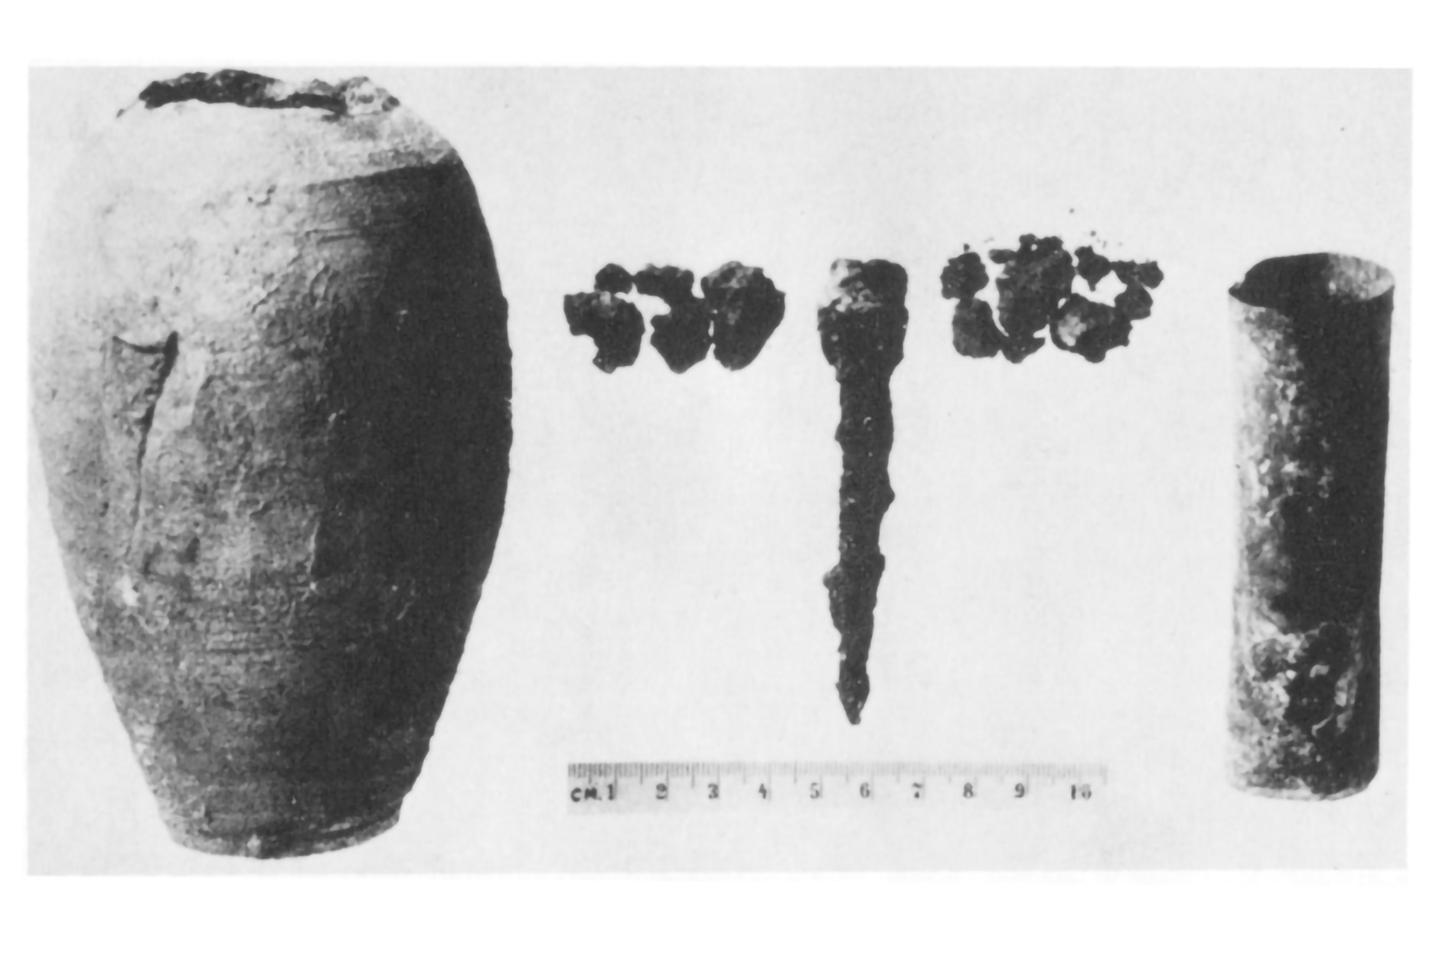
Was the Baghdad battery really two cells?
Science research news
Slide by Neil Goalby. Available from rsc.li/4tDO08M
A new study of a 2000 year-old artefact known as the Baghdad battery suggests it was not just a single electrochemical cell. Although the artefact was found in fragments, it seems to have consisted of a clay jar containing a sealed copper vessel surrounding an iron rod. The clay jar may have acted as a porous separator between an alkaline electrolyte and the ambient air. This design could have meant the outer cell and inner cell created by the copper and iron were connected in electrical series, creating a battery that produced 1.4 volts.
© Courtesy of Alexander Bazes
Researchers have suggested that the iron and copper in the jar would have acted as electrodes, with an acidic liquid stored inside acting as the electrolyte
Questions
How is a battery made from electrochemical cells? Suggest how the copper and iron vessel acted as a cell. Suggest why there is uncertainty about whether the artefact was a battery.
Notes:
This slide summarises a recent article published by Chemistry World. Use this as a lesson starter when teaching about electrochemical cells.
Answers
Batteries consist of two or more cells connected in series.
The copper vessel and iron rod may have acted as electrodes, with the vessel containing an electrolyte. Cells can be made from two different metals in contact with an electrolyte.
The battery was found in fragments. There is no evidence about what it might have been used for. There is no real evidence electrical cells were in use 2000 years ago. Some researchers do not think it was a cell and have suggested other uses.

