Slide 1
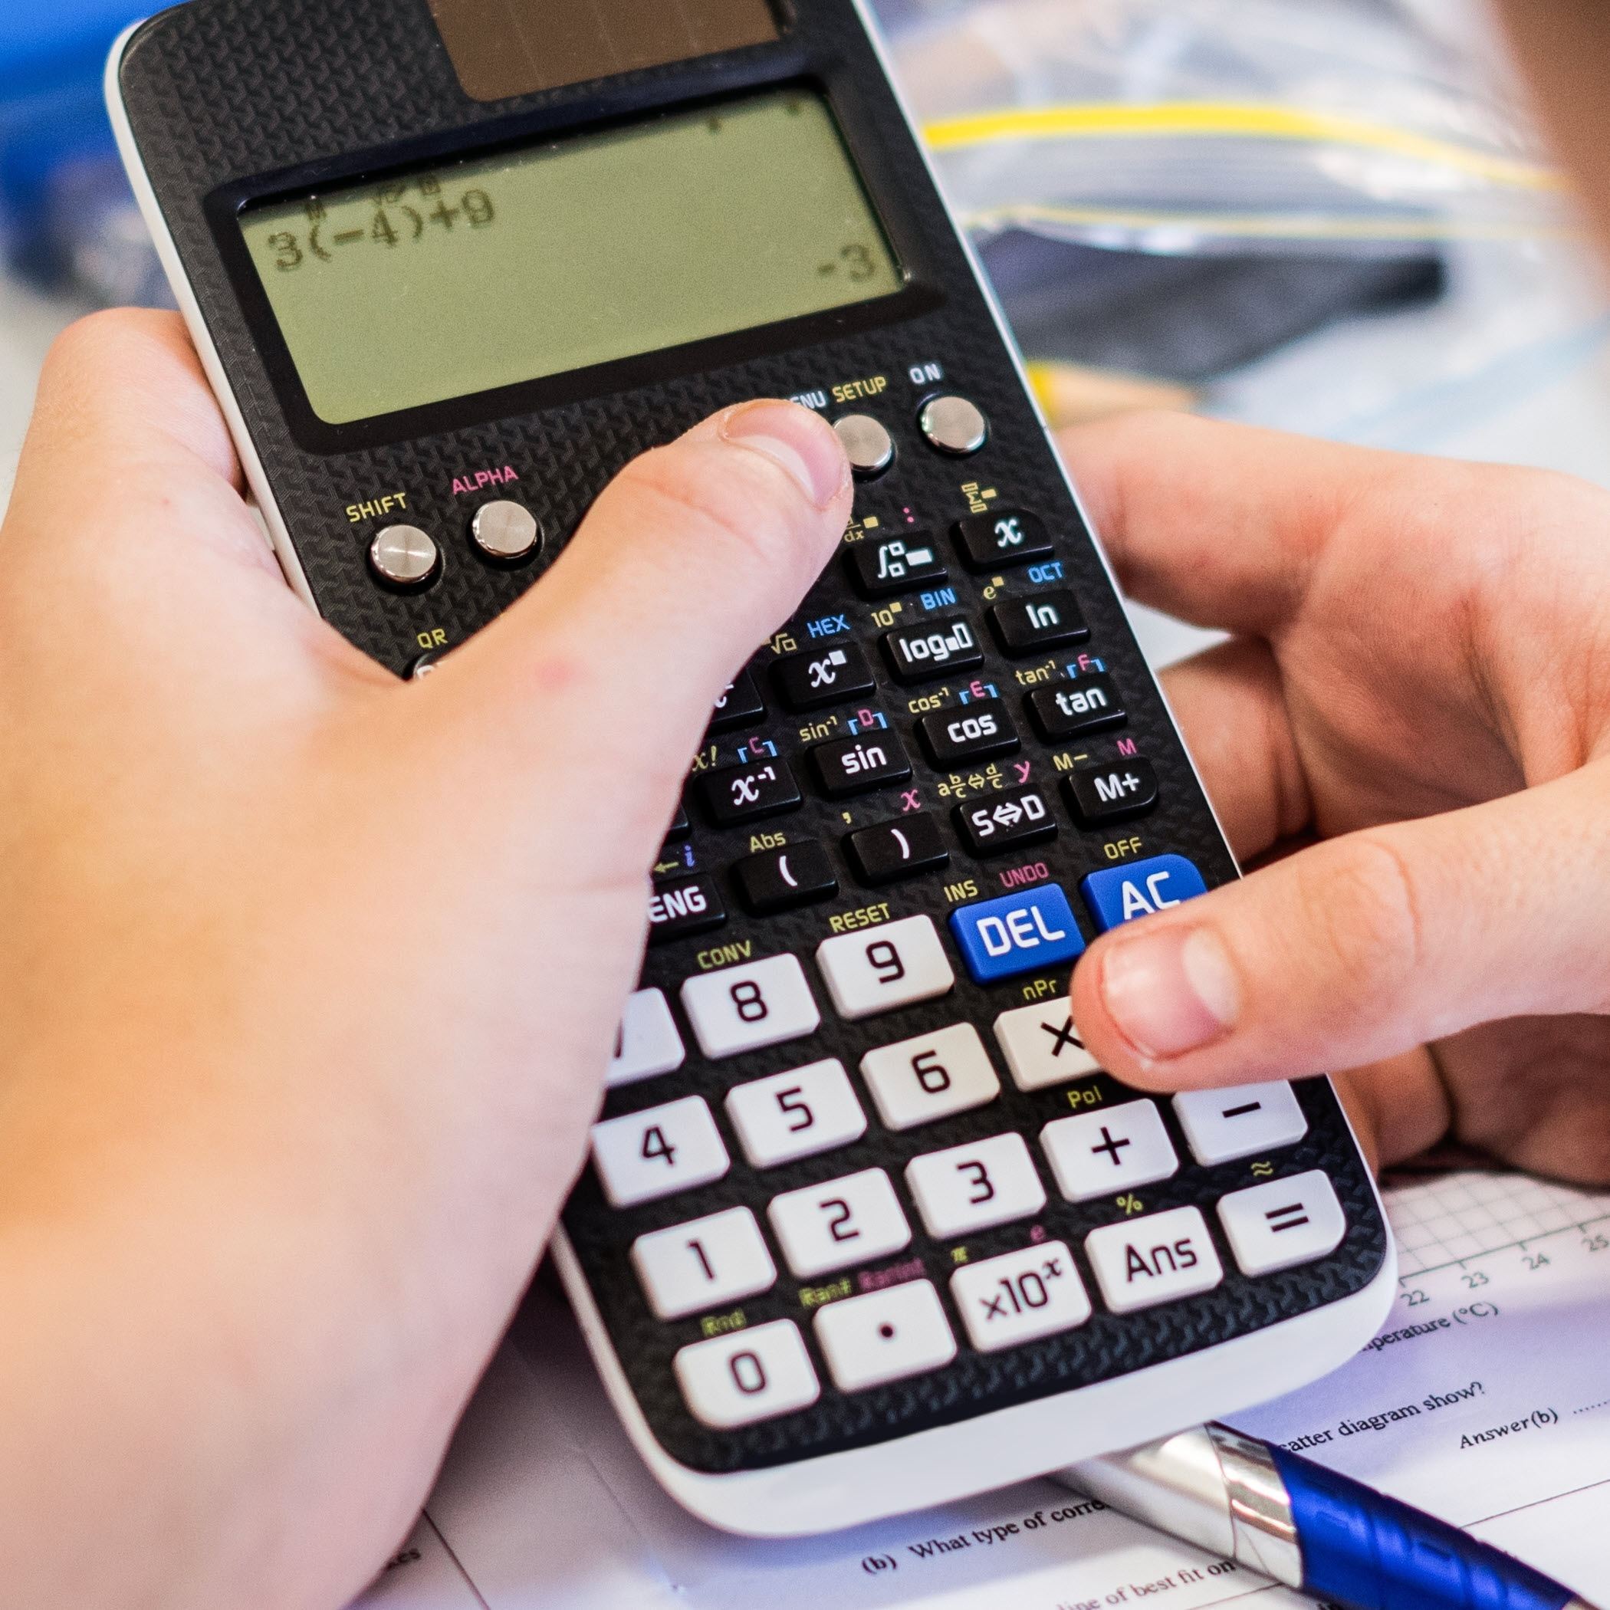
14–16 years
Practising calculations in chemistry
Downloaded from: rsc.li/3bnMC36
Notes:
Image ©: Shutterstock/Rawpixel.com

Slide 2
Learning objectives
Learning objectives
Calculate the relative formula mass of a compound given its formula and appropriate relative atomic masses.
Calculate the percentage by mass of an element from a given formula.
Calculate masses of reactants and products from balanced equations using the mole equation.

Slide 3
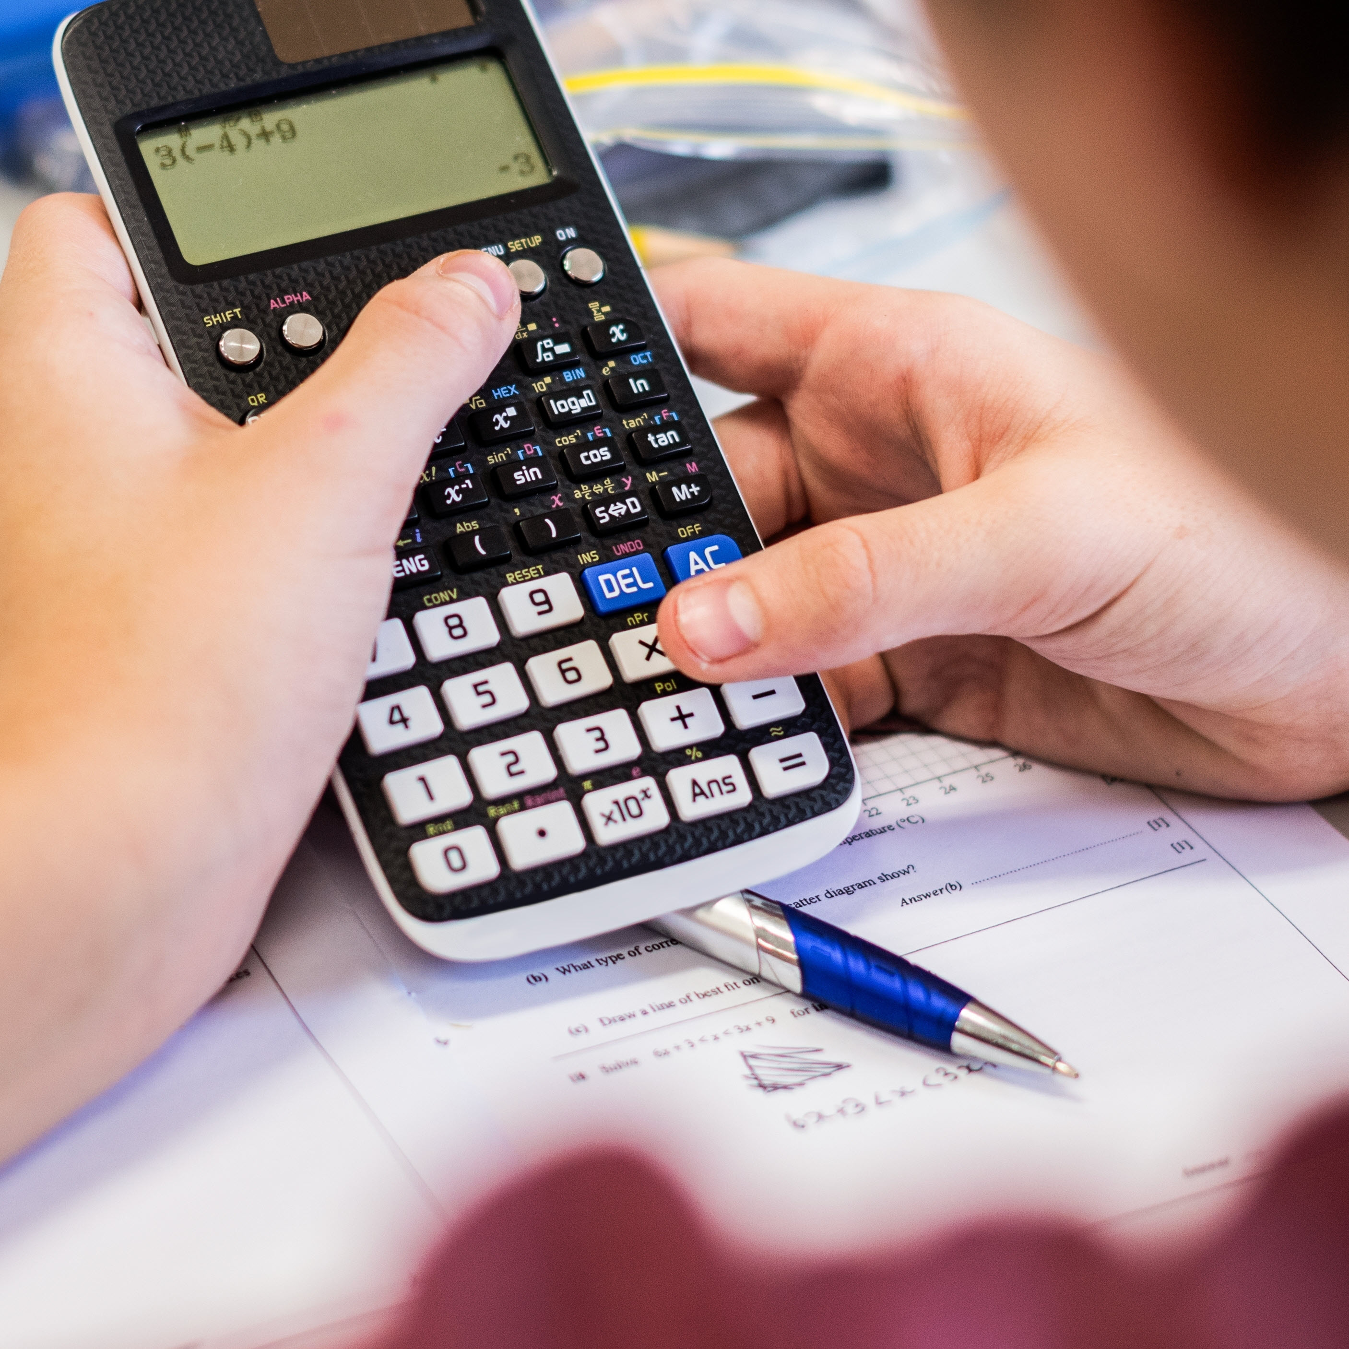
Introduction
Introduction
In chemistry, it is not enough just to know which substances react, we also need to know how much of each substance is involved. This part of chemistry is called quantitative chemistry.
By mastering these skills, you will gain a deeper understanding of how chemists use maths to make chemistry precise, reliable and useful in the real world.
Notes:
Image ©: Shutterstock/Rawpixel.com

Slide 4
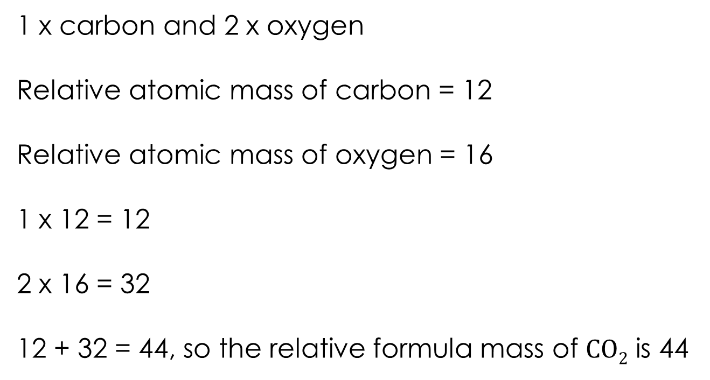
Calculating relative formula mass
Worked example
Calculating relative formula mass
Calculate the relative formula mass for:
CO₂
1 x carbon and 2 x oxygen
Relative atomic mass of carbon = 12
Relative atomic mass of oxygen = 16
1 x 12 = 12
2 x 16 = 32
12 + 32 = 44, so the relative formula mass of $CO2$ is 44

Slide 5
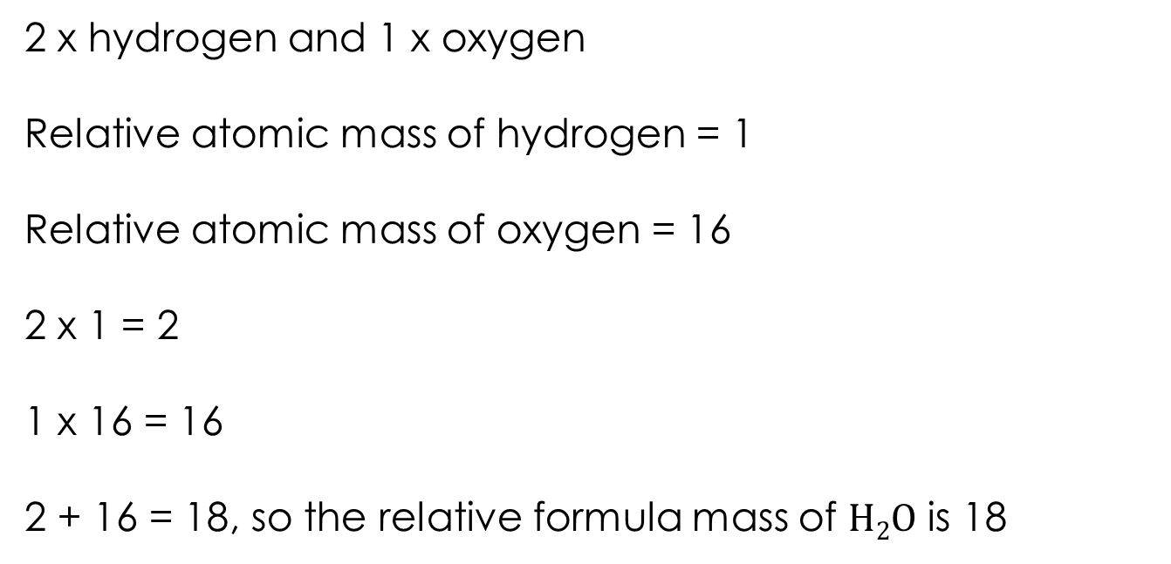
Checkpoint one
Calculating relative formula mass
On your mini whiteboard, calculate the relative formula mass for:
H₂O
2 x hydrogen and 1 x oxygen
Relative atomic mass of hydrogen = 1
Relative atomic mass of oxygen = 16
2 x 1 = 2
1 x 16 = 16
2 + 16 = 18, so the relative formula mass of $H2O$ is 18

Slide 6
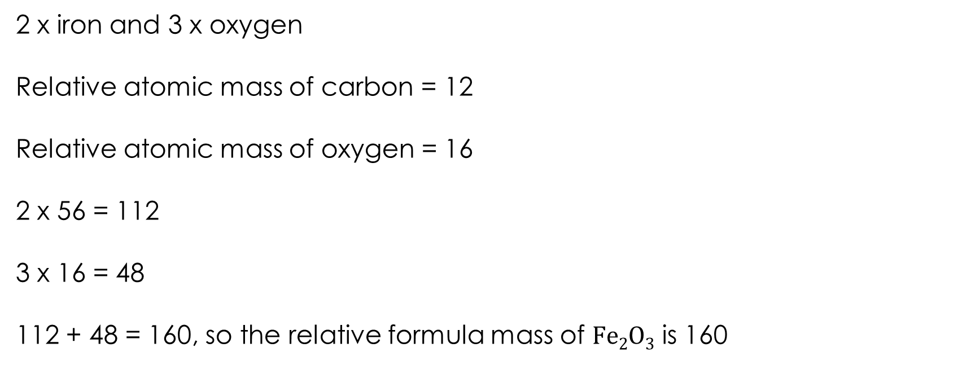
Checkpoint two
Calculating relative formula mass
On your mini whiteboard, calculate the relative formula mass for:
Fe₂O₃
2 x iron and 3 x oxygen
Relative atomic mass of carbon = 12
Relative atomic mass of oxygen = 16
2 x 56 = 112
3 x 16 = 48
112 + 48 = 160, so the relative formula mass of $Fe2O3$ is 160

Slide 7
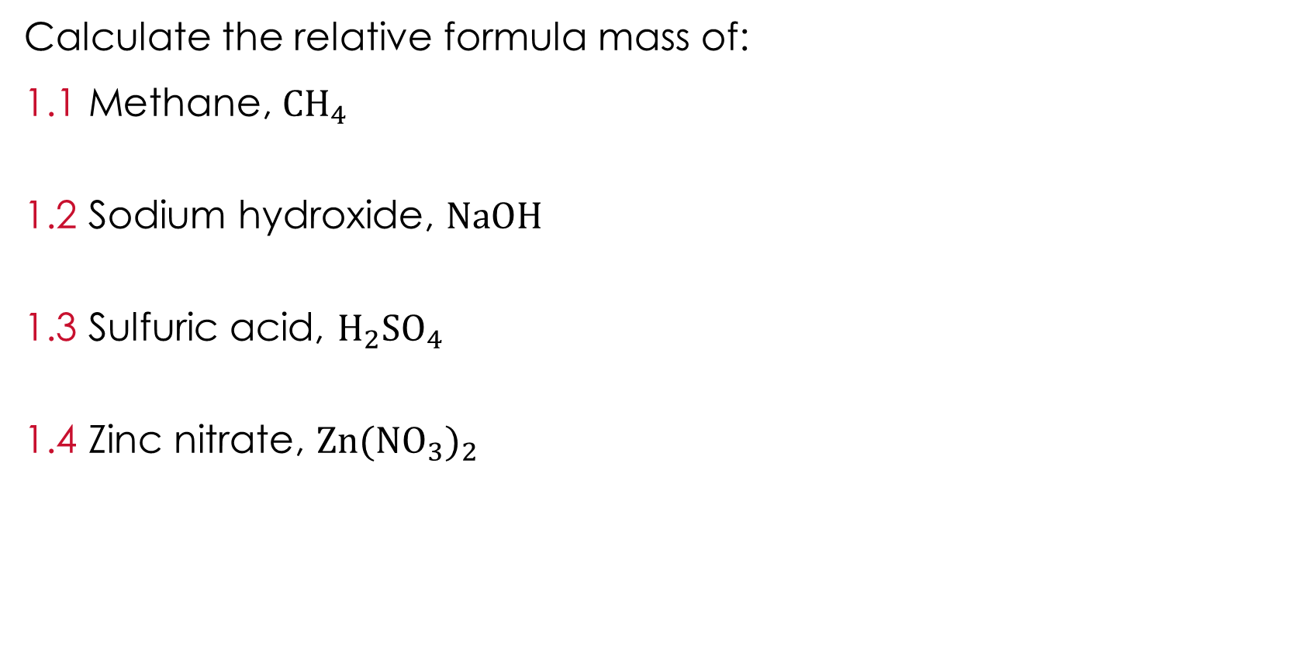
Independent questions
Calculating relative formula mass
Calculate the relative formula mass of:
1.1 Methane, $CH_{4}$
1.2 Sodium hydroxide, $NaOH$
1.3 Sulfuric acid, $H_{2}SO_{4}$
1.4 Zinc nitrate, $Zn{(NO_{3})}_{2}$

Slide 8
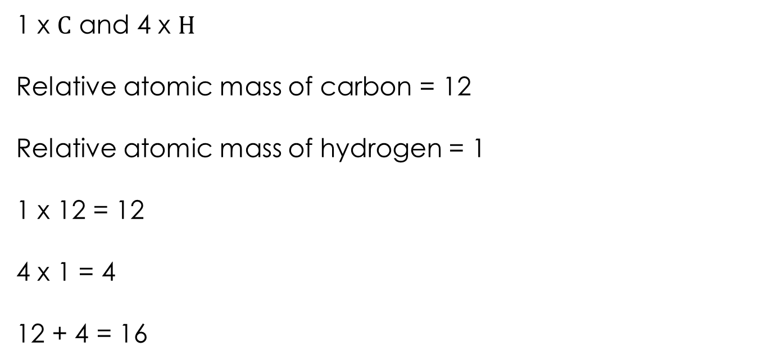
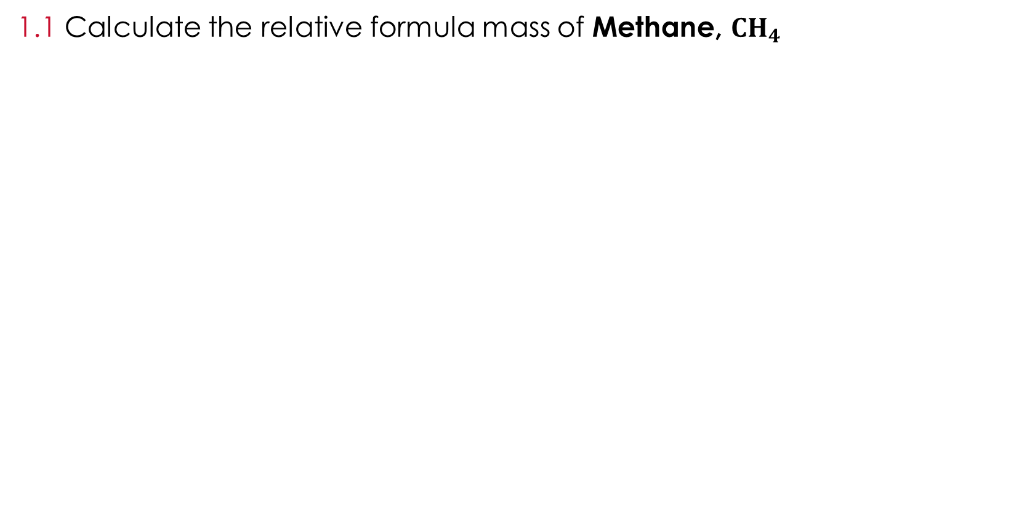
Answer to Q1.1
Calculating relative formula mass
1.1 Calculate the relative formula mass of Methane, $CH_{4}$
1 x $C$ and 4 x $H$
Relative atomic mass of carbon = 12
Relative atomic mass of hydrogen = 1
1 x 12 = 12
4 x 1 = 4
12 + 4 = 16

Slide 9
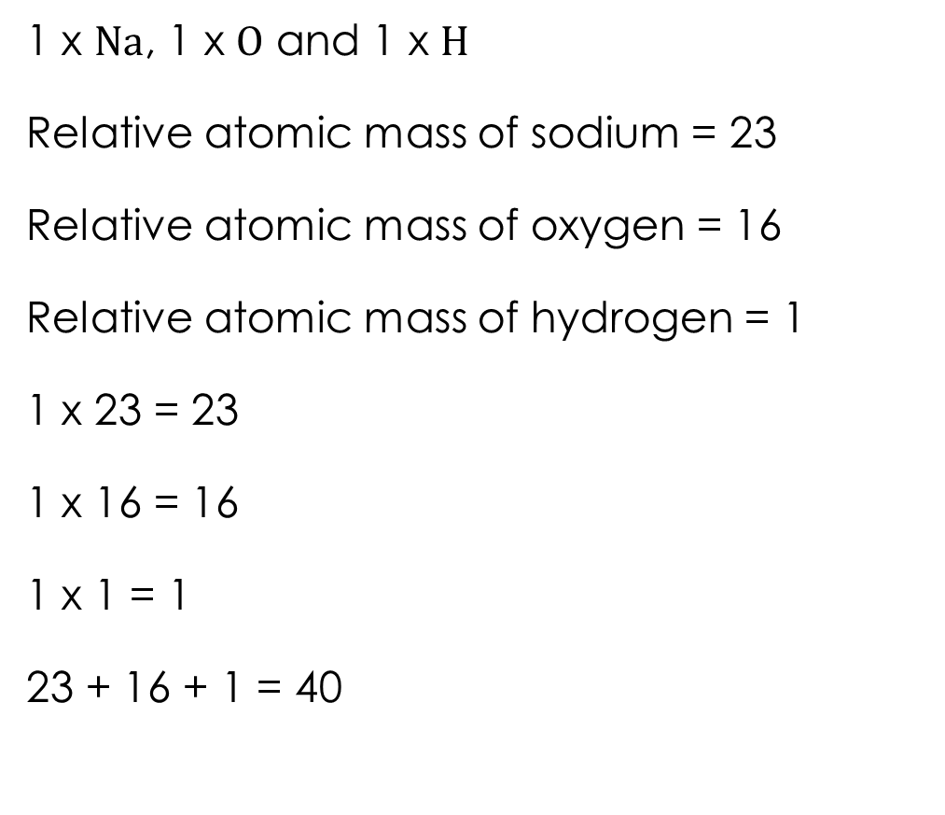
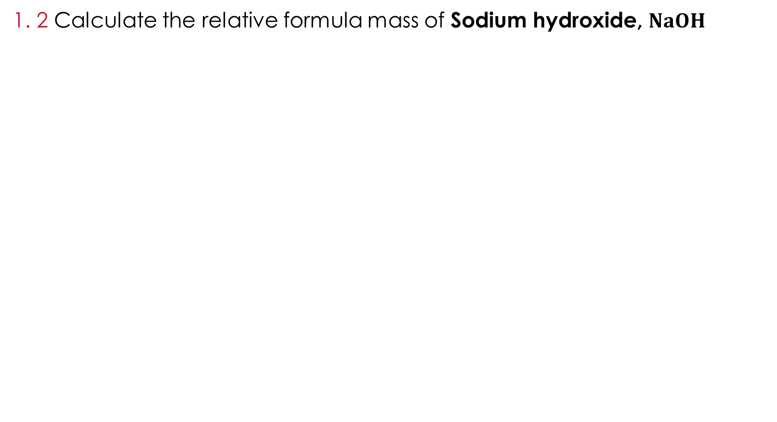
Answer to Q1.2
Calculating relative formula mass
1. 2 Calculate the relative formula mass of Sodium hydroxide, $NaOH$
1 x $Na$, 1 x $O$ and 1 x $H$
Relative atomic mass of sodium = 23
Relative atomic mass of oxygen = 16
Relative atomic mass of hydrogen = 1
1 x 23 = 23
1 x 16 = 16
1 x 1 = 1
23 + 16 + 1 = 40

Slide 10
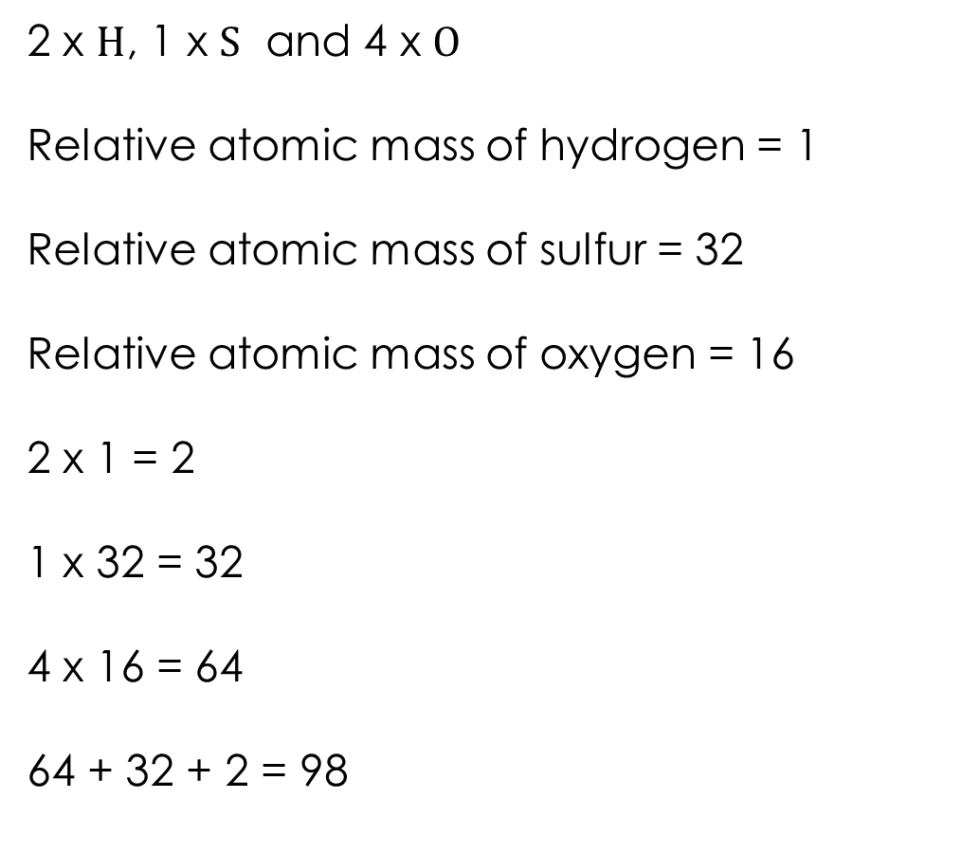
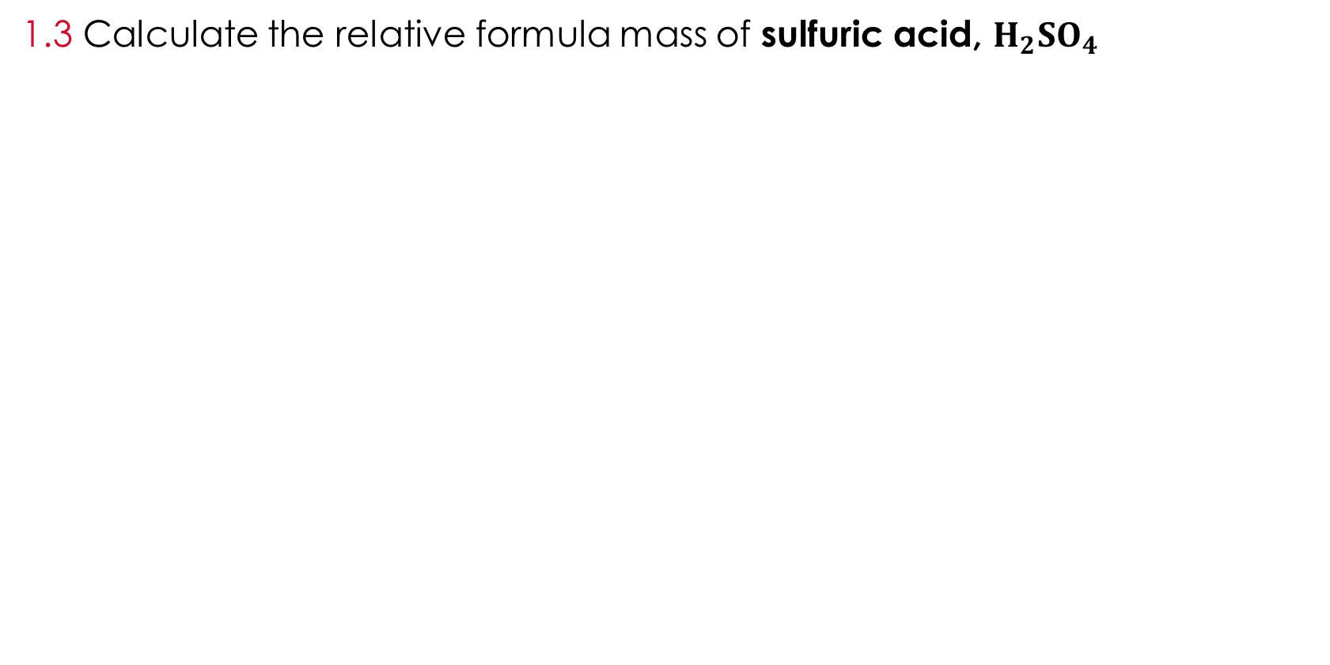
Answer to Q1.3
Calculating relative formula mass
1.3 Calculate the relative formula mass of sulfuric acid, $H_{2}SO_{4}$
2 x $H$, 1 x $S$ and 4 x $O$
Relative atomic mass of hydrogen = 1
Relative atomic mass of sulfur = 32
Relative atomic mass of oxygen = 16
2 x 1 = 2
1 x 32 = 32
4 x 16 = 64
64 + 32 + 2 = 98

Slide 11
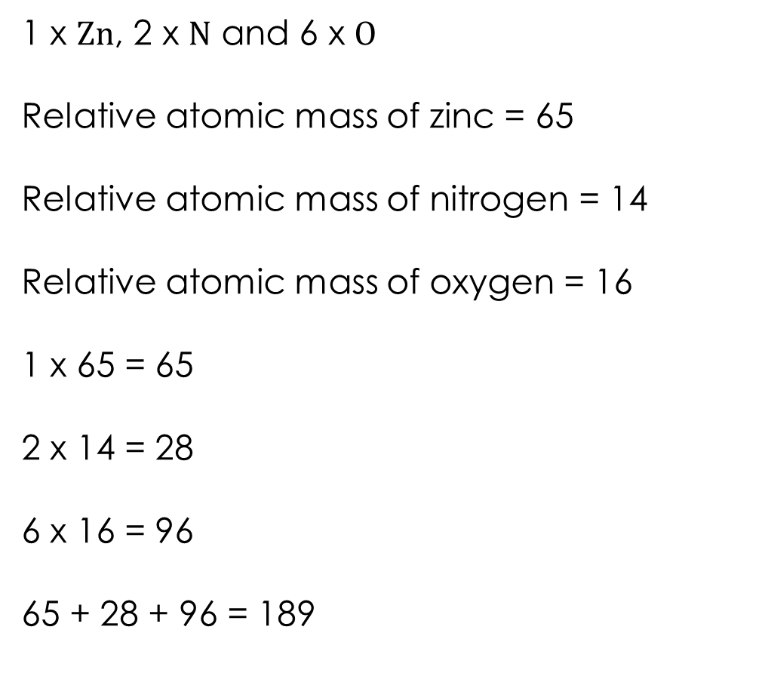
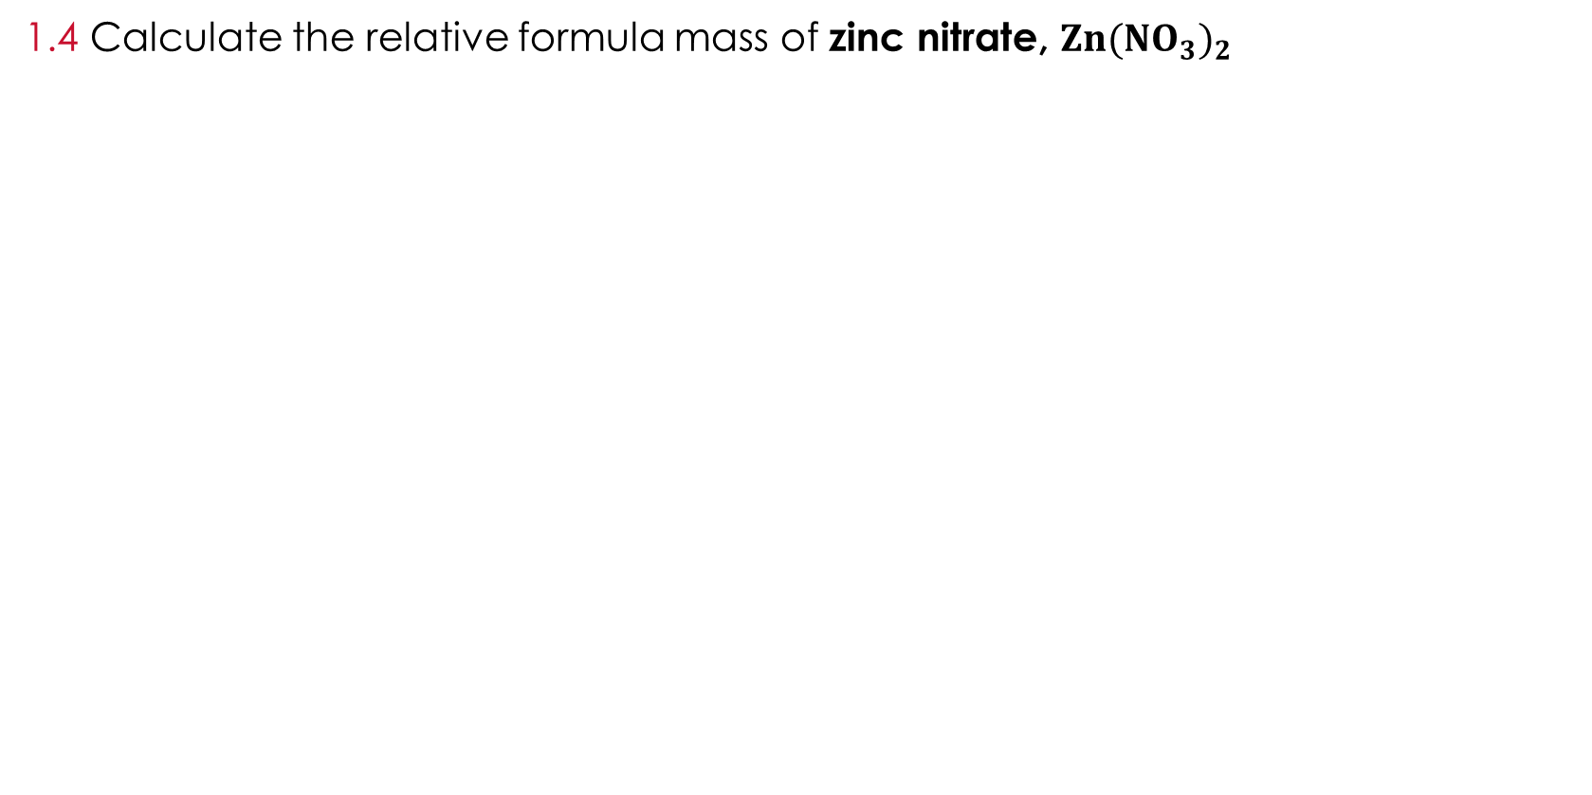
Answer to Q1.4
Calculating relative formula mass
1.4 Calculate the relative formula mass of zinc nitrate, $Zn{(NO_{3})}_{2}$
1 x $Zn$, 2 x $N$ and 6 x $O$
Relative atomic mass of zinc = 65
Relative atomic mass of nitrogen = 14
Relative atomic mass of oxygen = 16
1 x 65 = 65
2 x 14 = 28
6 x 16 = 96
65 + 28 + 96 = 189

Slide 12
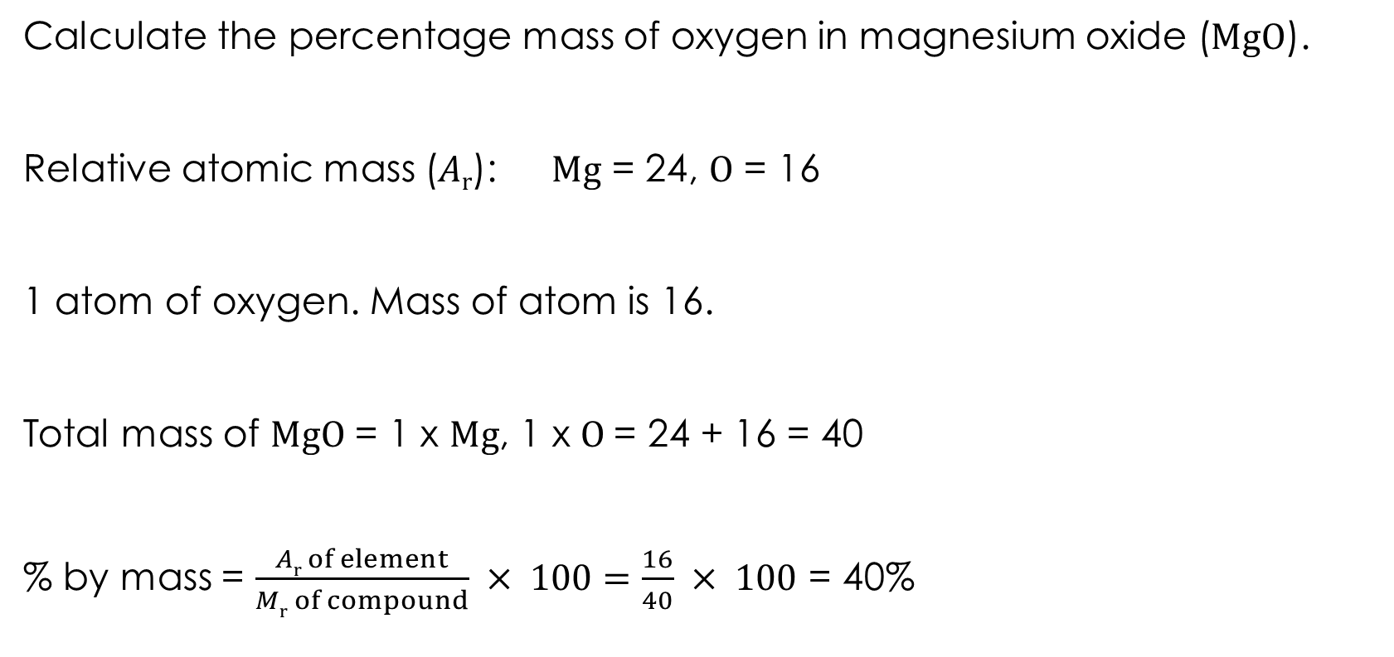
Calculating percentage by mass
Worked example
Calculating percentage by mass
Calculate the percentage mass of oxygen in magnesium oxide (MgO).​
Relative atomic mass ($Ar$): $Mg$ = 24, $O$ = 16
1 atom of oxygen. Mass of atom is 16.
Total mass of $MgO$ = 1 x $Mg$, 1 x $O$= 24 + 16 = 40
% by mass = $\frac{Ar of element}{Mr of compound} × 100=$ $\frac{16}{40} × 100$ = 40%

Slide 13
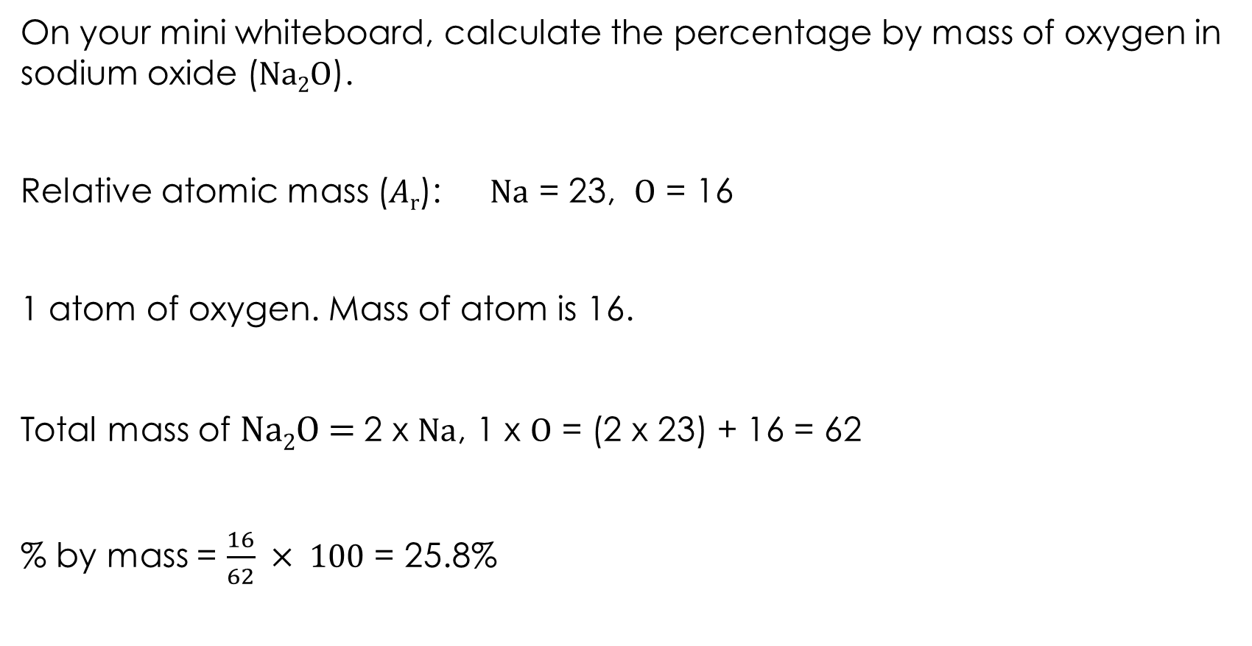
Checkpoint one
Calculating percentage by mass
On your mini whiteboard, calculate the percentage by mass of oxygen in sodium oxide (Na₂O).​
Relative atomic mass ($Ar$): $Na$ = 23, $O$ = 16
1 atom of oxygen. Mass of atom is 16.
Total mass of Na₂O = 2 x $Na$, 1 x $O$ = (2 x 23) + 16 = 62
% by mass = $\frac{16}{62} × 100$ = 25.8%

Slide 14
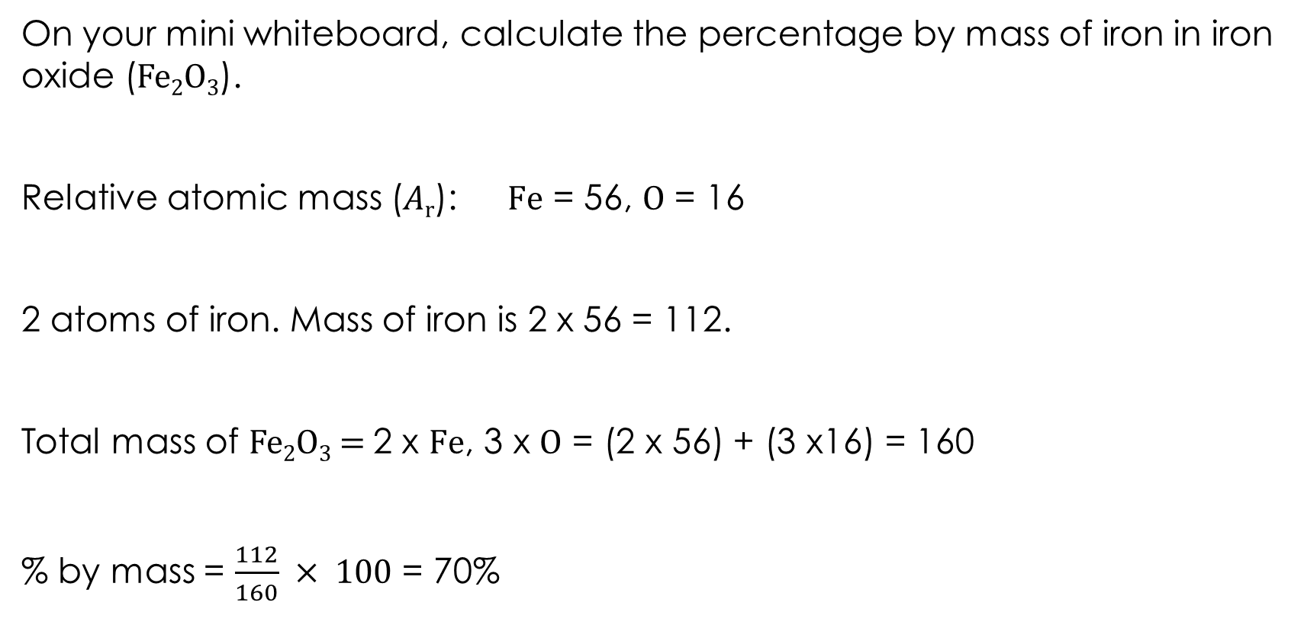
Checkpoint two
Calculating percentage by mass
On your mini whiteboard, calculate the percentage by mass of iron in iron oxide (Fe₂O₃).​
Relative atomic mass ($Ar$): $Fe$ = 56, $O$ = 16
2 atoms of iron. Mass of iron is 2 x 56 = 112.
Total mass of Fe₂O₃ = 2 x $Fe$, 3 x $O$ = (2 x 56) + (3 x16) = 160
% by mass = $\frac{112}{160} × 100$ = 70%

Slide 15
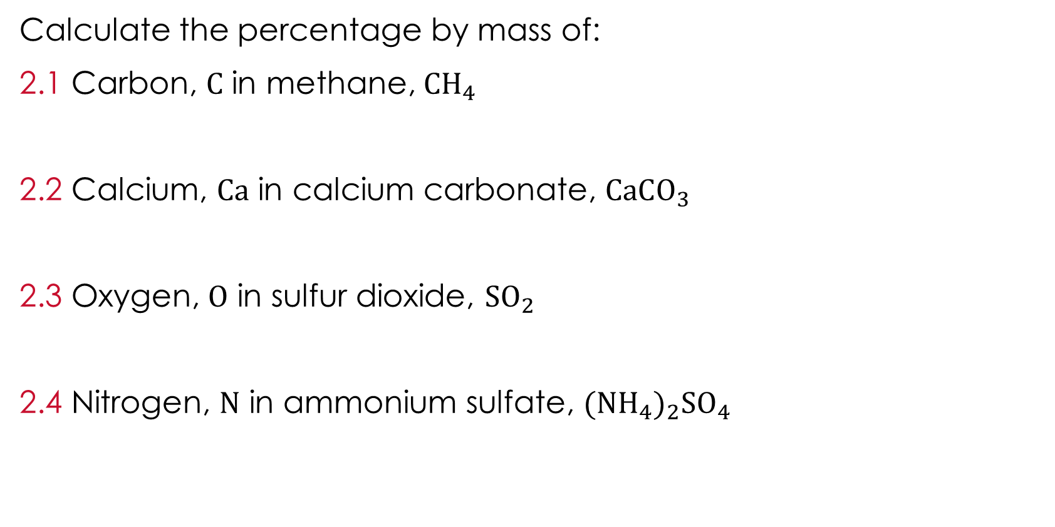
Independent questions
Calculating percentage by mass
Calculate the percentage by mass of:
2.1 Carbon, $C$ in methane, $CH_{4}$
2.2 Calcium, $Ca$ in calcium carbonate, $CaCO_{3}$
2.3 Oxygen, $O$ in sulfur dioxide, $SO_{2}$
2.4 Nitrogen, $N$ in ammonium sulfate, ${(NH_{4})}_{2}SO_{4}$

Slide 16
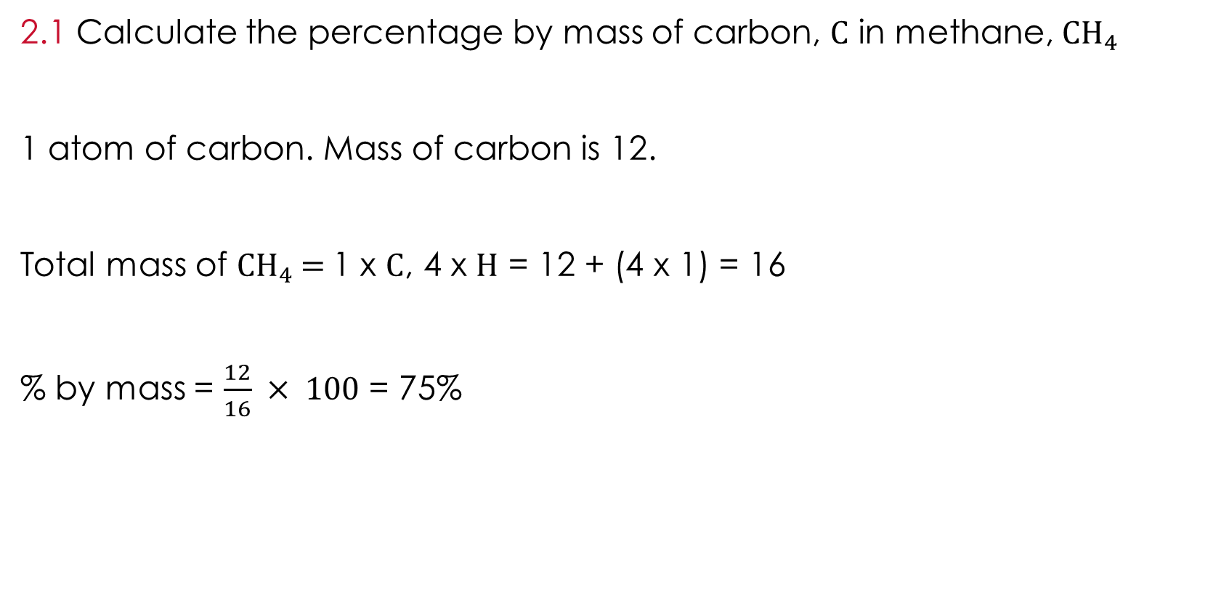
Answer to Q2.1
Calculating percentage by mass
2.1 Calculate the percentage by mass of carbon, $C$ in methane, $CH_{4}$
1 atom of carbon. Mass of carbon is 12.
Total mass of $CH_{4}$ = 1 x $C$, 4 x $H$ = 12 + (4 x 1) = 16
% by mass = $\frac{12}{16} × 100$ = 75%

Slide 17
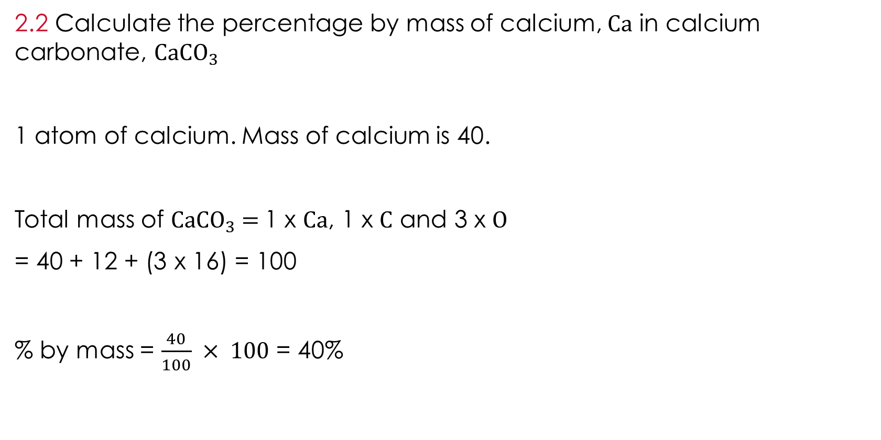
Answer to Q2.2
Calculating percentage by mass
2.2 Calculate the percentage by mass of calcium, $Ca$ in calcium carbonate, $CaCO_{3}$
1 atom of calcium. Mass of calcium is 40.
Total mass of $CaCO_{3}$ = 1 x $Ca$, 1 x $C$ and 3 x $O$
= 40 + 12 + (3 x 16) = 100
% by mass = $\frac{40}{100} × 100$ = 40%

Slide 18
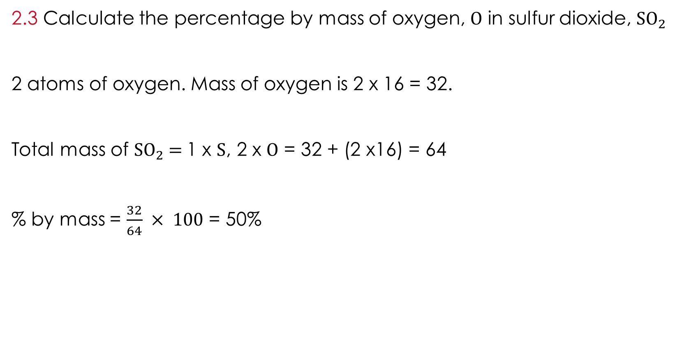
Answer to Q2.3
Calculating percentage by mass
2.3 Calculate the percentage by mass of oxygen, $O$ in sulfur dioxide, $SO_{2}$
2 atoms of oxygen. Mass of oxygen is 2 x 16 = 32.
Total mass of $SO_{2}$ = 1 x $S$, 2 x $O$ = 32 + (2 x16) = 64
% by mass = $\frac{32}{64} × 100$ = 50%

Slide 19
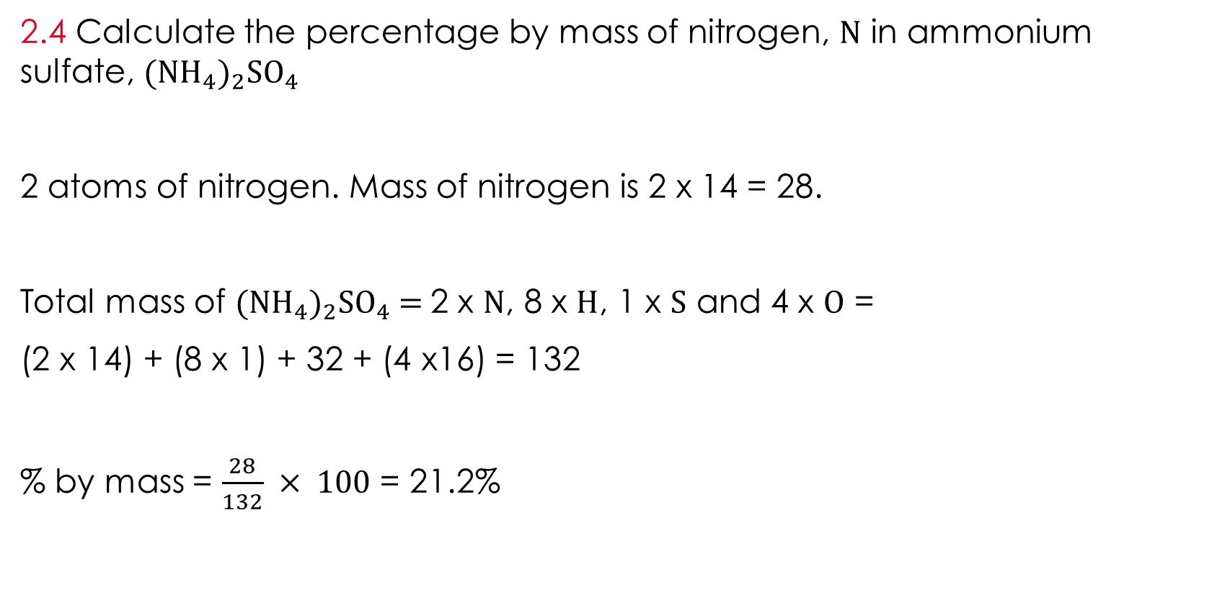
Answer to Q2.4
Calculating percentage by mass
2.4 Calculate the percentage by mass of nitrogen, $N$ in ammonium sulfate, ${(NH_{4})}_{2}SO_{4}$
2 atoms of nitrogen. Mass of nitrogen is 2 x 14 = 28.
Total mass of ${(NH_{4})}_{2}SO_{4}$ = 2 x $N$, 8 x $H$, 1 x $S$ and 4 x $O$ =
(2 x 14) + (8 x 1) + 32 + (4 x16) = 132
% by mass = $\frac{28}{132} × 100$ = 21.2%

Slide 20
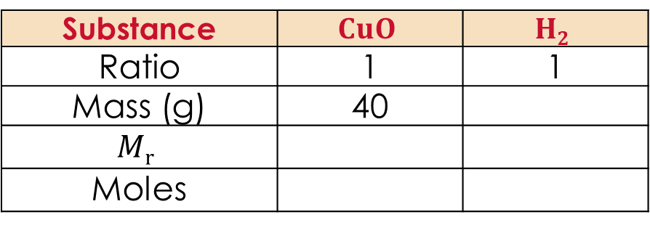
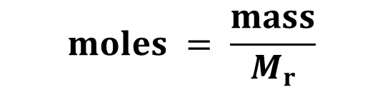
Calculating mass from balanced equations
Worked example
Calculating mass from balanced equations
What mass of hydrogen is needed to react with 40 g of copper oxide?
CuO + H₂ → Cu + H₂O
$$moles = \frac{mass}{M_{r}}$$
Step 1: fill out the table with the information from the question.
Substance | $$CuO$$ | $$H2$$
Ratio | 1 | 1
Mass (g) | 40
$$Mr$$
Moles

Slide 21
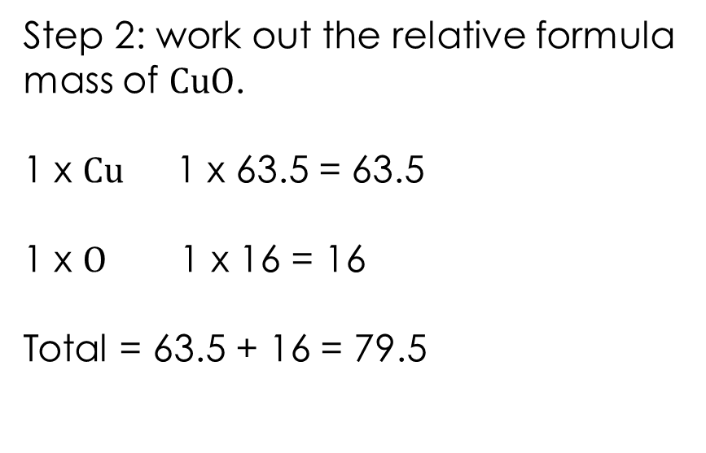
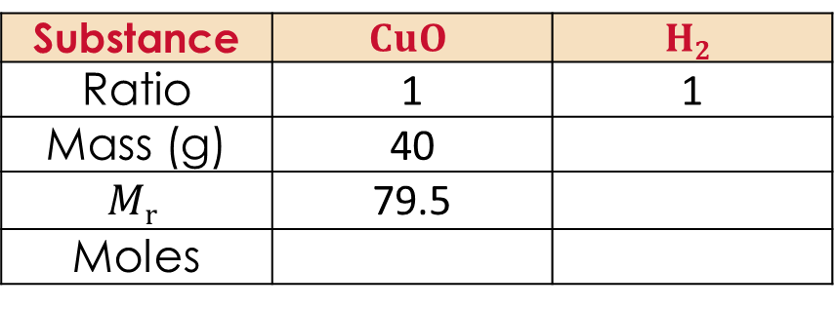
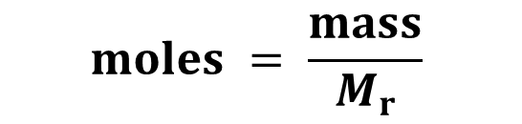
Worked example
Calculating mass from balanced equations
What mass of hydrogen is needed to react with 40 g of copper oxide?
CuO + H₂ → Cu + H₂O
$$moles = \frac{mass}{M_{r}}$$
Step 2: work out the relative formula mass of $CuO$.
1 x $Cu$ 1 x 63.5 = 63.5
1 x $O$ 1 x 16 = 16
Total = 63.5 + 16 = 79.5
Substance | $$CuO$$ | $$H2$$
Ratio | 1 | 1
Mass (g) | 40
$$Mr$$ | 79.5
Moles

Slide 22
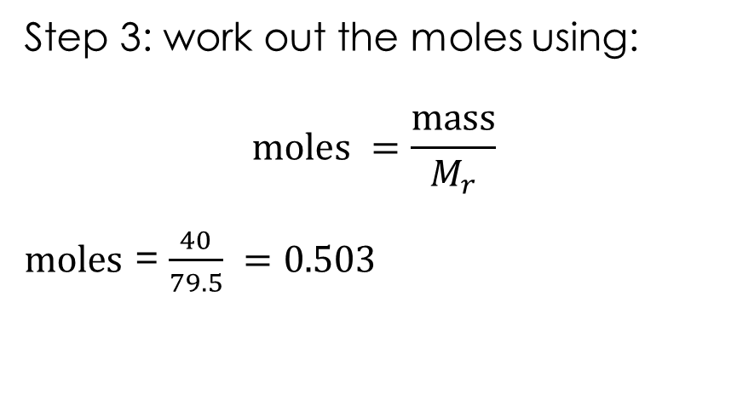
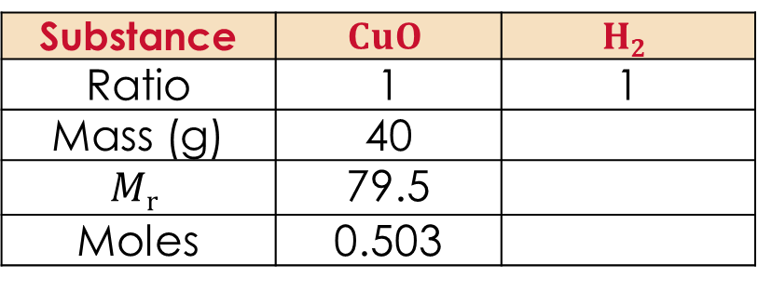
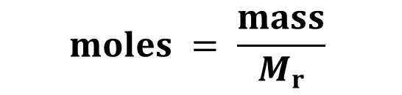
Worked example
Calculating mass from balanced equations
What mass of hydrogen is needed to react with 40 g of copper oxide?
CuO + H₂ → Cu + H₂O
$$moles = \frac{mass}{M_{r}}$$
Step 3: work out the moles using:
$$moles =\frac{mass}{M_{r}}$$
moles = $\frac{40}{79.5} =0.503$
Substance | $$CuO$$ | $$H2$$
Ratio | 1 | 1
Mass (g) | 40
$$Mr$$ | 79.5
Moles | 0.503

Slide 23
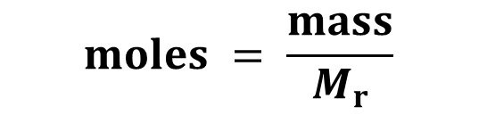
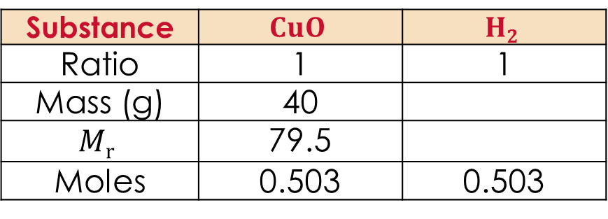
Worked example
Calculating mass from balanced equations
What mass of hydrogen is needed to react with 40 g of copper oxide?
CuO + H₂ → Cu + H₂O
$$moles = \frac{mass}{M_{r}}$$
Step 4: manipulate the ratio.
Divide moles by ratio on the left. Multiply by ratio on the right to determine the moles.
Since this is a 1:1 ratio the number of moles is the same.
Substance | $$CuO$$ | $$H2$$
Ratio | 1 | 1
Mass (g) | 40
$$Mr$$ | 79.5
Moles | 0.503 | 0.503

Slide 24
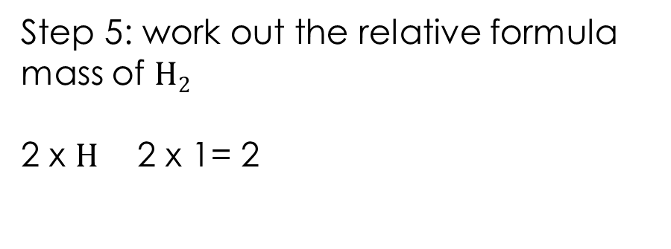
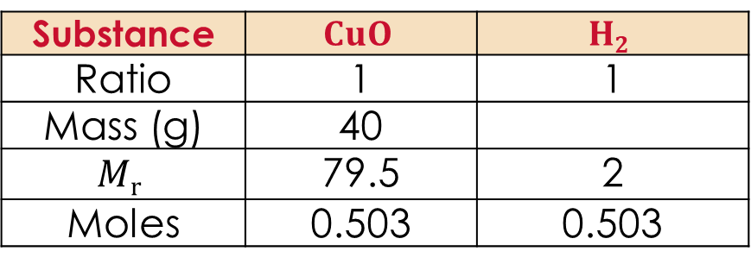
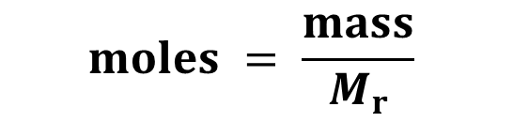
Worked example
Calculating mass from balanced equations
What mass of hydrogen is needed to react with 40 g of copper oxide?
CuO + H₂ → Cu + H₂O
$$moles = \frac{mass}{M_{r}}$$
Step 5: work out the relative formula mass of $H2$
2 x $H$ 2 x 1= 2
Substance | $$CuO$$ | $$H2$$
Ratio | 1 | 1
Mass (g) | 40
$$Mr$$ | 79.5 | 2
Moles | 0.503 | 0.503

Slide 25
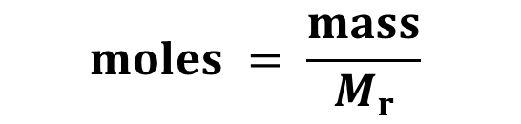
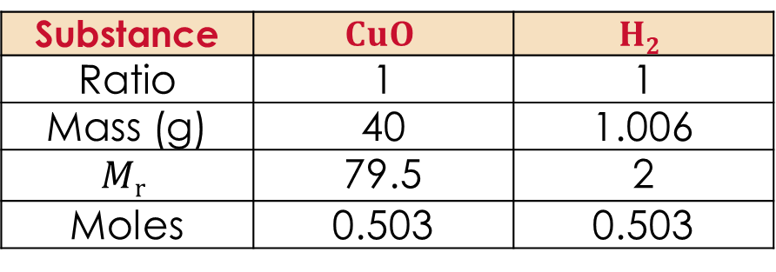
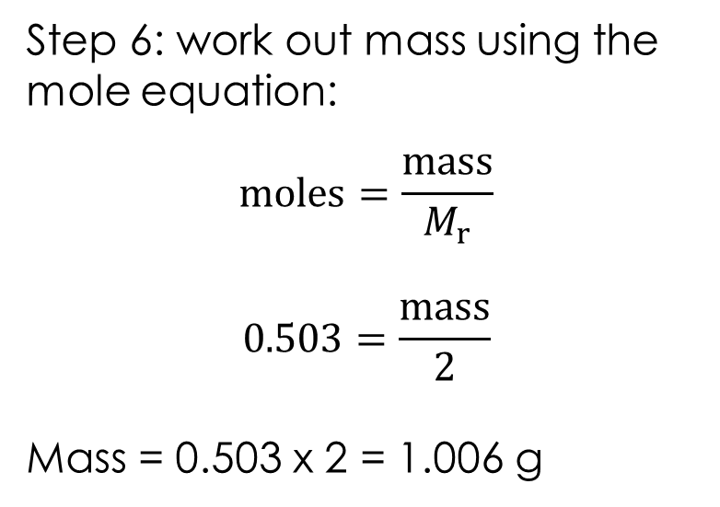
Calculating mass from balanced equations – worked example
Calculating mass from balanced equations
What mass of hydrogen is needed to react with 40 g of copper oxide?
CuO + H₂ → Cu + H₂O
$$moles = \frac{mass}{M_{r}}$$
Step 6: work out mass using the mole equation:
$$moles=\frac{mass}{M_{r}}$$
$$0.503=\frac{mass}{2}$$
Mass = 0.503 x 2 = 1.006 g
Substance | $$CuO$$ | $$H2$$
Ratio | 1 | 1
Mass (g) | 40 | 1.006
$$Mr$$ | 79.5 | 2
Moles | 0.503 | 0.503

Slide 26


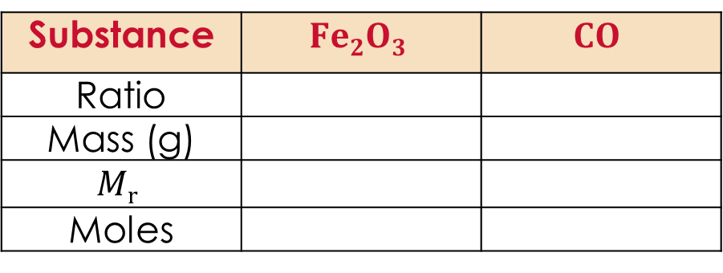

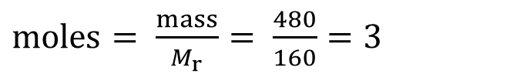
Checkpoint five
Calculating mass from balanced equations
On your mini whiteboard:
Calculate the mass of carbon monoxide needed to react with 480 g of iron oxide.
Fe₂O₃ + 3 CO → 2Fe + 3CO₂
Use the table provided to support you. Remember, you must show your working.
$Mr$ Fe₂O₃ = (2 x 56) + (3 x 16) = 160
Substance | $$Fe2O3$$ | $$CO$$
Ratio
Mass (g)
$$Mr$$
Moles
$moles= \frac{mass}{M_{r}}= \frac{480}{160}=3$
1
3
480
252
A ratio of 1:3 is equal to a ratio of 3:9
160
28
$Mr$ CO = 12 + 16 = 28
3
9
$mass=moles ×M_{r}=9 ×28=252$
Mass of $C0$ = 252 g

Slide 27
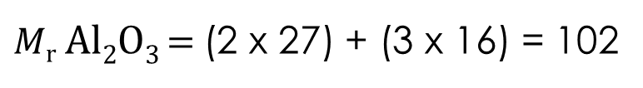

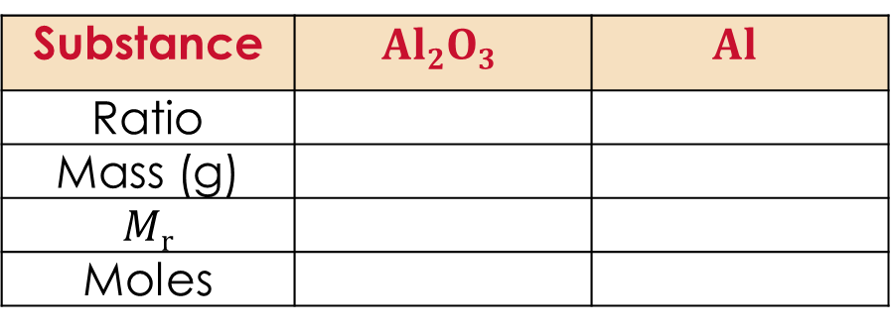

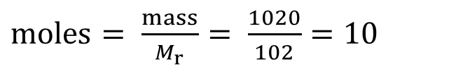
Checkpoint six
Calculating mass from balanced equations
On your mini whiteboard, :
Calculate the mass of aluminium that can be formed from 1020 g of aluminium oxide.
2Al₂O₃ → 4Al + 3O₂
Use the table provided to support you. Remember, you must show your working.
$Mr$ Al₂O₃ = (2 x 27) + (3 x 16) = 102
Substance | $$Al2O3$$ | $$Al$$
Ratio
Mass (g)
$Mr$
Moles
$moles= \frac{mass}{M_{r}}= \frac{1020}{102}=10$
2
4
A ratio of 2:4 is equal to a ratio of 10:20
1020
540
102
27
10
20
$Ar$ $Al$ = 27
$mass=moles ×A_{r}=20 ×27=540$
Mass of $Al$ = 540 g

Slide 28
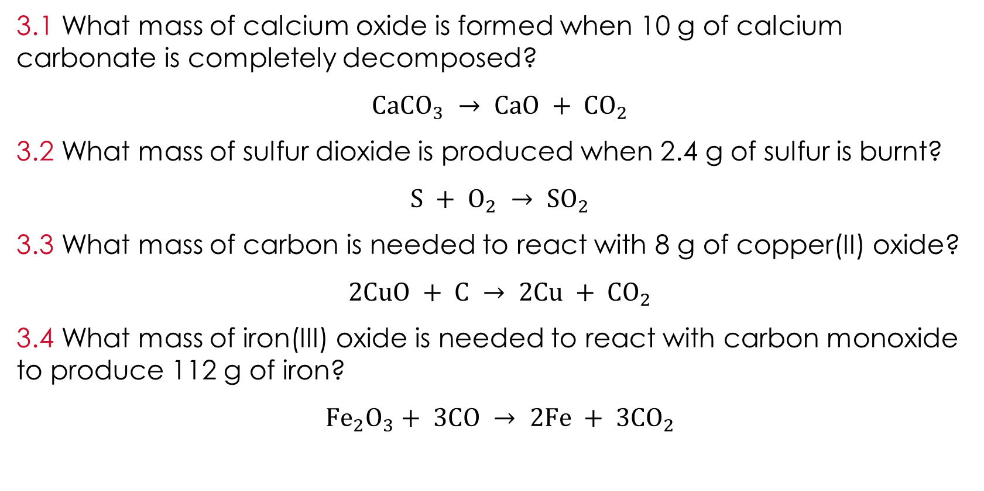
Independent questions
Calculating mass from balanced equations
3.1 What mass of calcium oxide is formed when 10 g of calcium carbonate is completely decomposed?
$$CaCO_{3} → CaO + CO_{2}$$
3.2 What mass of sulfur dioxide is produced when 2.4 g of sulfur is burnt?
$$S + O_{2} → SO_{2}$$
3.3 What mass of carbon is needed to react with 8 g of copper(II) oxide?
$$2CuO + C → 2Cu + CO_{2}$$
3.4 What mass of iron(III) oxide is needed to react with carbon monoxide to produce 112 g of iron?
$${Fe}_{2}O_{3}+ 3CO → 2Fe + 3CO_{2}$$

Slide 29

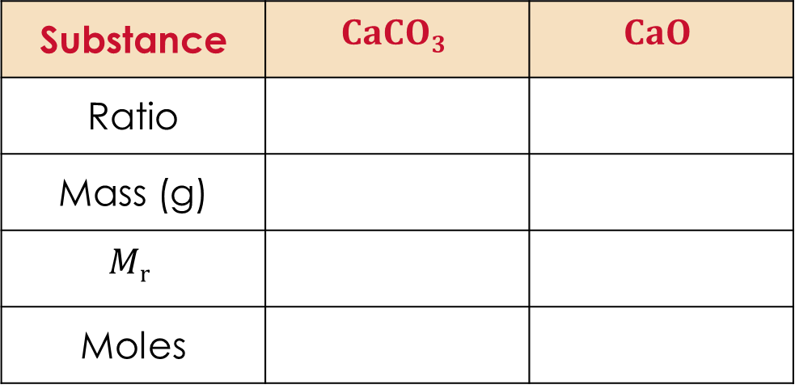
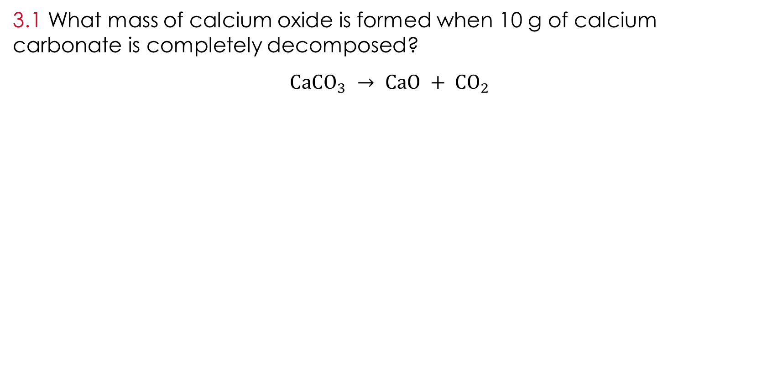

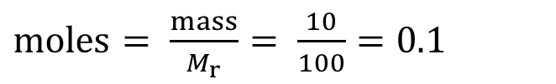
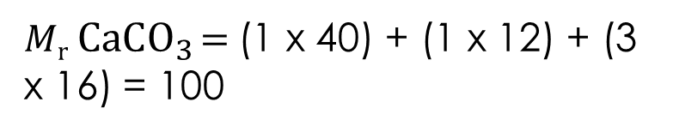
Answer to Q3.1
Calculating mass from balanced equations
3.1 What mass of calcium oxide is formed when 10 g of calcium carbonate is completely decomposed?
$$CaCO_{3} → CaO + CO_{2}$$
Substance | $$CaCO3$$ | $$CaO$$
Ratio
Mass (g)
$$Mr$$
Moles
$Mr$ $CaCO_{3}$ = (1 x 40) + (1 x 12) + (3 x 16) = 100
1
1
$moles= \frac{mass}{M_{r}}= \frac{10}{100}=0.1$
10
5.6
$Mr$ CaO = 40 + 16 = 56
100
56
$mass=moles ×M_{r}=0.1 ×56=5.6$
0.1
0.1
Mass of $Ca0$ = 5.6 g

Slide 30

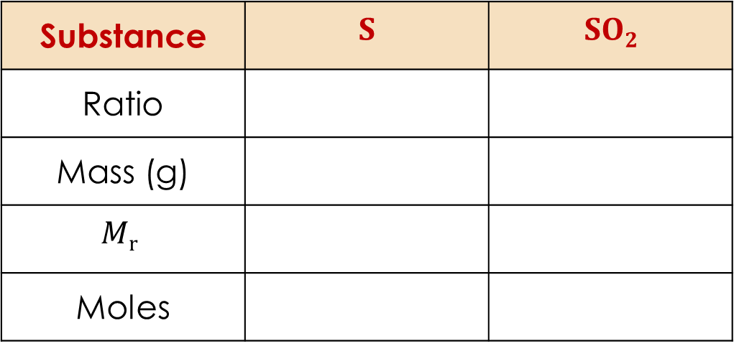
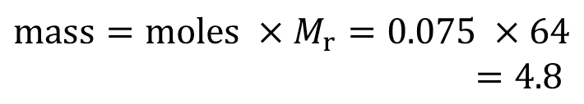




Answer to Q3.2
Calculating mass from balanced equations
3.2 What mass of sulfur dioxide is produced when 2.4 g of sulfur is burnt?
$$S + O_{2} → SO_{2}$$
Substance | $$S$$ | $$SO2$$
Ratio
Mass (g)
$$Mr$$
Moles
$Ar$ $S$ = 32
1
1
$moles= \frac{mass}{A_{r}}= \frac{2.4}{32}=0.075$
2.4
4.8
$Mr$ ${S0}_{2}$ = 32 + (2 $×$ 16) = 64
32
64
$$mass=moles ×M_{r}=0.075 ×64$$
$=4.8$
0.075
0.075
Mass of ${S0}_{2}$= 4.8 g

Slide 31






Answer to Q3.3
Calculating mass from balanced equations
3.3 What mass of carbon is needed to react with 8 g of copper(II) oxide?
$$2CuO + C → 2Cu + CO_{2}$$
$Mr$ $CuO$ = (1 x 63.5) + (1 x 16) = 79.5
Substance | $$CuO$$ | $$C$$
Ratio
Mass (g)
$$Mr$$
Moles
$moles= \frac{mass}{M_{r}}= \frac{8}{79.5}=0.1$
2
1
A ratio of 2:1 is equal to a ratio of 0.1:0.05
8
0.6
79.5
12
$Ar$ C = 12
0.1
0.05
$mass=moles ×A_{r}=0.05 ×12=0.6$
Mass of $Ca0$ = 0.6 g

Slide 32





Answer to Q3.4
Calculating mass from balanced equations
Q3.4 What mass of iron(III) oxide is needed to react with carbon monoxide to produce 112 g of iron?
$${Fe}_{2}O_{3}+ 3CO → 2Fe + 3CO_{2}$$
Substance | $$Fe$$ | $${Fe}_{2}O_{3}$$
Ratio
Mass (g)
$$Mr$$
Moles
$Ar$ Fe = 56
2
1
$moles= \frac{mass}{M_{r}}= \frac{112}{56}=2$
112
160
$Mr$ Fe₂O₃ = (2 x 56) + (3 x 16) = 160
56
160
$mass=moles ×M_{r}=1 ×160= 160$
2
1
Mass of Fe₂O₃= 160 g

