Slide 1
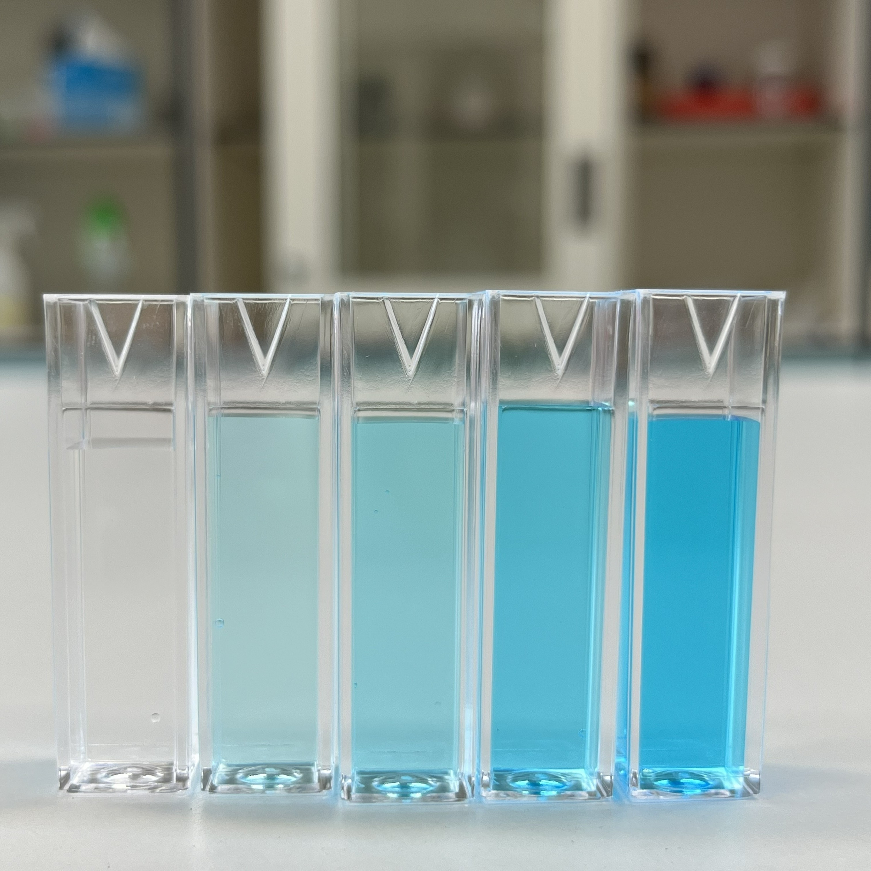
16–18 years
Calculating and comparing solution concentrations
Downloaded from: rsc.li/3hvXNIh
Notes:
Image ©: kit yu/Shutterstock

Slide 2
Learning objectives
Learning objectives
Recall how to convert between volumes in cm³ and dm³.
Define the word ‘concentration’ from a given numerical value.
Calculate the concentration of a solution in both g dm⁻³ and mol dm⁻³.
Convert the concentration of a solution from g dm⁻³ to mol dm⁻³ and vice versa.

Slide 3
Introduction
Introduction
In chemistry, concentration describes how much of a substance (the solute) is present in a given volume of solution.
Concentration is most commonly expressed in two ways: grams per cubic decimetre (g dm⁻³) and moles per cubic decimetre (mol dm⁻³).
Both units relate the amount of solute to the volume of solution, and being confident in using each is essential for quantitative chemistry, including titrations and stoichiometric calculations.

Slide 4
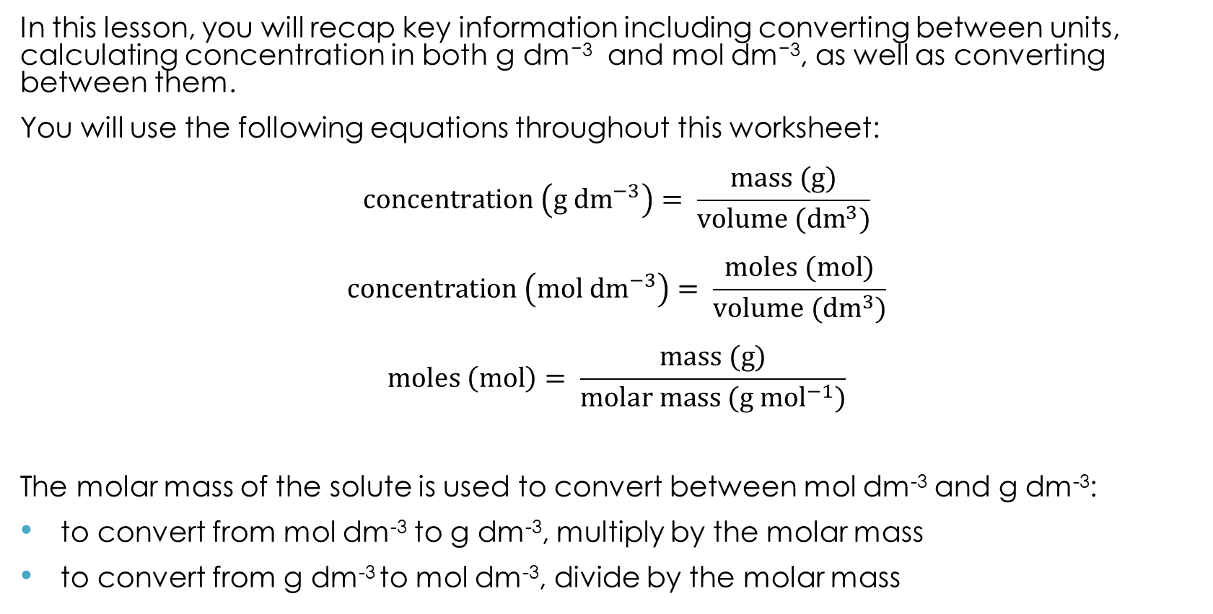
Introduction
Introduction
In this lesson, you will recap key information including converting between units, calculating concentration in both g dm⁻³ and mol dm⁻³, as well as converting between them.
You will use the following equations throughout this worksheet:
$$concentration \left(g {dm}^{−3}\right)= \frac{mass (g)}{volume ({dm}^{3})}$$
$$concentration \left(mol {dm}^{−3}\right)= \frac{moles (mol)}{volume ({dm}^{3})}$$
$$moles \left(mol\right)= \frac{mass (g)}{molar mass (g {mol}^{−1})}$$
The molar mass of the solute is used to convert between mol dm⁻³ and g dm⁻³:
to convert from mol dm⁻³ to g dm⁻³, multiply by the molar mass
to convert from g dm⁻³ to mol dm⁻³, divide by the molar mass

Slide 5
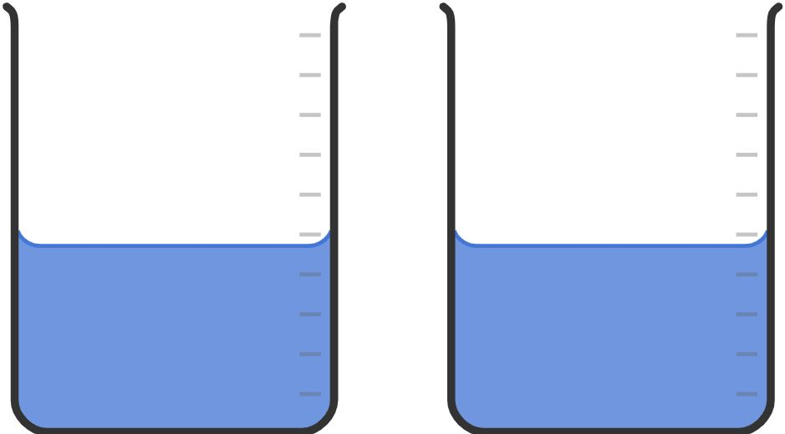
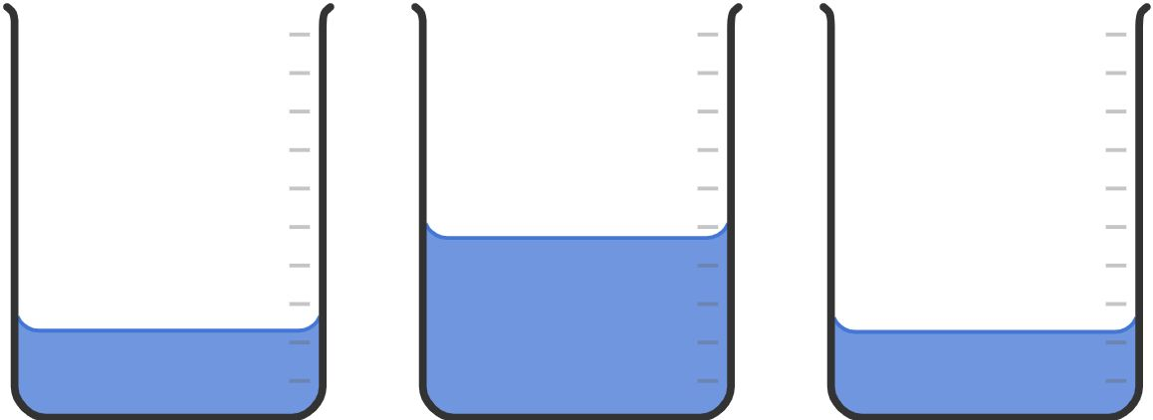
Comparing solutions − demonstration
Comparing solutions
Place 100 cm³ of copper(II) sulfate solution in each of two beakers A and B.
Pour half of the solution from beaker A into a third beaker, C.
Compare beaker B and beaker C in terms of:
(a) the number of moles of copper(II) sulfate in beakers B and C
  Different
  Unsure
  The same
Beaker A
Beaker B
Beaker A
Beaker B
Beaker C

Slide 6
Comparing solutions − demonstration
Comparing solutions
Place 100 cm³ of copper(II) sulfate solution in each of two beakers A and B.
Pour half of the solution from beaker A into a third beaker, C.
Compare beaker B and beaker C in terms of:
(b) the concentration of copper(II) sulfate in beakers B and C
  Different
  Unsure
  The same
Beaker A
Beaker B
Beaker A
Beaker B
Beaker C

Slide 7
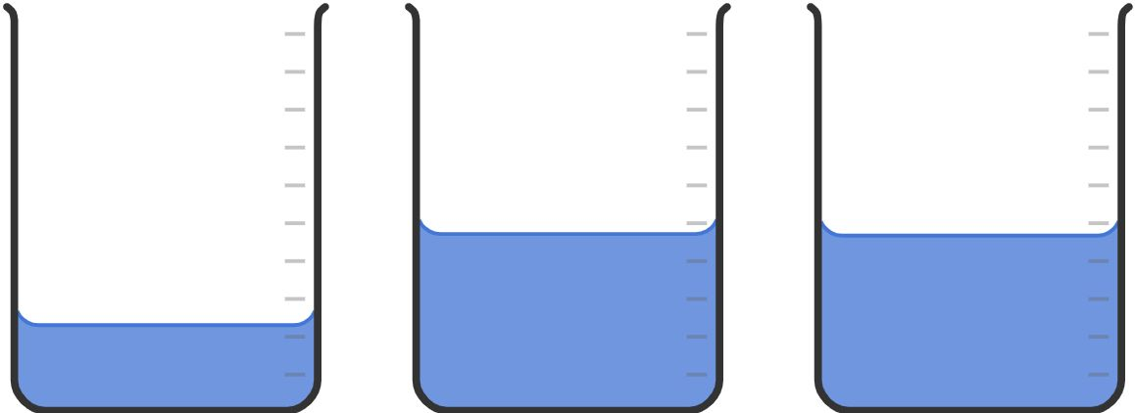
Comparing solutions − demonstration
Comparing solutions
Add water to beaker C to make the total volume 100 cm³ again.
Compare beaker B and beaker C in terms of:
(c) the number of moles of copper(II) sulfate in beakers B and C
  Different
  Unsure
  The same
Beaker A
Beaker B
Beaker C
Beaker A
Beaker B
Beaker C

Slide 8
Comparing solutions − demonstration
Comparing solutions
Add water to beaker C to make the total volume 100 cm³ again.
Compare beaker B and beaker C in terms of:
(d) the concentration of copper(II) sulfate in beakers B and C
  Different
  Unsure
  The same
Beaker A
Beaker B
Beaker C
Beaker A
Beaker B
Beaker C

Slide 9
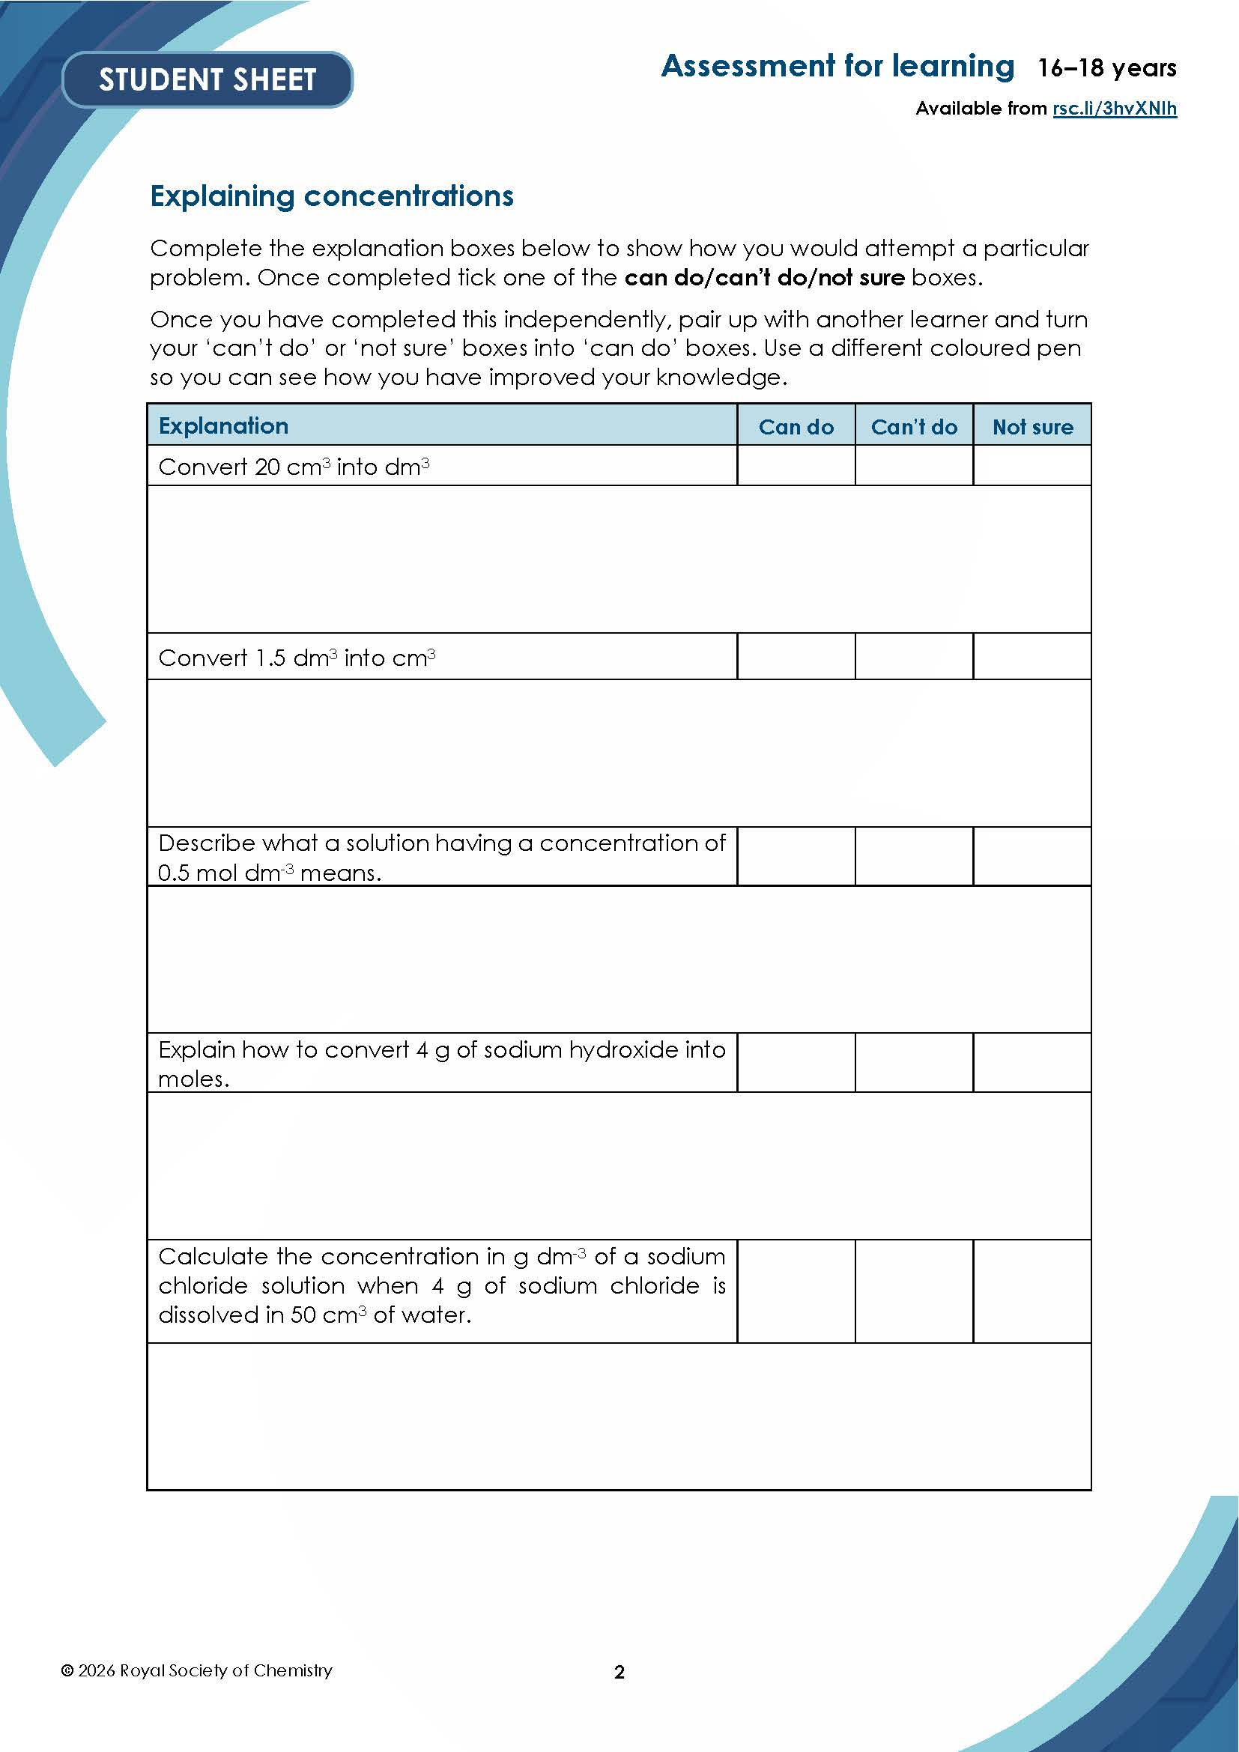
Explaining concentrations
Explaining concentrations
Complete the following explanation boxes to show how you would attempt a particular problem. Once completed tick one of the can do/can’t do/not sure boxes.
Once you have completed this independently, pair up with another person and turn your ‘can’t do’ or ‘not sure’ boxes into ‘can do’ boxes. Use a different coloured pen so you can see how you have improved your knowledge.
Notes:
Downloaded the student worksheet containing the ‘Explaining concentrations’ task from: rsc.li/3hvXNIh

Slide 10
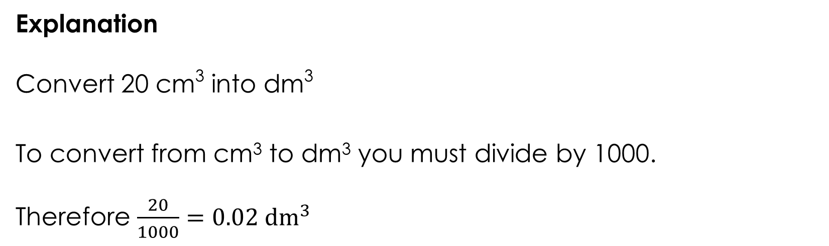
Explaining concentrations – answers
Explaining concentrations
Explanation
Convert 20 cm³ into dm³
To convert from cm³ to dm³ you must divide by 1000.
Therefore $\frac{20}{1000}=0.02 {dm}^{3}$

Slide 11
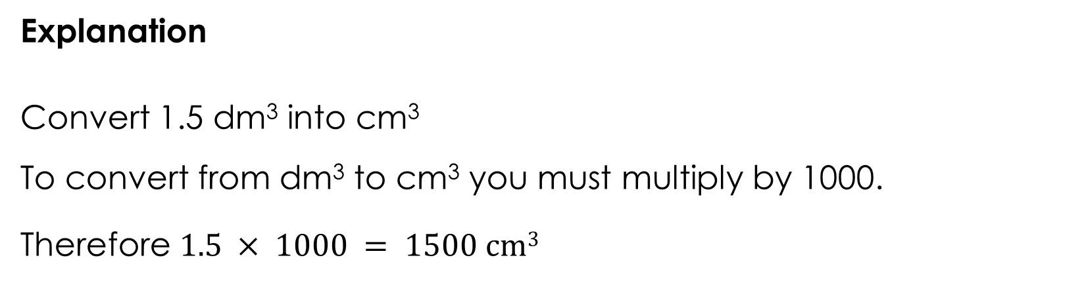
Explaining concentrations – answers
Explaining concentrations
Explanation
Convert 1.5 dm³ into cm³
To convert from dm³ to cm³ you must multiply by 1000.
Therefore $1.5 × 1000 = 1500 cm3$

Slide 12
Explaining concentrations – answers
Explaining concentrations
Explanation
Describe what a solution having a concentration of 0.5 mol dm⁻³ means.
A solution of 0.5 mol dm⁻³ means that there is 0.5 mol of a solute dissolved in every 1 dm³ (one litre) of the total solution.

Slide 13
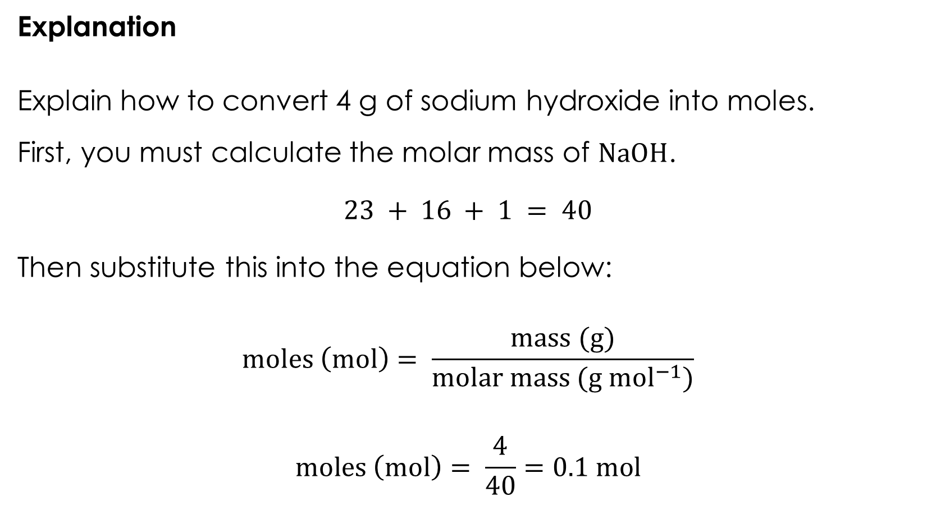
Explaining concentrations – answers
Explaining concentrations
Explanation
Explain how to convert 4 g of sodium hydroxide into moles.
First, you must calculate the molar mass of $NaOH$.
$$23 + 16 + 1 = 40$$
Then substitute this into the equation below:
$$moles \left(mol\right)= \frac{mass (g)}{molar mass (g {mol}^{−1})}$$
$$moles \left(mol\right)= \frac{4}{40}=0.1 mol$$

Slide 14
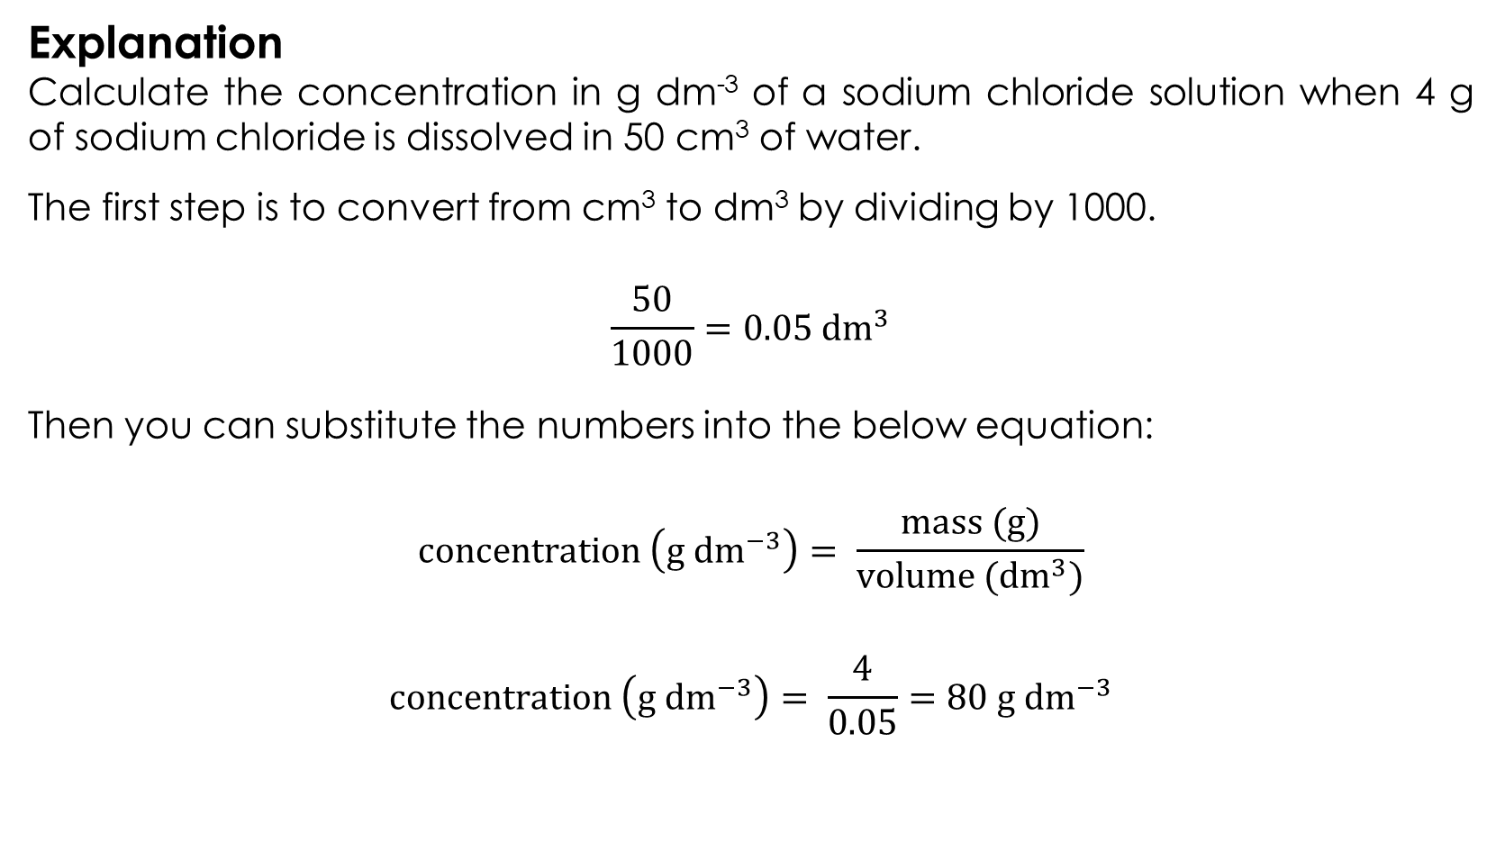
Explaining concentrations – answers
Explaining concentrations
Explanation
Calculate the concentration in g dm⁻³ of a sodium chloride solution when 4 g of sodium chloride is dissolved in 50 cm³ of water.
The first step is to convert from cm³ to dm³ by dividing by 1000.
$$\frac{50}{1000}=0.05 {dm}^{3}$$
Then you can substitute the numbers into the below equation:
$$concentration \left(g {dm}^{−3}\right)= \frac{mass (g)}{volume ({dm}^{3})}$$
$$concentration \left(g {dm}^{−3}\right)= \frac{4}{0.05}=80 g {dm}^{−3}$$

Slide 15
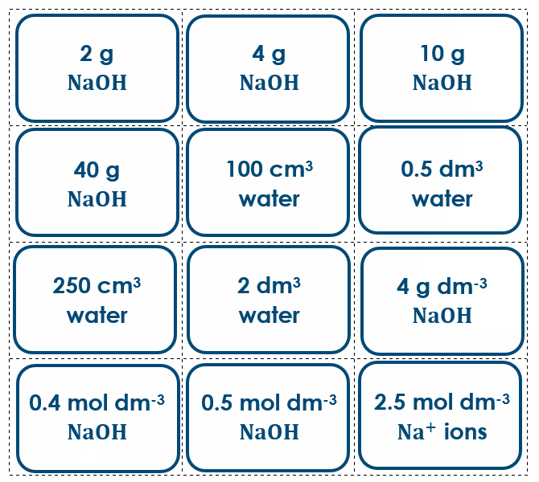
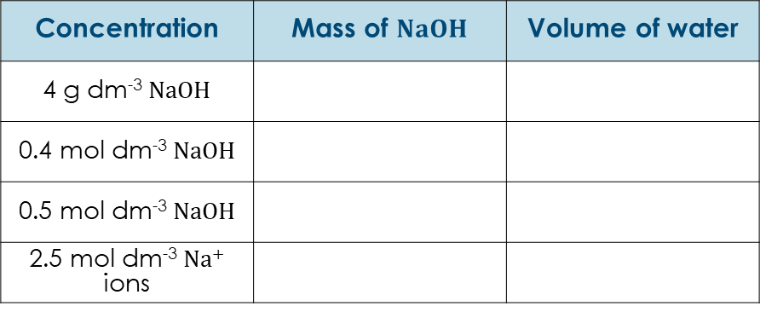
Card matching: task 1
Card matching: task 1
Your teacher will provide you with a series of concentration cards (reproduced on the right).
Work in pairs to match each concentration with the correct mass and volume.
Use the equations from the introduction to support you.
Write your answers in the table.
Concentration | Mass of $NaOH$ | Volume of water
4 g dm⁻³ $NaOH$
0.4 mol dm⁻³ $NaOH$
0.5 mol dm⁻³ $NaOH$
2.5 mol dm⁻³ Na⁺ ions

Slide 16
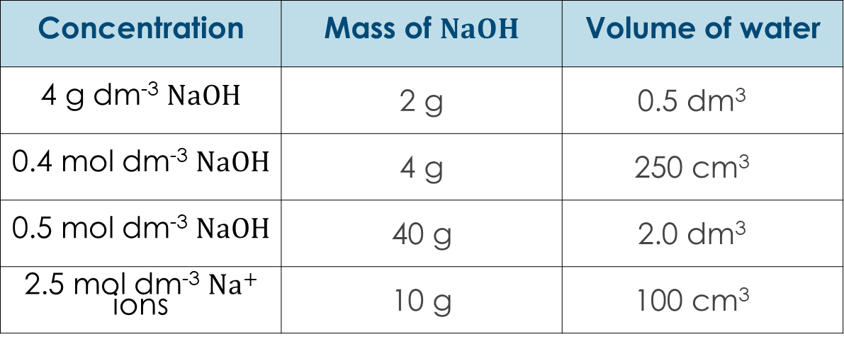
Card matching: task 1 – answers
Card matching: task 1
Concentration | Mass of $NaOH$ | Volume of water
4 g dm⁻³ $NaOH$ | 2 g | 0.5 dm³
0.4 mol dm⁻³ $NaOH$ | 4 g | 250 cm³
0.5 mol dm⁻³ $NaOH$ | 40 g | 2.0 dm³
2.5 mol dm⁻³ Na⁺ ions | 10 g | 100 cm³

Slide 17
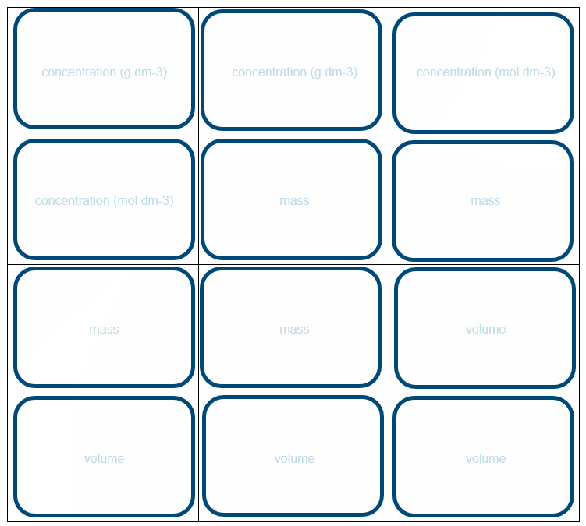
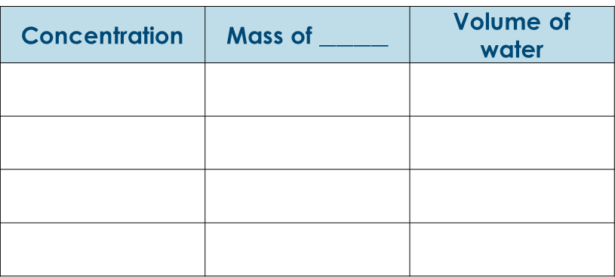
Card matching: task 2
Card matching: task 2
You have a set of blank concentration cards. You must pick one solute from the list below and create a series of calculations based on this.
sodium carbonate
sulfuric acid
potassium hydroxide
calcium bromide
copper(II) sulfate
As before, you need to have four different concentrations (a mixture of g dm⁻³ and mol dm⁻³) with the corresponding mass and volume. Record these in the table so that your classmates can assess their answers.
Concentration | Mass of $________$ | Volume of water

Slide 18
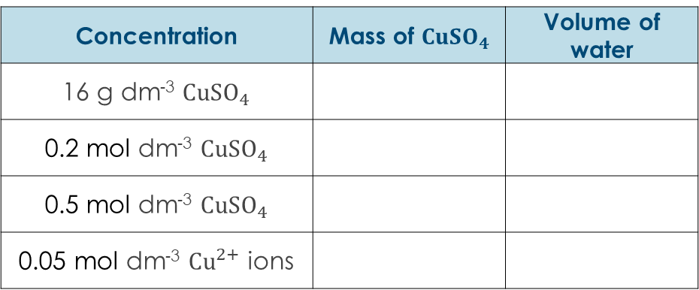
Card matching: task 2
(support)
Card matching: task 2 (support)
You have a set of blank concentration cards. Create a series of calculations based on copper(II) sulfate.
Four different concentrations (a mixture of g dm⁻³ and mol dm⁻³) have been added to the table for you.
Complete the table with the corresponding mass and volume so that your classmates can assess their answers.
Concentration | Mass of $CuSO_{4}$ | Volume of water
16 g dm⁻³ $CuSO_{4}$
0.2 mol dm⁻³ $CuSO_{4}$
0.5 mol dm⁻³ $CuSO_{4}$
0.05 mol dm⁻³ ${Cu}^{2+}$ ions

Slide 19
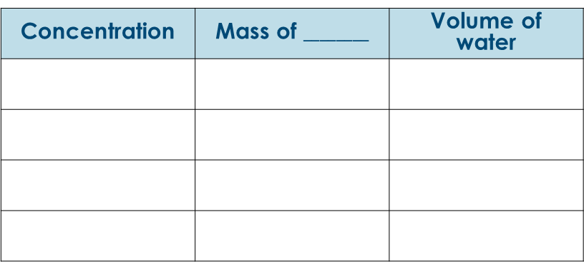
Card matching: task 3
Card matching: task 3
Swap your concentration cards with another group. Determine the mass and volume needed to make solutions of a certain concentration.
Write your answers in the table and show any working out.
Concentration | Mass of $________$ | Volume of water

Slide 20
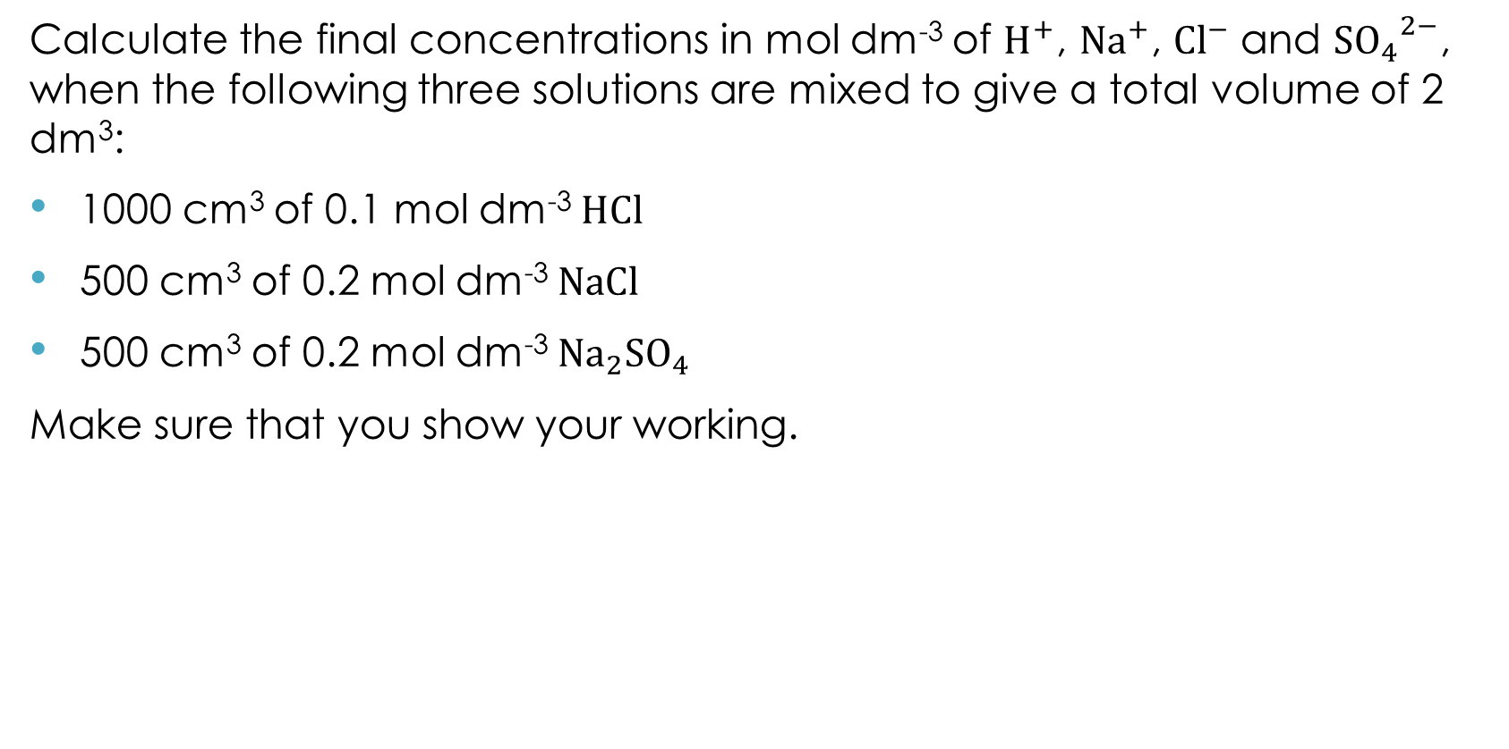
Extension activity
Extension activity
Calculate the final concentrations in mol dm⁻³ of $H^{+}$, ${Na}^{+}$, ${Cl}^{−}$and ${SO_{4}}^{2−}$, when the following three solutions are mixed to give a total volume of 2 dm³:
1000 cm³ of 0.1 mol dm⁻³ $HCl$
500 cm³ of 0.2 mol dm⁻³ $NaCl$
500 cm³ of 0.2 mol dm⁻³ ${Na}_{2}SO_{4}$
Make sure that you show your working.

