Slide 1
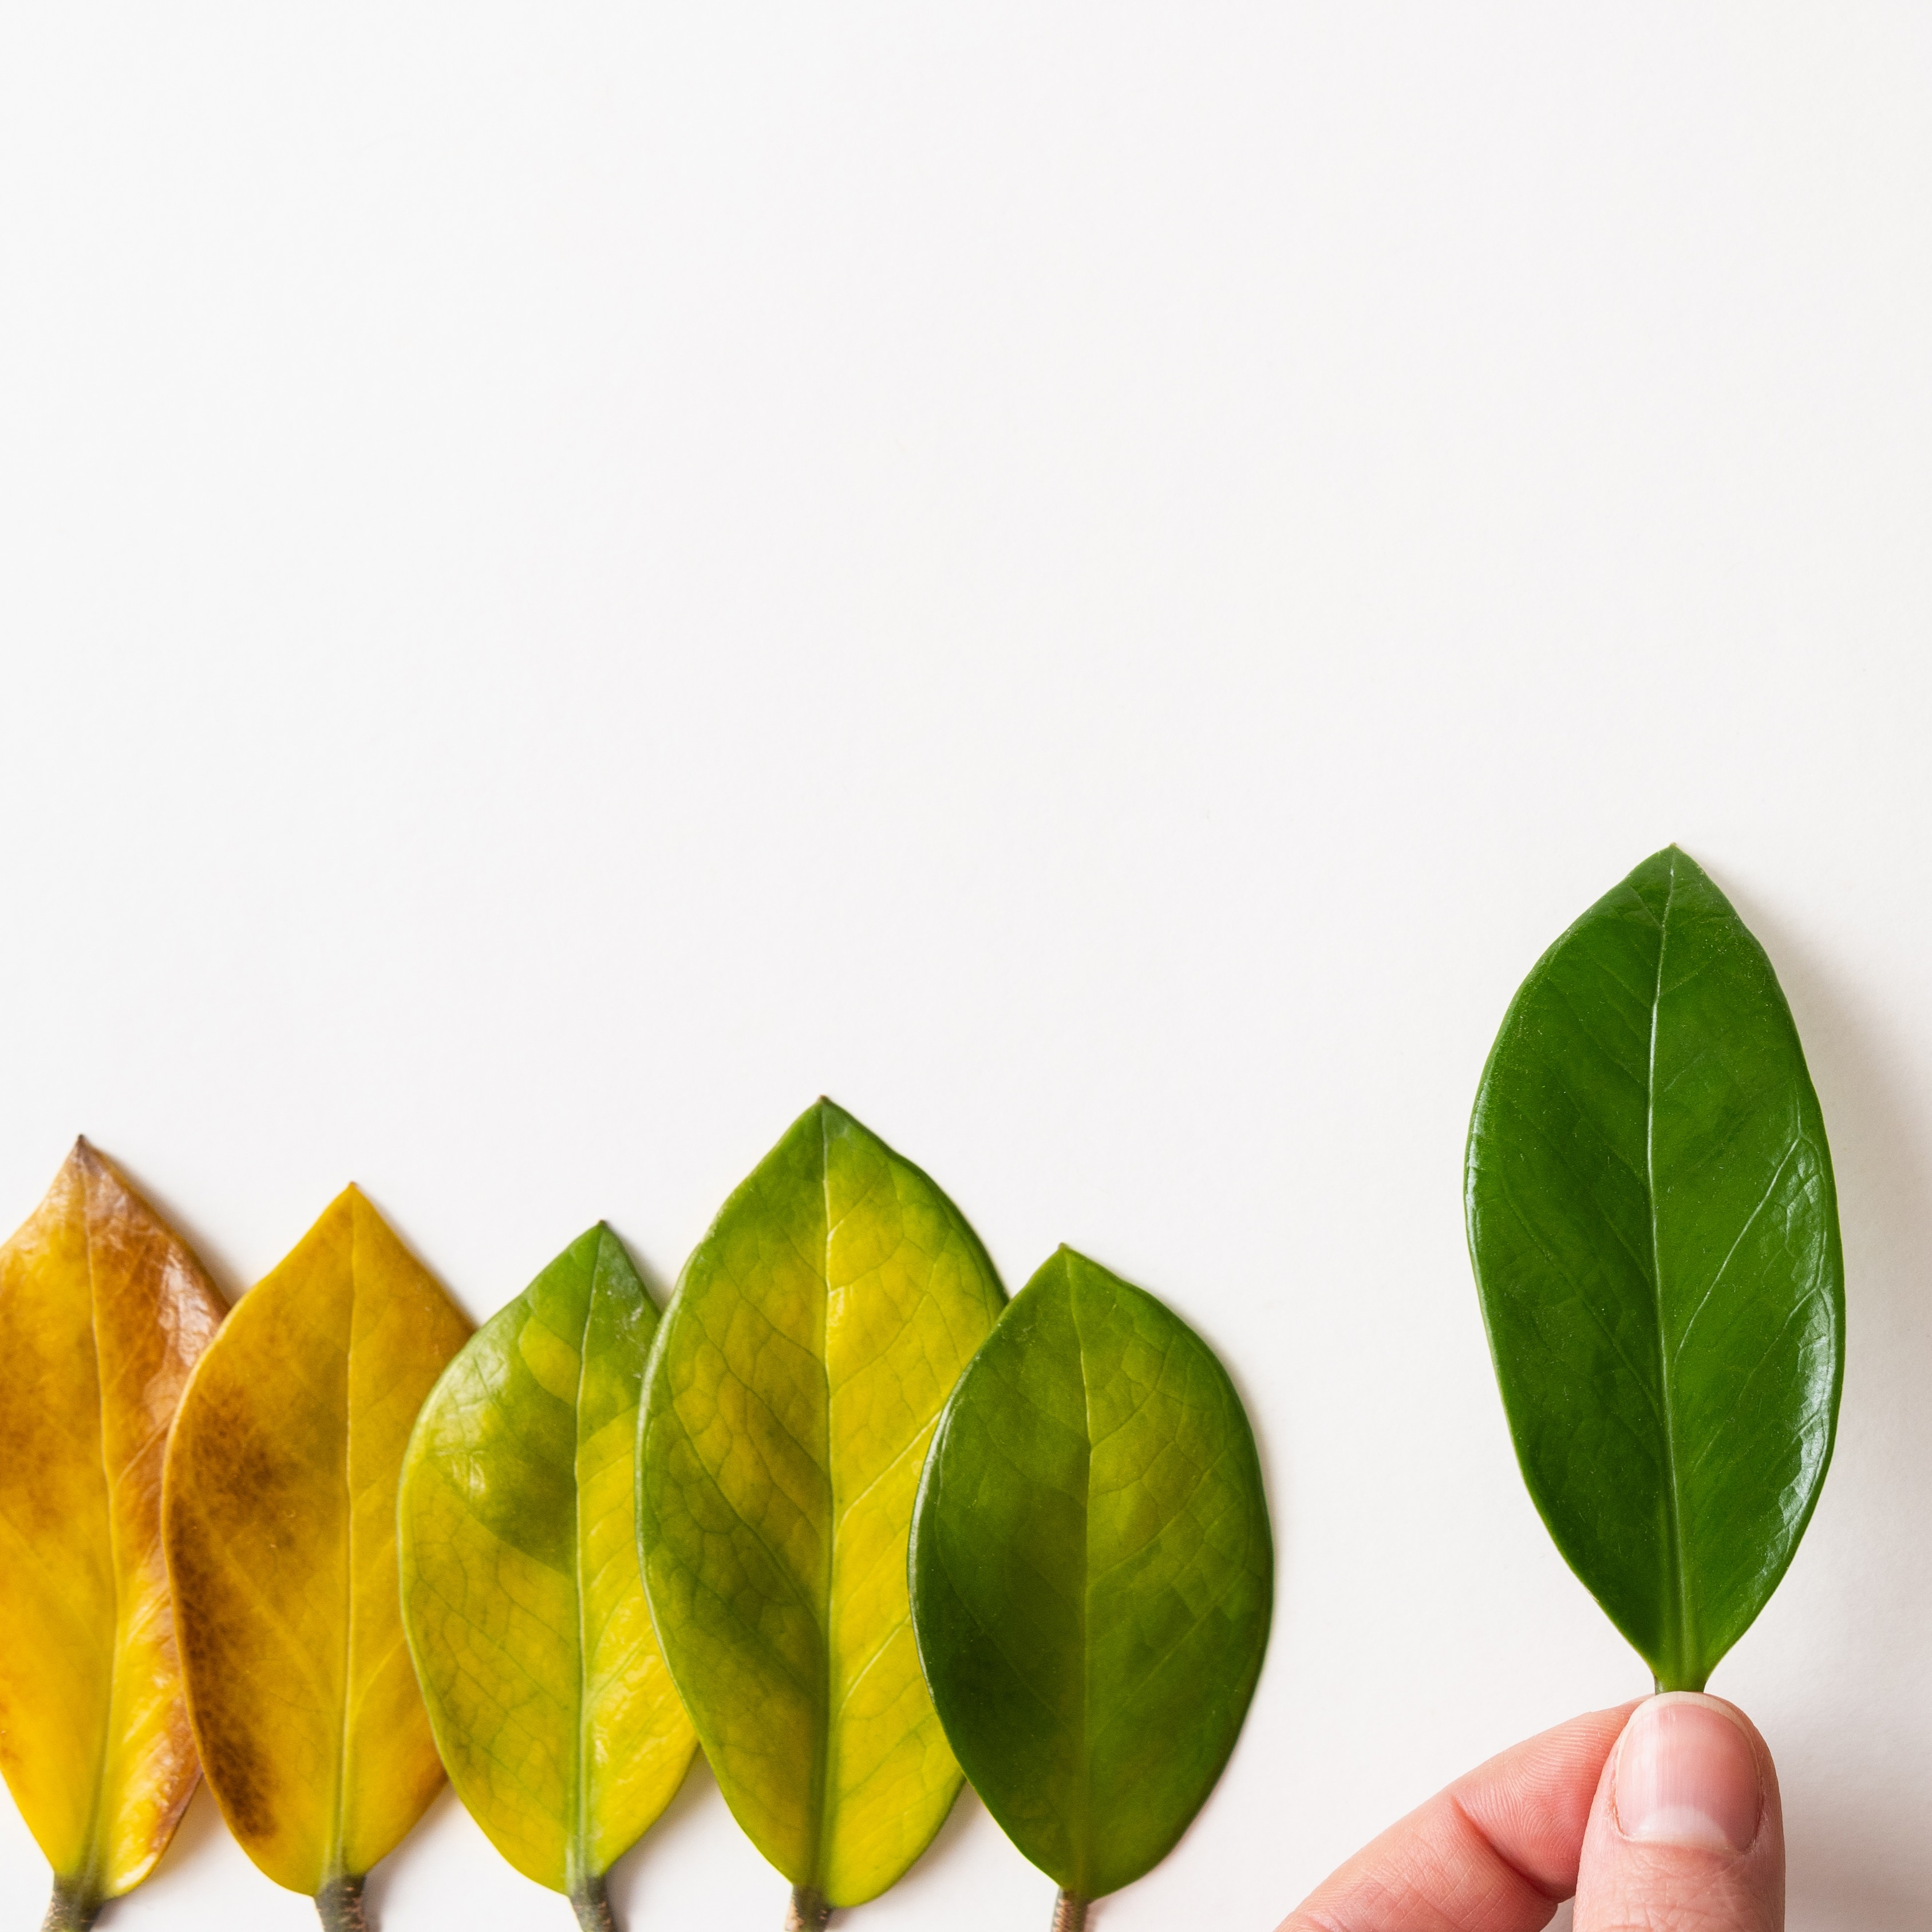
14–16 years
Leaf chromatography

Slide 2
Introduction
Introduction
Most leaves are green due to the chemical chlorophyll. This substance is important in photosynthesis (the process by which plants make their food).
In this experiment, you will investigate the different pigments present in a leaf, from chlorophyll to carotenes, using a technique called paper chromatography.

Slide 3
Introduction
Introduction
Chromatography has many real-world applications. These include testing the purity of foods and medicines, identifying the use of performance enhancing drugs during sports competitions, and testing for traces of explosives and accelerants from fires.

Slide 4
Learning objectives
Learning objectives
Carry out paper chromatography to find the pigments present in leaves and calculate their R_{f} values.
Identify stationary and mobile phases in paper chromatography.
Describe what the chromatogram can tell us about substances.
Explain why water is not always used as the solvent in chromatography.

Slide 5



Integrated instructions: leaf chromatography
 Mark solvent front. 
 Remove the chromatogram 
Cut-up leaves 
Add:
leaves 
sand 
six drops of propanone 
 Max 10 cm³ of propanone. 
Grind for three minutes 
 Draw a line 
 Spot of leaf extract. Let dry. Repeat five times     
 Secure chromatography paper 
Nuffield practical collection
Leaf chromatography
rsc.li/49nMlMP
Notes:
Method:
Measure out 20 cm³ of the coloured solution in a measuring cylinder and pour it into the conical flask.
Add a few anti-bumping granules to the flask.
Clamp the conical flask on a tripod and gauze over a Bunsen burner sitting on a heatproof mat.
Take the delivery tube and place the bung in the top of the conical flask and the other end of the delivery tube in the test tube in the beaker.
Add ice water to the beaker.
Light the Bunsen burner on the yellow safety flame, then open the air hole so you have a blue flame. Heat the solution until it boils, then turn down the Bunsen burner flame by reducing the gas so it boils gently until you collect 1 cm³ of distillate in the test tube.
Place some white anhydrous copper (II) sulfate onto a watch glass and use a pipette to add a few drops of the product on to it to see if you’ve collected water.
Adapted from AQA GCSE chemistry required practicals integrated instructions v0.1 09/07/18 © David Paterson, 2018

Slide 6
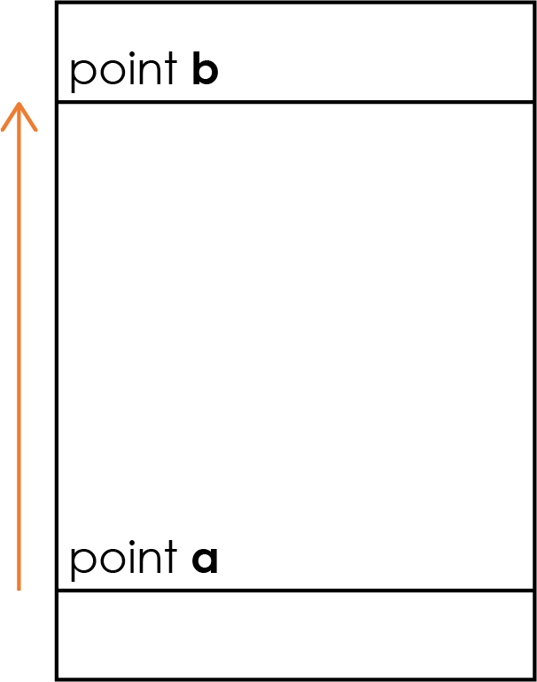
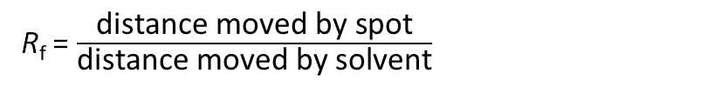
Results
Spots on leaf sample | Distance travelled (cm) |  | R_{f}
 | By spot | By solvent
Distance travelled by sample = __________ cm
(= distance between point a and the centre of the spot)
If there are multiple sample spots, calculate the distance for each spot separately
Distance travelled by solvent = __________ cm
(= distance between point a and point b)
R_{f} = $\frac{\text{distance} \text{moved} \text{by} \text{spot}}{\text{distance} \text{moved} \text{by} \text{solvent}}$

Slide 7
Example Results
Spots on leaf sample | Distance travelled (cm) |  | R_{f}
 | By spot | By solvent
1 | 0.0 | 5.0 | 0.00
2 | 1.6 | 5.0 | 0.32
3 | 2.5 | 5.0 | 0.50
4 | 4.5 | 5.0 | 0.90
Distance travelled by sample = __________ cm
(= distance between point a and the centre of the spot).
If there are multiple sample spots, calculate the distance for each spot separately.
4
3
2
1
R_{f} = $\frac{\text{distance} \text{moved} \text{by} \text{spot}}{\text{distance} \text{moved} \text{by} \text{solvent}}$
5.0
Distance travelled by solvent = __________ cm
(= distance between point a and point b)

Slide 8
Questions
Unscaffolded questions
State the stationary and mobile phase in this chromatography experiment.
Explain why water was not used as the solvent in this chromatography experiment.
Explain why the markings on the chromatography paper must be drawn in pencil (and not in pen).
State and explain which of the chemicals (using the spot numbers) within the leaf pigment was the most soluble in the solvent.
Using your chromatogram, is the pigment found within the dye a pure substance or a mixture? Explain how you can tell.
Look at the example data provided by your teacher.
  Why did spot 1 not travel up the chromatography paper?
  Why did spots 2, 3 and 4 travel different distances up the chromatography paper?

Slide 9
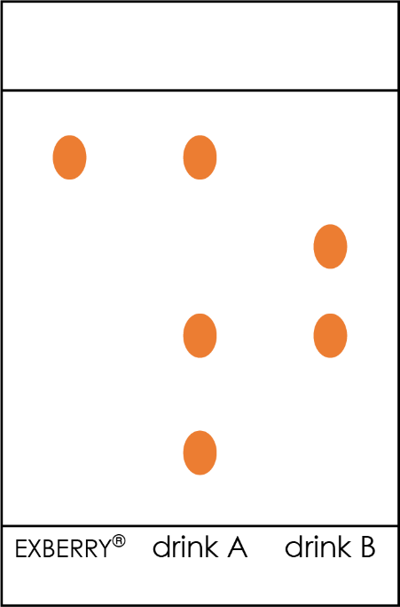
Questions
Carotenes are natural pigments produced by plants, algae and some bacteria, fungi and archaea. EXBERRY®, a brand of plant-based carotene food colouring extracted from saltwater algae Dunaliella salina, is used in a number of food and drink items. A student wanted to investigate whether this food colouring is used in two different soft drinks, A and B. The results are shown on the chromatogram.
Use the chromatogram to draw two conclusions about the colourings used in drinks A and B.
Unscaffolded questions
Carotene Food Coloring | EXBERRY®

Slide 10
Questions
Scaffolded questions
State the stationary (the phase which does not move) and mobile phase (the phase that moves).
Explain why water was not used as the solvent in this chromatography experiment. You should refer to solubility in your answer.
Explain why the markings on the chromatography paper must be drawn in pencil (and not in pen). You should refer to solubility in your answer.
Which of your spots travelled the greatest distance during the chromatography experiment? Is this the most or least soluble pigment?
Using your chromatogram, is the pigment found within the dye a pure substance or a mixture? Explain how you can tell using the number of spots produced by each pigment.

Slide 11
Questions
Scaffolded questions
Look at the example data provided by your teacher.
  Why did spot 1 not travel up the chromatography paper? You should refer to solubility in your answer.
  Why did spots 2, 3 and 4 travel different distances up the chromatography paper? You should refer to solubility in the solvent and attraction towards the chromatography paper in your answer.

Slide 12
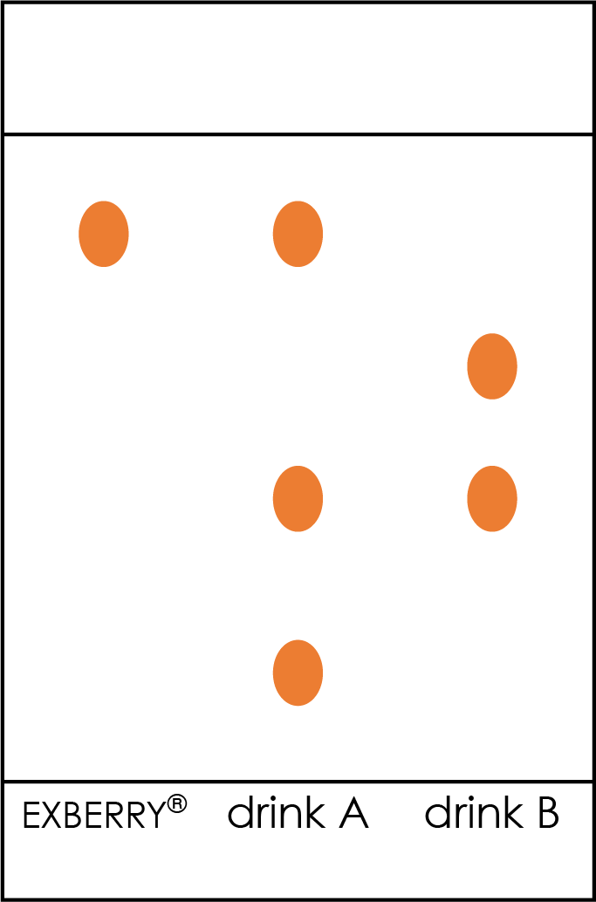
Questions
Scaffolded questions
Carotenes are natural pigments produced by plants, algae and some bacteria, fungi and archaea. EXBERRY®, a brand of plant-based carotene food colouring extracted from saltwater algae Dunaliella salina, is used in a number of food and drink items. A student wanted to investigate whether this food colouring is used in two different soft drinks, A and B. The results are shown on the chromatogram.

Slide 13
Questions
Scaffolded questions
  Which of the two drinks, A or B, contains EXBERRY® colourings?
  Which of the two drinks, A or B, contains the most colourings?
  Do drinks A and B contain any common ingredients? Explain how you can tell using the chromatogram.
  Which of the colourings was most soluble in the solvent used?

Slide 14
Answers
Answers
Stationary phase = chromatography paper
Mobile phase = propanone
Water is not used in this experiment as the dyes are not soluble in water, and would therefore not move up the chromatography paper.
Pencil must be used for all markings as it is insoluble in the solvent. Pen is soluble, and would also travel up the chromatography paper and interfere with results.
View alongside student results.
Students should identify the pigment which has travelled the greatest distance – this is the most soluble pigment.
View alongside student results.
If more than one spot is produced, the pigment is a mixture. Pure substances produce only one spot during chromatography.

Slide 15
Answers
Answers
  Spot 1 did not travel up the chromatography paper because it was insoluble in the solvent used.
  Spots 2, 3 and 4 travel different distances because they have different solubilities in the solvent and different attractions for the paper.
  Because Spot 4 travelled the furthest, it has the highest solubility and the lowest attraction to the paper.
  Spot 2 has the lowest solubility (apart from spot 1, which is insoluble) and the highest attraction to the paper.

Slide 16
Answers
Unscaffolded answers
Unscaffolded
Any two conclusions from:
    Drink A contains EXBERRY® but Drink B does not.
    Drink A contains three different colourings, one of which is EXBERRY®.
    Drink B contains two different colourings.
    EXBERRY® was the most soluble colouring.
    Drinks A and B contain only one common ingredient.

Slide 17
Answers
Scaffolded answers
Scaffolded
  Only Drink A contains EXBERRY® colouring.
  Drink A contains the most colourings – three spots are produced.
  Drinks A and B contain only one common ingredient. This is not EXBERRY®. They produced a spot with a common R_{f} value.
  EXBERRY® was the most soluble colouring in the solvent.

Slide 18
Acknowledgements
Carotene Food Coloring | EXBERRY®

