Slide 1
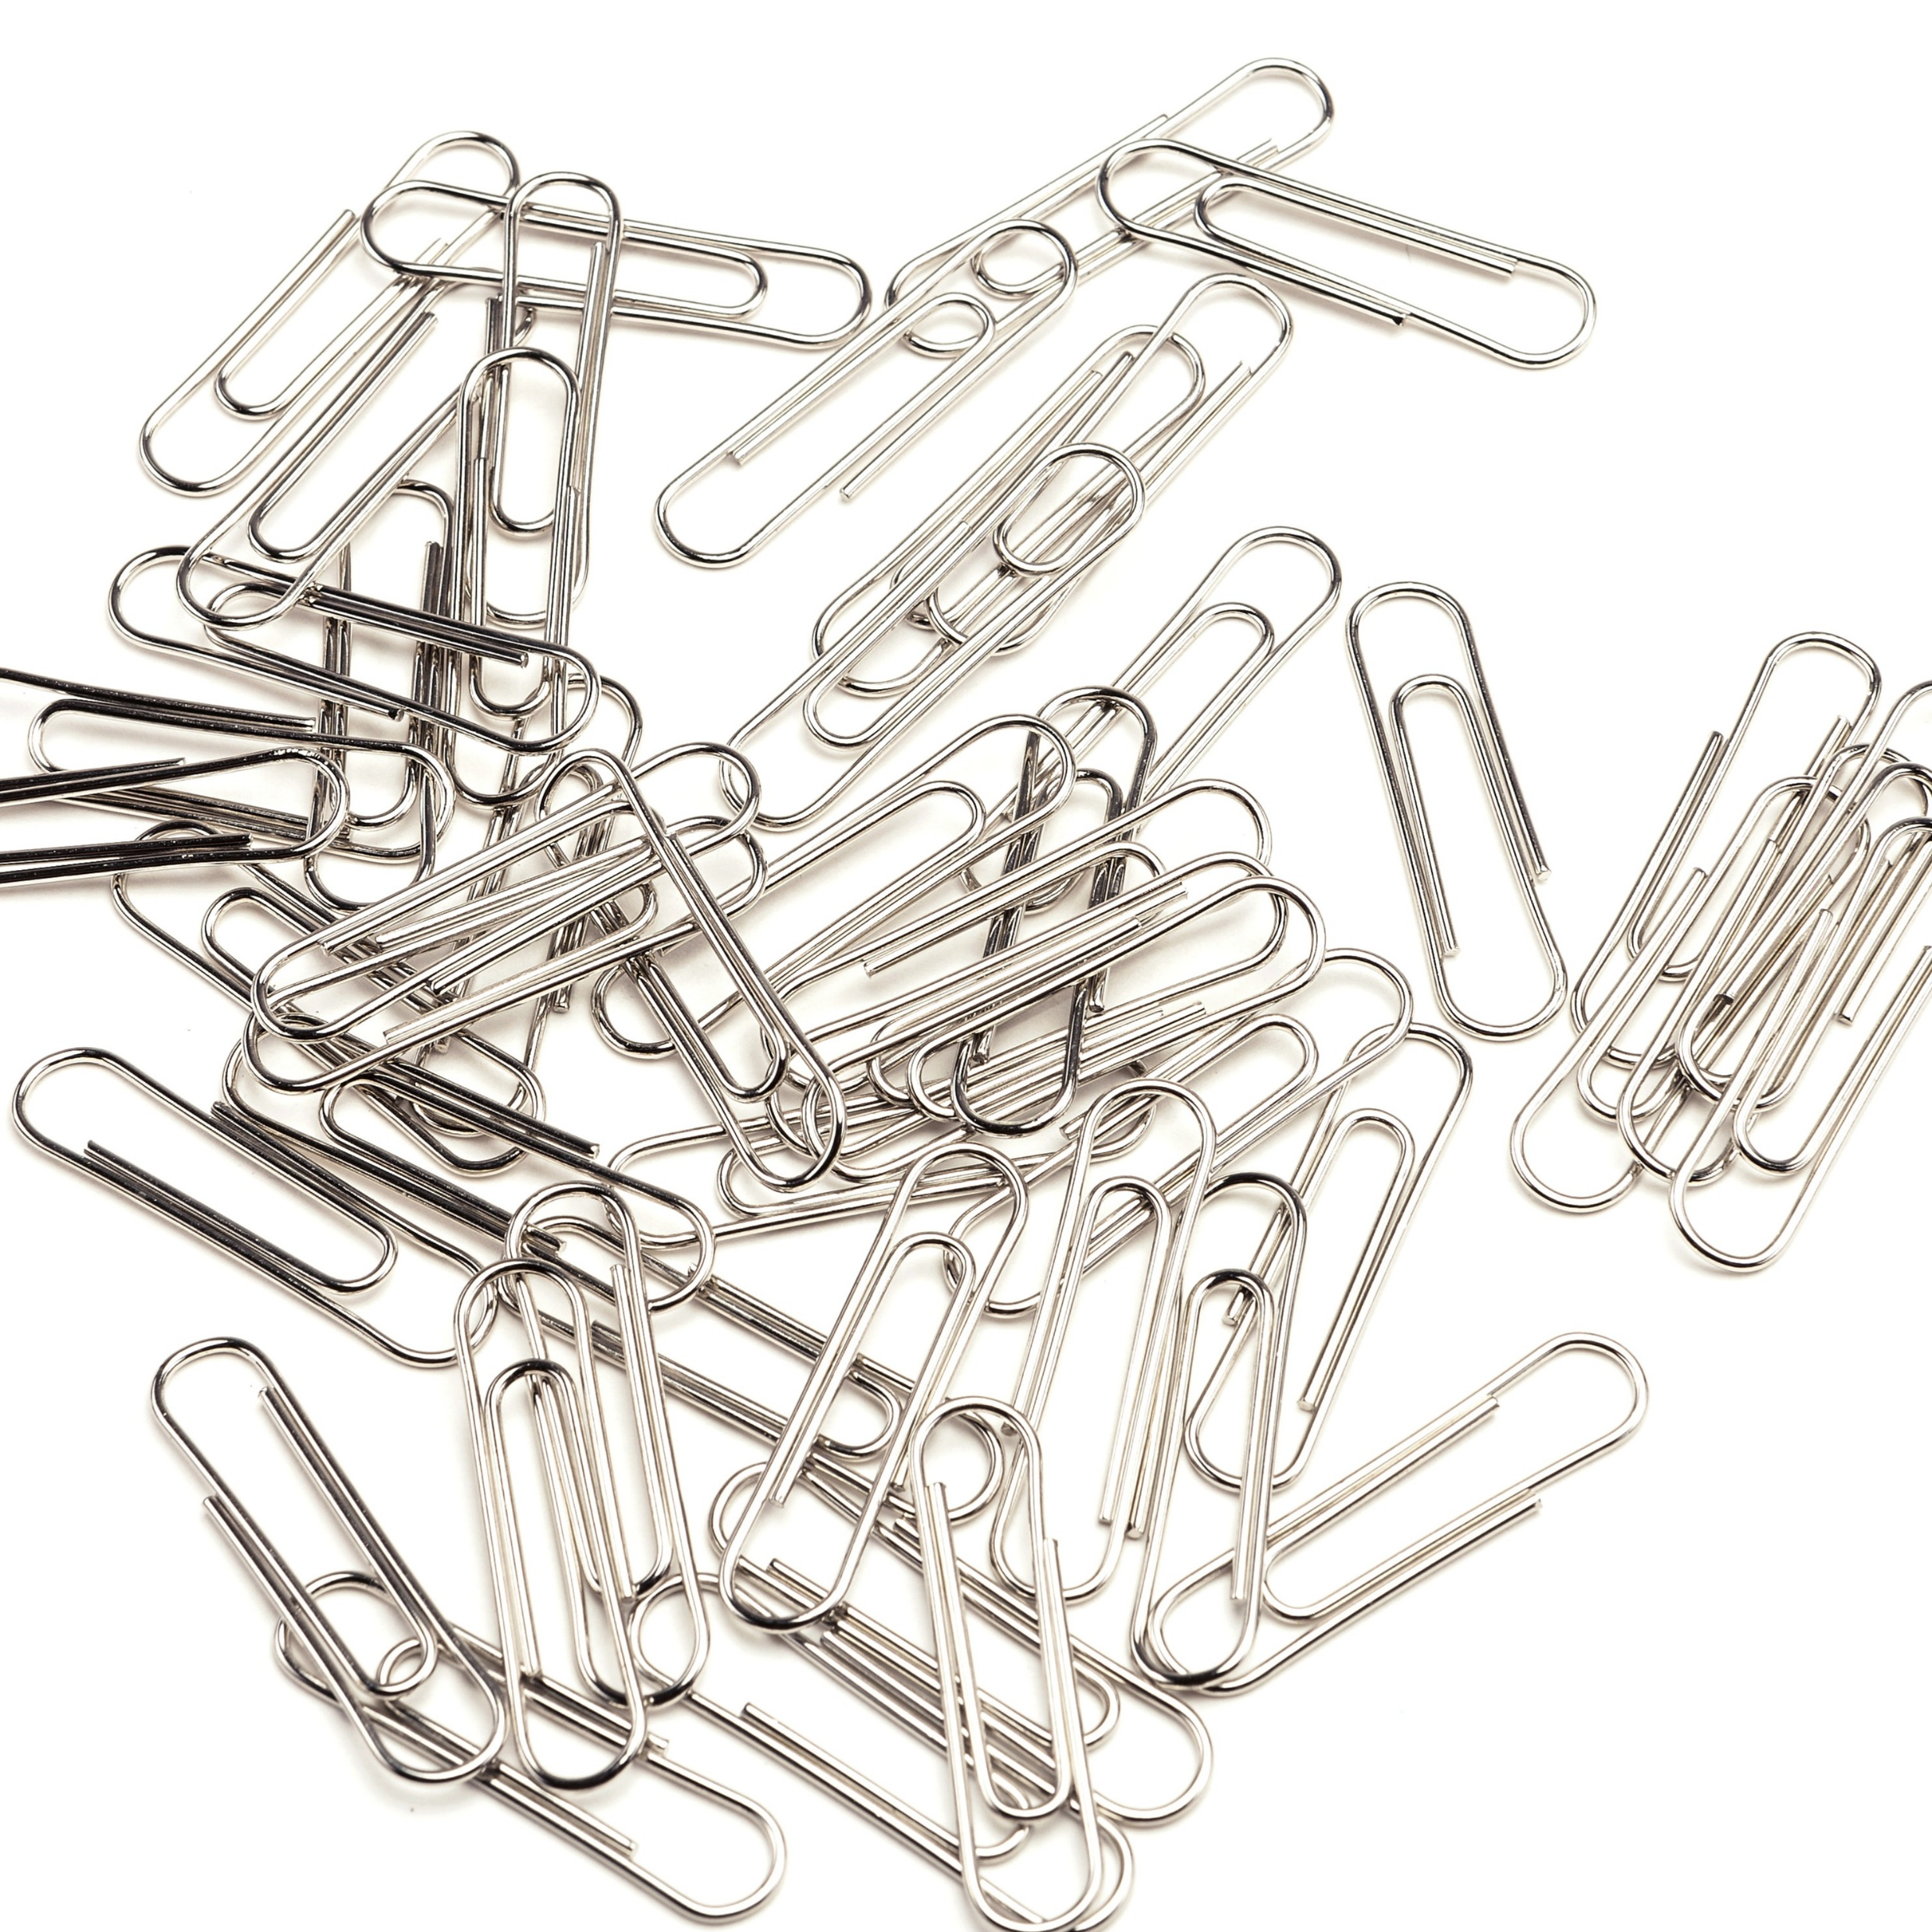
11–14 years
What is stuff made of? Exploring matter, atoms and elements
Downloaded from: rsc.li/32yJ6Qu
Notes:
Image © Shutterstock/Early Spring

Slide 2
Learning objectives
Recall that matter is made from atoms
Compare the size of atoms with small objects that we can see and other objects which are too small to see with the naked eye
Describe that atoms are the smallest parts of an element and that they retain the properties of that element using observations from a demonstration
Make deductions about the nature of atoms from a series of observations
Learning objectives

Slide 3
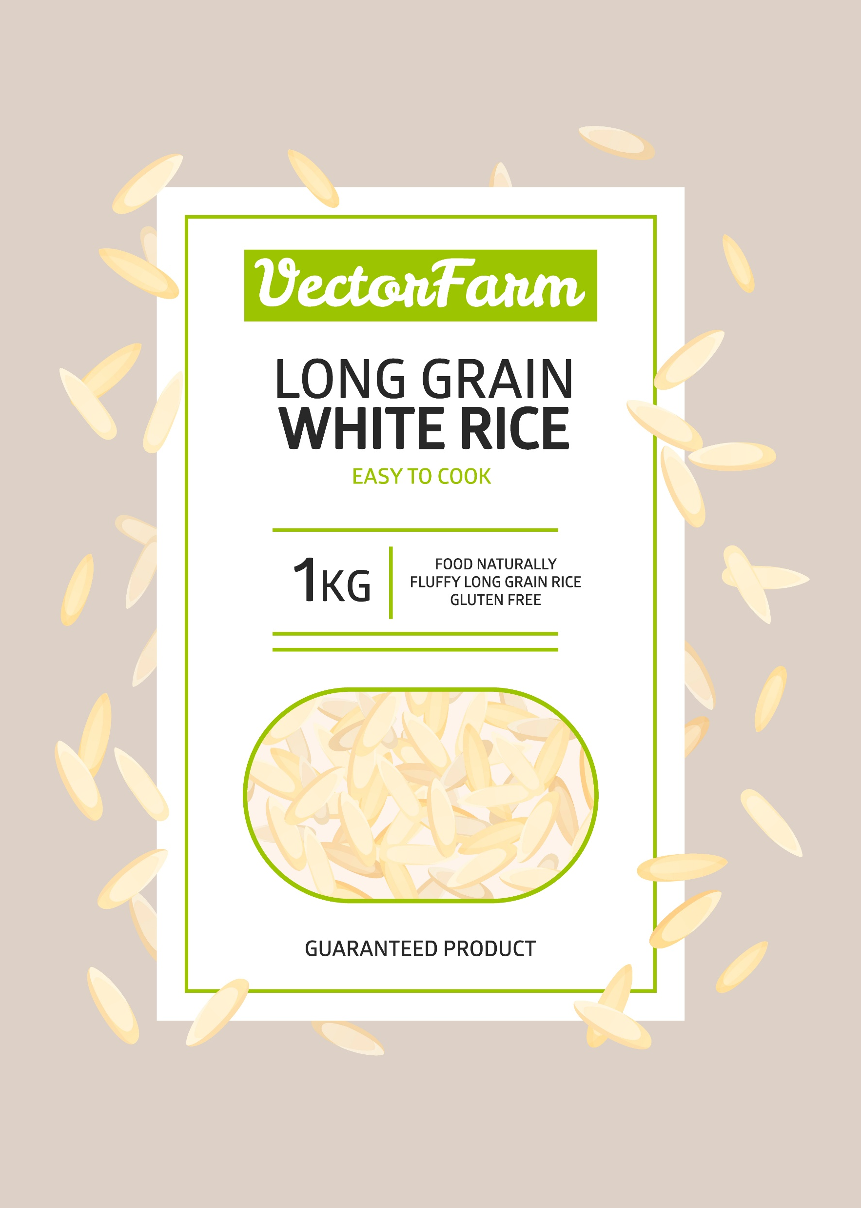
Introduction
Introduction
How many grains of rice are there in this 1 kg bag?
What if there are about 1000 grains
in 25 g?
That would be 4000 grains in 100g and 40,000 grains approximately in 1 kg!
Rice grains are small, but how much smaller are atoms?
© Shutterstock/Walnut Bird
Notes:
Image © Shutterstock/Walnut Bird

Slide 4
Introduction
Introduction
Look around you. Everything you can see, touch or hold, from the air you breathe to the phone in your hand, is made of matter.
Matter is the name scientists give to anything that has mass and takes up space. Matter is made of tiny building blocks called atoms that make up everything in the universe.
Atoms are incredibly small. So small that you cannot see them with the naked eye. However, they combine in different ways to create all the materials around us.
Different types of atoms are called elements, and each element has its own unique properties. For example, the element oxygen is part of the air we breathe, while carbon is found in living things, fuels and even diamonds.

Slide 5
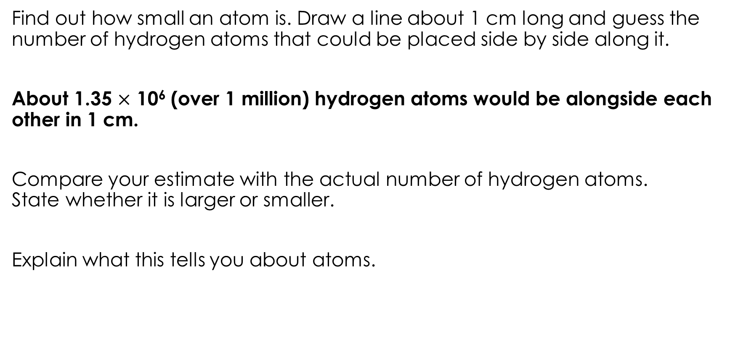
It’s a small world!
Activity one
Find out how small an atom is. Draw a line about 1 cm long and guess the number of hydrogen atoms that could be placed side by side along it.
About 1.35 $×$ 10⁶ (over 1 million) hydrogen atoms would be alongside each other in 1 cm.
Compare your estimate with the actual number of hydrogen atoms.
State whether it is larger or smaller.
Explain what this tells you about atoms.

Slide 6
It’s a small world!
Activity one
Here is a list of some small objects.
(a) Write the objects in order of size, from largest to smallest.
(b) Next to each object, write yes, no, or barely visible to state
whether or not you can see the object with the naked eye.
Ribosome | Grain of sand
Red ant | Grain of table salt
Skin cell | Water molecule
Atom | Human hair (diameter)
Red blood cell | Dust mite
Pin head | DNA (width of double helix)
Pollen grain | Mitochondrion
Human egg cell | Virus
Bacterium | Poppy seed

Slide 7
It’s a small world!
Small object | Can it be seen with the naked eye? | Approximate size
Red ant | Yes | ~3 mm
Pin head | Yes | ~1–2 mm
Poppy seed | Yes | ~1 mm
Grain of sand | Yes | ~0.5 mm
Sugar crystal | Yes | ~0.5 mm
Grain of table salt | Yes | ~0.3 mm
Dust mite | Barely visible | ~0.3 mm (300 µm)
Human hair (diameter) | Barely visible | ~17–180 µm
Human egg cell | No | ~100 µm
Pollen grain | No | ~30–100 µm
Skin cell | No | ~30 µm
Red blood cell | No | ~8 µm
Bacterium | No | ~2 µm
Mitochondrion | No | ~1 µm
Virus | No | ~100 nm
Ribosome | No | ~20–30 nm
DNA (width) | No | ~2 nm
Atom | No | ~0.2 nm
Activity one
Name the smallest thing your eyes can see. State the size of this.
Explain why our eyes cannot see some of the other small objects in the table.
Describe what all these small things made from.
Explain what this tells you about the sizes of atoms.

Slide 8
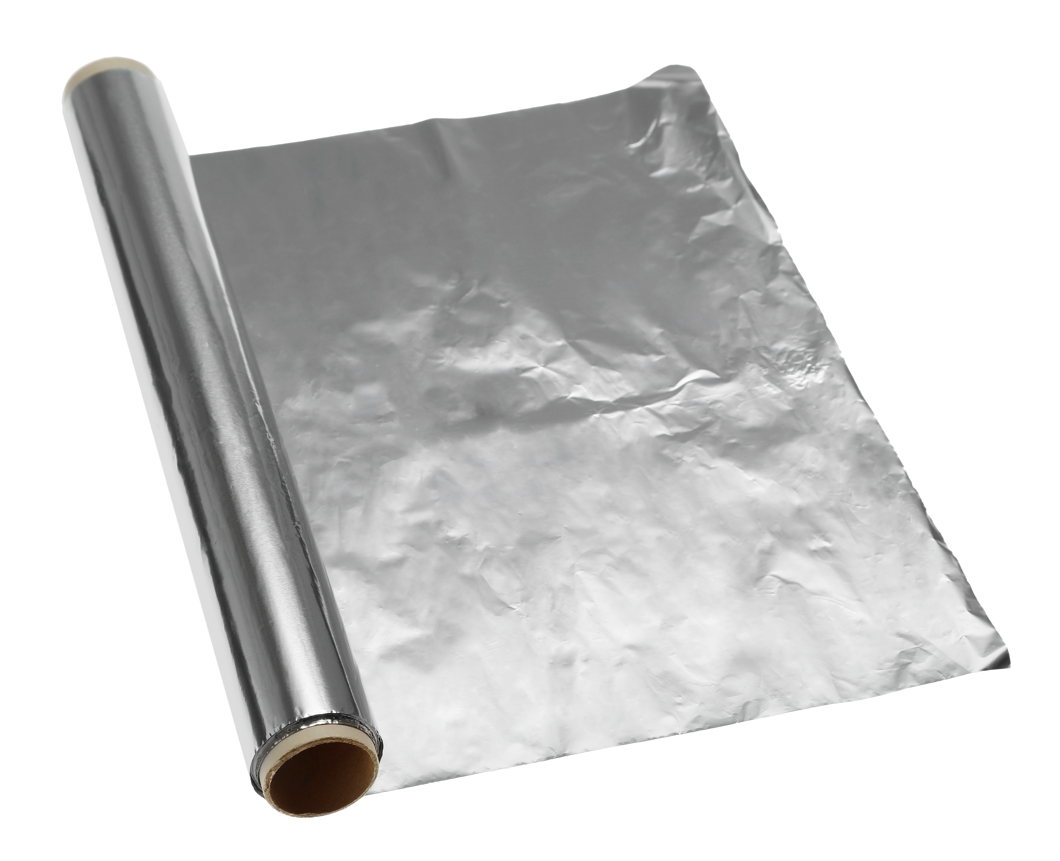
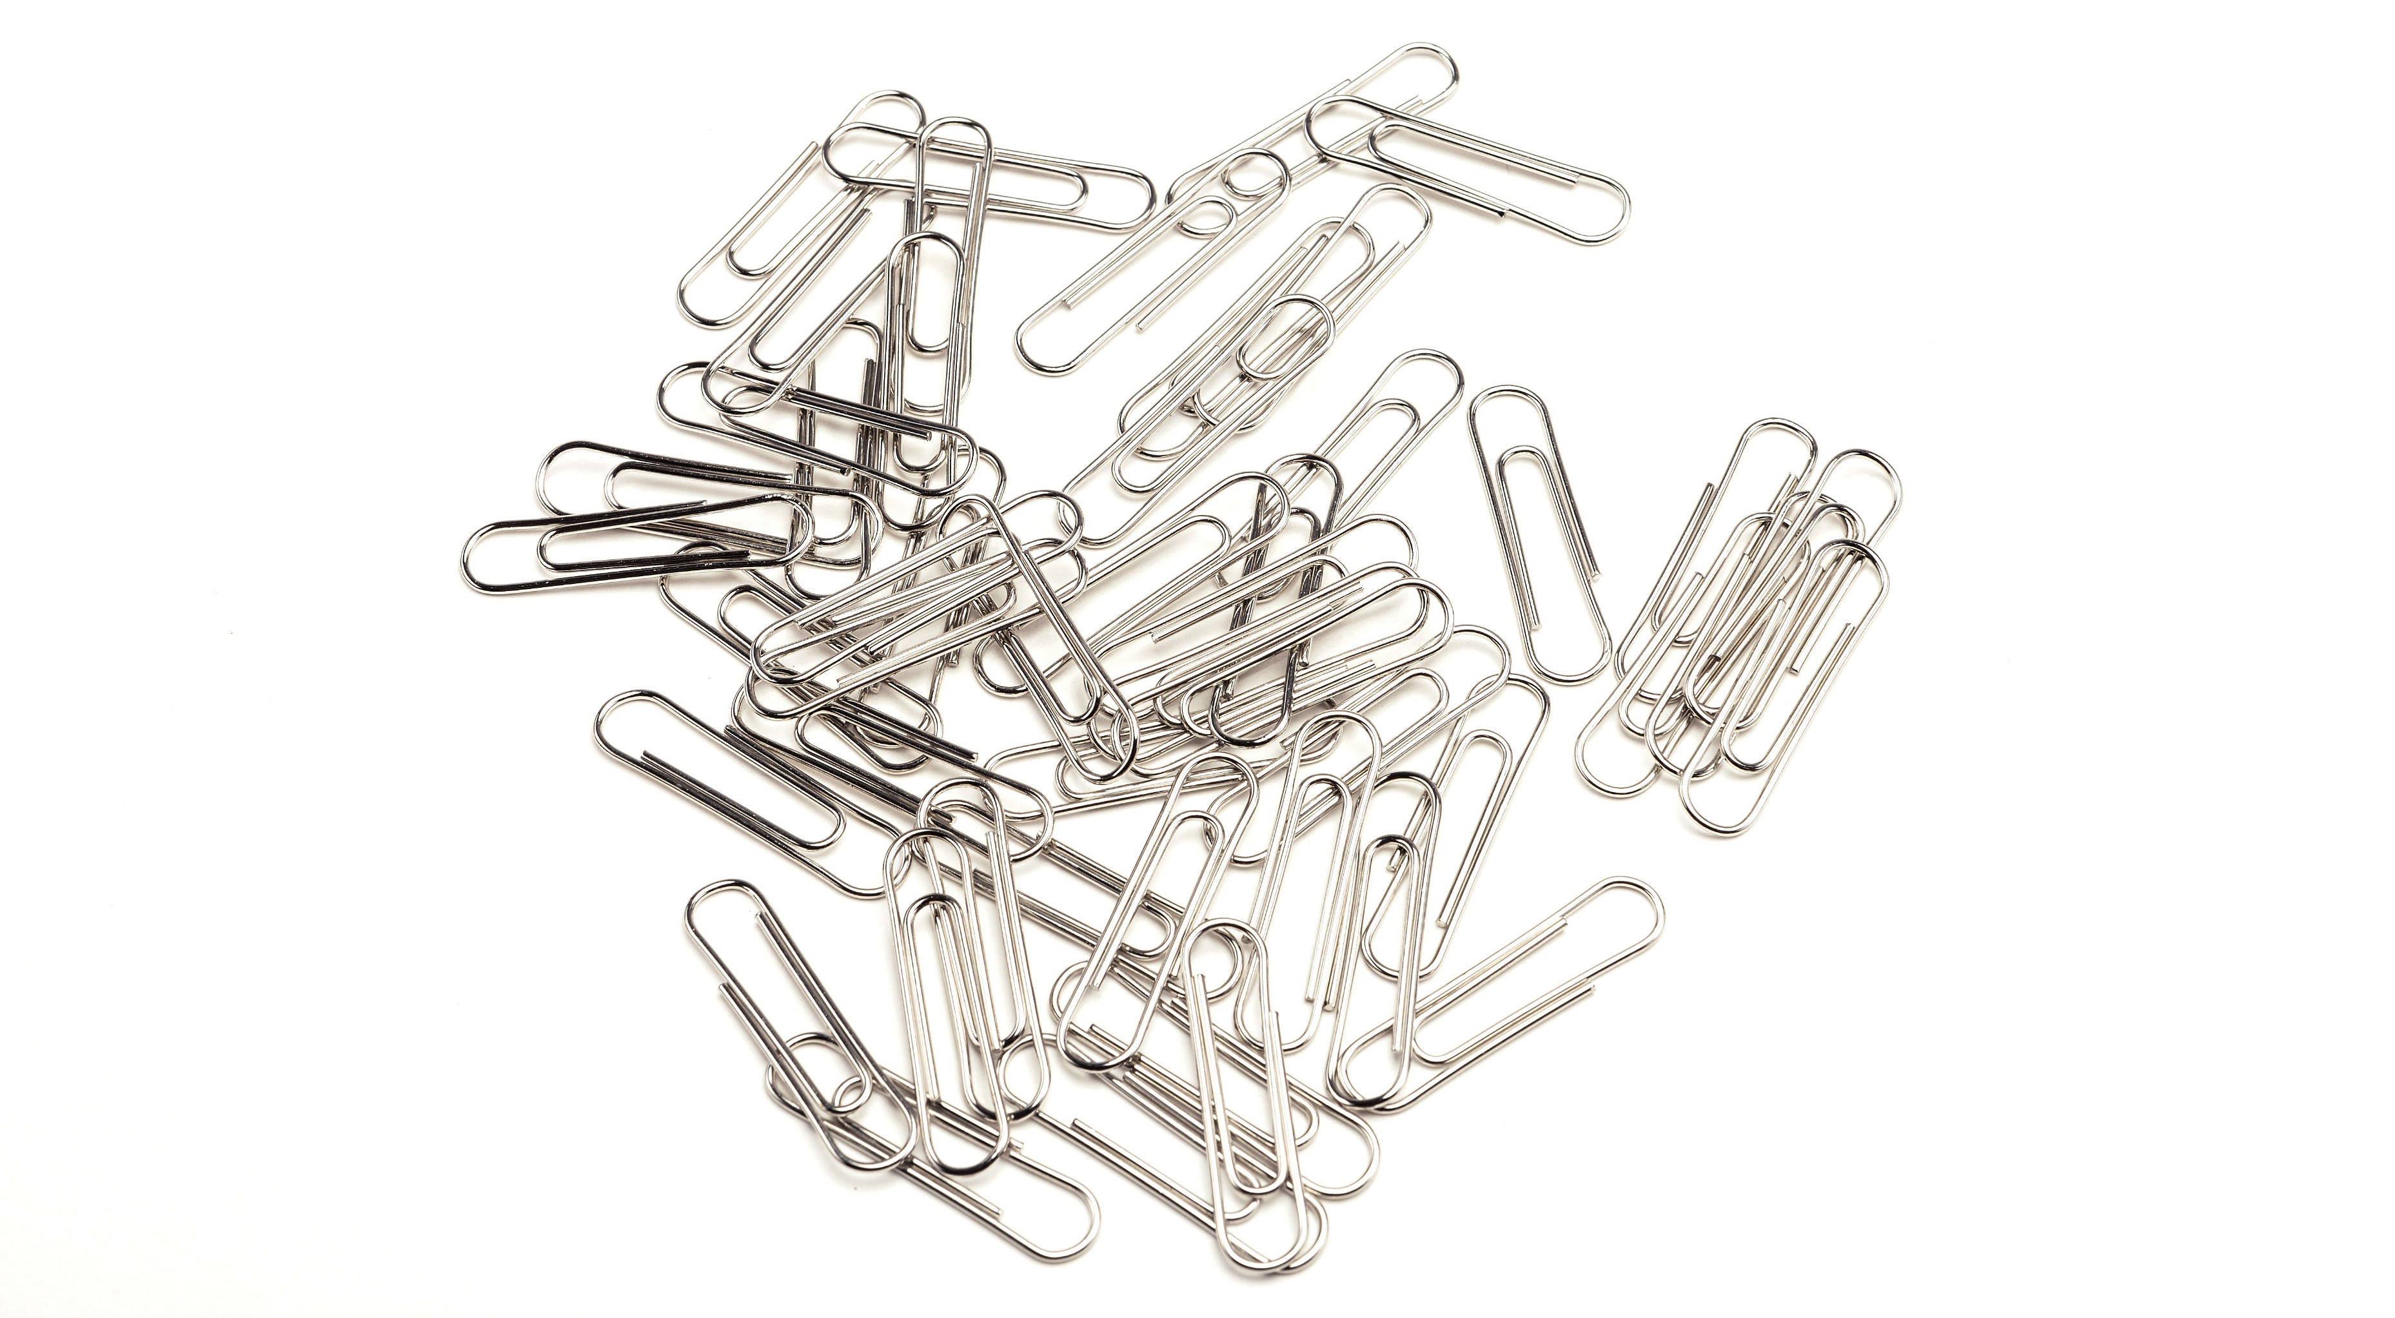
Atomic paper clips demonstration
Activity two
Notes:
Image 1: © Shutterstock / Early Spring
Image 2: © Shutterstock / New Africa

Slide 9
Atomic paper clips – follow-up questions
Activity two
Watch the demonstration and use your observations and your own knowledge to answer the following questions:
Name the smallest 'particle' in the paper clip pile.
Explain whether or not one paper clip would still function as a paper clip.
Make up names for the two parts of the broken paper clip. Name the parts of an atom.
Explain whether or not the broken paper clip is useable. Use your answer to explain whether or not a broken-up atom is useable.
Name the smallest particle in the metal.
Explain why the metal sheet cannot be torn into the smallest possible particles.
Will the smallest particle in the metal still be made of the metal? Explain your answer.
Describe how we could see the smallest particle in a piece of metal.
Explain whether or not the smallest particles in metal can be broken apart.
Explain whether or not the broken pieces of metal particles would still be metal.

Slide 10
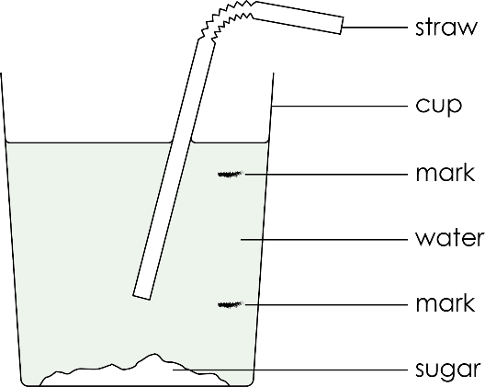
Tasty particles
In your next activity, you are going to investigate how particles behave.
You are going to add sugar and lemon juice to water to see how the taste changes depending on where in the cup you drink from.
You are also going to investigate how this changes after a period of time.
Practical activity

Slide 11
Tasty water – Method
1. Taste the water | Fill the cup with water to 1 cm from the top. Use the straw to taste the water in the three sections of the cup – above the top mark, between the two marks and below the bottom mark. Write down what it tastes like at each level. Refill the cup.
2. Add lemon juice | Add about 10 drops of lemon juice to the water. Taste the water again at the three levels. Write down what it tastes like at each level. Keep the water for the next step.
3. Add sugar | Add one teaspoon of sugar to the water. Don’t stir. Let the sugar settle. Taste the water again at the three levels. Write down what it tastes like at each level. Keep the water for the next step.
4. Wait and taste again | Wait for 2 minutes. After waiting, taste the water at the three levels. Write down what it tastes like at each level. If you can, wait even longer and taste again.
Method

Slide 12
Results
Use the following table to record your observations during the practical.
Level | Water alone | Water and lemon juice | Water lemon juice and sugar | Water, lemon juice and sugar after waiting
Top
Middle
Bottom
Results

Slide 13
Tasty water – follow-up questions
Use the test results to explain whether water, lemon juice and sugar particles are all the same.
Describe how particles can behave, using the results from your investigation.
Summarise what you have learned about particles (and atoms) in this lesson.
Activity 3

