Slide 1
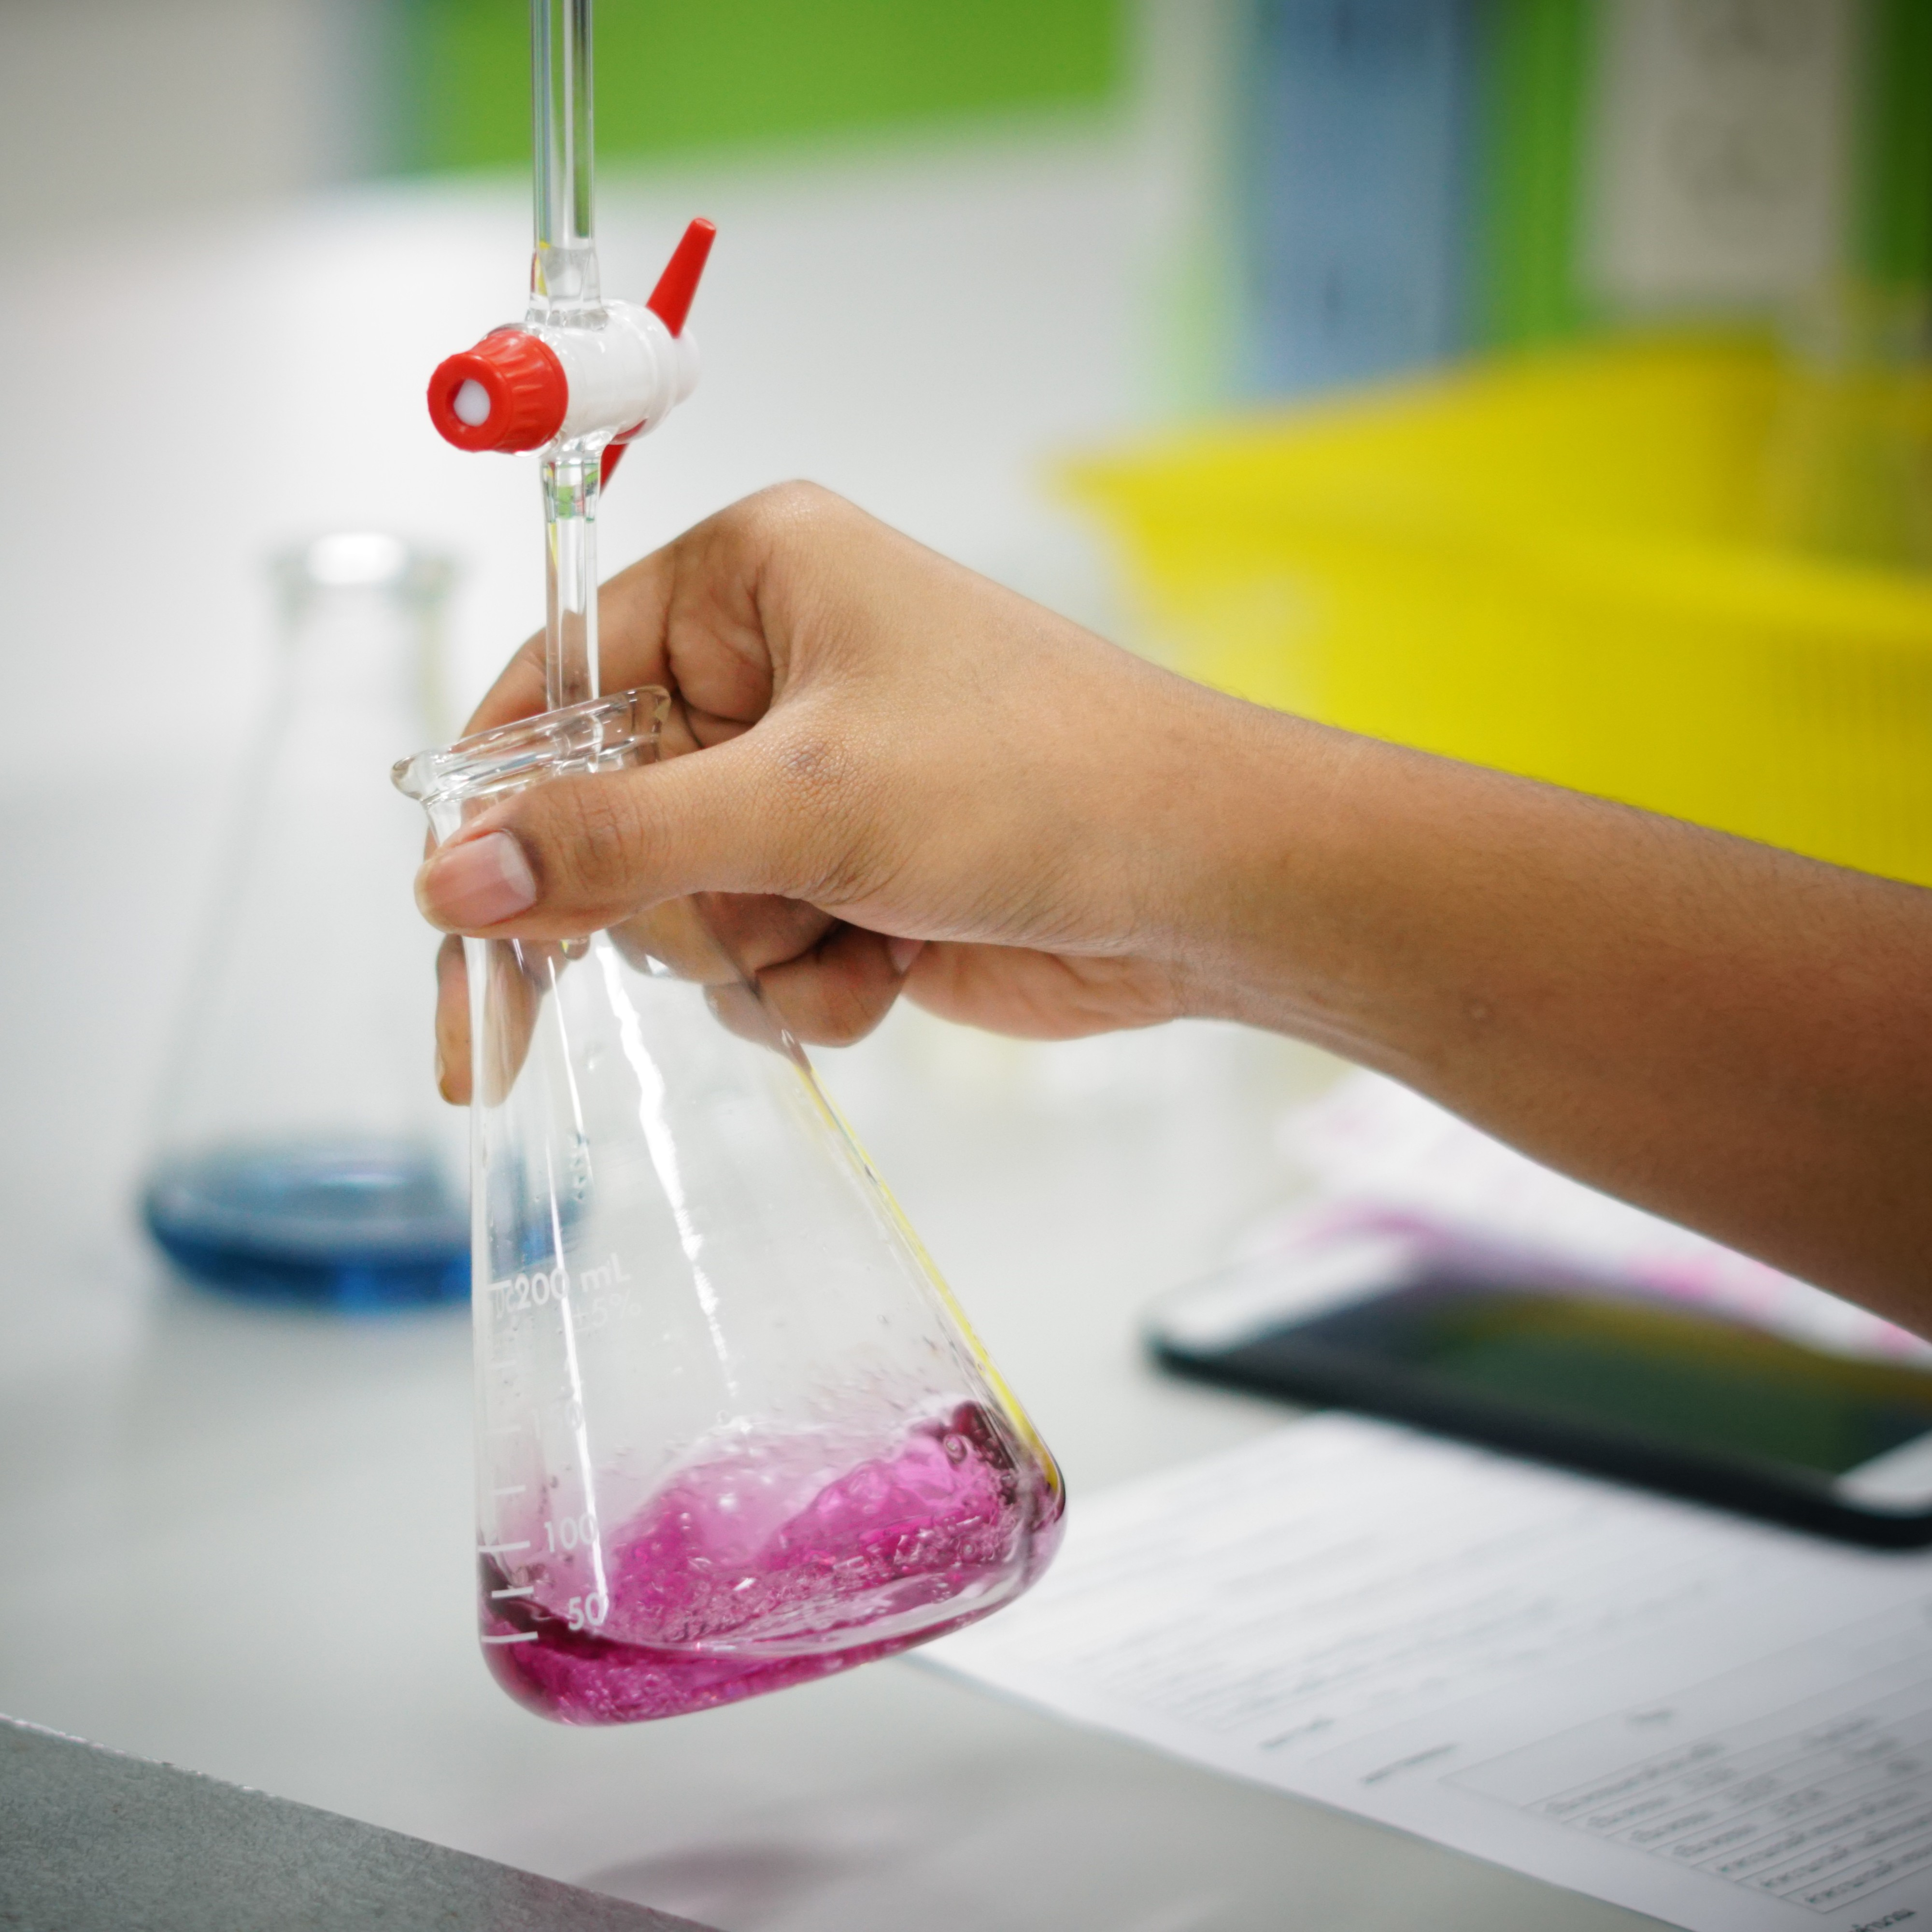
14–16 years
Scaffolding titration calculations
Downloaded from rsc.li/4atkTh7
Notes:
Image (c): Shutterstock/NamPu NiNu

Slide 2
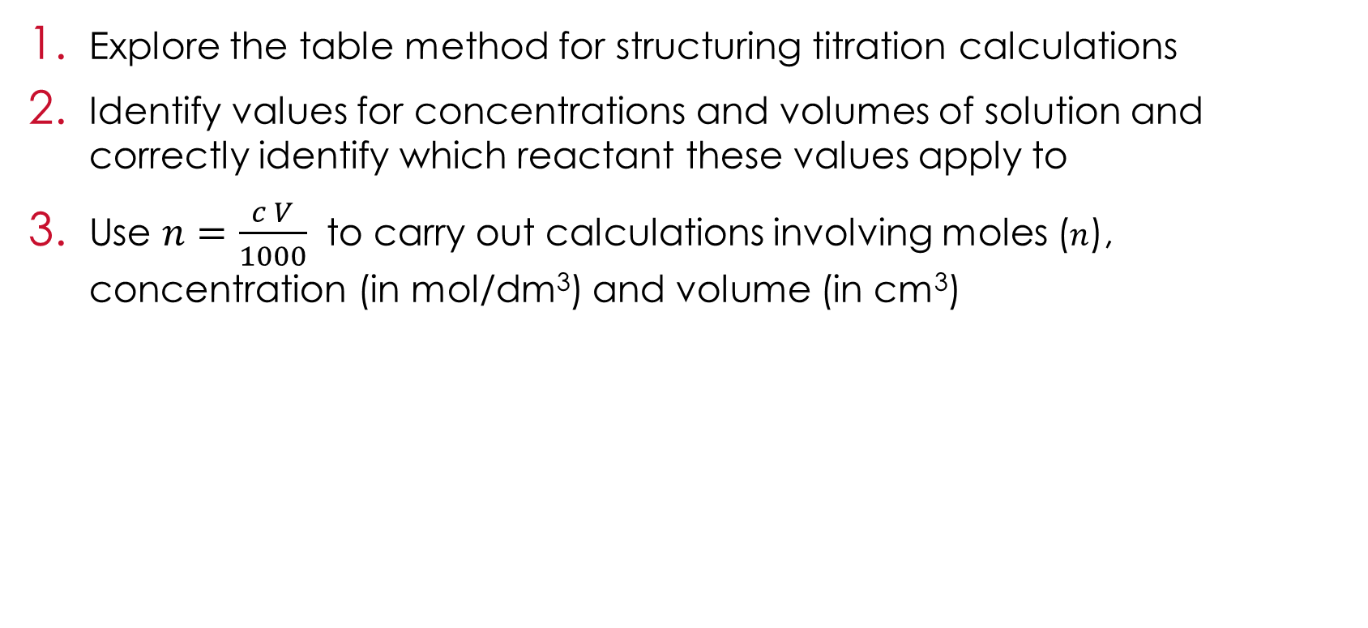
Learning objectives
Learning objectives
Explore the table method for structuring titration calculations
Identify values for concentrations and volumes of solution and correctly identify which reactant these values apply to
Use $n=\frac{c V}{1000}$ to carry out calculations involving moles ($n$), concentration (in mol/dm³) and volume (in cm³)

Slide 3
Using a scaffolded method for titration calculations
Introduction
Titration calculations can be challenging as it can be difficult to work out where to begin.
In this lesson, you will explore a method to scaffold the calculations and use it to calculate the concentration of one of the solutions.
Before you start, you will need to remember the formula for calculating the concentration of a solution.

Slide 4
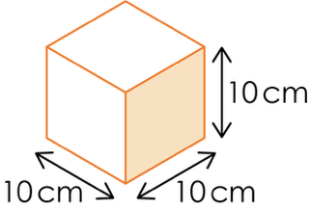
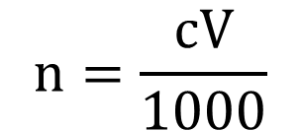
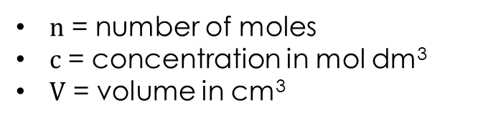
The formula relating moles, concentration and volume
Volumes in chemistry are usually measured in centimetres cubed, cm³.
Concentration has the units, moles per decimetre cubed, mol/dm³.
A decimetre is 10 cm.
A decimetre cubed is 1000 cm³.
This means that calculations involving both concentration and volume must include a factor of 1000.
Moles and concentration
$$n=\frac{cV}{1000}$$
$n$ = number of moles
$c$ = concentration in mol dm³
$V$ = volume in cm³

Slide 5
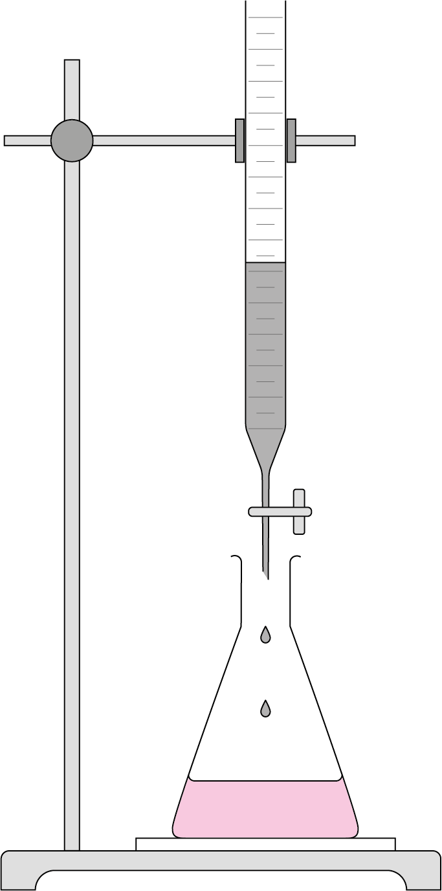
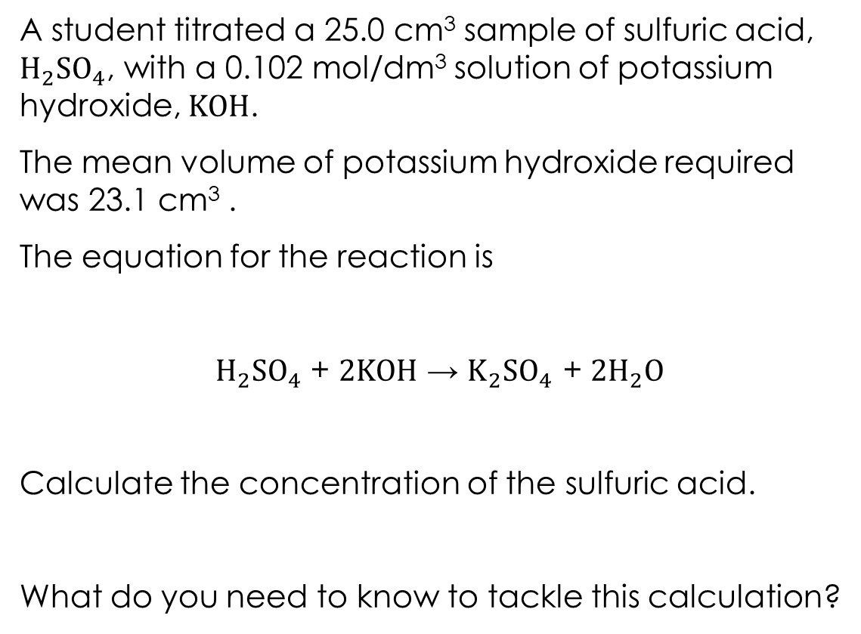
The problem
Worked example
A student titrated a 25.0 cm³ sample of sulfuric acid, $H_{2}SO_{4}$, with a 0.102 mol/dm³ solution of potassium hydroxide, $KOH$.
The mean volume of potassium hydroxide required was 23.1 cm³ .
The equation for the reaction is
$H_{2}SO_{4}$ + $2KOH$ → $K_{2}SO_{4}$ + $2H_{2}O$
Calculate the concentration of the sulfuric acid.
What do you need to know to tackle this calculation?

Slide 6
Scaffolding titration calculations
Table method
The table method can help you to extract the important information from the question and find out where to start the calculation.
Write the formulas of the acid and alkali in these columns
Find the numbers for these in the text of the question.
 | Acid | Alkali
Concentration (mol/dm³)
Volume (cm³)
Moles
Ratio
You won’t have anything in this row – moles are calculated in the next step.
These are the multipliers from the symbol equation.

Slide 7
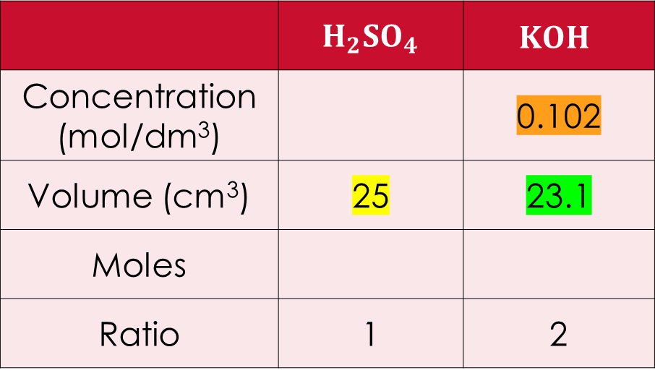
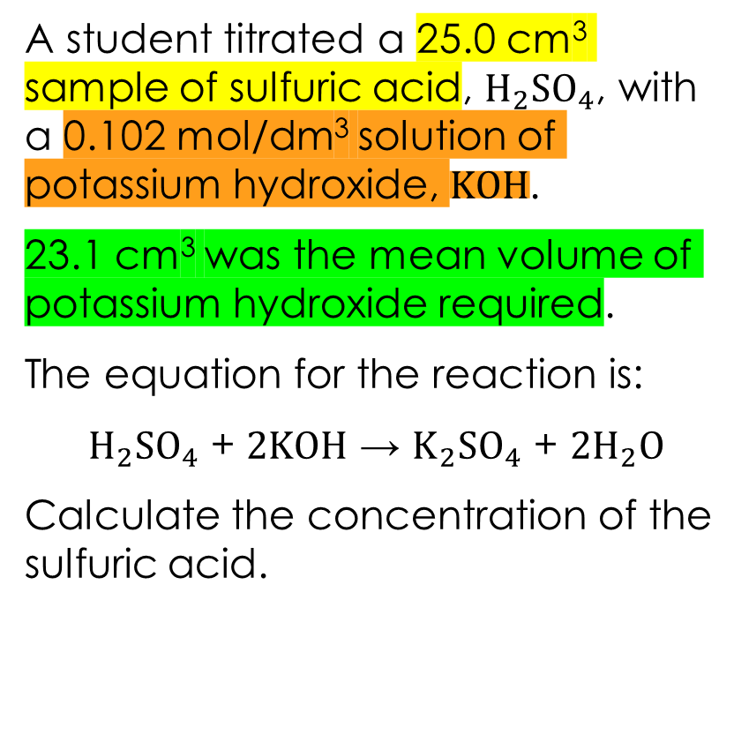
Returning to the titration problem
Applying the method
A student titrated a 25.0 cm³ sample of sulfuric acid, $H_{2}SO_{4}$, with a 0.102 mol/dm³ solution of potassium hydroxide, $KOH$.
23.1 cm³ was the mean volume of potassium hydroxide required.
The equation for the reaction is:
$H_{2}SO_{4}$ + $2KOH$ → $K_{2}SO_{4}$ + $2H_{2}O$
Calculate the concentration of the sulfuric acid.
 | $H_{2}SO_{4}$ | $$KOH$$
Concentration (mol/dm³) |  | 0.102
Volume (cm³) | 25 | 23.1
Moles
Ratio | 1 | 2

Slide 8
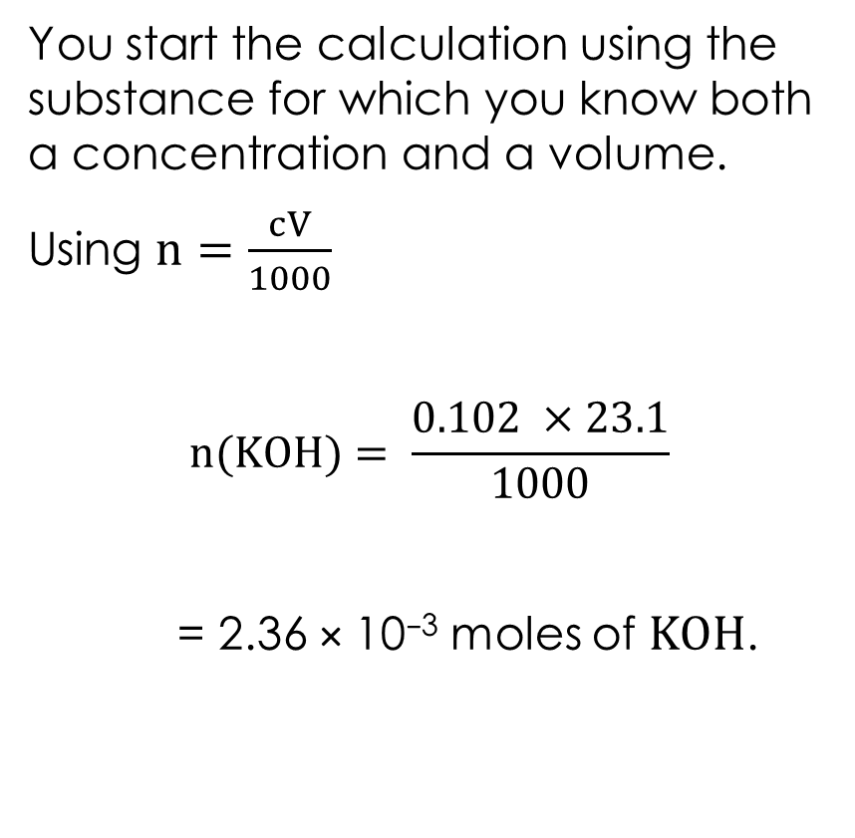
Next steps
Applying the method
You start the calculation using the substance for which you know both a concentration and a volume.
Using $n=\frac{cV}{1000}$
$$n(KOH)= \frac{0.102 ×23.1}{1000}$$
= 2.36 × 10⁻³ moles of $KOH$.
 | $H_{2}SO_{4}$ | $$KOH$$
Concentration (mol/dm³) |  | 0.102
Volume (cm³) | 25 | 23.1
Moles
Ratio | 1 | 2
2.36 × 10⁻³

Slide 9
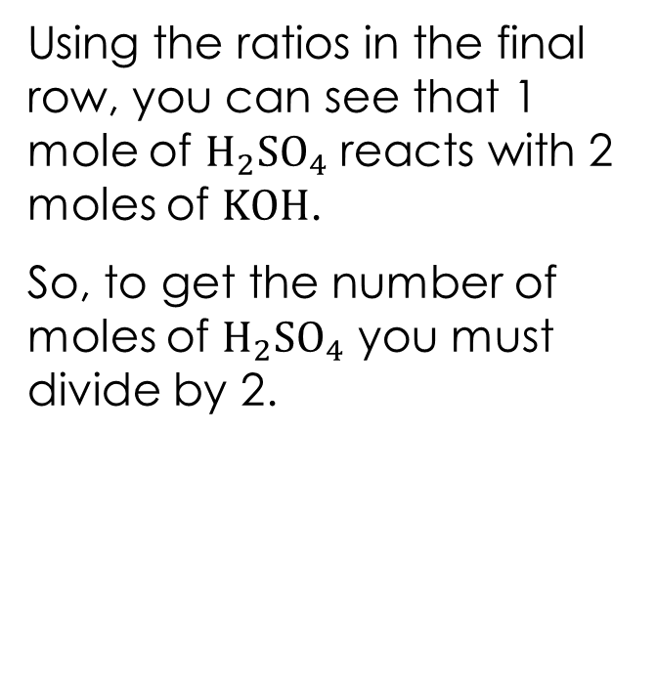
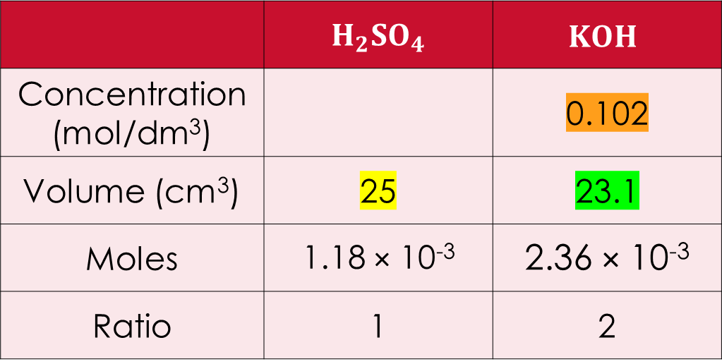
Using the mole ratio
Applying the method
Using the ratios in the final row, you can see that 1 mole of $H_{2}SO_{4}$ reacts with 2 moles of $KOH$.
So, to get the number of moles of $H_{2}SO_{4}$ you must divide by 2.
 | $H_{2}SO_{4}$ | $$KOH$$
Concentration (mol/dm³) |  | 0.102
Volume (cm³) | 25 | 23.1
Moles | 1.18 × 10⁻³ | 2.36 × 10⁻³
Ratio | 1 | 2

Slide 10
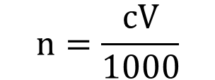
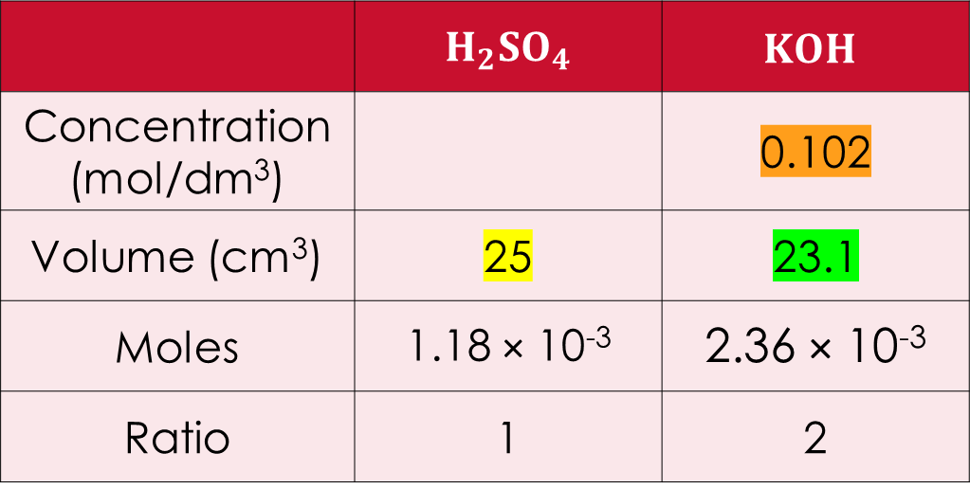
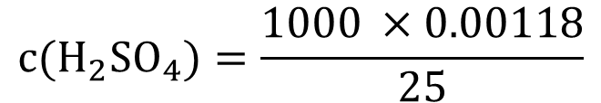
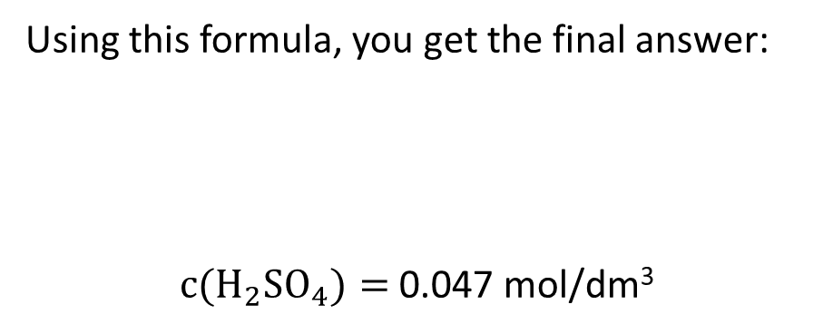
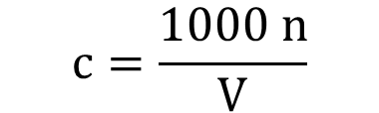
The final step
Applying the method
 | $H_{2}SO_{4}$ | $$KOH$$
Concentration (mol/dm³) |  | 0.102
Volume (cm³) | 25 | 23.1
Moles | 1.18 × 10⁻³ | 2.36 × 10⁻³
Ratio | 1 | 2
Now that you have both the moles and volume of H₂SO₄ it is possible to calculate the concentration using the rearranged version of the formula.
rearranges to:
$$n=\frac{cV}{1000}$$
Using this formula, you get the final answer:
$c(H_{2}SO_{4})=$ 0.047 mol/dm³
$$c=\frac{1000 n}{V}$$
$$c(H_{2}SO_{4})=\frac{1000 ×0.00118}{25}$$

Slide 11
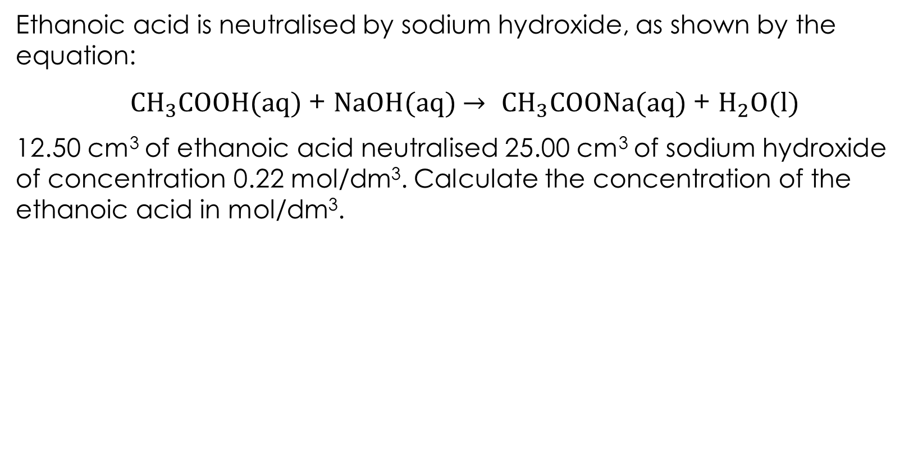
Question 1
Independent practice
Ethanoic acid is neutralised by sodium hydroxide, as shown by the equation:
$CH_{3}COOH(aq)$ + $NaOH(aq)$ $→$ $CH_{3}COONa(aq)$ + $H_{2}O(l)$
12.50 cm³ of ethanoic acid neutralised 25.00 cm³ of sodium hydroxide of concentration 0.22 mol/dm³. Calculate the concentration of the ethanoic acid in mol/dm³.

Slide 12
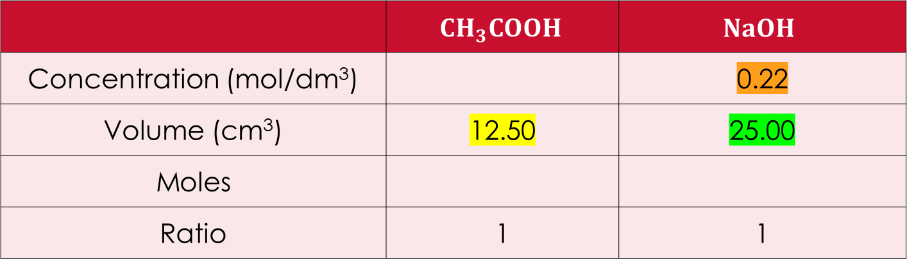
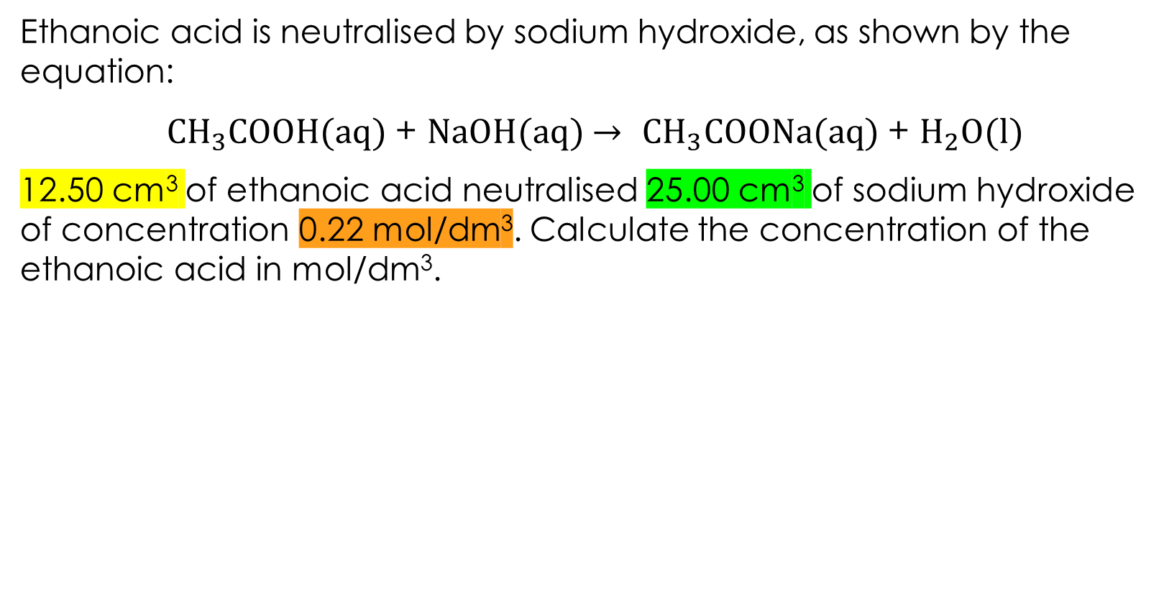
Question 1
Independent practice
Ethanoic acid is neutralised by sodium hydroxide, as shown by the equation:
$CH_{3}COOH(aq)$ + $NaOH(aq)$ $→$ $CH_{3}COONa(aq)$ + $H_{2}O(l)$
12.50 cm³ of ethanoic acid neutralised 25.00 cm³ of sodium hydroxide of concentration 0.22 mol/dm³. Calculate the concentration of the ethanoic acid in mol/dm³.
 | $$CH_{3}COOH$$ | $$NaOH$$
Concentration (mol/dm³) |  | 0.22
Volume (cm³) | 12.50 | 25.00
Moles
Ratio | 1 | 1

Slide 13
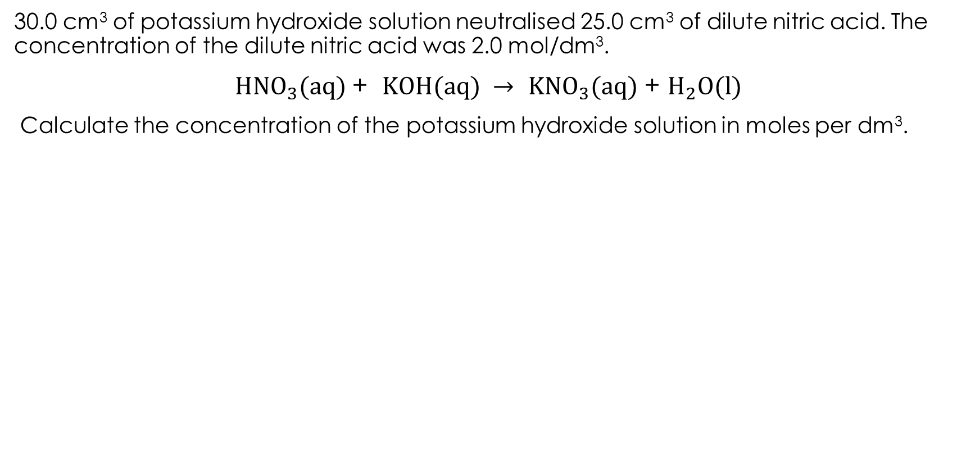
Question 2
Independent practice
30.0 cm³ of potassium hydroxide solution neutralised 25.0 cm³ of dilute nitric acid. The concentration of the dilute nitric acid was 2.0 mol/dm³.
$HNO_{3}(aq)$ + $KOH(aq)$ $→$ $KNO_{3}(aq)$ + $H_{2}O(l)$
Calculate the concentration of the potassium hydroxide solution in moles per dm³.

Slide 14
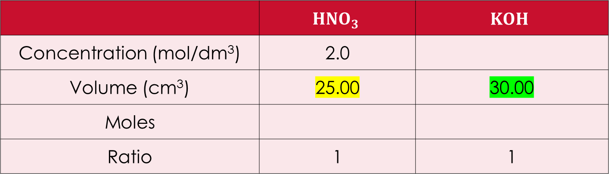
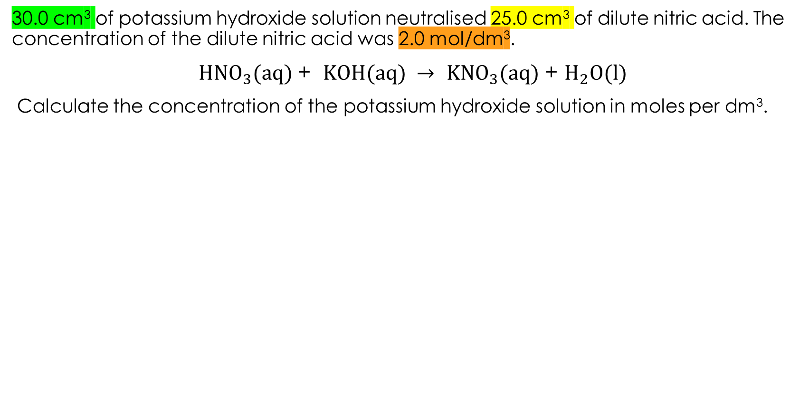
Question 2
Independent practice
30.0 cm³ of potassium hydroxide solution neutralised 25.0 cm³ of dilute nitric acid. The concentration of the dilute nitric acid was 2.0 mol/dm³.
$HNO_{3}(aq)$ + $KOH(aq)$ $→$ $KNO_{3}(aq)$ + $H_{2}O(l)$
Calculate the concentration of the potassium hydroxide solution in moles per dm³.
 | $$HNO_{3}$$ | $$KOH$$
Concentration (mol/dm³) | 2.0
Volume (cm³) | 25.00 | 30.00
Moles
Ratio | 1 | 1

Slide 15
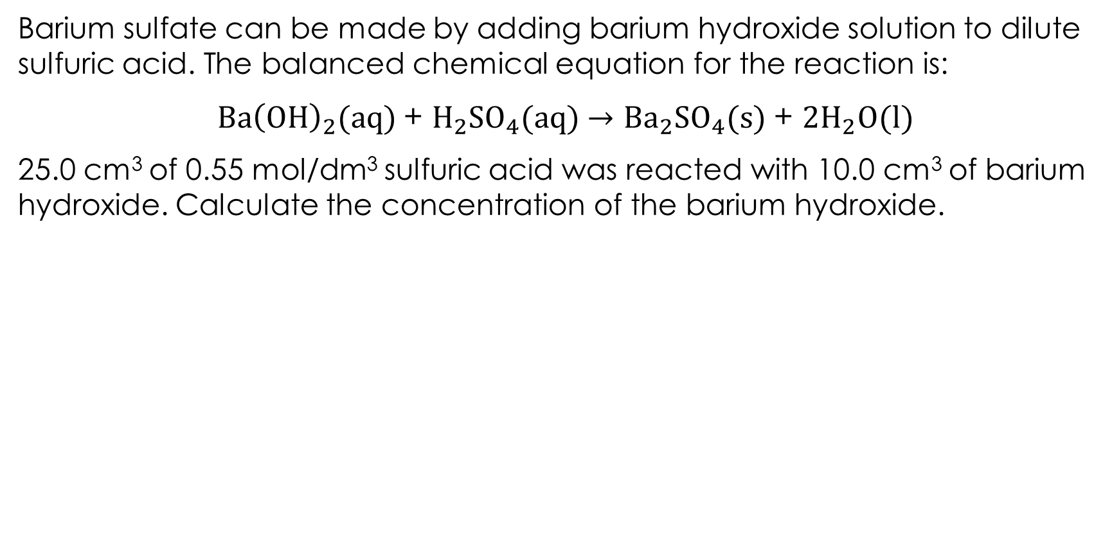
Question 3
Independent practice
Barium sulfate can be made by adding barium hydroxide solution to dilute sulfuric acid. The balanced chemical equation for the reaction is:
$Ba{\left(OH\right)}_{2}(aq)$ + $H_{2}SO_{4}(aq)$ $→$ ${Ba}_{2}SO_{4}(s)$ + ${2H}_{2}O(l)$
25.0 cm³ of 0.55 mol/dm³ sulfuric acid was reacted with 10.0 cm³ of barium hydroxide. Calculate the concentration of the barium hydroxide.

Slide 16
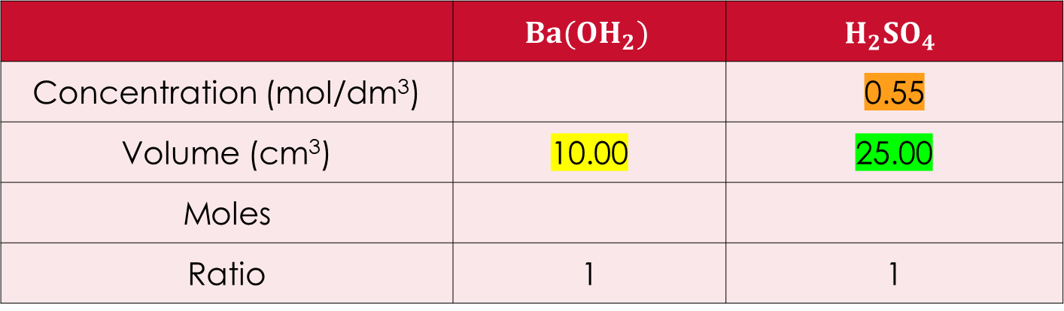
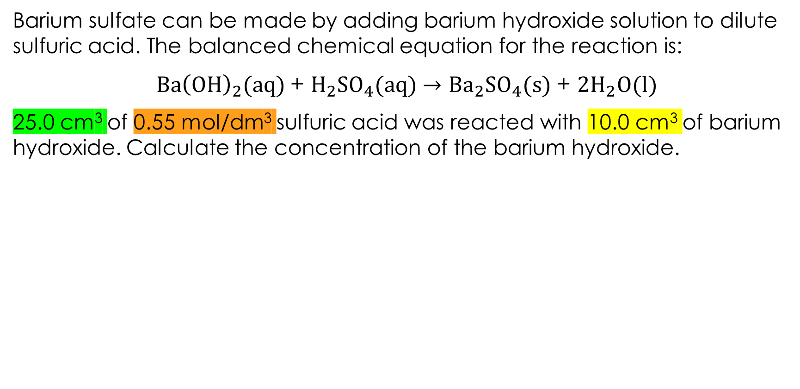
Question 3
Independent practice
Barium sulfate can be made by adding barium hydroxide solution to dilute sulfuric acid. The balanced chemical equation for the reaction is:
$Ba{\left(OH\right)}_{2}(aq)$ + $H_{2}SO_{4}(aq)$ $→$ ${Ba}_{2}SO_{4}(s)$ + ${2H}_{2}O(l)$
25.0 cm³ of 0.55 mol/dm³ sulfuric acid was reacted with 10.0 cm³ of barium hydroxide. Calculate the concentration of the barium hydroxide.
 | $$Ba(OH_{2})$$ | $$H_{2}SO_{4}$$
Concentration (mol/dm³) |  | 0.55
Volume (cm³) | 10.00 | 25.00
Moles
Ratio | 1 | 1

Slide 17
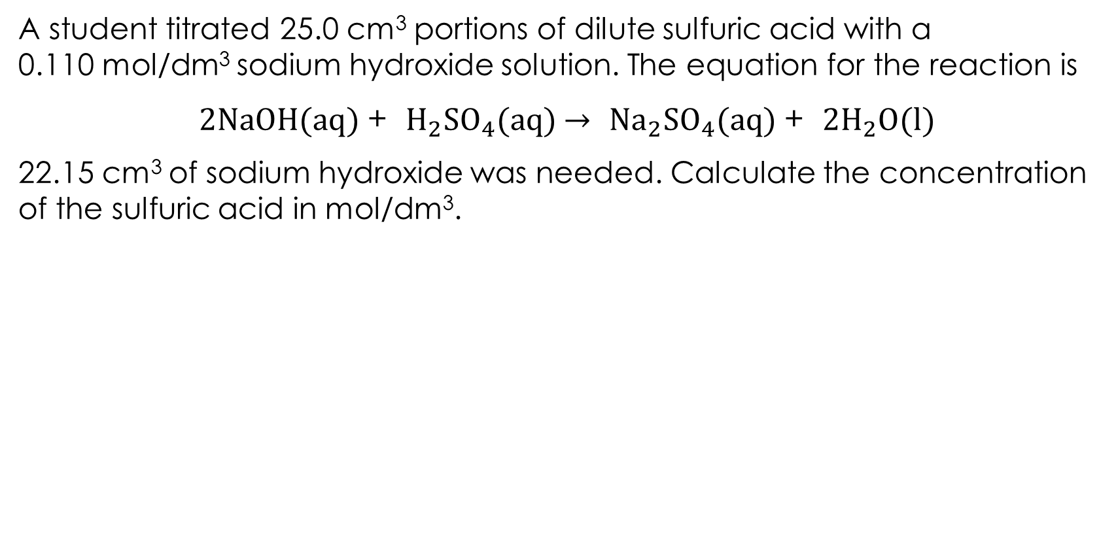
Question 4
Independent practice
A student titrated 25.0 cm³ portions of dilute sulfuric acid with a
0.110 mol/dm³ sodium hydroxide solution. The equation for the reaction is
$2NaOH(aq)$ + $H_{2}SO_{4}(aq)$ $→$ ${Na}_{2}SO_{4}(aq)$ + ${2H}_{2}O(l)$
22.15 cm³ of sodium hydroxide was needed. Calculate the concentration of the sulfuric acid in mol/dm³.

Slide 18
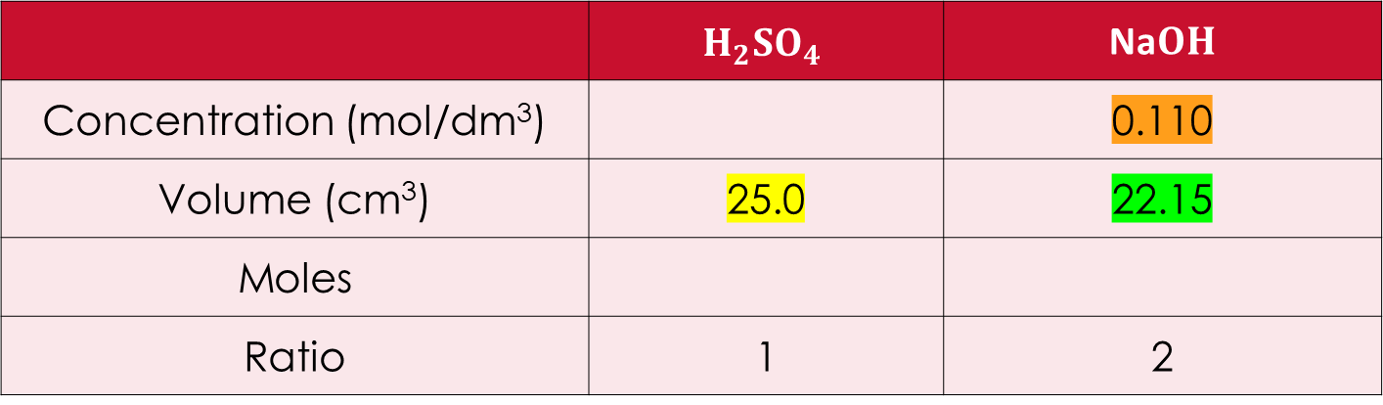
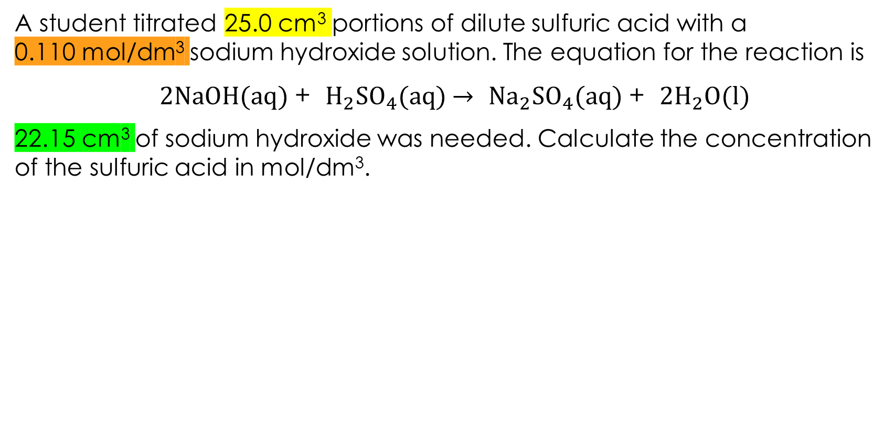
Question 4
Independent practice
A student titrated 25.0 cm³ portions of dilute sulfuric acid with a
0.110 mol/dm³ sodium hydroxide solution. The equation for the reaction is
$2NaOH(aq)$ + $H_{2}SO_{4}(aq)$ $→$ ${Na}_{2}SO_{4}(aq)$ + ${2H}_{2}O(l)$
22.15 cm³ of sodium hydroxide was needed. Calculate the concentration of the sulfuric acid in mol/dm³.
 | $$H_{2}SO_{4}$$ | Na$OH$
Concentration (mol/dm³) |  | 0.110
Volume (cm³) | 25.0 | 22.15
Moles
Ratio | 1 | 2

Slide 19
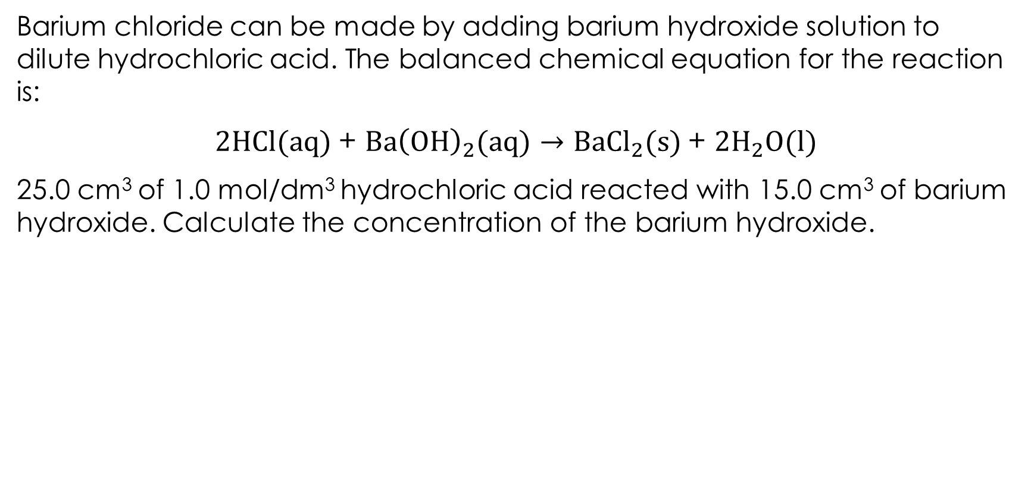
Question 5
Independent practice
Barium chloride can be made by adding barium hydroxide solution to dilute hydrochloric acid. The balanced chemical equation for the reaction is:
$2HCl(aq)$ + $Ba{\left(OH\right)}_{2}(aq)$ $→$ $Ba{Cl}_{2}(s)$ + ${2H}_{2}O(l)$
25.0 cm³ of 1.0 mol/dm³ hydrochloric acid reacted with 15.0 cm³ of barium hydroxide. Calculate the concentration of the barium hydroxide.

Slide 20
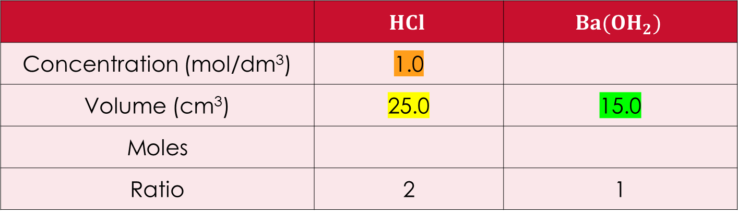
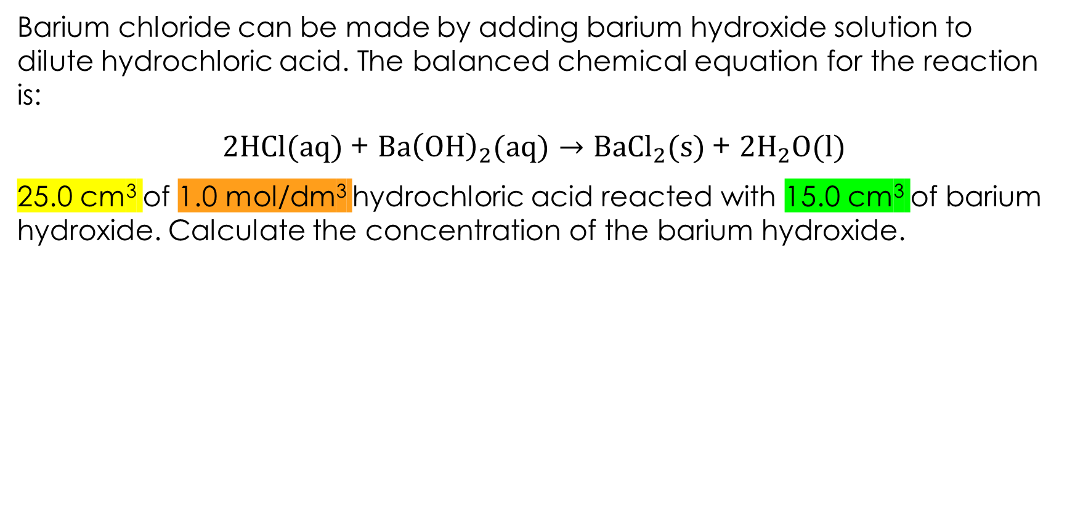
Question 5
Independent practice
Barium chloride can be made by adding barium hydroxide solution to dilute hydrochloric acid. The balanced chemical equation for the reaction is:
$2HCl(aq)$ + $Ba{\left(OH\right)}_{2}(aq)$ $→$ $Ba{Cl}_{2}(s)$ + ${2H}_{2}O(l)$
25.0 cm³ of 1.0 mol/dm³ hydrochloric acid reacted with 15.0 cm³ of barium hydroxide. Calculate the concentration of the barium hydroxide.
 | $$HCl$$ | $$Ba(OH_{2})$$
Concentration (mol/dm³) | 1.0
Volume (cm³) | 25.0 | 15.0
Moles
Ratio | 2 | 1

Slide 21

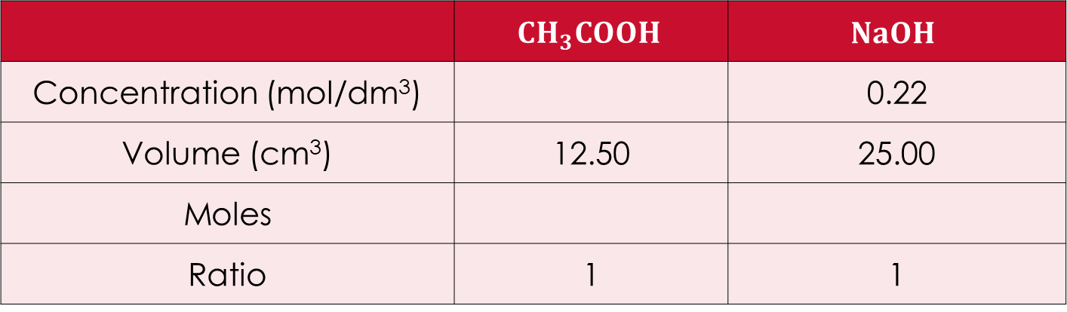


Worked answers
Answers
0.44 mol/dm³
 | $$CH_{3}COOH$$ | $$NaOH$$
Concentration (mol/dm³) |  | 0.22
Volume (cm³) | 12.50 | 25.00
Moles
Ratio | 1 | 1
$$0.44$$
$$5.5×{10}^{−3}$$
$$5.5×{10}^{−3}$$
$n=\frac{cV}{1000}= \frac{0.22 ×25.0}{1000}=5.5×{10}^{−3}$
$$c=\frac{1000n}{V}= \frac{1000 ×5.5×{10}^{−3}}{12.50}=0.44$$

Slide 22

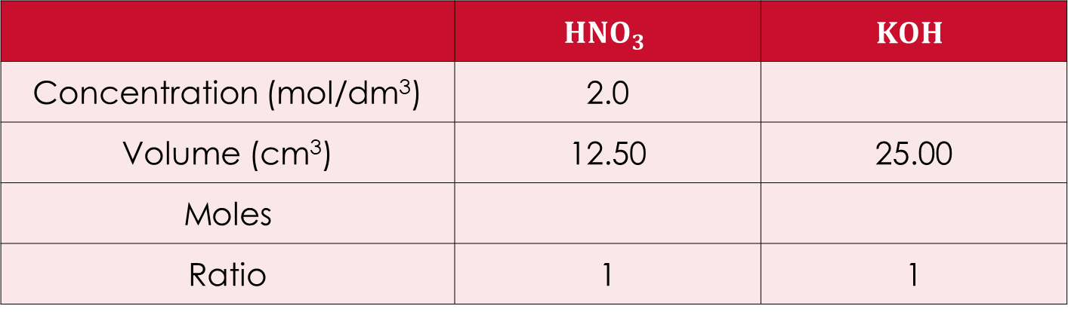


Worked answers
Answers
1.67 mol/dm³
 | $$HNO_{3}$$ | $$KOH$$
Concentration (mol/dm³) | 2.0
Volume (cm³) | 12.50 | 25.00
Moles
Ratio | 1 | 1
$$1.67$$
$$0.05$$
$$0.05$$
$n(HNO_{3})=\frac{cV}{1000}= \frac{2.0 ×12.50}{1000}=0.05$
$c(KOH)=\frac{1000n}{V}= \frac{1000 ×0.05}{25.00}=1.$67

Slide 23

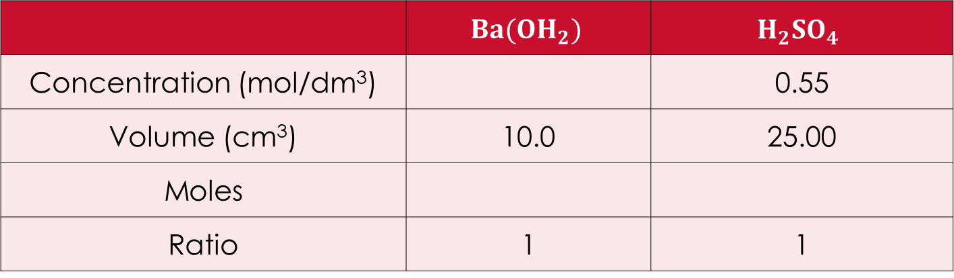


Worked answers
Answers
1.38 mol/dm³
 | $$Ba(OH_{2})$$ | $$H_{2}SO_{4}$$
Concentration (mol/dm³) |  | 0.55
Volume (cm³) | 10.0 | 25.00
Moles
Ratio | 1 | 1
$$1.38$$
$$0.01375$$
$$0.01375$$
$n=\frac{cV}{1000}= \frac{0.55 ×25.0}{1000}=$ 0.1375
$$c=\frac{1000n}{V}= \frac{1000 ×0.01375}{25.0}=1.38$$

Slide 24


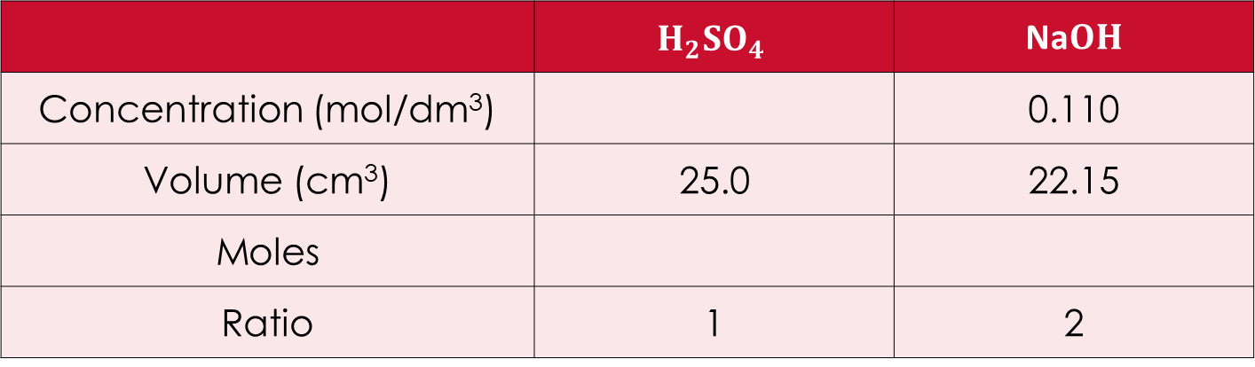


Worked answers
Answers
0.049 mol/dm³
 | $$H_{2}SO_{4}$$ | Na$OH$
Concentration (mol/dm³) |  | 0.110
Volume (cm³) | 25.0 | 22.15
Moles
Ratio | 1 | 2
$$0.049$$
$$1.22 × {10}^{−3}$$
$$2.44× {10}^{−3}$$
$n=\frac{cV}{1000}= \frac{0.110 ×22.15}{1000}=$ $2.44× {10}^{−3}$
$$c=\frac{1000n}{V}= \frac{1000 ×1.22 × {10}^{−3} }{25.0}=0.049$$

Slide 25

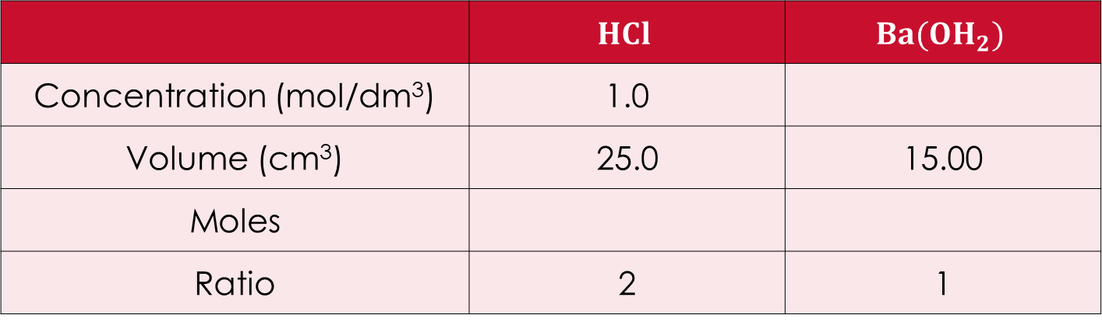


Worked answers
Answers
0.83 mol/dm³
 | $$HCl$$ | $$Ba(OH_{2})$$
Concentration (mol/dm³) | 1.0
Volume (cm³) | 25.0 | 15.00
Moles
Ratio | 2 | 1
$$0.83$$
$$0.025$$
$$0.0125$$
$n(HCl)=\frac{cV}{1000}= \frac{1.0 ×25.0}{1000}=0.025$
$c(Ba\left(OH_{2}\right))=\frac{1000n}{V}= \frac{1000 ×0.0125}{15.00}=$0.83

