Slide 1
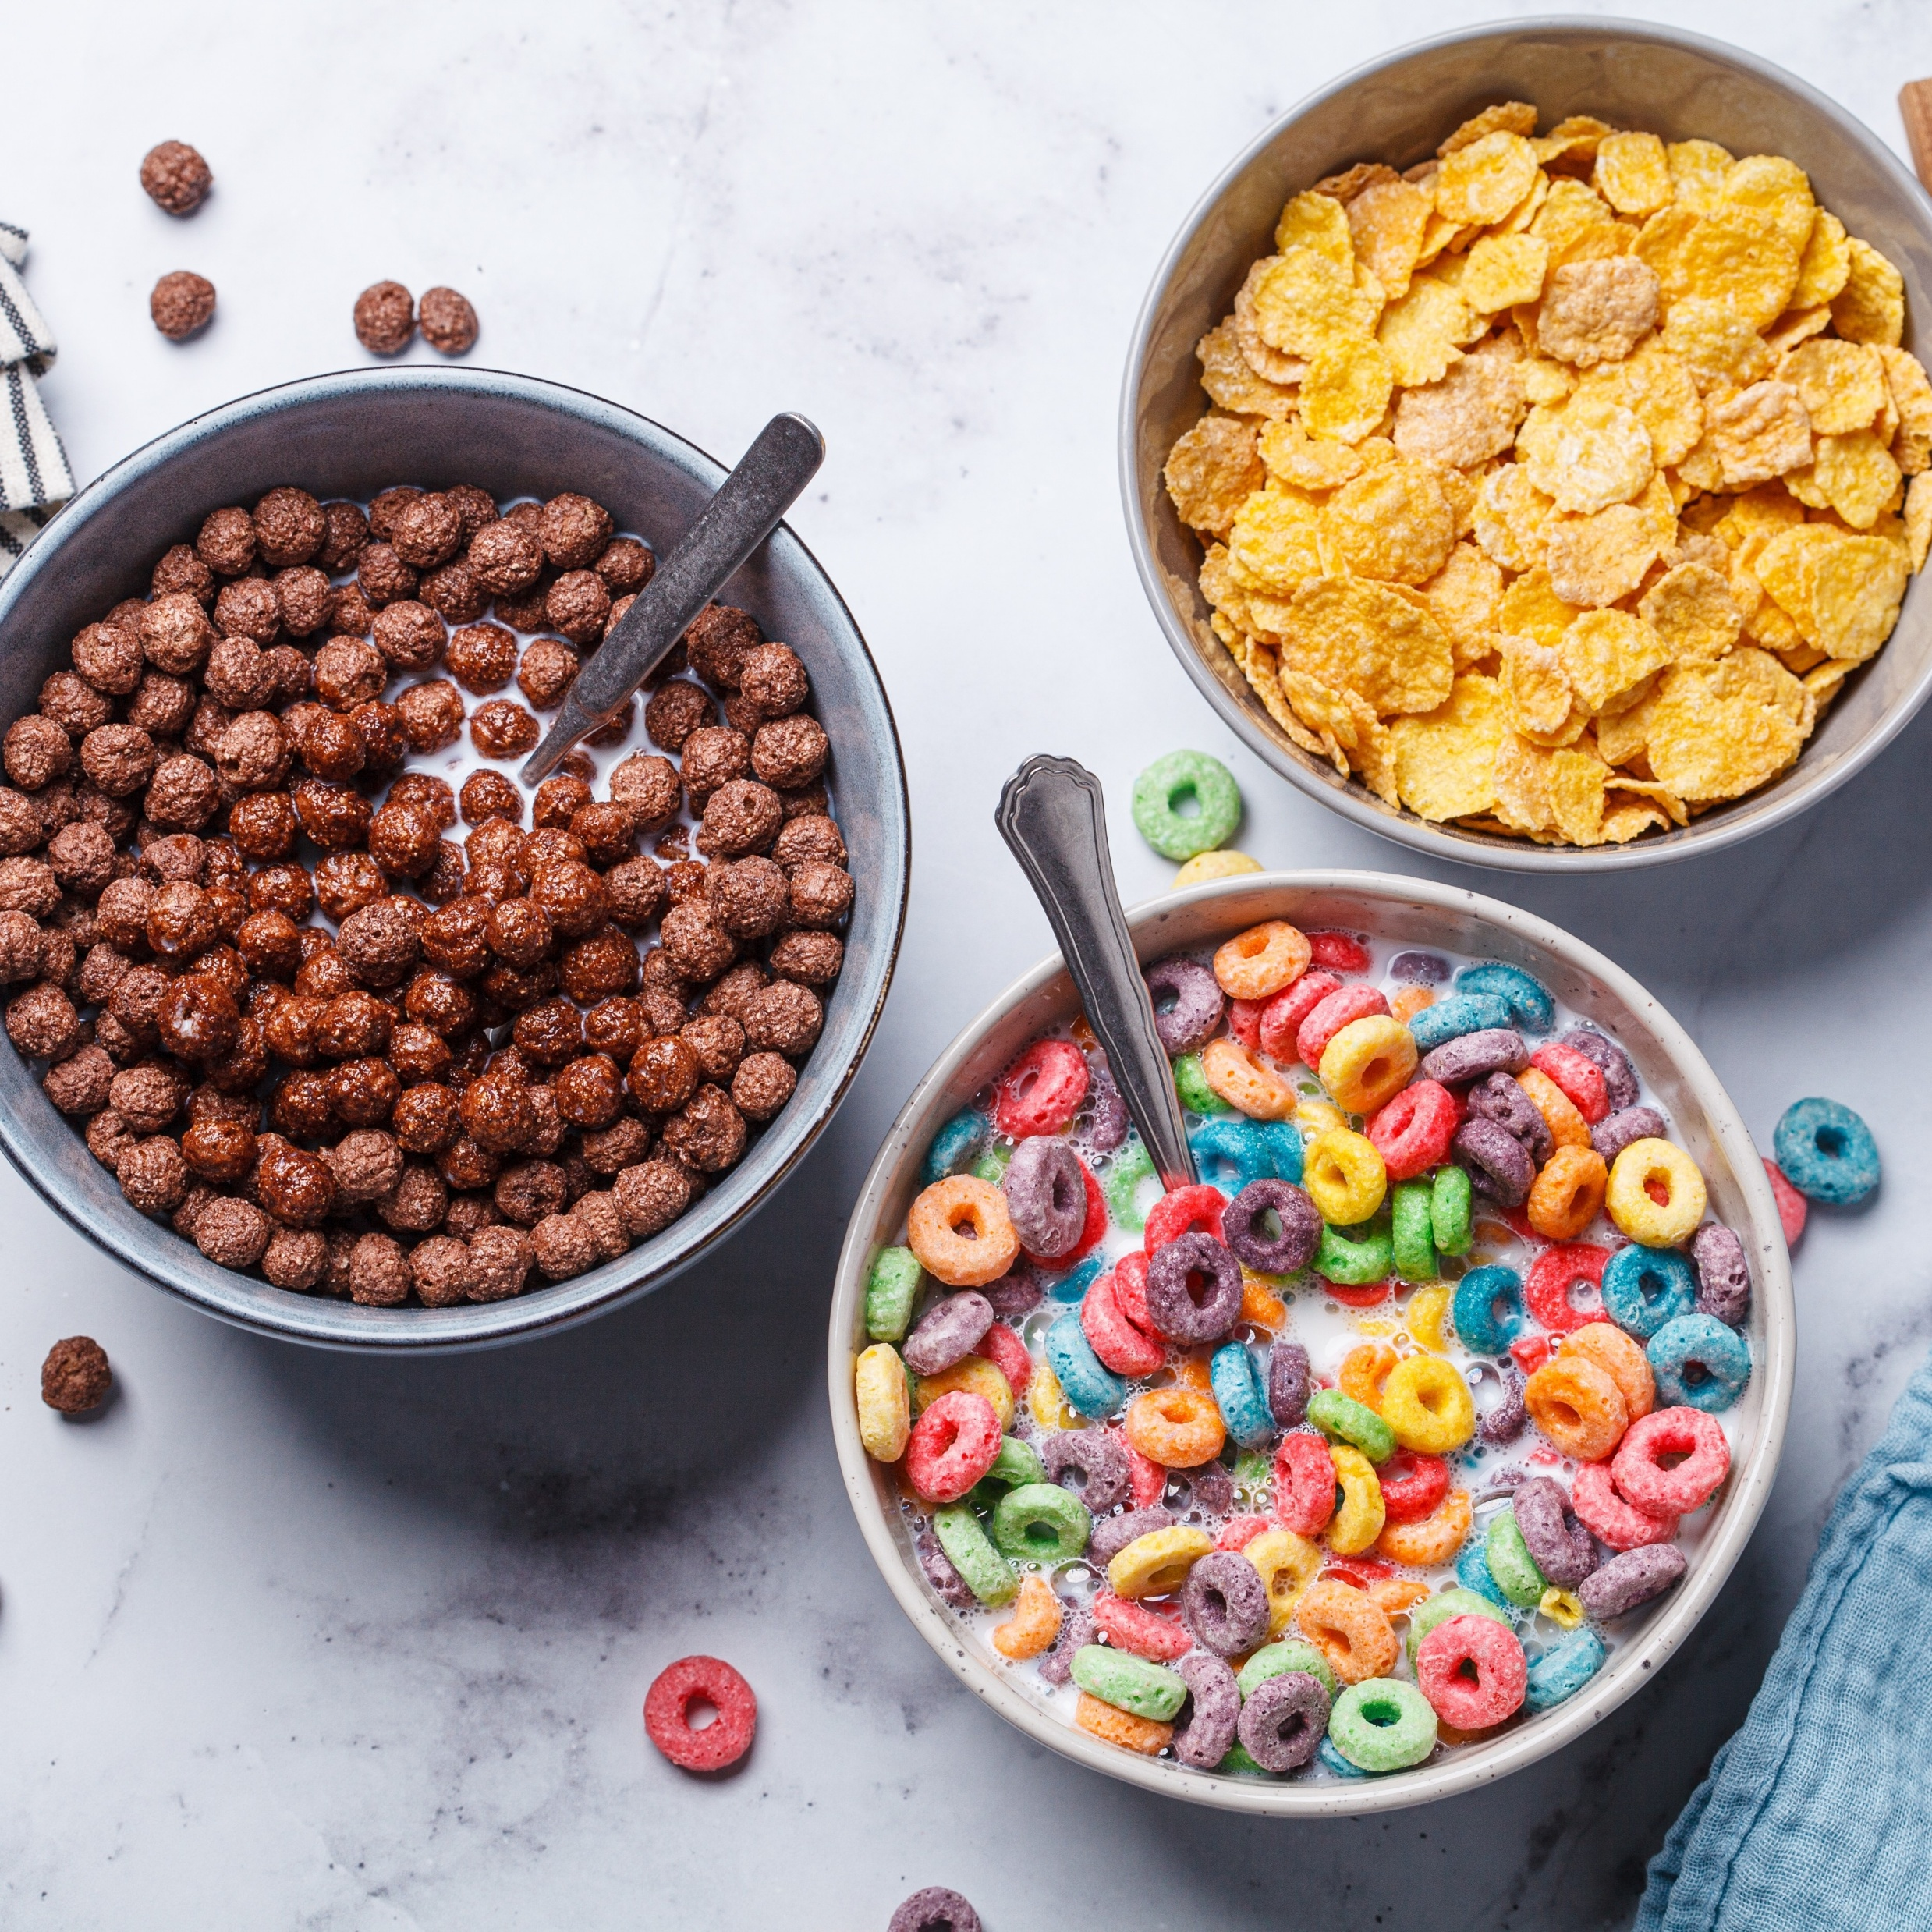
11–14 years
Extracting iron from breakfast cereal
Downloaded from: rsc.li/3Qlw7aT
Notes:
Image (c) Shutterstock/Nina Firsova

Slide 2
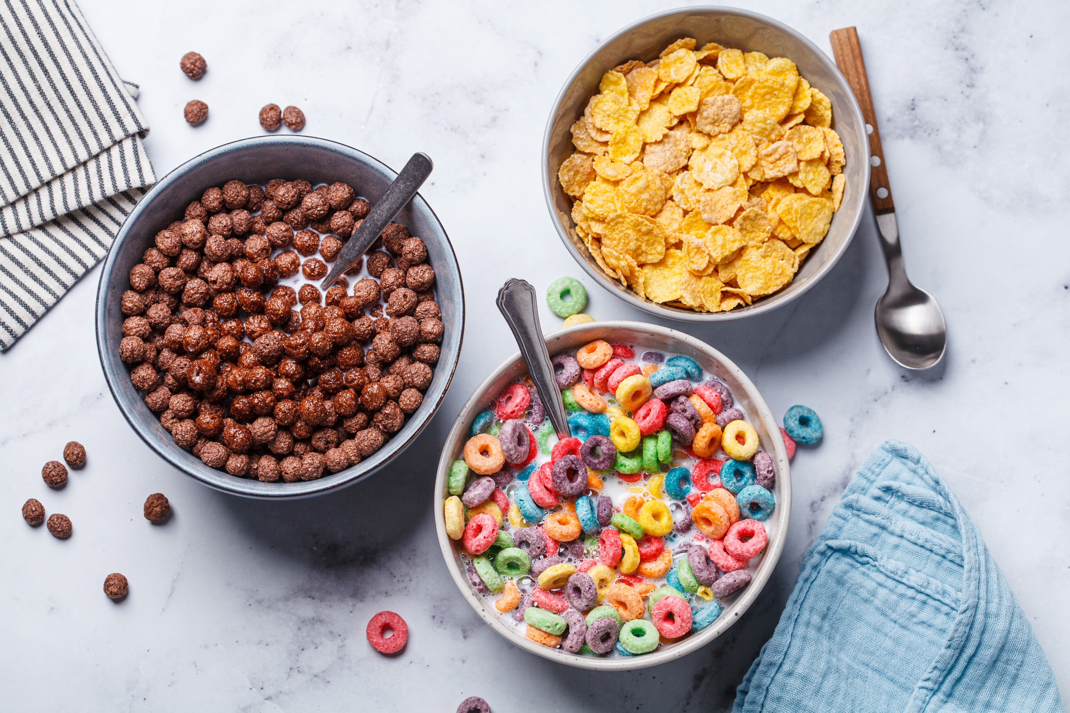
Introduction
Introduction
Many breakfast cereals – and other food products such as flour – contain iron as a mineral supplement.
Cereals containing added iron are often known as fortified breakfast cereals. The iron is added in the form of a food-grade iron powder because this does not produce any taste or react with any other ingredients within the product.
Notes:
Image (c) Shutterstock/Nina Firsova

Slide 3
Introduction
Introduction
The iron is believed to react with our stomach acid before passing to the small intestine. Our bodies contain roughly the same amount of iron as two small nails!
In this experiment, you will extract the metallic iron from a mixture of crushed cereal in water using a strong type of magnet (usually made from neodymium).
Notes:
Image (c) Shutterstock/Nina Firsova

Slide 4
Learning objectives
Extract iron from different breakfast cereals.
Compare the amounts of iron in different breakfast cereals.
Explain the importance of iron in our diets.

Slide 5
Method
Place a few flakes of cereal in the mortar. Hold the magnet close to the flakes to see if they stick to the magnet or are moved by it.
Crush the dry flakes into a fine powder with the pestle.
Transfer the powder into the sandwich bag. Add enough distilled water to cover the powder. Carefully seal the bag.
Allow the cereal to soften and gently shake the contents for a few minutes. If the mixture has absorbed too much water and appears too dry, add some more distilled water.
Place the magnet on the outside of the bag. Move the magnet backwards and forwards over the mixture.
Carefully turn the bag over, keeping the magnet touching the bag. Squeeze the bag slightly to lift the magnet above the cereal mixture to see what has been collected. You should see tiny iron particles.
Compare the amount of iron you have collected with groups who used a different cereal brand.
Method

Slide 6


Integrated instructions: simple distillation
◆ Add cereal flakes 
❖ Test with magnet 
⬥ Crush flakes 
 Separate the iron using the magnet. 
 Transfer powder to sandwich bag 
 Add distilled water. 
 Seal the bag 
 Shake gently
for 2 or 3 mins 
 Compare with other groups. 
Nuffield practical collection
Extracting iron from breakfast cereal
<<campaign URL>>
Notes:
Method:
Measure out 20 cm³ of the coloured solution in a measuring cylinder and pour it into the conical flask.
Add a few anti-bumping granules to the flask.
Clamp the conical flask on a tripod and gauze over a Bunsen burner sitting on a heatproof mat.
Take the delivery tube and place the bung in the top of the conical flask and the other end of the delivery tube in the test tube in the beaker.
Add ice water to the beaker.
Light the Bunsen burner on the yellow safety flame, then open the air hole so you have a blue flame. Heat the solution until it boils, then turn down the Bunsen burner flame by reducing the gas so it boils gently until you collect 1 cm³ of distillate in the test tube.
Place some white anhydrous copper (II) sulfate onto a watch glass and use a pipette to add a few drops of the product on to it to see if you’ve collected water.
Adapted from AQA GCSE chemistry required practicals integrated instructions v0.1 09/07/18 © David Paterson, 2018

Slide 7
Questions
  Estimate which of the cereals tested contained the most iron.
  Compare your answer to a) with the nutritional information on the cereal boxes.
  Suggest a reason why your answer to (a) and (b) may not be the same.
The iron collected from the cereal is in its elemental form.
  Define the term ‘element’.
  State which physical property of the element iron allowed it to be collected during this practical. Do all metals have this property?
  State two other properties of metallic elements.
Questions

Slide 8
Questions
Fortified cereals have iron added to them. You should be able to get all the iron you need from your daily diet.
Kellogg’s ‘Special K’®, which contains around 14 mg of iron per 100g of cereal, contains a higher proportion of iron than many other breakfast cereals.
State whether the iron in fortified breakfast cereals is part of a mixture or a compound. Explain your answer.
According to the NHS, an adult woman between the ages of 19-49 needs a recommended daily intake of 14.8 mg of iron.
Calculate the number of portions of Special K® an adult woman would need to eat to consume an equivalent to their recommended daily intake. A portion of Special K® is 30g.
Suggest a reason why you should not eat more than one portion of fortified cereal per day.
List as many other foods that can provide dietary sources of iron as you can.
Questions

Slide 9
Questions
Iron is essential in our bodies for producing haemoglobin. Thalassaemia is a group of inherited conditions that affect haemoglobin production. People with thalassaemia produce no (or too little) haemoglobin. This causes severe anaemia, and patients with this condition require frequent blood transfusions.
  What is the role of haemoglobin in our blood?
  Explain why giving extra iron does not help someone with thalassaemia.
  Regular blood transfusions can lead to excess iron in the body – a condition called iron overload. Medicines such as Exjade and Desferal treat iron overload by binding excess iron in the body and facilitating its release through the urine.
  With your partner, research the symptoms of iron deficiency and iron overload. Use your research to explain why monitoring of iron levels is particularly important for patients with thalassaemia.
Questions

Slide 10
Answers
a) Make a judgement on which cereal contained the most iron.
b) Check this against the nutritional information on the cereal boxes.
c) Answers may include:
Not all of the iron will have been separated from the flakes during the practical.
Some cereals may have been easier to separate
Some groups may have had more success separating the iron.
The amount of iron in each individual flake of cereal may vary throughout the same cereal.
The method asks for a ‘few flakes’ but the actual mass of cereal could vary between the different cereals and the different groups.
Answers

Slide 11
Answers
  Elements are the simplest form of a substance, made up of the same type of atoms.
  Iron is magnetic. Not all metals are magnetic – only iron, cobalt and nickel.
  Any two from: shiny, malleable, ductile, high tensile strength, electrical and thermal conductors.
Answers

Slide 12
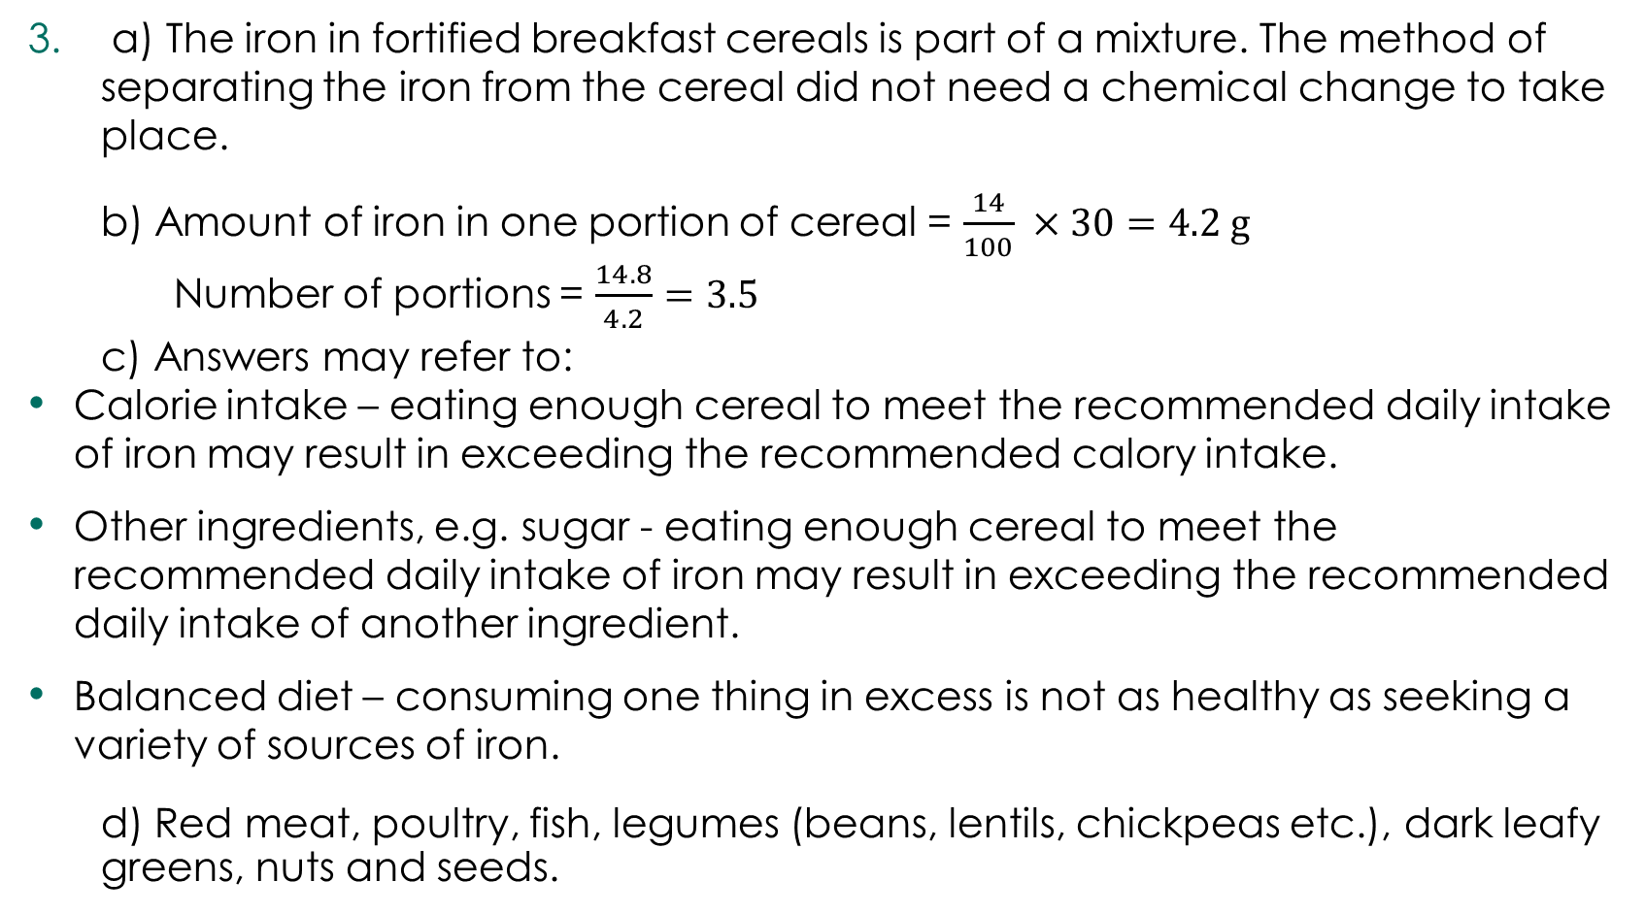
Answers
a) The iron in fortified breakfast cereals is part of a mixture. The method of separating the iron from the cereal did not need a chemical change to take place.
  b) Amount of iron in one portion of cereal = $\frac{14}{100} ×30=4.2 g$
  Number of portions = $\frac{14.8}{4.2}=3.5$
  c) Answers may refer to:
Calorie intake – eating enough cereal to meet the recommended daily intake of iron may result in exceeding the recommended calory intake.
Other ingredients, e.g. sugar - eating enough cereal to meet the recommended daily intake of iron may result in exceeding the recommended daily intake of another ingredient.
Balanced diet – consuming one thing in excess is not as healthy as seeking a variety of sources of iron.
  d) Red meat, poultry, fish, legumes (beans, lentils, chickpeas etc.), dark leafy greens, nuts and seeds.
Answers

Slide 13
Answers
  Haemoglobin helps oxygen to bind to our red blood cells.
  Patients with thalassaemia cannot produce haemoglobin – even if they have enough iron in their body.
  Iron deficiency and iron overload have many common symptoms, such as dizziness, fatigue, muscle ache etc. This means it is very important to monitor patients and know whether they have too little or too much iron in their bodies.
Answers

