Slide 1

14–16 years
Green chemistry, atom economy and sustainable development
Downloaded from: rsc.li/49NqSLB
Notes:
Image © Mark B Pixels / Shutterstock

Slide 2
Learning objectives
Learning objectives
1 Understand what sustainable development is and the role of green chemistry in advancing it.
2 Explain the importance of percentage yield and atom economy for sustainable development.
3 Calculate the percentage yield and atom economy of a chemical process given relevant data.

Slide 3

Sustainable development
Introduction
Around the world, millions of people live in poverty. Many don’t have access to healthcare and even in richer communities, education and healthcare could be better.
To improve this, countries need to grow their economies, but economic growth can cause pollution and harm the environment. The challenge is to grow in a way that helps people today without damaging the planet for future generations. This is called sustainable development, and it is becoming more important as the world’s population grows.
Notes:
Image © Mark B Pixels / Shutterstock

Slide 4
Green chemistry
Introduction
One way the chemical industry is helping sustainable development is through green chemistry.
One of the principles of green chemistry is to avoid producing harmful substances, instead of making them and then cleaning them up later. Green chemistry is:
safer
uses fewer raw materials
often cheaper than traditional methods
How do you think chemists could adapt chemical processes to make them greener?

Slide 5
Green chemistry
Introduction
There are three main ways to make chemical processes ‘greener’:
Use safer starting materials
Use gentler conditions such as better catalysts and safer solvents
Use methods with fewer steps and less waste

Slide 6

Questions
Explain why it is better to avoid pollution and making harmful substances than to make them and clean them up later.
Explain why using a catalyst might make a chemical process faster.
Unscaffolded questions

Slide 7
Percentage yield
Percentage yield
Most of the chemical industry is about changing one material (a raw material) into a more useful and valuable substance (the product). This process can have several steps and is called a chemical synthesis.
Scientists and engineers want to make as much product as possible from the raw materials they use.
They can measure how successful a process is by calculating the yield. This shows how much product is actually made compared to how much could be made.
The percentage yield of a reaction is calculated using the equation:
$$\% yield= \frac{mass of product actually made}{maximum mass of product that could be made} ×100$$

Slide 8

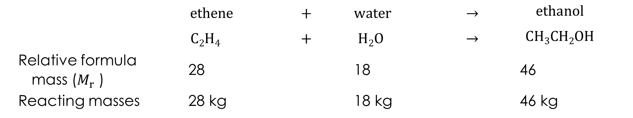
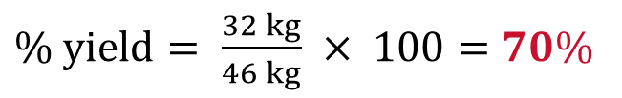
Calculating percentage yield
Worked example
Ethanol is produced by the reaction of ethene and water.
 | $$ethene$$ | $$+$$ | $$water$$ | $$→$$ | $$ethanol$$
 | $$C2H4$$ | $$+$$ | $$H2O$$ | $$→$$ | $$CH3CH2OH$$
Relative formula mass ($M_{r}$ ) | 28 |  | 18 |  | 46
Reacting masses | 28 kg |  | 18 kg |  | 46 kg
When 28 kg of ethene is reacted with an excess of water, the maximum mass of ethanol that can be made is 46 kg.
Calculate the percentage yield if only 32 kg of ethanol is actually made.
$$\% yield= \frac{mass of product actually made}{maximum mass of product that could be made} ×100$$
$\% yield= \frac{32 kg}{46 kg} × 100=70\%$

Slide 9



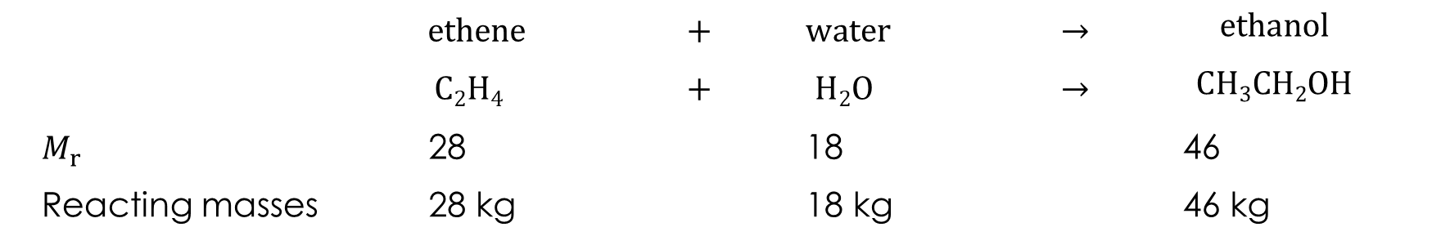
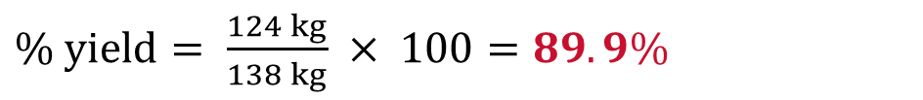
Calculating percentage yield
Worked example
Ethanol is produced by the reaction of ethene and water.
 | $$ethene$$ | $$+$$ | $$water$$ | $$→$$ | $$ethanol$$
 | $$C2H4$$ | $$+$$ | $$H2O$$ | $$→$$ | $$CH3CH2OH$$
$M_{r}$ | 28 |  | 18 |  | 46
Reacting masses | 28 kg |  | 18 kg |  | 46 kg
When 84 kg of ethene is reacted with an excess of water, 124 kg of ethanol is produced. What is the percentage yield of the reaction?
$$\% yield= \frac{mass of product actually made}{maximum mass of product that could be made} ×100$$
$$Maximum mass of ethanol that could$$
$$be made from 84 kg of ethene$$
$$= \frac{84 kg}{28 kg} ×46kg=138kg$$
$\% yield= \frac{124 kg}{138 kg} × 100=89.9\%$

Slide 10
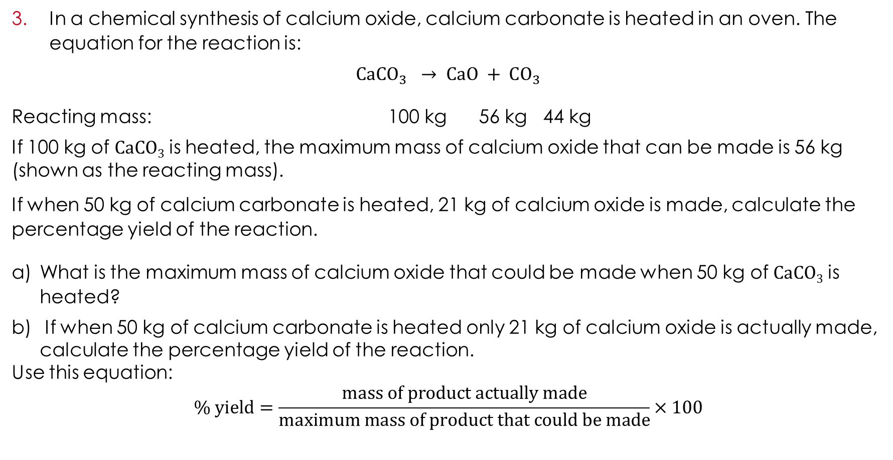
Questions
In a chemical synthesis of calcium oxide, calcium carbonate is heated in an oven. The equation for the reaction is:
$$CaCO_{3} → CaO + CO_{3}$$
Reacting mass: 100 kg 56 kg 44 kg
If 100 kg of CaCO₃ is heated, the maximum mass of calcium oxide that can be made is 56 kg (shown as the reacting mass).
If when 50 kg of calcium carbonate is heated, 21 kg of calcium oxide is made, calculate the percentage yield of the reaction.
What is the maximum mass of calcium oxide that could be made when 50 kg of CaCO₃ is heated?
If when 50 kg of calcium carbonate is heated only 21 kg of calcium oxide is actually made, calculate the percentage yield of the reaction.
Use this equation:
$$\% yield=\frac{mass of product actually made}{maximum mass of product that could be made}×100$$
Scaffolded questions

Slide 11
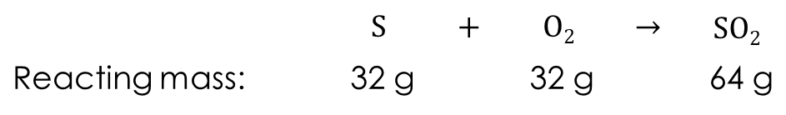
Questions
To make sulfur dioxide, sulfur is burned in oxygen:
If 32 g of sulfur is burned in oxygen, the maximum mass of sulfur dioxide that can be produced is 64 g.
If, when 32 g of sulfur is burned only 48 g of sulfur dioxide is produced, calculate the percentage yield.
In a different reaction, 8 g of sulfur is burned in oxygen and 14 g of sulfur dioxide is produced.
c) Calculate the percentage yield of this reaction.
HINT: first calculate the maximum mass of sulfur dioxide that could be produced from the 8 g of sulfur.
 | $$S$$ | $$+$$ | $$O2$$ | $$→$$ | $$SO2$$
Reacting mass: | 32 g |  | 32 g |  | 64 g
Scaffolded questions

Slide 12
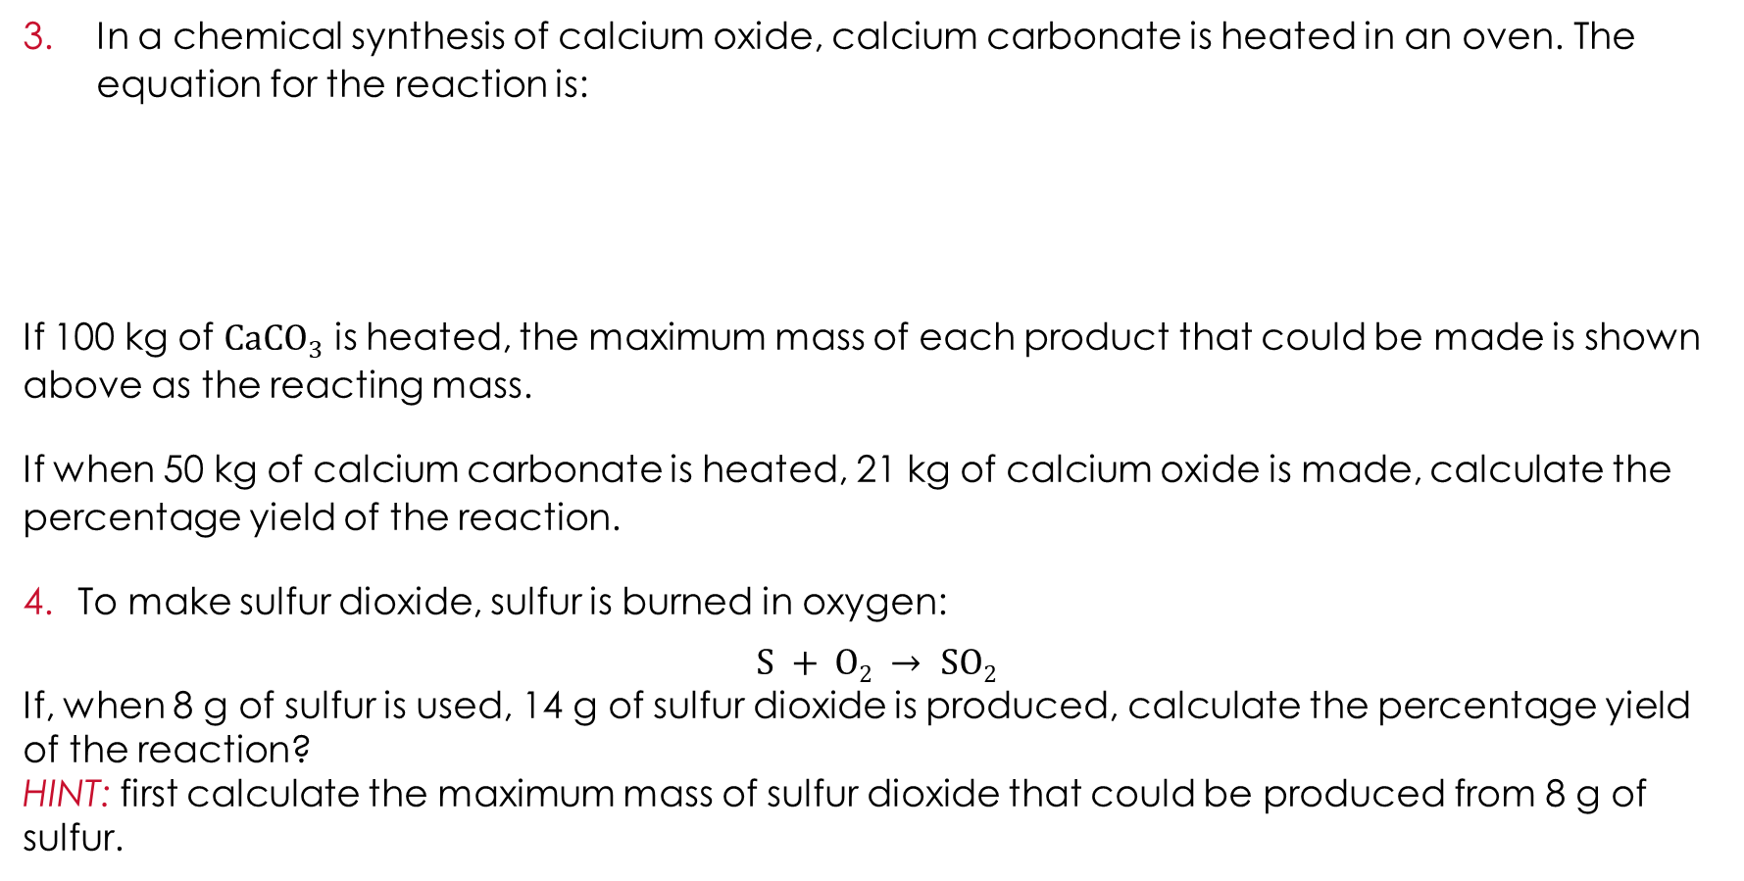
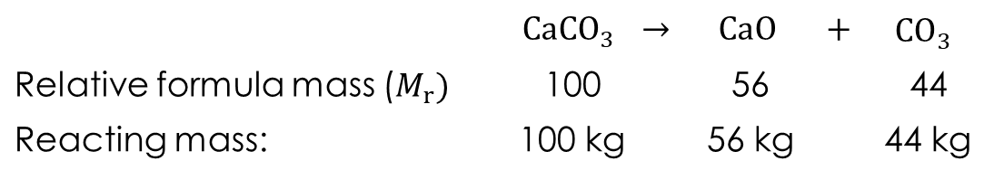
Questions
In a chemical synthesis of calcium oxide, calcium carbonate is heated in an oven. The equation for the reaction is:
If 100 kg of $CaCO_{3}$ is heated, the maximum mass of each product that could be made is shown above as the reacting mass.
If when 50 kg of calcium carbonate is heated, 21 kg of calcium oxide is made, calculate the percentage yield of the reaction.
To make sulfur dioxide, sulfur is burned in oxygen:
$$S + O2 → SO2$$
If, when 8 g of sulfur is used, 14 g of sulfur dioxide is produced, calculate the percentage yield of the reaction?
HINT: first calculate the maximum mass of sulfur dioxide that could be produced from 8 g of sulfur.
 | $$CaCO_{3}$$ | $$→$$ | $$CaO$$ | $$+$$ | $$CO_{3}$$
Relative formula mass ($M_{r})$ | 100 |  | 56 |  | 44
Reacting mass: | 100 kg |  | 56 kg |  | 44 kg
Unscaffolded questions

Slide 13
Atom economy
Atom economy
Yield is useful, but it does not tell the whole story. This is because yield is calculated by looking at only one reactant and one product.
Green chemistry aims to use as much of the raw materials as possible to make the final product and to produce as little waste as possible.
Sometimes, a reaction can have a high yield but still create a lot of waste. This means it has a low atom economy.
To make a process more environmentally friendly, scientists need to think about both yield and atom economy.

Slide 14
Atom economy
Atom economy
Consider the reaction for making calcium oxide, $CaO$:
$$CaCO3 → CaO + CO2$$
If we split up the formulas, we can look at what happens to each atom in the reaction.
$$Ca C O O O$$ | $$→$$ | $$Ca O$$ | $$+$$ | $$C O O$$
The atoms shown in bold end up in the product we want (the calcium oxide), the rest do not.
From the original atoms, one $C$ atom and two $O$ atoms are wasted – they are not in the final desired product.

Slide 15
Atom economy
Atom economy
For any given balanced symbol equation, green chemists define atom economy as:
$\% atom economy= \frac{relative formula mass of desired product}{total relative formula mass of all reactants} × 100$
Where the relative formula mass is the total relative atomic mass of all the atoms in the final desired product or reactants.
The higher the atom economy of a reaction, the more of the reactant atoms that end up in the desired product. The less waste there is.

Slide 16
How to calculate atom economy step-by-step
Atom economy
Step one: Write out the balanced symbol equation.
Step two: Calculate the relative formula mass of the desired product (the relative atomic mass of all the atoms in the desired product). Remember to account for any numbers in front of the symbols indicating that multiples of that product are produced.
Step three: Calculate the total relative formula mass of all reactants (the relative atomic mass of all the atoms going into the reaction).
Step four: Apply the formula:
$\% atom economy= \frac{relative formula mass of desired product}{total relative formula mass of all reactants} × 100$

Slide 17
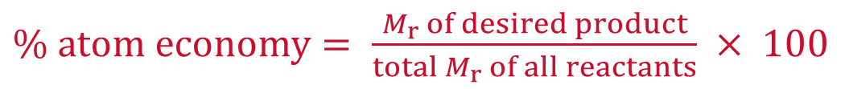
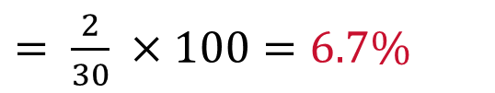
Calculating atom economy
Worked example
Hydrogen gas, $H2$ can be made from the reaction of water with coke (a form of carbon). The equation for the reaction is:
$$C + H2O → H2 + CO$$
Calculate the atom economy of the process for making hydrogen.
Relative atomic masses: $H=1, C=12, O=16.$
$\% atom economy= \frac{M_{r} of desired product}{total{ M}_{r} of all reactants} × 100$
$= \frac{M_{r} of H_{2}}{M_{r} of C +M_{r} of H_{2}O} × 100= \frac{2 ×1}{12+[\left(2 ×1\right)+16]} ×100$
$= \frac{2}{30} ×100=6.7\%$

Slide 18

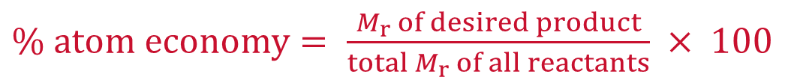
Calculating atom economy
Worked example
Nitric acid, $HNO3$ is made by the reaction:
$$2NH3 + 4O2 + H2O → 3H2O + 2HNO3$$
Calculate the atom economy of the process for making nitric acid.
Relative atomic masses: $H=1, N =14, O=16.$
$\% atom economy= \frac{M_{r} of desired product}{total{ M}_{r} of all reactants} × 100$
Mass of desired product ($2HNO3$) = 2 × [1 + 14 + (3 × 16)] = 126
Total mass of all reactants ($2NH3 + 4O2 + H2O$) = (2 × 17) + (4 × 32) + 18 = 180
$$\% atom economy= \frac{126}{180} ×100=70\%$$

Slide 19
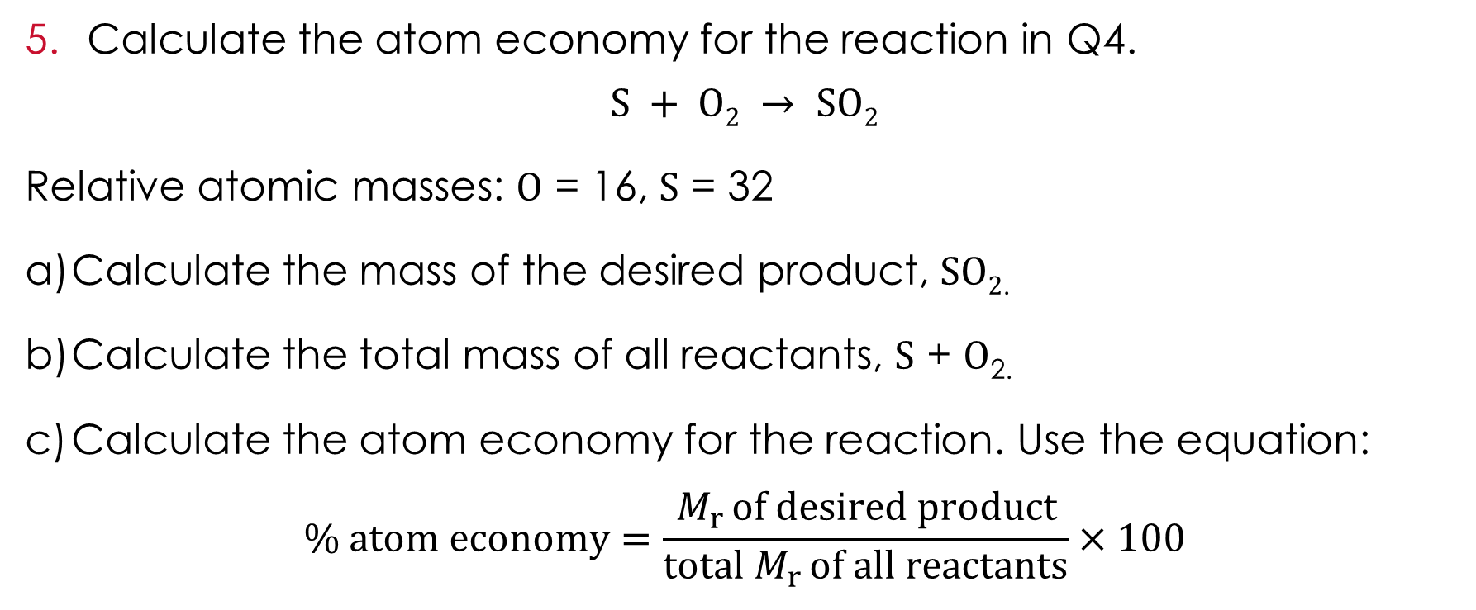
Questions
Calculate the atom economy for the reaction in Q4.
$$S + O2 → SO2$$
Relative atomic masses: O = 16, S = 32
Calculate the mass of the desired product, SO_{2.}
Calculate the total mass of all reactants, S + O_{2.}
Calculate the atom economy for the reaction. Use the equation:
$$\% atom economy=\frac{M_{r }of desired product}{total M_{r }of all reactants}×100$$
Scaffolded questions

Slide 20
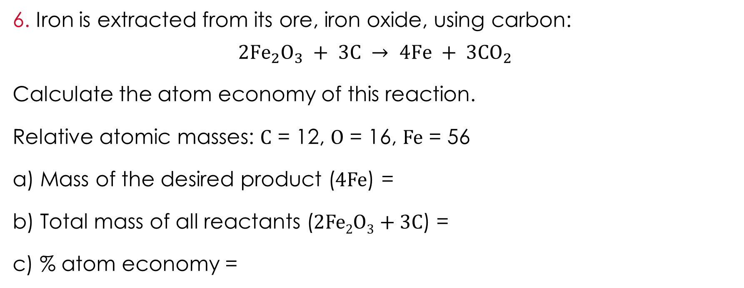
Questions
Iron is extracted from its ore, iron oxide, using carbon:
$$2{Fe}_{2}O_{3} + 3C → 4Fe + 3{CO}_{2}$$
Calculate the atom economy of this reaction.
Relative atomic masses: C = 12, O = 16, Fe = 56
a) Mass of the desired product (4Fe) =
b) Total mass of all reactants (2Fe₂O₃ + 3C) =
c) % atom economy =
Scaffolded questions

Slide 21
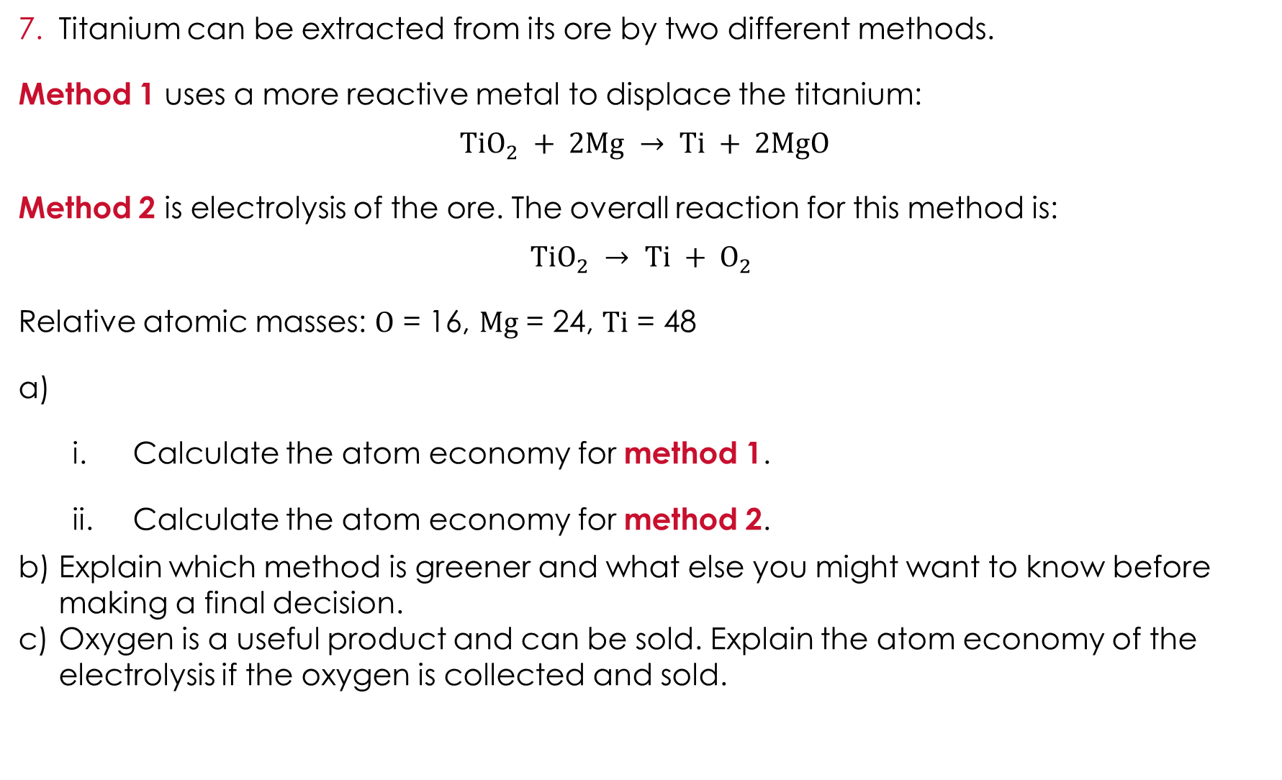
Questions
Titanium can be extracted from its ore by two different methods.
Method 1 uses a more reactive metal to displace the titanium:
$$TiO_{2} + 2Mg → Ti + 2MgO$$
Method 2 is electrolysis of the ore. The overall reaction for this method is:
$$TiO_{2} → Ti + O_{2}$$
Relative atomic masses: O = 16, Mg = 24, Ti = 48
  Calculate the atom economy for method 1.
  Calculate the atom economy for method 2.
Explain which method is greener and what else you might want to know before making a final decision.
Oxygen is a useful product and can be sold. Explain the atom economy of the electrolysis if the oxygen is collected and sold.
Scaffolded questions

Slide 22
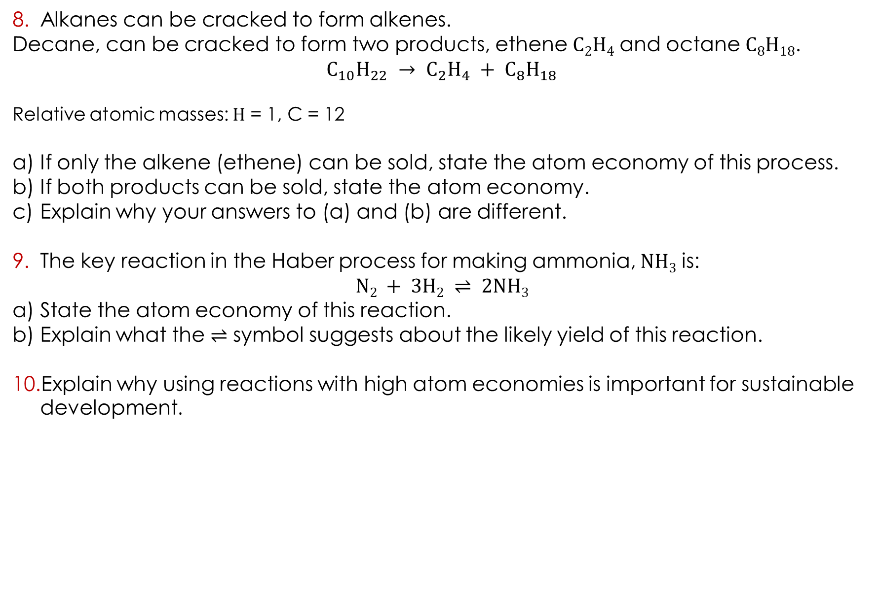
Questions
Alkanes can be cracked to form alkenes.
Decane, can be cracked to form two products, ethene C₂H₄ and octane C₈H₁₈.
$$C_{10}H_{22} → C_{2}H_{4} + C_{8}H_{18}$$
Relative atomic masses: H = 1, C = 12
If only the alkene (ethene) can be sold, state the atom economy of this process.
If both products can be sold, state the atom economy.
Explain why your answers to (a) and (b) are different.
The key reaction in the Haber process for making ammonia, NH₃ is:
$$N2 + 3H2 ⇌ 2NH3$$
State the atom economy of this reaction.
Explain what the ⇌ symbol suggests about the likely yield of this reaction.
Explain why using reactions with high atom economies is important for sustainable development.
Scaffolded questions

Slide 23
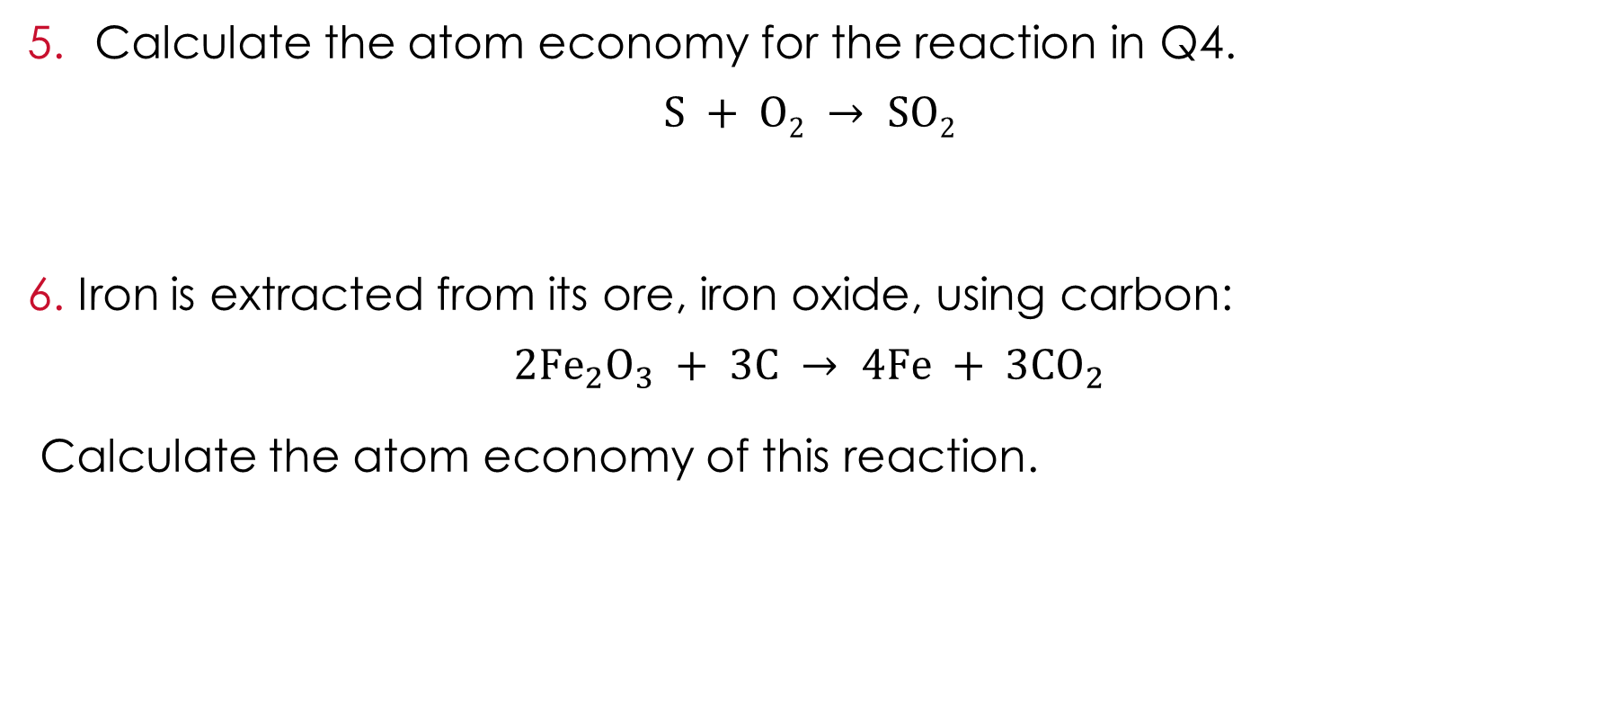
Questions
Calculate the atom economy for the reaction in Q4.
$$S + O2 → SO2$$
Iron is extracted from its ore, iron oxide, using carbon:
$$2{Fe}_{2}O_{3} + 3C → 4Fe + 3{CO}_{2}$$
Calculate the atom economy of this reaction.
Unscaffolded questions

Slide 24
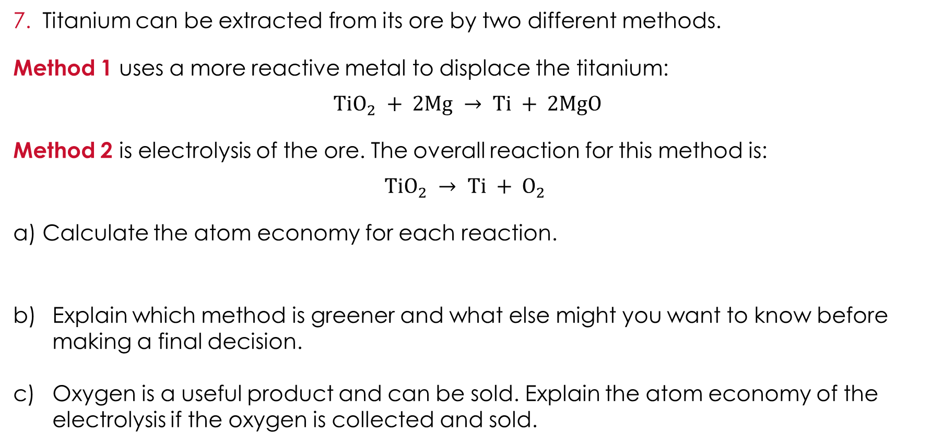
Questions
Titanium can be extracted from its ore by two different methods.
Method 1 uses a more reactive metal to displace the titanium:
$$TiO_{2} + 2Mg → Ti + 2MgO$$
Method 2 is electrolysis of the ore. The overall reaction for this method is:
$$TiO_{2} → Ti + O_{2}$$
Calculate the atom economy for each reaction.
Explain which method is greener and what else might you want to know before making a final decision.
Oxygen is a useful product and can be sold. Explain the atom economy of the electrolysis if the oxygen is collected and sold.
Unscaffolded questions

Slide 25
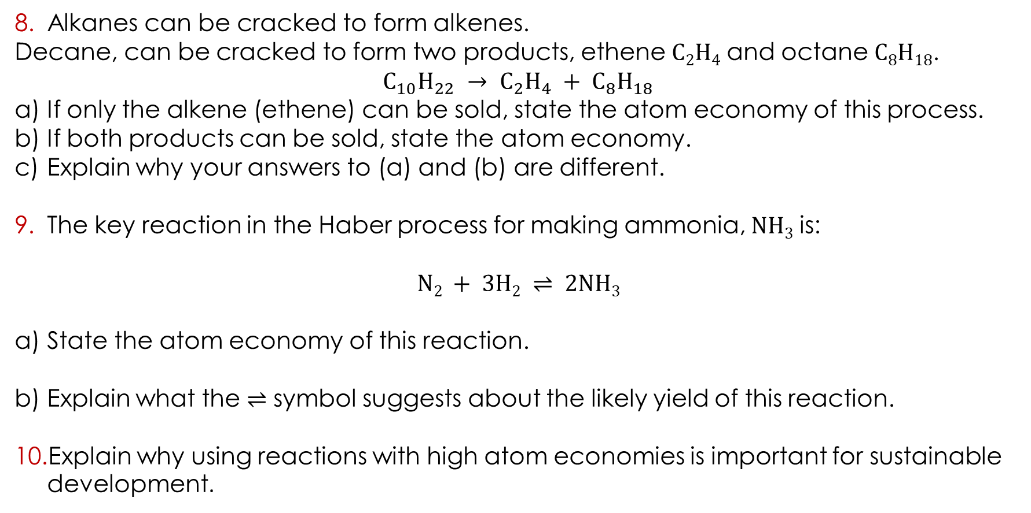
Questions
Alkanes can be cracked to form alkenes.
Decane, can be cracked to form two products, ethene C₂H₄ and octane C₈H₁₈.
$$C_{10}H_{22} → C_{2}H_{4} + C_{8}H_{18}$$
If only the alkene (ethene) can be sold, state the atom economy of this process.
If both products can be sold, state the atom economy.
Explain why your answers to (a) and (b) are different.
The key reaction in the Haber process for making ammonia, NH₃ is:
$$N2 + 3H2 ⇌ 2NH3$$
State the atom economy of this reaction.
Explain what the ⇌ symbol suggests about the likely yield of this reaction.
Explain why using reactions with high atom economies is important for sustainable development.
Unscaffolded questions

Slide 26
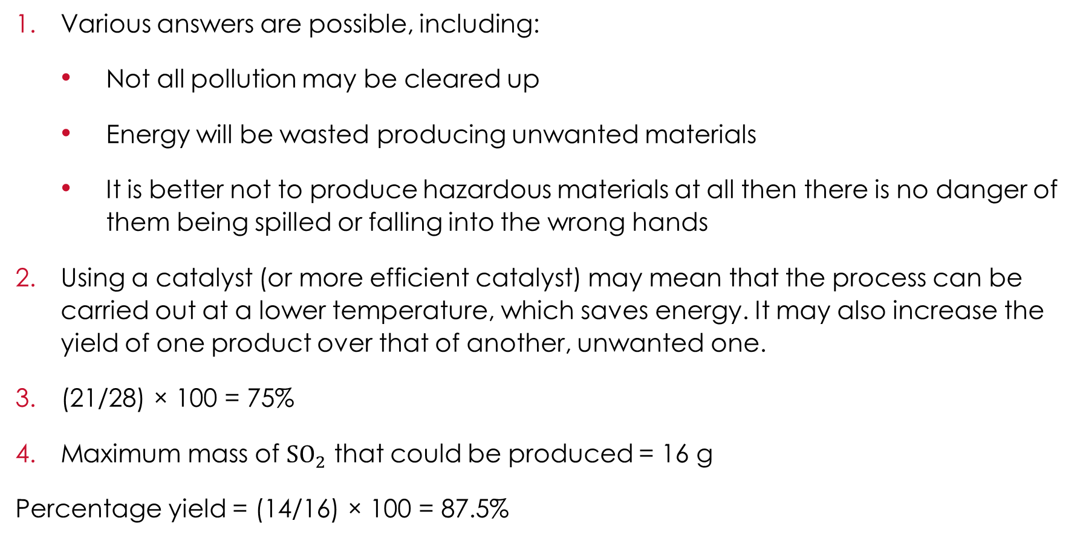
Answers
Various answers are possible, including:
  Not all pollution may be cleared up
  Energy will be wasted producing unwanted materials
  It is better not to produce hazardous materials at all then there is no danger of them being spilled or falling into the wrong hands
Using a catalyst (or more efficient catalyst) may mean that the process can be carried out at a lower temperature, which saves energy. It may also increase the yield of one product over that of another, unwanted one.
(21/28) × 100 = 75%
Maximum mass of ${SO}_{2}$ that could be produced = 16 g
Percentage yield = (14/16) × 100 = 87.5%
Unscaffolded answers

Slide 27
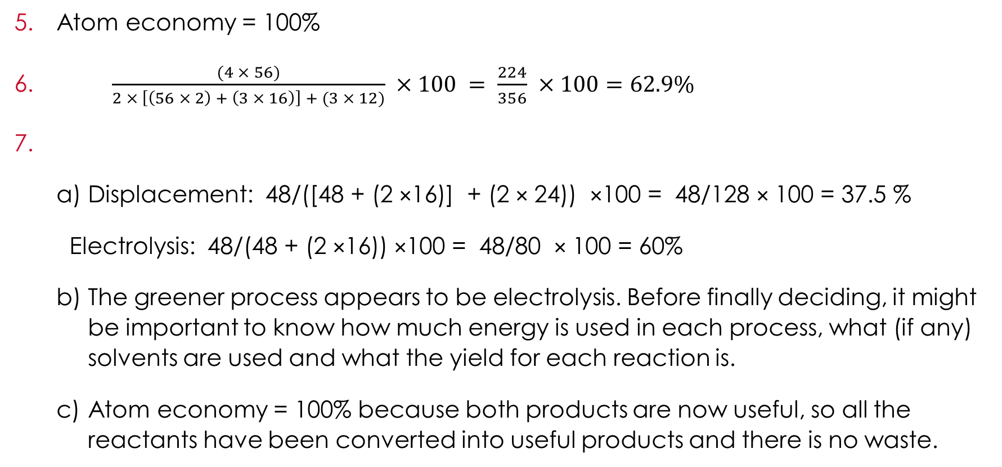
Answers
Atom economy = 100%
$\frac{(4 × 56)}{2 × \left[\left(56 × 2\right) + \left(3 × 16\right)\right] + (3 × 12)} ×100 = \frac{224}{356} ×100=62.9\%$
  Displacement: 48/([48 + (2 ×16)] + (2 × 24)) ×100 = 48/128 × 100 = 37.5 %
  Electrolysis: 48/(48 + (2 ×16)) ×100 = 48/80 × 100 = 60%
  The greener process appears to be electrolysis. Before finally deciding, it might be important to know how much energy is used in each process, what (if any) solvents are used and what the yield for each reaction is.
  Atom economy = 100% because both products are now useful, so all the reactants have been converted into useful products and there is no waste.
Unscaffolded answers

Slide 28
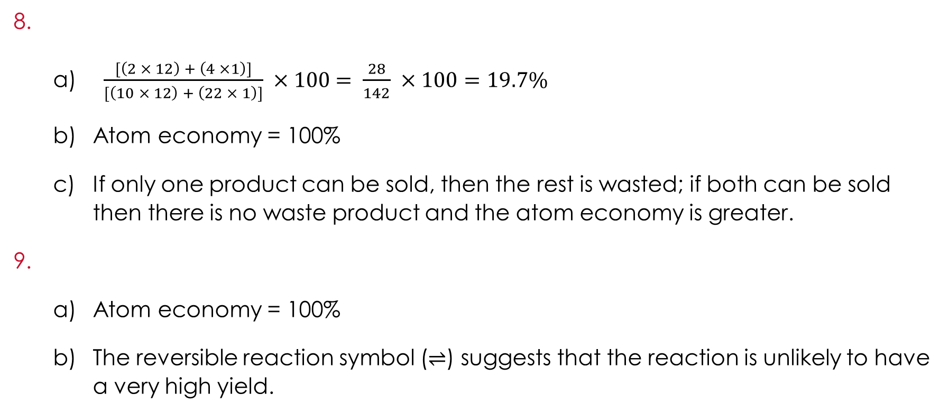
Answers
  $\frac{[\left(2 × 12\right) + \left(4 ×1\right)]}{[\left(10 × 12\right) + \left(22 × 1\right)]} ×100$ $= \frac{28}{142} ×100=19.7\%$
  Atom economy = 100%
  If only one product can be sold, then the rest is wasted; if both can be sold then there is no waste product and the atom economy is greater.
  Atom economy = 100%
  The reversible reaction symbol (⇌) suggests that the reaction is unlikely to have a very high yield.
Unscaffolded answers

Slide 29
Answers
Answers include:
  more efficient use of resources
  less waste
  less pollution
  less energy used
  These things are important for sustainable development because they all help to make sure that we leave the planet healthy for future generations and do not use up all the available resources.
Unscaffolded answers

Slide 30
Answers
Various answers are possible, including:
  Not all pollution may be cleared up
  Energy will be wasted producing unwanted materials
  It is better not to produce hazardous materials at all then there is no danger of them being spilled or falling into the wrong hands
Using a catalyst (or more efficient catalyst) may mean that the process can be carried out at a lower temperature, which saves energy. It may also increase the yield of one product over that of another, unwanted one.
  28 kg
  (21/28) × 100 = 75%
Scaffolded answers

Slide 31
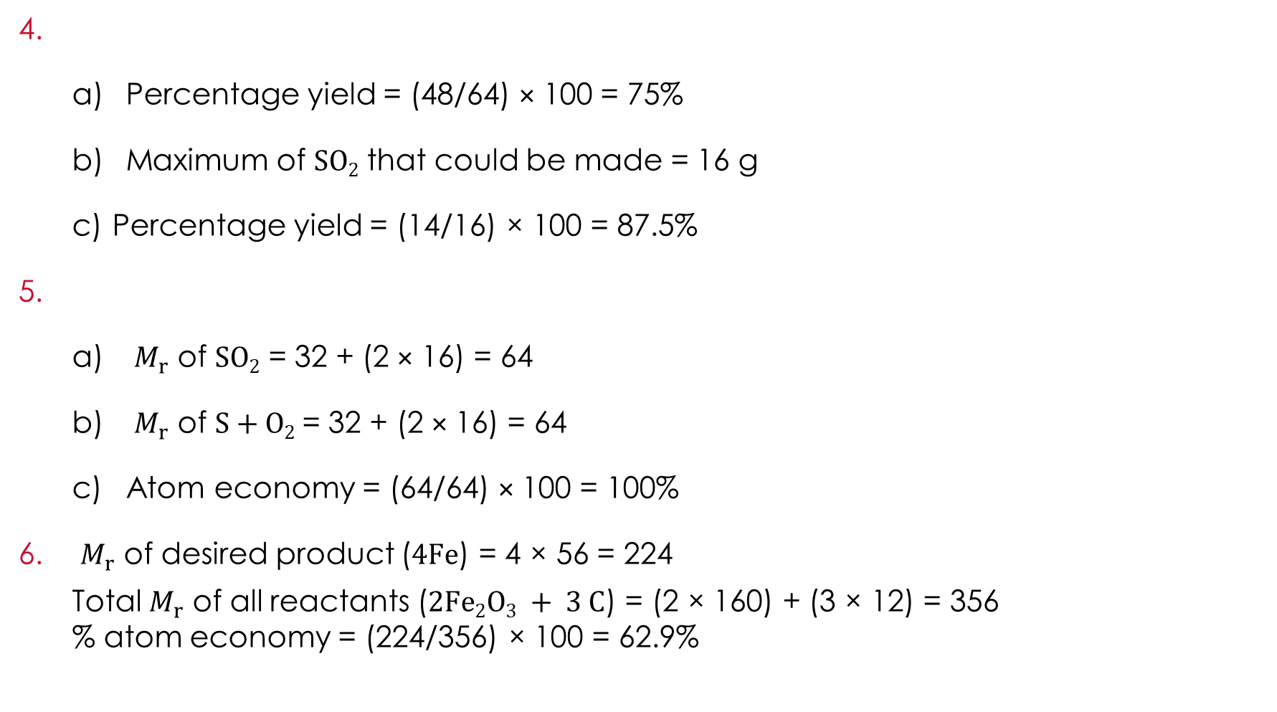
Answers
  Percentage yield = (48/64) × 100 = 75%
  Maximum of SO₂ that could be made = 16 g
  Percentage yield = (14/16) × 100 = 87.5%
  $M_{r}$ of $SO2$ = 32 + (2 × 16) = 64
  $M_{r}$ of $S+O2$= 32 + (2 × 16) = 64
  Atom economy = (64/64) × 100 = 100%
$M_{r}$ of desired product ($4Fe$) = 4 × 56 = 224
  Total $M_{r}$ of all reactants ($2Fe2O3 + 3 C$) = (2 × 160) + (3 × 12) = 356
  % atom economy = (224/356) × 100 = 62.9%
Scaffolded answers

Slide 32
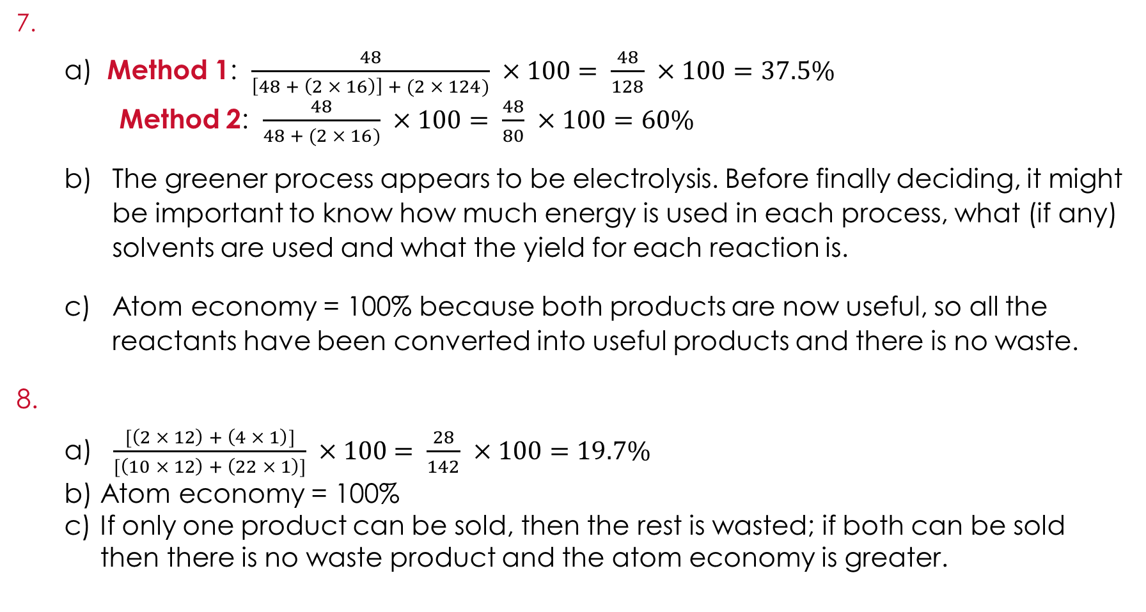
Answers
  Method 1: $\frac{48}{\left[48 + \left(2 × 16\right)\right] + (2 × 124)} ×100$ $= \frac{48}{128} ×100=37.5\%$
Method 2: $\frac{48}{48 + (2 × 16)} ×100$ $= \frac{48}{80} ×100=60\%$
  The greener process appears to be electrolysis. Before finally deciding, it might be important to know how much energy is used in each process, what (if any) solvents are used and what the yield for each reaction is.
  Atom economy = 100% because both products are now useful, so all the reactants have been converted into useful products and there is no waste.
  $\frac{[\left(2 × 12\right) + \left(4 × 1\right)]}{[\left(10 × 12\right) + \left(22 × 1\right)]} ×100$ $= \frac{28}{142} ×100=19.7\%$
  Atom economy = 100%
  If only one product can be sold, then the rest is wasted; if both can be sold then there is no waste product and the atom economy is greater.
Scaffolded answers

Slide 33
Answers
  Atom economy = 100%
  The reversible reaction symbol (⇌) suggests that the reaction is unlikely to have a very high yield.
Answers include:
  more efficient use of resources
  less waste
  less pollution
  less energy used
  These things are important for sustainable development because they all help to make sure that we leave the planet healthy for future generations and do not use up all the available resources.
Scaffolded answers

Slide 34
Find out more
Further reading
To find out more about how chemists can contribute to sustainable development have a look at the following articles:
Life cycle assessment of fast-food containers (rsc.li/48PcLEY)
How can life cycle assessments help compare the environmental impact of fast-food containers?
Fixing fashion (rsc.li/2Jdg7HU)
What can we do to reduce the environment impact of our clothes throughout their life cycle?
Why the world urgently needs more chemists (rsc.li/4eT6BYp)
How can learners make a difference by pursuing a career in chemistry?

