Slide 1
Rainbow fizz
pH and indicator demonstrations
Education in Chemistry
May 2016
rsc.li/EiC316ec

Slide 2
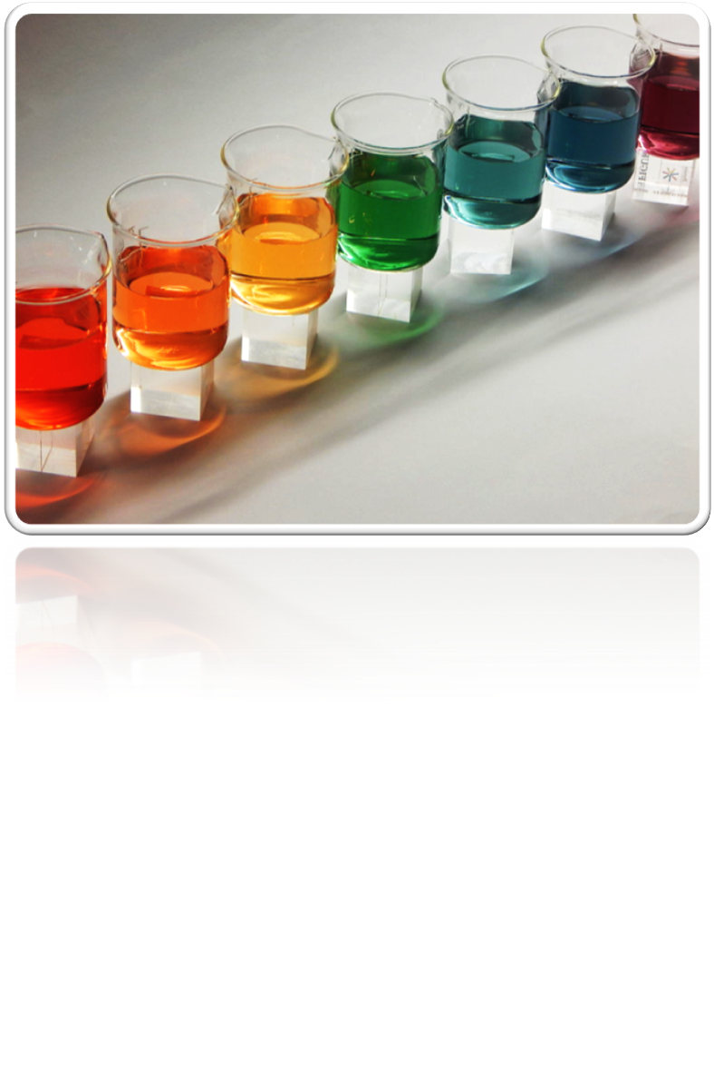
Notes:
Picture by Dejan Jovic DJ (Own work) [CC BY-SA 4.0 (http://creativecommons.org/licenses/by-sa/4.0)], via Wikimedia Commons: https://commons.wikimedia.org/wiki/File:Skala_boja_2.JPG
2

Slide 3
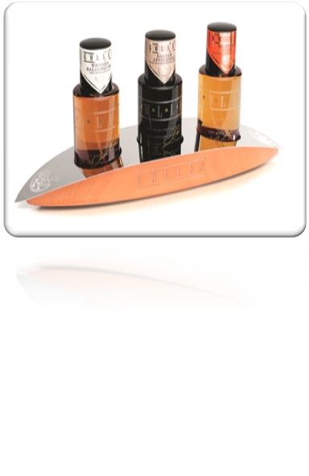
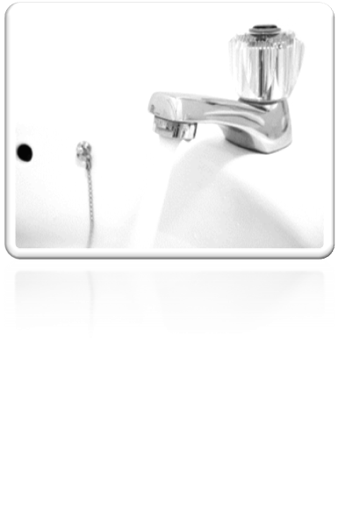
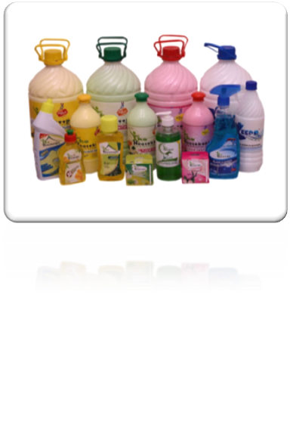
1 2 3 4 5 6 7 8 9 10 11 12 13 14
Notes:
Vinegar by Goelles Alois (Own work) [CC BY-SA 3.0 (http://creativecommons.org/licenses/by-sa/3.0)], via Wikimedia Commons: https://commons.wikimedia.org/wiki/File%3AG%C3%B6lles_Essig.jpg
Water tap by Matthew Bowden www.digitallyrefreshing.com (http://www.sxc.hu/photo/158242) [Attribution], via Wikimedia Commons: https://commons.wikimedia.org/wiki/File%3AWasserhahn.jpg
Cleaning products by THK18 (Own work) [CC BY-SA 4.0 (http://creativecommons.org/licenses/by-sa/4.0)], via Wikimedia Commons: https://commons.wikimedia.org/wiki/File:ALL_PRODUCT.jpg
3

Slide 4
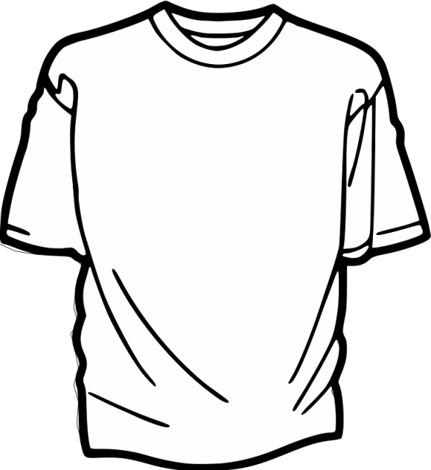
Na₂CO₃

Slide 5
Na₂CO₃(aq) + HCl(aq) ⇨ NaHCO₃(aq) + NaCl(aq)

Slide 6
Notes:
Picture by Dejan Jovic DJ (Own work) [CC BY-SA 4.0 (http://creativecommons.org/licenses/by-sa/4.0)], via Wikimedia Commons: https://commons.wikimedia.org/wiki/File:Skala_boja_2.JPG
6

Slide 7
Methyl Orange
Methyl Red
Bromothymol Blue
Phenolphthalein
pK_{a} = 3.7
pK_{a} = 5.1
pK_{a} = 7.0
pK_{a} = 9.6

Slide 8
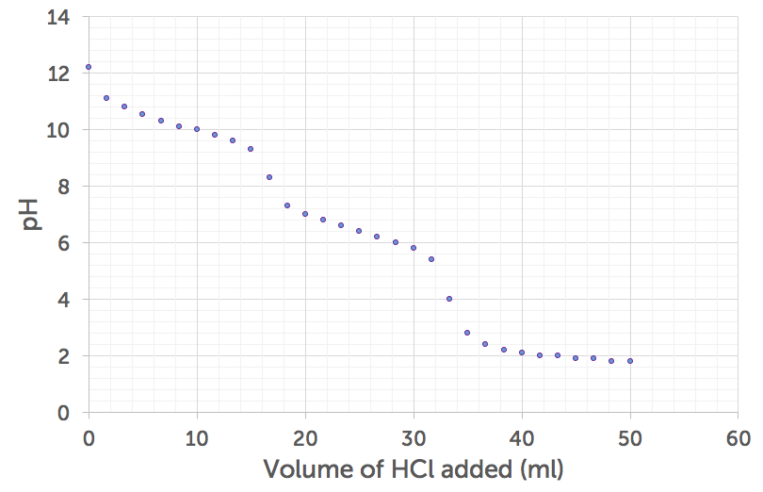
phenolphthalein
methyl orange

Slide 9
pH

Slide 10
Volume of HCl added (cm³) | Initial [H⁺] (mol dm⁻³) | New [H⁺] (mol dm⁻³) | Initial pH | New pH | approx change in [H⁺] | change in [pH]
100 | 1.0 × 10⁻¹⁴ | 1.2 × 10⁻¹⁴ | 14.0 | 13.9 | 20% | 1%
… | … | … | … | … | … | …
900
1000

Slide 11
pH = -log₁₀[H⁺]

Slide 12
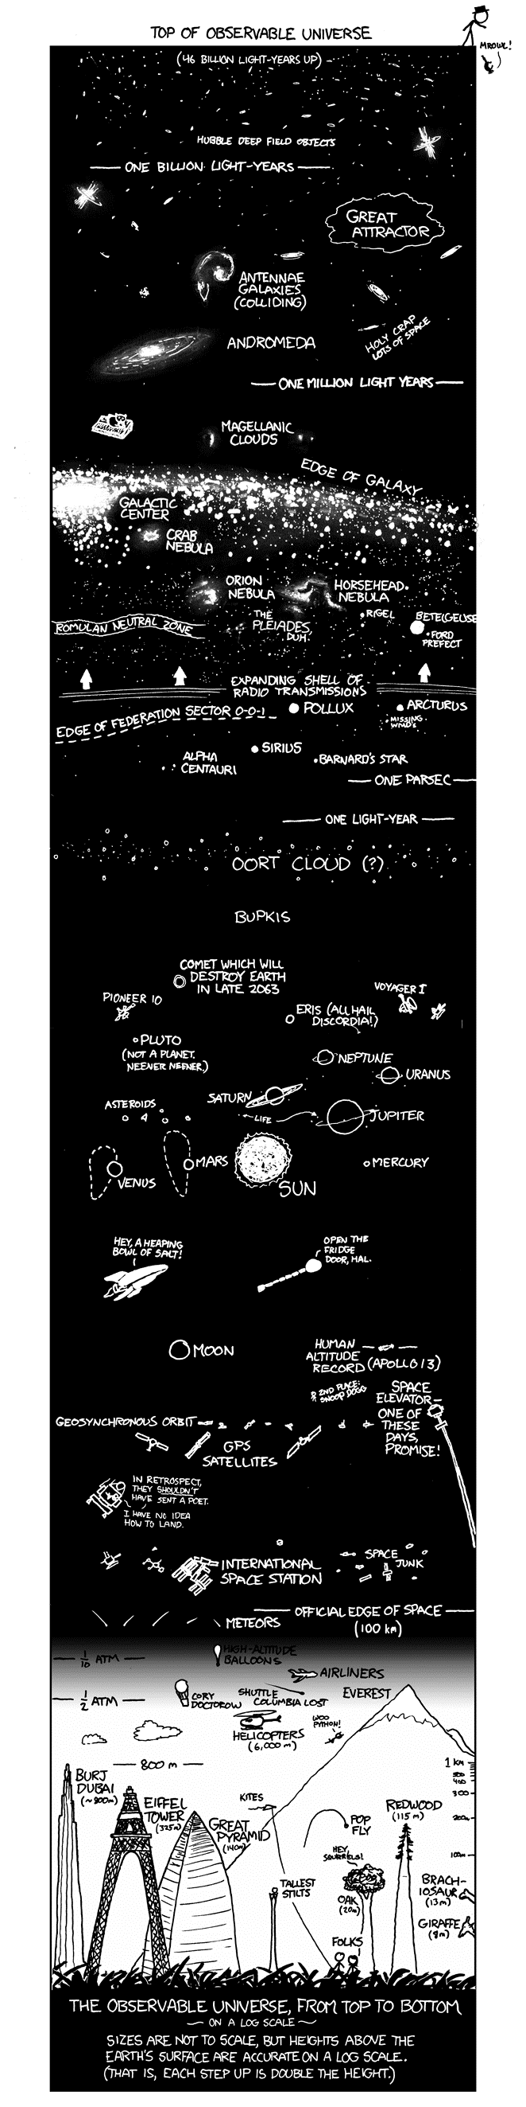
Notes:
Image credit: Randall Monroe / XKCD https://xkcd.com/482/ (CC BY-NC.2.5 http://creativecommons.org/licenses/by-nc/2.5/)
12

Slide 13
Volume of HCl added (cm³) | Initial [H⁺] (mol dm⁻³) | New [H⁺] (mol dm⁻³) | Initial pH | New pH | approx change in [H⁺] | change in [pH]
100 | 1.0 × 10⁻¹⁴ | 1.2 × 10⁻¹⁴ | 14.0 | 13.9 | 20% | 1%
… | … | … | … | … | … | …
900 | 9.0 × 10⁻¹⁴ | 1.9 × 10⁻¹³ | 13.0 | 12.7 | 100% | 2%
1000 | 1.9 × 10⁻¹³ | 1.0 × 10⁻⁷ | 12.7 | 7.0 | 100000000% | 45%

Slide 14
[H⁺][OH⁻] = 1×10⁻¹⁴ mol² dm⁻⁶ @ 298K

Slide 15
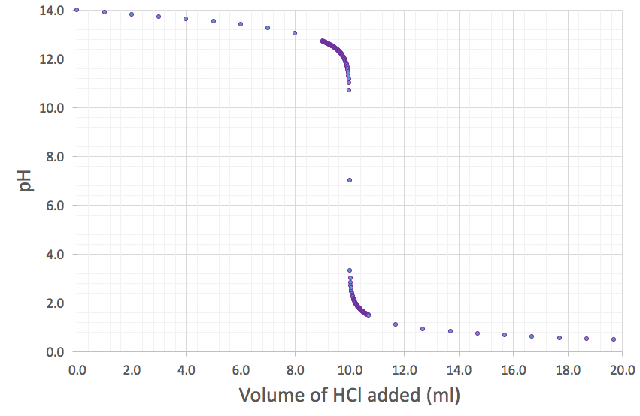
Equivalence
Point
phenolphthalein
bromothymol blue
methyl orange

Slide 16
Equivalence
Point
phenolphthalein
methyl orange
methyl orange

Slide 17
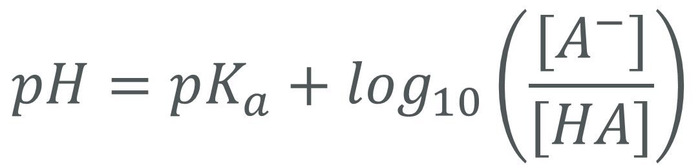
Henderson-Hasselbalch Equation

Slide 18
Methyl Orange
Methyl Red
Bromothymol Blue
Phenolphthalein
pK_{a} = 3.7
pK_{a} = 5.1
pK_{a} = 7.0
pK_{a} = 9.6

