Slide 1
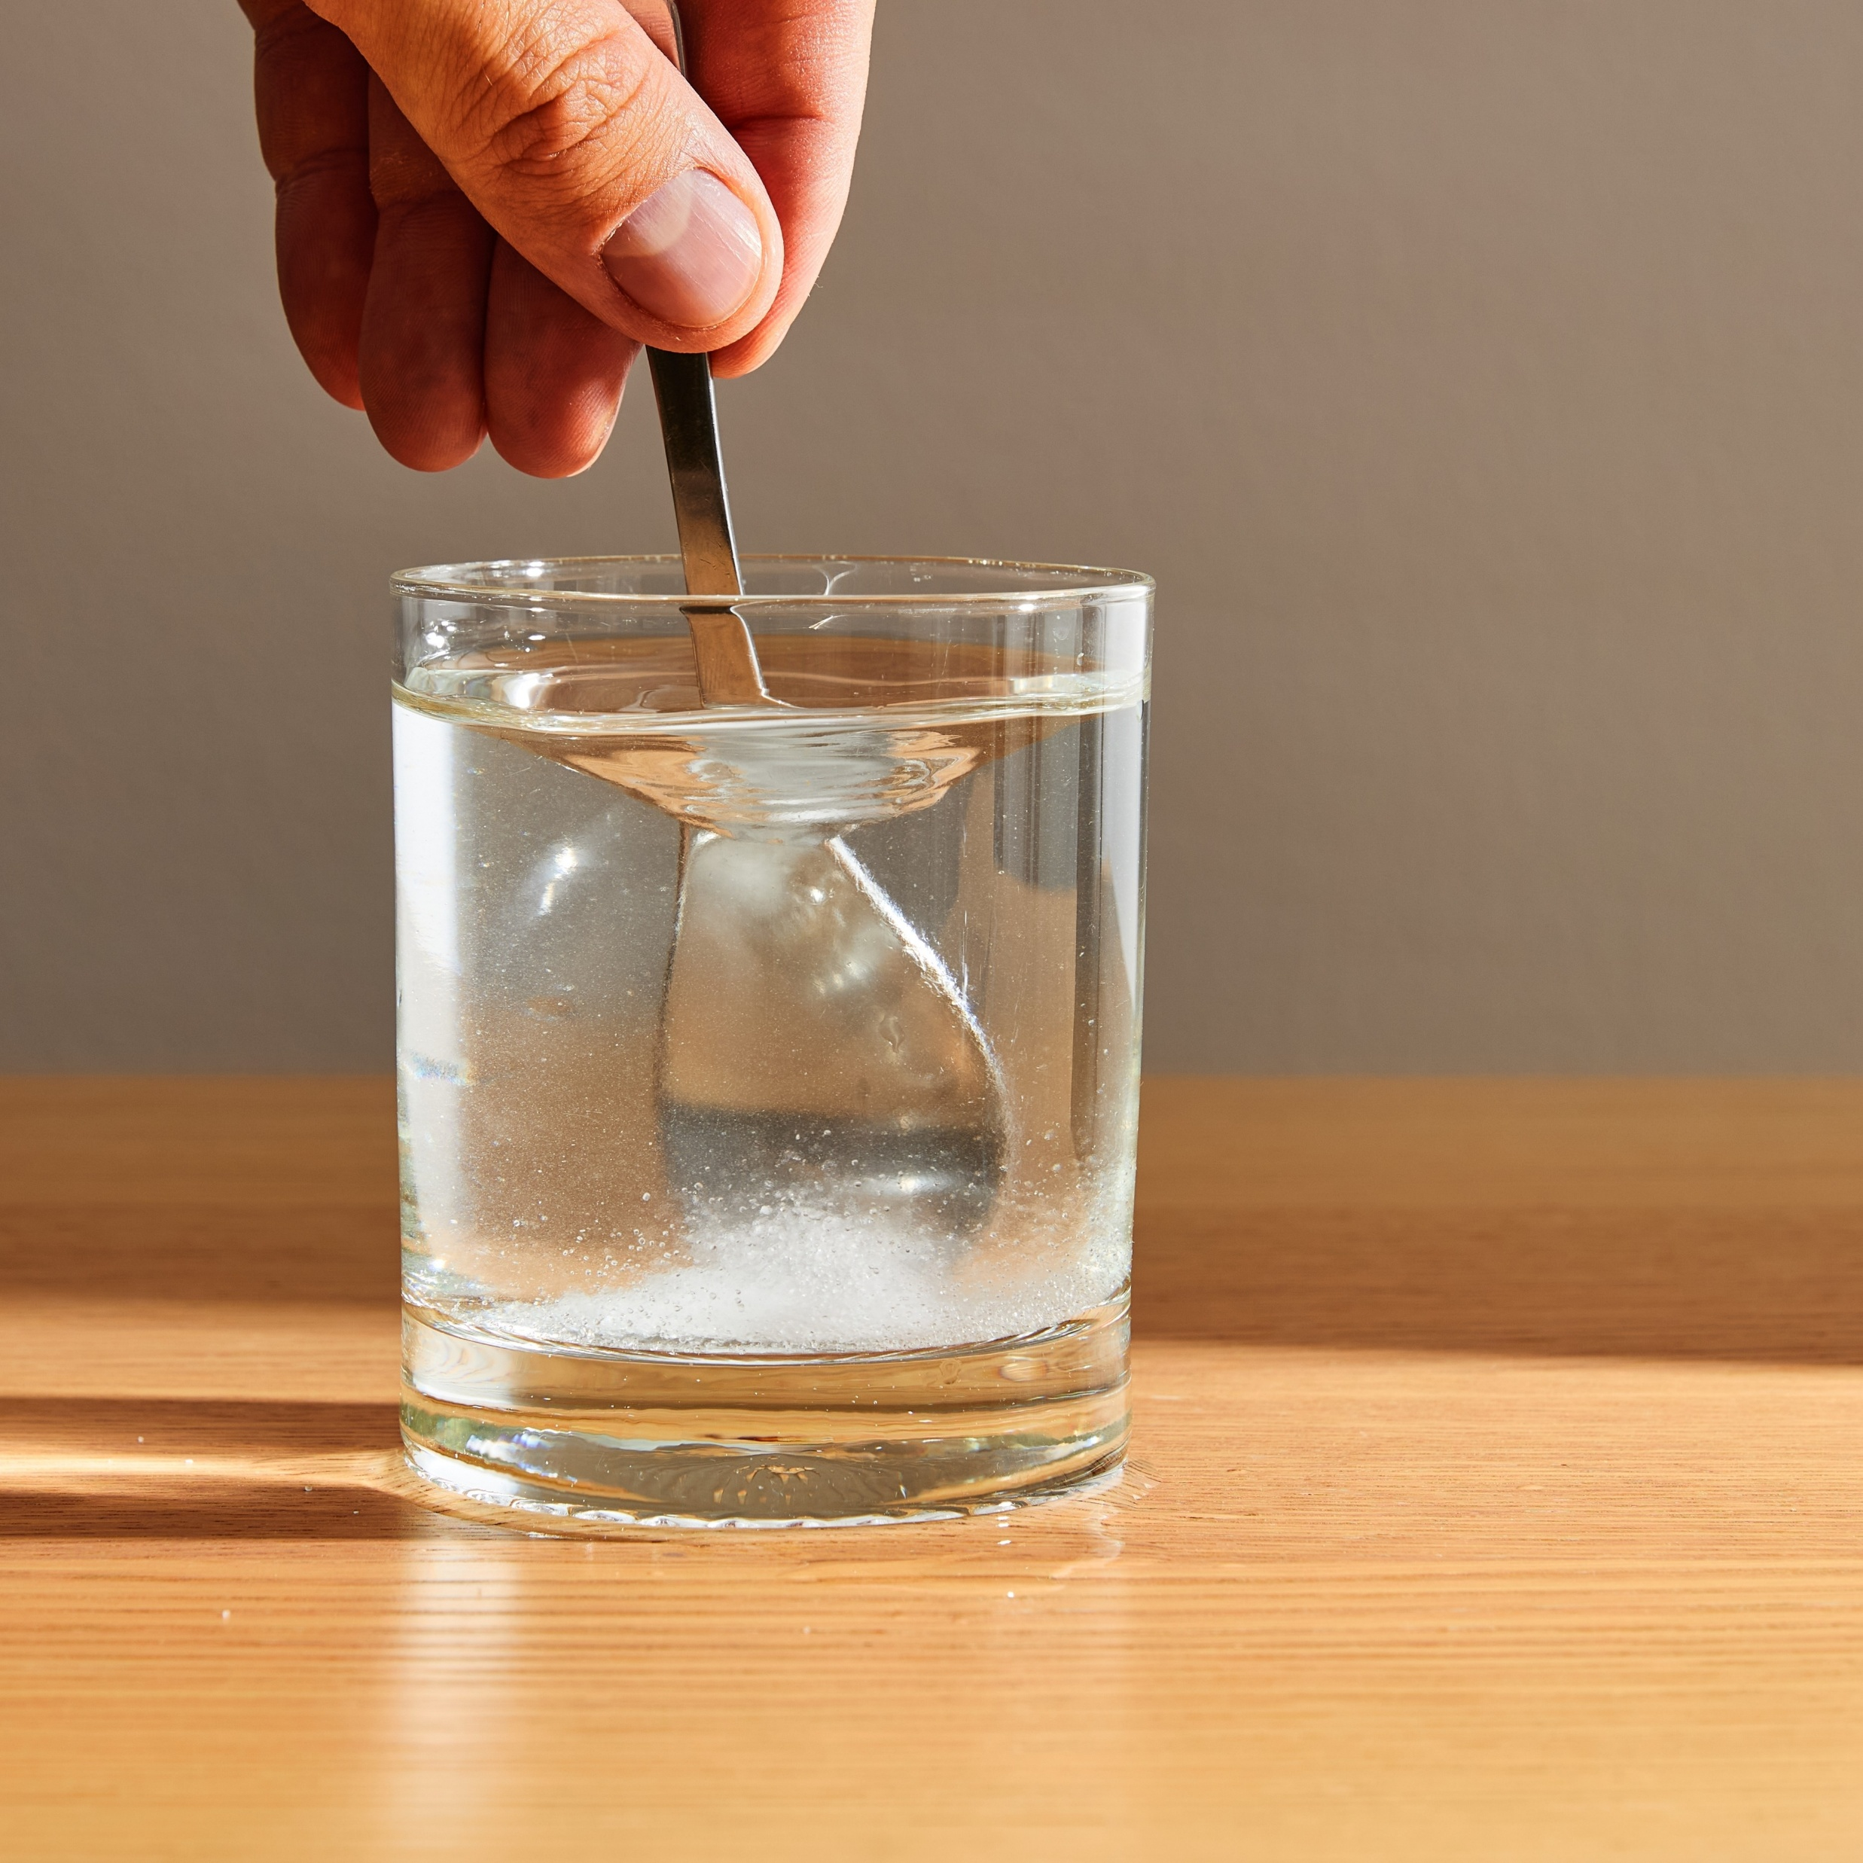
11–14 years
Conservation of mass in dissolving and precipitation
Downloaded from: rsc.li/32yFM8a
Notes:
Image ©: Shutterstock/Zim2697

Slide 2
Learning objectives
Recall the definition of conservation of mass.
Predict the finding of an experiment using prior knowledge of particles and conservation of mass.
Measure the mass of a solution accurately using a 2 decimal place top pan balance.
Analyse your results and link these to the principle of conservation of mass.
Learning objectives

Slide 3
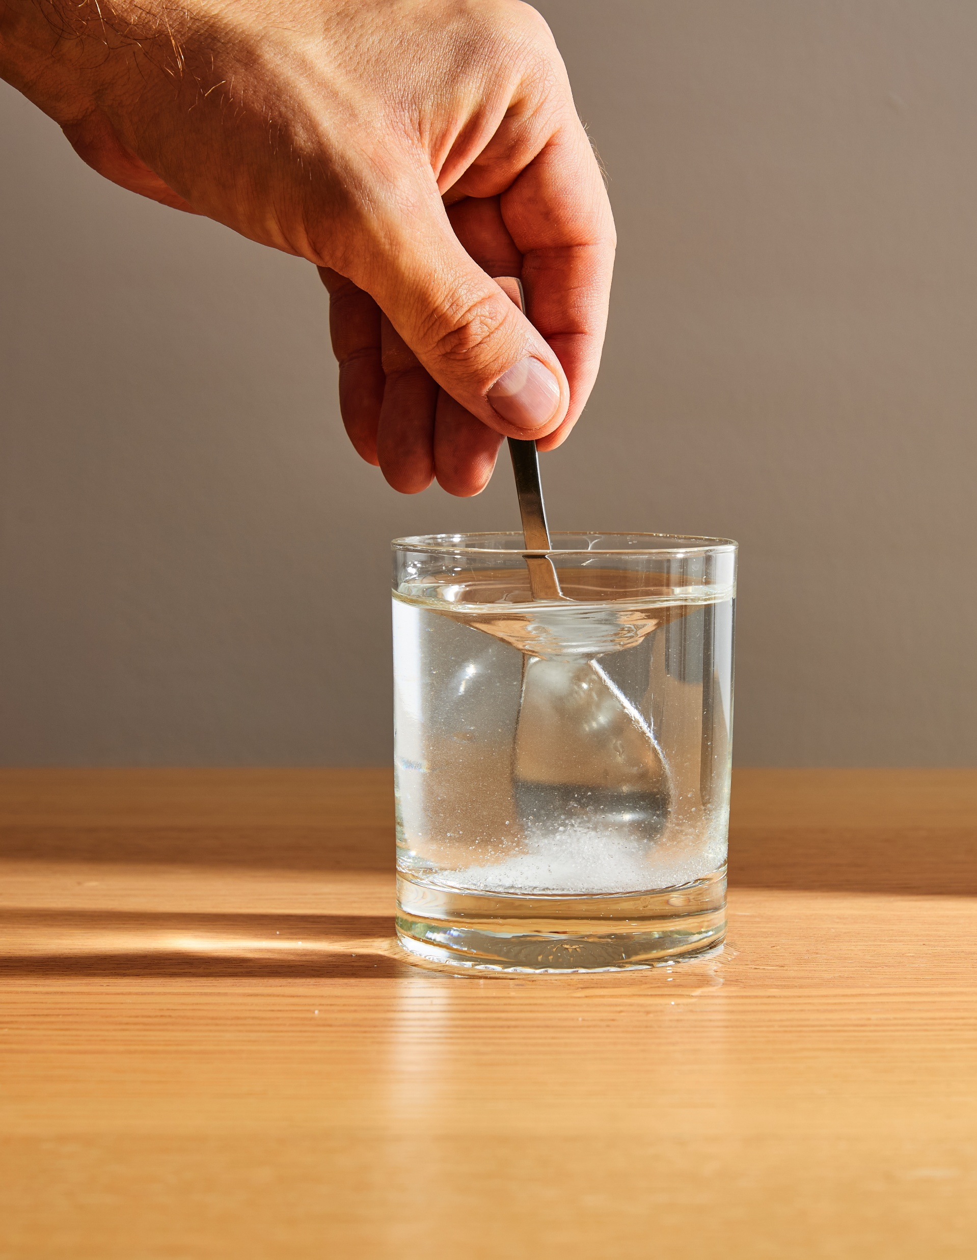
Introduction
Introduction
In this lesson, you are going to carry out a practical where you dissolve substances in water and mix solutions to form new solids.
Consider this:
When a solid dissolves, it seems to disappear.
When two clear liquids are mixed, a solid can suddenly appear.
Where does the solid go when it dissolves, and where does it come from when it appears?
Notes:
Image ©: Shutterstock/Zim2697

Slide 4
Introduction
Introduction
Scientists explain this using an important idea called the conservation of mass. This means that mass cannot be created or destroyed, even during chemical reactions.
As you carry out your practical, your challenge is to look carefully at what happens and think about this rule. By the end of the lesson, you should be able to explain what’s really happening to the particles.

Slide 5
Prediction
Use this table during the experiment to record your predictions. Put a tick in one column and complete the sentence below.
I predict this because …
Experiment name | After mixing the substances in the flask, the mass will be …
 | … greater than before | … the same as before | … less than before
Dissolving
Precipitation
Prediction

Slide 6
Method – Dissolving
Method
Find the mass of the flask labelled ‘Dissolving'. Write this in the results table.
Tip the flask to one side so that the solid substance in the tube goes into the water in the flask.
Gently shake the flask.
Stop shaking when there is nothing changing in the flask.
Put a tick in the prediction table to show what you think the mass will be now.
Write down why you ticked that box.
Find the mass of the flask again. Write this in the results table.
Were you right? Write a conclusion explaining what you think happened.

Slide 7
Results
Use the following table to record your results from the practical.
Experiment name | Mass before (g) | Mass after (g) | Difference in mass (g)
Dissolving
Precipitation
Results

Slide 8
Prediction
Use this table during the experiment to record your predictions. Put a tick in one column and complete the sentence below.
I predict this because …
Experiment name | After mixing the substances in the flask, the mass will be …
 | … greater than before | … the same as before | … less than before
Dissolving
Precipitation
Prediction

Slide 9
Method – Precipitation
Method
Find the mass of the flask labelled Precipitation. Write this in the results table.
Tip the flask so that the liquid in the tube goes into the liquid in the flask.
Gently shake the flask to make sure the liquids mix well.
Put a tick in the prediction table to show what you think the mass will be now.
Write down why you ticked that box.
Find the mass of the flask again. Write this in the results table.
Were you right? Write a conclusion explaining what you think happened.

Slide 10
Results
Use the following table to record your results from the practical.
Experiment name | Mass before (g) | Mass after (g) | Difference in mass (g)
Dissolving
Precipitation
Results

Slide 11
Conclusion
Complete the following sentences to describe and explain your results.
When dissolving a substance in water,
the mass _______________________. This is because ….
When adding the two substances together in a precipitation reaction, the mass _______________________. This is because …
Conclusion

Slide 12
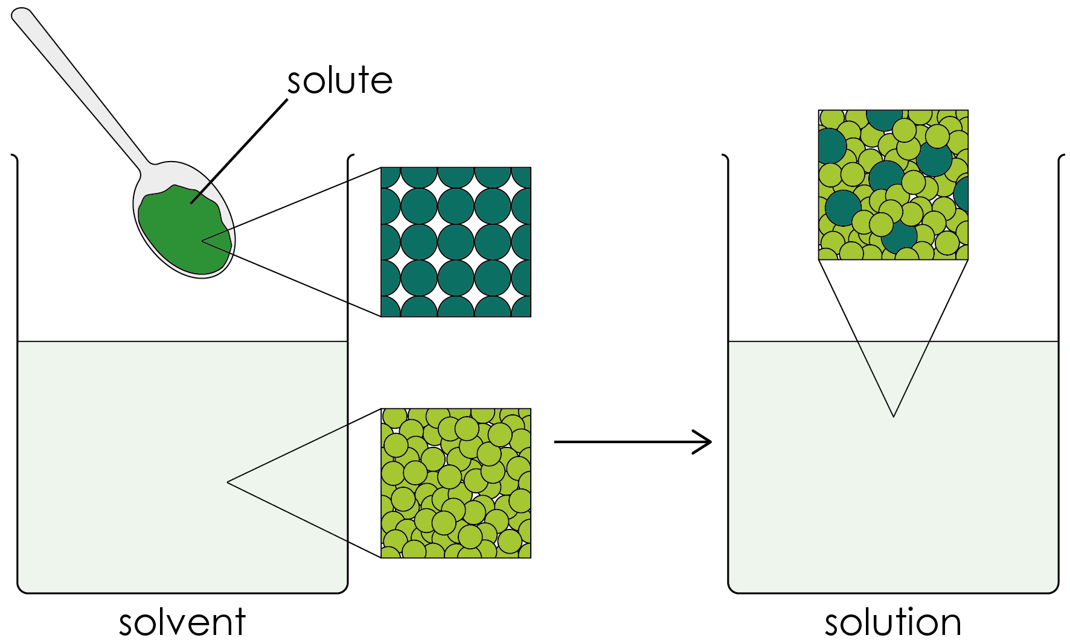
Explanation – Dissolving
When dissolving a substance in water, the mass stays the same. This is because the particles of the solid separate and mix with the water particles, but none are lost.

Slide 13
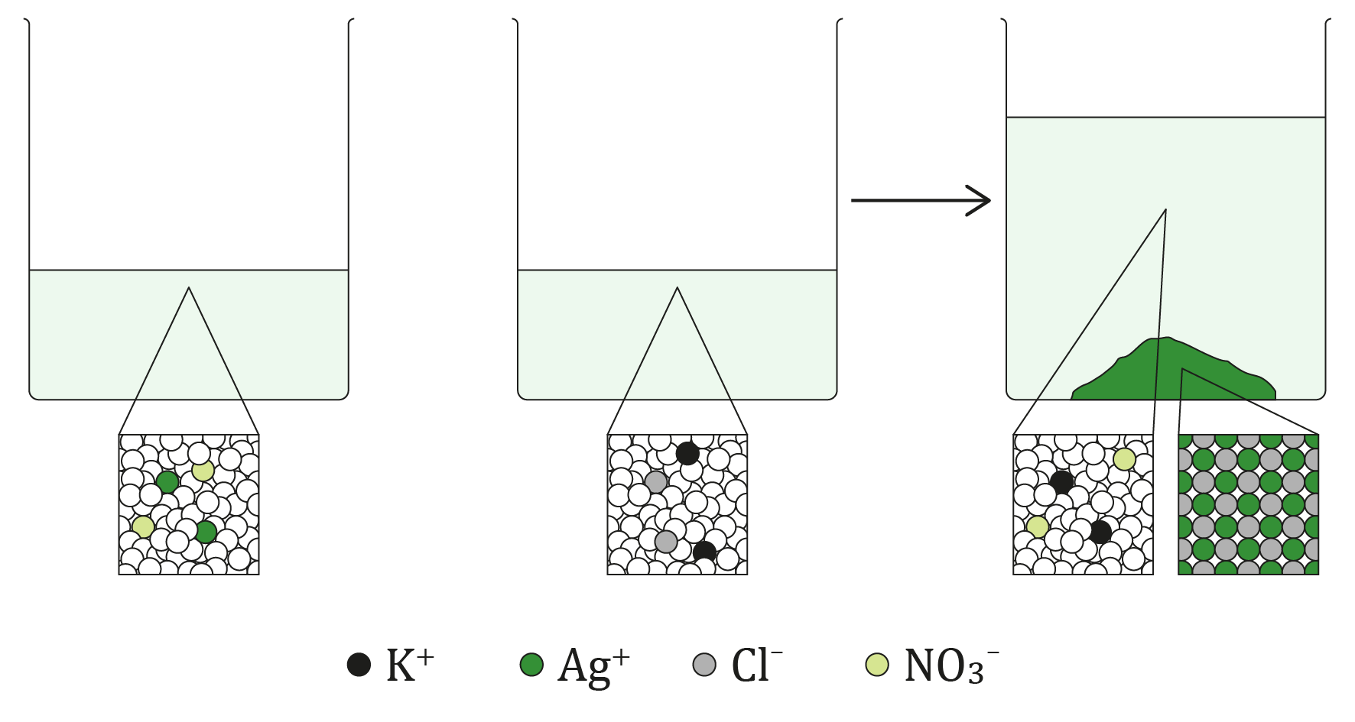
Explanation – Precipitation
When adding the two substances together in a precipitation reaction, the mass stays the same. This is because the precipitate forms from particles in the solutions that join together to make a solid.

Slide 14
Follow-up questions
Define the term ‘conservation of mass’.
When a substance dissolves in water, does the total mass change? Explain your answer.
If you weigh water before and after adding a solid that dissolves, describe what should happen to the total mass.
Explain why it might look like the solid has ‘disappeared’ even though its mass is still present.
At a particle level, how does dissolving explain why mass is conserved?
Suggest what could cause an experiment to incorrectly imply that mass has been lost during dissolving.
When two solutions are mixed and a precipitate forms, describe what happens to the total mass of the system.
Explain where the solid (precipitate) comes from if it was not visible before mixing.
Explain, using particles, why the total mass stays the same during a precipitation reaction even though a new solid forms.
Explain how conservation of mass applies to both dissolving and precipitation reactions.
Questions

Slide 15
Follow-up questions – Answers
The principle of conservation of mass states that mass cannot be created or destroyed in a chemical reaction, only rearranged.
No, the total mass does not change because the dissolved substance is still present in the solution.
The total mass should increase by the mass of the solid added.
It looks like it has disappeared because it has spread out evenly in the water, but its particles are still there.
The particles of the solid separate and mix with the water particles, but none are lost, so the mass stays the same.
Spilling liquid, evaporation or not measuring carefully could make it seem like mass has been lost.
The total mass stays the same.
The precipitate forms when particles in the two solutions join together to make a solid.
This is because all of the substances present (liquids and solids) contribute to the total mass.
In both processes, particles are rearranged or spread out, but none are lost, so the total mass stays the same.
Answers

