Slide 1
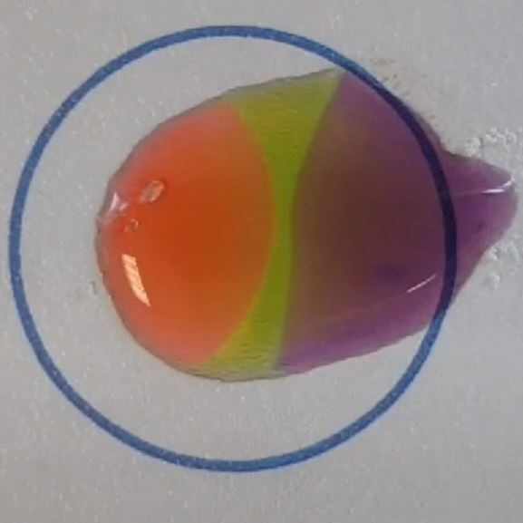
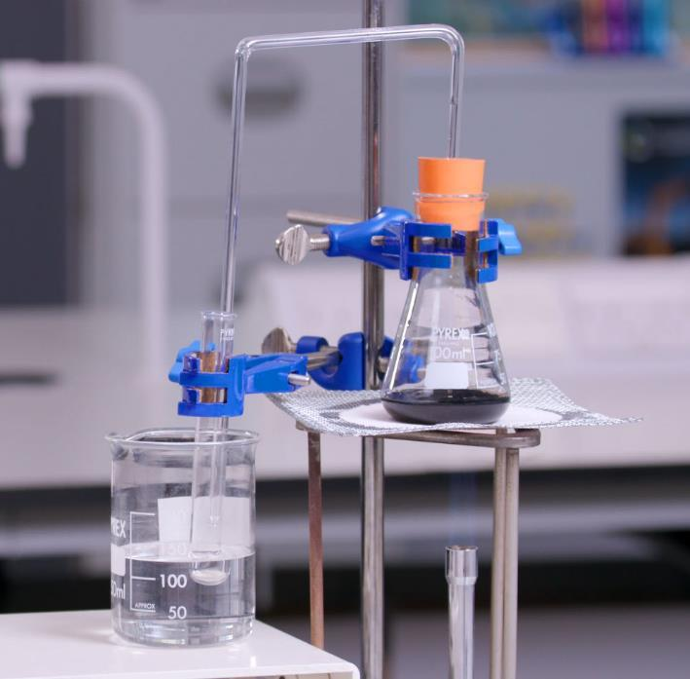
Microscale precipitation and neutralisation reactions
Integrated instructions
Downloaded from: rsc.li/3dl7WbA
Notes:
Image © David Paterson.

Slide 2
Integrated instructions
Introduction
Integrated instructions use clear numbering, arrows and simple pictograms (for example, an eye showing when to make observations). They were developed using cognitive load theory and remove unnecessary information. Integrated instructions reduce extraneous load on learners, increasing the capacity of their working memory to think about what they are doing and why.
Read more at rsc.li/47bIKi5.

Slide 3
Learning objectives
Learning objectives
Make detailed and accurate observations of chemical reactions.
Use your observations to infer what is happening as these reactions take place.

Slide 4


Integrated instructions: precipitation
❖ 10 drops water 
⬥ A few crystals Pb(NO₃)₂ 
◆ A few crystals KI 
 Observe 
 Push crystals into water 
 Push crystals into water 
RSC Microscale chemistry
Precipitation reaction
Downloaded from rsc.li/3dl7WbA
Notes:
Method
Add a few crystals of potassium iodide to the left-hand small circle.
Add a few crystals of lead(II) nitrate(V) to the right-hand small circle.
Add 10 drops of water to the large central circle.
Carefully push the crystals into the edges of the water.
Observe the dissolution of the crystals and the formation of lead iodide.

Slide 5
Integrated instructions: neutralisation
❖ 10 drops water 
⬥ 1 drop universal indicator solution 
◆ A few crystals citric acid 
 A few crystals sodium carbonate 
 Observe 
 Push crystals into water 
 Push crystals into water 
RSC Microscale chemistry
Neutralisation reaction
Downloaded from rsc.li/3dl7WbA
Notes:
Method
Add a few crystals of anhydrous sodium carbonate to the left-hand small circle.
Add a few crystals of citric acid to the right-hand small circle.
Add 10 drops of water to the large central circle.
Add 1 drop of universal indicator solution to the water.
Carefully push the crystals into the edges of the water.
Observe the dissolution of the crystals, the change in colour of the indicator and the formation of carbon dioxide bubbles.

Slide 6
Discussion questions
Discussion questions
Prompt questions for precipitation reaction
What has happened to the lead nitrate crystals?
What has happened to the potassium iodide?
What is the yellow band appearing in the drop?
Why is the yellow band nearer to one side than the other?
Prompt questions for neutralisation reaction
What do the changes to the colour of the indicator on each side of the drop show?
What is happening where the solutions meet?

