Slide 1
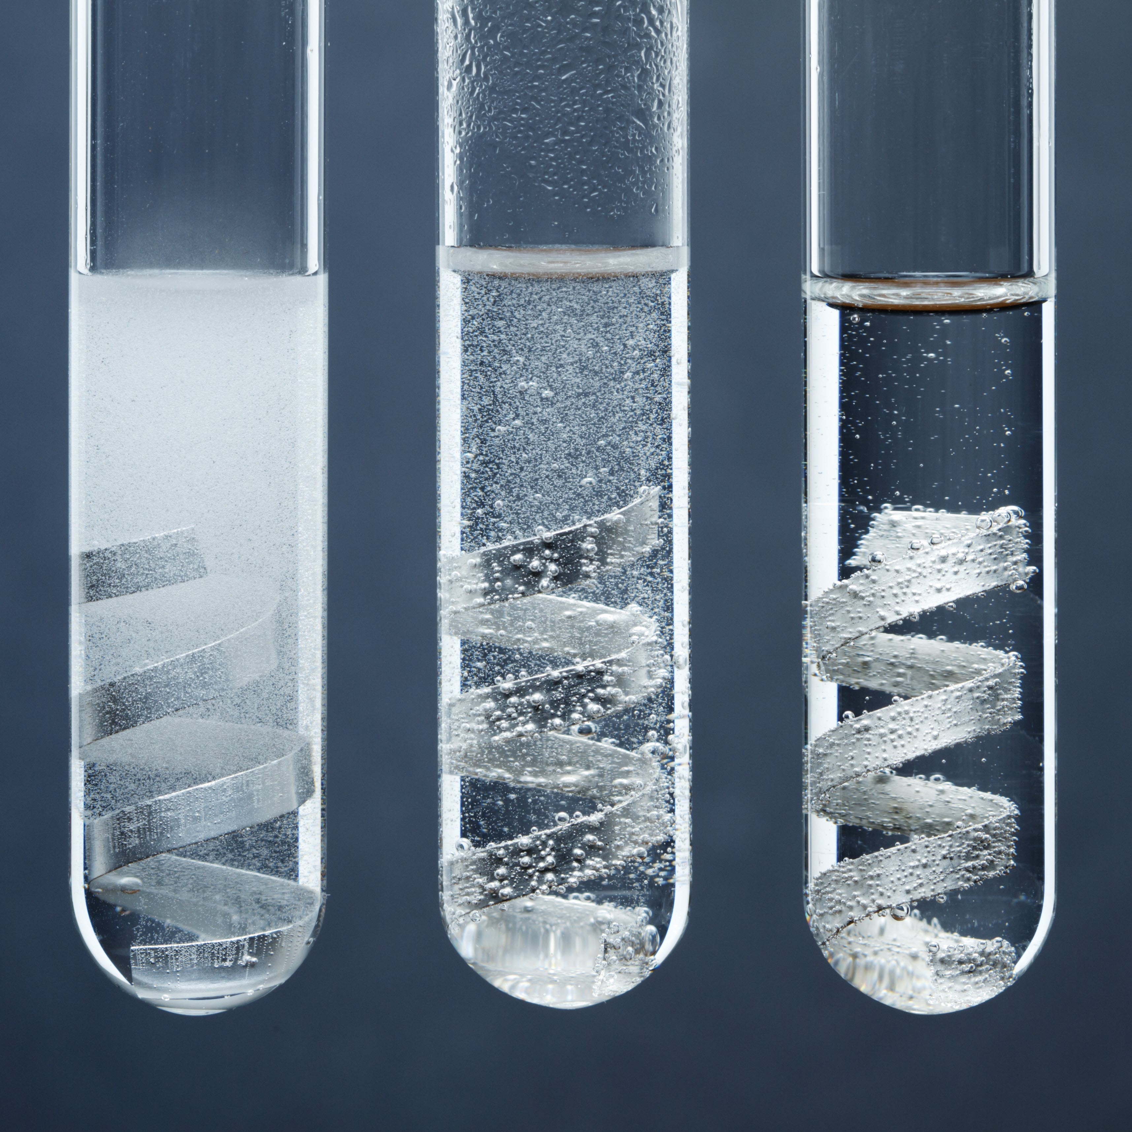
14–16 years
Determining the volume of one mole of hydrogen gas
Downloaded from: rsc.li/3VXrSVX

Slide 2
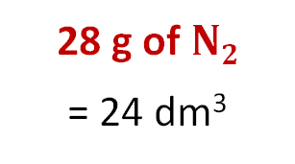
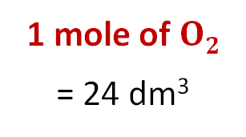
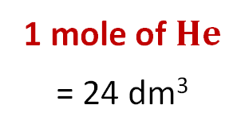
Introduction
Introduction
One mole of any gas occupies the same volume when measured under the same conditions of temperature and pressure.
At room temperature and pressure (RTP) this volume is 24.0 dm³ or 24,000 cm³.
In chemistry, room temperature and pressure are 20°C and 1 atmosphere.
1 mole of $He$
= 24 dm³
1 mole of $O2$
= 24 dm³
28 g of $N2$
= 24 dm³
Notes:
Image (c): Shutterstock/

Slide 3
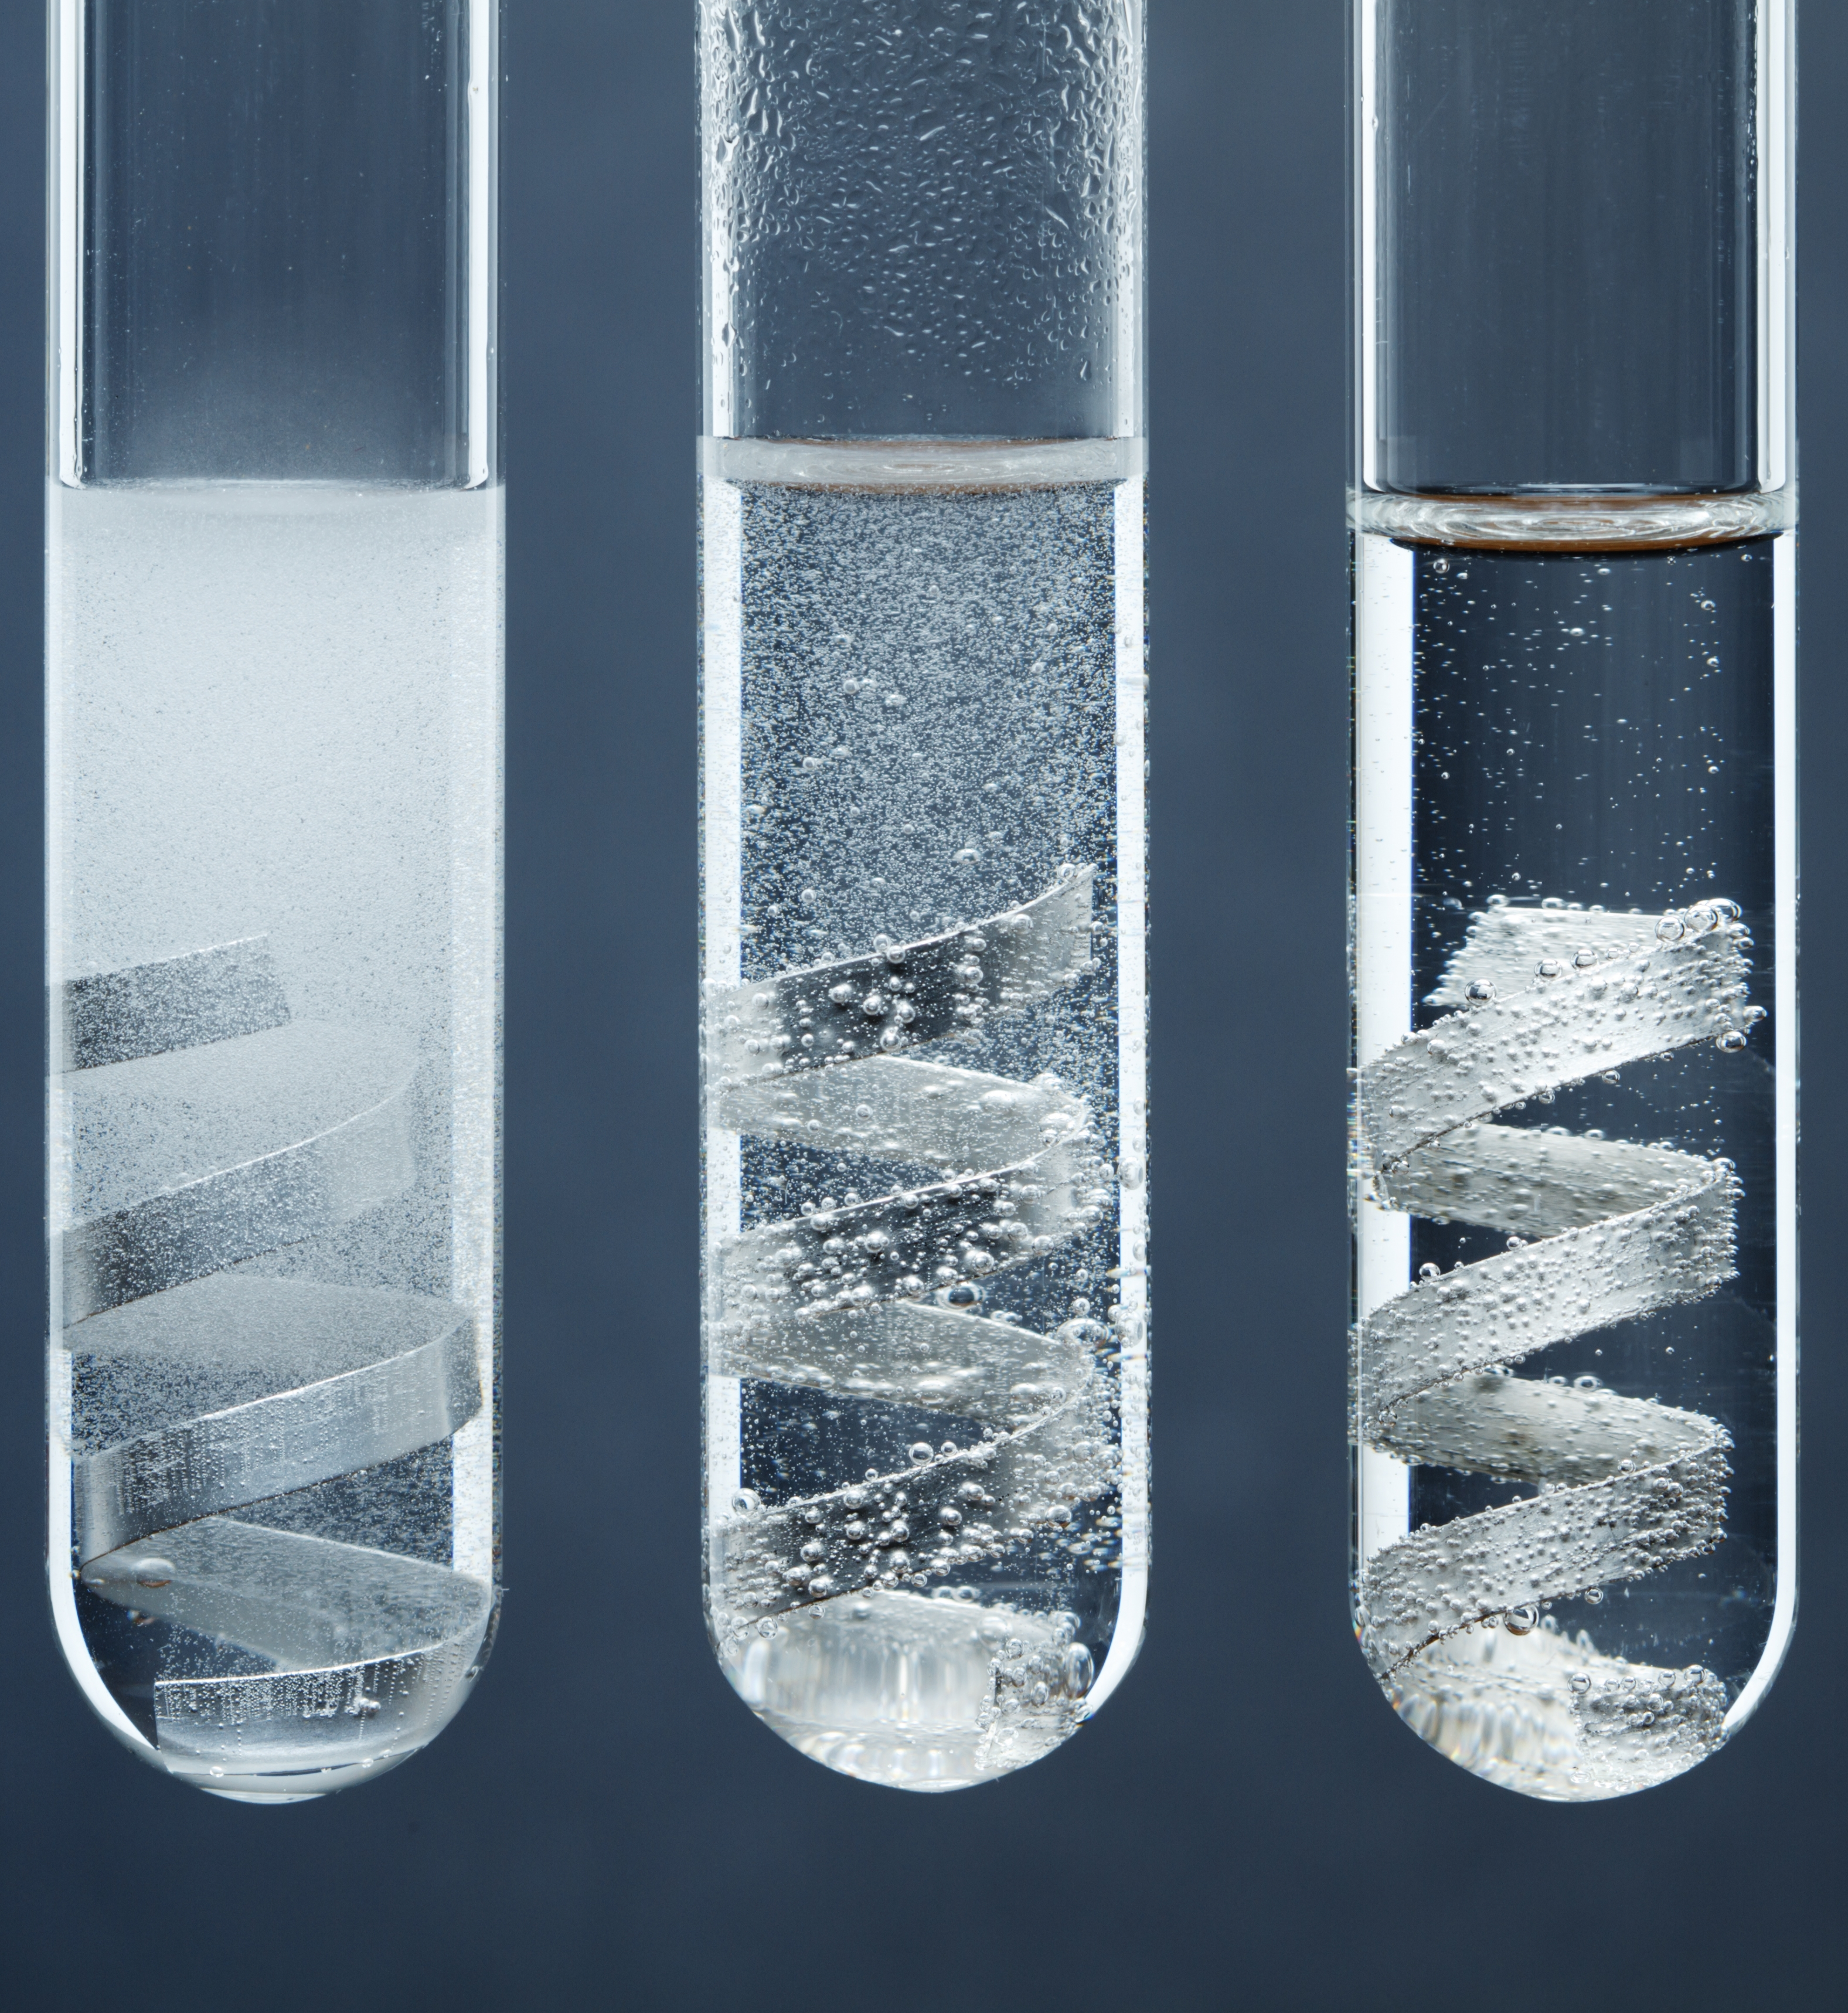
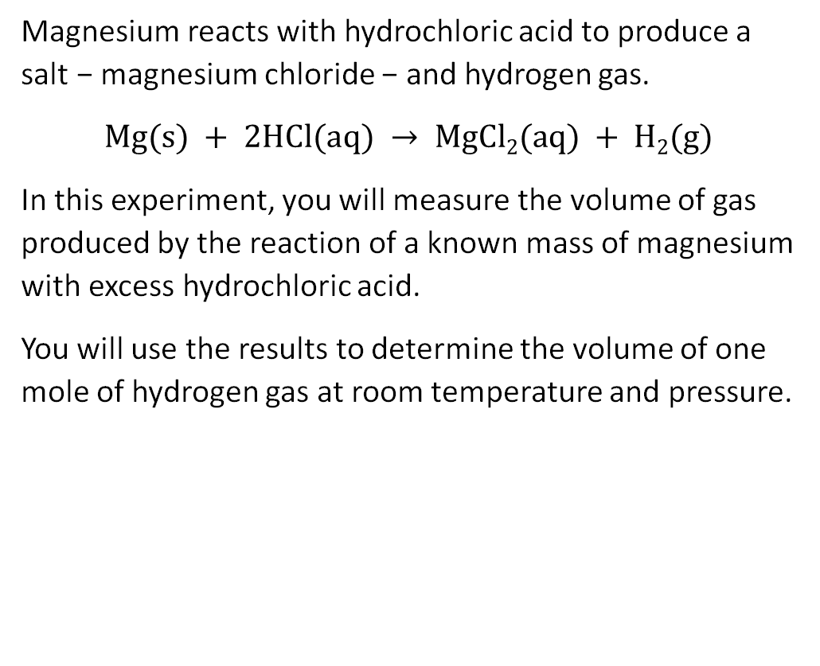
Introduction
Introduction
Magnesium reacts with hydrochloric acid to produce a salt − magnesium chloride − and hydrogen gas.
$$Mg(s) + 2HCl(aq) → MgCl2(aq) + H2(g)$$
In this experiment, you will measure the volume of gas produced by the reaction of a known mass of magnesium with excess hydrochloric acid.
You will use the results to determine the volume of one mole of hydrogen gas at room temperature and pressure.
© Science Photo Library

Slide 4
Learning objectives
Learning objectives
1 Measure the volume of hydrogen gas produced by a metal−acid reaction.
2 Analyse the results to determine the volume of one mole of a gas.
3 Evaluate the accuracy of the result obtained.

Slide 5
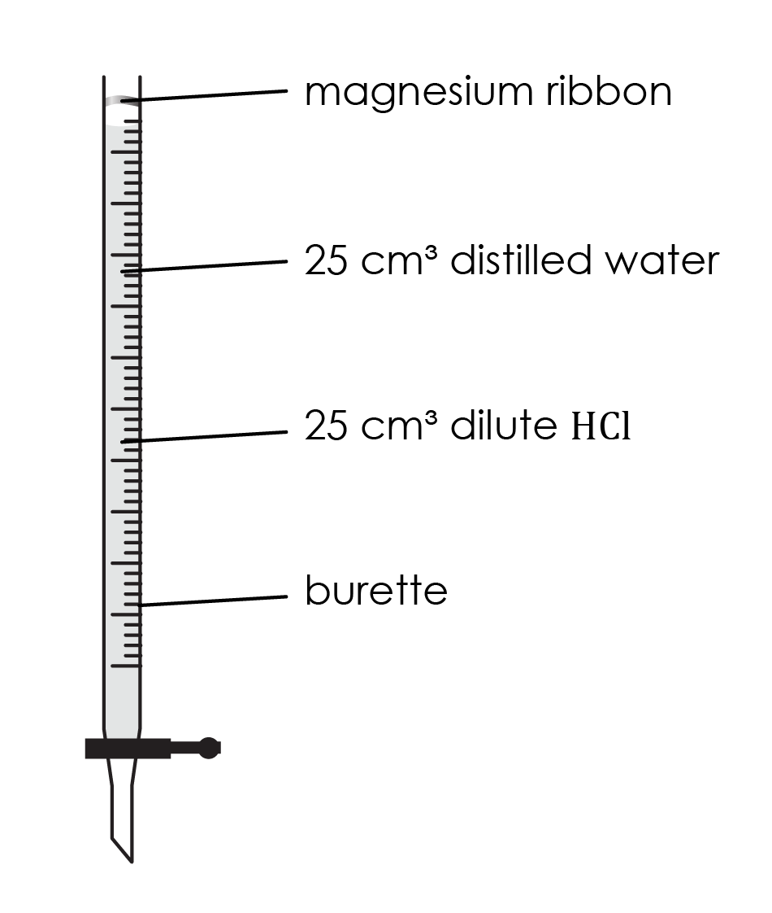
Method
Method
Clean a piece of magnesium ribbon about 3.5 cm long by gently rubbing it with emery paper and measure its mass accurately. It should have a mass between 0.02 g and 0.04 g. If not, adjust the amount used.
Measure 25 cm³ of 2.0 mol/dm³ hydrochloric acid into the burette. Slightly tilt the burette and carefully add 25 cm³ of water on top of the acid by running the water down the inside of the burette. Try not to disturb the acid layer.
Push the magnesium into the end of the burette so it will stay in position with its own tension.

Slide 6
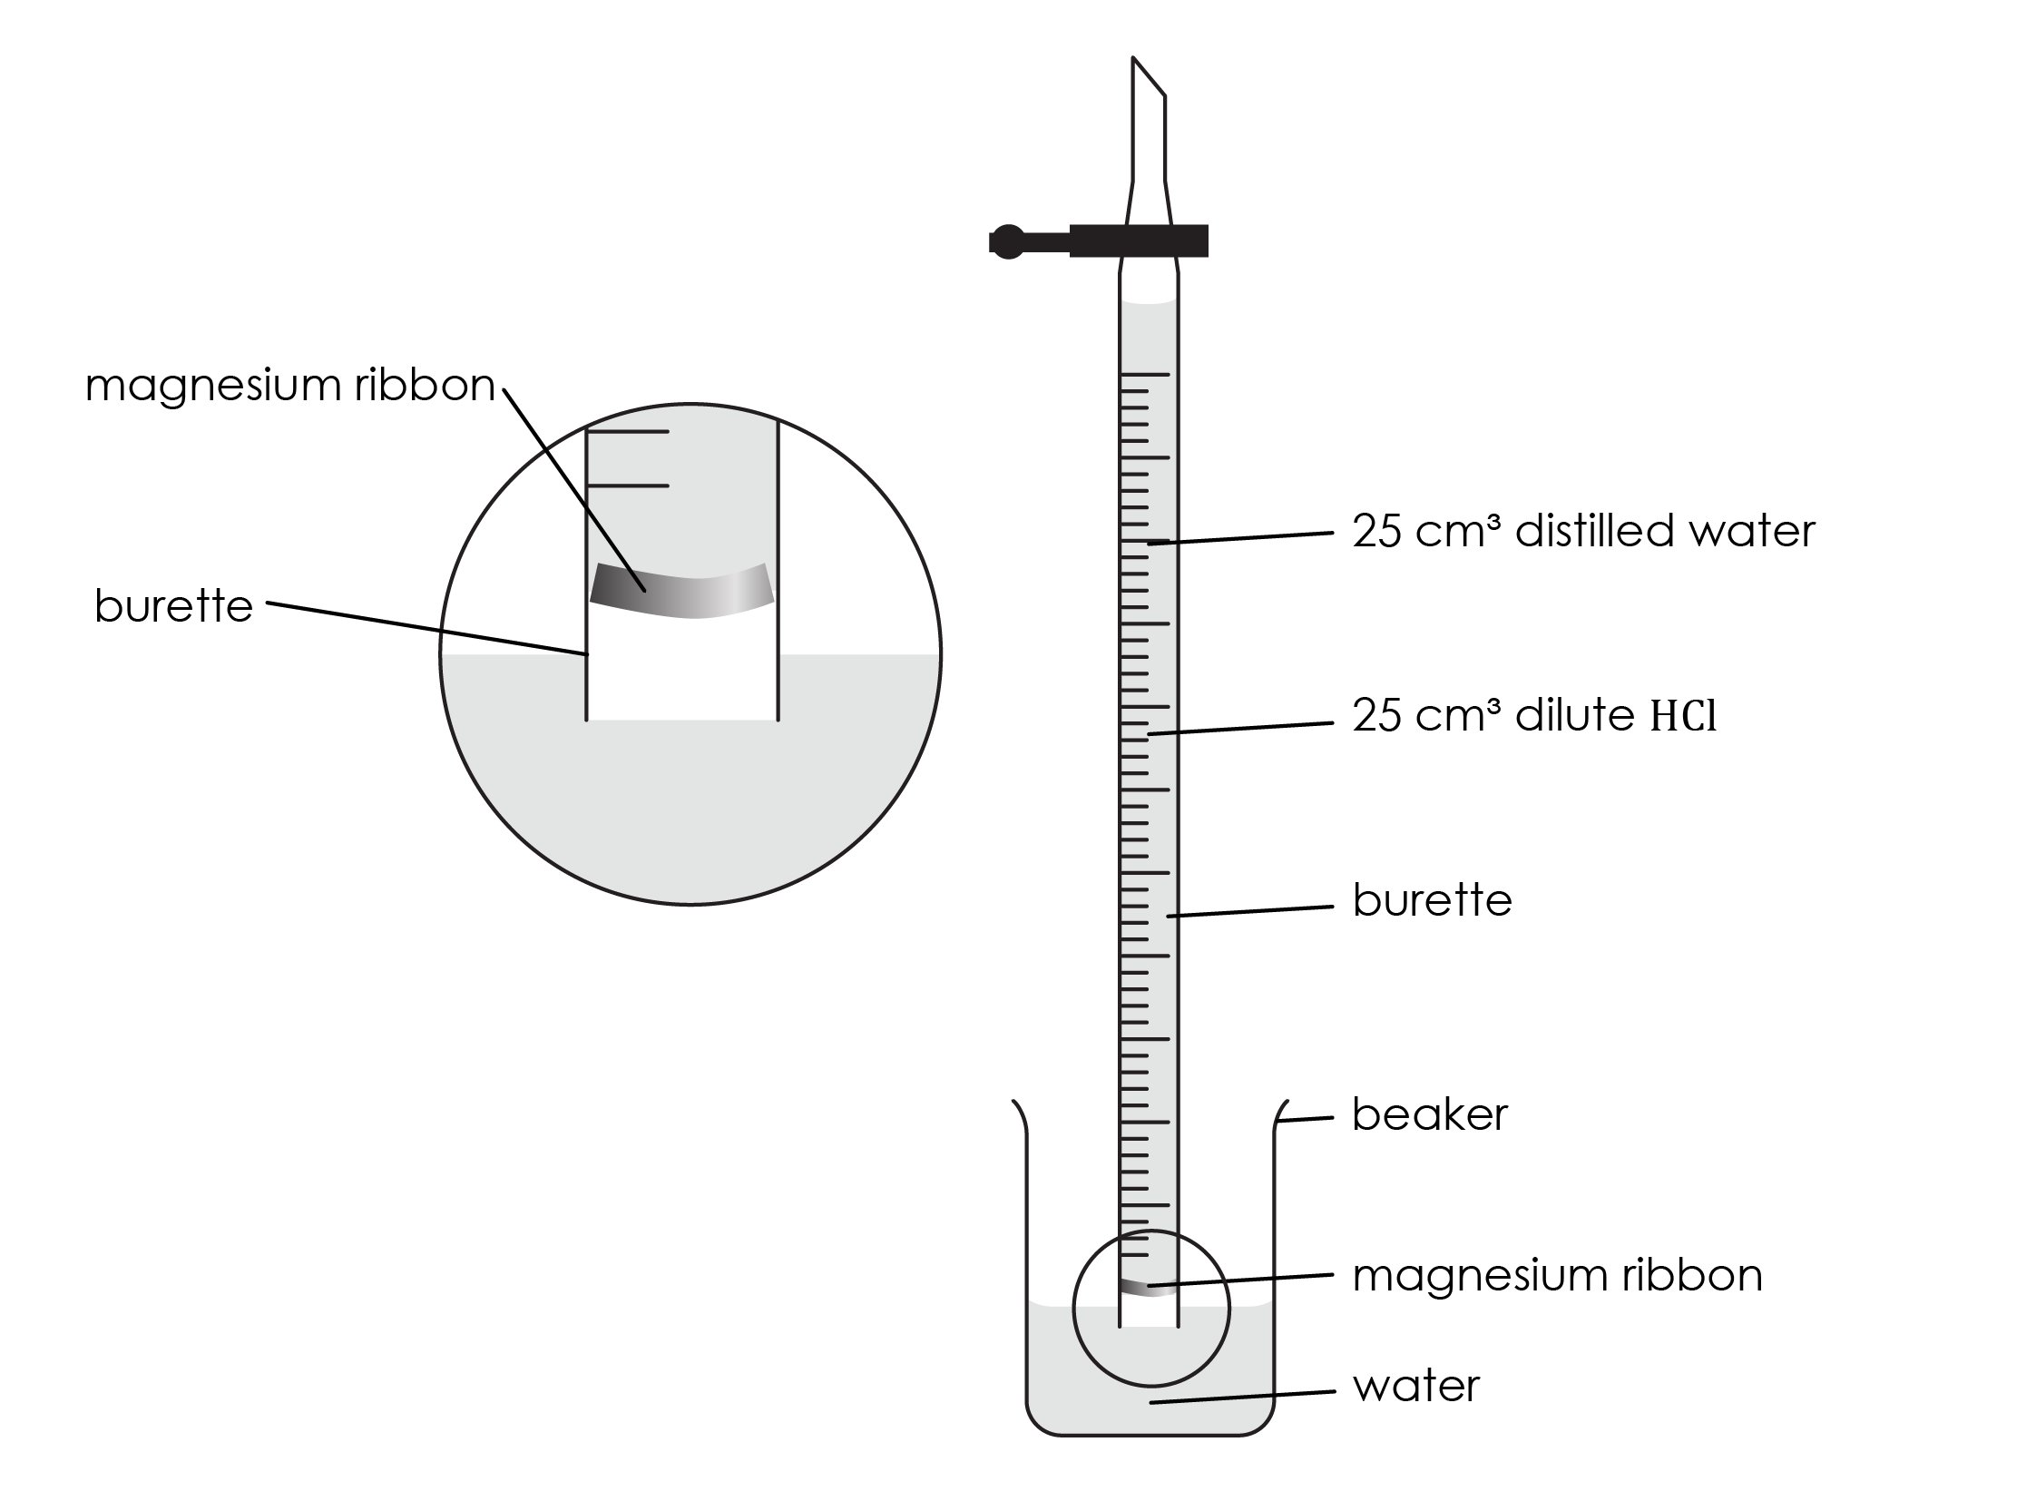
Method continued
Add 50 cm³ of water to a 250 cm³ beaker.
Quickly invert the burette into the water – your teacher will show you how to do this. If this is done quickly and carefully, very little liquid is lost. Clamp the burette vertically.
It is important that the liquid level in the burette starts on the graduated scale. If it is not on the scale, momentarily open the tap. This allows the level to drop.
Take the burette reading (Remember: the burette is upside down).
Observe the magnesium reacting as the acid diffuses downwards. Wait until all the magnesium has reacted.
Record the new volume in the burette (care: the burette is upside down).
Method

Slide 7


Results and analysis
Results and analysis
Mass of magnesium ribbon used (g) | ______________
Initial burette reading (cm³) | ______________
Final burette reading (cm³) | ______________
Volume of hydrogen produced (cm³) | ______________
Use your results to calculate the volume of one mole of hydrogen gas under the conditions used.

Slide 8

Results and analysis
Results and analysis
A | Mass of magnesium ribbon used / g
B | Initial burette reading / cm³
C | Final burette reading / cm³
D | Volume of hydrogen produced / cm³ | B – C =
Complete the results table by calculating the volume of hydrogen produced. This is the difference between the two burette readings.

Slide 9
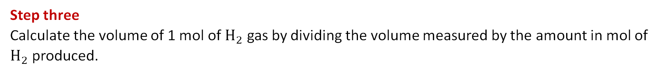
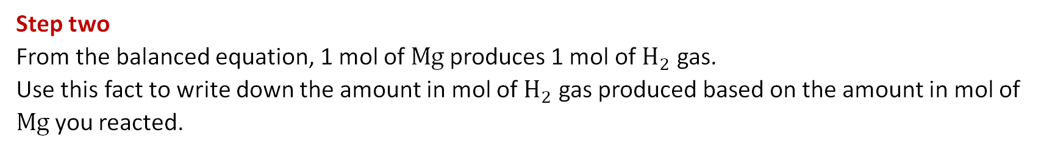

Results and analysis
Results and analysis
Follow the steps to determine the volume of one mole of hydrogen.
Step one
Calculate the amount in mol of Mg reacted.
Relative atomic mass (RAM) of Mg = 24
$$mol = \frac{mass in g}{RAM}$$
Step two
From the balanced equation, 1 mol of Mg produces 1 mol of $H_{2}$ gas.
Use this fact to write down the amount in mol of $H_{2}$ gas produced based on the amount in mol of Mg you reacted.
Step three
Calculate the volume of 1 mol of $H_{2}$ gas by dividing the volume measured by the amount in mol of $H_{2}$ produced.
$$volume of 1 mol of H2 in cm3 = \frac{volume measured in cm3}{amount of H2 produced in mol}$$

Slide 10
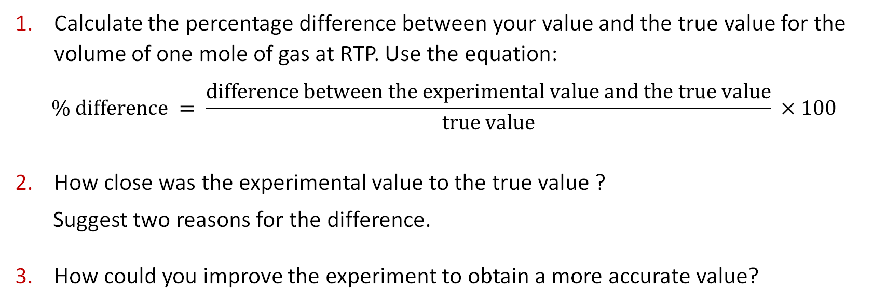
Evaluation /
Evaluation
Calculate the percentage difference between your value and the true value for the volume of one mole of gas at RTP. Use the equation:
$$\% difference = \frac{difference between the experimental value and the true value}{true value} ×100$$
How close was the experimental value to the true value ?
Suggest two reasons for the difference.
How could you improve the experiment to obtain a more accurate value?

Slide 11
Further questions
Further questions
Answer the following questions about the method used.
4. Why was 25 cm³ of water added on top of the 2 mol/dm³ hydrochloric acid in the burette?
5. A student missed the instruction to take care not to disturb the acid layer in step 2 and mixed the acid and water prior to inverting the burette. Describe what impact would this have on the outcome of the experiment.
6. Explain why it was important to use between 0.02 g and 0.04 g of magnesium ribbon.

Slide 12
Further questions
Further questions
Answer the following questions about the method used.
4. Why was 25 cm³ of water added on top of the 2 mol/dm³ hydrochloric acid in the burette?
5. Show by calculation that the hydrochloric acid was in excess.
6. A student missed the instruction to take care not to disturb the acid layer in step 2 and mixed the acid and water prior to inverting the burette. Describe what impact would this have on the outcome of the experiment.
7. Explain why it was important to use between 0.02 g and 0.04 g of magnesium ribbon.

Slide 13
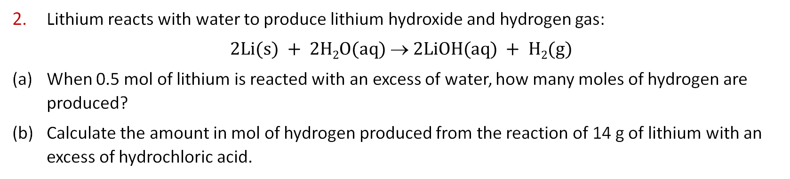
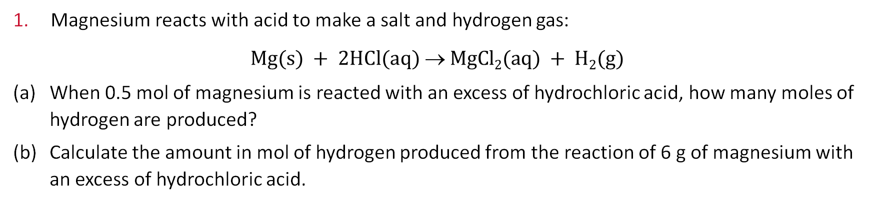
Practice calculations
Practice calculations
Magnesium reacts with acid to make a salt and hydrogen gas:
$$Mg(s) + 2HCl(aq)  MgCl2(aq) + H2(g)$$
(a) When 0.5 mol of magnesium is reacted with an excess of hydrochloric acid, how many moles of hydrogen are produced?
(b) Calculate the amount in mol of hydrogen produced from the reaction of 6 g of magnesium with an excess of hydrochloric acid.
2. Lithium reacts with water to produce lithium hydroxide and hydrogen gas:
$$2Li(s) + 2H2O(aq)  2LiOH(aq) + H2(g)$$
(a) When 0.5 mol of lithium is reacted with an excess of water, how many moles of hydrogen are produced?
(b) Calculate the amount in mol of hydrogen produced from the reaction of 14 g of lithium with an excess of hydrochloric acid.
3. If 0.05 mol of gas has a volume of 1,200 cm³ at room temperature and pressure, show by calculation that the volume of 1 mol of gas is 24,000 cm³.

Slide 14
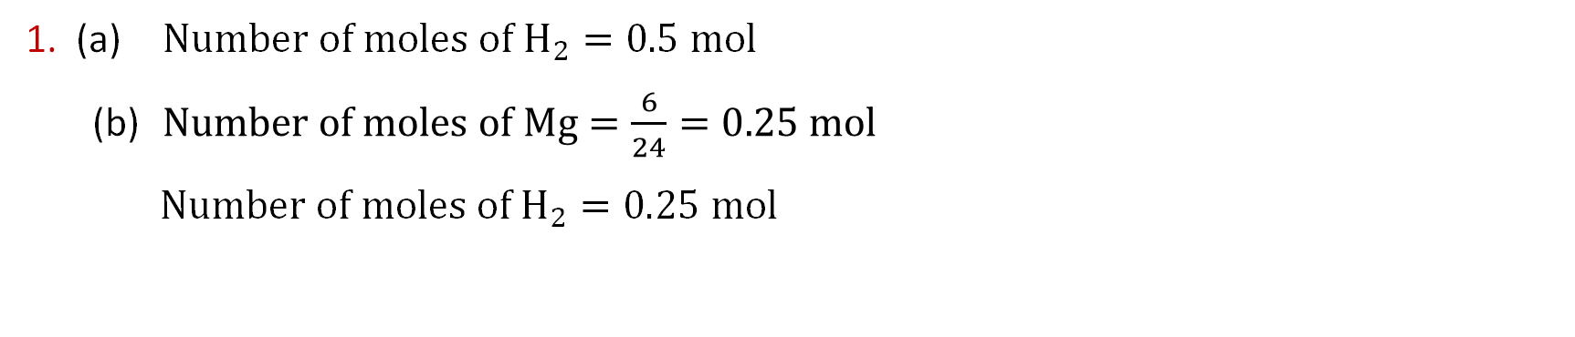
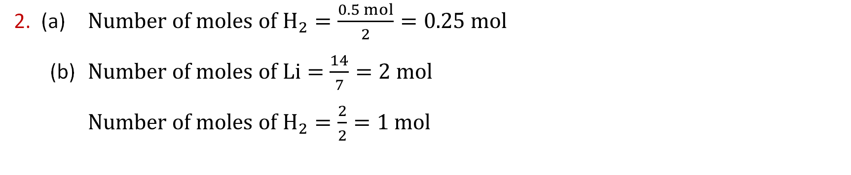
Practice calculations − answers
Practice calculations − answers
1. (a) $Number of moles of H_{2}=0.5 mol$
(b) $Number of moles of Mg=\frac{6}{24}=0.25 mol$
$Number of moles of H_{2}=0.25 mol$
2. (a) $Number of moles of H_{2}=\frac{0.5 mol}{2}=0.25 mol$
(b) $Number of moles of Li=\frac{14}{7}=2 mol$
$Number of moles of H_{2}=\frac{2}{2}=1 mol$
3. $Volume of 1 mol of gas=\frac{1,200 {cm}^{3}}{0.05 mol}=24,000 {cm}^{3}$

Slide 15
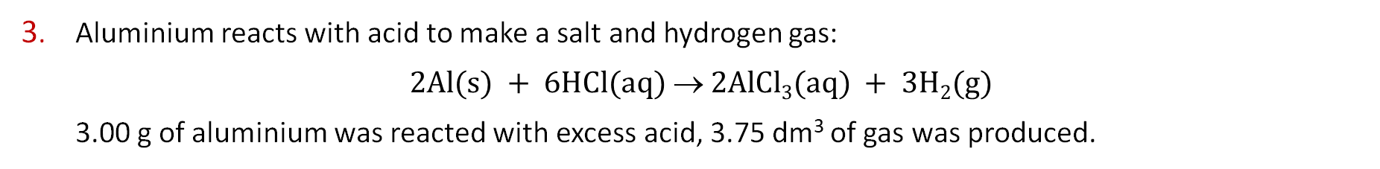
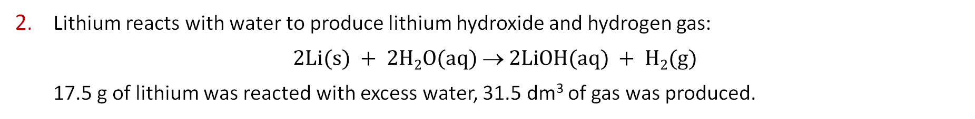
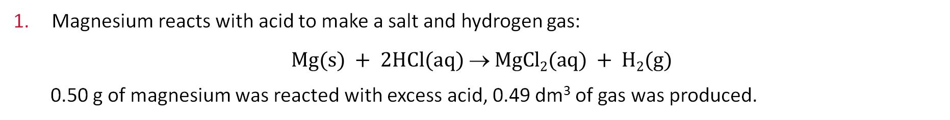
Practice calculations
Practice calculations
In each case, calculate the volume of one mole of gas based on the experimental results.
Magnesium reacts with acid to make a salt and hydrogen gas:
$$Mg(s) + 2HCl(aq)  MgCl2(aq) + H2(g)$$
0.50 g of magnesium was reacted with excess acid, 0.49 dm³ of gas was produced.
2. Lithium reacts with water to produce lithium hydroxide and hydrogen gas:
$$2Li(s) + 2H2O(aq)  2LiOH(aq) + H2(g)$$
17.5 g of lithium was reacted with excess water, 31.5 dm³ of gas was produced.
3. Aluminium reacts with acid to make a salt and hydrogen gas:
$$2Al(s) + 6HCl(aq)  2AlCl3(aq) + 3H2(g)$$
3.00 g of aluminium was reacted with excess acid, 3.75 dm³ of gas was produced.

Slide 16
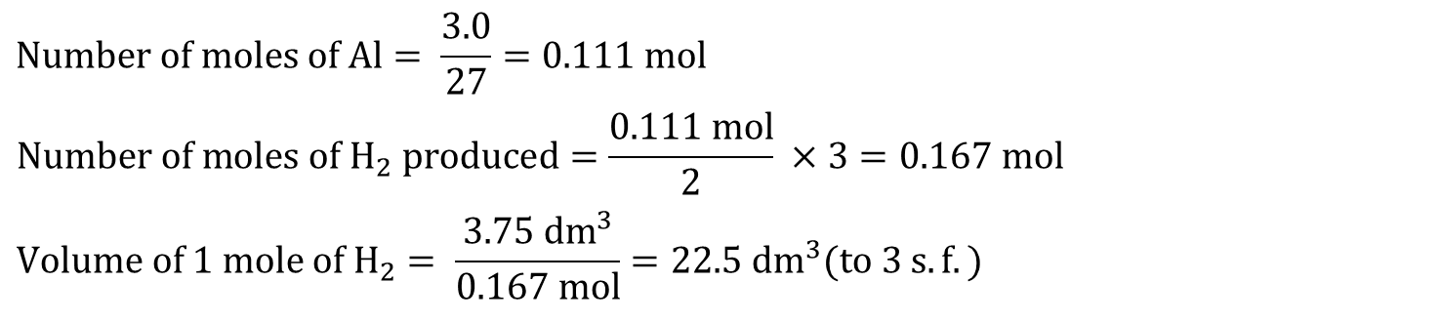
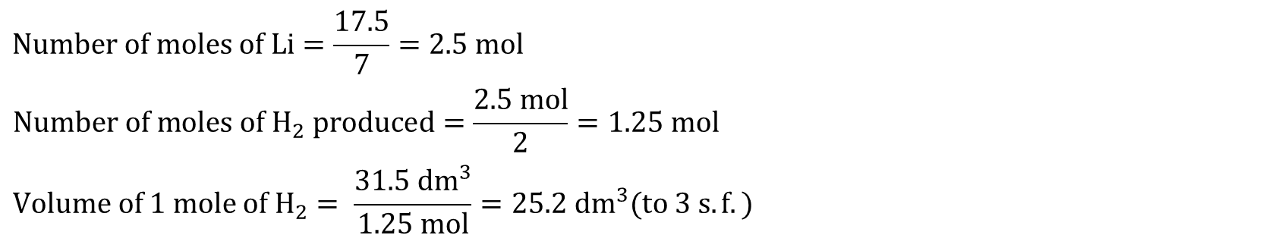
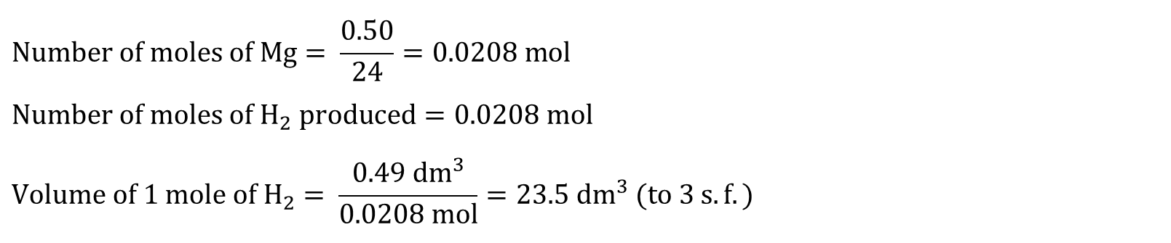
Practice calculations − answers
Practice calculations − answers
$$Number of moles of Mg= \frac{0.50}{24}=0.0208 mol$$
$$Number of moles of H_{2} produced=0.0208 mol$$
$$Volume of 1 mole of H_{2}= \frac{0.49 {dm}^{3}}{0.0208 mol}=23.5 {dm}^{3} (to 3 s.f.)$$
$$Number of moles of Li=\frac{17.5}{7}=2.5 mol$$
$$Number of moles of H_{2} produced=\frac{2.5 mol}{2}=1.25 mol$$
$$Volume of 1 mole of H_{2}= \frac{31.5 {dm}^{3}}{1.25 mol}=25.2 {dm}^{3}(to 3 s.f.)$$
$$Number of moles of Al= \frac{3.0}{27}=0.111 mol$$
$$Number of moles of H_{2} produced=\frac{0.111 mol}{2} ×3=0.167 mol$$
$$Volume of 1 mole of H_{2}= \frac{3.75 {dm}^{3}}{0.167 mol}=22.5 {dm}^{3}(to 3 s.f.)$$

