Slide 1

Stage 1
Algebra and equations
Downloaded from: rsc.li/4wqEoi

Slide 2
Introduction
These activities use the same estimation and checking skills you have already practised in maths, but you will apply them to chemical situations.
You will learn to predict the missing results of reactions, write those reactions using words and symbols, and understand that mass never simply disappears, even when substances change completely (which might seem surprising at first).
Learning objectives
Make estimates of the results of simple calculations.
Recognise that mass is conserved during a chemical reaction.
Understand some of the common symbols used in word and symbol equations.
Introduction

Slide 3
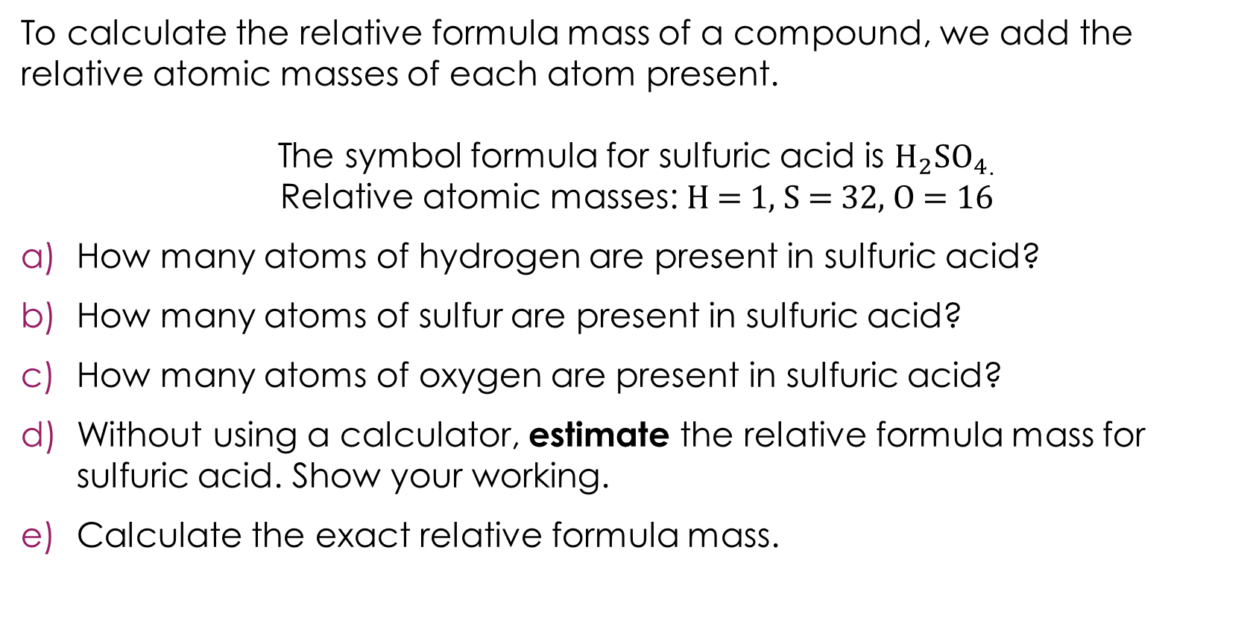
Round to 1 significant figure and estimate
To calculate the relative formula mass of a compound, we add the relative atomic masses of each atom present.
The symbol formula for sulfuric acid is $H_{2}{SO}_{4}$.
Relative atomic masses: H = 1, S = 32, O = 16
How many atoms of hydrogen are present in sulfuric acid?
How many atoms of sulfur are present in sulfuric acid?
How many atoms of oxygen are present in sulfuric acid?
Without using a calculator, estimate the relative formula mass for sulfuric acid. Show your working.
Calculate the exact relative formula mass.
Activity
Notes:
Check that learners understand how to calculate relative formula mass before revealing the question. Use a different example such as water: H = 1 and O = 16, so the relative formula mass is 18. If we estimated this it would be 2 + 20 = 22.

Slide 4
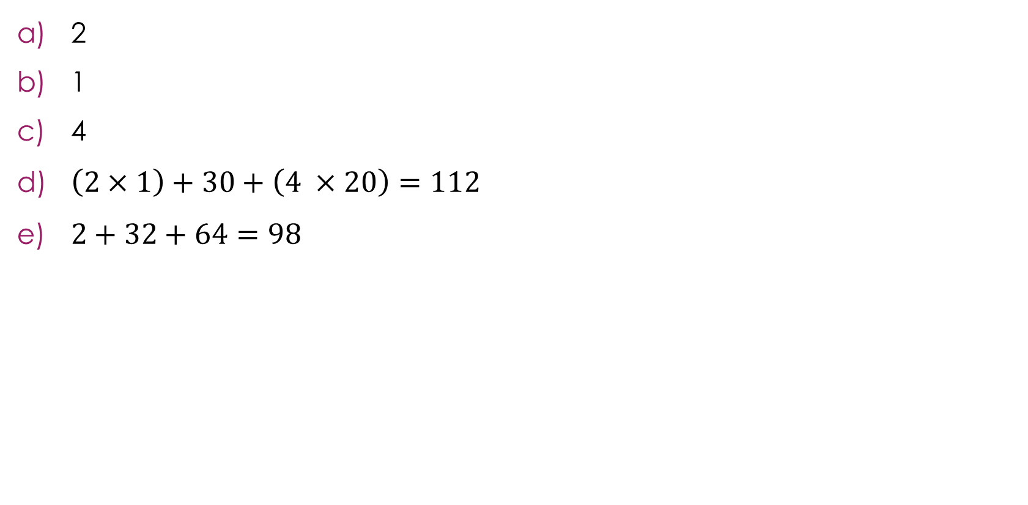
Round to 1 significant figure and estimate – answers
2
1
4
$\left(2×1\right)+30+\left(4 ×20\right)=112$
$2+32+64=98$
Answers

Slide 5
Reactants and products
Hydrochloric acid reacts with sodium hydroxide to produce sodium chloride and water.
Write a word equation for this reaction.
A learner measured the masses of the reactants and products. Here are the results:
Calculate the mass of water produced. Show your working.
Which law did you use to find the missing mass of water?
Activity
Substance | Mass (g)
hydrochloric acid (reactant) | 36.5
sodium hydroxide (reactant) | 40.0
sodium chloride (product) | 58.5
water (product) | ?
Notes:
Give learners sufficient time to read and complete the question independently.

Slide 6
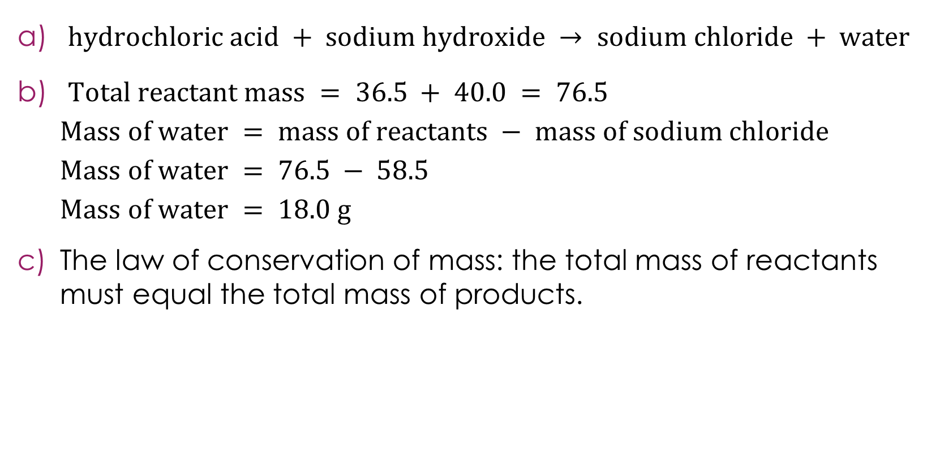
Reactants and products - answers
$hydrochloric acid + sodium hydroxide → sodium chloride + water$
$Total reactant mass = 36.5 + 40.0 = 76.5$
$$Mass of water = mass of reactants − mass of sodium chloride$$
$$Mass of water = 76.5 − 58.5$$
$$Mass of water = 18.0 g$$
The law of conservation of mass: the total mass of reactants must equal the total mass of products.
Anwers
Notes:
Ask learners if this is correct: $sodium hydroxide + hydrochloric acid → water + sodium chloride,$to check they understand that it is the reactants being on the left and products being on the right that are important rather than the order. Ask learners why it is incorrect to use an equals sign rather than an arrow. They should know that the arrow represents the direction the reaction proceeds and that a transformation has occurred. The atoms are rearranged to make new products so things cannot be equal.

Slide 7
Where did the extra mass come from?
A learner heats magnesium ribbon in an open container. The magnesium reacts with oxygen from the air.
Write a word equation for this reaction
The learner thinks that they have made a mistake in their experiment because the mass of the product is greater than the mass of the reactants.
Explain to the learner why this is not a mistake.
Substance | Mass (g)
Magnesium ribbon | 3.6
Magnesium oxide | 6.0
Activity
Notes:
This question tests the less commonly taught direction of apparent mass increase. Learners who have only seen the gas-escaping scenario often assume an experimental error here. Some learners correctly identify that oxygen is involved, but still say mass is not conserved because they think gases have no mass.

Slide 8
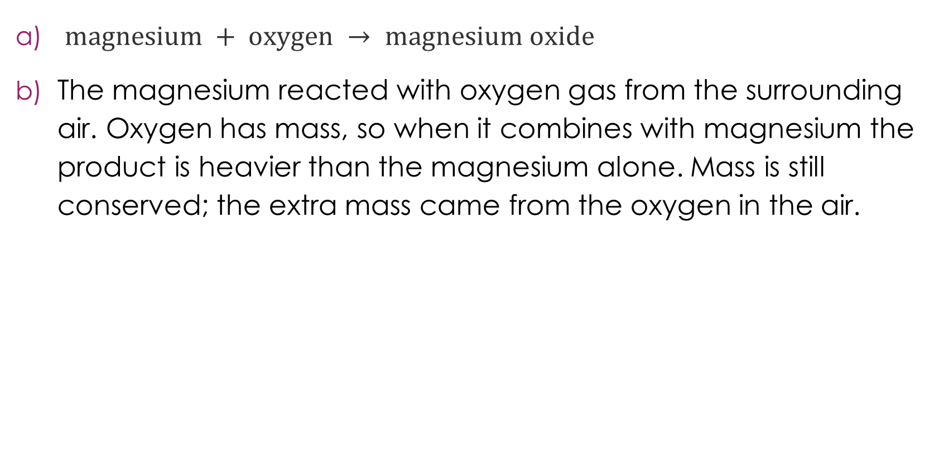
Where did the extra mass come from? Answers
$magnesium + oxygen → magnesium oxide$
The magnesium reacted with oxygen gas from the surrounding air. Oxygen has mass, so when it combines with magnesium the product is heavier than the magnesium alone. Mass is still conserved; the extra mass came from the oxygen in the air.
Answers
Notes:
We would not normally write magnesium ribbon in the same way we do not write oxygen gas. Later in their studies, learners will learn about state symbols. This has not been included here because the focus is on being able to write a word equation. Introduce the state symbols if you feel learners are ready for this.

Slide 9
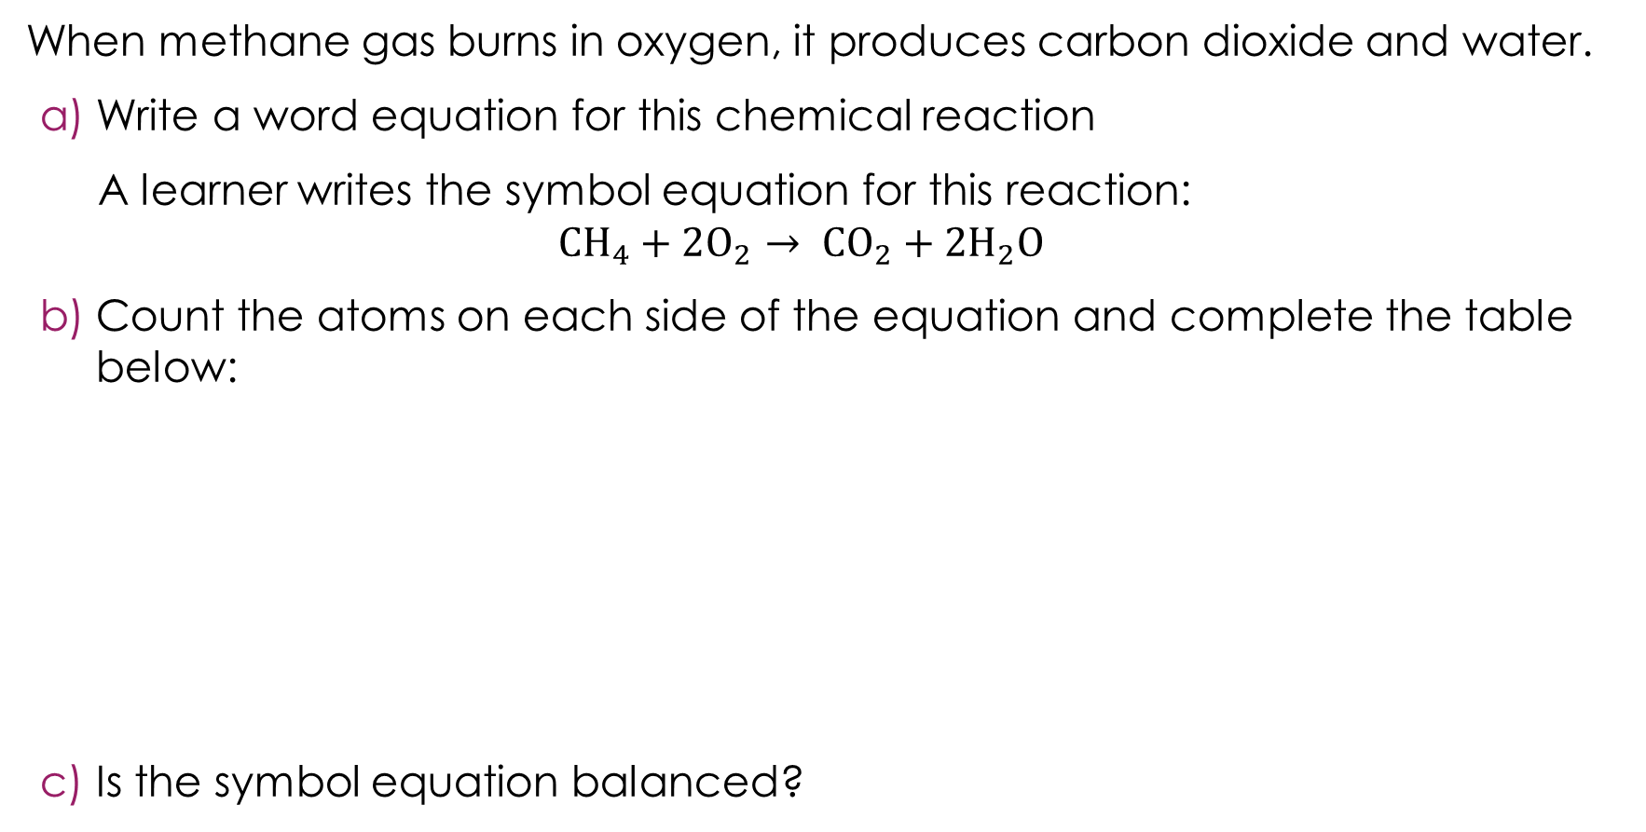
Using a table to count atoms
When methane gas burns in oxygen, it produces carbon dioxide and water.
Write a word equation for this chemical reaction
A learner writes the symbol equation for this reaction:
$${CH}_{4}+2O_{2}→ {CO}_{2}+2H_{2}O$$
Count the atoms on each side of the equation and complete the table below:
Is the symbol equation balanced?
Activity
Element | Number of atoms on the left side | Number of atoms on the right side
C
H
O
Notes:
Remind learners what the subscript and the coefficient numbers mean before they independently complete the question.

Slide 10
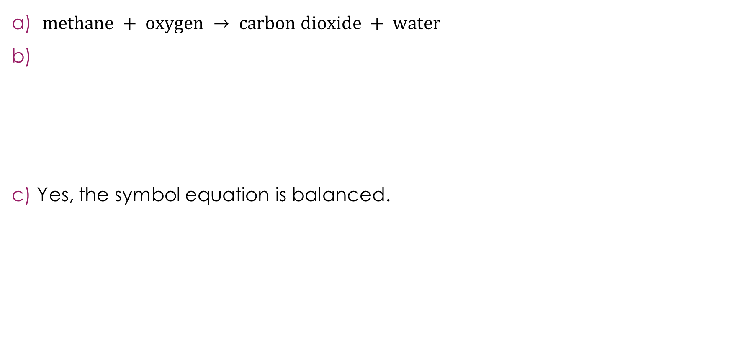
Using a table to count atoms – answers
$methane + oxygen → carbon dioxide + water$
Yes, the symbol equation is balanced.
Element | Number of atoms on the left side | Number of atoms on the right side
C | 1 | 1
H | 4 | 4
O | 4 | 4
Answers

Slide 11
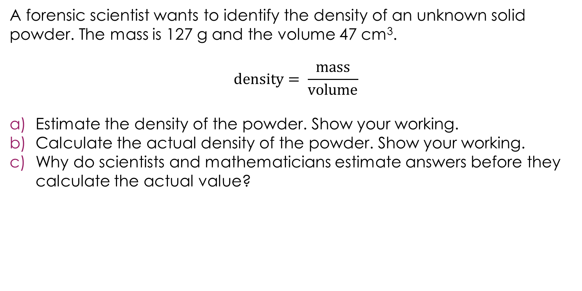
Estimating density
A forensic scientist wants to identify the density of an unknown solid powder. The mass is 127 g and the volume 47 cm³.
$$density= \frac{mass}{volume}$$
Estimate the density of the powder. Show your working.
Calculate the actual density of the powder. Show your working.
Why do scientists and mathematicians estimate answers before they calculate the actual value?
Activity

Slide 12
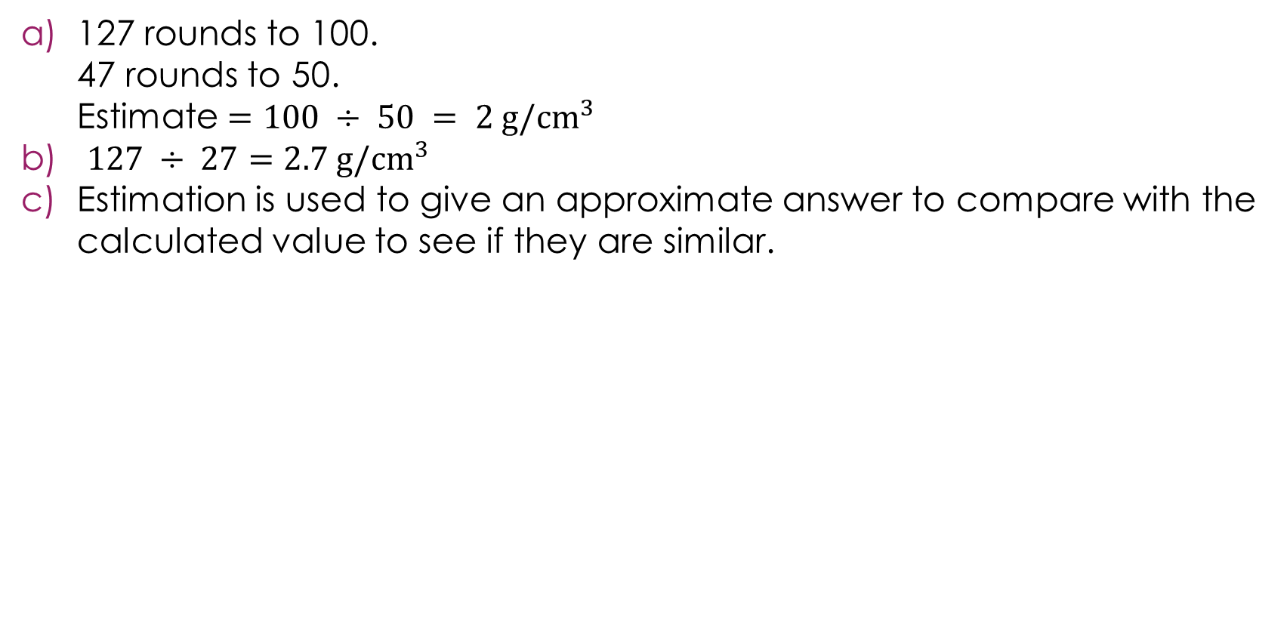
Estimating density – answers
127 rounds to 100.
47 rounds to 50.
Estimate $=100 ÷ 50 = 2 {g/cm}^{3}$
${127 ÷ 27=2.7 g/cm}^{3}$
Estimation is used to give an approximate answer to compare with the calculated value to see if they are similar.
Answers

Slide 13
Symbols in chemistry 1
Complete the table by selecting the correct symbol from the box.
Not all these symbols will be used.
Fe Pb Na Ag Cu C Co S Si I
Activity
Element | Symbol
Sodium
Iron
Copper
Lead
Silver
Carbon
Cobalt
Notes:
Give learners access to a periodic table to help them, if required: e.g. https://periodic-table.rsc.org/

Slide 14
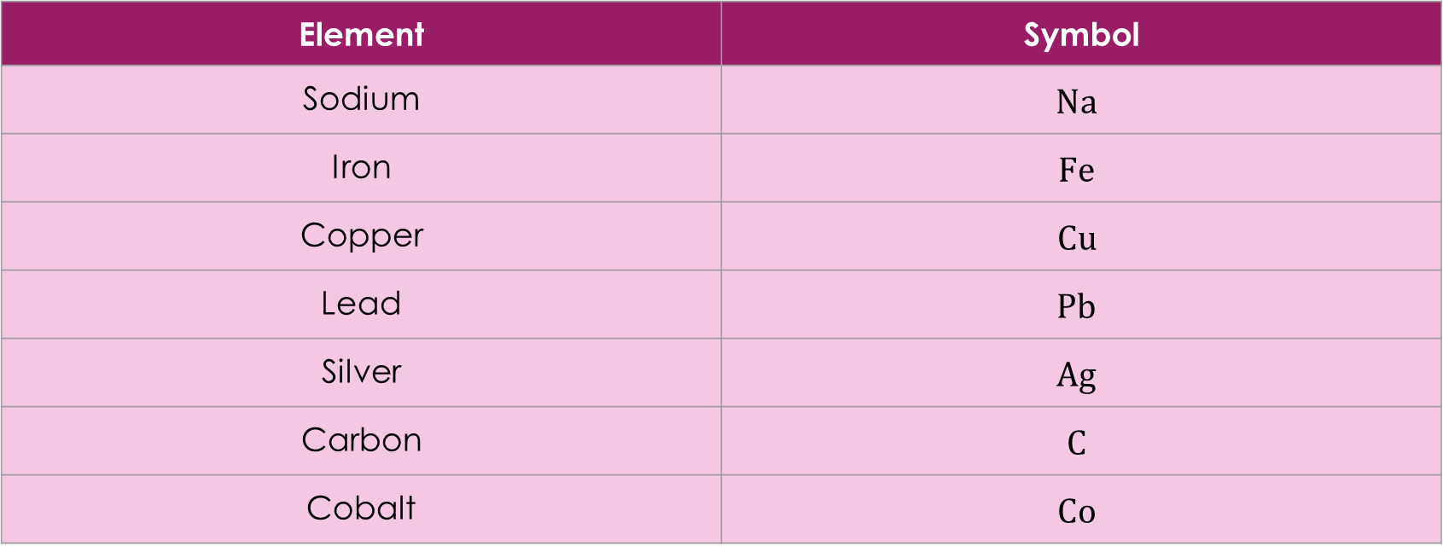
Symbols in chemistry 1 - answers
Element | Symbol
Sodium | $$Na$$
Iron | $$Fe$$
Copper | $$Cu$$
Lead | $$Pb$$
Silver | $$Ag$$
Carbon | $$C$$
Cobalt | $$Co$$
Activity

Slide 15
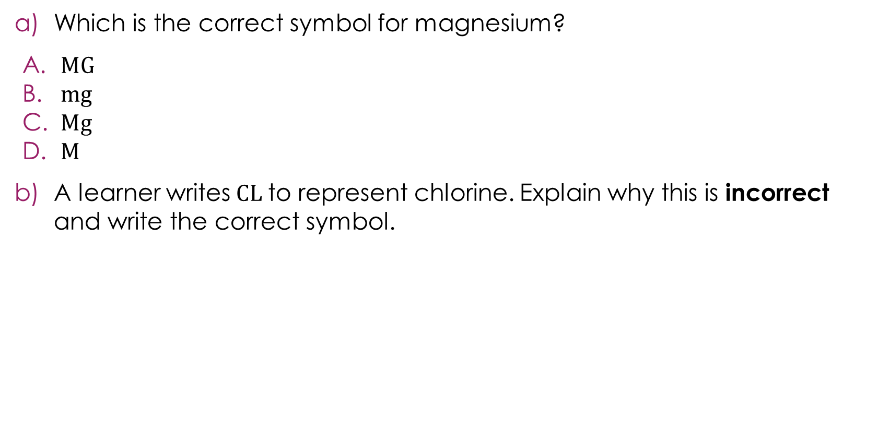
Symbols in chemistry 2
Which is the correct symbol for magnesium?
$MG$
$mg$
$Mg$
M
A learner writes$CL$to represent chlorine. Explain why this is incorrect and write the correct symbol.
Activity

Slide 16
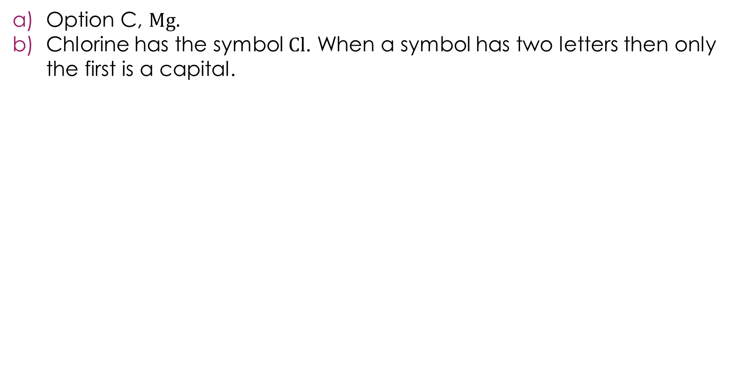
Symbols in chemistry 2 – answers
Option C, $Mg.$
Chlorine has the symbol $Cl$. When a symbol has two letters then only the first is a capital.
Answers

Slide 17
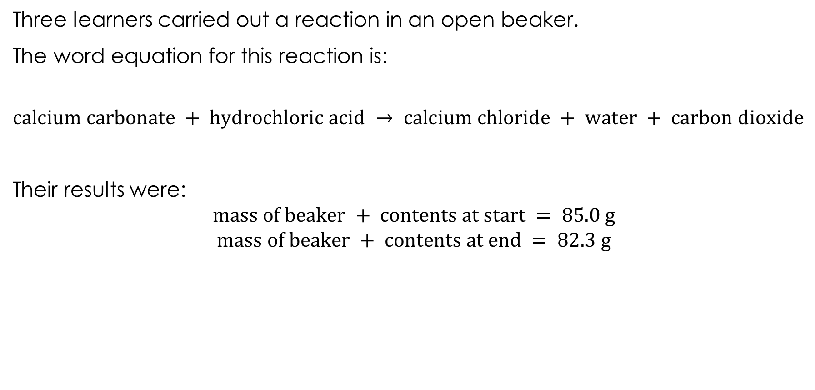
Discussing conservation of mass
Three learners carried out a reaction in an open beaker.
The word equation for this reaction is:
$$calcium carbonate + hydrochloric acid → calcium chloride + water + carbon dioxide$$
Their results were:
$$mass of beaker + contents at start = 85.0 g$$
$$mass of beaker + contents at end = 82.3 g$$
Activity
Notes:
This slide gives context, see the next slides for the learner question.

Slide 18
Discussing conservation of mass
Their teacher asked the learners to explain their results using the law of conservation of mass.
Which learner gave the best explanation? Explain why the other two learners were wrong.
Learner C
Learner A
Learner B
Activity
The law has not been broken. The missing mass has turned into energy when the chemicals reacted.
The law has been broken. The mass decreased by 2.7 g, so some atoms have been destroyed in the reaction.
The law has not been broken. The missing 2.7 g left the beaker as carbon dioxide gas.

Slide 19
Discussing conservation of mass – answer
Learner B is correct.
Learner A is wrong because atoms are never destroyed in a chemical reaction, they are rearranged. The mass did not disappear as it left the beaker as carbon dioxide gas.
Learner C is wrong because the missing mass did not turn into energy. Mass is always conserved in chemical reactions. The 2.7 g left the beaker as carbon dioxide gas.
Learner B
Answer
The law has not been broken. The missing 2.7 g left the beaker as carbon dioxide gas.

