Slide 1

Stage 2
Algebra and equations
Downloaded from: rsc.li/4wqEoip

Slide 2
Introduction
In maths, you have learned how to substitute values into equations and solve for unknowns. In chemistry, we use the same algebra – with formulas for quantities like concentration, density and moles. This session builds on those maths skills and applies them to chemical calculations.
Learning objectives
Understand the algebra needed for balancing chemical equations.
Substitute numerical values into formulas and expressions using appropriate units.
Change the subject of an equation.
Solve for unknowns in chemical equations and stoichiometry problems.
Introduction

Slide 3
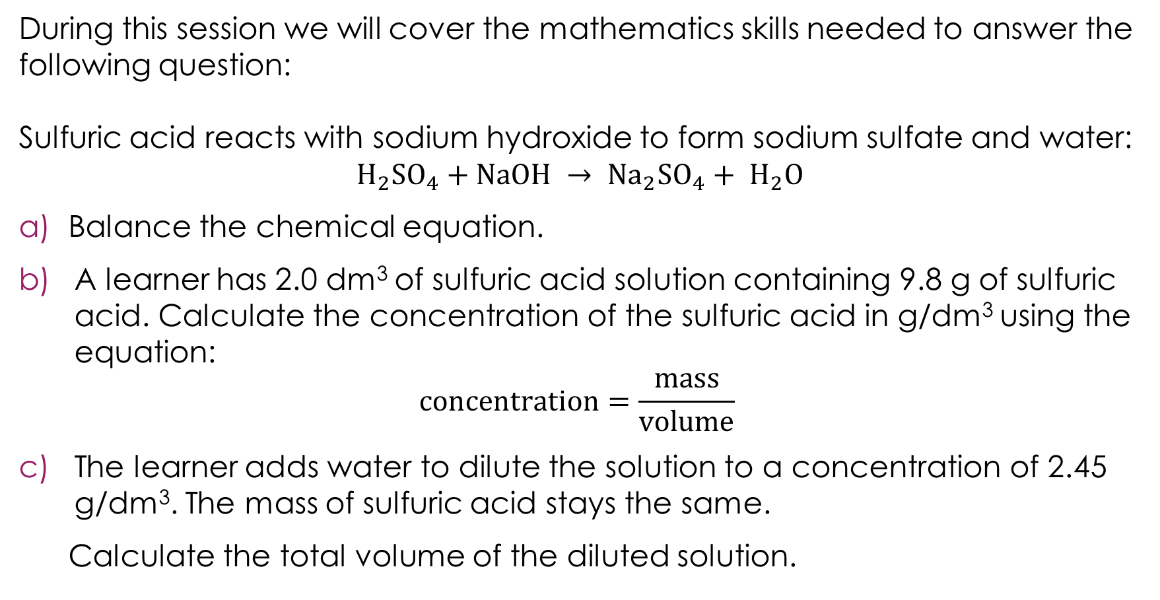
Lesson question
During this session we will cover the mathematics skills needed to answer the following question:
Sulfuric acid reacts with sodium hydroxide to form sodium sulfate and water:
$$H_{2}{SO}_{4}+NaOH → {Na}_{2}{SO}_{4}+ H_{2}O$$
Balance the chemical equation.
A learner has 2.0 dm³ of sulfuric acid solution containing 9.8 g of sulfuric acid. Calculate the concentration of the sulfuric acid in g/dm³ using the equation:
$$concentration=\frac{mass}{volume}$$
The learner adds water to dilute the solution to a concentration of 2.45 g/dm³. The mass of sulfuric acid stays the same.
Calculate the total volume of the diluted solution.
Lesson question
Notes:
This slide introduces the challenge question that learners will return to at the end of the lesson. Learners are not expected to attempt it at this point.
Briefly talk through the scenario. The question combines three skills from the lesson:
Part (a): balancing a chemical equation.
Part (b): substituting values into a formula.
Part (c): rearranging a formula to find the unknown (making volume the subject).
Ask learners: what skills do you think you will need to answer this? This activates prior knowledge and helps learners identify what they already know and what they need to learn.

Slide 4
Learning from stage 1
Conservation of mass
In a chemical reaction, atoms are not created or destroyed − they are rearranged to form new substances. The total mass of the reactants equals the total mass of the products.
Balanced chemical equations
The number of atoms of each element must be the same on both sides of a chemical equation.
Quick check
10 g of calcium carbonate fully decomposes into calcium oxide and carbon dioxide. If the final mass of calcium oxide produced is 5.6 g, what is the mass of carbon dioxide?
Notes:
A brief recap of algebra and equations stage 1 content to activate prior knowledge.
Quick check answer: $10 –5.6=4.4 g$. This uses conservation of mass – the total mass of products must equal the total mass of reactants.
If learners struggle with this recap, then consider revisiting the stage 1 resource.

Slide 5
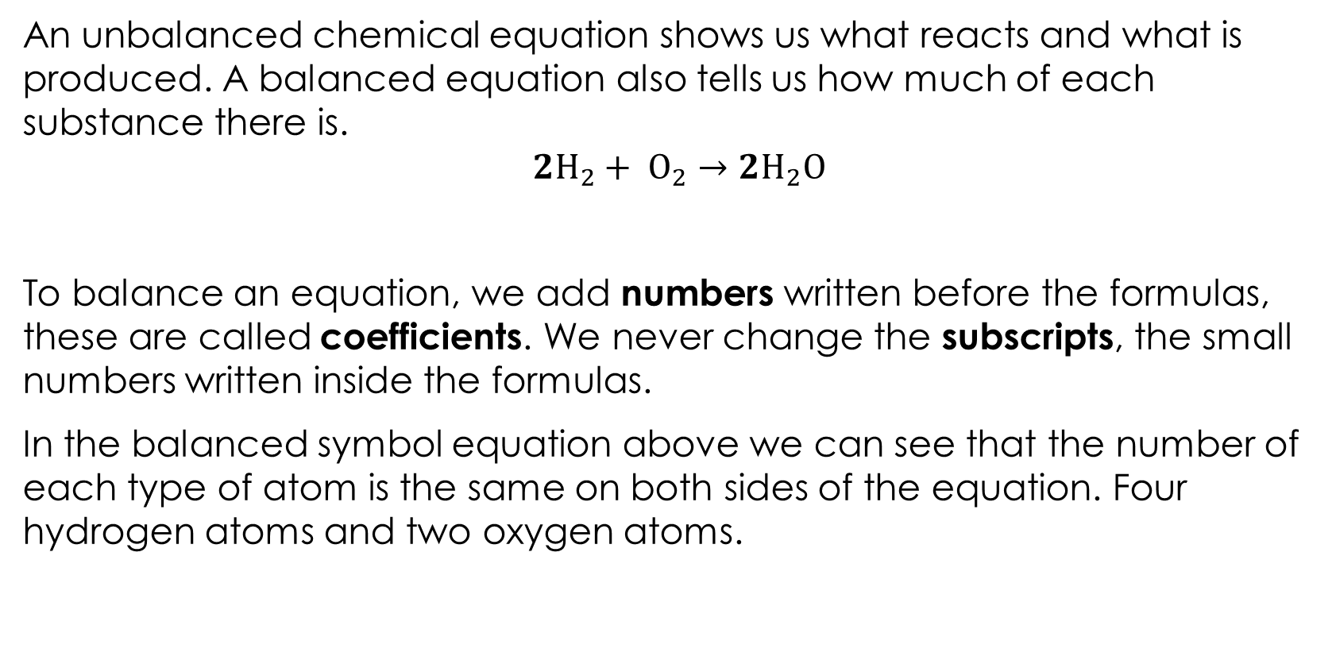
What does balancing mean?
An unbalanced chemical equation shows us what reacts and what is produced. A balanced equation also tells us how much of each substance there is.
$$2H_{2}+ O_{2}→2H_{2}O$$
To balance an equation, we add numbers written before the formulas, these are called coefficients. We never change the subscripts, the small numbers written inside the formulas.
In the balanced symbol equation above we can see that the number of each type of atom is the same on both sides of the equation. Four hydrogen atoms and two oxygen atoms.
Notes:
This slide introduces the difference between an unbalanced and a balanced equation. It also introduces the key vocabulary: coefficients and subscripts.
Explain that an unbalanced equation tells us what reacts and what is produced, but a balanced equation also tells us how much. Discuss why this matters – without knowing how much, we cannot calculate quantities in chemistry.
Remind learners that the subscript numbers written within the formulas tell us how many atoms of a particular element are in a single molecule. Use the example of $O_{2}$to illustrate this – the subscript $2$ tells us there are $2$ atoms of oxygen in $1$ molecule of oxygen.
Describe the difference between the unbalanced and balanced equation. Ask learners to count the atoms on each side of the balanced equation and confirm that there are $4$ hydrogen atoms and $2$ oxygen atoms on both sides.
Explain that the key rule is critical: we balance by adding coefficients, never by changing subscripts. Changing subscripts changes the substance itself ($H_{2}O$ becomes $H_{2}O_{2}$, which is hydrogen peroxide, not water).
Ask: what would happen if we wrote $2O$ instead of $O_{2}$? Discuss – $2O$means $2$ separate oxygen atoms, while $O_{2}$means $1$ molecule containing $2$ oxygen atoms. This reinforces the difference between coefficients (how many molecules) and subscripts (how many atoms within a molecule).
You can find more information on ratios in balanced chemical equations and how this relates to the coefficients in the stage 2 ratio and proportion teacher-led presentation: rsc.li/4zsNyho.

Slide 6
How do we balance equations?
Step 1: list all the elements in the equation.
Step 2: count the number of atoms of each element on each side.
Step 3: balance one element at a time – start with the one that appears in the fewest formulas. Adjust the coefficients.
Step 4: check all elements balance.
Step 5: simplify. Make sure the coefficients are the simplest whole number ratio.
Notes:
Describe the systematic method for balancing equations. This gives learners a reliable process to follow rather than relying on trial and error.
Explain each step:
Step 1: list all the elements in the equation.
Step 2: count the atoms of each element on both sides. Encourage learners to draw a table with columns for element, left side and right side. This makes it easier to see which elements need balancing.
Step 3: balance one element at a time, starting with the element that appears in the fewest formulas. Explain why – if an element only appears in one formula on each side, changing its coefficient won't affect other elements as much. Leave oxygen and hydrogen until last as they often appear in multiple formulas. Adjust the coefficients. Remind learners that they can only add numbers in front of formulas, not change the subscripts. After each adjustment, recount the atoms – changing one coefficient may unbalance another element.
Step 4: check all elements balance. Every element must have the same count on both sides. Ask learners to go through each element systematically rather than assuming it looks right.
Step 5: simplify. Make sure the coefficients are in the simplest whole number ratio. For example, if all coefficients are even, divide them all by $2$. Discuss: $4H_{2}+2O_{2}→4H_{2}O$ is balanced but not simplified – it should be $2H_{2}+ O_{2}→2H_{2}O$.
Link to maths: describe how balancing is like solving a set of constraints – each element gives a condition that must be satisfied on both sides, just like simultaneous equations in maths.
Display these steps on the board for reference during the worked examples and practice questions (the next slides in this presentation).

Slide 7
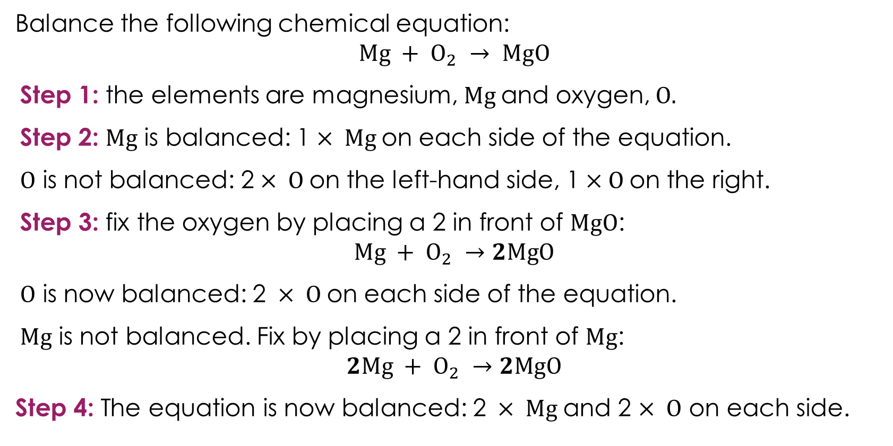
Balancing equations
Balance the following chemical equation:
$$Mg + O_{2} → MgO$$
Step 1: the elements are magnesium, Mg and oxygen, O.
Step 2: Mg is balanced: 1$× Mg$on each side of the equation.
O is not balanced: 2$× O$on the left-hand side, 1$×O$on the right.
Step 3: fix the oxygen by placing a 2 in front of MgO:
$$Mg + O_{2} →2MgO$$
O is now balanced: 2$× O$on each side of the equation.
Mg is not balanced. Fix by placing a 2 in front of Mg:
$$2Mg + O_{2} →2MgO$$
Step 4: The equation is now balanced: 2$× Mg$and 2 $× O$ on each side.
Worked example
Notes:
Walk through this worked example step by step with learners, following the systematic method from slide 6.
Explain each step:
Step 1: list the elements
Step 2: count the atoms on each side. Magnesium has 1 on each side so it already balances. Oxygen has 2 on the left ($O_{2}$) but only 1 on the right ($MgO$), so it doesn't balance. Ask learners: which element do we need to fix?
Step 3: fix oxygen by placing a 2 in front of $MgO$. This gives 2 oxygen atoms on the right, matching the 2 on the left. Remind learners: we add a coefficient in front of $MgO$, we do not change the subscript.
Recount all atoms after the change. Oxygen now balances, but the coefficient 2 in front of $MgO$ means there are now 2 $Mg$ on the right and only 1 on the left. Ask learners: what do we do? Fix magnesium by placing a 2 in front of $Mg$.
Discuss: this is a key teaching point – changing one coefficient can unbalance another element. Learners should always recount after every adjustment.
Step 4: final check: $2Mg + O_{2} →2MgO$. $Mg: 2 = 2. O: 2 = 2$. All balanced.
Ask learners: could we have started by balancing oxygen a different way, for example by changing $O_{2}$to $O$? No – $O_{2}$is the correct formula for oxygen gas and we cannot change it. This reinforces the key rule from slide 5.
This is a relatively simple three-step example to build confidence. The final step – simplify is not required. The practice slide has progressively harder equations.

Slide 8
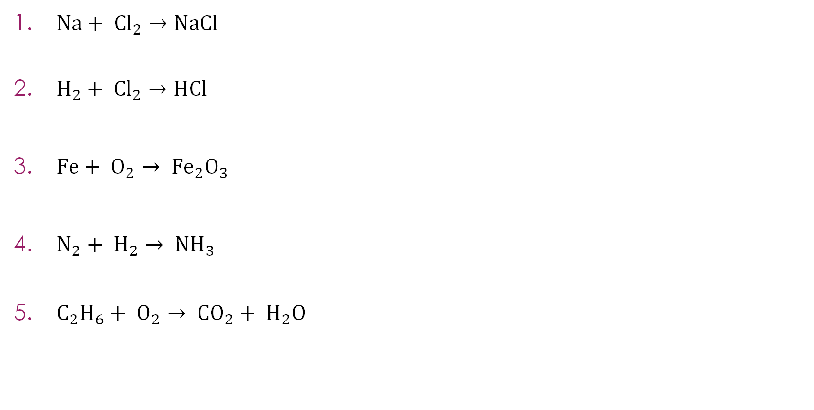
Balancing equations practice
$Na+ {Cl}_{2}→NaCl$
$H_{2}+ {Cl}_{2}→HCl$
$Fe+ O_{2}→ {Fe}_{2}O_{3}$
$N_{2}+ H_{2}→ {NH}_{3}$
$C_{2}H_{6}+ O_{2}→ {CO}_{2}+ H_{2}O$
Practice
Notes:
Practice balancing equations. Allow learners time to attempt each one. Encourage them to use the systematic method from slide 6 and draw an atom count table for each one. The questions increase in difficulty.

Slide 9
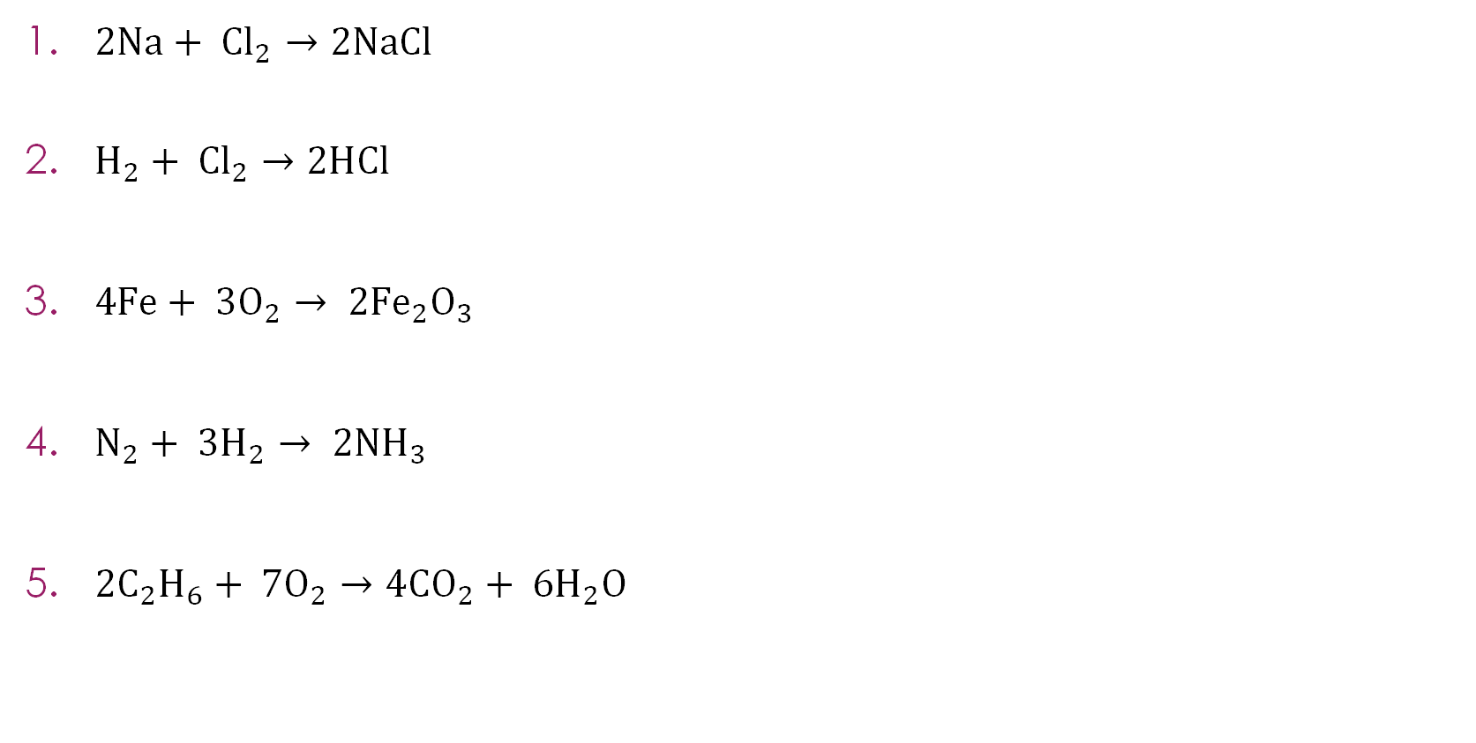
Balancing equations practice – answers
$2Na+ {Cl}_{2}→2NaCl$
$H_{2}+ {Cl}_{2}→2HCl$
$4Fe+ {3O}_{2}→ {2Fe}_{2}O_{3}$
$N_{2}+ {3H}_{2}→ {2NH}_{3}$
${2C}_{2}H_{6}+ {7O}_{2}→4{CO}_{2}+ {6H}_{2}O$
Answers
Notes:
$2Na+ {Cl}_{2}→2NaCl$. There are $2$ Cl on the left (${Cl}_{2}$), therefore, we need $2 NaCl$. Then we need $2$ $Na$.
$H_{2}+ {Cl}_{2}→2HCl.$There is $1$ $H$ and $1 Cl$ on the right ($HCl$), but $2$of each on the left. Put a $2$ in front of $HCl$ to balance both elements at once. This is a straightforward example to build confidence.
$4Fe+ {3O}_{2}→ {2Fe}_{2}O_{3}$. This is harder. ${Fe}_{2}O_{3}$has $2$ $Fe$ and $3$ $O$. Start with oxygen: $3 O$ on the right means we need $3$ $O$ on the left, but $O_{2}$ gives us $2$ at a time. We need ${3O}_{2}$ ($6$ oxygens) and ${2Fe}_{2}O_{3}$ ($6$oxygens). Then ${2Fe}_{2}O_{3}$ needs $4 Fe$.
$N_{2}+ {3H}_{2}→ {2NH}_{3}$. Start with nitrogen: $2$ $N$ on the left ($N_{2}$) so we need ${2NH}_{3}$ on the right. Now hydrogen: ${2NH}_{3}$ has $6$ $H$, so we need ${3H}_{2}$ on the left. Check: $N: 2 = 2$, $H: 6 = 6.$
${2C}_{2}H_{6}+ {7O}_{2}→4{CO}_{2}+ {6H}_{2}O$
Balance carbon: $2 C$in $C_{2}H_{6}$, $1$in ${CO}_{2}$, so ${2CO}_{2}$. But try ${2C}_{2}H_{6}$ giving $4C$, so $4{CO}_{2}$.
Balance hydrogen: ${2C}_{2}H_{6}$ has $12 H$, so ${6H}_{2}O$.
Balance oxygen: right side $=(4×2) +(6×1) = 14 O$. So ${7O}_{2}$ on the left.
Check: $C: 4=4$, $H: 12=12$, $O: 14=14$
Equation 5 is the most challenging. Some learners may find ${2C}_{2}H_{6}+ {7O}_{2}→4{CO}_{2}+ {6H}_{2}O$. Others may start with $C_{2}H_{6}+ \frac{7}{2}O_{2} →2{CO}_{2}+ {3H}_{2}O$ and then multiply through by 2. Both approaches are valid.
Discuss: ask learners which equations they found easiest and hardest. Equations 1 and 2 only involve two elements. Equations 3 and 4 require larger coefficients. Equation 5 has three elements and multiple products, making it the most complex.

Slide 10
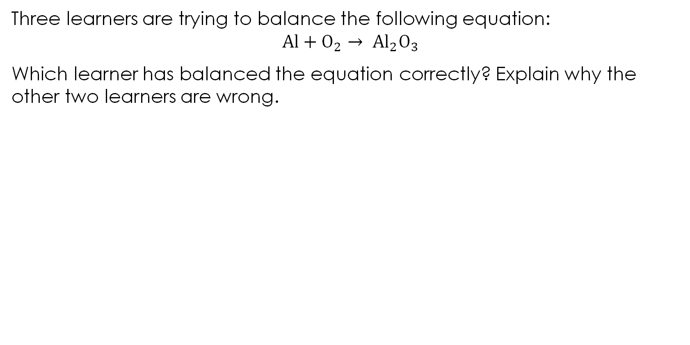
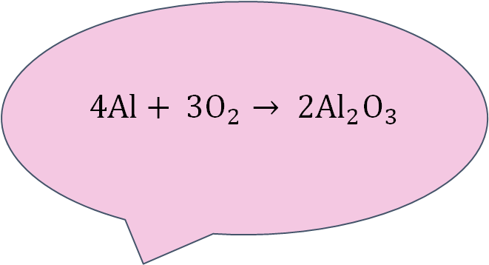
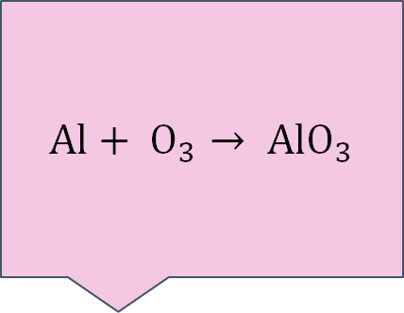
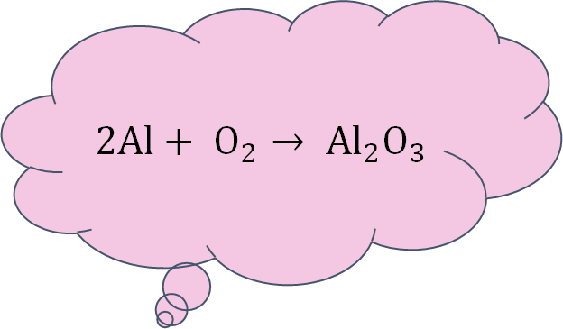
Discuss balancing
Three learners are trying to balance the following equation:
$$Al+O_{2}→ {Al}_{2}O_{3}$$
Which learner has balanced the equation correctly? Explain why the other two learners are wrong.
Activity
Learner A
Learner B
Learner C
$$2Al+ O_{2}→ {Al}_{2}O_{3}$$
$$Al+ O_{3}→ {AlO}_{3}$$
$4Al+ {3O}_{2}→ {2Al}_{2}O_{3}$
Notes:
Ask learners to count the atoms on each side for all three attempts, in pairs or on mini-whiteboards, before revealing which is correct.

Slide 11
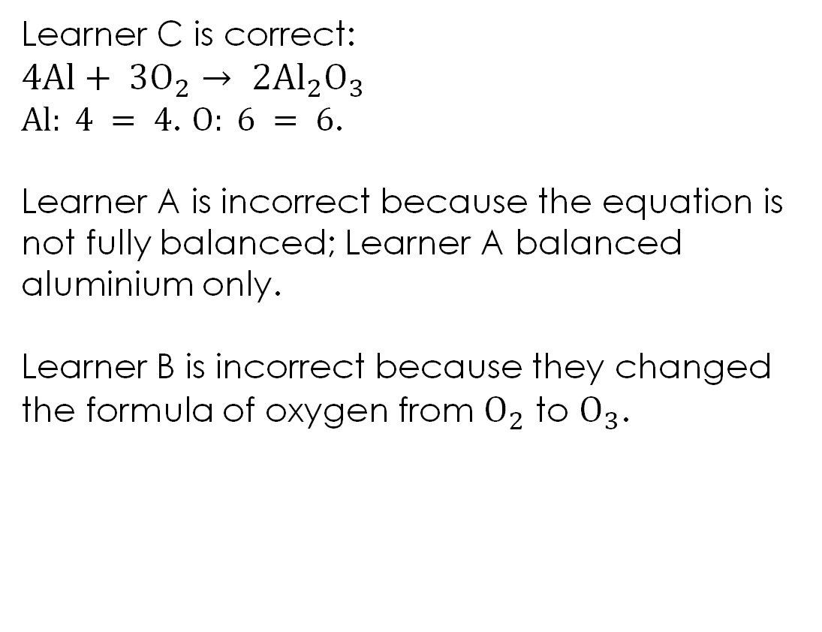
Discuss balancing – answer
Learner C is correct:
$4Al+ {3O}_{2}→ {2Al}_{2}O_{3}$
$Al: 4 = 4$. $O: 6 = 6$.
Learner A is incorrect because the equation is not fully balanced; Learner A balanced aluminium only.
Learner B is incorrect because they changed the formula of oxygen from $O_{2}$ to $O_{3}$.
Learner C
$4Al+ {3O}_{2}→ {2Al}_{2}O_{3}$
Answer
Notes:
Learner C is correct: $4Al+ {3O}_{2}→ {2Al}_{2}O_{3}$
$Al: 4 = 4$. $O: 6 = 6$.
Learner A is incorrect because the equation is not fully balanced. Count the atoms$: Al: 2 = 2$, but $O: 2 ≠ 3$. Learner A balanced aluminium but gave up when oxygen didn't work out neatly.
Discuss: what should they have done? They needed to find a number of $O_{2}$ and ${Al}_{2}O_{3}$ that gives the same number of oxygen atoms on both sides. Since $O_{2}$ gives oxygens in 2s and ${Al}_{2}O_{3}$ needs them in 3s, the lowest common multiple is $6$, so ${3O}_{2}$ and ${2Al}_{2}O_{3}$. Then recount aluminium: ${2Al}_{2}O_{3}$ has $4$ $Al$, so we need $4Al$on the left.
Learner B is incorrect because they changed the formula of oxygen from $O_{2}$ to $O_{3}$. $O_{3}$ is ozone, a completely different substance to oxygen gas ($O_{2}$). Remind learners of the key rule: we never change the formulas, only the coefficients. The formulas are fixed by the chemistry; the coefficients are what we adjust.
Ask learners: how could you check your own answers? By counting every type of atom on both sides. If any element doesn't balance, the equation is not balanced, even if some elements do.
Discuss: this equation is harder than the earlier examples because it requires larger coefficients. Ask learners: what made it difficult? The fact that oxygen atoms come in 2s ($O_{2}$) but are needed in 3s (${Al}_{2}O_{3}$). Finding the lowest common multiple is a useful strategy when this happens. This links directly to maths.

Slide 12
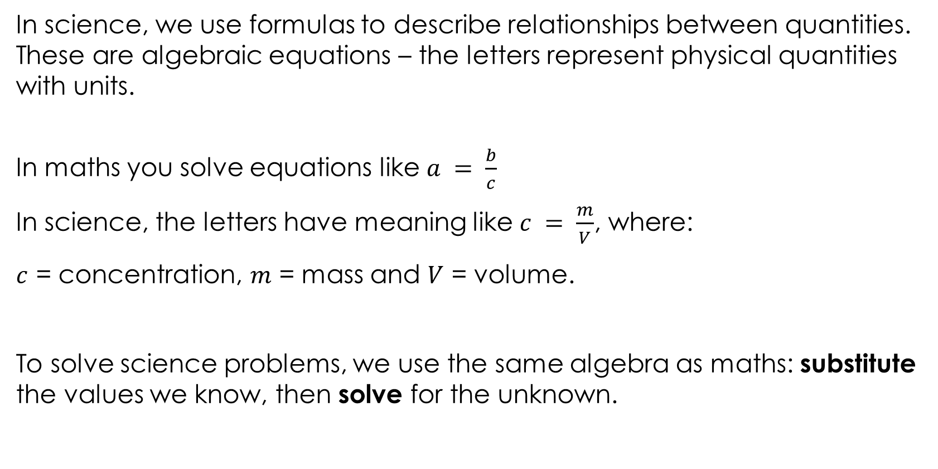
Scientific formulas and algebraic equations
In science, we use formulas to describe relationships between quantities. These are algebraic equations – the letters represent physical quantities with units.
In maths you solve equations like $a = \frac{b}{c}$
In science, the letters have meaning like $c = \frac{m}{V}$, where:
$c$ = concentration, $m$ = mass and $V$ = volume.
To solve science problems, we use the same algebra as maths: substitute the values we know, then solve for the unknown.
Notes:
This is the bridge slide between the balancing section and the algebra section.
Explain that every science formula is just an algebraic equation. The letters represent real physical quantities that can be measured.
Ask learners: what is the difference between $a = b ÷ c$and $c = m ÷V$? Discuss: mathematically there is no difference. The structure is identical. The only differences are that the science letters have specific meanings (concentration, mass, volume) and the answer needs units.
Explain that if learners can solve equations in maths, they can solve science formulas. The process is identical: substitute the values you know, then solve for the unknown.
You can show other formulas that follow the same pattern:
$density = mass ÷ volume$($d = \frac{m}{V}$)
$speed = distance ÷ time$($s = \frac{d}{t}$)
$pressure = force ÷ area$($P = \frac{F}{A}$)
These include physics formulas, but they use the same algebra. Recognising this helps learners see that the mathematical skill transfers across all sciences, not just chemistry. If learners are also studying physics, they can apply the same substitute-then-solve approach to those equations too.
Ask learners: what do all these formulas have in common? They are all in the form ‘something = something ÷ something’, just like $a = b ÷ c$. Recognising this pattern means learners don't need to learn a different method for each formula.
Emphasise the approach that will be used throughout the rest of the lesson: substitute first, then rearrange. This mirrors what learners do in maths when they solve equations by replacing letters with numbers and then working out the unknown.

Slide 13
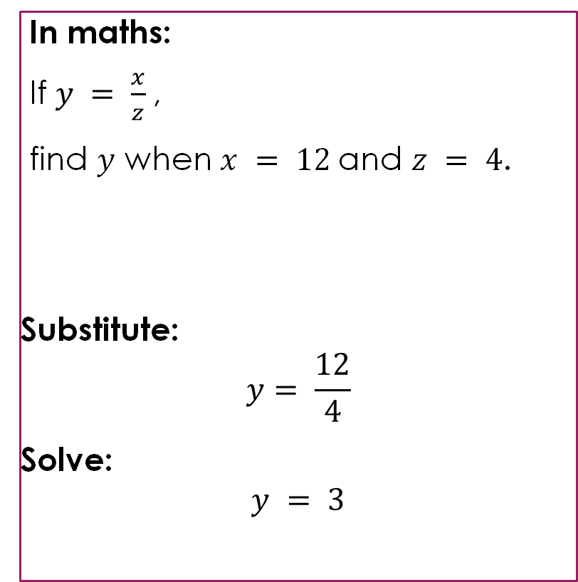
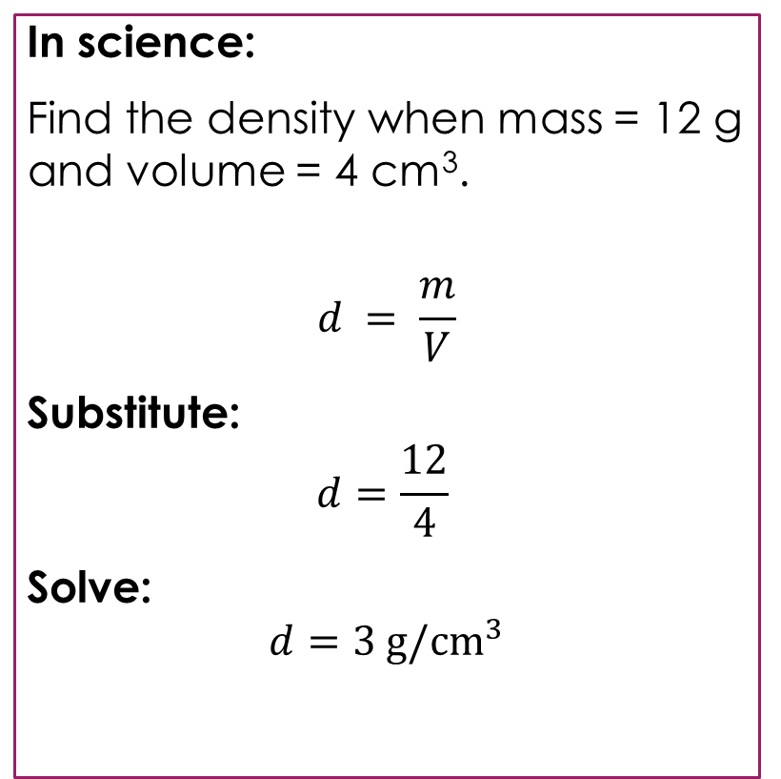
Substitution – you already do this in maths
In maths:
If $y = \frac{x}{z}$,
find $y$ when $x = 12$and $z = 4$.
Substitute:
$$y= \frac{12}{4}$$
Solve:
$$y = 3$$
In science:
Find the density when mass = 12 g and volume = 4 cm³.
$$d = \frac{m}{V}$$
Substitute:
$$d=\frac{12}{4}$$
Solve:
$$d=3 g/{cm}^{3}$$
Worked example
Notes:
This slide makes the connection between maths and science substitution explicit through a side-by-side comparison.
What is the same and what is different?
Ask learners to look at both examples. Discuss: what is the same and what is different?
Same
Both start by writing the formula
Both substitute numbers in place of letters
Both calculate $12 ÷ 4 = 3$
The arithmetic is identical
Different
In maths, the letters are abstract ($x, y, z$). In science, they represent real quantities (density, mass, volume).
The science answer has units ($g/{cm}^{3}$). The maths answer does not.
Why do the units matter?
Ask: why do units matter? 3 on its own is meaningless in science. $3 g/{cm}^{3}$ tells us it is a density. $3 g$would be a mass. $3 {cm}^{3}$would be a volume. The units tell the reader what the number represents.
Describe the four steps learners should follow when substituting into a science formula.
Step 1: write the formula
Step 2: substitute the values you know (with units)
Step 3: calculate
Step 4: write the answer with units
Explain that this is the method learners will use for every substitution question in this session and in their exams. Step 1 is important because it shows the examiner which equation is being used. Step 4 is where learners most commonly lose marks, by forgetting units.

Slide 14
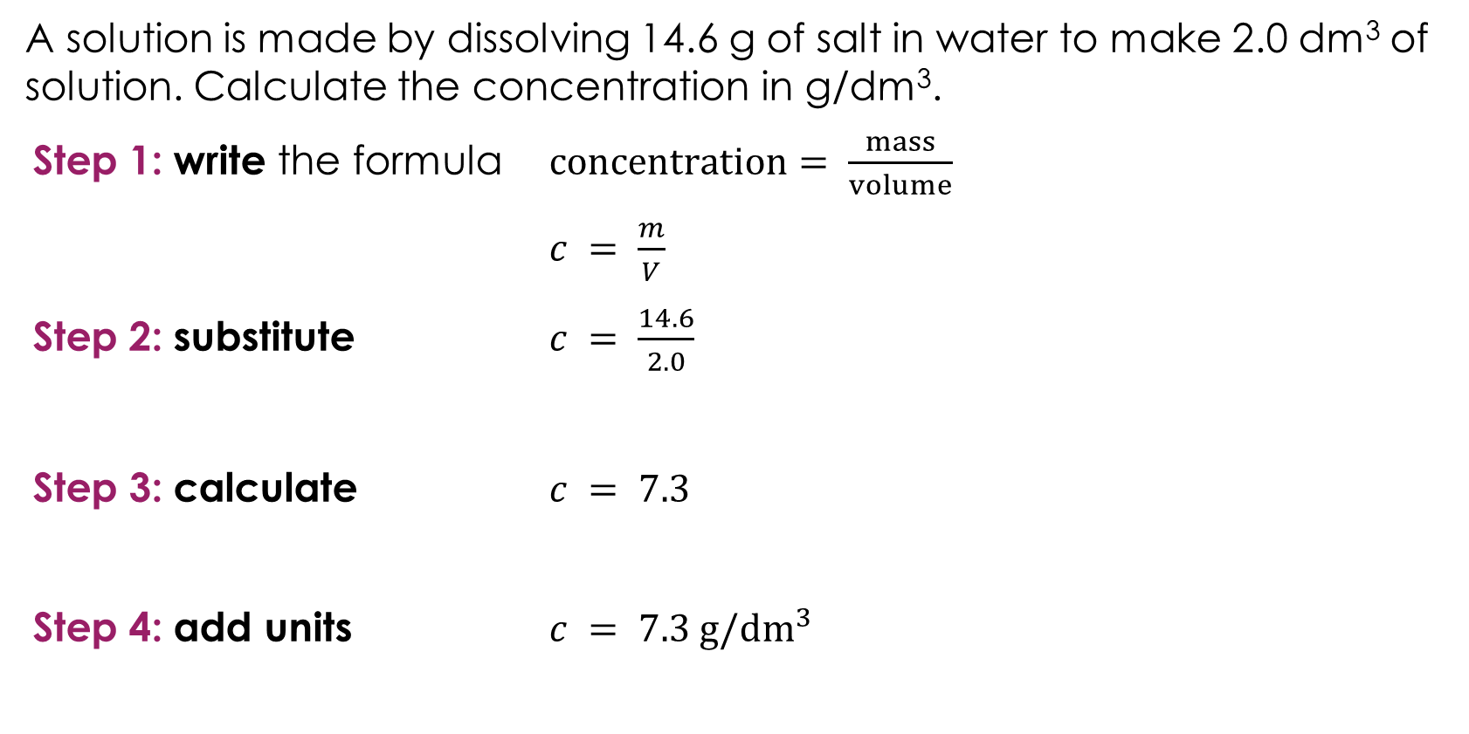
Substitution
A solution is made by dissolving 14.6 g of salt in water to make 2.0 dm³ of solution. Calculate the concentration in g/dm³.
Step 1: write the formula $concentration= \frac{mass}{volume}$
$c = \frac{m}{V}$
Step 2: substitute $c = \frac{14.6}{2.0}$
Step 3: calculate $c = 7.3$
Step 4: add units $c = 7.3 g/{dm}^{3}$
Worked example
Notes:
Walk through the four steps with learners. This is the first worked example using a chemistry context.
Step 1: explain that we always write the formula first, both in words and in letters. This shows the examiner which equation is being used and helps learners organise their working.
Step 2: substitute the values from the question. Ask learners: which number goes where? Mass = 14.6 g, volume = 2.0 dm³. Remind learners to check they are putting the right values in the right places. A common error is dividing the wrong way round ($2.0 ÷ 14.6$instead of $14.6 ÷ 2.0$).
Step 3: calculate. This is just arithmetic: $14.6÷2.0=7.3$.
Step 4: add units. Ask learners: where do the units come from? Mass is in grams and volume is in dm³$.$ So, concentration is g/dm³. The units follow from the formula, grams divided by dm³ gives g/dm³.
Ask: what would happen if the volume was given in cm³ instead of dm³? The units of the answer would be g/cm³ instead. Discuss why it is important to check the units of the values before substituting.
This example is deliberately straightforward as it requires substitution only, no rearranging. Ask learners: what if the question asked you to find the mass instead of the concentration? We would need to rearrange, which is covered next.

Slide 15
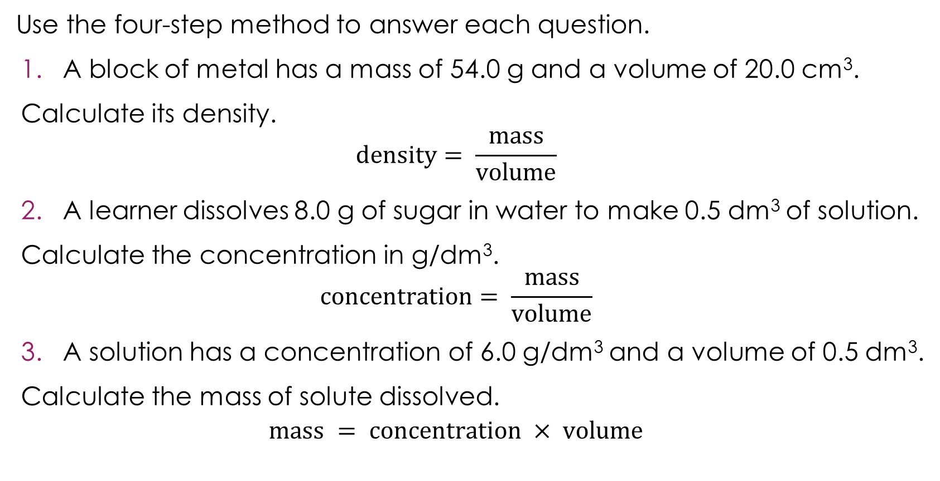
Substitution practice
Use the four-step method to answer each question.
A block of metal has a mass of 54.0 g and a volume of 20.0 cm³.
Calculate its density.
$$density= \frac{mass}{volume}$$
A learner dissolves 8.0 g of sugar in water to make 0.5 dm³ of solution.
Calculate the concentration in g/dm³.
$$concentration= \frac{mass}{volume}$$
A solution has a concentration of 6.0 g/dm³ and a volume of 0.5 dm³.
Calculate the mass of solute dissolved.
$$mass = concentration × volume$$
Practice
Notes:
Allow learners time to attempt each question using the four-step method from slide 14. Encourage learners to show all four steps in their working.

Slide 16
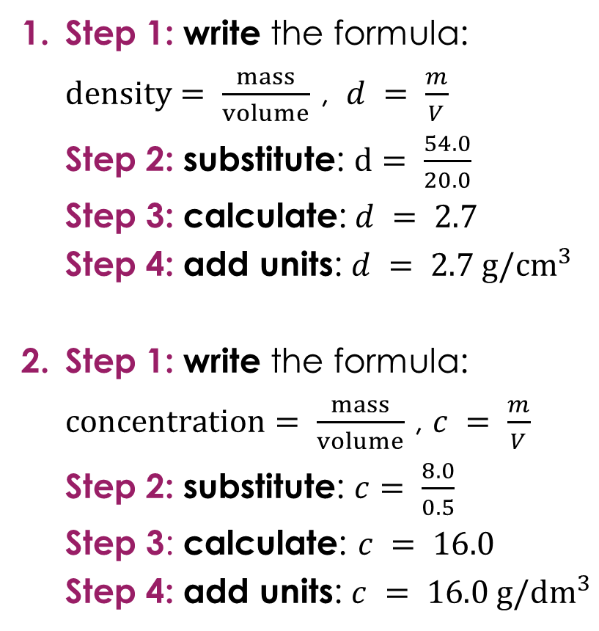
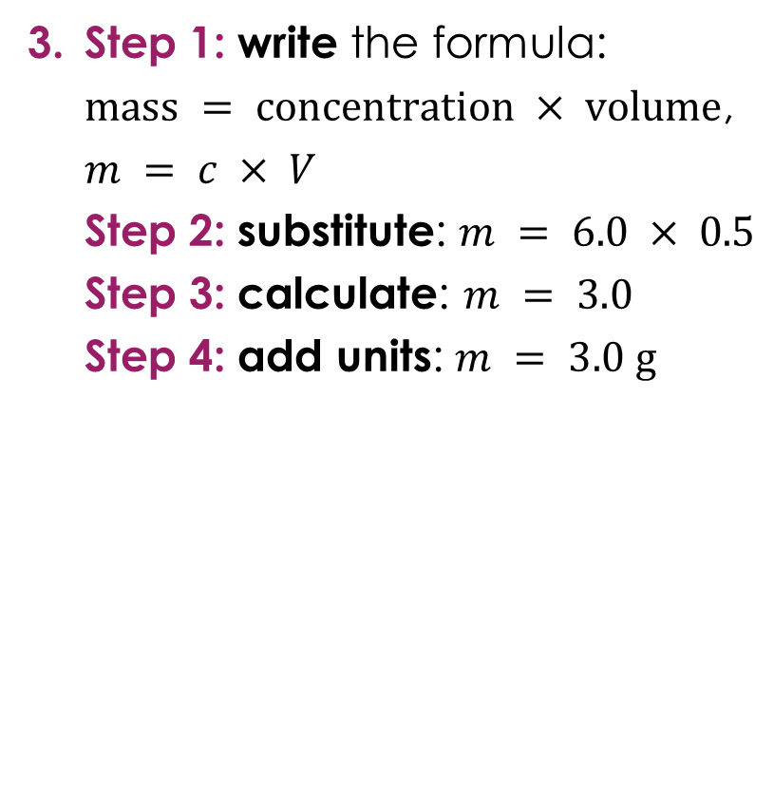
Substitution practice – answers
Step 1: write the formula:
$density= \frac{mass}{volume}$ , $d = \frac{m}{V}$
Step 2: substitute: $d= \frac{54.0}{20.0}$
Step 3: calculate:$d = 2.7$
Step 4: add units: $d = 2.7 g/{cm}^{3}$
Step 1: write the formula: $concentration= \frac{mass}{volume}$ , $c = \frac{m}{V}$
Step 2: substitute: $c= \frac{8.0}{0.5}$
Step 3: calculate: $c = 16.0$
Step 4: add units: $c = 16.0 g/{dm}^{3}$
Step 1: write the formula:
$mass = concentration × volume$, $m = c × V$
Step 2: substitute: $m = 6.0 × 0.5$
Step 3: calculate: $m = 3.0$
Step 4: add units: $m = 3.0 g$
Anwers
Notes:
Some learners may be unsure about dividing by 0.5. Ask: what is 8 divided by 0.5? Remind them that dividing by 0.5 is the same as multiplying by 2. If the answer seems surprisingly large, encourage learners to check whether it makes sense: if there are 8.0 g in half a dm³, this means there would be 16.0 in a full dm³.
This last question uses multiplication rather than division.
Ask learners: does the four-step method still work? Yes, the process is identical regardless of whether the formula involves multiplying or dividing.
Some learners may recognise that $mass = concentration × volume$is just a rearranged version of $concentration= \frac{mass}{volume}$ from question 2.
Discuss: these are not two different formulas; they are the same relationship written differently. This links to the next section on rearranging.

Slide 17
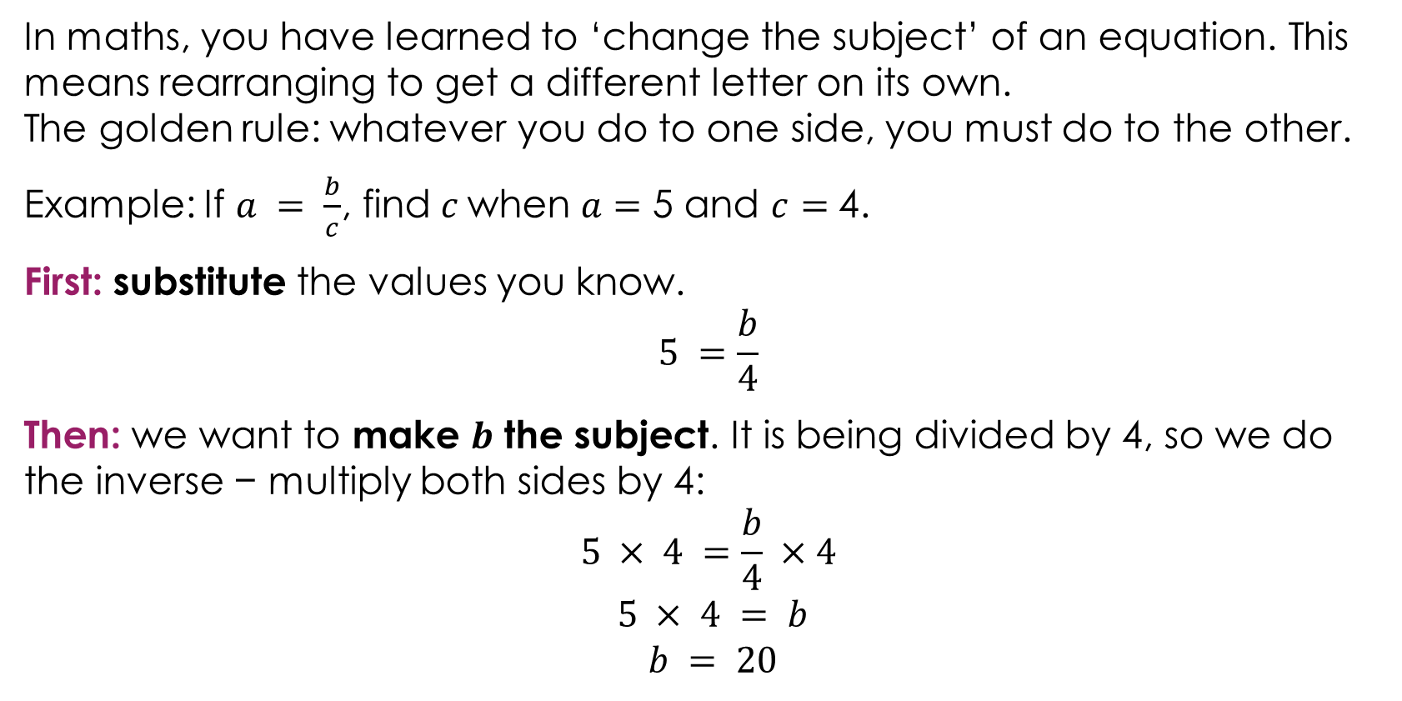
Changing the subject of an equation
In maths, you have learned to ‘change the subject’ of an equation. This means rearranging to get a different letter on its own.
The golden rule: whatever you do to one side, you must do to the other.
Example: If $a = \frac{b}{c}$, find$c$when $a=$ 5 and $c=$ 4.
First: substitute the values you know.
$$5 =\frac{b}{4}$$
Then: we want to make $b$ the subject. It is being divided by 4, so we do the inverse − multiply both sides by 4:
$$5 × 4 =\frac{b}{4} ×4$$
$$5 × 4 = b$$
$$b = 20$$
Notes:
This slide is purely maths. The purpose is to establish the method and language before applying it to science on the next slide.
Explain that ‘changing the subject’ means getting a different letter on its own on one side of the equation. In maths this is sometimes phrased as ‘make b the subject’ or ‘find b’. Learners will have encountered this language in maths lessons.
Walk through the example step by step.
First: substitute. Explain that once the known values are in, learners are left with a simple equation with one unknown, just like they solve in maths lessons. Ask learners: what do we know? $a = 5, c = 4.$What don't we know? $b$. So, we substitute and get $5 =\frac{b}{4}$.
Then: ask learners: where is $b$? It is being divided by 4. Ask: what is the inverse of dividing by 4? Multiplying by 4. So, we multiply both sides by 4. Explain that we do the same thing to both sides to keep the equation balanced. This gives us $5 × 4 = b$, so $b = 20$.
Discuss: this is a one-step rearrangement because the unknown ($b$) is on the top of the division. It only takes one inverse operation to get $b$ on its own. Later in the session we will look at examples where the unknown is on the bottom of the division, which requires an extra step.
Discuss: why do we substitute first rather than rearranging the letters? Because once the numbers are in, learners can see what they are working with. $5 =\frac{b}{4}$ is easier to solve than rearranging $a = \frac{b}{c}$to $b = a × c$ with letters only.
Remind learners of the inverse operations: $×$ undoes $÷$, $÷$ undoes $×$, $+$ undoes $−$, $−$ undoes $+$. These are the same inverse operations learners use in maths.

Slide 18
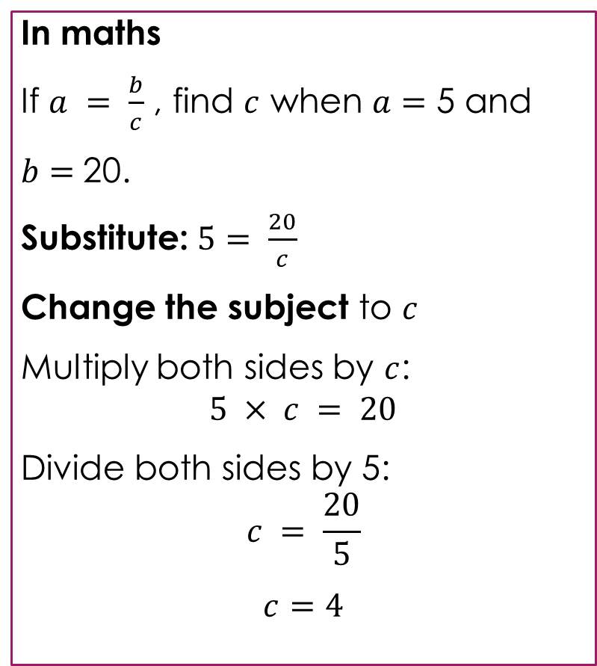
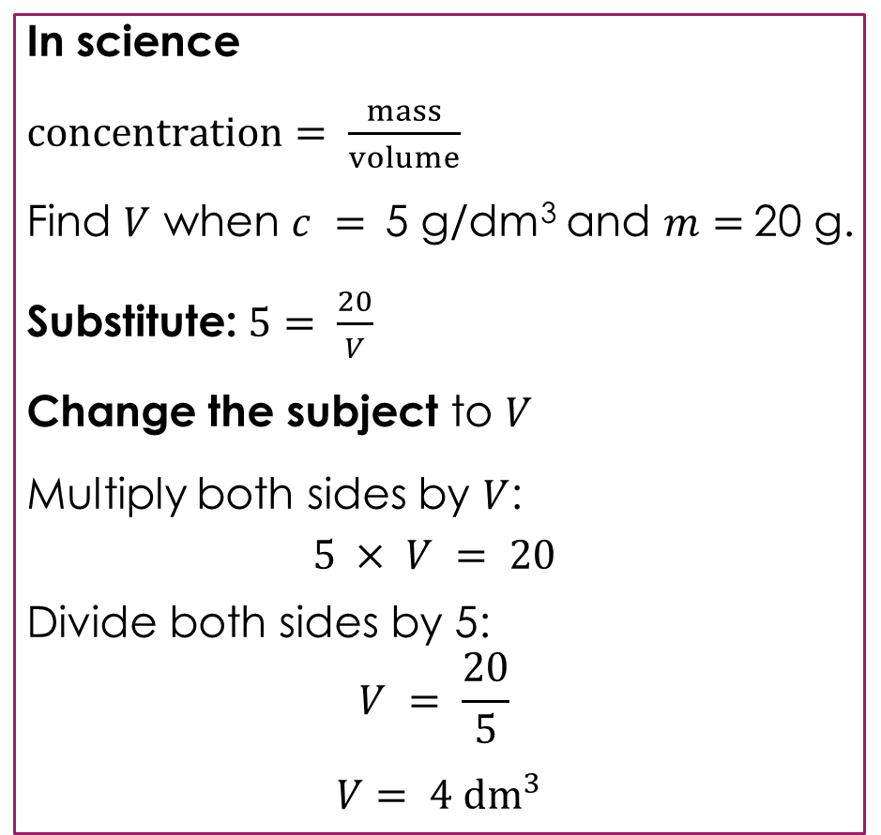
Changing the subject of an equation example
In maths
If $a = \frac{b}{c}$, find $c$ when $a=$ 5 and
$b=$20.
Substitute: $5= \frac{20}{c}$
Change the subject to $c$
Multiply both sides by $c$:
$$5 × c = 20$$
Divide both sides by 5:
$$c = \frac{20}{5}$$
$$c=4$$
In science
$concentration= \frac{mass}{volume}$
Find $V$ when $c =$5 g/dm³ and $m=$20 g.
Substitute: $5= \frac{20}{V}$
Change the subject to $V$
Multiply both sides by $V$:
$$5 × V = 20$$
Divide both sides by 5:
$$V = \frac{20}{5}$$
$$V= 4 {dm}^{3}$$
Worked example
Notes:
This slide shows the maths and science side by side. The numbers are deliberately the same so learners can see that the working is identical.
Explain that this example is harder than slide 14 because the unknown is on the bottom of the division. This means it takes two steps to isolate it instead of one. Ask learners: why can't we just do it in one step like before? Because when the unknown is on the bottom, we first need to get it out of the bottom (multiply by the unknown) and then get it on its own (divide by the number).
Ask learners to compare the two columns line by line. Discuss: what is the same? The steps, the operations and the arithmetic are all identical. What is different? Only the letters and the units.
Explain that the phrase ‘change the subject to $c$’ in maths means the same thing as ‘find $V′$ or ‘solve for $V′$ in science. Using the maths language reinforces that this is the same skill.
Walk through both examples, emphasising the parallel at each step:
Substitute: both give a number $=$ a number $÷$ an unknown
Multiply both sides by the unknown: both give a number $×$ unknown $=$ a number
Divide both sides: both isolate the unknown
Ask: what is the only extra thing we need in science? Units. The maths answer is 4. The science answer is 4 dm³. Remind learners that units come from the formula: mass in grams divided by concentration in g/dm³ gives volume in dm³.
Ask: does it matter that the science formula uses $c, m$and $V$ instead of $a, b$and $c$? No. The letters are different, but the algebra is the same. Once learners substitute the numbers, the letters disappear and they are left with a straightforward equation to solve.

Slide 19
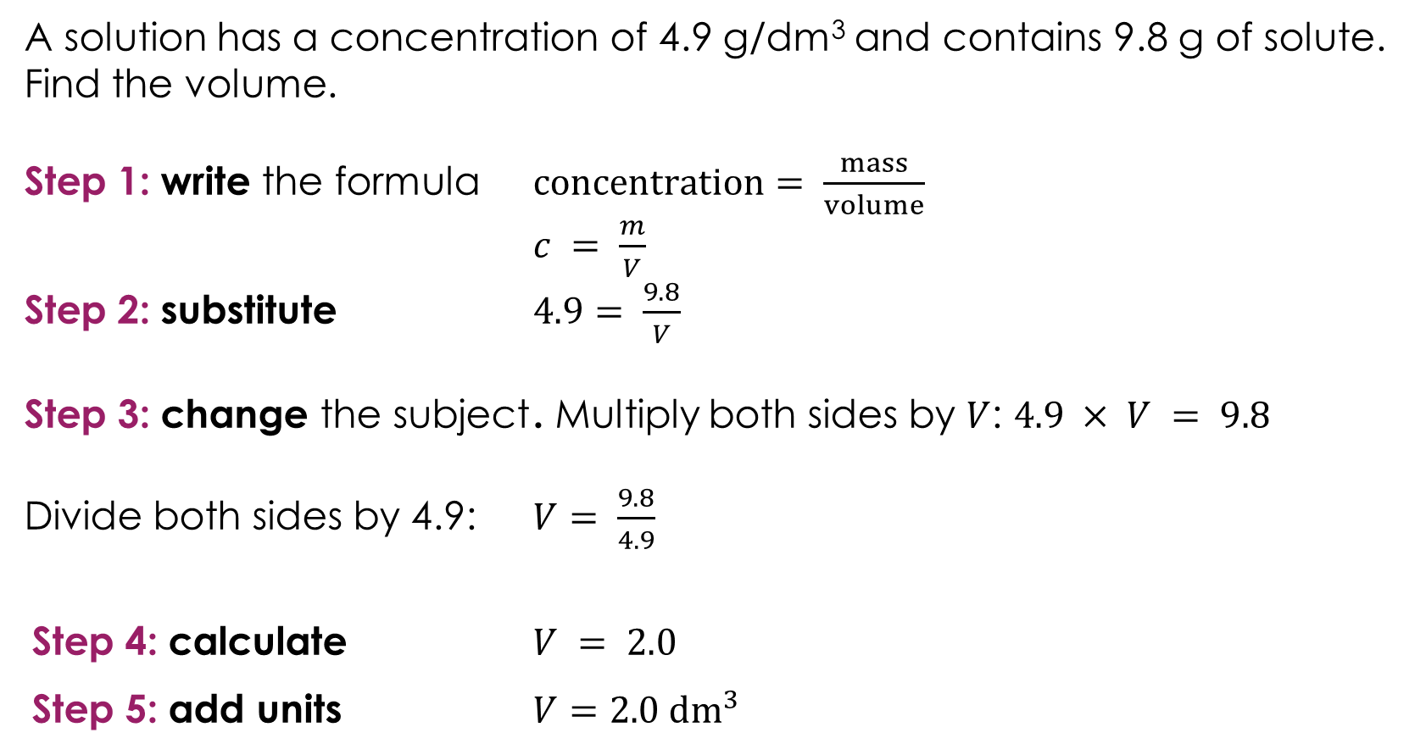
Finding an unknown
A solution has a concentration of 4.9 g/dm³ and contains 9.8 g of solute. Find the volume.
Step 1: write the formula $concentration= \frac{mass}{volume}$
$c = \frac{m}{V}$
Step 2: substitute $4.9= \frac{9.8}{V}$
Step 3: change the subject . Multiply both sides by $V$: $4.9 × V = 9.8$
Divide both sides by 4.9: $V= \frac{9.8}{4.9}$
Step 4: calculate $V = 2.0$
Step 5: add units $V=2.0 {dm}^{3}$
Worked example
Notes:
Walk through this worked example step by step. This is the first full example where the unknown is on the bottom of the division, so learners need the two-step rearrangement from the previous slide.
Step 1: write the formula. Ask learners: which formula links concentration, mass and volume? $concentration= \frac{mass}{volume}$
Step 2: substitute the values we know. Ask: what do we know? $concentration = 4.9 g/{dm}^{3}$, $mass = 9.8 g$. What don't we know? Volume. So, we get $4.9 = \frac{9.8}{V}$.
Step 3: change the subject. Ask learners: where is $V$? It is on the bottom of a division, so this is the harder type from slide 16. We need two steps.
First, multiply both sides by $V$ to get it out of the bottom: $4.9 × V = 9.8$. Ask: what kind of equation does this look like now? It looks like $4.9 × V = 9.8$, which is the same as the simple maths equation $4.9c = 9.8$.
Then divide both sides by 4.9 to get $V$ on its own: $V =\frac{9.8}{4.9}$.
Step 4: calculate $V = 2.0 .$
Step 5: add units. $V = 2.0 {dm}^{3}$. Ask: where do the units come from? The mass was in grams and the concentration was in g/dm³, so the volume is in dm³..
Ask learners: does the answer make sense? The concentration is 4.9 g/dm³, meaning there are 4.9 g in every dm³. We have 9.8 g, which is double 4.9, so we need 2.0 dm³. This is a useful check.
Discuss: this question uses the same formula as the substitution example on slide 12 ($c = \frac{m}{V}$), but here we are finding a different unknown. The formula is the same, only the subject has changed.

Slide 20
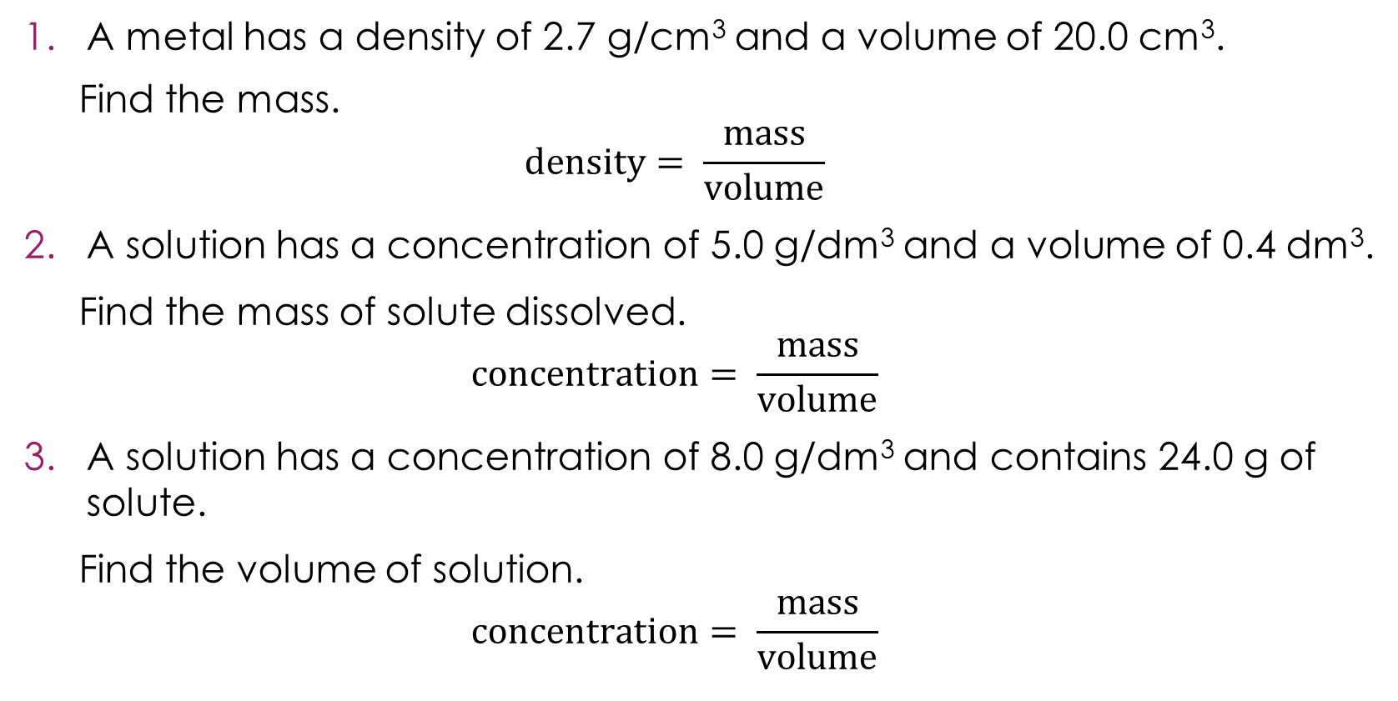
Finding unknowns practice
A metal has a density of 2.7 g/cm³ and a volume of 20.0 cm³.
Find the mass.
$$density= \frac{mass}{volume}$$
A solution has a concentration of 5.0 g/dm³ and a volume of 0.4 dm³.
Find the mass of solute dissolved.
$$concentration= \frac{mass}{volume}$$
A solution has a concentration of 8.0 g/dm³ and contains 24.0 g of solute.
Find the volume of solution.
$$concentration= \frac{mass}{volume}$$
Practice
Notes:
Allow learners time to attempt each question. Remind them to substitute first, then change the subject.

Slide 21
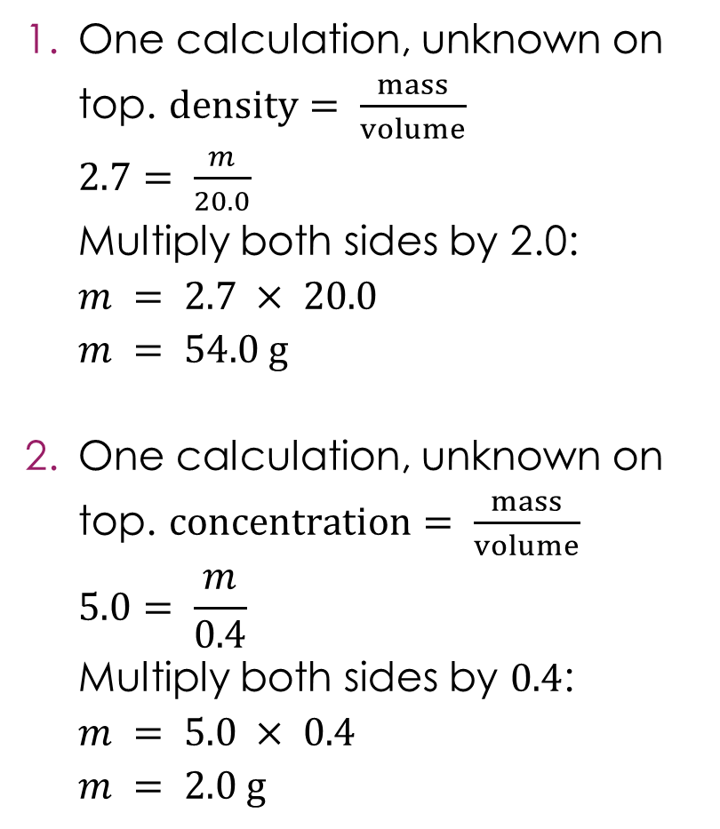
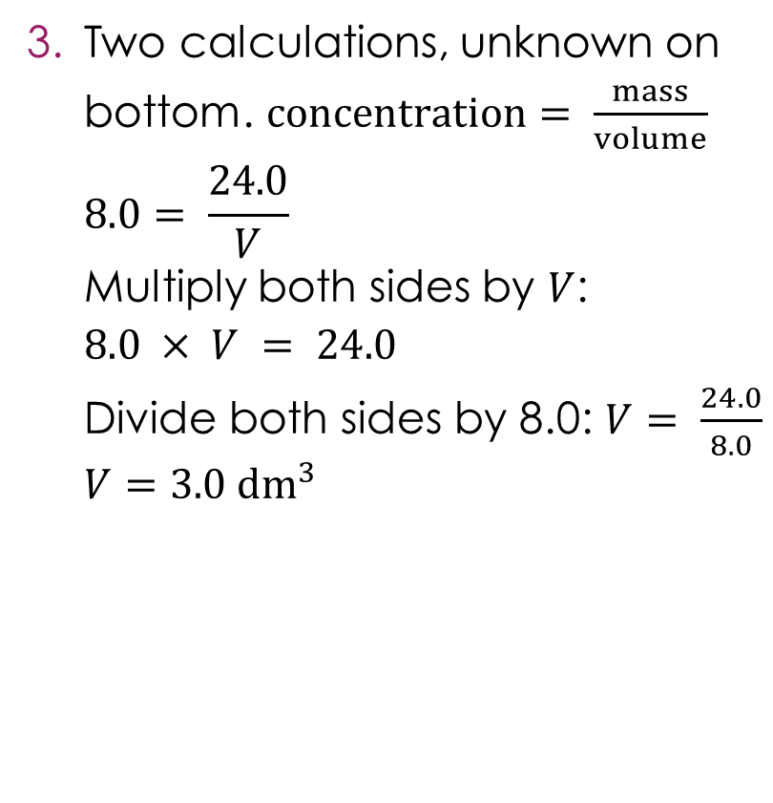
Finding unknowns practice – answers
One calculation, unknown on top. $density= \frac{mass}{volume}$
$2.7= \frac{m}{20.0}$
Multiply both sides by 2.0:
$$m = 2.7 × 20.0$$
$$m = 54.0 g$$
One calculation, unknown on top. $concentration= \frac{mass}{volume}$
$$5.0= \frac{m}{0.4}$$
Multiply both sides by $0.4$:
$$m = 5.0 × 0.4$$
$$m = 2.0 g$$
Two calculations, unknown on bottom. $concentration= \frac{mass}{volume}$
$$8.0= \frac{24.0}{V}$$
Multiply both sides by $V$:
$$8.0 × V = 24.0$$
Divide both sides by 8.0: $V= \frac{24.0}{8.0}$
$$V=3.0 {dm}^{3}$$
Answers
Notes:
2. Some learners may be unsure about multiplying by 0.4. Ask: does the answer make sense? The concentration is 5.0 in every dm³, but we only have 0.4 dm³, which is less than one dm³. So, the mass must be less than 5.0 g. 2.0 g makes sense.
Ask learners: how can you tell whether the question needs one calculation or two? Look at where the unknown is after substituting. If it is on the top of the equation (being multiplied or divided by a number), one step is enough. If it is on the bottom of a division, two steps are needed.
Discuss: all three questions use the same type of formula (something $=$something $÷$ something) but the unknown is in a different position each time. The four-step method works regardless of which quantity is unknown.

Slide 22
Putting it all together
Many chemistry questions combine balancing, substitution and rearranging. Here is a general approach:
Balance the equation – use coefficients to make sure atoms balance on both sides
Choose the right formula – which equation links the quantities in the question?
Substitute the known values – replace letters with numbers
Rearrange and calculate – use inverse operations to find the unknown
Add units – remember to include the correct units
Note: some examples will also need unit conversions too. It is normally easier to convert units before substituting numbers into the equation.
Notes:
This slide brings everything together before the final worked example and lesson challenge question. This approach is a general problem-solving framework that works for any chemistry calculation.
Explain the approach briefly.
Balance the equation – not every question will require this, but learners should always check. If the equation is already balanced, they can move on. On examination papers this is often a separate part of the question. (This is the first stage – three step process on slide 7.)
Choose the right formula – ask learners: how do you know which formula to use? Look at what quantities the question gives you and what it asks you to find. The formula must link those quantities.
The rest of the process is this is the same four-step method from the substitution section (slide 14) – or with the additional step to rearrange (slide 19).
Substitute the known values – replace the letters with numbers.
Rearrange and calculate – use inverse operations to make the unknown the subject, just like in maths. Remind learners: if the unknown is on the top, one calculation. If it is on the bottom, two calculations.
Add units – remind learners that this is where marks are commonly lost in exams. The units follow from the formula and the values substituted.
Discuss the note about unit conversions. Ask: when might you need to convert units? Common examples include cm³ to dm³ (divide by 1000) when using concentration in g/dm³. Explain that it is easier to convert units before substituting because once the numbers are in the equation, it is harder to keep track of which values need converting. For learners needing further support, use the understanding number unit conversion resources: rsc.li/4gbEt3p
Not every question will require all stages. Some may not need balancing (stage 1), some may not need rearranging (stage 4), and some may not need unit conversions. But the framework gives learners a reliable starting point for any question.

Slide 23
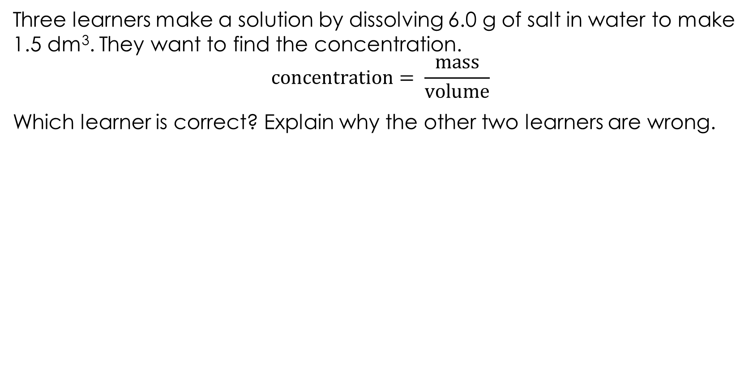
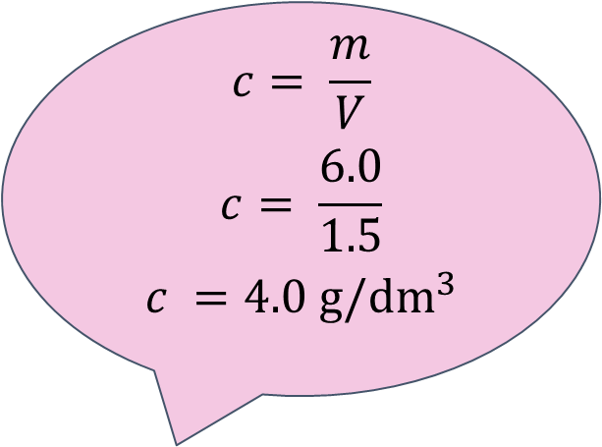
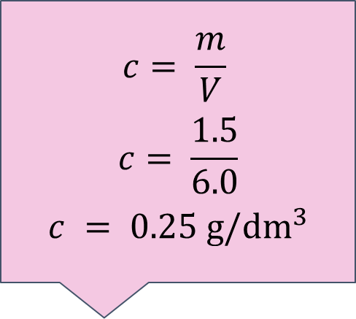
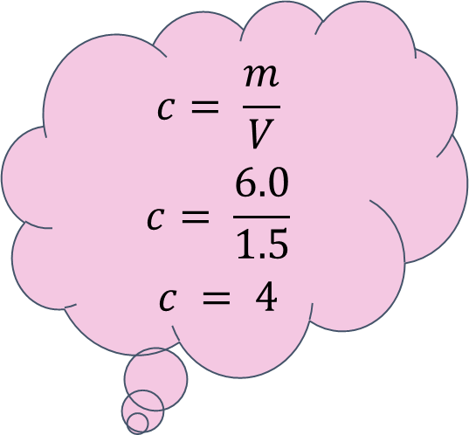
Discussing algebra in chemistry
Three learners make a solution by dissolving 6.0 g of salt in water to make 1.5 dm³. They want to find the concentration.
$$concentration= \frac{mass}{volume}$$
Which learner is correct? Explain why the other two learners are wrong.
Learner A
Learner B
Learner C
$$c= \frac{m}{V}$$
$$c= \frac{6.0}{1.5}$$
$$c = 4$$
$$c= \frac{m}{V}$$
$$c= \frac{1.5}{6.0}$$
$$c = 0.25 g/{dm}^{3}$$
$$c= \frac{m}{V}$$
$$c= \frac{6.0}{1.5}$$
$$c =4.0 g/{dm}^{3}$$
Notes:
Ask learners to work through each learner's answer, in pairs or on mini whiteboards, before revealing which is correct.

Slide 24
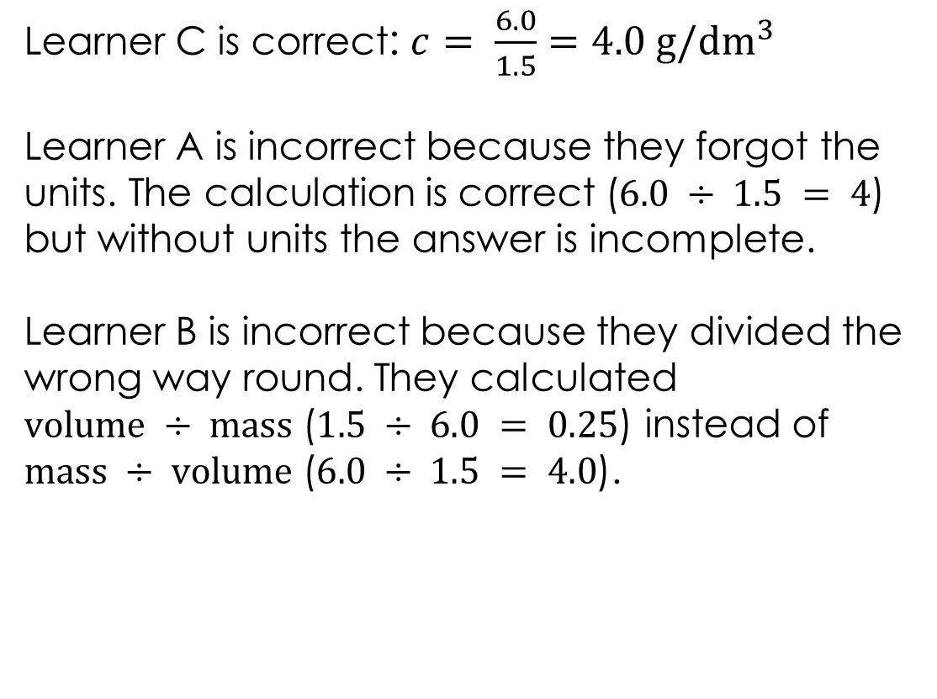
Discussing algebra in chemistry – answer
Learner C is correct: $c= \frac{6.0}{1.5}$ $=4.0 g/{dm}^{3}$
Learner A is incorrect because they forgot the units. The calculation is correct ($6.0 ÷ 1.5 = 4$) but without units the answer is incomplete.
Learner B is incorrect because they divided the wrong way round. They calculated
$volume ÷ mass$($1.5 ÷ 6.0 = 0.25$) instead of $mass ÷ volume$($6.0 ÷ 1.5 = 4.0$).
Learner C
$$c= \frac{m}{V}$$
$$c= \frac{6.0}{1.5}$$
$$c =4.0 g/{dm}^{3}$$
Answer
Notes:
Learner C is correct: $c= \frac{6.0}{1.5}$ $=4.0 g/{dm}^{3}$
Learner A is incorrect because they forgot the units. The calculation is correct ($6.0 ÷ 1.5 = 4$) but without units the answer is incomplete. Ask learners: what does ‘4’ mean on its own? It could be 4 g, 4 dm³, 4 mol. Units tell the reader what the number represents. In exams, forgetting units will lose marks.
Learner B is incorrect because they divided the wrong way round. They calculated $volume ÷ mass$($1.5 ÷ 6.0 = 0.25$) instead of $mass ÷ volume$($6.0 ÷ 1.5 = 4.0$). This is a very common error. Remind learners to look at the formula carefully: $concentration= \frac{mass}{volume}$ means mass is on the top and volume is on the bottom.
Ask: how could learner B have spotted their error? Encourage learners to check whether the answer makes sense. A concentration of 0.25 g/dm³ means there is only 0.25 g in every dm³. But they started with 6.0 g in 1.5 dm³, which is clearly more than 0.25 per dm³. Checking whether an answer is reasonable is a valuable habit.
Discuss: these two errors (forgetting units and substituting values the wrong way round) are the most common mistakes learners make in calculation questions. Ask learners: how can you avoid them? Writing the formula first helps with both, because it shows which value goes where and what units the answer should have.

Slide 25
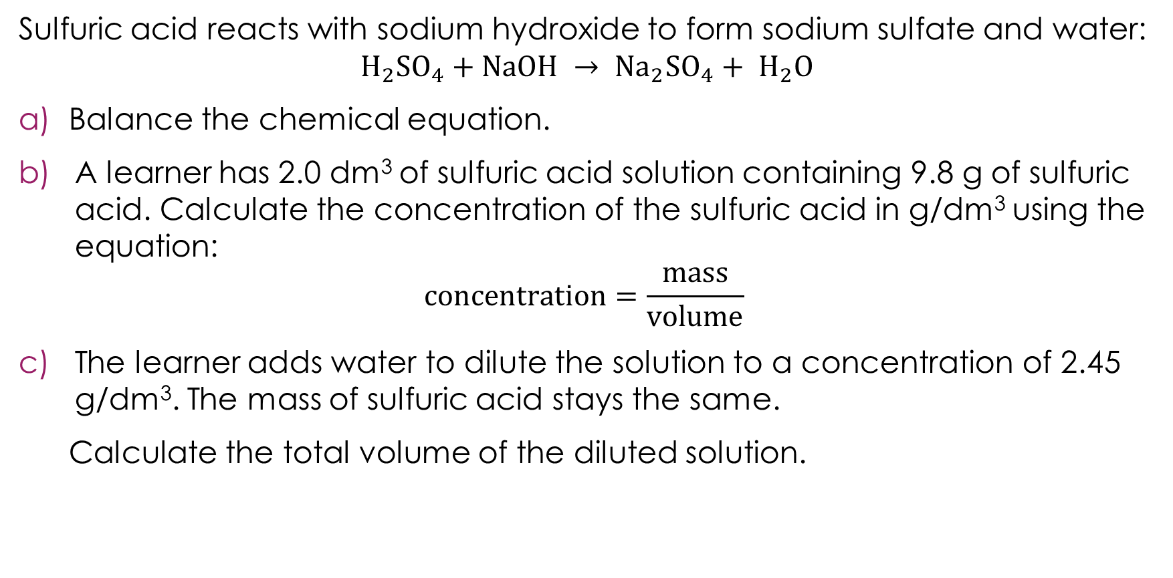
Returning to the lesson question
Sulfuric acid reacts with sodium hydroxide to form sodium sulfate and water:
$$H_{2}{SO}_{4}+NaOH → {Na}_{2}{SO}_{4}+ H_{2}O$$
Balance the chemical equation.
A learner has 2.0 dm³ of sulfuric acid solution containing 9.8 g of sulfuric acid. Calculate the concentration of the sulfuric acid in g/dm³ using the equation:
$$concentration=\frac{mass}{volume}$$
The learner adds water to dilute the solution to a concentration of 2.45 g/dm³. The mass of sulfuric acid stays the same.
Calculate the total volume of the diluted solution.
Notes:
We return to the challenge question from the start of the lesson. Allow learners time to attempt it independently before discussing as a class.

Slide 26
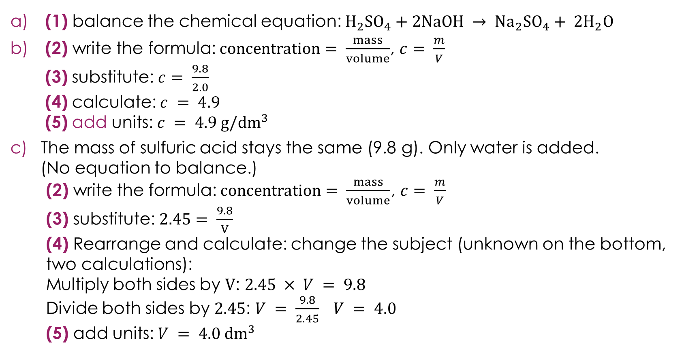
Returning to the lesson question – answers
(1) balance the chemical equation: $H_{2}{SO}_{4}+2NaOH → {Na}_{2}{SO}_{4}+ {2H}_{2}O$
(2) write the formula: $concentration= \frac{mass}{volume}$, $c= \frac{m}{V}$
(3) substitute: $c= \frac{9.8}{2.0}$
(4) calculate: $c = 4.9$
(5) add units: $c = 4.9 g/{dm}^{3}$
The mass of sulfuric acid stays the same (9.8 g). Only water is added.
(No equation to balance.)
(2) write the formula: $concentration= \frac{mass}{volume}$, $c= \frac{m}{V}$
(3) substitute: $2.45= \frac{9.8}{V}$
(4) Rearrange and calculate: change the subject (unknown on the bottom, two calculations):
Multiply both sides by $V$: $2.45 × V = 9.8$
Divide both sides by $2.45$: $V = \frac{9.8}{2.45} V = 4.0$
(5) add units: $V = 4.0{ dm}^{3}$
Answers
Notes:
Note that the numbers on this answer relate to slide 22, i.e. putting all of the steps together.
There are $2$ $Na$ on the right (${Na}_{2}{SO}_{4}$), so we need $2NaOH$on the left. This gives $4$ $H$on the left ($2$ from $H_{2}{SO}_{4}$, $2$ from $2NaOH$) matching $4$ $H$ on the right (${2H}_{2}O$). Check all elements: $H: 4 = 4$, $S: 1 = 1$, $O: 6 = 6$, $Na: 2 = 2$
Common errors:
Part a): forgetting to put $2$ in front of $H_{2}O$ as well as $NaOH$. Remind learners to check every element after balancing.
Part b): dividing the wrong way round ($2.0 ÷ 9.8$instead of $9.8 ÷ 2.0$). Remind learners to write the formula first and substitute carefully.
Part c): not realising the mass stays the same when diluting. Discuss: when you add water to a solution, you are not adding or removing any solute. The same $9.8 g$ of sulfuric acid is now spread through a larger volume, which is why the concentration decreases.
Part c): substituting incorrectly, for example calculating $2.45 × 9.8$. Remind learners to look at the formula: $concentration=\frac{mass}{volume}$. After substituting, $2.45= \frac{9.8}{V}$. The unknown is on the bottom, so this is the two-step rearrangement from slide 17.
Discuss: this question combines all three skills from the session: balancing (part a), substitution (part b), and changing the subject (part c). Ask learners: which part did you find most difficult?

