Slide 1

Stage 2
Algebra and equations
Downloaded from: rsc.li/4wqEoi

Slide 2
Introduction
In maths, you have learned how to substitute values into equations and solve for unknowns. In chemistry, we use the same algebra – with formulas for quantities like concentration, density and moles. This session builds on those maths skills and applies them to chemical calculations.
Learning objectives
Understand the algebra needed for balancing chemical equations.
Substitute numerical values into formulas and expressions using appropriate units.
Change the subject of an equation.
Solve for unknowns in chemical equations and stoichiometry problems.
Introduction

Slide 3
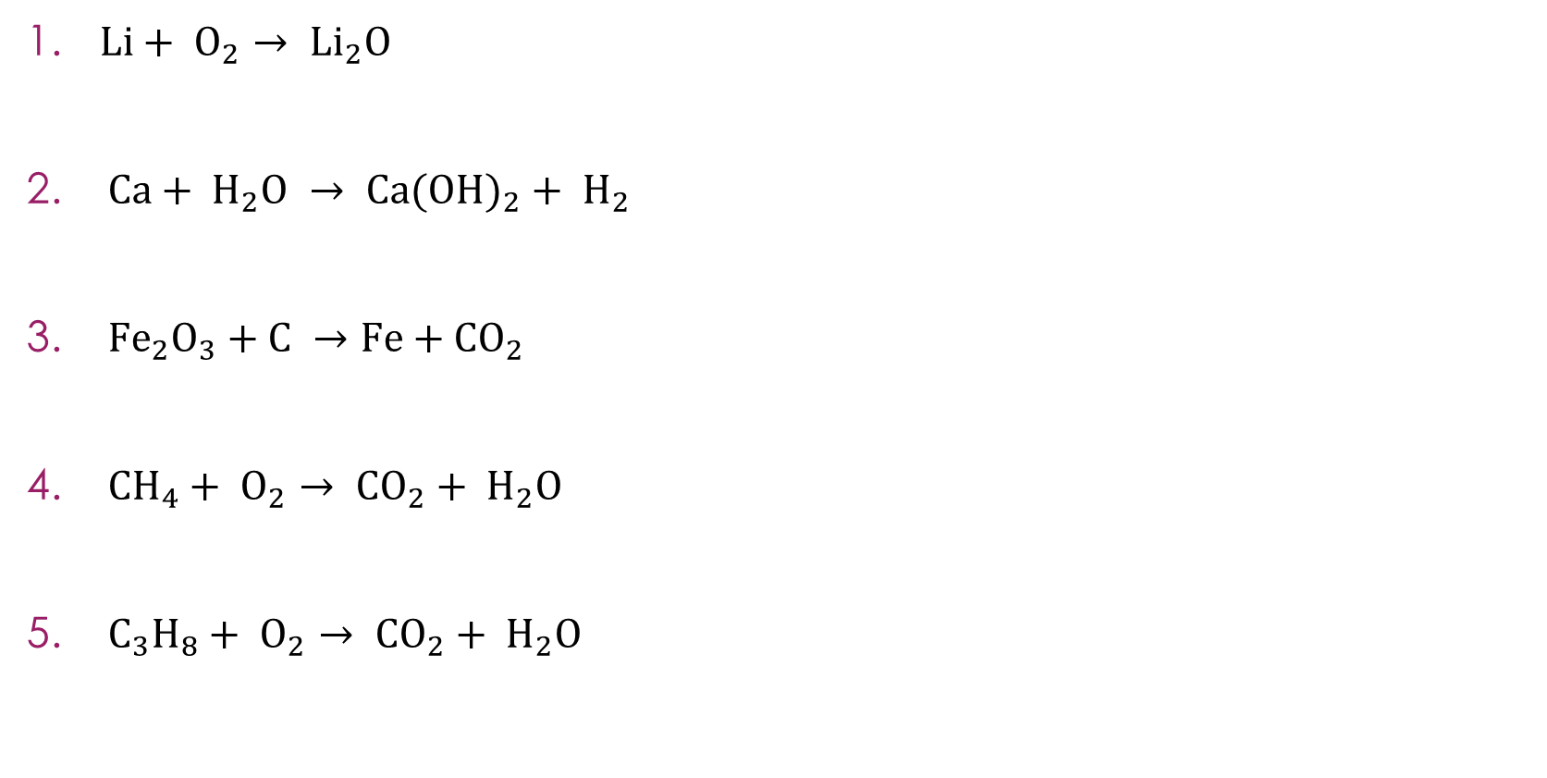
Balancing chemical equations
$Li+ O_{2}→ {Li}_{2}O$
$Ca+ H_{2}O → {Ca(OH)}_{2}+ H_{2}$
${Fe}_{2}O_{3}+C →Fe+{CO}_{2}$
${CH}_{4}+ O_{2}→ {CO}_{2}+ H_{2}O$
$C_{3}H_{8}+ O_{2}→ {CO}_{2}+ H_{2}O$
Activity
Notes:
Allow learners time to attempt each equation. Encourage them to draw an atom count table for each one and to check that all elements balance at the end.

Slide 4
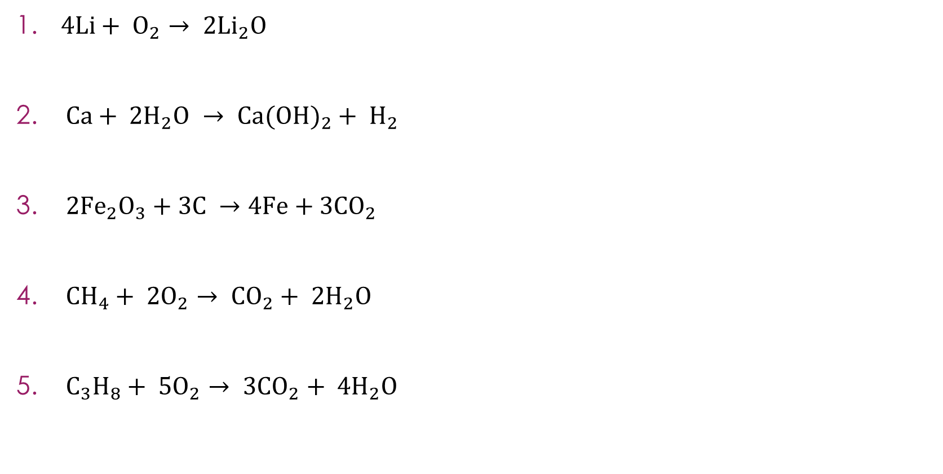
Balancing chemical equations – answers
$4Li+ O_{2}→ {2Li}_{2}O$
$Ca+ {2H}_{2}O → {Ca(OH)}_{2}+ H_{2}$
${2Fe}_{2}O_{3}+3C →4Fe+3{CO}_{2}$
${CH}_{4}+ {2O}_{2}→ {CO}_{2}+ {2H}_{2}O$
$C_{3}H_{8}+ {5O}_{2}→ {3CO}_{2}+ {4H}_{2}O$
Answers
Notes:
${Li}_{2}O$ has $2 Li$, so we need ${2Li}_{2}O$ to use both oxygens from $O_{2}$ (giving $2 O$on each side). Then ${2Li}_{2}O$ needs $4 Li$on the left. Check: $Li: 4 = 4, O: 2 = 2$
Start with hydrogen: ${Ca(OH)}_{2}$has $2 H$ in the hydroxide groups, plus $H_{2}$ has $2 H$on the right. Total $H$ on right $= 4$. So, we need ${2H}_{2}O$on the left ($4 H, 2 O$). Check: $Ca: 1 = 1, H: 4 = 4, O: 2 = 2$
Start with iron: ${2Fe}_{2}O_{3}$gives $4 Fe$, so $4Fe$on the right. Oxygen: ${2Fe}_{2}O_{3}$ has $6 O$, so need $3{CO}_{2} (6 O)$ on the right. Carbon: $3$ on each side. Check: $Fe: 4 = 4, O: 6 = 6, C: 3 = 3$
Carbon: $1$ on each side. Hydrogen: $4$ in ${CH}_{4}$, so ${2H}_{2}O$ on the right. Oxygen on the right: $2$ (from ${CO}_{2}$) $+ 2$ (from ${2H}_{2}O$) $= 4$, so ${2O}_{2}$ on the left. Check: $C: 1 = 1, H: 4 = 4, O: 4 = 4$. This is the combustion of methane (natural gas).
Carbon: $3$ in $C_{3}H_{8}$, so ${3CO}_{2}$. Hydrogen: $8$ in $C_{3}H_{8}$, so ${4H}_{2}O$ Oxygen on the right: $6$ (from ${3CO}_{2}$) + $4$ (from ${4H}_{2}O$) $= 10$, so ${5O}_{2}$ on the left. Check: $C: 3 = 3, H: 8 = 8, O: 10 = 10$. This is the combustion of propane. Remind learners to balance oxygen last in combustion equations as it appears in both products.

Slide 5
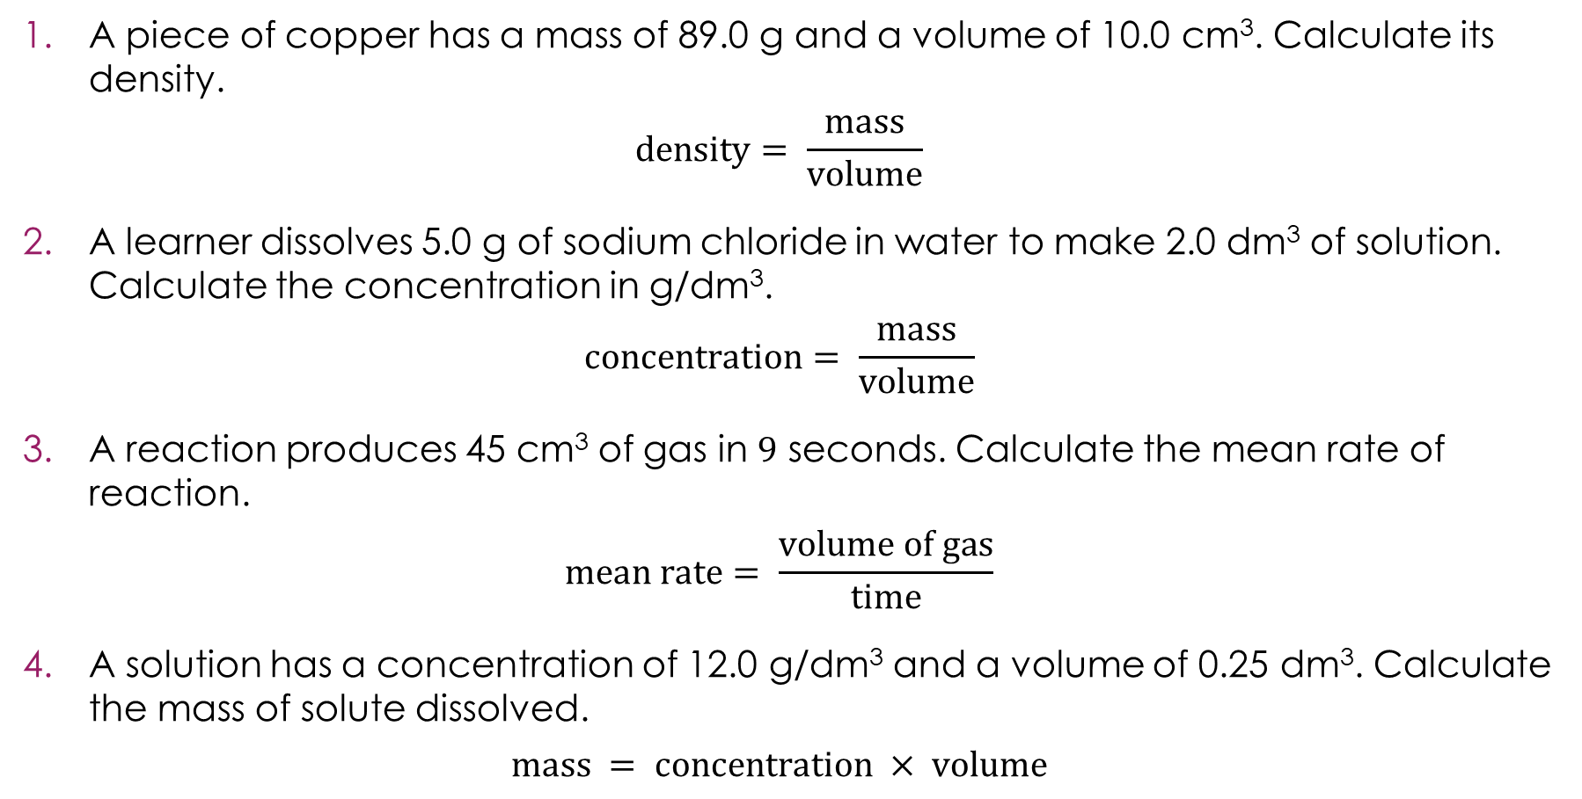
Substitution into formulas
A piece of copper has a mass of 89.0 g and a volume of 10.0 cm³. Calculate its density.
$$density= \frac{mass}{volume}$$
A learner dissolves 5.0 g of sodium chloride in water to make 2.0 dm³ of solution. Calculate the concentration in g/dm³.
$$concentration= \frac{mass}{volume}$$
A reaction produces 45 cm³ of gas in 9 seconds. Calculate the mean rate of reaction.
$$mean rate= \frac{volume of gas}{time}$$
A solution has a concentration of 12.0 g/dm³ and a volume of 0.25 dm³. Calculate the mass of solute dissolved.
$$mass = concentration × volume$$
Activity
Notes:
Allow learners time to attempt each question using the four-step method: write the formula, substitute, solve, units.

Slide 6
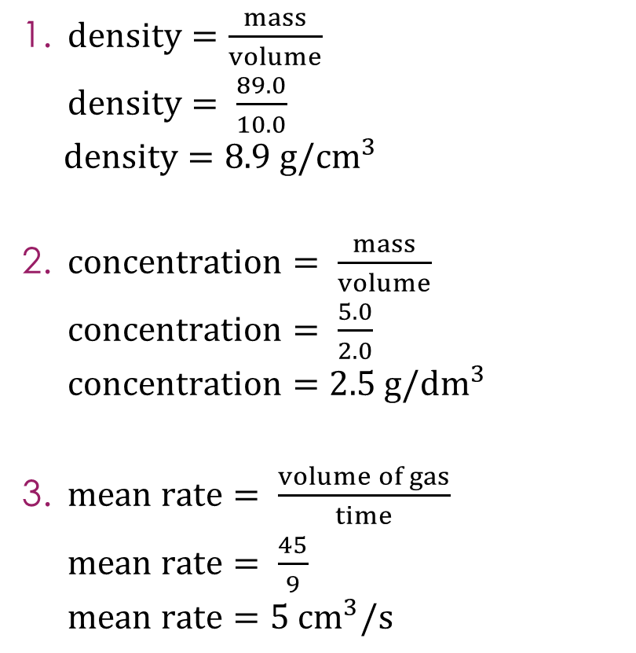
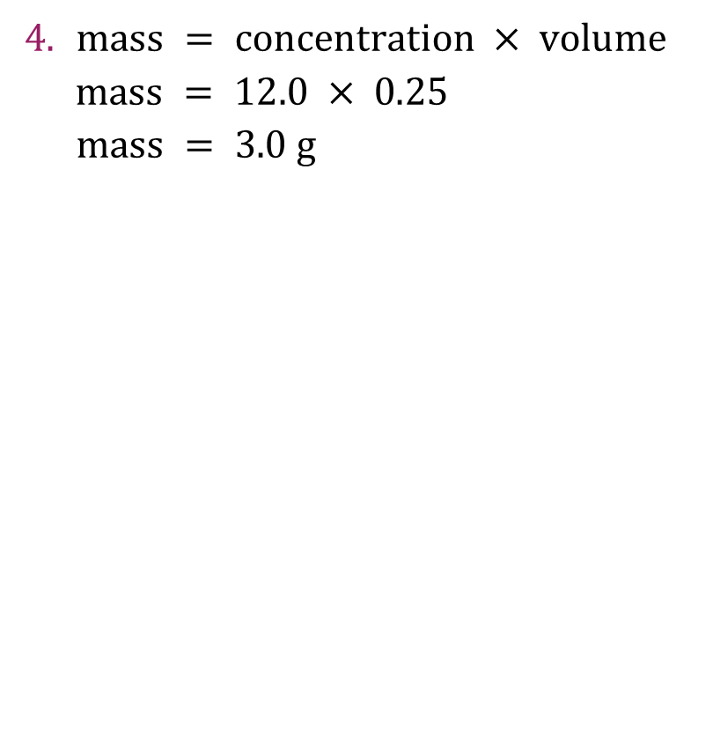
Substitution into formulas – answers
$density=\frac{mass}{volume}$
$density= \frac{89.0}{10.0}$
$density=8.9 {g/cm}^{3}$
$concentration= \frac{mass}{volume}$
$concentration= \frac{5.0}{2.0}$
$concentration=2.5 {g/dm}^{3}$
$mean rate= \frac{volume of gas}{time}$
$mean rate= \frac{45}{9}$
$mean rate=5{ cm}^{3}/s$
$mass = concentration × volume$
$mass = 12.0 × 0.25$
$mass = 3.0 g$
Answers
Notes:
This is close to the actual density of copper ($8.96 {g/cm}^{3}$). Ask learners: what metal do you think this is?
Ask: where do the units come from? Volume is in ${cm}^{3}$ and time is in seconds (s), so the rate is ${ cm}^{3}/s$. The units follow from the formula.
This question uses multiplication rather than division. Some learners may recognise that this is the same formula as Q2 rearranged. Discuss: these are not two different formulas; they are the same relationship written differently. This links to the ‘changing the subject’ slides (the next slides in this PowerPoint).
Ask learners: which questions used division and which used multiplication? Q1, Q2 and Q3 use division. Q4 uses multiplication. The four-step method works the same way for both.

Slide 7
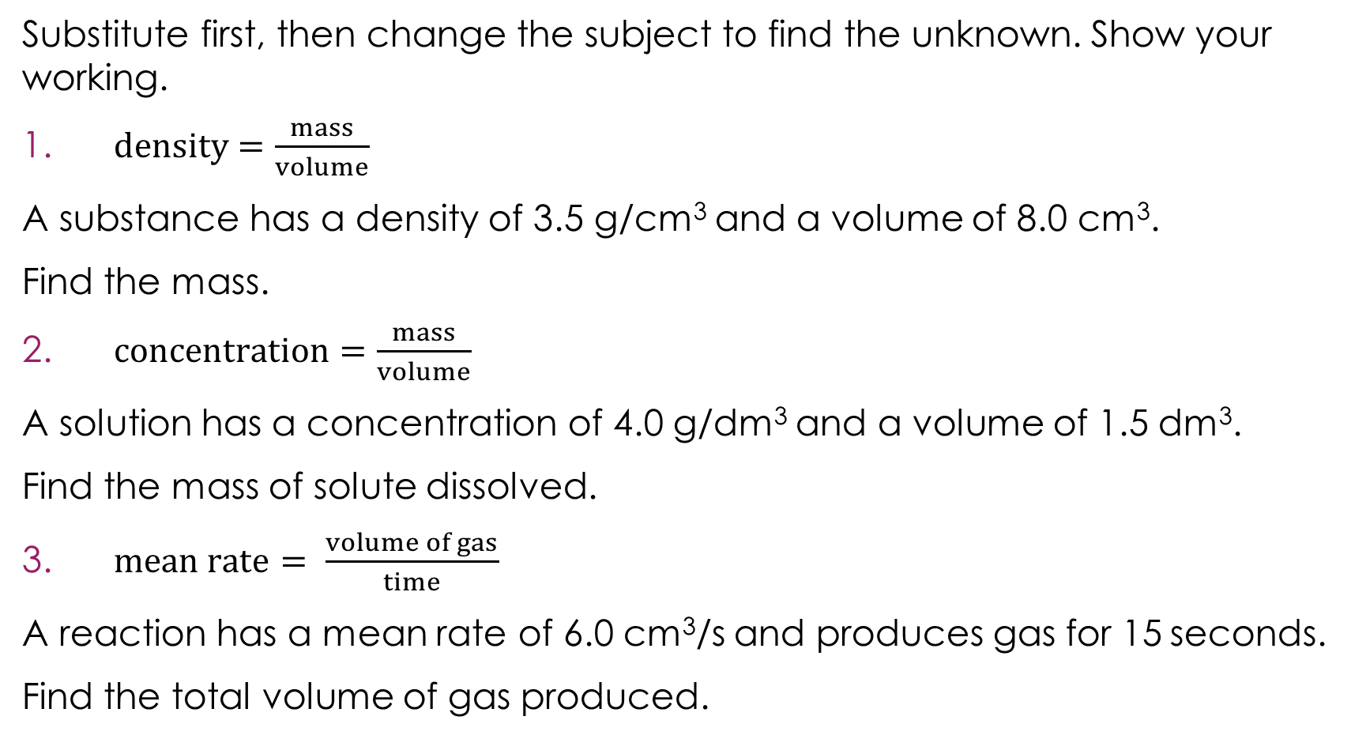
Changing the subject − one calculation
Substitute first, then change the subject to find the unknown. Show your working.
$density=\frac{mass}{volume}$
A substance has a density of 3.5 g/cm³ and a volume of 8.0 cm³.
Find the mass.
$concentration=\frac{mass}{volume}$
A solution has a concentration of 4.0 g/dm³ and a volume of 1.5 dm³.
Find the mass of solute dissolved.
$mean rate= \frac{volume of gas}{time}$
A reaction has a mean rate of 6.0 cm³/s and produces gas for 15 seconds.
Find the total volume of gas produced.
Activity
Notes:
These questions all have the unknown on the top of the division, so only one step is needed to change the subject. Allow learners time to attempt each one. Remind them to substitute first, then rearrange.

Slide 8
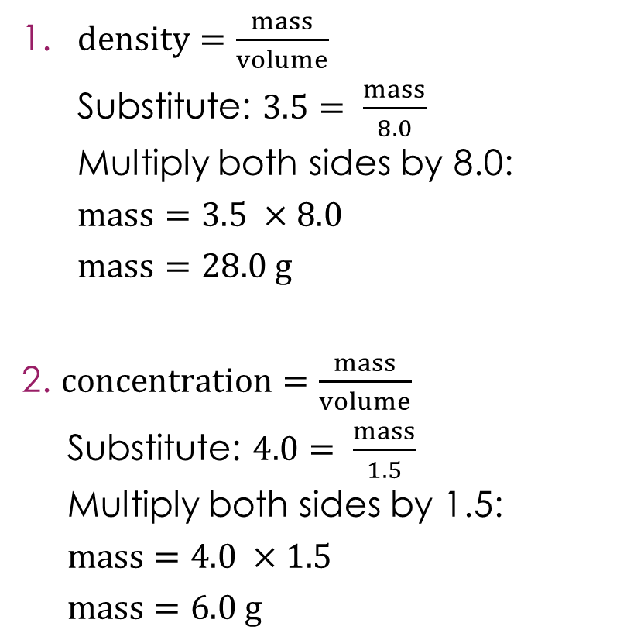
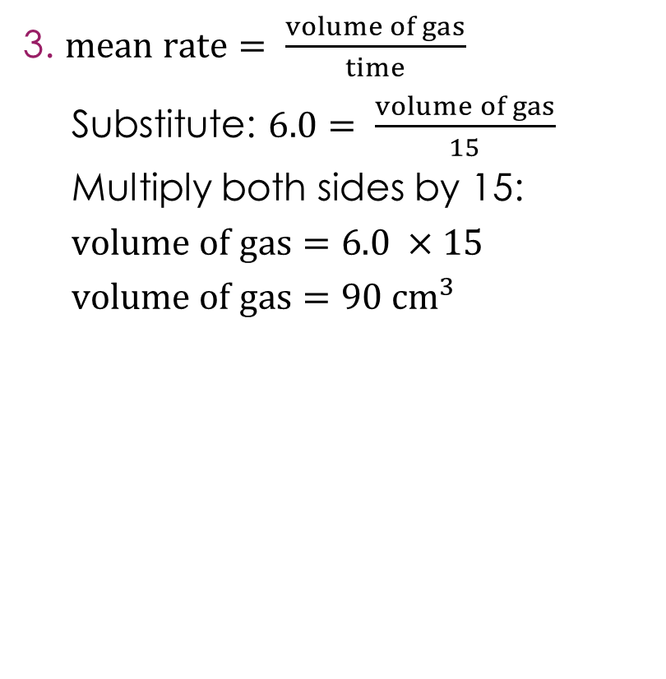
Changing the subject − one calculation – answers
$density=\frac{mass}{volume}$
Substitute: $3.5= \frac{mass}{8.0}$
Multiply both sides by 8.0:
$mass=3.5 ×8.0$
$mass=28.0 g$
$concentration=\frac{mass}{volume}$
Substitute: $4.0= \frac{mass}{1.5}$
Multiply both sides by 1.5:
$mass=4.0 ×1.5$
$mass=6.0 g$
$mean rate= \frac{volume of gas}{time}$
Substitute: $6.0= \frac{volume of gas}{15}$
Multiply both sides by 15:
$volume of gas=6.0 ×15$
$volume of gas=90 {cm}^{3}$
Answers
Notes:
Ask learners: how can you tell this is the one-step type? After substituting, the unknown is being divided by a number (e.g. $mass ÷ 8.0$). The unknown is on the top, so one multiplication gets it on its own.
Discuss: compare these with the substitution questions on slide 5. The algebra is slightly harder because the unknown is not already the subject of the formula. But the process is the same: substitute, then use an inverse operation.

Slide 9
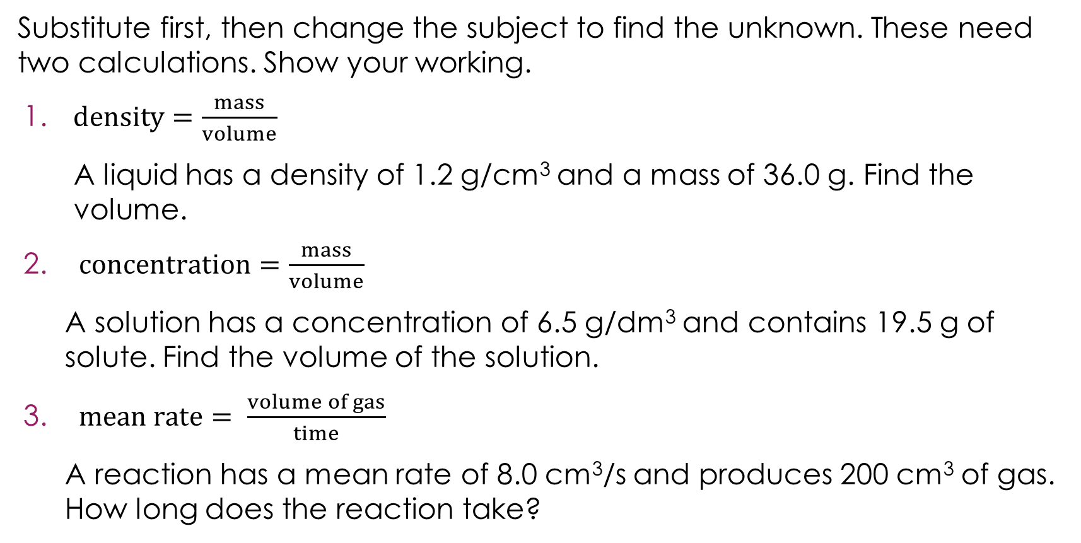
Changing the subject − two calculations
Substitute first, then change the subject to find the unknown. These need two calculations. Show your working.
$density=\frac{mass}{volume}$
A liquid has a density of 1.2 g/cm³ and a mass of 36.0 g. Find the volume.
$concentration=\frac{mass}{volume}$
A solution has a concentration of 6.5 g/dm³ and contains 19.5 g of solute. Find the volume of the solution.
$mean rate= \frac{volume of gas}{time}$
A reaction has a mean rate of 8.0 cm³/s and produces 200 cm³ of gas. How long does the reaction take?
Activity
Notes:
These questions all have the unknown on the bottom of the division, so two steps are needed. Allow learners time to attempt each one. Remind them to substitute first, then use two inverse operations to change the subject.

Slide 10
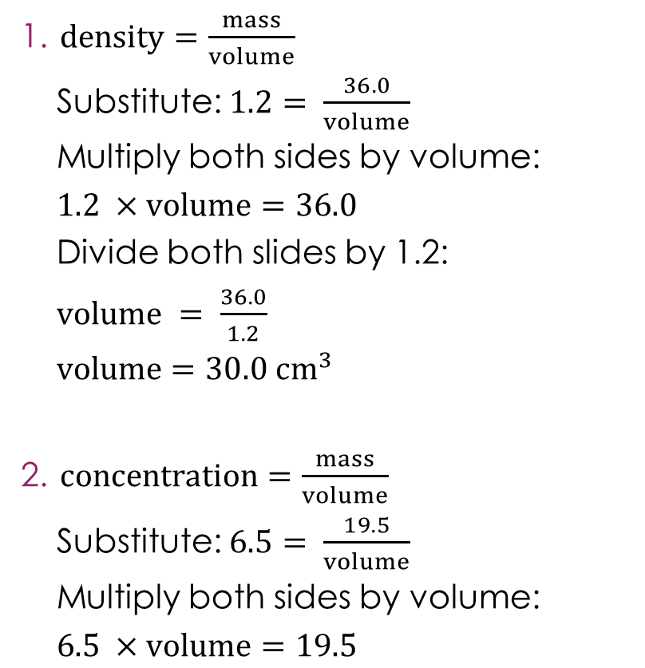
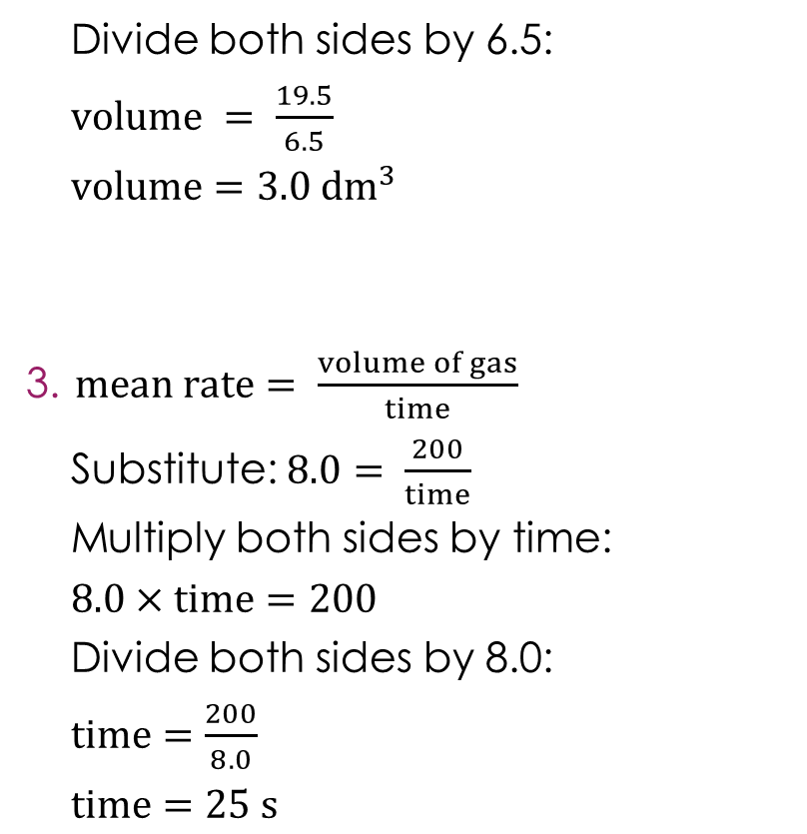
Changing the subject − two calculations – answers
$density=\frac{mass}{volume}$
Substitute: $1.2= \frac{36.0}{volume}$
Multiply both sides by volume:
$1.2 ×volume=36.0$
Divide both slides by 1.2:
$volume = \frac{36.0}{1.2}$
$volume=30.0{ cm}^{3}$
$concentration=\frac{mass}{volume}$
Substitute: $6.5= \frac{19.5}{volume}$
Multiply both sides by volume:
$6.5 ×volume=19.5$
Divide both sides by 6.5:
$volume = \frac{19.5}{6.5}$
$volume=3.0{ dm}^{3}$
$mean rate= \frac{volume of gas}{time}$
Substitute: $8.0= \frac{200}{time}$
Multiply both sides by time:
$8.0×time=200$
Divide both sides by 8.0:
$time=\frac{200}{8.0}$
$time=25 s$
Answers
Notes:
Ask learners: how can you tell this is the two-step type? After substituting, the unknown is the letter that the number is being divided by (e.g. $36.0÷volume$). The unknown is on the bottom, so you need to multiply both sides by the unknown first to bring it to the top, then divide to get it on its own.
Discuss: compare these with the one-step questions on slide 7. Ask learners: what is the key difference? In slide 7, the unknown was on the top (being divided by a number). Here, the unknown is on the bottom (a number is being divided by it). Recognising which type a question is before starting helps learners plan their working.

Slide 11
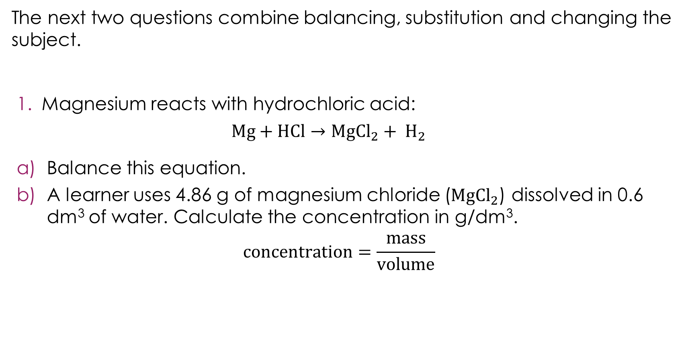
Putting it all together
The next two questions combine balancing, substitution and changing the subject.
Magnesium reacts with hydrochloric acid:
$$Mg+HCl→Mg{Cl}_{2}+ H_{2}$$
Balance this equation.
A learner uses 4.86 g of magnesium chloride ($Mg{Cl}_{2}$) dissolved in 0.6 dm³ of water. Calculate the concentration in g/dm³.
$$concentration=\frac{mass}{volume}$$
Activity
Notes:
This question combines multiple skills. Allow learners time to attempt each one. Encourage them to identify which skills are needed before starting.

Slide 12
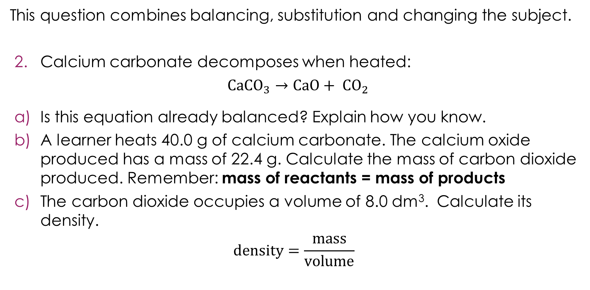
Putting it all together 2
This question combines balancing, substitution and changing the subject.
Calcium carbonate decomposes when heated:
$Ca{CO}_{3}→CaO+ {CO}_{2}$
Is this equation already balanced? Explain how you know.
A learner heats 40.0 g of calcium carbonate. The calcium oxide produced has a mass of 22.4 g. Calculate the mass of carbon dioxide produced. Remember: mass of reactants = mass of products
The carbon dioxide occupies a volume of 8.0 dm³. Calculate its density.
$$density=\frac{mass}{volume}$$
Activity
Notes:
This question combines multiple skills. Allow learners time to attempt each one. Encourage them to identify which skills are needed before starting.

Slide 13
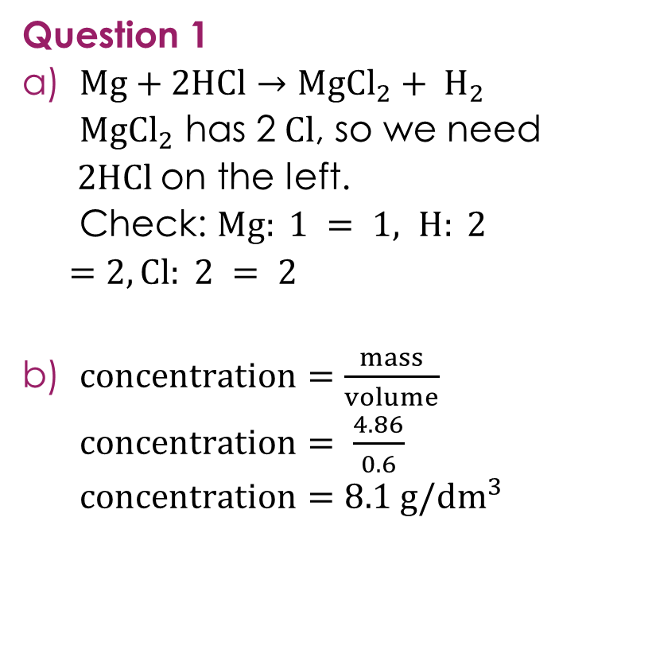
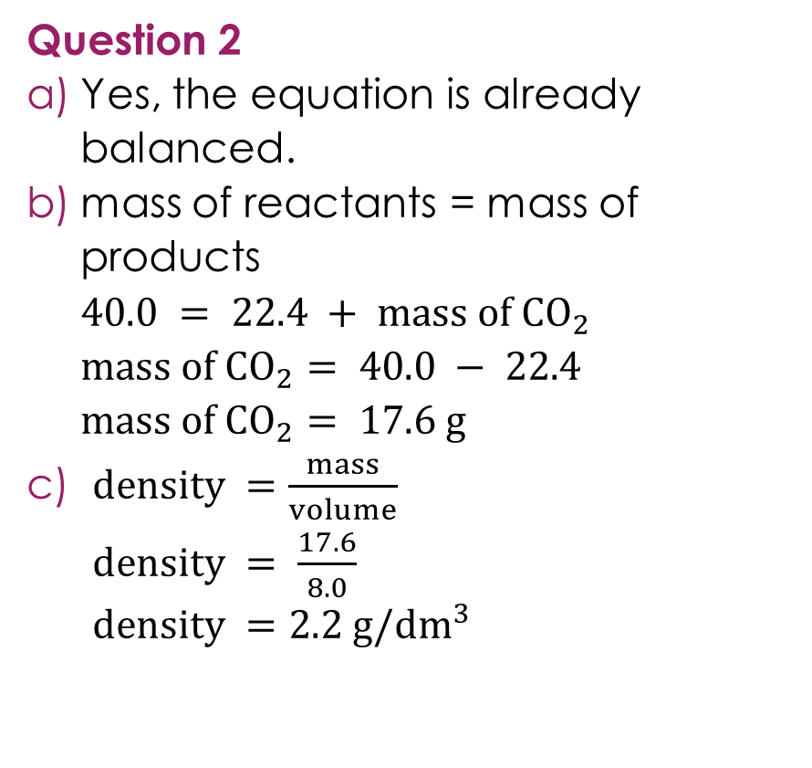
Putting it all together – answers
Question 1
$Mg+2HCl→Mg{Cl}_{2}+ H_{2}$
$Mg{Cl}_{2}$ has 2$Cl$, so we need $2HCl$on the left.
Check: $Mg: 1 = 1, H: 2 =2, Cl: 2 = 2$
$concentration=\frac{mass}{volume}$
$concentration= \frac{4.86}{0.6}$
$concentration=8.1 g/{dm}^{3}$
Question 2
Yes, the equation is already balanced.
mass of reactants = mass of products
$40.0 = 22.4 + mass of {CO}_{2}$
$mass of {CO}_{2}= 40.0 − 22.4$
$mass of {CO}_{2}= 17.6 g$
$density =\frac{mass}{volume}$
$density = \frac{17.6}{8.0}$
$density =2.2 g/{dm}^{3}$
Answers
Notes:
Discuss: question 2 is a multi-step problem. Part (b) uses conservation of mass from stage 1. Part (c) uses the answer from part (b) as the mass in the density formula. Ask learners: what would happen if they got part (b) wrong? Their answer to part (c) would also be wrong, even if they used the formula correctly. This is why showing working is important, as examiners can award marks for correct method even if an earlier error carries through.

Slide 14
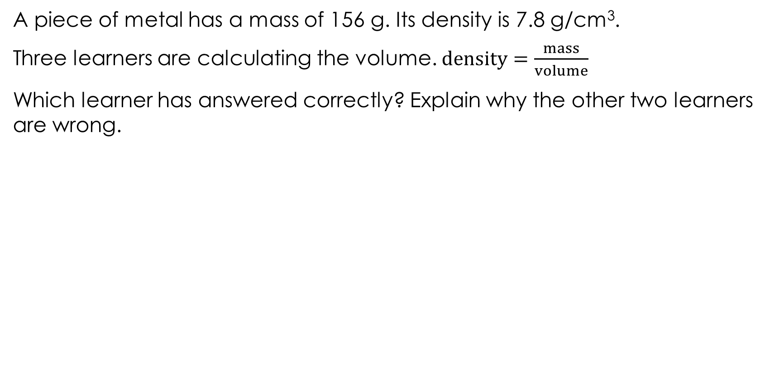
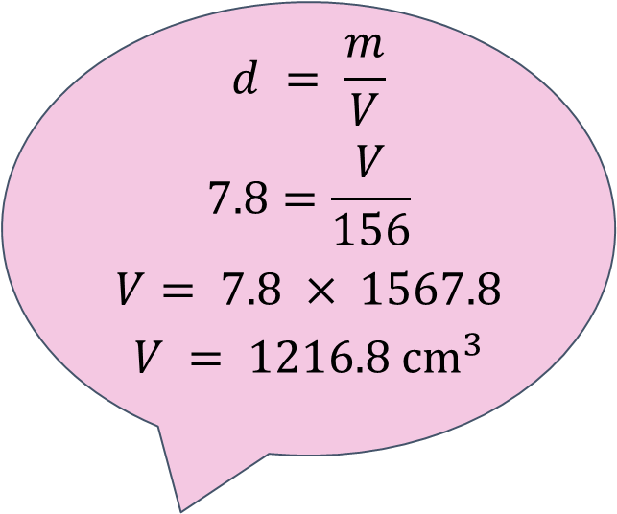
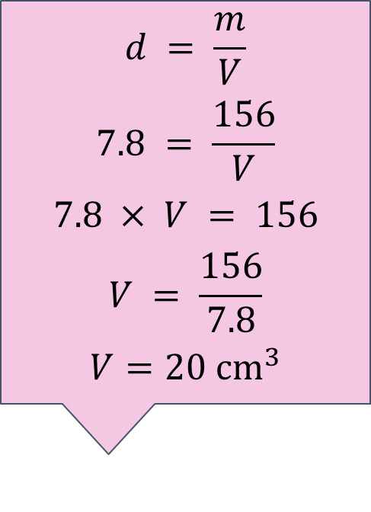
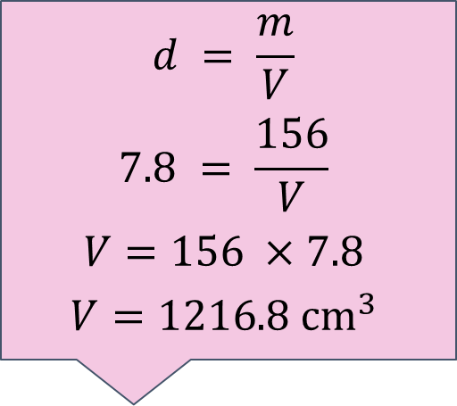
Discussing algebra in chemistry
A piece of metal has a mass of 156 g. Its density is 7.8 g/cm³.
Three learners are calculating the volume. $density=\frac{mass}{volume}$
Which learner has answered correctly? Explain why the other two learners are wrong.
Activity
Learner B
Learner C
Learner A
$$d = \frac{m}{V}$$
$$7.8 = \frac{156}{V}$$
$$7.8 × V = 156$$
$$V = \frac{156}{7.8}$$
$${V=20 cm}^{3}$$
$$d = \frac{m}{V}$$
$$7.8=\frac{V}{156}$$
$$V= 7.8 × 1567.8$$
$$V = 1216.8 {cm}^{3}$$
$$d = \frac{m}{V}$$
$$7.8 = \frac{156}{V}$$
$$V=156 ×7.8$$
$$V=1216.8 {cm}^{3}$$
Notes:
Ask learners to work through each learner's answer, in pairs or on mini whiteboards, before revealing which is correct.

Slide 15
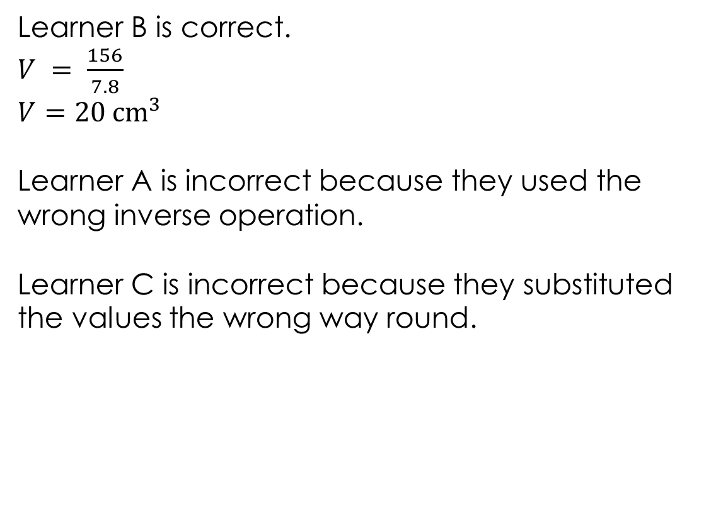

Discussing algebra in chemistry – answer
Learner B
Learner B is correct.
$V = \frac{156}{7.8}$
$${V=20 cm}^{3}$$
Learner A is incorrect because they used the wrong inverse operation.
Learner C is incorrect because they substituted the values the wrong way round.
$$d = \frac{m}{V}$$
$$7.8 = \frac{156}{V}$$
$$7.8 × V = 156$$
$$V = \frac{156}{7.8}$$
$${V=20 cm}^{3}$$
Answer
Notes:
Learner B is correct.
$V = \frac{156}{7.8}$
$${V=20 cm}^{3}$$
Learner A is incorrect because they used the wrong inverse operation. They correctly substituted ($7.8 = 156 ÷ V$) and correctly multiplied both sides by $V$ ($7.8 × V = 156$). But then they multiplied $156$ by $7.8$instead of dividing. They confused the second step. Ask learners: after $7.8 × V = 156$, what do we need to do to get $V$ on its own? Divide both sides by $7.8,$not multiply.
Learner C is incorrect because they substituted the values the wrong way round. They wrote $7.8 = V ÷ 156$instead of $7.8 = 156 ÷ V$. The formula says $density = mass ÷ volume$, so mass goes on the top and volume on the bottom. Learner C put volume on the top and mass on the bottom. Remind learners to look at the formula carefully before substituting.
Discuss: both Learner A and Learner C got the same wrong answer ($1216.8 {cm}^{3})$ but for completely different reasons. Ask learners: how could they have spotted the error? A density of $7.8 g/{cm}^{3}$is quite high, like the density of iron. A volume of $1216.8 {cm}^{3}$ for $156 g$of a dense metal doesn't make sense. That would be over a litre. Checking whether an answer is reasonable is a good habit.
Ask: which type of rearrangement is this? The unknown ($V$) is on the bottom of the division, so it is the two-step type from slide 4. Learner B correctly used both steps.

