Slide 1

Stage 1
Understanding number: significant figures and rounding
Downloaded from: rsc.li/4gbEt3p

Slide 2
Introduction
Scientists need to record measurements and calculations to an appropriate level of precision. Writing every calculator digit suggests false accuracy, while rounding too much loses important information. We will build on rounding skills from maths and learn to use significant figures.
Learning objectives
Understand what rounding means and why it is used in science.
Understand what significant figures are and why they matter in science.
Round numbers to a given number of significant figures.
Choose an appropriate number of significant figures when recording measurements and carrying out calculations.
Introduction

Slide 3
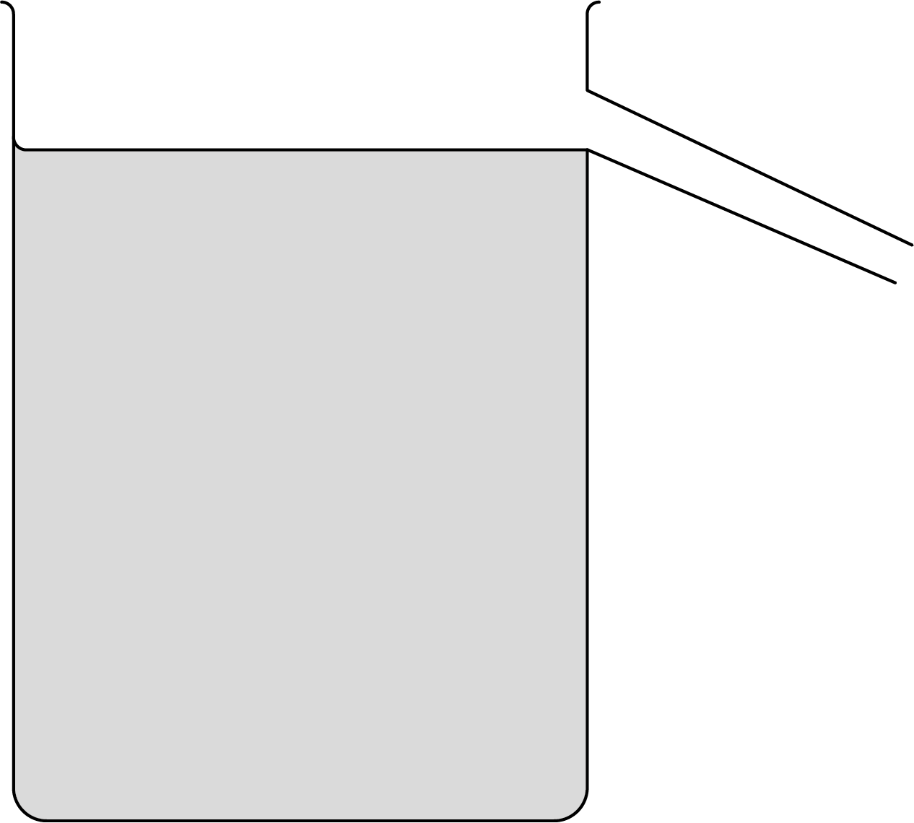
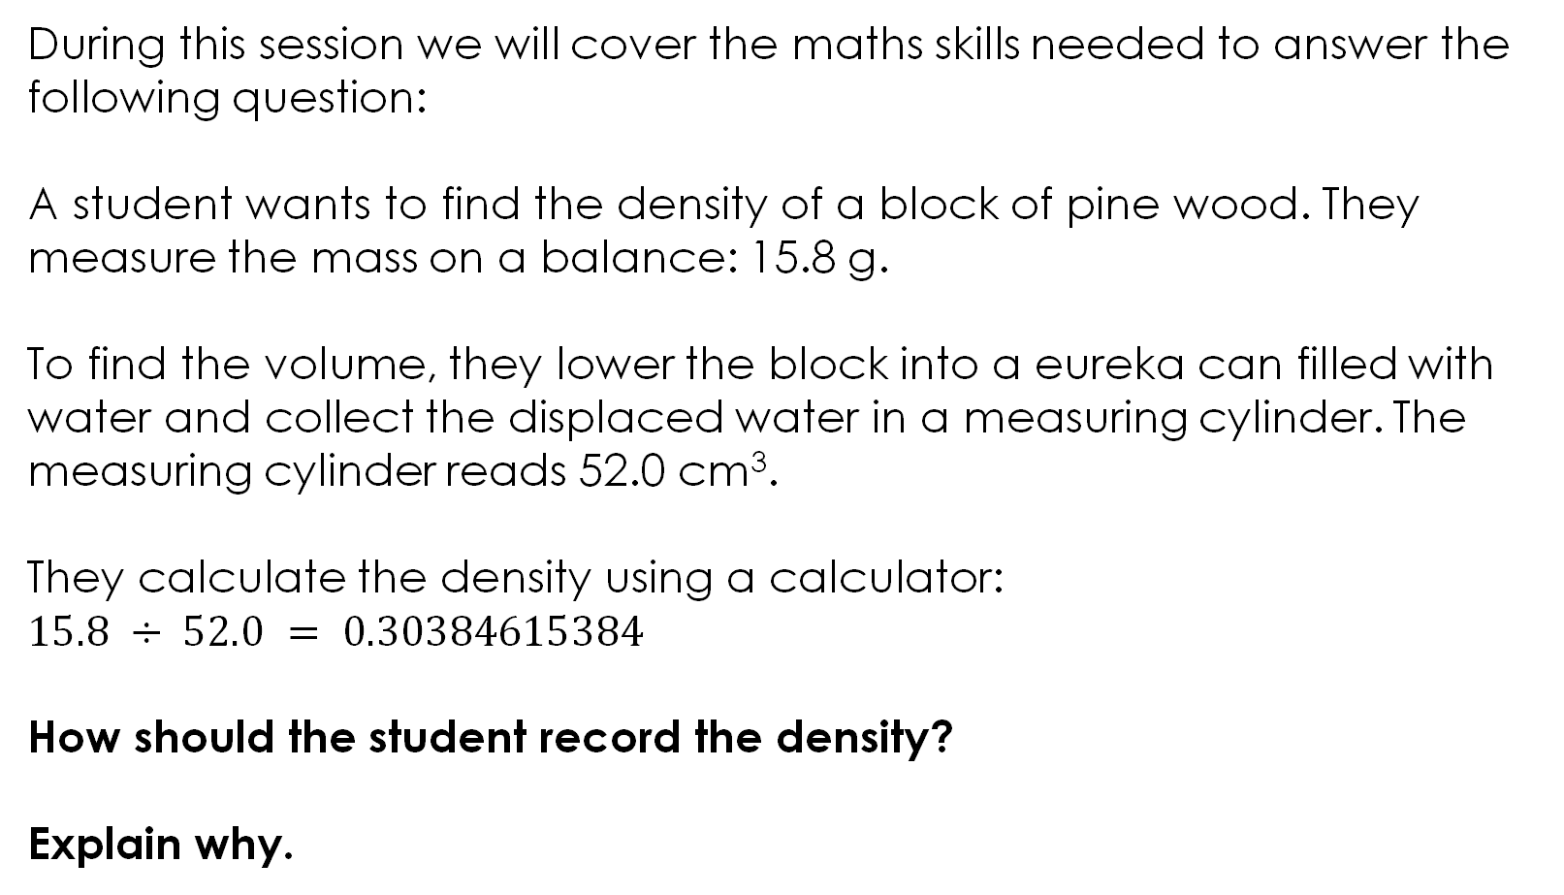
Lesson question
During this session we will cover the maths skills needed to answer the following question:
A student wants to find the density of a block of pine wood. They measure the mass on a balance: 15.8 g.
To find the volume, they lower the block into a eureka can filled with water and collect the displaced water in a measuring cylinder. The measuring cylinder reads 52.0 cm³.
They calculate the density using a calculator:
$$15.8 ÷ 52.0 = 0.30384615384$$
How should the student record the density?
Explain why.
Lesson question
Notes:
This slide introduces the challenge question that learners will return to at the end of the session. Learners are not expected to attempt it at this point. Explain what a eureka can is. Show an example if you have one available.
Briefly talk through the scenario: a learner has measured the mass and volume of a block of wood and calculated the density using a calculator. The calculator has given a long string of digits. By the end of the session, learners will have the skills to decide how this answer should be recorded and be able to explain why.
You can ask learners: ‘What do you think the problem is with this answer?’ to prompt initial thinking, but a full attempt is not needed here. The question is designed to elicit the most common mistakes made during this type of calculation.

Slide 4
Rounding recap
Rounding makes numbers simpler and easier to work with. In science, we also round because our measurements have limited precision. Our answer should match the precision of the equipment we used.
In maths, you have been taught how to round to the nearest 10, 100, and to decimal places. The same process is used in science.
Round the following numbers:
3.456 to 1 decimal place
7.823 to 2 decimal places
0.0483 to 2 decimal places
Activity
Notes:
This slide should feel like revision for most learners, rounding should be familiar from the primary phrase. Explain that the purpose is to activate prior knowledge and show that the core rounding process (identify the digit, look at the decider, round up or down) is already familiar from maths.
Discuss each example, asking learners to identify the decider digit before you reveal the answer.
Question (c) is the most useful for discussion. Some learners may write 0.048, which is rounding to 3 d.p. rather than 2 d.p. Remind learners that decimal places are counted from the decimal point: the first decimal place is the 0, the second is the 4, so the decider is 8.
This example also foreshadows the problem with decimal places that comes on the next slide – rounding 0.0483 to 2 d.p. gives 0.05, which has lost most of the useful information. Significant figures will offer a better approach.
Do a quick mini whiteboard check to confirm understanding: ‘round 4.271 to 1 d.p.’ (answer: 4.3).
This is deliberately quick – the main content of the session is significant figures, which comes next.

Slide 5
Rounding recap – answers
Round the following numbers:
3.456 to 1 decimal place
Look at the 2nd decimal place digit: 5. This is 5 or more, so round up.
Answer: 3.5
7.823 to 2 decimal places
Look at the 3rd decimal place digit: 3. This is less than 5, so round down.
Answer: 7.82
0.0483 to 2 decimal places
Look at the 3rd decimal place digit: 8. This is 5 or more, so round up.
Answer: 0.05
Answers
Notes:
Question (c) is the most useful for discussion. Some learners may write 0.048, which is rounding to 3 d.p. rather than 2 d.p. Remind learners that decimal places are counted from the decimal point: the first decimal place is the 0, the second is the 4, so the decider is 8.
This example also foreshadows the problem with decimal places that comes on the next slide – rounding 0.0483 to 2 d.p. gives 0.05, which has lost most of the useful information. Significant figures will offer a better approach.
Do a quick mini whiteboard check to confirm understanding: ‘round 4.271 to 1 d.p.’ (answer: 4.3).
This is deliberately quick – the main content of the session is significant figures, which comes next.

Slide 6
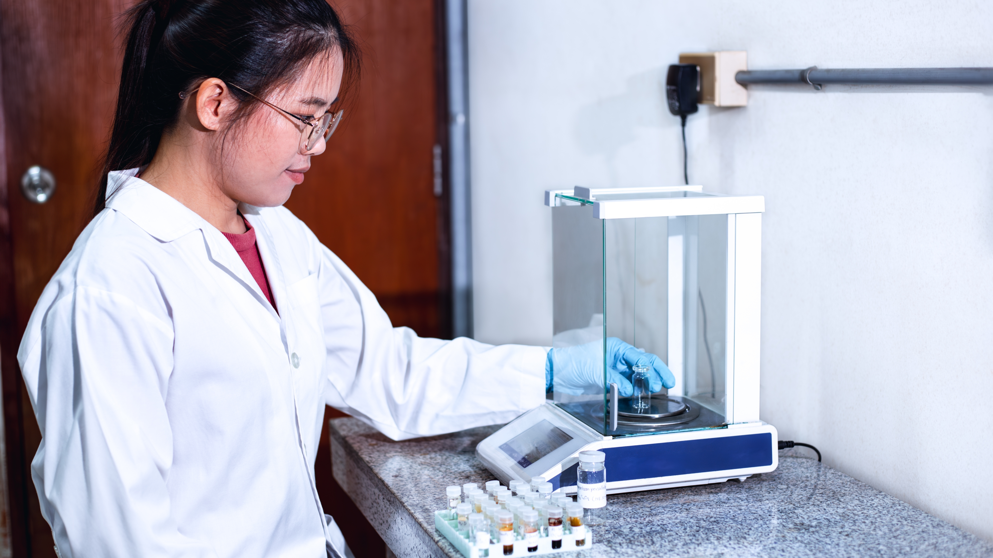
The problem with decimal places in science
Rounding to decimal places works well for some numbers. But what happens with very small numbers?
A scientist uses a sensitive balance to measure 0.00247 g of a chemical in a lab.
What would happen if they rounded the number to 1 decimal place?
0.0 g
What if they round to 2 significant figures instead?
0.0025 g
Notes:
This slide is the bridge between what learners know (decimal places) and what they need to learn (significant figures – s.f.). This slide is animated so you can reveal answers to learners as you teach.
Ask learners to work out what 0.00247 rounded to 1 d.p. would be before revealing the answer.
Answer: 0.0 g – all the useful information has been lost.
Then ask: what if we round to 2 significant figures instead?
Answer: 0.0025 g – the important information is kept.
Explain that decimal places count from the decimal point, but significant figures count from the first meaningful digit. For very small numbers, rounding to decimal places can destroy the information.
Learners may ask why a scientist would measure such a small mass. Describe how analytical balances in research laboratories can measure to 0.00001 g (five decimal places). Analytical balances in laboratories can measure to 4–6 decimal places depending on the model. This is far more precise than the balances learners use in school, but the principle is the same – the number of digits we record must reflect the precision of the equipment.
Discuss very large numbers to reinforce the point: a population of 7,894,352 rounded to 1 d.p. is still 7,894,352.0 – decimal places don't help there either. Significant figures would give 7,900,000 (2 s.f.), which is much more useful.
Learners should leave this slide understanding why significant figures exist, not just how to use them. The rest of the session builds on this motivation.
Image © S. Singha/Shutterstock

Slide 7
What are significant figures?
Significant figures (s.f.) tell us how precise a number is. They count the meaningful digits (the significant digits), regardless of where the decimal point is.
So, how do we work out which digits are significant?
Rule 1: All non-zero digits are significant.
247 is to 3 s.f.
Rule 2: Zeros between non-zero digits are significant.
204 is to 3 s.f.
Rule 3: Leading zeros are not significant digits.
0.003 is to 1 s.f.
Rule 4: Trailing zeros after a decimal point are significant.
2.50 is to 3 s.f.
Notes:
Explain that significant figures (s.f.) tell us how precise a number is by counting the meaningful digits, regardless of where the decimal point sits.
Discuss with learners the comparison of 3 g, 3.0 g and 3.00 g. Ask: are these the same number?
Mathematically yes, but in science they communicate different things. 3.00 g means the measurement was made with a more precise instrument than 3 g. The trailing zeros tell the reader something important about the precision of the equipment.
Discuss the fact that all non-zero digits are significant – this is straightforward and learners rarely make errors with this rule. It is deciding whether the zeros are significant or not that makes the process difficult and is where learners make the most mistakes. Emphasise that rules 2, 3 and 4 are all about zeros.
Work through the four rules with learners:
Rule 1: All non-zero digits are significant. 247 has 3 s.f. – this is the easiest rule and learners are usually confident with it.
Rule 2: Zeros between non-zero digits (trapped zeros) are significant. 204 has 3 s.f., not 2.
Ask learners: why does this zero count? Because it is part of the number – removing it would change 204 to 24, which is a completely different value.
Rule 3: Leading zeros are not significant – they are just placeholders showing where the decimal point is. 0.003 has only 1 s.f. Explain that the zeros in 0.003 are not telling us anything about precision – they are just positioning the 3.
Ask: what would happen if we removed them? We couldn't – the number would become 3, which is a thousand times bigger. So, the zeros are necessary, but they don't carry information about precision.
Rule 4: Trailing zeros after a decimal point are significant. 2.50 has 3 s.f.
Ask learners: why did someone bother writing that zero? Because it tells us the measurement was precise to the hundredths – the equipment could distinguish between 2.50 and 2.51. If the zero didn't matter, they would have just written 2.5.
Discuss: what about trailing zeros without a decimal point? For example, is 6500 given to 2, 3, or 4 s.f.? This is genuinely ambiguous, which is why in science we can use standard form to remove doubt ($6.5 × 103 = 2 s.f.$, $6.50 × 103 = 3 s.f.$). You can mention this briefly here or save it for the practice slide.
Extension task: Ask learners to write down a number that has exactly 4 significant figures and includes at least one zero that is significant. Then ask them to write a number that has exactly 2 significant figures and includes at least one zero that is not significant. Discuss their examples as a class – this tests whether learners can apply the rules rather than just recall them.

Slide 8
How many significant figures?
For each value, identify the number of significant figures and which rule(s) have been applied:
Activity
Value | Number of significant figures | Which rule(s)?
45
3.07
0.025
1.00
0.0040
Notes:
Many learners think decimal places and significant figures are the same, this is a common misconception.
Ask learners to identify the number of significant figures for each value. This can be done individually, in pairs, or on mini whiteboards. Encourage learners to write down which rule(s) they used (see previous slide), not just the answer.

Slide 9
How many significant figures? – Answers
For each value, identify the number of significant figures and which rule(s) have been applied:
Answers
Value | Number of significant figures | Which rule(s)?
45 | 2 s.f. | Rule 1
3.07 | 3 s.f. | Rules 1 and 2
0.025 | 2 s.f. | Rules 1 and 3
1.00 | 3 s.f. | Rules 1 and 4
0.0040 | 2 s.f. | Rules 1, 3 and 4
Notes:
Answers:
45 – 2 s.f.
Rule 1: both digits are non-zero.
This is straightforward and builds confidence before the trickier examples.
3.07 – 3 s.f.
Rules 1 and 2: the 3 and 7 are non-zero (rule 1), and the zero is between two non-zero digits so it is significant (rule 2).
Ask: what would happen if a learner ignored the zero and said 2 s.f.? They would be treating 3.07 as if it were 3.7, which is a different number.
0.025 – 2 s.f.
Rules 1 and 3: the 2 and 5 are non-zero (rule 1), and the leading zeros are not significant (rule 3).
Discuss: learners often count the leading zeros and say 3 or 4 s.f. Remind them that leading zeros are just placeholders – they position the decimal point but don't carry information about precision.
1.00 – 3 s.f.
Rules 1 and 4: the 1 is non-zero (rule 1), and the trailing zeros after the decimal point are significant (rule 4).
Discuss: why isn't this just 1 s.f.? Because someone deliberately wrote those zeros to show that the measurement was precise to the hundredths. Explain that 1, 1.0 and 1.00 are mathematically equal but communicate different levels of precision in science.
0.0040 – 2 s.f.
Rules 1, 3 and 4: the 4 is non-zero (rule 1), the leading zeros are not significant (rule 3), and the trailing zero after the decimal point is significant (rule 4).
This is the most challenging example because it combines three rules. Learners may say 1 s.f. (only counting the 4), or 4 s.f. (counting every digit). Describe how to work through it: start from the left, skip the leading zeros until you reach the first non-zero digit (4), then count from there – the 4 and the trailing 0 are both significant.
Ask learners which examples they found most difficult. Discuss common errors and clarify any confusion before moving on to rounding.
Extension task: Ask learners to identify the number of significant figures in 6500. Discuss why this is ambiguous – we cannot tell whether the trailing zeros are significant or just placeholders. Explain that in science, standard form removes this ambiguity: $6.5 × {10}^{3}$ is 2 s.f., $6.50 × {10}^{3}$ is 3 s.f., and $6.500 ×{10}^{3}$ is 4 s.f.

Slide 10
Worked example
Round 0.04572 to 2 s.f. | Your turn
Step 1: Find the first significant figure First significant figure = 4 Step 2: Count to the required number of significant figures and identify the decider digit Decider digit = 7 Step 3: Round Round up as decider digit is greater than 5 Answer = 0.046 | Round 67.83 to 2 s.f. Round 0.00361 to 2 s.f. Round 4.997 to 3 s.f Round 25480 to 2 s.f.
Worked example
Notes:
Discuss the worked example step by step with learners before they attempt the practice questions.
Step 1: The leading zeros are not significant (rule 3). The first significant figure is 4.
Step 2: The second significant figure is 5. The decider digit is 7.
Step 3: The decider is 7, which is 5 or more, so round up. The 5 becomes 6.
Answer: 0.046
Ask learners: why do the leading zeros stay in the answer? Because they are placeholders – without them the number would be 46, which is a completely different value. Remind learners that rounding does not remove leading zeros.

Slide 11
Worked example - answers
Round 0.04572 to 2 s.f. | Your turn
Step 1: Find the first significant figure First significant figure = 4 Step 2: Count to the required number of significant figures and identify the decider digit Decider digit = 7 Step 3: Round Round up as decider digit is greater than 5 Answer = 0.046 | 68 0.0036 5.00 25000
Worked example – answers
Notes:
Practice answers:
First s.f. is 6, second s.f. is 7. Decider is 8 (≥5), so round up. Answer: 68
Leading zeros are not significant. First s.f. is 3, second s.f. is 6. Decider is 1 (<5), so round down. Answer: 0.0036
First s.f. is 4, second s.f. is 9, third s.f. is 9. Decider is 7 (≥5), so round up. The third s.f. (9) becomes 10, which cascades: 4.997 becomes 5.00. Answer: 5.00. This catches many learners out. Discuss: why must the answer be written as 5.00 and not 5? Because 5 is 1 s.f. and 5.00 is 3 s.f. – dropping the trailing zeros changes what the number communicates about precision. This links directly to rule 4 from slide 6.
First s.f. is 2, second s.f. is 5. Decider is 4 (<5), so round down. Answer: 25000 Discuss why we fill in zeros. Because without them the number would be 25, which is a thousand times smaller. The zeros are placeholders that keep the number the correct size.
Ask learners which question they found most difficult. Question (c) is typically the hardest because of the cascading rounding and the need to keep trailing zeros. Question (d) also causes problems because learners forget to fill in placeholder zeros.
Extension task: ask learners to round 0.009962 to 2 s.f. This combines the cascading rounding from question (c) with the leading zeros from question 2.
Answer: 0.010 – learners must keep both the leading zeros and the trailing zero. The first significant figure is the 1 (after rounding), and the trailing zero shows it is 2 s.f.

Slide 12
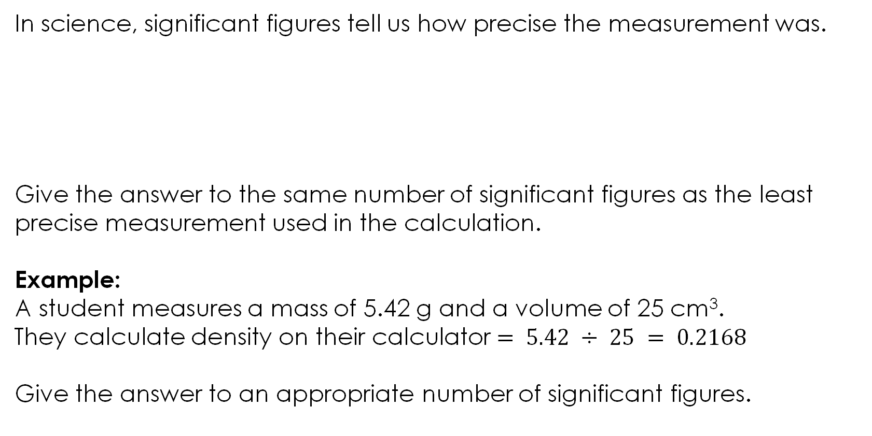
Why do significant figures matter in chemistry?
In science, significant figures tell us how precise the measurement was.
Give the answer to the same number of significant figures as the least precise measurement used in the calculation.
Example:
A student measures a mass of 5.42 g and a volume of 25 cm³.
They calculate density on their calculator $= 5.42 ÷ 25 = 0.2168$
Give the answer to an appropriate number of significant figures.
Balance reads: 12.35 g which is 4 s.f. | Measuring cylinder reads: 25 cm³ which is 2 s.f. | Thermometer reads 21.5 °C which is 3 s.f.
Notes:
Explain that, in science, the number of significant figures we write tells the reader how precise our measurement was. Different equipment gives different levels of precision.
Describe the three equipment examples:
A balance reading 12.35 g gives 4 s.f.
A measuring cylinder reading 25 cm³ gives 2 s.f.
A thermometer reading 21.5°C gives 3 s.f.
Ask learners: why do these have different numbers of significant figures? Discuss how different instruments measure to different levels of precision – a balance that reads to 2 decimal places is more precise than a measuring cylinder that reads to the nearest cm³.
Introduce the key rule: give your answer to the same number of significant figures as the least precise measurement used in the calculation. Explain that there is no point giving an answer to 4 s.f. if one of the measurements only had 2 s.f. – the answer cannot be more precise than the data it came from.
Worked example
Ask learners to attempt the example before revealing the answer.
Ask: which measurement is least precise? The volume, which is 2 s.f.
Ask: so how many significant figures should the answer have? 2 s.f.
Ask: what is 0.2168 rounded to 2 s.f.? First s.f. is 2, second s.f. is 1. Decider is 6 (≥5), so round up.
Answer: 0.22 g/cm³
Discuss: why not write 0.2168 g/cm³?
Because the measuring cylinder only measured to 2 s.f. – writing 4 s.f. suggests a level of precision that the equipment did not have. The calculator does not know how precise the measurements were – the learner must decide.
Discuss: why not write 0.2 g/cm³?
Because that is only 1 s.f., which throws away precision that the data does support. The volume justified 2 s.f., so the answer should be 2 s.f.
Explain that this is where science differs from maths. In maths, learners are often told ‘give your answer to 2 d.p.’ – the precision is specified in the question. In science, the appropriate precision comes from the data itself.
Extension task
A learner measures a mass of 24.81 g on a balance and a volume of 8.2 cm³ using a measuring cylinder. They calculate density = 3.025609756 on their calculator. How should they record their answer?
Answer: 3.0 g/cm³ (2 s.f., matching the volume).
Discuss: why must they write 3.0 and not 3? Because 3 is 1 s.f. but 3.0 is 2 s.f. This reinforces the trailing zero issue.

Slide 13
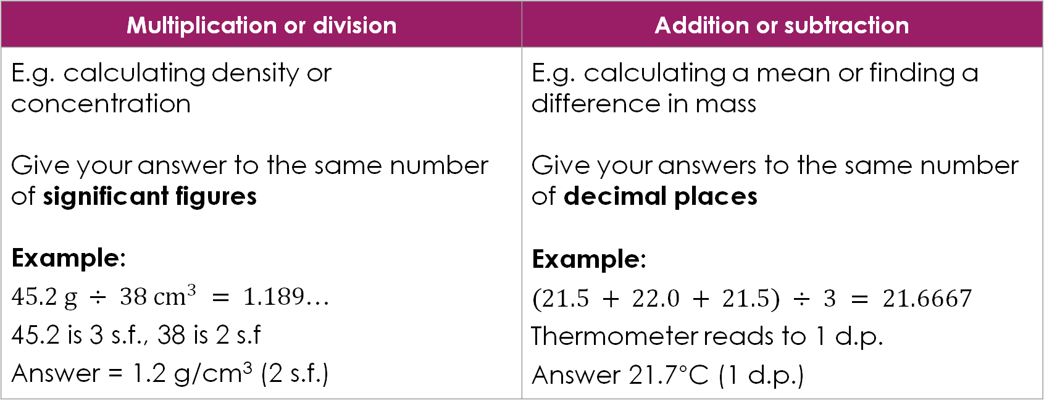
Do I use significant figures or decimal places?
It depends on the type of calculation and the mathematical operation that you are using:
Multiplication or division | Addition or subtraction
E.g. calculating density or concentration Give your answer to the same number of significant figures Example: $45.2 g ÷ 38 {cm}^{3} = 1.189$… 45.2 is 3 s.f., 38 is 2 s.f Answer = 1.2 g/cm³ (2 s.f.) | E.g. calculating a mean or finding a difference in mass Give your answers to the same number of decimal places Example: $(21.5 + 22.0 + 21.5) ÷ 3 = 21.6667$ Thermometer reads to 1 d.p. Answer 21.7°C (1 d.p.)
Notes:
Explain that the rule learners use depends on the type of calculation they are doing. This is a convention used in science – it is not something learners will have met in maths.
Note: This distinction between the two rules is a simplification appropriate for lower and upper secondary. At post-16, learners calculate uncertainties explicitly using propagation rules, which replaces these guidelines with a more rigorous quantitative approach. However, these two principles are a solid foundation that covers the majority of situations learners will encounter.
Describe how for multiplication or division, the answer should have the same number of significant figures as the least precise value used in the calculation. Walk through the example.
Round to 2 s.f.: first s.f. is 1, second s.f. is 1. Decider is 8 (≥5), so round up.
Answer: 1.2 g/cm³
Ask: why not 1.189? Because the measuring cylinder only measured to 2 s.f. – the answer cannot be more precise than the equipment.
Explain that for addition or subtraction, the answer should have the same number of decimal places as the equipment used. Walk through the example.
The values are from a thermometer that reads to 1 d.p.
Calculator gives 2.799... (this occurs because of the way calculators handle decimal arithmetic)
The thermometer reads to 1 d.p., so the answer should be to 1 d.p.
Answer: 21.7°C
Ask: why not write 21.6667? Because the thermometer only measures to 0.1°C – writing four decimal places suggests a level of precision the equipment does not have. A mean of repeated measurements from the same instrument should match the precision of that instrument.
Note for teachers: Many exam boards accept a mean quoted to one more significant figure than the raw data if it is the exact result of the calculation. This nuance is not addressed at this level but may be relevant at upper secondary and post-16.

Slide 14
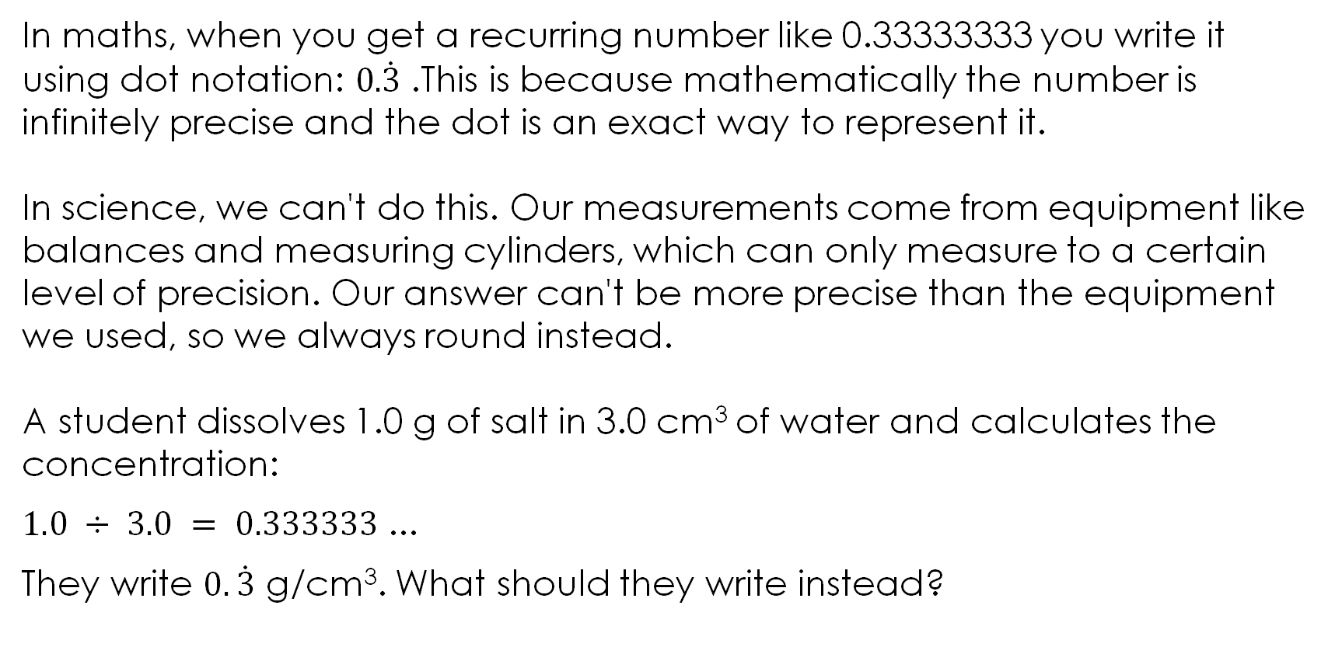
Recurring numbers
In maths, when you get a recurring number like 0.33333333 you write it using dot notation: 0.$\dot{3}$. This is because mathematically the number is infinitely precise and the dot is an exact way to represent it.
In science, we can't do this. Our measurements come from equipment like balances and measuring cylinders, which can only measure to a certain level of precision. Our answer can't be more precise than the equipment we used, so we always round instead.
A student dissolves 1.0 g of salt in 3.0 cm³ of water and calculates the concentration:
$1.0 ÷ 3.0 = 0.333333$...
They write $0.\dot{3}$ g/cm³. What should they write instead?
Notes:
This is a direct conflict with what learners learn in maths, so address it explicitly.
0.33 g/cm³ (2 s.f., matching the least precise measurement). The recurring dot notation has no place in a science answer.
In maths, recurring notation is elegant and exact. In science, it is meaningless because no measurement is infinitely precise. Some learners may argue that 0.3 is ‘more accurate’ than 0.33 - the response is that accuracy in science is limited by the equipment, not by the mathematics. The dot notation has no place in a science answer.

Slide 15
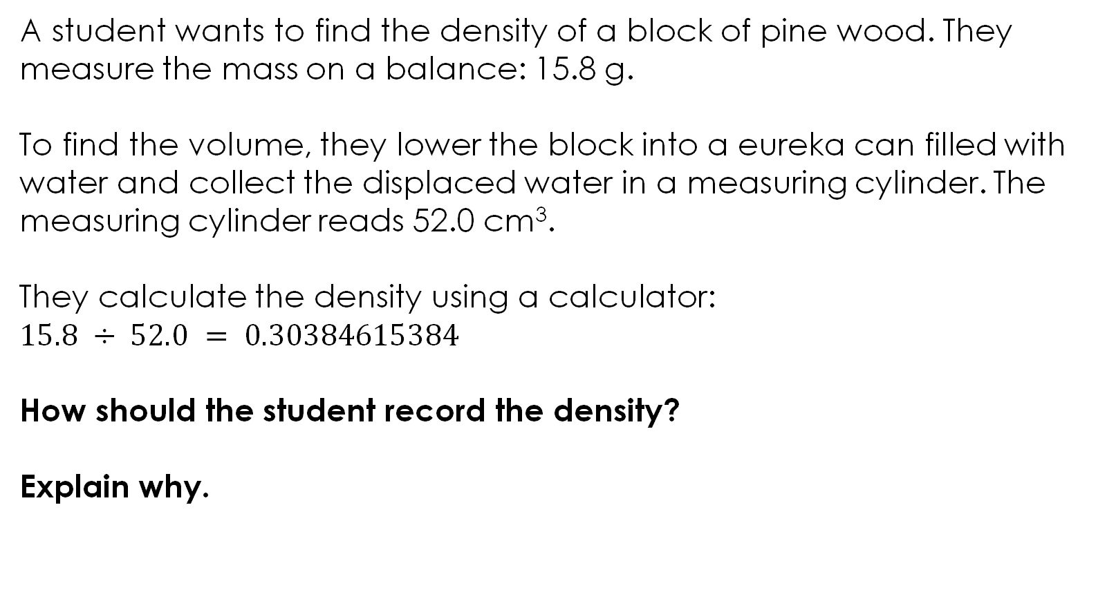
Returning to the lesson question:
A student wants to find the density of a block of pine wood. They measure the mass on a balance: 15.8 g.
To find the volume, they lower the block into a eureka can filled with water and collect the displaced water in a measuring cylinder. The measuring cylinder reads 52.0 cm³.
They calculate the density using a calculator:
$15.8 ÷ 52.0 = 0.30384615384$
How should the student record the density?
Explain why.
Lesson question
Notes:
Return to the challenge question from the start of the session. Allow students time to attempt it independently before discussing as a class. This question tests multiple skills simultaneously: choosing the correct number of significant figures, identifying which digits are significant (including the trapped zero), and rounding correctly. Common errors students make are written below the answer.

Slide 16
Returning to the lesson question – answers
How should the student record the density?
Explain why.
The correct answer is 0.304 g/cm³ (3 significant figures).
The answer should be given to 3 s.f. because this is a division and the rule is to match the least number of significant figures from the data. The mass (15.8 g) is 3 s.f. and the volume (52.0 cm³) is 3 s.f., so the answer should be 3 s.f.
To round 0.30384615384 to 3 s.f.: the first three significant figures are 3, 0 and 3 (leading zeros are not significant, but the trapped zero is). The decider digit is 8 (≥5), so round up to give 0.304 g/cm³.
Answers
Notes:
Answer:
The correct answer is 0.304 g/cm³ (3 significant figures).
The answer should be given to 3 s.f. because this is a division and the rule is to match the least number of significant figures from the data. The mass (15.8 g) is 3 s.f. and the volume (52.0 cm³) is 3 s.f., so the answer should be 3 s.f.
To round 0.30384615384 to 3 s.f.: the first three significant figures are 3, 0 and 3 (leading zeros are not significant, but the trapped zero is). The decider digit is 8 (≥5), so round up to give 0.304 g/cm³.
Common errors:
Error 1 – matching decimal places instead of significant figures. Learners write 0.3 g/cm³ because both measurements are to 1 d.p. This is the wrong rule – for division, match significant figures, not decimal places. The d.p. rule applies to addition and subtraction. This is the most likely error because it sounds reasonable.
Error 2 – truncating instead of rounding. Learners write 0.303 g/cm³. They have correctly identified 3 s.f. but chopped rather than rounded. The digit after the third s.f. is 8, so the 3 should round up to 4.
Error 3 – counting leading zeros as significant. Learners write 0.30 g/cm³, claiming 3 s.f. They have counted the leading zero as significant. Rule 3 from slide 6: leading zeros are never significant.
Error 4 – miscounting significant figures. Learners write 0.3038 g/cm³ (4 s.f.) or 0.30 g/cm³ (2 s.f.). Revisit the rules – the trapped zero between the 3s is significant (rule 2), but leading zeros are not (rule 3).
Error 5 – copying the calculator. Learners write 0.30384615384 g/cm³. This is shown on the slide, so students are unlikely to do it – but it is a useful discussion point. Ask: what does writing 11 significant figures imply about the precision of a school balance and measuring cylinder?

Slide 17
Acknowledgements
Image on slide 3 and 15 © Royal Society of Chemistry
Image on slide 6 © S. Singha/Shutterstock

