Slide 1

Stage 1
Understanding number:
significant figures and rounding
Downloaded from: rsc.li/4gbEt3p

Slide 2
Introduction
Scientists need to record measurements and calculations to an appropriate level of precision. Writing every calculator digit suggests false accuracy, while rounding too much loses important information. We will be building on your rounding skills from maths to learn to use significant figures.
Learning objectives
Understand what rounding means and why it is used in science.
Understand what significant figures are and why they matter in science.
Round numbers to a given number of significant figures.
Choose an appropriate number of significant figures when recording measurements and carrying out calculations.
Introduction

Slide 3
Significant figure and rounding
State the number of significant figures (s.f.) and which rule(s) apply.
302
0.071
4.60
0.500
10.03
Round each example to the given number of s.f.
3.782 to 2 s.f.
0.02854 to 2 s.f.
1647 to 3 s.f.
0.5985 to 3 s.f.
7.996 to 3 s.f.
Activity
Notes:
It may be useful to recap the rules presented in the teacher-led presentation (slide 7, full presentation from: rsc.li/4gbEt3p).
How do we work out which digits are significant?​
Rule 1: All non-zero digits are significant.​
Rule 2: Zeros between non-zero digits are significant. ​
Rule 3: Leading zeros are not significant digits.​
Rule 4: Trailing zeros after a decimal point are significant.​

Slide 4
Significant figure and rounding – answers
1.
3 s.f. Rules 1 and 2
2 s.f. Rules 1 and 3
3 s.f. Rules 1 and 4
3 s.f. Rules 1, 3 and 4
4 s.f. Rules 1 and 2
2.
3.8
0.029
1650
0.599
8.00
Answers
Notes:
Identifying significant figures:
The 3 and 2 are non-zero (rule 1), and the zero is between non-zero digits so it is significant (rule 2).
The 7 and 1 are non-zero (rule 1), and the leading zeros are not significant (rule 3).
The 4 and 6 are non-zero (rule 1), and the trailing zero after the decimal point is significant (rule 4).
The 5 is non-zero (rule 1), the leading zeros are not significant (rule 3), and the two trailing zeros after the decimal point are significant (rule 4). Learners may say 1 s.f. (only counting the 5) or 4 s.f. (counting every digit).
The 1 and 3 are non-zero (rule 1), and both zeros are between non-zero digits, so they are significant (rule 2).
Rounding:
3.782 to 2 s.f. First s.f. is 3, second s.f. is 7. Decider is 8 (≥5), round up.
0.02854 to 2 s.f. Leading zeros are not significant. First s.f. is 2, second s.f. is 8. Decider is 5 (≥5), round up.
1647 to 3 s.f. First s.f. is 1, second s.f. is 6, third s.f. is 4. Decider is 7 (≥5), round up. Learners must fill in the placeholder zero. Without it the number would be 165, which is ten times too small.
0.5985 to 3 s.f. First s.f. is 5, second s.f. is 9, third s.f. is 8. Decider is 5 (≥5), round up.
7.996 to 3 s.f. First s.f. is 7, second s.f. is 9, third s.f. is 9. Decider is 6 (≥5), round up. The 9 becomes 10, which cascades: 7.996 becomes 8.00. Discuss: why must the answer be written as 8.00 and not 8? Because 8 is 1 s.f. and 8.00 is 3 s.f. – dropping the trailing zeros changes what the number communicates about precision.
Extension task: Ask learners to round 0.009962 to 2 s.f. This combines the cascading rounding from question (e) with the leading zeros from question (b). Answer: 0.010 – learners must keep both the leading zeros and the trailing zero.

Slide 5
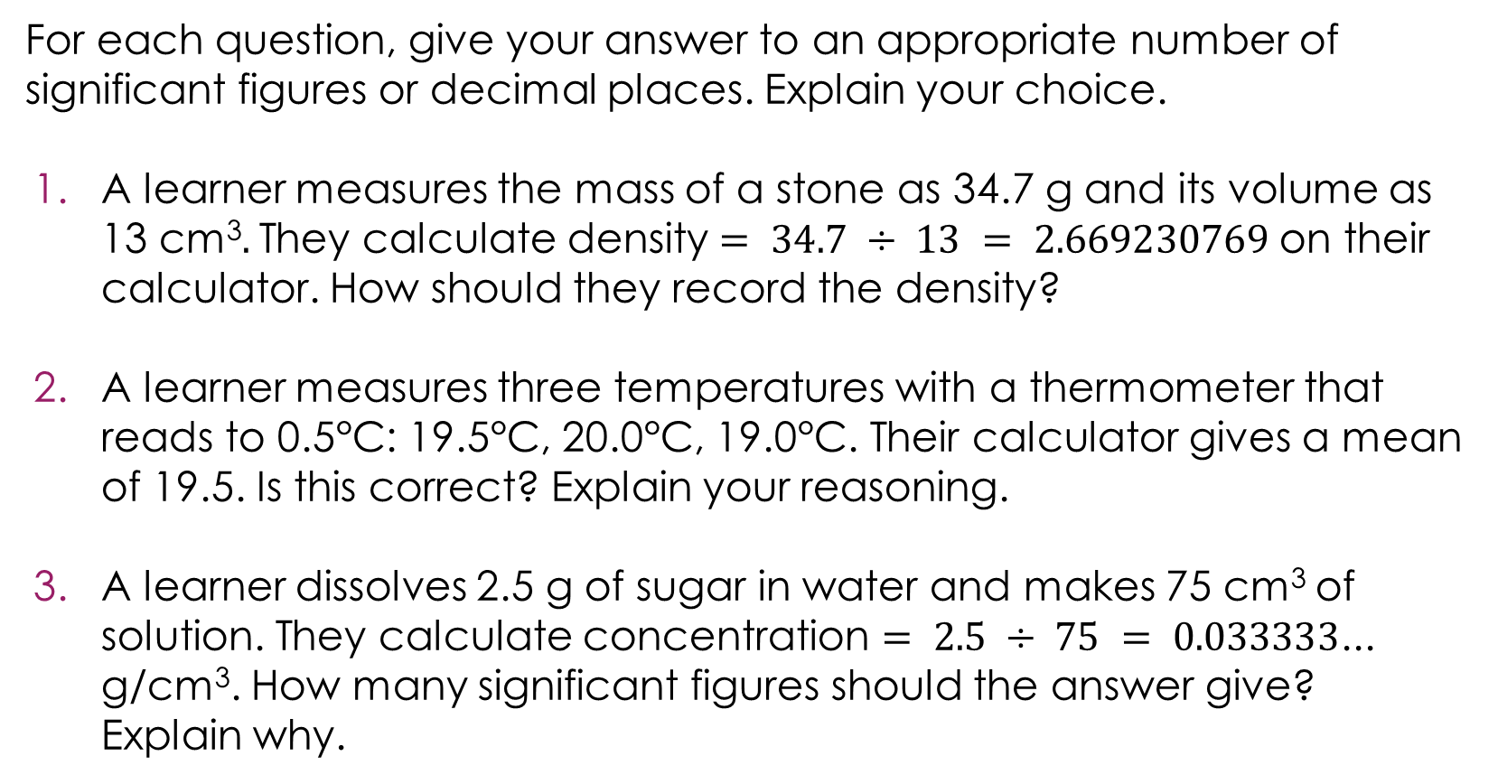
Recording answers to the right level of precision
For each question, give your answer to an appropriate number of significant figures or decimal places. Explain your choice.
A learner measures the mass of a stone as 34.7 g and its volume as 13 cm³$.$ They calculate density $= 34.7 ÷ 13 = 2.669230769$on their calculator. How should they record the density?
A learner measures three temperatures with a thermometer that reads to 0.5°C: 19.5°C, 20.0°C, 19.0°C. Their calculator gives a mean of 19.5. Is this correct? Explain your reasoning.
A learner dissolves 2.5 g of sugar in water and makes 75 cm³ of solution. They calculate concentration $= 2.5 ÷ 75 = 0.033333$... g/cm³. How many significant figures should the answer give? Explain why.
Activity

Slide 6
Recording answers to the right level of precision - answers
For each question, give your answer to an appropriate number of significant figures or decimal places. Explain your choice.
Mass is 3 s.f., volume is 2 s.f. The least precise is the volume (2 s.f.), so the answer should be to 2 s.f. First s.f. is 2, second s.f. is 6. Decider is 6 (≥5), round up. Answer: 2.7 g/cm³.
The mean is 19.5°C, which is to 1 d.p. The thermometer reads to 1 d.p., so 19.5°C is correct.
Both values are 2 s.f., so the answer should be to 2 s.f. Leading zeros are not significant. First s.f. is 3, second s.f. is 3. Decider is 3 (<5), round down. Answer: 0.033 g/cm³.
Answers
Notes:
Question 1: this is a division, so match significant figures.
Common errors and misconceptions:
Writing 2.67 (3 s.f., matching the mass instead of the volume)
Writing 2.669230769 (copying the calculator)
Writing 3 (over-rounding to 1 s.f.)
Question 2: The purpose is to check that learners can explain why it is correct: the answer matches the precision of the thermometer, not just because the calculator said so.
Ask: what if the mean had been 19.5333...? Then they would round to 19.5 °C (1 d.p., matching the thermometer).
Question 3: this is a division, so match significant figures.
Discuss: some learners may want to write $0.3\dot{3 }$using recurring dot notation from maths. Explain that this is not acceptable in science – measurements have limited precision, so our answer cannot be infinitely precise. In chemistry, we always round instead.

Slide 7
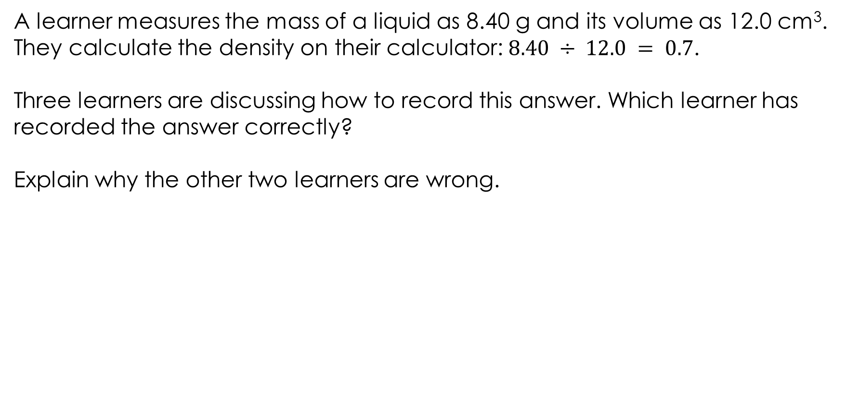
Discussing significant figure
A learner measures the mass of a liquid as 8.40 g and its volume as 12.0 cm³. They calculate the density on their calculator: $8.40 ÷ 12.0 = 0.7$.
Three learners are discussing how to record this answer. Which learner has recorded the answer correctly?
Explain why the other two learners are wrong.
Activity
The answer is 0.70 g/cm³. The answer should be to 1 d.p. because both measurements are to 1 d.p.
The answer is 0.7 g/cm³.
The calculator gave 0.7 so that is the answer.
The answer is 0.700 g/cm³.
Both measurements are 3 s.f. so I need 3 s.f. in my answer.
Learner A
Learner B
Learner C

Slide 8
Discussing significant figure – answer
Learner B is correct.
Learner A is incorrect because they have just accepted the calculator display. The calculator shows 0.7, which is only 1 significant figure.
The measurements justify 3 significant figure:
mass = 8.40 g, which is 3 s.f.
volume = 12.0 cm³ which is 3 s.f.
Both are 3 significant figures; therefore, the answer should be to 3 significant figures.
Learner C is incorrect because they have used the decimal places rule instead of the significant figures rule.
Answer
The answer is 0.700 g/cm³.
Both measurements are 3 s.f. so I need 3 s.f. in my answer.
Learner B
Notes:
Learner B is correct. This is a division, so match significant figures.
Mass = 8.40 g (3 s.f. – the trailing zero after the decimal point is significant, rule 4)
Volume = 12.0 cm³ (3 s.f. – the trailing zero after the decimal point is significant, rule 4)
Both are 3 s.f., so the answer should be to 3 s.f. 0.7 written to 3 s.f. is 0.700 $g/cm³$
Learner A is incorrect because they have just accepted the calculator display. The calculator shows 0.7, which is only 1 s.f. The measurements justify 3 s.f., so trailing zeros must be added to show the answer is precise to 3 s.f. This is the reverse of the usual problem – normally learners write too many digits, but here the calculator has given too few.
Learner C is incorrect because they have used the decimal places rule instead of the significant figures rule. This is a division, so significant figures apply, not decimal places. The d.p. rule is for addition and subtraction. Even though both measurements are to 1 d.p., that is not the relevant consideration here.
Common misconception
Learner C's reasoning sounds plausible, which makes it a valuable misconception to explore. Ask learners to explain what is wrong with the logic in Learner C's own words. Ask: how would the answer change if the measurements were 8.4 g (2 s.f.) and 12 $cm³$ (2 s.f.)? Then the answer would be 0.70 $g/cm³$(2 s.f.). Learner C's answer would then be numerically correct but still for the wrong reason.

