Slide 1

Stage 1
Understanding number: unit conversion
Downloaded from: rsc.li/4gbEt3p

Slide 2
Introduction
Unit conversion is very important in chemistry and in everyday life. Using the wrong amount of a substance could lead to serious and expensive mistakes. For example, if you used 50 mg of butter instead of 50 g when baking a cake, the cake would turn out very dry and hard. In the same way, if someone added 1 litre of chemical to treat a fish tank instead of 1 millilitre, it could harm the fish.
Learning objectives
Recognise the units of measurements we use in chemistry.
Convert between different units of measurement.
Know when we need to convert between units.
Introduction
Notes:
Ask students to think of an example of when using the wrong unit could cause a problem.

Slide 3
Identify the conversion factor
For each pair of units, write down the conversion factor and state whether you would multiply or divide to convert from the first unit to the second unit.
kg to g
mm to m
μm to nm
cm³ to dm³
Convert the following and show your workings.
4.5 kg to g
250 cm³ to dm³
6200 mm to m
0.75 g to mg
Activity

Slide 4
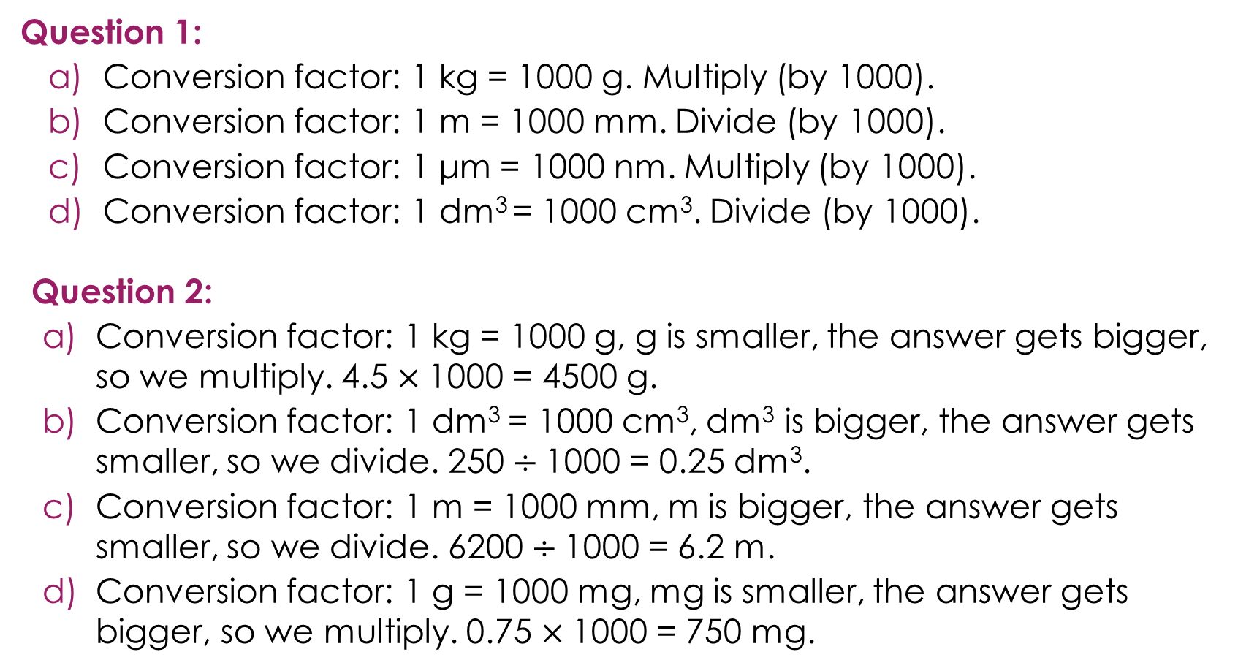
Identify the conversion factor – answers
Question 1:
Conversion factor: 1 kg = 1000 g. Multiply (by 1000).
Conversion factor: 1 m = 1000 mm. Divide (by 1000).
Conversion factor: 1 μm = 1000 nm. Multiply (by 1000).
Conversion factor: 1 dm³ = 1000 cm³. Divide (by 1000).
Question 2:
Conversion factor: 1 kg = 1000 g, g is smaller, the answer gets bigger, so we multiply. 4.5 $×$1000 = 4500 g.
Conversion factor: 1 dm³ = 1000 cm³, dm³ is bigger, the answer gets smaller, so we divide. 250 $÷$1000 = 0.25 dm³.
Conversion factor: 1 m = 1000 mm, m is bigger, the answer gets smaller, so we divide. 6200 $÷$1000 = 6.2 m.
Conversion factor: 1 g = 1000 mg, mg is smaller, the answer gets bigger, so we multiply. 0.75 $×$1000 = 750 mg.
Answers
Notes:
Question 1:
Conversion factor: 1 kg = 1000 g. Multiply.
Is the unit getting bigger or smaller? g is smaller than kg
Is the answer getting bigger or smaller? The answer gets bigger (more grams than kilograms)
Do we multiply or divide? Multiply by 1000.
mm to m. Conversion factor: 1 m = 1000 mm
Is the unit getting bigger or smaller? m is bigger than mm
Is the answer getting bigger or smaller? The answer gets smaller (fewer metres than millimetres)
Do we multiply or divide? Divide by 1000
μm to nm. This may prove challenging to learners as nanometres are often not introduced until post-16. However, learners are practising unit conversions for this example, so the process is the same. Conversion factor: 1 μm = 1000 nm
Is the unit getting bigger or smaller? nm is smaller than μm
Is the answer getting bigger or smaller? The answer gets bigger (more nanometres than micrometres)
Do we multiply or divide? Multiply by 1000
d) ${\text{c}\text{m}}^{3}$ to ${\text{d}\text{m}}^{3}$. Conversion factor: 1 ${\text{d}\text{m}}^{3}$ = 1000 ${\text{c}\text{m}}^{3}$ (because volumes are cubed: 10 x 10 x 10 = 1000)
Is the unit getting bigger or smaller? ${\text{d}\text{m}}^{3}$ is bigger than ${\text{c}\text{m}}^{3}$
Is the answer getting bigger or smaller? The answer gets smaller (fewer ${\text{d}\text{m}}^{3}$ than ${\text{c}\text{m}}^{3}$)
Do we multiply or divide? Divide by 1000

Slide 5
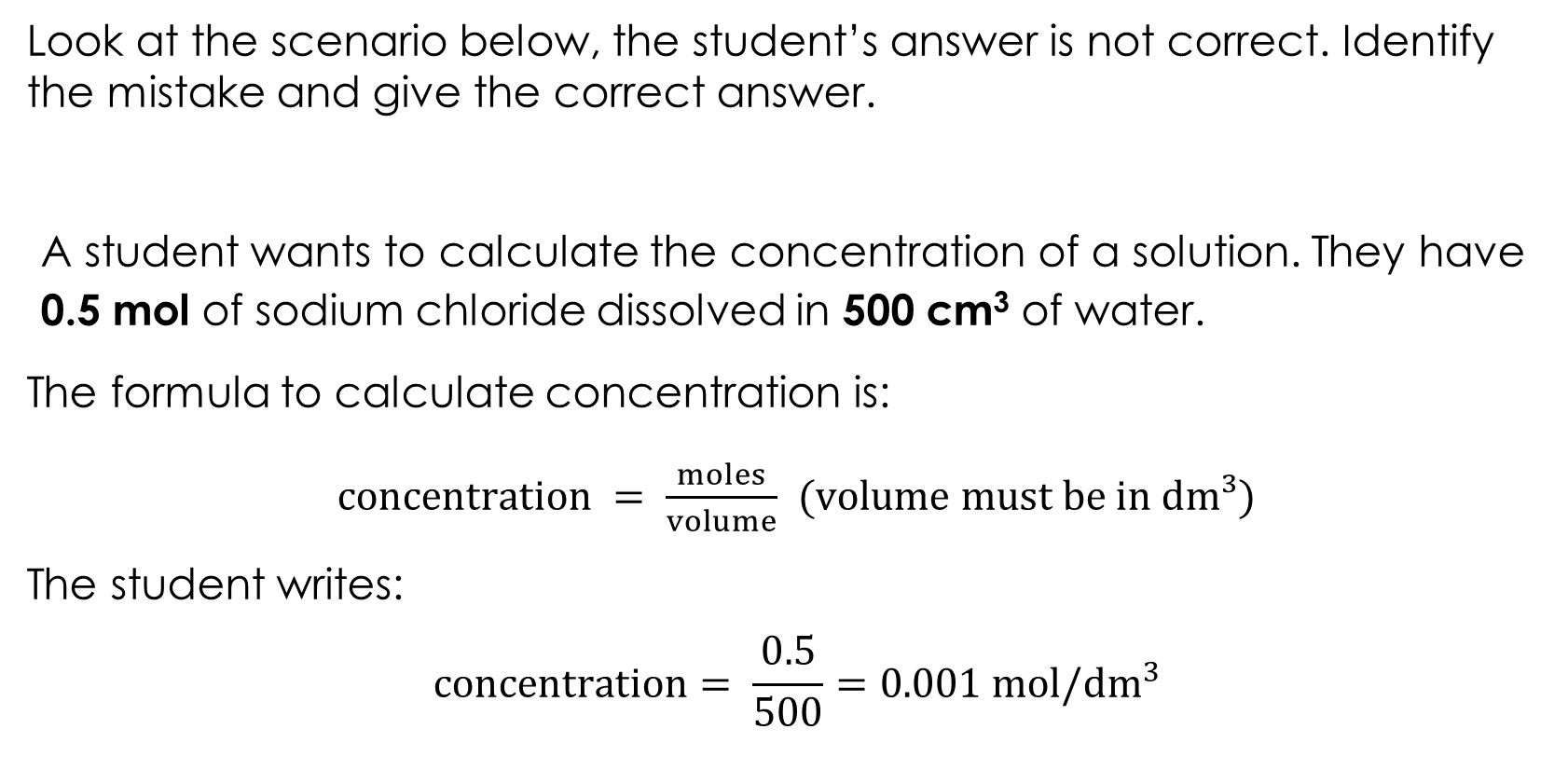
Using the correct units
Look at the scenario below, the student’s answer is not correct. Identify the mistake and give the correct answer.
A student wants to calculate the concentration of a solution. They have 0.5 mol of sodium chloride dissolved in 500 cm³ of water.
The formula to calculate concentration is:
$concentration = \frac{moles}{volume}$ (volume must be in dm³)
The student writes:
$$concentration= \frac{0.5}{500}=0.001 mol/{dm}^{3}$$
Activity

Slide 6
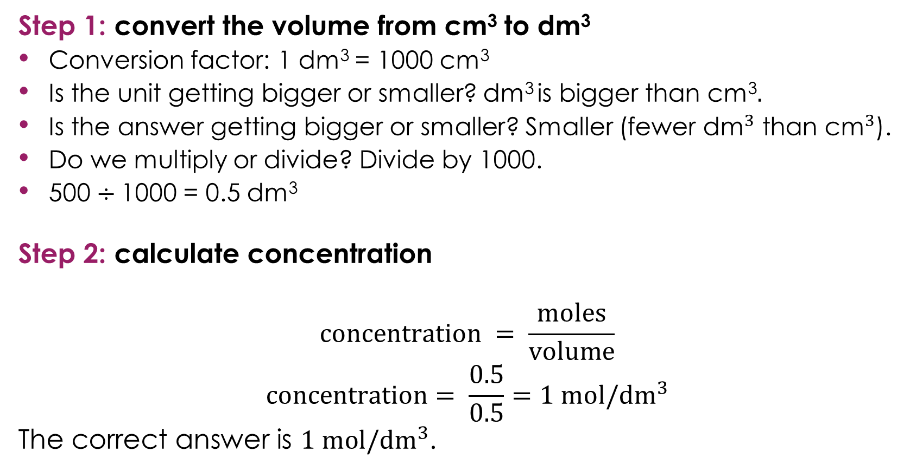
Using the correct units – answers
Step 1: convert the volume from cm³ to dm³
Conversion factor: 1 dm³ = 1000 cm³
Is the unit getting bigger or smaller? dm³ is bigger than cm³$.$
Is the answer getting bigger or smaller? Smaller (fewer ${\text{dm}}^{3}$ than ${\text{c}\text{m}}^{3}$).
Do we multiply or divide? Divide by 1000.
500 $÷$1000 = 0.5 dm³
Step 2: calculate concentration
$$concentration = \frac{moles}{volume}$$
$$concentration= \frac{0.5}{0.5}=1 mol/{dm}^{3}$$
The correct answer is $1 mol/{dm}^{3}$.
Answers

Slide 7
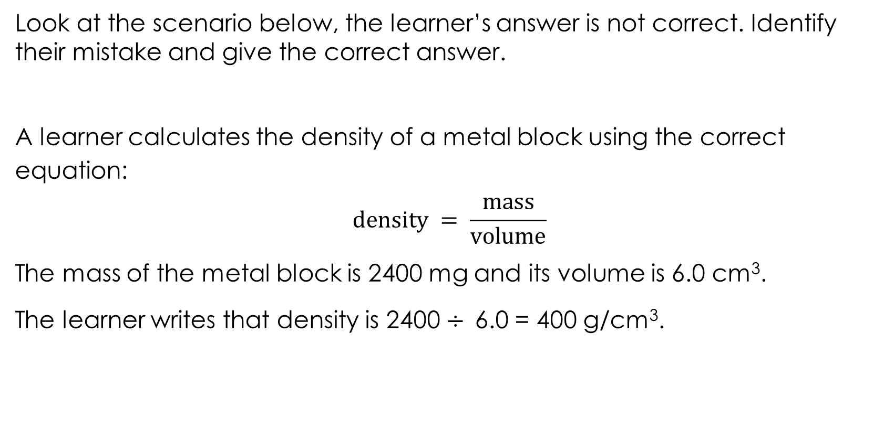
Using the correct units 2
Look at the scenario below, the learner’s answer is not correct. Identify their mistake and give the correct answer.
A learner calculates the density of a metal block using the correct equation:
$$density = \frac{mass}{volume}$$
The mass of the metal block is 2400 mg and its volume is 6.0 cm³.
The learner writes that density is 2400 $÷$6.0 = 400 g/cm³.
Activity

Slide 8
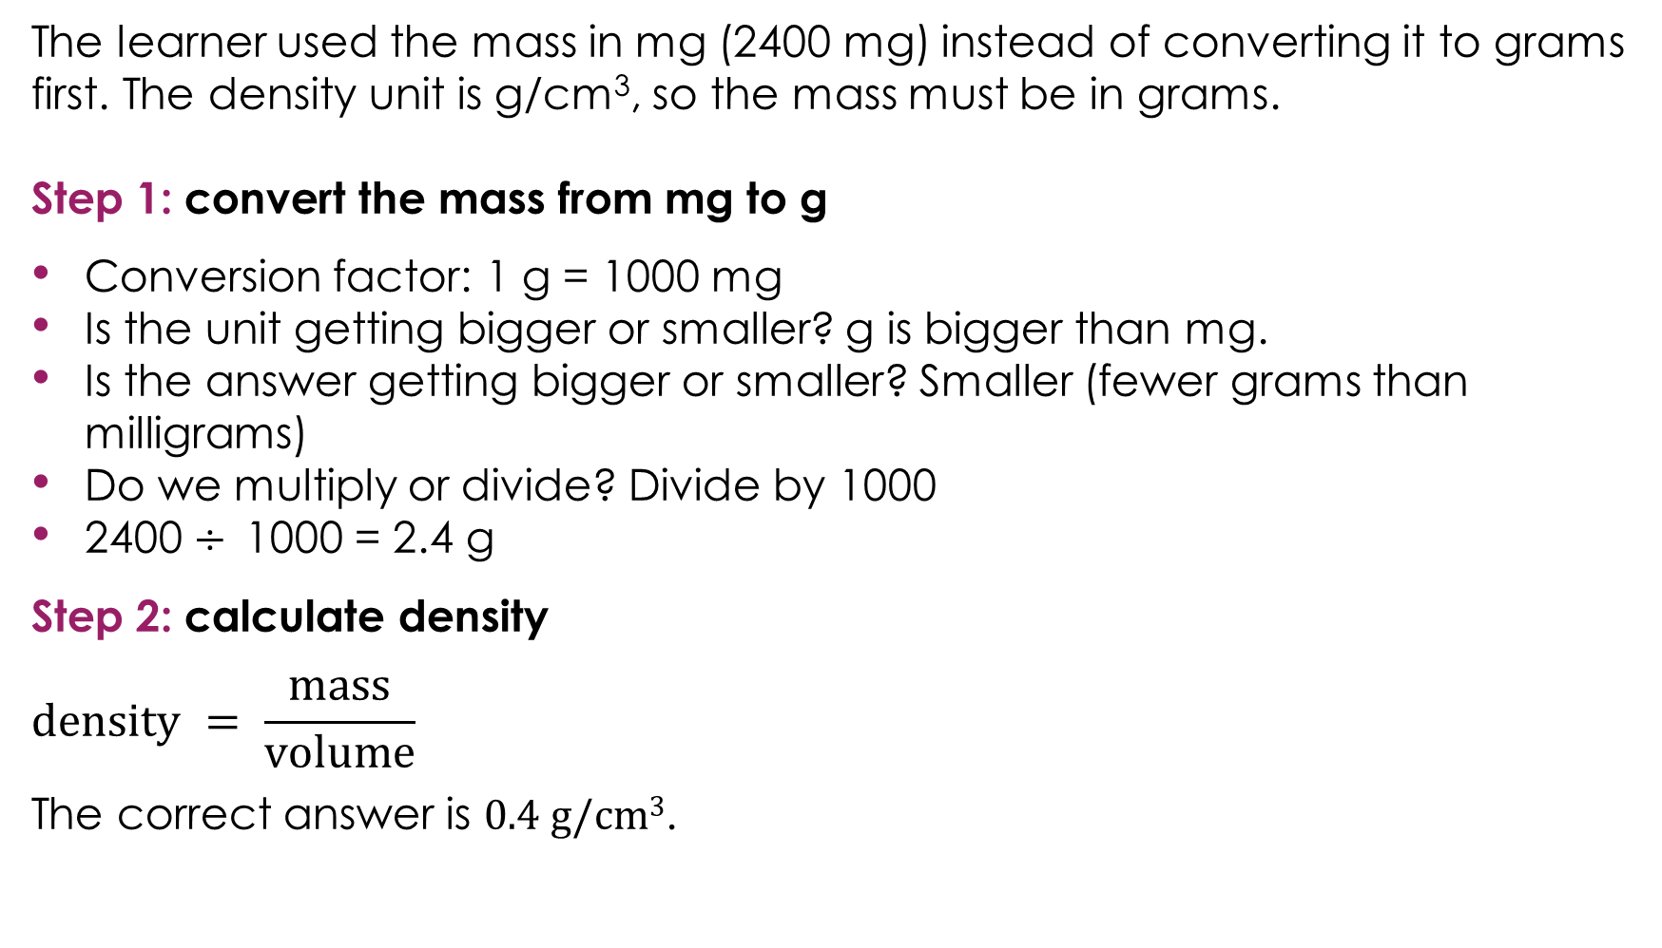
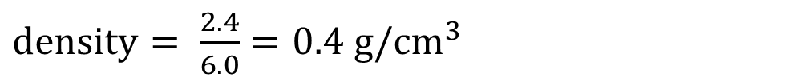
Using the correct units 2 – answer
The learner used the mass in mg (2400 mg) instead of converting it to grams first. The density unit is g/cm³, so the mass must be in grams.
Step 1: convert the mass from mg to g
Conversion factor: 1 g = 1000 mg
Is the unit getting bigger or smaller? g is bigger than mg.
Is the answer getting bigger or smaller? Smaller (fewer grams than milligrams)
Do we multiply or divide? Divide by 1000
2400 $÷$1000 = 2.4 g
Step 2: calculate density
$$density = \frac{mass}{volume}$$
The correct answer is 0.4 g/cm³.
Answer
$density= \frac{2.4}{6.0}=0.4 g/{cm}^{3}$

Slide 9
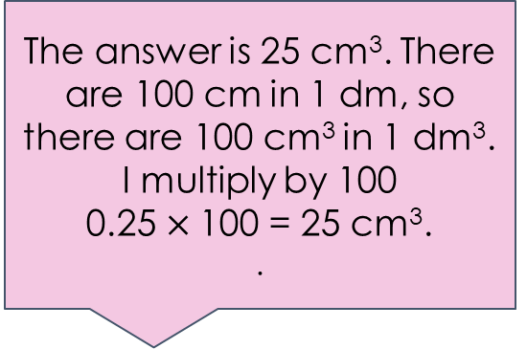
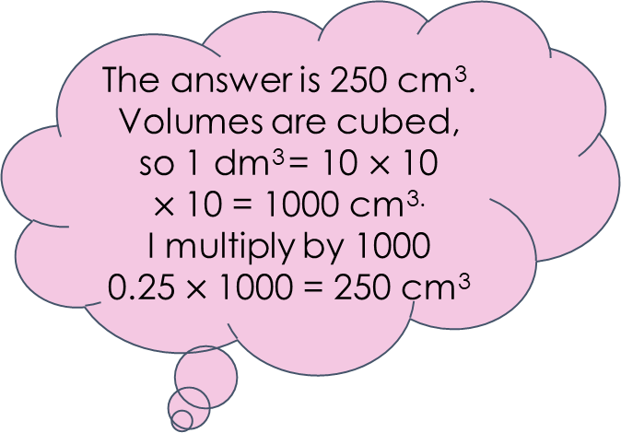
Discussing unit conversion
A learner needs to calculate the concentration of a solution. They measure out 0.25 dm³ of water and dissolve 5.0 g of salt in it. They need to convert the volume to cm³ before using it in a different calculation.
Three learners are discussing how to convert the volume.
Which learner is correct? Explain why the other two learners are wrong.
Activity
The answer is 25 cm³. There are 100 cm in 1 dm, so there are 100 cm³ in 1 dm³.
I multiply by 100
0.25 $×$100 = 25 cm³.
.
The answer is 250 cm³. Volumes are cubed, so 1 dm³ = 10 $×$10 $×$10 = 1000 cm^{3.}
I multiply by 1000
0.25 $×$1000 = 250 cm³
The answer is 2500 cm³. I need to make the number bigger because cm³ is a smaller unit, so I multiply by 10,000.
Learner A
Learner C
Learner B

Slide 10
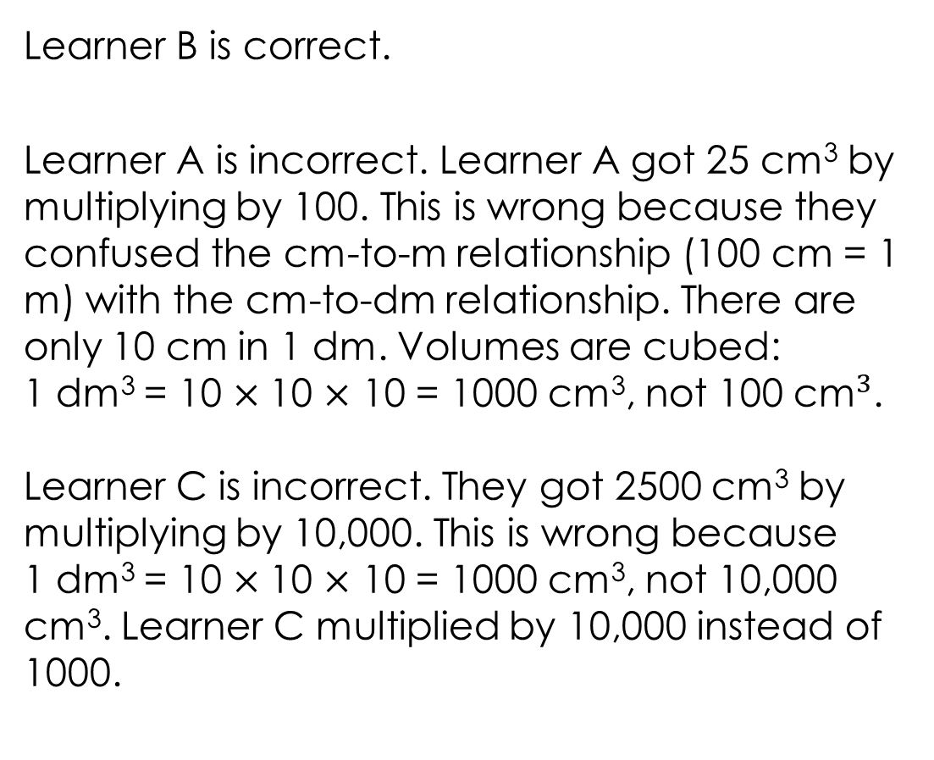

Discussing unit conversion – answer
Learner B is correct.
Learner A is incorrect. Learner A got 25 cm³ by multiplying by 100. This is wrong because they confused the cm-to-m relationship (100 cm = 1 m) with the cm-to-dm relationship. There are only 10 cm in 1 dm. Volumes are cubed:
1 dm³ = 10 $×$10 $×$ 10 = 1000 cm³, not 100 ${\text{c}\text{m}}^{3}$.
Learner C is incorrect. They got 2500 cm³ by multiplying by 10,000. This is wrong because
1 dm³ = 10 $×$10 $×$ 10 = 1000 cm³, not 10,000 cm³. Learner C multiplied by 10,000 instead of 1000.
The answer is 250 cm³. Volumes are cubed, so 1 dm³ = 10 $×$10 $×$10 = 1000 cm^{3.}
I multiply by 1000
0.25 $×$1000 = 250 cm³
Answer
Learner B
Notes:
Learner B is correct.
Conversion factor: 1 dm³ = 1000 cm³ (volumes are cubed: $10 × 10 × 10 = 1000$)
Is the unit getting bigger or smaller? cm³ is smaller than dm³
Is the answer getting bigger or smaller? Bigger – more cm³ than dm³
Do we multiply or divide? Multiply by 1000
$0.25 × 1000 = 250 {cm}^{3}$

