Slide 1

Stage 1
Understanding number: unit conversion
Downloaded from: rsc.li/4gbEt3p

Slide 2
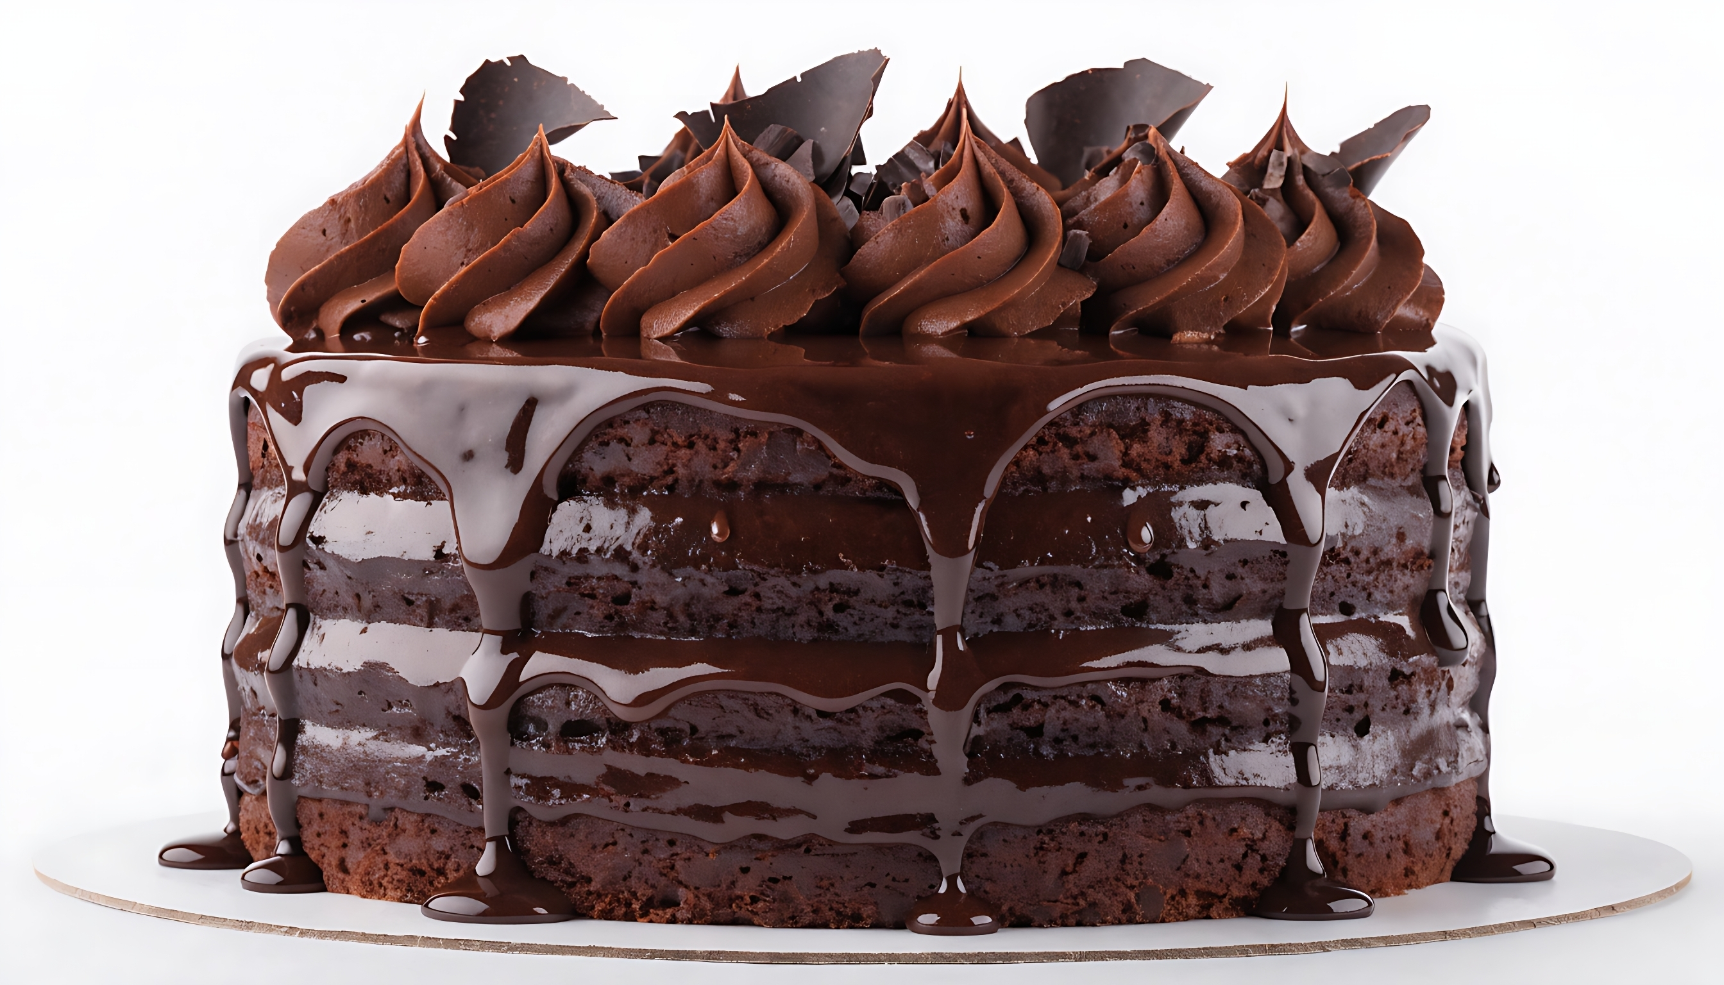
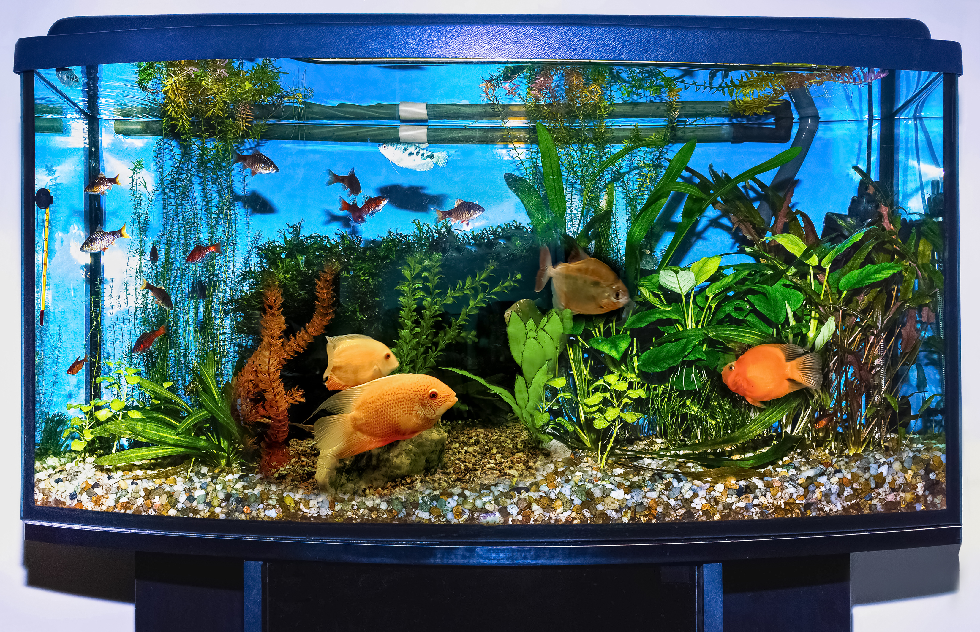
Introduction
Unit conversion is important in chemistry and in everyday life. Using the wrong amount of a substance can lead to serious and expensive mistakes.
Introduction
For example, if you used 50 mg of butter instead of 50 g when baking a cake, the cake would turn out very dry and hard.
In the same way, if someone added one litre of chemical to treat a fish tank instead of one millilitre, it could harm the fish.
Notes:
Ask learners to think of an example of when using the wrong unit could cause a problem.

Slide 3
Learning objectives
Recognise the units of measurements we use in chemistry.
Convert between different units of measurement.
Know when we need to convert between units.
Introduction

Slide 4
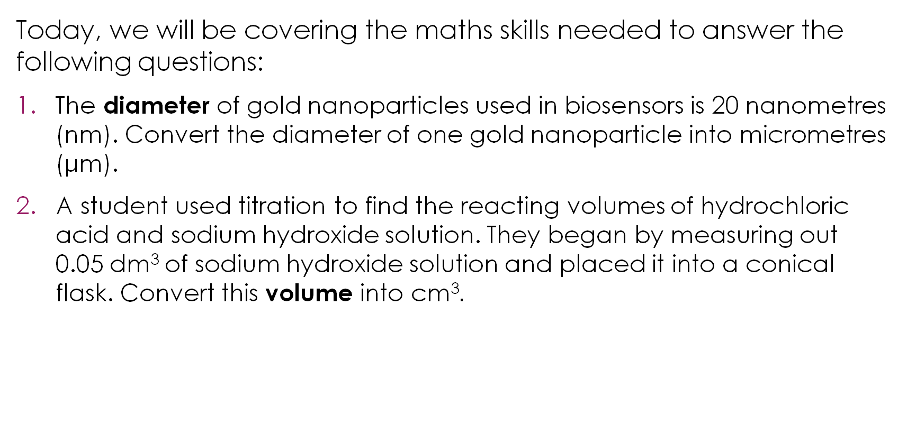
Lesson questions
Today, we will be covering the maths skills needed to answer the following questions:
The diameter of gold nanoparticles used in biosensors is 20 nanometres (nm). Convert the diameter of one gold nanoparticle into micrometres (μm).
A student used titration to find the reacting volumes of hydrochloric acid and sodium hydroxide solution. They began by measuring out 0.05 dm³ of sodium hydroxide solution and placed it into a conical flask. Convert this volume into cm³$.$
Lesson questions
Notes:
This slide introduces two challenge questions that learners will return to at the end of the lesson. Learners are not expected to attempt it at this point.
Learners are used to converting units in primary maths. Learners may not be familiar with the prefixes, nano- and micro- at this point but this question will apply what they know from using familiar units throughout the presentation.
Discuss the two forms of measurement highlighted in bold (diameter and volume). Ask learners to name any units associated with these types of measurement.
Diameter: learners may recall centimetres and millimetres. You can extend this by asking about length - learners may recall metres, kilometres, nanometres, micrometres.
Volume: learners may recall litres, millilitres, cubic centimetres, and cubic decimetres.
The rapid COVID-19 antigen test is an example of a biosensor containing gold nanoparticles that learners may be familiar with. Break down the word biosensor to bio and sensor. Bio means ‘to do with life’ and sensor means ‘to sense or perceive something’.

Slide 5
Types of units
In science and maths, the most common units include those for length, mass and volume.
Look at these units and place them under the correct heading:
g m kg km ml cm mg L dm³ mm dm³ μm t nm
Activity
Volume | Mass | Length
Notes:
This slide should feel like revision for most learners. Explain that the purpose is to activate prior knowledge and refresh learners’ identification of units and symbols they are already familiar with from maths.
Encourage learners to say the name of the unit such as millimetre rather than mm. Learners may not be as confident with nanometre, micrometre, cubic decimetre and tonne. A tonne is also called a metric tonne and is equivalent to 1000 kg.
Learners may not realise that 1 litre is equivalent to 1${ \text{d}\text{m}}^{3}$. The litre is commonly used in maths but in chemistry we use cubic decimetres, so it is helpful to make sure learners realise this.
See the teacher guidance notes for common misconceptions on these units.

Slide 6
Types of units – answer
Volume | Mass | Length
ml L dm³ dm³ | g kg mg t | m km cm μm mm nm
Answer
Notes:
Discuss any units that learners found difficult.
Learners may find dm³ hard to place. Support them to recognise that this is equivalent to a litre. The litre is commonly used in maths and in everyday language, but in chemistry we use cubic decimetres, so it is helpful to make sure students realise this. Highlight that cm³ and ml are equivalent and students may encounter both in different chemistry and maths contexts. Students could look at a measuring cylinder and notice the units used on this piece of common equipment.
As an extension activity, ask learners to order the units from smallest to largest. You can demonstrate this on an interactive white board.

Slide 7
Prefix check
Do you know what the prefix is for each of these symbols?
Symbol | Prefix | Value | Power of 10
M |  | 1000 000 | 10⁶
k | kilo | 1000 | 10³
 | base unit | 1 | 10⁰
d |  | 0.1 | 10⁻¹
c |  | 0.01 | 10⁻²
m |  | 0.001 | 10⁻³
μ |  | 0.000001 | 10⁻⁶
n |  | 0.000000001 | 10⁻⁹
Activity
Notes:
Ask learners to fill in the prefix column before revealing the answers. Get them to say each prefix name out loud. In maths the prefixes which tend to be regularly used are kilo-, centi- and milli-.
Remove the final column relating to powers of 10 if you feel this is too challenging for learners and simply leave the value column.
Talk through the table. Ask simple questions such as: if the base unit was a metre – how many metres are in a kilometre? How many centimetres are in a meter?
Point to the base unit row and explain that this is the reference point everything else is measured against. So, if the base unit was 1 metre, then 1000 metres is a kilometre.
The pattern going down the table is $×$1000 at each step. Kilo is 1000 times bigger than the base unit, milli is 1000 times smaller, micro is 1000 times smaller than milli, and so on. This is why the conversion factor between adjacent prefixes in this table is always 1000.
Centi- and deci- are the exceptions as they sit between the base unit and milli and do not follow the $×$1000 pattern. Centi- is less common in chemistry, but learners will recognise it from centimetres and from maths.
Watch for two common errors: learners confusing milli with million (milli means 1000th, not millionth), and learners mixing up capital M (mega) and lowercase m (milli), which is a mistake that changes a value by a factor of 1,000,000,000.
Ask learners: what is the conversion factor between nano and micro? They should spot it is 1000, just like every other adjacent pair. This supports learners to be able to answer the nanoparticle question at the end of the session.

Slide 8
Prefix check – answer
Symbol | Prefix | Value | Power of 10
M | mega | 1000 000 | 10⁶
k | kilo | 1000 | 10³
 | base unit | 1 | 10⁰
d | deci | 0.1 | 10⁻¹
c | centi | 0.01 | 10⁻²
m | milli | 0.001 | 10⁻³
μ | micro | 0.000001 | 10⁻⁶
n | nano | 0.000000001 | 10⁻⁹
Answer
Notes:
Answer slide.

Slide 9
Unit names and symbols
Complete the columns to show the unit names and symbols in brackets.
Symbol | Prefix | Length | Mass | Volume
k | kilo | kilometre (km)
 | base unit | metre (m) | gram (g) | cubic metre
d | deci
c | centi
m | milli |  | milligram (mg)
μ | micro
n | nano |  |  | cubic nanometre (nm³)
Activity
Notes:
Discuss with learners what the units are for the following different base units: metres, grams, cubic metres. Some of these units are very rarely used in chemistry but are included for completeness and practice in using the prefixes and symbols.
These resources commonly use dm³ rather than litre. The files for this resource are all available in editable versions, for you to modify as best suits your learners’ needs.
Lab equipment is commonly measured in ml. Make sure learners understand that 1 ml and 1 cm³ are equivalent.

Slide 10
Unit names and symbols
Symbol | Prefix | Length | Mass | Volume
k | kilo | kilometre (km) | kilogram (kg) | cubic kilometre (km³)
 | base unit | metre (m) | gram (g) | cubic metre (m³)
d | deci | decimetre (dm) | decigram (dg) | cubic decimetre (dm³)
c | centi | centimetre (cm) | centigram (cg) | cubic centimetre (cm³)
m | milli | millimetre (mm) | milligram (mg) | cubic millimetre (mm³)
μ | micro | micrometre (μm) | microgram (μg) | cubic micrometre (μm³)
n | nano | nanometre (nm) | nanogram (ng) | cubic nanometre (nm³)
Answer
Notes:
Note on cubic metres versus metres cubed: the SI (International System of Units) for volume is the cubic metre.

Slide 11



Conversion factor
What is a conversion factor?
A conversion factor is the number you multiply or divide by to convert a measurement from one unit to another.
When we convert from a smaller unit into a larger unit, we divide by the conversion factor.
Will the number get bigger or smaller?
When we convert from a larger unit to a smaller unit, we multiply by the conversion factor.
Will the number get bigger or smaller?
kilogram
gram
milligram
microgram
$×1000$
$$÷ 1000$$
$$×1000$$
$$÷ 1000$$
$×1000$
$$÷ 1000$$
Notes:
This slide is the conceptual part of the lesson. Emphasise that the bigger the unit, the smaller the number becomes when we convert between units.
Talk through the image showing the conversion of the base unit grams. When we convert 1 g into kilograms we divide by 1000. When we convert 1 g into milligrams then we multiply by 1000.
Consider a physical analogy. Use metre as the base unit here to make it more relatable. Show learners a 1 m ruler. If we break the ruler into centimetre pieces we go from 1 ruler to 100 pieces of 1 cm. A larger unit to a smaller unit makes the number bigger.
Ask learners to make their own conversion factor tables for different base units such as metres.

Slide 12
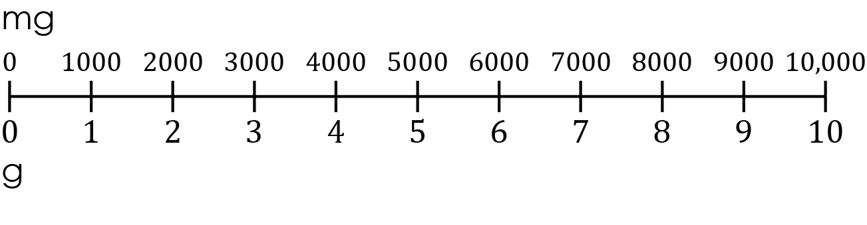
Number line
A number line can be used to help with unit conversions.
What is 1 g equivalent to in mg?
Use the number line to complete the following unit conversions:
Convert 2000 mg into g
Convert 8 g into mg
Convert 10 g into mg
Convert 2.5 g into mg
Convert 500 mg into g
Activity
Notes:
Before talking through the slide, ask learners what the prefix milli- means. Learners may incorrectly think it is linked to million. Milli means thousandth.
The number line provides a visual scaffold for learners who find the abstract idea of conversion factors difficult. By showing the two scales on the same line for mg and g it aids understanding.
Ask learners what 1 g is equivalent to in mg. The word equivalent means they have the same value. When we convert values, we are simply changing them from one form to another. 1 kg = 1000 g. They are equivalent. 6 g = 6000 mg. They are equivalent.
Talk through the first example if necessary, highlighting the mg and g scales.
Ask these questions repeatedly:
What is the conversion factor?
Is the unit getting bigger or smaller?
Will the number become bigger or smaller?
Do we multiply or divide by the conversion factor?
Some learners may find d) and e) challenging. If necessary, solve them through ideas from a class discussion and then demonstrate on an interactive whiteboard by adding in extra divisions on the number line to represent 0.5 g or 500 mg.
Answers:
2 g. This is the most accessible as the answer is clearly on the line.
8000 mg. This answer reverses the direction. Watch for learners who write 0.008 g as they have used the wrong operation here. Ask learners: ‘are we going to a bigger unit or a smaller unit?’
10 000 mg
2500 mg. Learners who are over-reliant on the number line may struggle as 2.5 sits between the marked divisions.
0.5 g
Ask learners if they can convert 450 mg into g. Check for learners who might give 45 g or 4.5 g as the answer. They are not dividing by 1000 to get 0.45 g. If this happens, provide more conversions to complete using the whole integer values and then use numbers between the marked divisions. The number line is a tool to use and not a replacement for understanding the conversion factor.
Ask learners if they need a number line or can do this just using the conversion factor. The goal is to help learners internalise the $×$1000 and $÷$1000 and not need a visual scaffold.

Slide 13
Number line – answers
2 g
8000 mg
10 000 mg
2500 mg
0.5 g
Answers
Notes:
This is the most accessible as the answer is clearly on the line.
This answer reverses the direction. Watch for learners who write 0.008 g as they have used the wrong operation here. Ask learners are we going to a bigger unit or a smaller unit?
Learners who are over-reliant on the number line may struggle as 2.5 sits between the marked divisions.
Ask learners if they can convert 450 mg into g. Check for learners who might give 45 g or 4.5 g as the answer. They are not dividing by 1000 to get 0.45 g. If this happens, provide more conversions to complete using the whole integer values and then use numbers between the marked divisions. The number line is a tool to use and not a replacement for understanding the conversion factor.
Ask learners if they need a number line or can do this just using the conversion factor. The goal is to help learners internalise the $×$1000 and $÷$1000 and not need a visual scaffold.

Slide 14
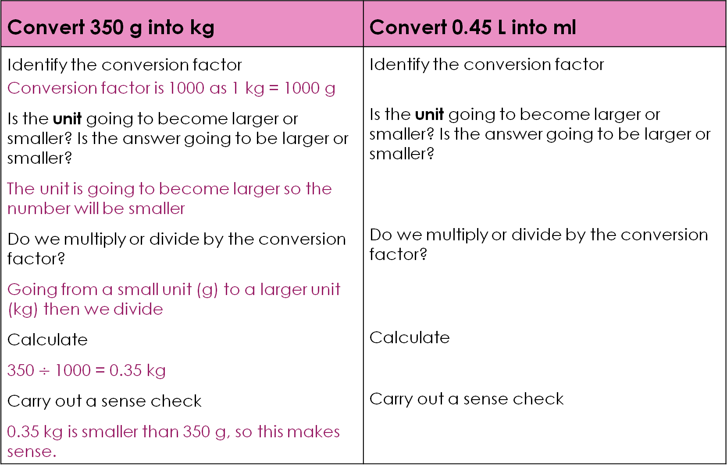
Worked example
Convert 350 g into kg | Convert 0.45 L into ml
Identify the conversion factor Conversion factor is 1000 as 1 kg = 1000 g Is the unit going to become larger or smaller? Is the answer going to be larger or smaller? The unit is going to become larger so the number will be smaller Do we multiply or divide by the conversion factor? Going from a small unit (g) to a larger unit (kg) then we divide Calculate 350$÷$1000 = 0.35 kg Carry out a sense check 0.35 kg is smaller than 350 g, so this makes sense. | Identify the conversion factor Is the unit going to become larger or smaller? Is the answer going to be larger or smaller? Do we multiply or divide by the conversion factor? Calculate Carry out a sense check
Worked example
Notes:
Learners are introduced to unit conversions in the primary phase. Learners are used to the units, litres and millilitres in maths and everyday life. This example is about converting units and gaining confidence in the process. This slide provides a scaffolded worked example to help learners lay out their working, in contexts which will be familiar from the primary phase.
Walk through the worked example step by step, narrating every decision aloud to model your thinking process. Encourage learners to lay out their answer in a similar way and always write out the conversion factor and whether they are multiplying or dividing before doing the calculation.
Watch for learners dividing in the second example, ml is smaller than L, so $×$1000. You can use this example to discuss that 1 ml is equivalent to 1 ${\text{cm}}^{3}$. The answer is on the next slide.
.

Slide 15
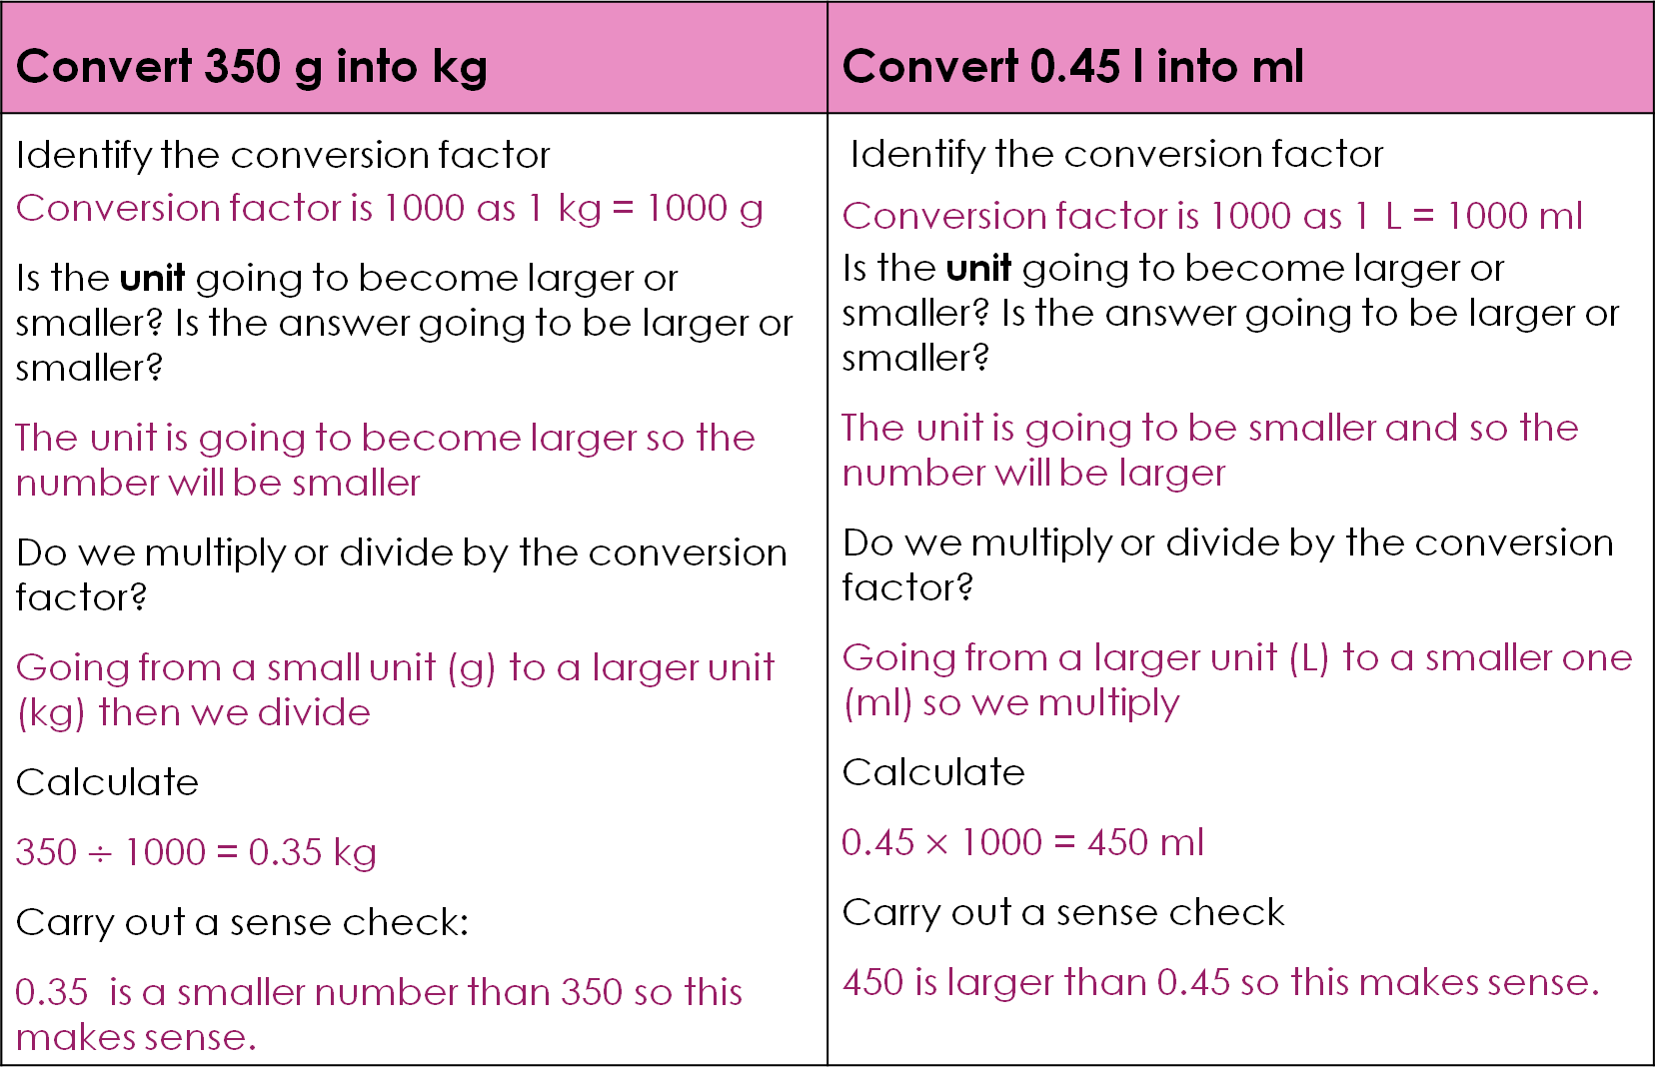
Worked example – answer
Convert 350 g into kg | Convert 0.45 l into ml
Identify the conversion factor Conversion factor is 1000 as 1 kg = 1000 g Is the unit going to become larger or smaller? Is the answer going to be larger or smaller? The unit is going to become larger so the number will be smaller Do we multiply or divide by the conversion factor? Going from a small unit (g) to a larger unit (kg) then we divide Calculate 350$÷$1000 = 0.35 kg Carry out a sense check: 0.35 is a smaller number than 350 so this makes sense. | Identify the conversion factor Conversion factor is 1000 as 1 L = 1000 ml Is the unit going to become larger or smaller? Is the answer going to be larger or smaller? The unit is going to be smaller and so the number will be larger Do we multiply or divide by the conversion factor? Going from a larger unit (L) to a smaller one (ml) so we multiply Calculate 0.45$×$ 1000 = 450 ml Carry out a sense check 450 is larger than 0.45 so this makes sense.
Worked example – answer

Slide 16
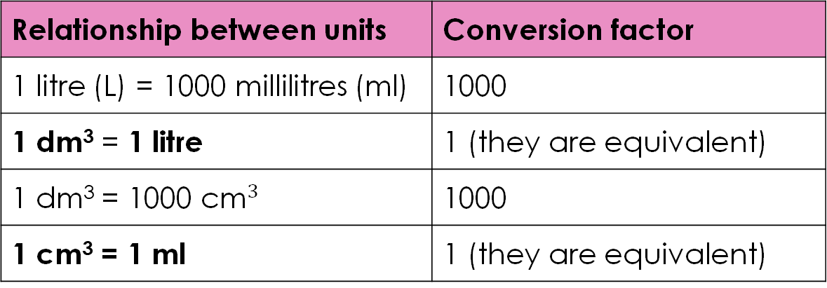
Converting volume units
The units for volume can be confusing as there are different units used.
Can you remember any units which are used for measuring volume?
This cube has sides which measure 10 cm.
What is the volume of this cube in dm³?
Relationship between units | Conversion factor
1 litre (L) = 1000 millilitres (ml) | 1000
1 dm³ = 1 litre | 1 (they are equivalent)
1 dm³ = 1000${\text{ cm}}^{3}$ | 1000
1 cm³ = 1 ml | 1 (they are equivalent)
Notes:
In maths, 11–14-year-old learners are expected to be able to change freely between related standard units including area and volume. However, explicit teaching of squaring and cubing of conversion factors for units of area and volume can be left until later in the secondary phase.
The unit cubic decimetre most common in science curriculums. In maths and everyday life, most learners will be exposed to the unit litre and its related unit of millilitre. Emphasise repeatedly the equivalence between cubic decimetres and litres. There is also terminology which uses millilitres and cubic centimetres, which are also correct and equivalent.
Discuss the relationship between the units in the table. Artifacts like a 1 ml syringe and a 1 litre plastic bottle can be useful for having a visual representation of how these volumes relate to each other with a x 1000 scale difference.
Learners often think 1 dm³ = 100 cm³ because 1 m = 100 cm. This is incorrect. Ask learners what the prefix deci- means. It means ‘tenth’, so a decimetre is a tenth of a meter or equivalent to 10 cm. Cubic decimetre means the conversion factor is also cubed.
Show the cube and give learners a moment to calculate the answer. Learners can use mini whiteboards and reveal their answers at the same time. The correct answer is 1 dm³ because each side of the cube is 10 cm = 1 dm, so volume = 1 dm $×$ 1 dm $×$ 1 dm = 1 dm³. This is also equal to 1 litre and 1000 cm³ (since 10 $×$ 10 $×$ 10 = 1000).
The cube question helps learners to understand that 1 dm³ = 1000 cm³ rather than just accept it. They will then be less likely to think 1 dm³ = 100 cm³.
Once learners have accepted 1 dm³ = 1000 cm³, point out that this is why the conversion factor for dm³ to cm³ is 1,000, not 10 or 100 (the conversion factor is cubed 10 $×$ 10 $×$ 10).

Slide 17
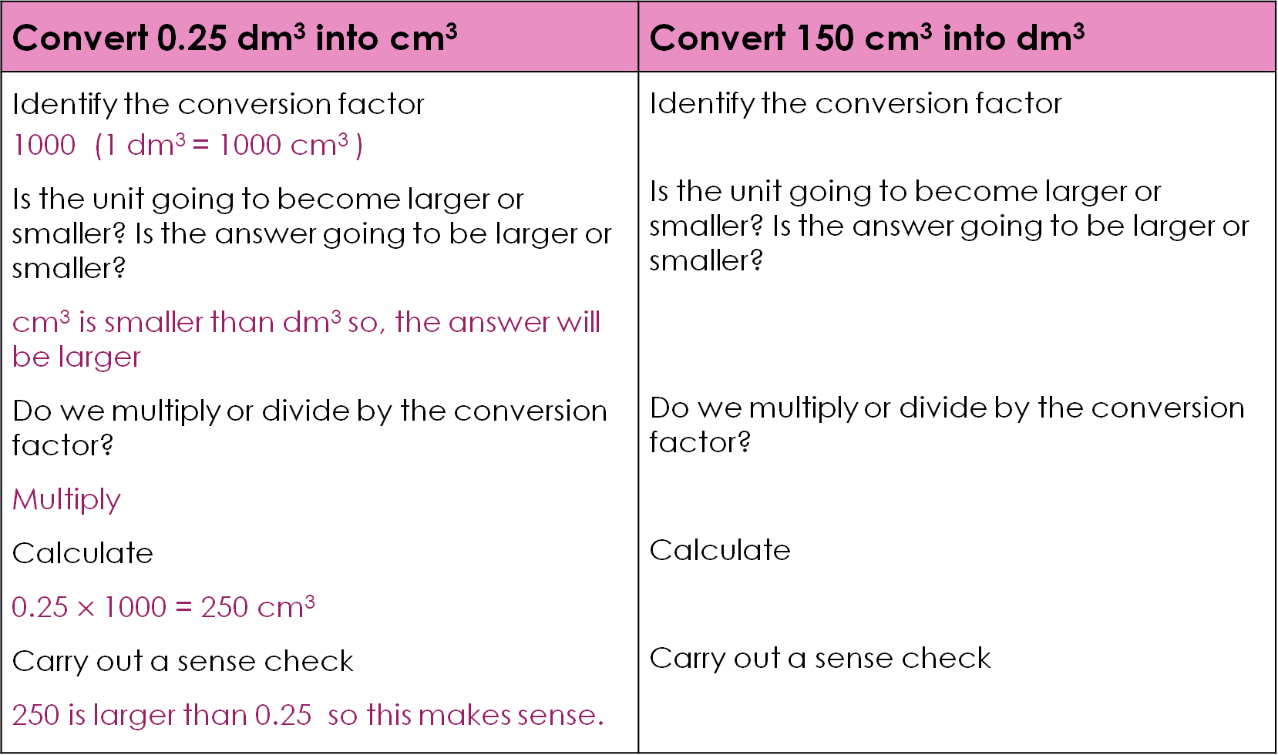
Worked example 2
Convert 0.25 dm³ into cm³ | Convert 150 cm³ into dm³
Identify the conversion factor 1000 (1 dm³ = 1000 cm³ ) Is the unit going to become larger or smaller? Is the answer going to be larger or smaller? cm³ is smaller than dm³ so, the answer will be larger Do we multiply or divide by the conversion factor? Multiply Calculate 0.25 $×$1000 = 250 cm³ Carry out a sense check 250 is larger than 0.25 so this makes sense. | Identify the conversion factor Is the unit going to become larger or smaller? Is the answer going to be larger or smaller? Do we multiply or divide by the conversion factor? Calculate Carry out a sense check
Worked example
Notes:
Walk through the worked example step by step, narrating every decision aloud to model your thinking process.
Encourage learners to lay out their answer in a similar way and always write out the conversion factor and whether they are multiplying or dividing before doing the calculation.

Slide 18
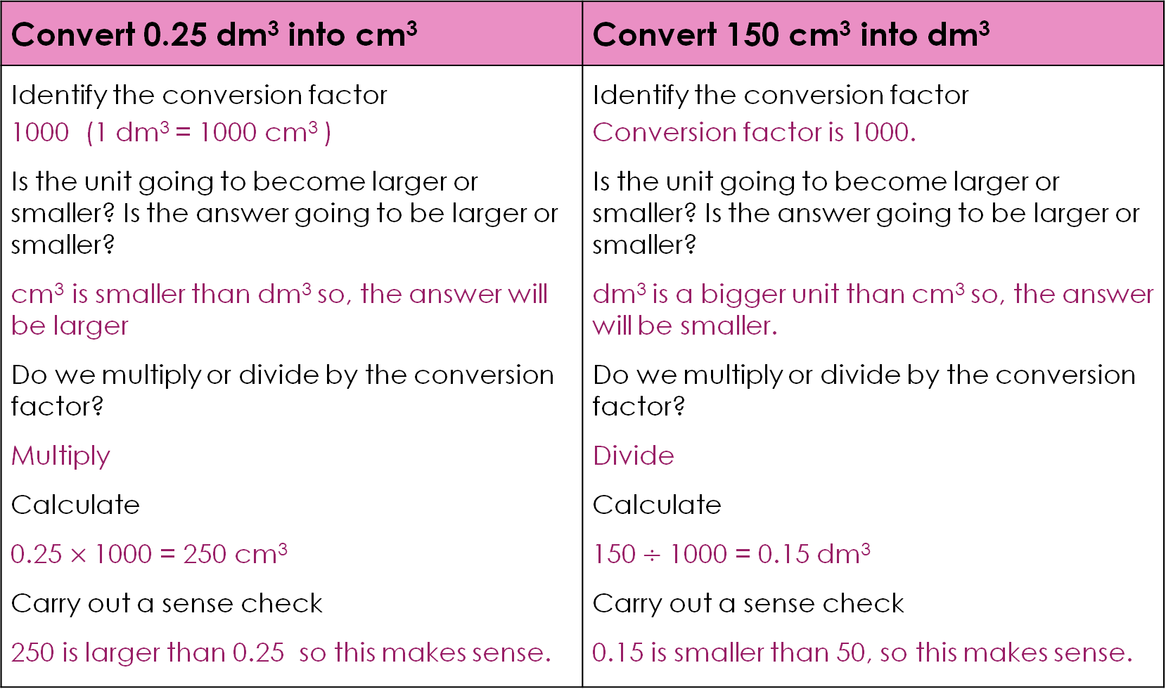
Worked example 2 – answer
Convert 0.25 dm³ into cm³ | Convert 150 cm³ into dm³
Identify the conversion factor 1000 (1 dm³ = 1000 cm³ ) Is the unit going to become larger or smaller? Is the answer going to be larger or smaller? cm³ is smaller than dm³ so, the answer will be larger Do we multiply or divide by the conversion factor? Multiply Calculate 0.25 $×$1000 = 250 cm³ Carry out a sense check 250 is larger than 0.25 so this makes sense. | Identify the conversion factor Conversion factor is 1000. Is the unit going to become larger or smaller? Is the answer going to be larger or smaller? dm³ is a bigger unit than cm³ so, the answer will be smaller. Do we multiply or divide by the conversion factor? Divide Calculate 150$÷$ 1000 = 0.15 dm³ Carry out a sense check 0.15 is smaller than 50, so this makes sense.
Worked example – answer
Notes:
Watch for learners who do 150 ÷ 100 rather than ÷ 1000. This is the dm³/cm³ misconception again. If several learners make this error, return to the cube diagram on slide 16 before moving on.

Slide 19
Chemistry context
A student has 2.5 litres of a solution. They need the volume in cm³.
How many cm³ of solution do they have?
Activity
Notes:
This is a two-step calculation. Learners must realise that litres and dm³ are equivalent before they can apply the conversion factor.

Slide 20
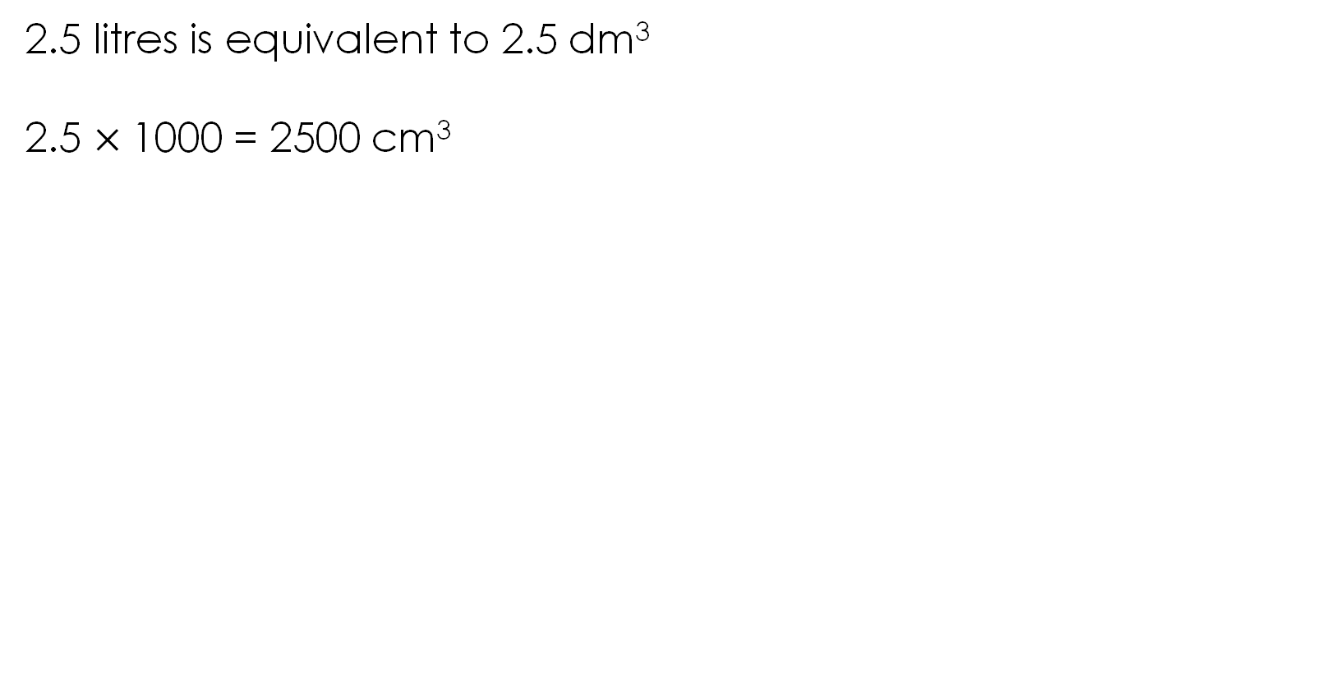
Chemistry context – answer
2.5 litres is equivalent to 2.5 dm³
2.5 $×$1000 = 2500 cm³
Answer
Notes:
The most likely error is learners trying to convert directly from litres to cm³ using an incorrect conversion factor (often $×$100 or $×$ 10). If this happens, direct them back to the volume relationships table and ask: what is 1 litre equal to in dm³? Once they see they are equivalent, the second step ($×$ 1000) should be obvious. Another common error is that learners stop after step one and write 2.5 dm³ as their final answer, not realising there is still a conversion to do.
If learners are stuck, ask them to rewrite 2.5 litres using a different unit from the table we looked at earlier. This nudges them toward the litres = dm³ equivalence without giving the answer away.
This question is good preparation for concentration calculations, where volumes are frequently given in litres or cm³ in the question, but the formula requires dm³. Learners who can fluently move between all three of these units will be well prepared for this.

Slide 21
Returning to the lesson questions
The diameter of gold nanoparticles used in biosensors is 20 nanometres (nm). Convert the diameter of one gold nanoparticle into micrometres (μm).
A student used titration to find the reacting volumes of hydrochloric acid and sodium hydroxide solution.
They began by measuring out 0.05 dm³ of sodium hydroxide solution and placed it into a conical flask.
Convert this volume into cm³.
Lesson questions
Notes:
We return to the challenge questions from the start of the lesson. Allow learners time to attempt them independently before discussing as a class.

Slide 22
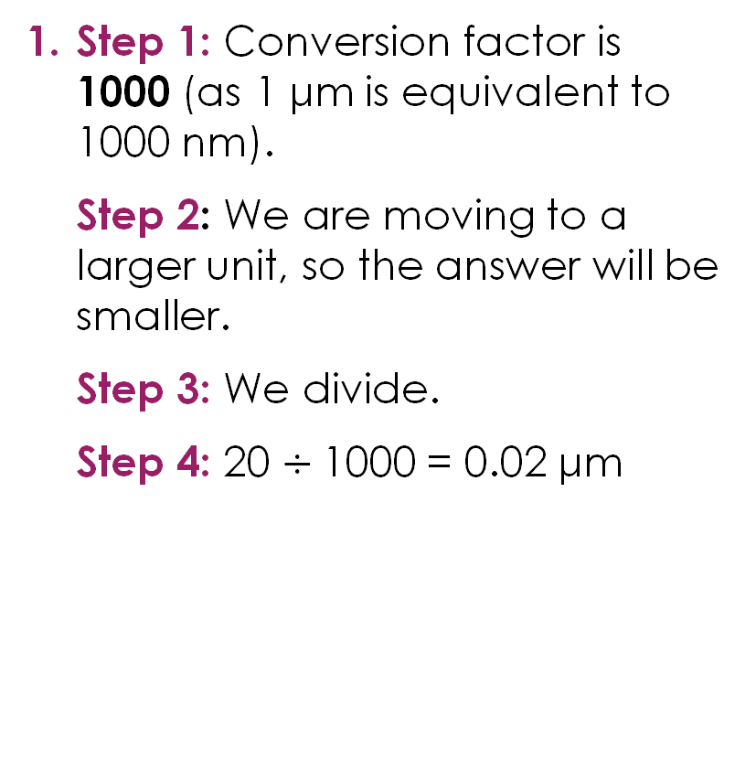
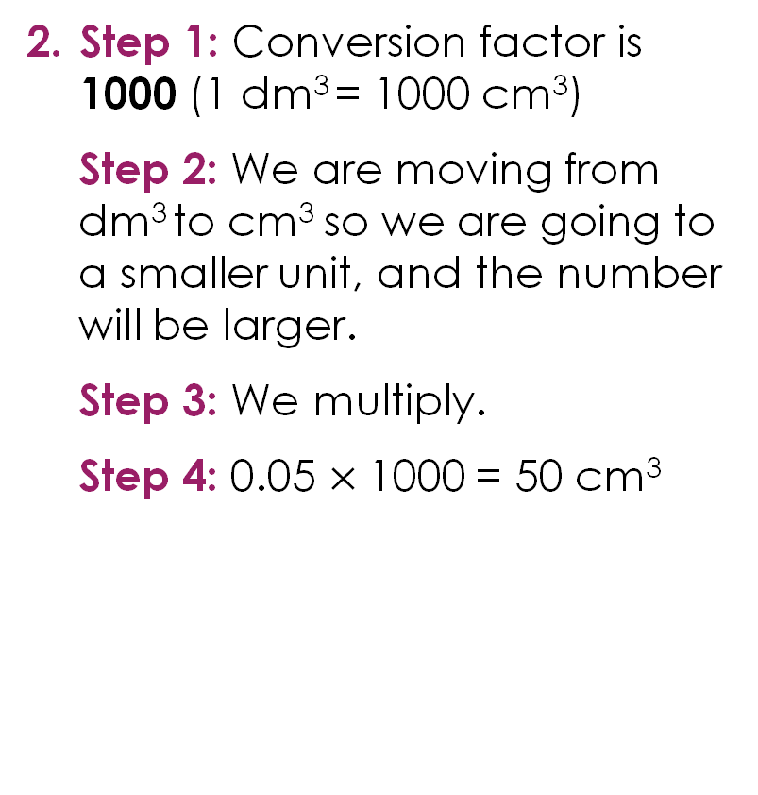
Returning to the lesson questions – answers
Step 1: Conversion factor is 1000 (as 1 μm is equivalent to 1000 nm).
Step 2: We are moving to a larger unit, so the answer will be smaller.
Step 3: We divide.
Step 4: 20 $÷$1000 = 0.02 μm
Step 1: Conversion factor is 1000 (1 dm³ = 1000 cm³)
Step 2: We are moving from dm³ to cm³ so we are going to a smaller unit, and the number will be larger.
Step 3: We multiply.
Step 4: 0.05 $×$1000 = 50 cm³
Answers

Slide 23
Acknowledgements
Image of chocolate cake on slide 2 © Lumora Pixels/Shutterstock
Image of fish tank on slide 2 © Solarisys/Shutterstock

