Slide 1

Stage 1
Creating graphs
Downloaded from: rsc.li/4gA2Lp7

Slide 2
Introduction
In this lesson we will cover the mathematical skills needed to create a graph in science.
Learning objectives
Translate information between graphs and tables.
Design suitable scales for the axes on a graph.
Plot coordinates accurately onto a graph.
Draw an appropriate line of best fit.
Introduction
Notes:
Explain that we will cover these key maths skills in a chemistry context using data from practicals learners are likely to recognise.
Learners at secondary level need to be confident in both reading and plotting coordinates in all four quadrants of a graph from mathematics in the primary phase. However, only two quadrants (the typical L-shaped graph) are usually required in chemistry for this age range. Only two quadrants will be used throughout this resource.

Slide 3
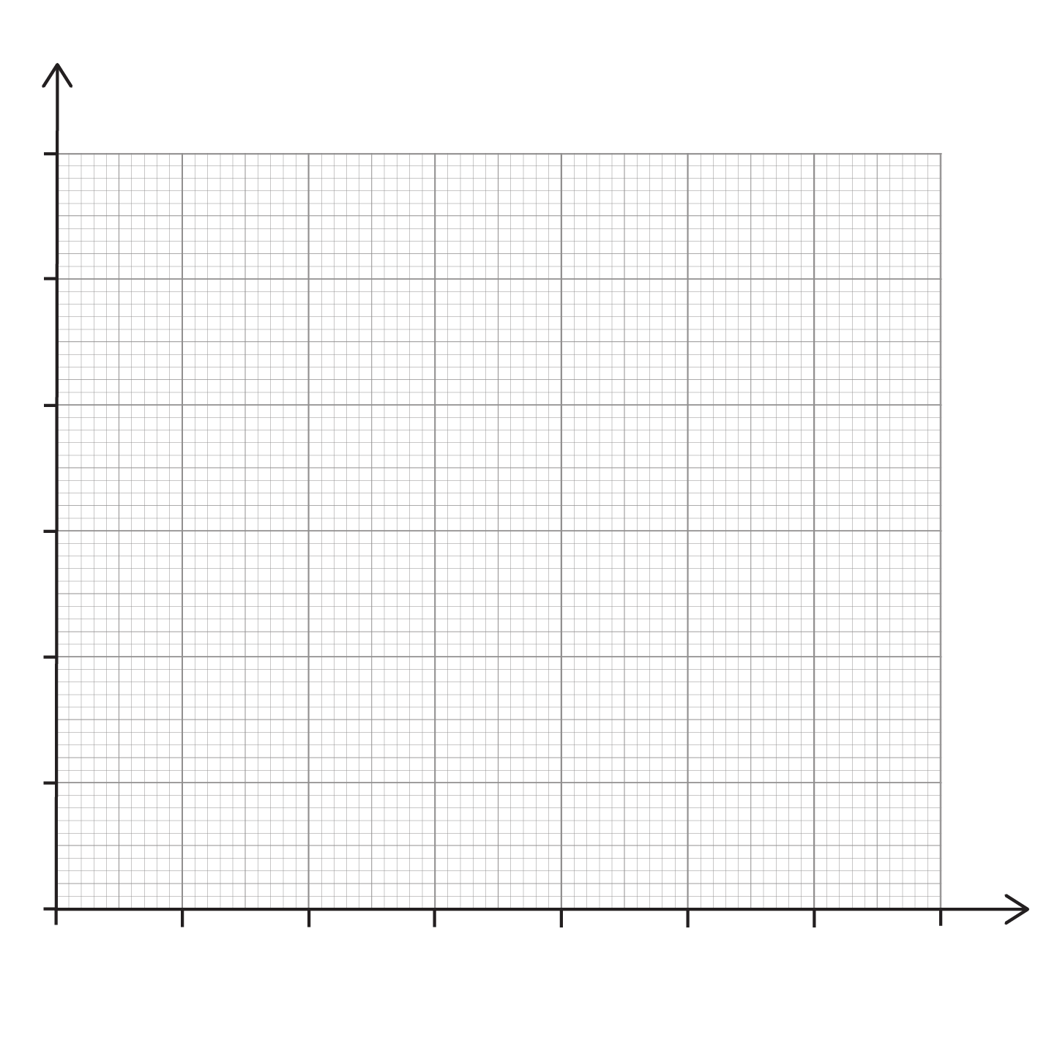
Lesson question
Lesson question
Imagine you are investigating the volume of gas produced over time when magnesium ribbon reacts with hydrochloric acid. Here are the experimental results:
Time (s) | Volume of gas (cm³)
0 | 0
10 | 12
20 | 22
40 | 38
60 | 48
80 | 53
90 | 54
100 | 53
120 | 54
Produce a graph to represent the data:
Design suitable scales.
Plot the results.
Draw a line of best fit.
Describe the trend.
Notes:
This slide introduces the challenge question that learners will return to at the end of the lesson. Learners are not expected to attempt it at this point. We will return to complete the question at the end of the session. Discuss the question and the key words which are in bold, these terms are explained on the next slide.

Slide 4
Lesson question – vocabulary
Vocabulary
A scale is a set of marks on the axes with equal intervals.
A suitable scale is one which enables the data to be plotted clearly and accurately making full use of the graph paper.
Plot means marking the corresponding coordinates onto the graph accurately and precisely using the scales.
A line of best fit is a line which passes close to most of the plotted points. It does not have to pass through every point but should have the same number of points on each side of the line. The line of can be straight or a curve.
Trend relates to the general direction of how a variable changes over time, indicated by the line of best fit – for example, whether the values are increasing, decreasing, or staying the same as one variable changes.
Notes:
More key terms are available for learners in the key terms support: rsc.li/4wypuqq.

Slide 5
Choosing a suitable scale for each axis
Before choosing a scale, we need to know the range of the data.
Look at the smallest value in each column.
Look at the largest value in each column.
The scale should:
cover the full range of data
use simple intervals such as 1, 2, 5 or 10
make good use of the graph paper provided
What scale would be suitable for the x and y axes for this table of data?
Time (s) | Temperature (°C)
0 | 20
20 | 35
40 | 48
60 | 57
What is the range of this data?
What is the
range of this data?
Notes:
Discuss the meaning of the terms: range and interval.
Talk to learners about how to choose suitable scales.
Discuss the fact that scales do not have to start at zero, but they must increase in equal intervals.
Learners may think that the x-axis and y-axis need to have the same scale. This is often the case in the primary phase but not in science at secondary phase.
Range is the smallest value to the highest value. In maths this can involve a calculation, but this is not necessary when we are looking to decide on a suitable scale.
Interval is the space or gap between the values on the axis.
Answers:
The range for time is 0 to 60
The range for temperature is 20 to 57
There will be several possible scales depending on the graph paper provided. Some suggestions are provided below.
x-axis scale − start x-axis at 0 and use intervals of 5, 10 or 20 units up to a maximum of 70 or 80. (recommend intervals of 10).
y-axis scale − start y-axis at 20 and use intervals of 5 up to a maximum of 60 or start y-axis at 10 and use intervals of 5 or 10 units.

Slide 6
Choosing a suitable scale for each axis – answers
The range for time is 0 to 60.
The range for temperature is 20 to 57.
There will be several possible scales depending on the graph paper provided. Some suggestions are provided below:
x -axis scale: start x -axis at 0 and use intervals of 5, 10 or 20 units up to a maximum of 70 or 80.
y -axis scale: start y -axis at 20 and use intervals of 5 up to a maximum of 60 or start y -axis at 10 and use intervals of 5 or 10 units.
Answers

Slide 7
Coordinate pairs 1
Each row in a table gives a coordinate pair to plot such as (1, 5).
The first coordinate value (1) represents x. This value gives an instruction to move horizontally 1 unit along the x-axis from the origin.
The second coordinate value (5) represents y. This value instructs us to move vertically upwards 5 units from the x-axis.
The combination of these movements give the position of the plotted point (1, 5).
Time (hours) | Distance (km)
0 | 0
1 | 5
2 | 10
3 | 15
4 | 20
Notes:
Discuss how we transfer information from the table onto a graph. The first column contains the x-coordinate values which are plotted on the x-axis. Make sure learners recognise the term origin.

Slide 8
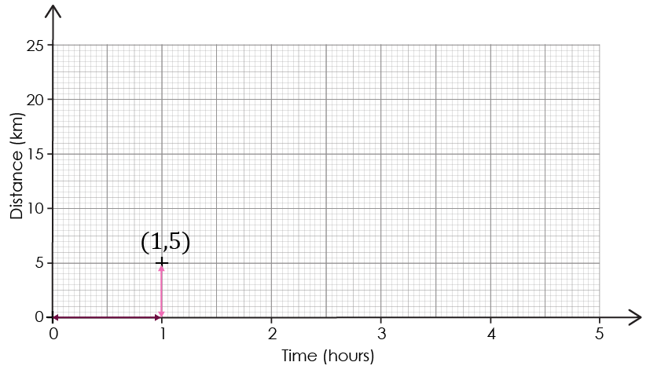
Coordinate pairs 2
Mark this point (1, 5) carefully using a cross, or other symbol, with a sharp pencil.
Time (hours) | Distance (km)
0 | 0
1 | 5
2 | 10
3 | 15
4 | 20
Notes:
Discuss the x, y coordinates and model how to plot the coordinate (1, 5) using a ruler and a sharp pencil. Draw arrows using your interactive smartboard to show the relationship between the table heading and the x and y axes.
A sharp pencil makes a thin precise point so you can plot the data points in exactly the right place. If the pencil is blunt the marks are much thicker and this makes it more difficult to see exactly where the points are. A sharp pencil creates a point less than 0.5 mm wide. A blunt pencil might create marks of 1−2 mm wide. The graph paper we usually use is 1 mm x 1 mm, so this can significantly affect the accuracy.

Slide 9
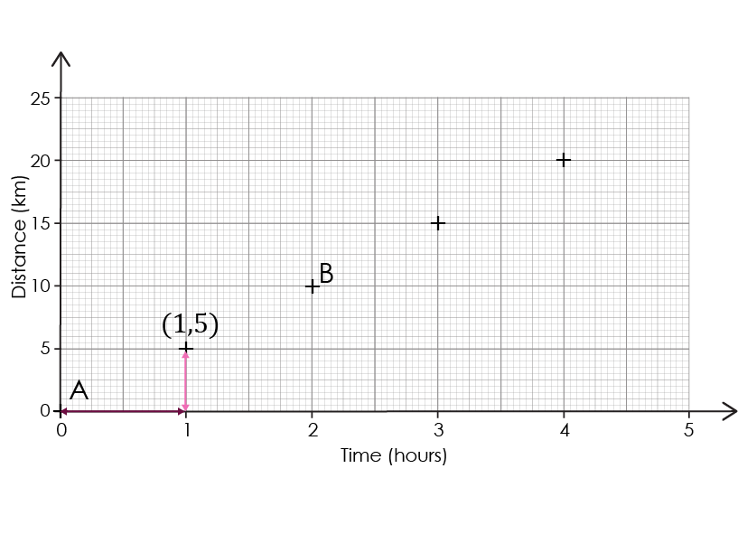
Coordinate pairs – activity
What are the coordinate pairs for points A and B?
Activity

Slide 10
Coordinate pairs – answers
Point A is (0, 0). This is also called the origin.
Point B is (2, 10): along the x-axis 2 units and the y -axis 10 units.
Answers
Notes:
Ask learners to describe what they did to work out the coordinate pair for A and B. Some may say they looked at the table and some may say they read the coordinates from the graph. It is important that learners know how to do both as there is not always a table of data provided. The next slide provides the graph and table side by side for learners to practice these skills.

Slide 11
Coordinate pairs – practice
Time (hours) | Distance (km)
0 | 0
1 | 5
2 | 10
3 | 15
4 | 20
Practice
Notes:
Draw arrows using your interactive smartboard to show the relationship between the table heading and the x and y axes.
Discuss with learners if all axes need to start at (0, 0). This one does but this is not always necessary.

Slide 12
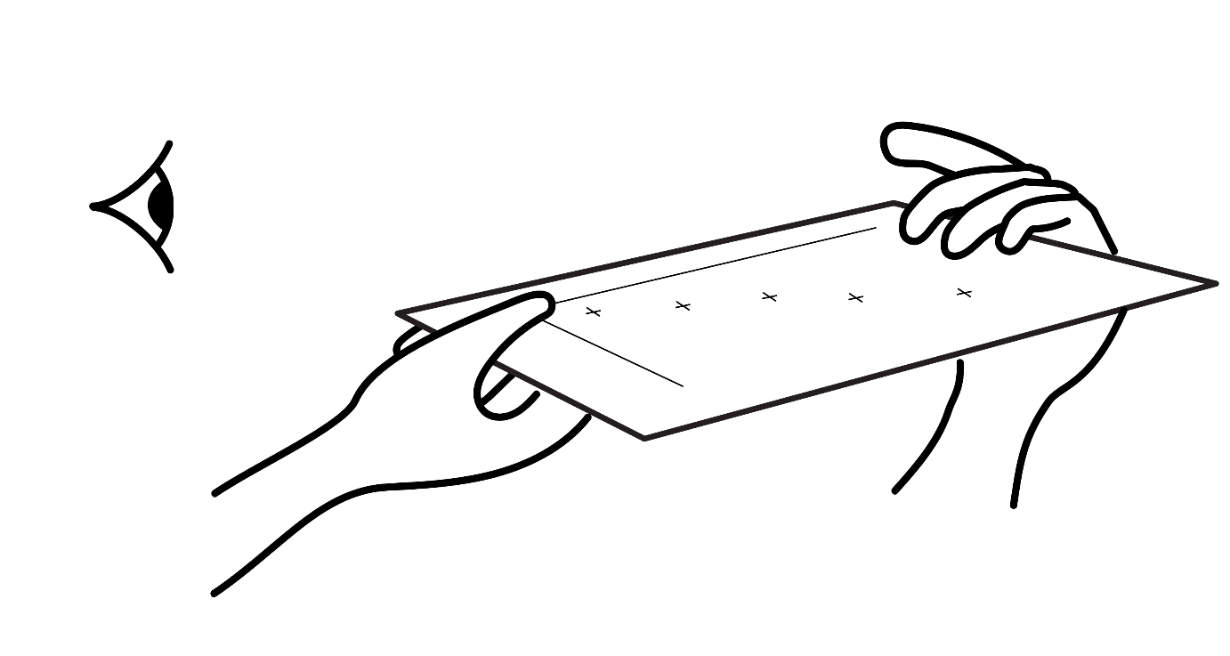
Drawing line of best fit
Hold the graph paper up to your eye and look along the points.
Does it look as if the points are in straight line or a curved line?
Notes:
Show learners how to hold up the graph paper with plotted points close to your eye and look down the points to see if it looks like a straight or curved line. It is clear that these points form a straight line of best fit.

Slide 13
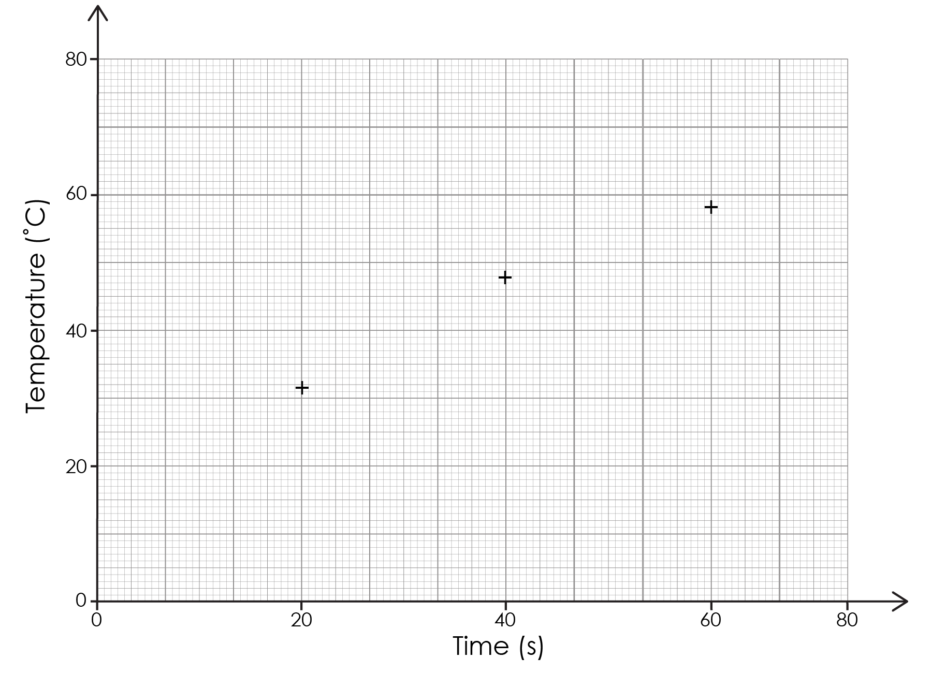
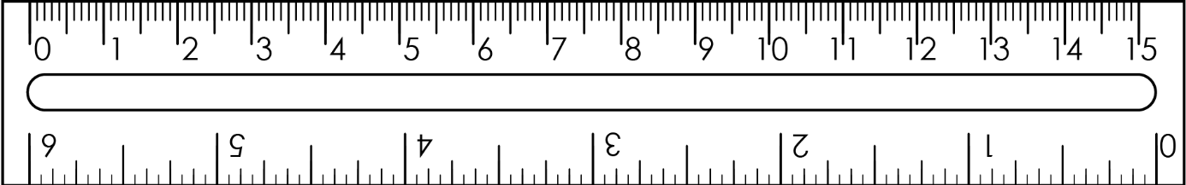
Drawing a straight line of best fit
If they are straight: position a ruler over the points and draw a line of best fit with a sharp pencil.
The line should pass through, or as close as possible to, as many points as possible.
Notes:
Model how to draw a line of best fit.
What does a straight line mean? A straight line of best fit means there's a linear relationship between the two variables – as one variable changes, the other changes at a constant rate.
In maths, the points tend to follow a perfect mathematical relationship and so most, if not all, points will be on the line of best fit. In science, the line of best fit may not pass through any points directly but will be as close to as many as possible and the number of points above the line will be as balanced as possible with the number below the line.

Slide 14
Drawing a curved line of best fit
Time (minutes) | Temperature (℃)
0 | 80
2 | 61
4 | 49
6 | 41
8 | 36
10 | 33
12 | 30
Worked example
Notes:
Look at this data set. Discuss with learners why a line might be curved. It is curved because the relationship between variables isn't linear, i.e. when one variable doesn't change at a constant rate relative to the other.
Return to the graph and table on slide 11 if needed to demonstrate a linear relationship.

Slide 15
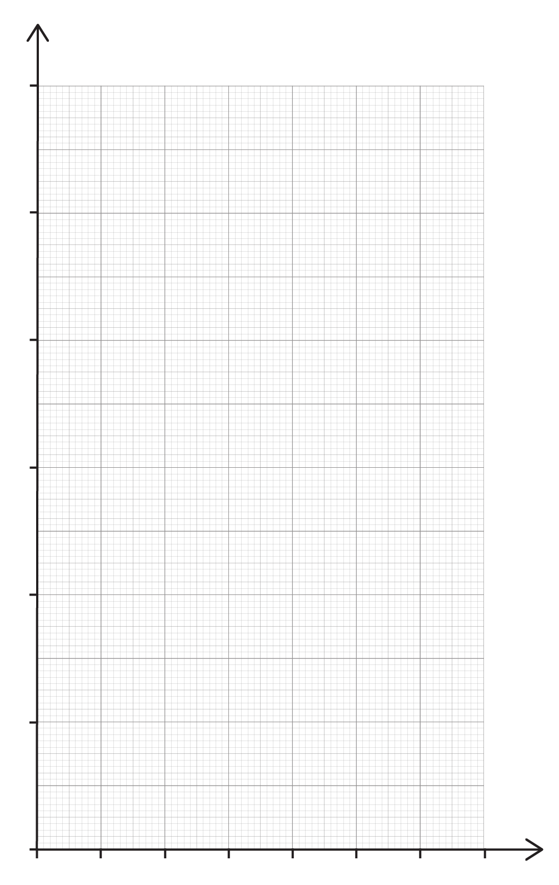
Drawing a curved line of best fit – worked example
Time (minutes) | Temperature (℃)
0 | 80
2 | 61
4 | 49
6 | 41
8 | 36
10 | 33
12 | 30
Worked example
Decide upon suitable scales for this graph.
Plot the coordinate pairs.
Take a pencil and draw the curved line in one movement, so it passes as close to as many points as possible.
Do not sketch the line.
Notes:
Discuss which value goes on the x-axis and which on the y-axis. Time on the x-axis and temperature on the y-axis.
Check the scales are suitable before learners start to plot.
A suitable scale to fit this graph paper and which makes the best use of the size could be:
x-axis − start at 0 and go up in intervals of 2 (every 5 small squares) up to 14. Each small square represents 0.4 units
y-axis − start at 30 and go up in intervals of 10 (every 10 small squares) up to 90. Each small square represents 1 unit.
This graph paper is available to print from page 2 of the interpreting graphs stage 1 learner worksheet: rsc.li/3S9bXHV.

Slide 16
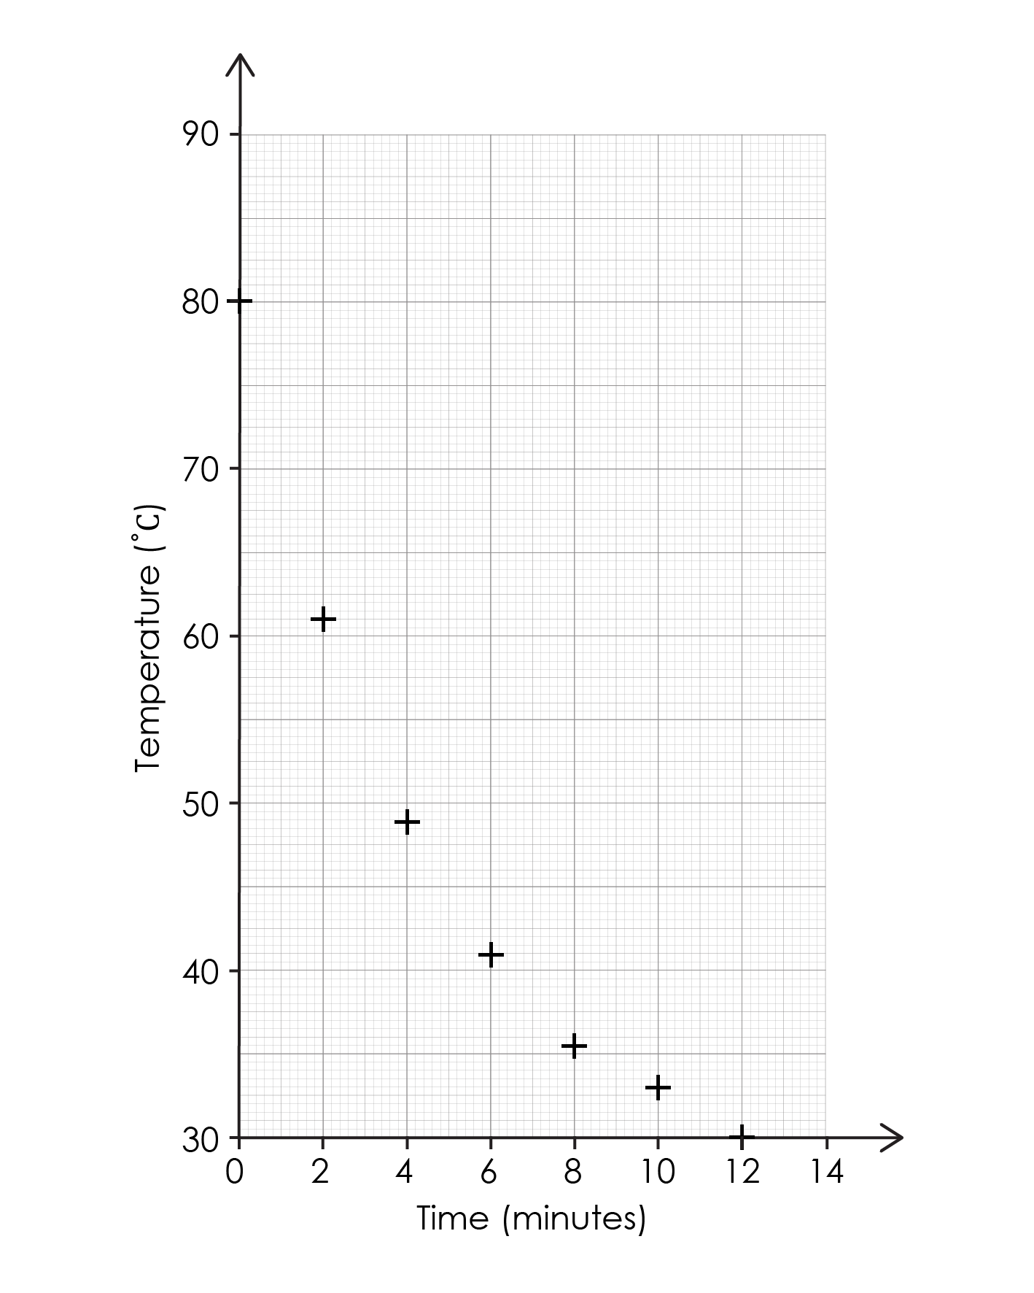
Drawing a curved line of best fit – worked example 2
Time (minutes) | Temperature (℃)
0 | 80
2 | 61
4 | 49
6 | 41
8 | 36
10 | 33
12 | 30
Worked example
Draw a curved line of best fit.
Notes:
This slide shows the points plotted. Model how to draw the curved line in one go without sketching. It can help to hold the pencil further away from the tip.

Slide 17
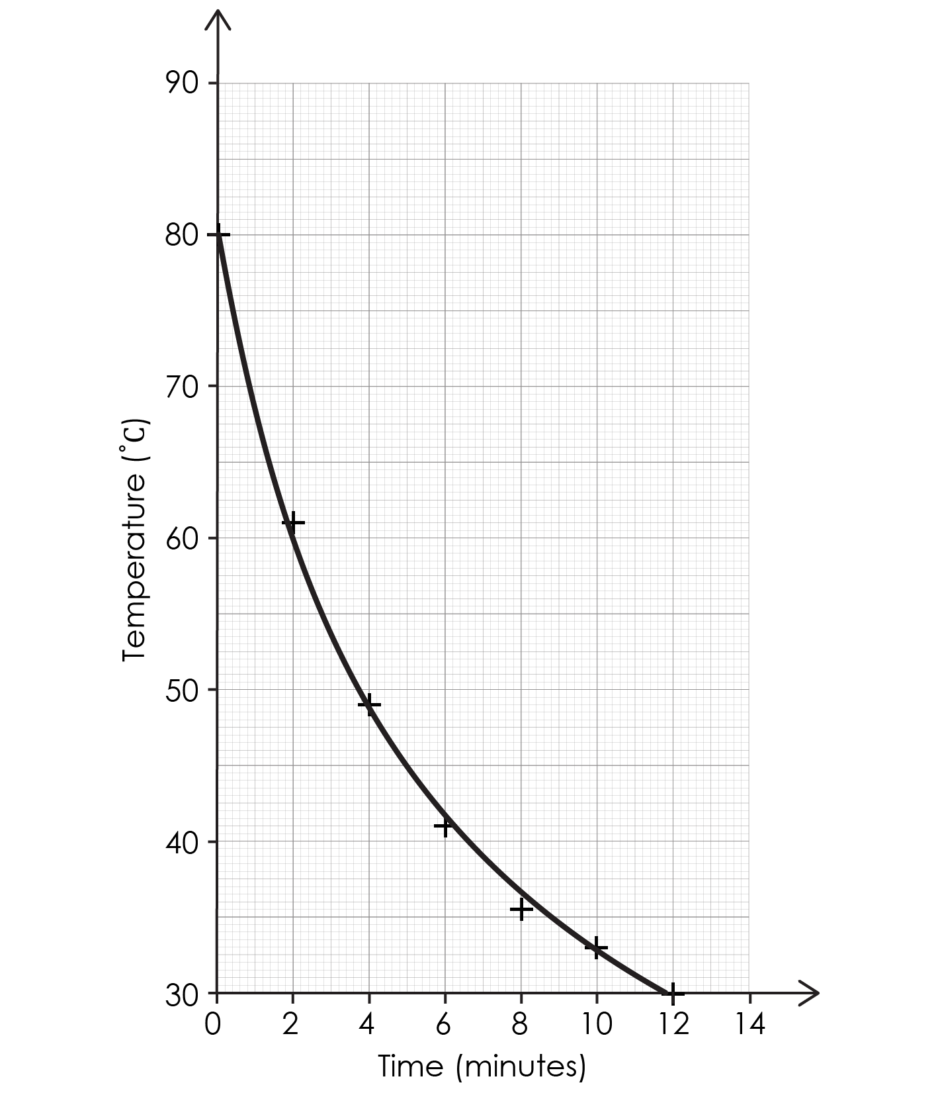
Drawing a curved line of best fit – option 1
Time (minutes) | Temperature (℃)
0 | 80
2 | 61
4 | 49
6 | 41
8 | 36
10 | 33
12 | 30
Worked example
Notes:
Here is one interpretation of the line of best fit. Another line (on the next slide) may miss some of the points such as (12, 30) for example. There is no perfect line of best fit.
Line of best fit: option 1.

Slide 18
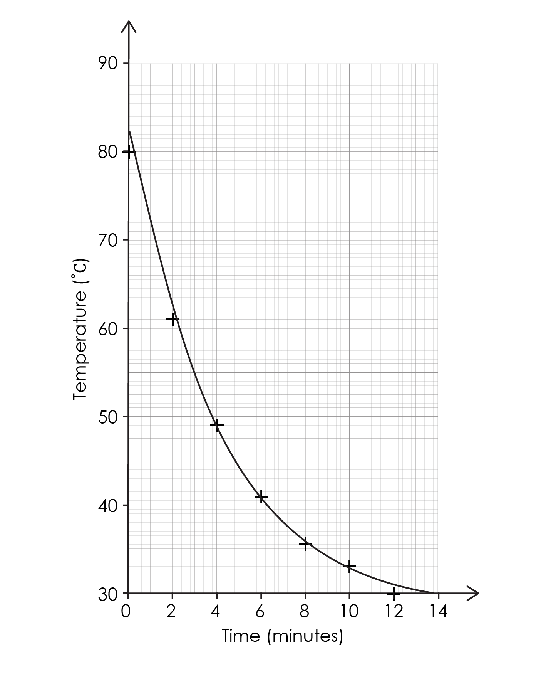
Drawing a curved line of best fit – option 2
Time (minutes) | Temperature (℃)
0 | 80
2 | 61
4 | 49
6 | 41
8 | 36
10 | 33
12 | 30
Worked example
Notes:
Line of best fit option 2: misses (12, 30).

Slide 19
Differences between mathematics and science
Terminology
Mathematics uses the term coordinates or coordinate pairs.
Science uses the terms independent (what the scientist chooses to change) and dependent (what is measured) variables. The independent variable is usually plotted on the x-axis.
Axes
Graphs in mathematics often use matching scales on both axes.
Science graphs typically have different scales to suit each variable.
Lines of best fit
In mathematics, the line of best fit is usually a straight line which passes through most of the points, reflecting an exact mathematical relationship.
In scientific graphs, the line of best fit can be straight, or it can be a curve showing the overall trend. Experimental data is not perfect and so the points may be scattered above or below the line.
Notes:
Talk to your colleagues in the mathematics team about whether learners are using graph paper or block paper in lessons.
If learners tend to use block paper in mathematics, then spend time discussing how to use the graph paper provided in science. Exam boards tend to use the 1 mm x 1 mm paper. Make sure learners are comfortable in using this. For example, what does each small square represent, what do the larger squares represent? Can learners see the markings on the graph paper? Sometimes, when graph paper is copied, the integrity of the lines can be lost.

Slide 20
Returning to the lesson question
Lesson question
Imagine you are investigating the volume of gas produced over time when magnesium ribbon reacts with hydrochloric acid. Here are the experimental results:
Time (s) | Volume of gas (cm³)
0 | 0
10 | 12
20 | 22
40 | 30
60 | 48
80 | 53
90 | 54
100 | 53
120 | 54
Produce a graph to represent the data:
Design suitable scales.
Plot the results.
Draw a line of best fit.
Describe the trend.
Notes:
Explain that we are going to use the mathematical methods mentioned earlier to answer this question.

Slide 21
Apply your learning – design suitable scales
Imagine you are investigating the volume of gas produced over time when magnesium ribbon reacts with hydrochloric acid. Here are the experimental results:
Which variable should be plotted on the x-axis? What label would be added?
Explain why both axes should start at zero for this experiment.
What is the range of data for both the independent and dependent variables?
Why is it important that the graph uses most of the space on the paper?
Time (s) | Volume of gas (cm³)
0 | 0
10 | 12
20 | 22
40 | 30
60 | 48
80 | 53
90 | 54
100 | 53
120 | 54
Notes:
Qualitative: the focus is on the discussion about a suitable scale for this set of data.
Before plotting we need to consider what information we can find out from the table.
Look at the headings and the question.
What is the scientist choosing to change during the experiment? Time is being monitored at regular points, so this is what the scientist is choosing to change.
The independent variable is usually plotted on the x-axis. The label would be Time (s) or Time /s. The solidus (/) is recommended at post-16 and brackets are suggested pre-16. Throughout these resources, Time (s) has been used. Both are correct, however.
Where should both axes start? The table of data has the first set of coordinates as (0, 0) this can be explained because before the experiment begins no gas has been produced so it should be zero.
The range of data is 0−120 for the independent variable and 0−54 for the dependent variable. This helps us design the best scales.
The graph itself should occupy most of the graph paper (not just the axes) so it is easier to read, and the pattern can be seen more clearly. This can be demonstrated by using different sized scales.
A suitable scale for the graph paper in the original question might be: x-axis − 0 to 140 in intervals of 20 per 5 small squares (each small square = 4 units), y-axis − 0 to 60 in intervals of 10 per 5 small squares (each small square = 2 units).
Make sure the labels and units are correctly added: x-axis label is Time (s) and y-axis label is Volume (cm³).

Slide 22
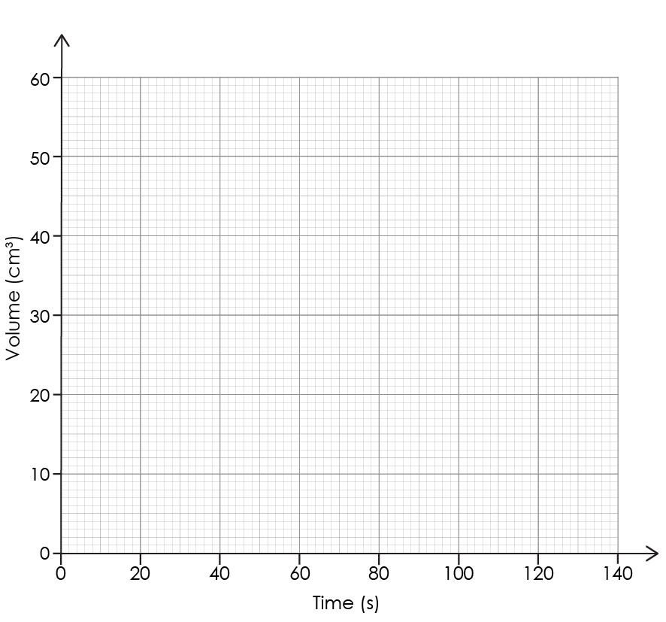
Apply your learning – plot the results
Imagine you are investigating the volume of gas produced over time when magnesium ribbon reacts with hydrochloric acid. Here are the experimental results:
Time (s) | Volume of gas (cm³)
0 | 0
10 | 12
20 | 22
40 | 30
60 | 48
80 | 53
90 | 54
100 | 53
120 | 54
Notes:
Quantitative: Here we develop from the qualitative discussion about scales to placing the coordinates on the scales precisely and accurately.

Slide 23
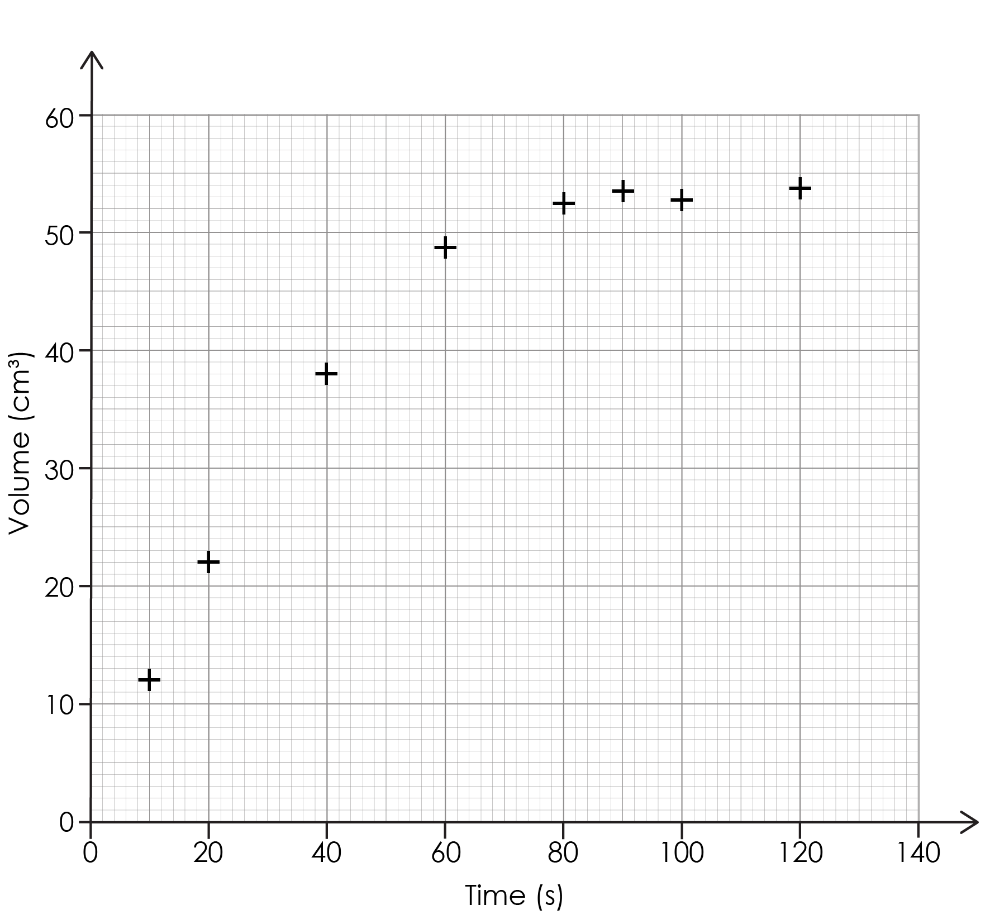
Apply your learning – draw the line of best fit
What is the shape that the line of best fit should follow?
Why might the plotted points not form a perfect line or curve?
What does the line of best fit tell us?
Why is a line of best fit more useful than joining the dots?
Notes:
Here we move to a conceptual stage.

Slide 24
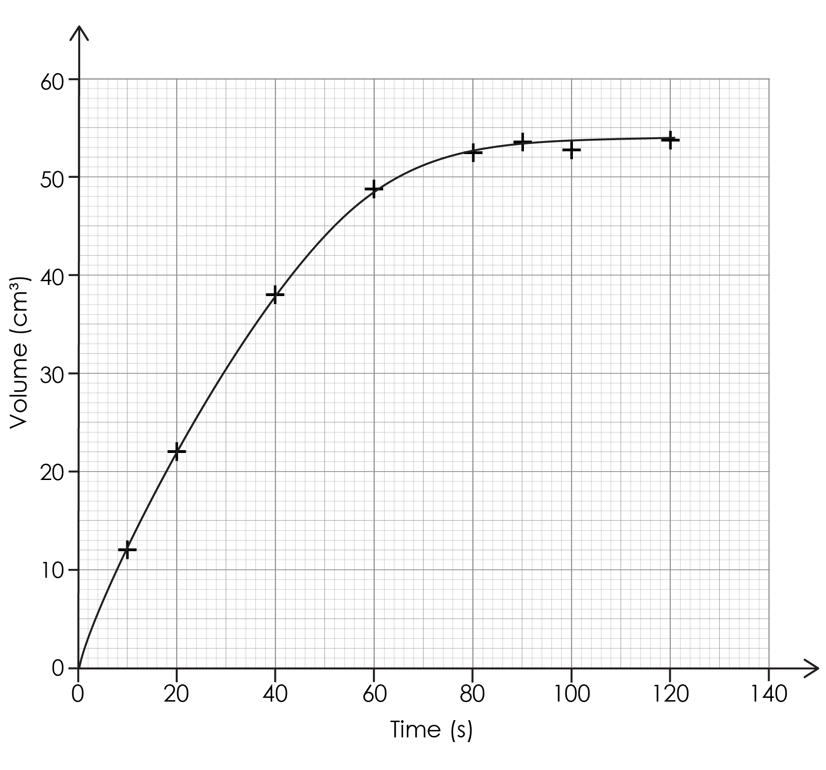
Apply your learning – line of best fit – answers a–b
The line of best fit will start off steep and straight showing a fast increase, then it curves and becomes less steep and finally it becomes horizontal showing no more increase.
The plotted points do not form a perfect line because there are always small errors when measuring in experiments. It can be hard to read the exact volume or the exact time on a stopwatch.
Answers
Notes:
a) A good answer will use terms like steep, increase and slows. If learners simply say ‘it goes up’ then more discussion is needed to model a more suitable response.
b) A good answer will mention errors, but a weaker answer may talk about mistakes. Emphasise that these are random errors and not mistakes usually.

Slide 25
Apply your learning – line of best fit – answers c–d
The line of best fit shows the overall trend or pattern in results and smooth out any small random errors.
Joining the dots can produce a zig-zag line that includes all the errors, and this can make interpreting the pattern more challenging. The line of best fit also helps us to predict values which we did not measure.
Answers

Slide 26
Apply your learning – describe the trend
How does the volume of gas change as time increases?
When does gas production slow down? How do you know?
When does the reaction appear to stop or reach a maximum volume? How do you know?
Notes:
This slide shows a line of best fit but there are other possible lines of best fit which might be slightly different.
There is no perfect line as it is a generalisation.
The trend shows the general change over time.

Slide 27
Apply your learning – describe the trend – answers
The volume of gas increases as time increases.
This occurs more quickly at first because the line is steeper and then slows off at about 20 seconds.
The maximum volume is reached around 90 seconds as the line levels off.
Answers

