Slide 1

Stage 1
Creating graphs
Downloaded from: rsc.li/4gA2Lp7

Slide 2
Introduction
Chemists may receive information in the form of tables of data. Being able to plot this data on a suitable graph can provide useful information about
the relationship between the variables.
Learning objectives
Translate information between graphs and tables.
Design suitable scales for the axes on a graph.
Plot coordinates accurately onto a graph.
Draw an appropriate line of best fit.
Introduction

Slide 3
Which axis to plot?
In chemistry, the independent variable is usually plotted on the x-axis. This is the variable which the scientist decides to change. In a table of data, the independent variable data usually increases or decreases in equal intervals.
In chemistry the dependent variable is what the scientist measures. This is plotted on the y-axis.
Look at the experimental descriptions below and decide which variable will go on the x- and y-axes.
Investigate how the length of magnesium ribbon (mm) affects the volume of hydrogen gas produced (cm³).
Find out how the time taken for a tablet to completely dissolve changes in different water temperatures (°C).
Investigate how the concentration of hydrochloric acid (mol/dm³) affects the volume of gas (cm³) produced when it reacts with calcium.
Activity
Notes:
In mathematics, learners plot the coordinate which comes first in the pair on the x-axis. In science, we need to make decisions as it is not always apparent which is the x-coordinate or y-coordinate.
Check learners understand the terms independent and dependent variable and the relationship between the x and y axes.
More guidance on mathematical terminology for graphs is available in our key terms support, which contains an accessible glossary and key term list: (LINK)

Slide 4
Which axis to plot? Answer
Independent variable is the length of the magnesium ribbon – x-axis
Dependent variable is the volume of hydrogen gas – y-axis
Independent variable is the water temperature – x-axis
Dependent variable is the time taken for the tablet to dissolve – y-axis
Independent variable is the concentration of acid – x-axis
Dependent variable is the volume of hydrogen gas – y-axis
Answers

Slide 5
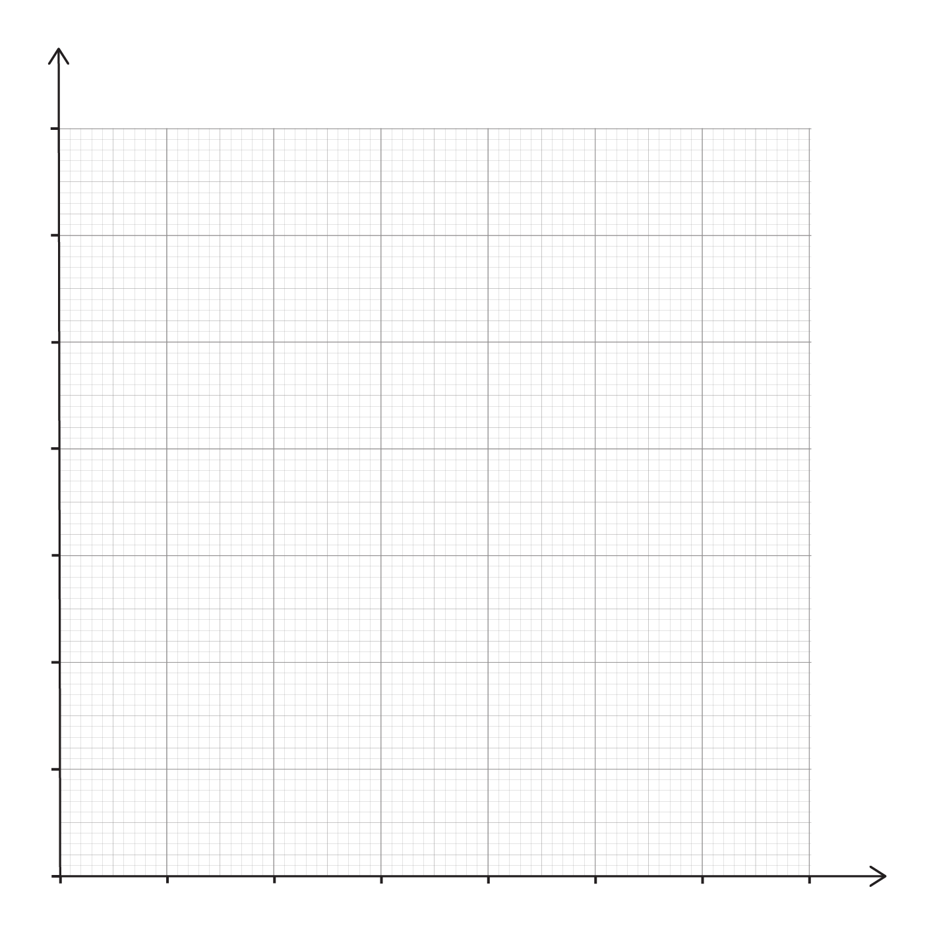
Select an appropriate scale
A
25 | 2
32 | 4
37 | 7
39 | 8
48 | 14
Activity
B
2 | 1.9
4 | 2.3
6 | 2.7
8 | 3.3
10 | 3.8
14 | 3.4
Find the range for both axes.
Suggest suitable scale intervals to plot the data onto this graph paper.
Notes:
Talk to learners about how to choose suitable scales. Discuss the fact that scales do not have to start at zero, but they must increase in equal intervals.
Learners may mistakenly think that the x-axis and y-axis need to have the same scale.
Discuss B further because it has decimal values. The same guidance applies and suitable intervals might be 0.1, 0.2, 0.5, for example. Table B has a higher value in the penultimate row.

Slide 6
Select an appropriate scale – answers
A
x-axis: start at 20 and go up in intervals of 5 up to 50. Each small square = 1 unit
y--axis: start at 0 and go up in intervals of 2 up to 16. Each small square = 0.4 units
B
x-axis: start at 0 (or 2) and go up in intervals of 2 up to 16. Each small square is 0.4 unit
y--axis: start at 0 and go up in intervals of 0.5 up to a maximum of 4.0. Each small square = 0.1 unit.
Answers
Notes:
There are several options for both tables, but the critical factor is the graph paper and making the best use of it so that the graph is plotted over as large an area as possible.
For the graph paper on the slide here is a suggestion.

Slide 7
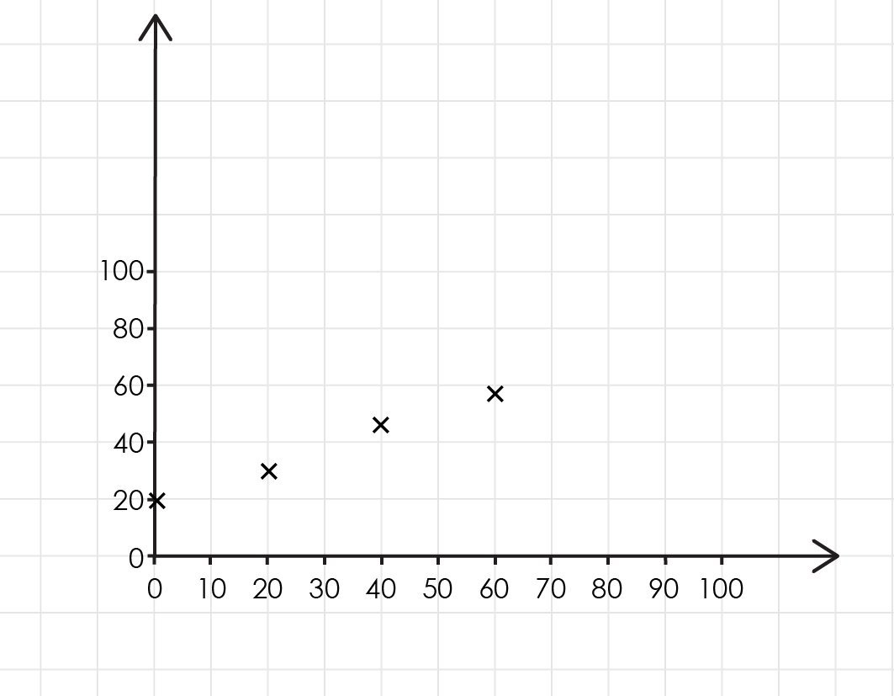
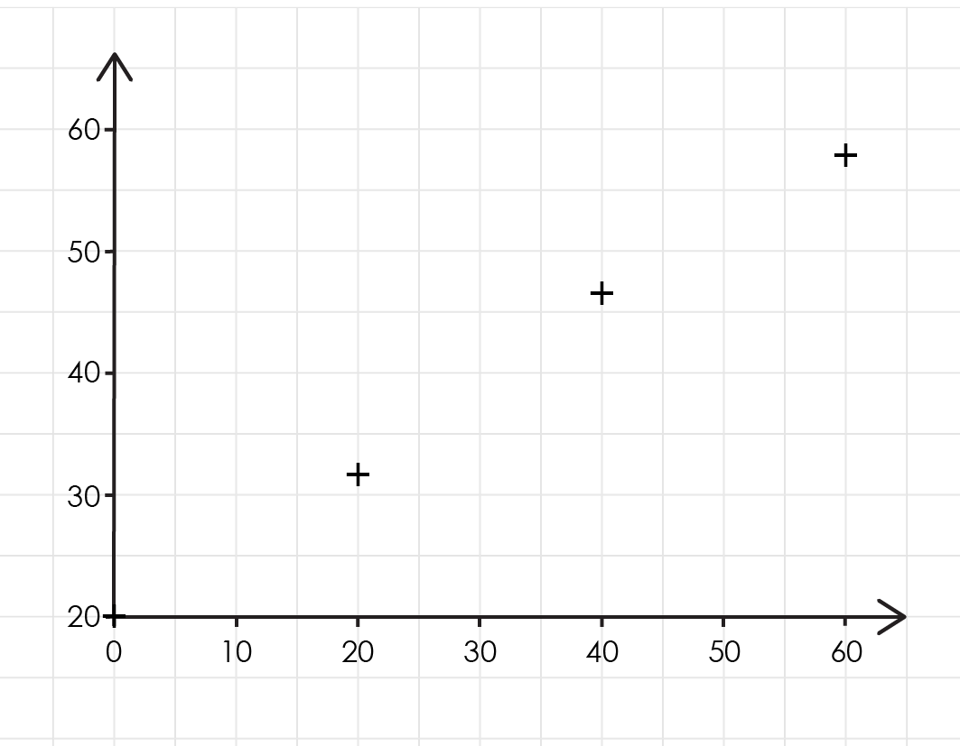
Suitable scales
Two learners (A and B) have plotted the same data.
Which scales are better?
Explain why.
How could these scales be improved?
Activity
A
B

Slide 8
Suitable scales – answers
The scale on learner B's graph is better.
The scale is better because they make full use of the graph paper so that the pattern is easier to see and the values easier to plot.
The scale could be improved by using one more square x-axis to make sure that the coordinates do not fall off the edge.
Answers
A
B

Slide 9
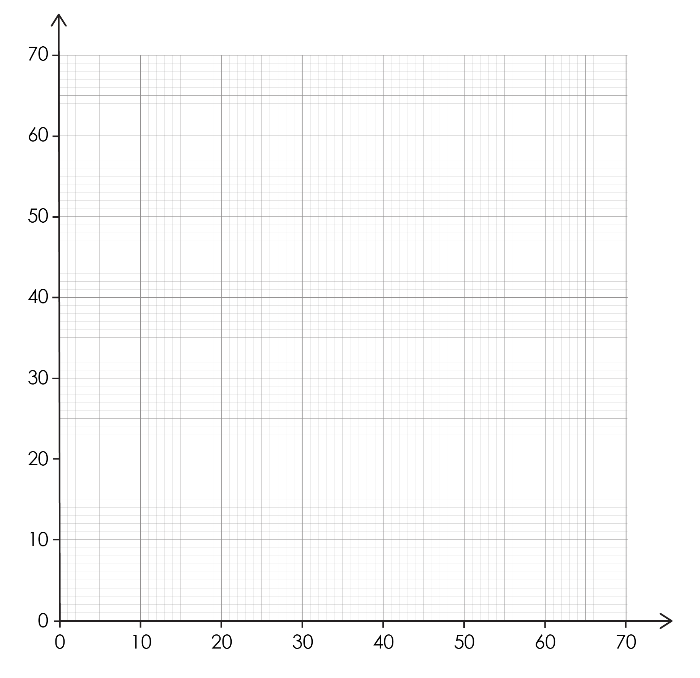
Plotting the points
Time (s) | Temperature (°C).
0 | 20
20 | 33
40 | 46
60 | 58
Activity
Label the axes on the graph.
What is the coordinate pair for 40 seconds?
Plot the coordinate pairs.
Explain why it is important to use a sharp pencil.
Notes:
Check that the axes are correctly labelled. The x-axis is time (s) and y-axis temperature (℃). Insist on correct labelling in words and the unit.
The coordinate pair at 40 seconds are (40, 46). They must be in this order.
The next slide provides a plotted graph.
A sharp pencil makes a thin precise point so you can plot the data points in exactly the right place. If the pencil is blunt the marks are much thicker and this makes it more difficult to see exactly where the points are. A sharp pencil creates a point less than 0.5 mm wide. A blunt pencil might create marks of $1−2 mm$wide. The graph paper we use is usually $1 mm × 1 mm$, so this can significantly affect the accuracy.

Slide 10
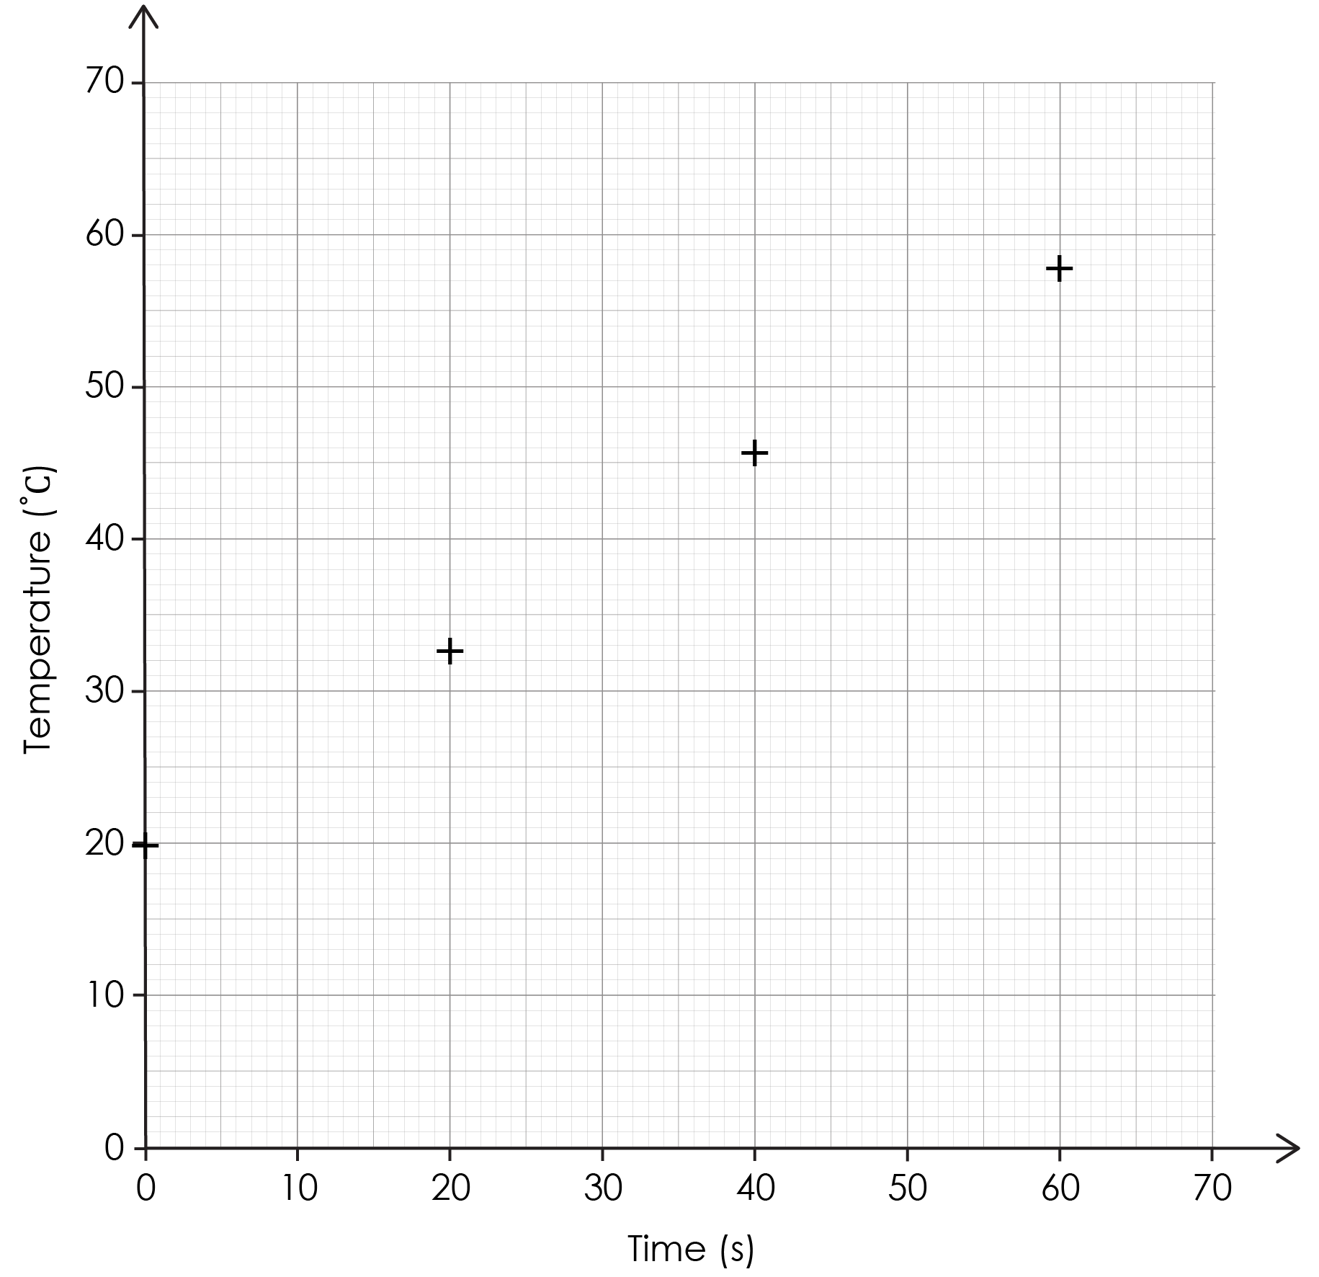
Plotting the points – answers
Answer
Notes:
This slide shows the points plotted in the correct position. The coordinate pairs are (0, 20), (20, 33), (40, 46) and (60, 58).
The plots are in a straight line. Learners could be asked to draw the line of best fit too.

Slide 11
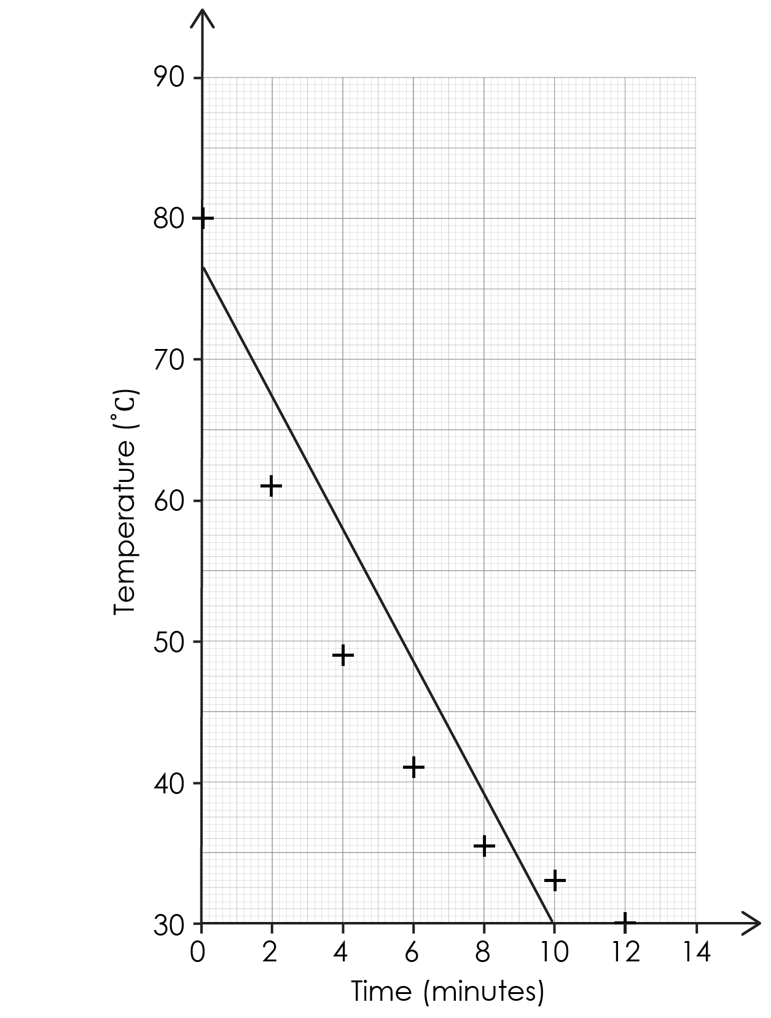
Line of best fit
A learner has drawn a line of best fit on this graph.
Look at both statements and explain whether you agree with the learner or not.
The line of best fit for this data should be a curve.
Activity
The line of best fit is balanced as there are three points above the line and four below it. So, it is correct.
Learner A
Learner B

Slide 12
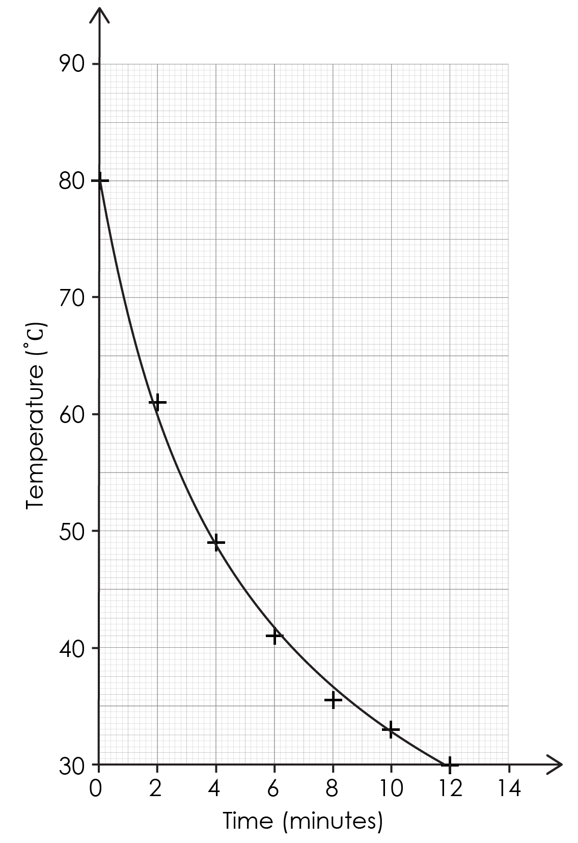
Line of best fit – answer
Learner A is correct with the statement about balancing the points either side of the line of best fit.
However, the data shows that the relationship is not linear. The line of best fit should be a curve, so Learner B is correct.
Answer
Notes:
Learner A is correct with the statement about balancing the points either side of the line of best fit. However, the data shows that the relationship is not linear. The line of best fit should be a curve, so Learner B is correct.

